Slide 1
01 / WHERE WE ARE 0:00–0:50
SLIVER CARE
Family care after the reminder
For adult children coordinating a parent’s care
Working local MVP • Initial customer feedback
GROUP6 / 01 OF 06
Notes:
Speaker 1 | 0:00–0:50
Good morning. We are Group Six. Imagine two family members both thinking the other person has checked on an older parent. A reminder alone does not tell them who will follow up.
Sliver Care helps families make that responsibility clear and keep a record of what happened. Our proposed buyer is the adult child coordinating a parent’s care.
We have built a working local MVP with care records and downloadable reports. The working version runs in one browser, with fictional care data. We have also collected initial feedback. My teammate will explain our development and evidence.
操作：第1页；0:50交给Speaker 2，并翻到第2页。
Sources: Report sections 1–4; S03, S05, S14, S23–S24.

Slide 2
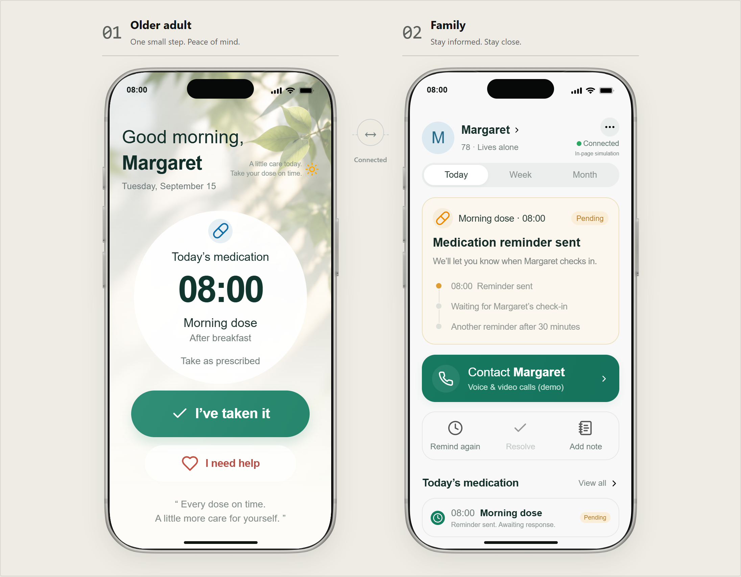
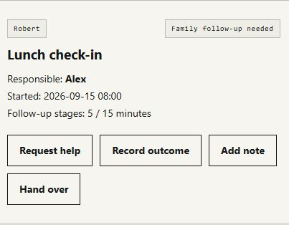
02 / EVIDENCE AND COMMITMENT 0:50–1:35
Problem, prototype and MVP
Who follows up — and what happened?
Earlier retained prototype
Saved care records and outcomes
12 functional experiments + 15 additional local checks; no independent user task test
GROUP6 / 02 OF 06
Notes:
Speaker 2 | 0:50–1:35
Our starting problem was uncertainty after a reminder: who responds, and what happens next?
The earlier prototype illustrated the older adult and family views. The current MVP lets us start a care item, see its responsible person, save an outcome, and export it.
We recorded twelve functional experiments and fifteen additional local checks. They tested product rules, including reporting and data retention. For example, an unresolved care item must remain visible even when it falls outside the selected reporting period. These checks show that local functions work; they do not establish that families can use the product independently.
操作：第2页；指左侧原型、右侧MVP；1:35翻到第3页。
Sources: Report sections 4–5; S03, S04, S14–S16. Earlier artifact date is not established.

Slide 3
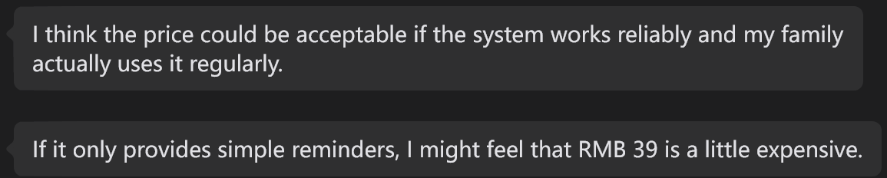
02 / EVIDENCE AND COMMITMENT 1:35–2:35
Feedback and commitment
8
¥39/month: conditional acceptance
Individuals consulted
20–22 September 2026
Selected chat evidence
10
Selected response • Source S19
Organisations emailed
Clear responsibility matters.
Shared updates and alerts requested.
Video + product introduction
No replies by 22 September
No purchase or agreed pilot
Consultations show initial reactions; the screenshots are selected examples.
GROUP6 / 03 OF 06
Notes:
Speaker 2 | 1:35–2:35
Between September twentieth and twenty-second, we consulted eight people. One contact valued clear responsibility. Another said thirty-nine yuan per month could be acceptable if the system was reliable and used regularly. Simple reminders alone might feel expensive. We also heard requests for automatic notifications and shared updates.
The screenshots are selected examples, so we cannot turn these comments into response percentages. This feedback supports our focus and identifies missing capabilities; it does not prove demand. We also emailed ten organisations with an MVP video and product introduction. As of September twenty-second, none had replied. We have no purchase or agreed pilot.
Now we will demonstrate the working care flow.
操作：第3页；2:35交给Speaker 3并翻到第4页。
Sources: Report sections 5 and 7; S17–S24. Four chats are selected excerpts. No percentages or completed trials inferred.

Slide 4
03 / THE PRODUCT 2:35–4:55
A care outcome, recorded and exported
LIVE
01 Start a reminder and request help
02 Save Alex’s follow-up outcome
Margaret + Alex
Fictional family scenario
03 Export the same saved record
Simulated Plus enabled before the talk • Actual charge ¥0 • No real notifications
GROUP6 / 04 OF 06
Notes:
Speaker 3 | 2:35–4:55
We will use Margaret and Alex, a fictional family. We enabled simulated Plus before this presentation. No money was charged.
Let’s start a care reminder. Alex is the responsible family member. The name makes the next action clear to anyone reviewing this local record.
Margaret needs help. This changes the local record; it does not send a real notification.
Alex follows up and records what happened. I’ll save the outcome here: Alex contacted Margaret and agreed the next step.
The saved outcome now appears in the report. Here is the sentence we just entered.
We can also take this record away. I’ll download the report and open the file. The same sentence is here.
This report comes from the saved care record. It does not use AI generation.
操作：2:50切工作台；按操作表执行。4:55返回第5页。故障超过10秒切备用；5:15无条件交给Speaker 4。
Sources: Local workspace UI and downloaded report. Controlled fictional scenario, no external participant.

Slide 5
03 / THE PRODUCT 4:55–5:15
What works today
A named person. A saved outcome.
Plus: proposed ¥39 per family / month
Today’s local evaluation is free.
Shared accounts, sync and remote notifications
remain unbuilt.
GROUP6 / 05 OF 06
Notes:
Speaker 3 | 4:55–5:15
The product connects a named person with a saved follow-up result. Plus is proposed at thirty-nine yuan per family per month. Today’s demo is local and free. Shared accounts and remote notifications remain unbuilt. My teammate will explain our decision.
操作：第5页；若已超过5:05，删去价格句；5:15翻到第6页交接。
Sources: Report sections 3 and 8; S05, S15, S19.

Slide 6
04 / NEXT STEPS 5:15–6:30
STOP
Team time and future resource commitments
Ongoing development, maintenance and support need sustained capacity.
01–30
Organise feedback and archive the project.
31–60
Complete our review and record unresolved questions.
61–90
Remain stopped; no development or launch promises.
Proposed closure plan starts after the course • Thank you
GROUP6 / 06 OF 06
Notes:
Speaker 4 | 5:15–6:30
Our decision is to stop after the course. The main reason is our team’s time and future resource commitments. We cannot commit the ongoing development, maintenance and user support that a live service would need.
The feedback remains useful, but it does not establish repeat use or paid demand. These are separate limits on what we can claim.
In the first thirty days, we will organise the feedback and archive the product, report and evidence. In days thirty-one to sixty, we will complete our team review and record unresolved questions. In days sixty-one to ninety, the project will remain stopped, with no new development or launch promises.
We have built a working local flow and learned what still needs testing. Thank you. We are ready for questions.
操作：第6页讲完保持此页；不要继续翻到备用页。目标6:30结束。
Sources: Owner-confirmed stop reason in this task; report sections 1 and 8; S02. Future actions are plans, not completed work.

Slide 7
Q&A ONLY / PRICING AND CURRENT LIMITS
Proposed family plans
Plan | Monthly / RMB | Annual total / RMB
Free | 0 | 0
Plus | 39 | 390
Pro 5x | 79 | 790
Pro 20x | 99 | 990
Pro adds rota, backups and handovers. 20x adds allowance, not care features.
Annual totals upfront • Local evaluation ¥0 • Costs and paid demand unvalidated
GROUP6 / Q&A 1 OF 02
Notes:
Q&A only. Sources: report section 3 and 6, S05, S10, S15, S19. Monthly allowance: Plus 20, Pro 5x 100, Pro 20x 400. Local templates, no connected AI. Pricing is proposed, no live payment. Variable cost RMB18.19 is an illustrative assumption, not a measured result.

Slide 8
Q&A ONLY / WHAT THE EVIDENCE SUPPORTS
Evidence and boundaries
Consultations
8 people; selected chat excerpts; no completed trial recorded
Organisation outreach
10 invitations; no replies reported by 22 September 2026
Local checks
12 experiments + 15 checks; product behaviour in controlled scenarios
Stop decision
Team time and future resources; no promised reopening
GROUP6 / Q&A 2 OF 02
Notes:
Q&A only. Sources: S04, S15–S24; report sections 5, 7 and 8; owner decision S02. Do not equate silence with rejection, conditional price acceptance with payment, or local functional checks with customer trials.

