Slide 1
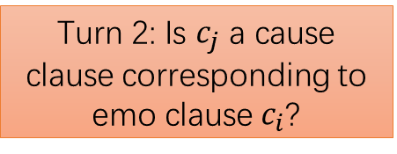
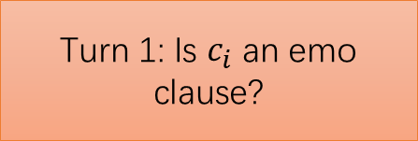
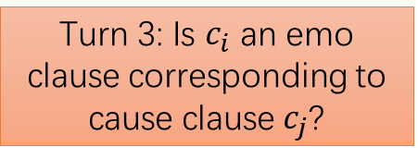
Data Mining
Data Preprocessing
Encoding
Pair up each emo clause and each non-emo clause (emoarg, arg).
Turn 1: Is $c_{i}$ an emo clause?
Re-Encoding
Add conn into pairs (emoarg, conn, arg) and calculate the PR over LM.
(Use original corpus)
For each candidate pair (cauarg, emoarg)
Turn 2: Is $c_{j}$ a cause clause corresponding to emo clause $c_{i}$?
If the PRsum of cause is greatest, add conn with PR into original corpus.
Add conn (cauarg, conn, emoarg) and calculate the PR over LM.
Re-Encoding
If the PRsum of cause is greatest, add conn with PR into original corpus.
Turn 3: Is $c_{i}$ an emo clause corresponding to cause clause $c_{j}$?

