Slide 1


Suppression of High PAPR for OFDM Signals
Khashayar Namdar
Seyedashkan Miraftabi
2021-2022

Slide 2

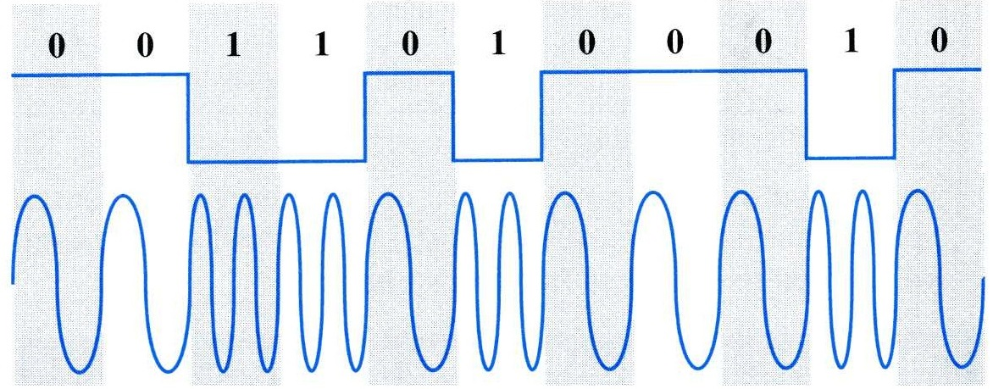
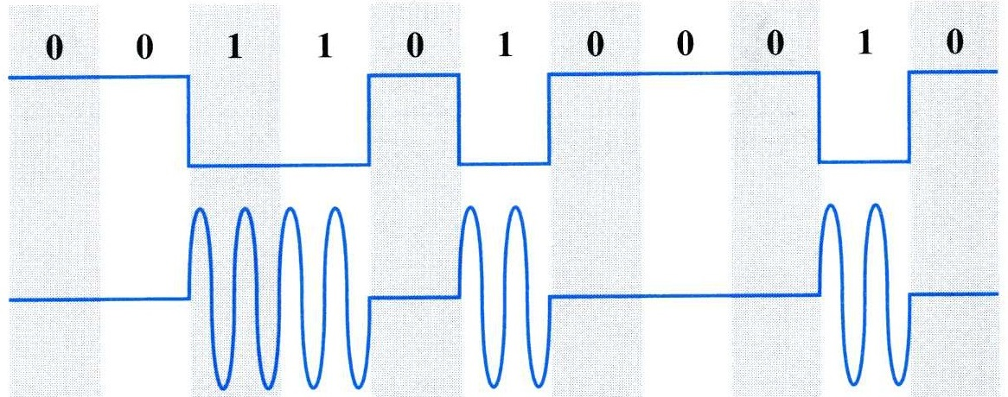
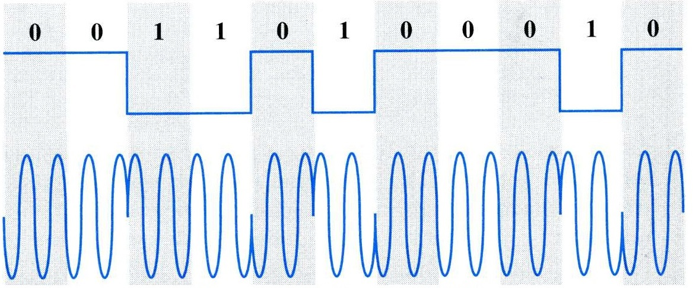
Digital Modulation
1
Frequency Shift Keying (FSK)
Amplitude Shift Keying (ASK)
Phase Shift Keying (PSK)

Slide 3
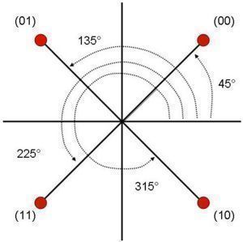
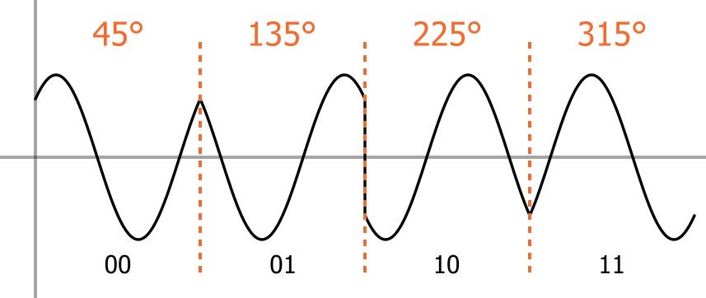
Digital Modulation >
2
Phase Shift Keying (PSK)
11
10
Quadrature Phase-Shift Keying (QPSK) or 4-PSK

Slide 4
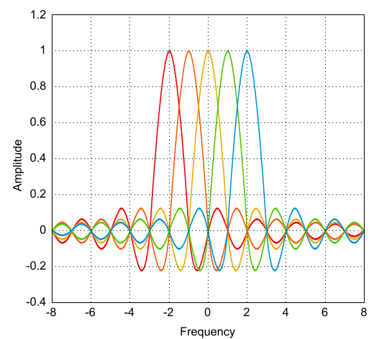
Suppression of High PAPR for OFDM Signals
3
Orthogonal Frequency-Division Multiplexing
Multicarrier
Overlap in frequency domain

Slide 5
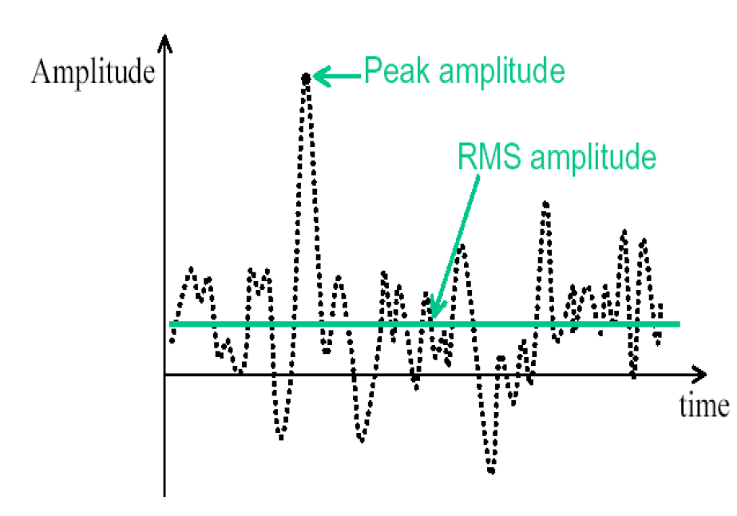

Suppression of High PAPR for OFDM Signals
4
Peak-to-Average Power Ratio (PAPR)
$$PAPR=\frac{Peak Power}{Average Power}=\frac{{(Peak Amp)}^{2}}{{(RMS Amp)}^{2}}$$

Slide 6
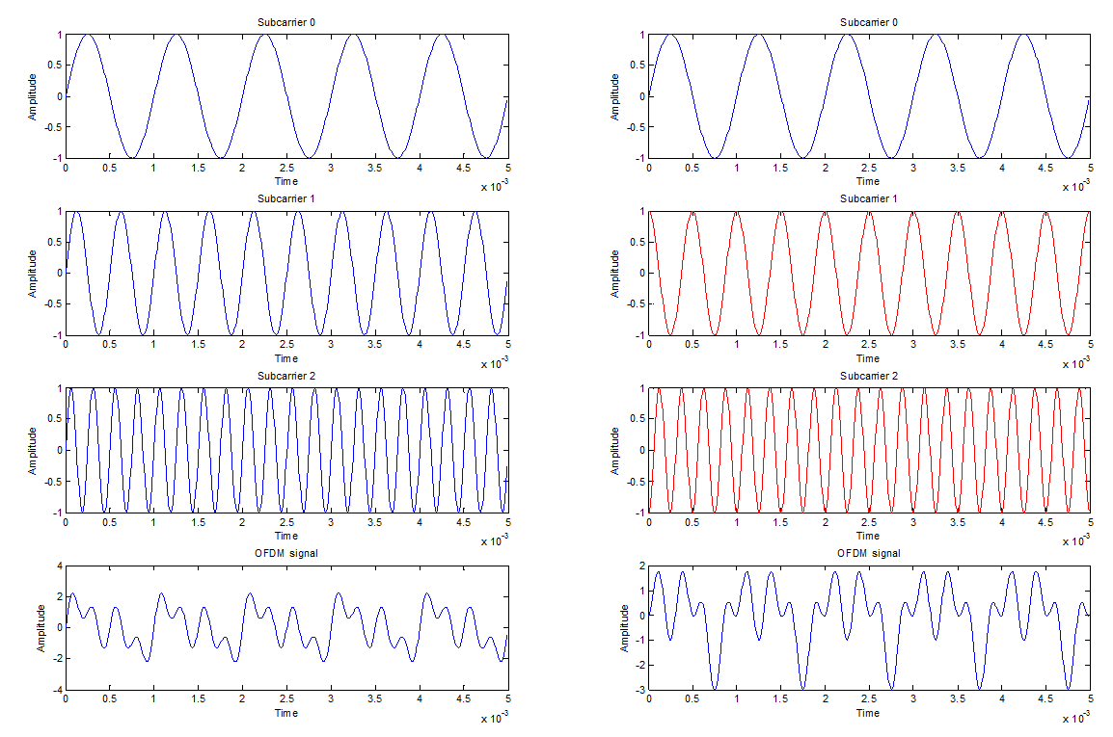
How high PAPR occurs in OFDM?
5

Slide 7
Why high PAPR Should be avoided?
6
Transmitter’s power amplifiers (PAs) are peak-power limited
High PAPR
in-band distortion & out-of-band radiation
increasing the back-off
reducing PA efficiency
Negative impact on ADC and DAC

Slide 8
7
Probabilistic [1] [2]
PAPR Reduction Techniques
Coding [3]
Companding [4]
Clipping/Filtering [5]
Criteria
Complexity
Data Rate
BER Performance

Slide 9


Companding = Compressing + Expanding
8
Variable-gain Amplifier
Source
Receiver
Dynamic
Range
Input
Compression
Expansion

Slide 10





Formulation
9
N: Number of carriers (or subcarriers)
At times 0, $τ$, $2τ$, … N symbols ($a_{k}$∊ C) are received.
k=0,1,2,…N-1
Modulation --------> $a_{k}$
Equal Energy -----> $\sum_{k=0}^{N−1}{{\left|a_{k}\right|}^{2}}=N$ ${\left|a_{k}\right|}^{2}$

Slide 11
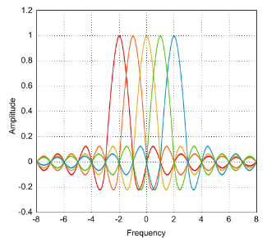




Formulation
10
$f_{0}$: Carrier Frequency $f_{s}$: Bandwidth
$$f_{s}=\frac{1}{τ}$$
Transmitted Signal in t=[0, $\frac{1}{f_{s}}$]:
S(t)=$\sum_{k=0}^{N−1}{{a_{k}e}^{2πi\left(f_{0}+kf_{s}\right)t}}$ ${\left|\text{S}\text{(}\text{t}\text{)}\right|}^{2}$

Slide 12



Formulation
11
$f_{0}$: Carrier Frequency $f_{s}$: Bandwidth
$ζ=\frac{f_{0}}{f_{s}}$ t=[0, $1$)
PAPR(a)=$\frac{Max({\left|\text{S}\text{(}\text{t}\text{)}\right|}^{2})}{Avg({\left|\text{S}\text{(}\text{t}\text{)}\right|}^{2})}=\frac{Max({\left|\sum_{k=0}^{N−1}{{a_{k}e}^{2πi\left(ζ+k\right)t}}\right|}^{2})}{N}$
PAPR(a)$≤$PMEPR(a)= $\frac{Max({\left|\sum_{k=0}^{N−1}{{a_{k}e}^{2πikt}}\right|}^{2})}{N}$

Slide 13








Clipping
12
$CCDF$: Complimentary Cumulative Distributive Function
$CCDF\left[PAPR\left(x^{n}\left(t\right)\right)\right]=$prob[$PAPR\left(x^{n}\left(t\right)\right)>δ$]
$$T\left(x\left[n\right]\right)=\left\{\begin{aligned}x\left[n\right] if \left|x\left[n\right]\right|≤CL \\ CLe^{j∠x\left[n\right]} if\left|x\left[n\right]\right|>CL\end{aligned}\right.$$
$$CR=20\log_{10}(\frac{CL}{E[x\left[n\right]]})$$

Slide 14
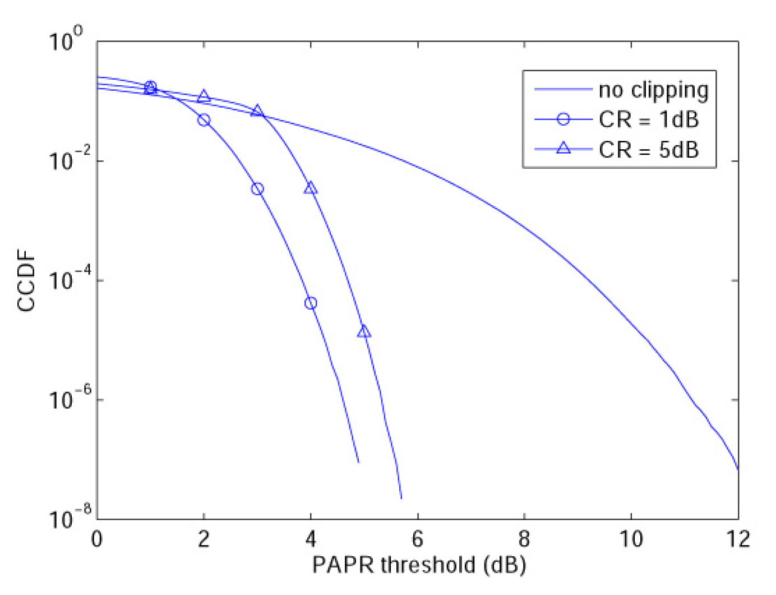


Results
13
N=1024
QPSK
AWGN

Slide 15
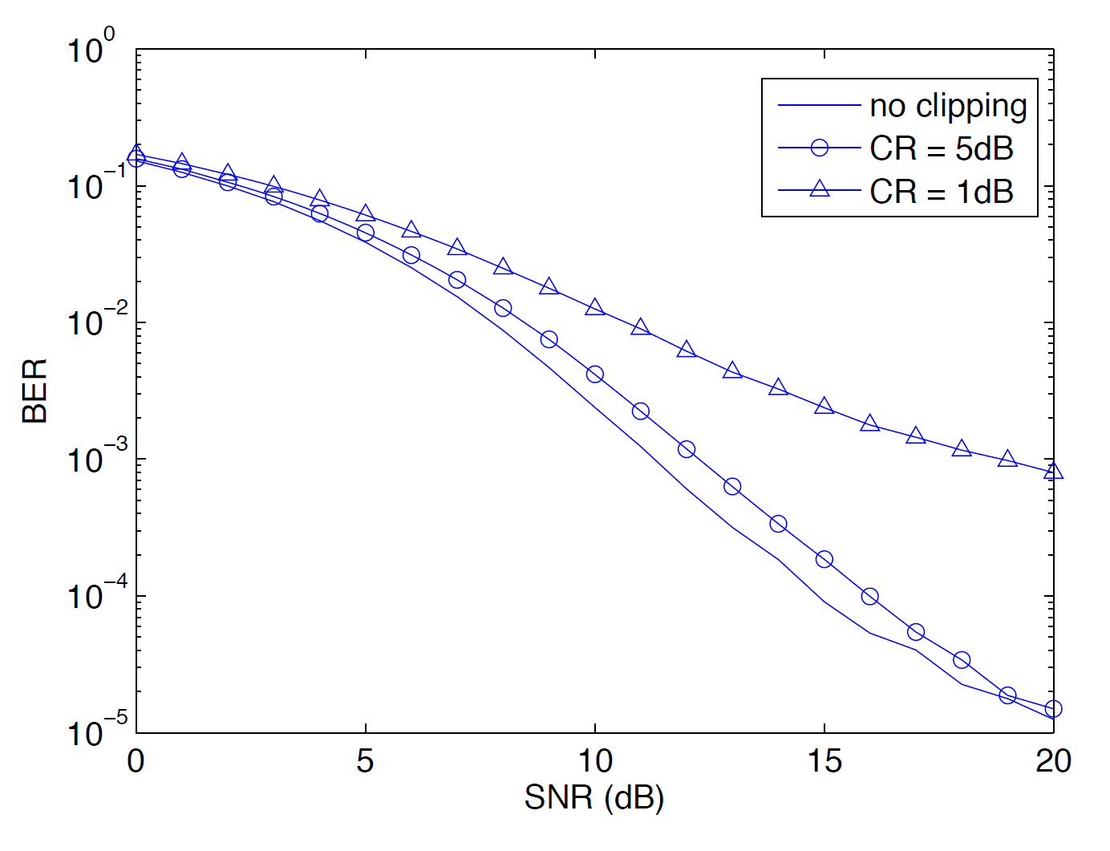


Results
14
N=1024
QPSK
AWGN

Slide 16
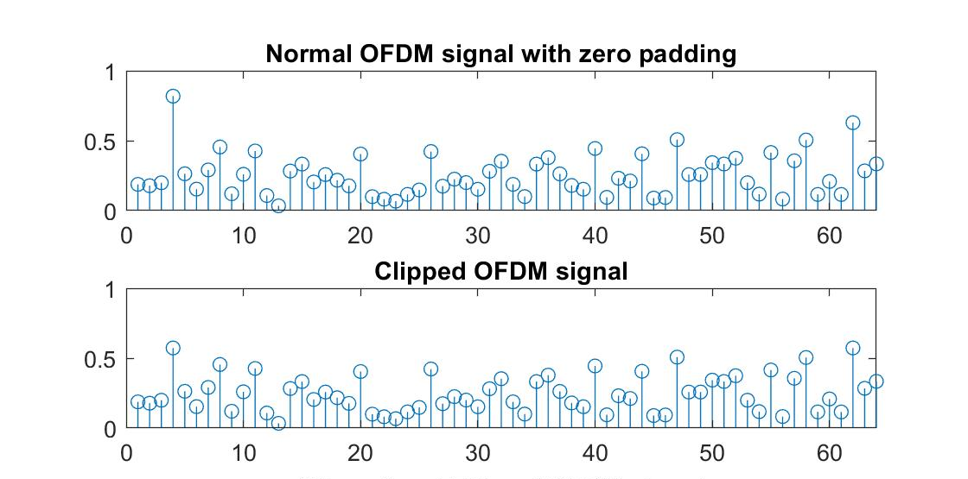

Results
15
N=64
QPSK
AWGN
CL=0.7
PAPR of normal OFDM=20.5339
PAPR of clipped OFDM=11.0855
Almost the same results as [5]
Very low complexity

Slide 17


Conclusion
16
CL CR PAPR BER
Trade-off
Clipping can inhibit PAPR problem completely
Efficiency has to be checked

Slide 18
References
[1] C.-L. Wang and S.-J. Ku, “Novel conversion matrices for simplifying the IFFT computation of an SLM-based PAPR reduction scheme for OFDM systems,” IEEE Trans. Commun., vol. 57, no. 7, pp. 1903–1907, July 2009
[2] Z. Du, N. C. Beaulieu, and J. Zhu, “Selective time-domain filtering for reduced-complexity PAPR reduction in OFDM,” IEEE Trans. Wireless Commun., vol. 58, no. 3, pp. 1170–1176, Mar. 2009
[3] M. Sabbaghian, Y. Kwak, B. Smida, and V. Tarokh, “Near Shannon limit and low peak to average power ratio turbo block coded OFDM,” IEEE Trans. Commun., vol. 59, no. 8, pp. 2042–2045, Aug. 2011
[4] X. Zhu, G. Zhu, and P. Lin, “Transforming the distribution of OFDM signals for peak-to-average power ratio reduction,” Eur. Trans. Telecommun., vol. 12, pp. 352–362, Apr. 2010
[5] X. Zhu, W. Pan, H. Li, and Y. Tang, “Simplified Approach to Optimized Iterative Clipping and Filtering for PAPR Reduction of OFDM Signals”, IEEE Trans. Commun., vol. 61, no. 5,pp. 1891-1901, May 2013

