Slide 1
Networking and Internetworking
Concepts
Switching
Routing (IP)
End-to-End Protocols (UDP/TCP)
Wireless LAN

Slide 2
Introduction

Slide 3
Building Blocks
Nodes: PC, special-purpose hardware…
  hosts
  switches
Links: coax cable, optical fiber…
  point-to-point
  multiple access
(a)
(b)
■ ■ ■

Slide 4
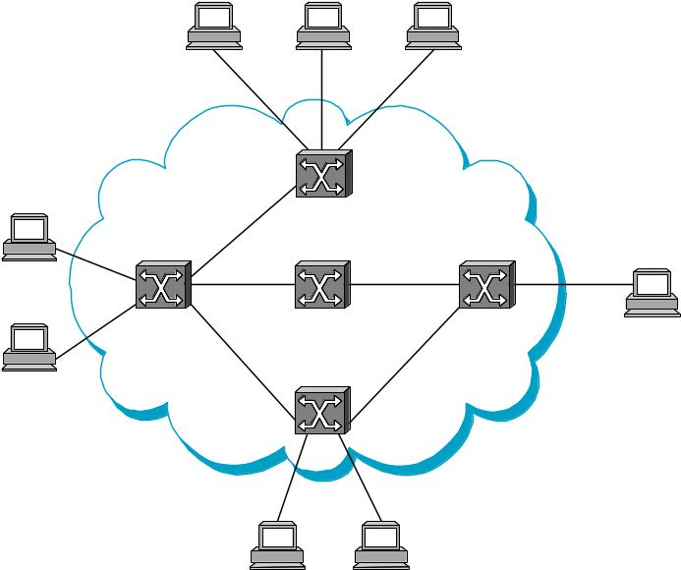
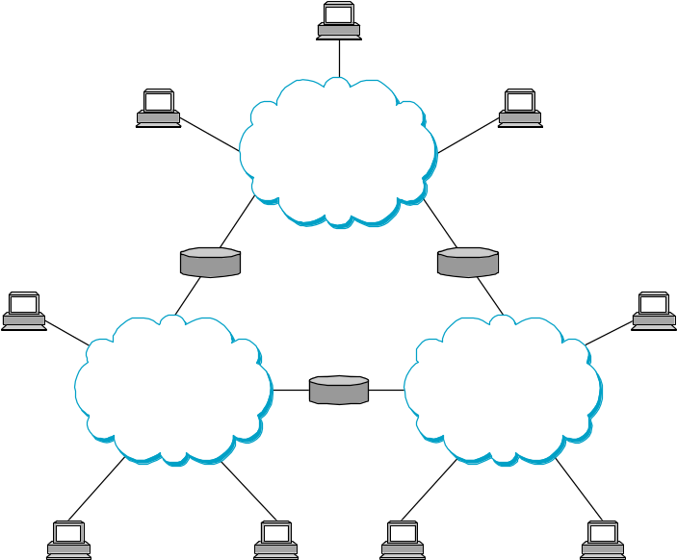
Switched Networks
A network can be defined recursively as...
  two or more nodes connected by a link, or
  two or more networks connected by a node

Slide 5
Simplified view of a network
Campus
138.37.95.240/29
138.37.95.241
router/
router
subnet
firewall
hammer
Staff subnet
Student subnet
138.37.88
138.37.88.251
138.37.94.251
138.37.94
compute
Eswitch
Eswitch
file server/
server
gateway
bruno
138.37.88.249
custard
printers
dialup
138.37.94.246

server
henry
138.37.88.230
other
file
servers
server
hotpoint
138.37.88.162
web
server
copper
138.37.88.248
hub
hub
desktop computers
138.37.88.xx
desktop computers
138.37.94.xx
Campus
138.37.95.248/29
sickle
100 Mbps Ethernet
router
subnet
138.37.95.249
router/
firewall
1000 Mbps Ethernet
Eswitch: Ethernet switch

Slide 6
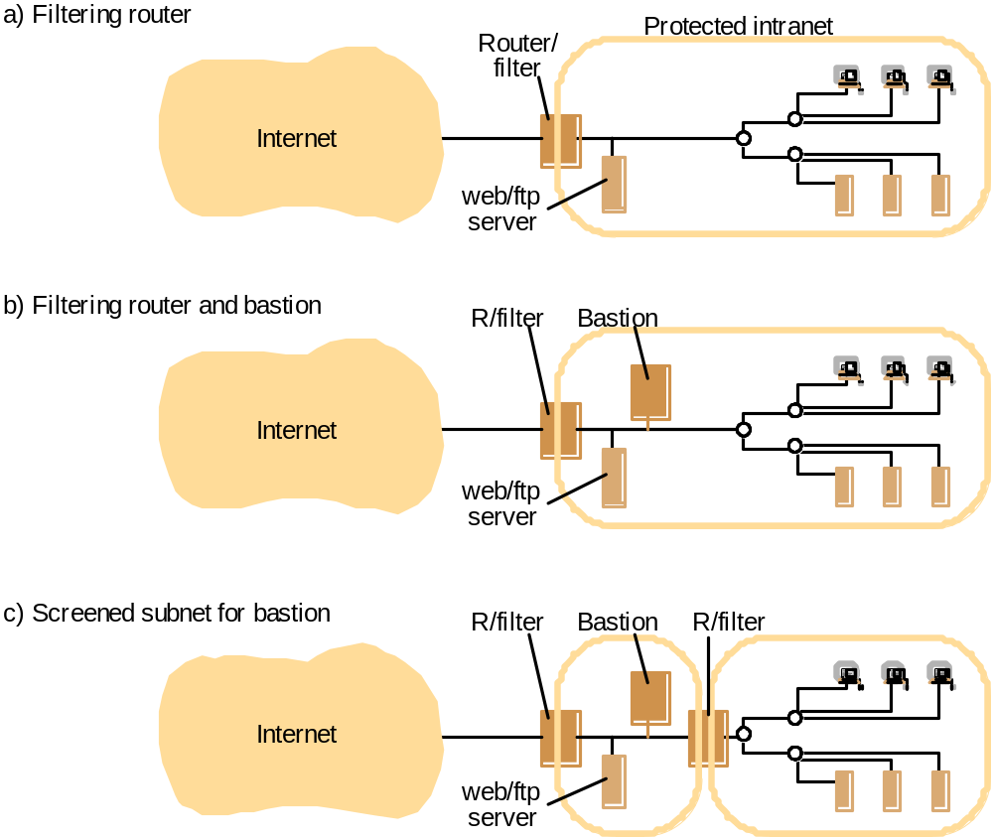
Firewall configurations

Slide 7
Addressing and Routing
Address: byte-string that identifies a node
  usually unique
Routing: process of forwarding messages to the destination node based on its address
Types of addresses
  unicast: node-specific
  broadcast: all nodes on the network
  multicast: some subset of nodes on the network

Slide 8
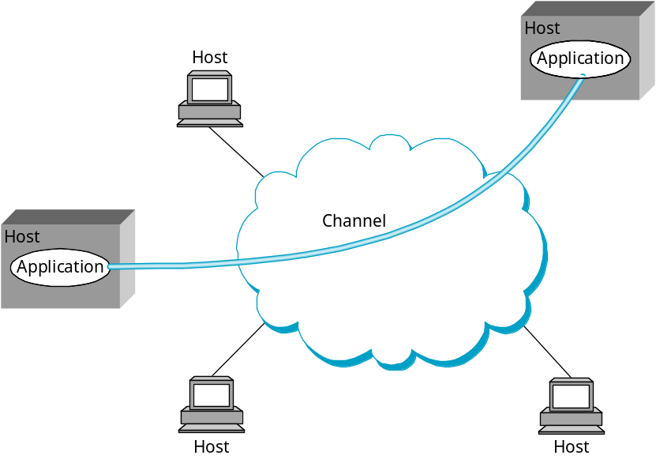
Inter-Process Communication
Turn host-to-host connectivity into process-to-process communication.
Fill gap between what applications expect and what the underlying technology provides.

Slide 9
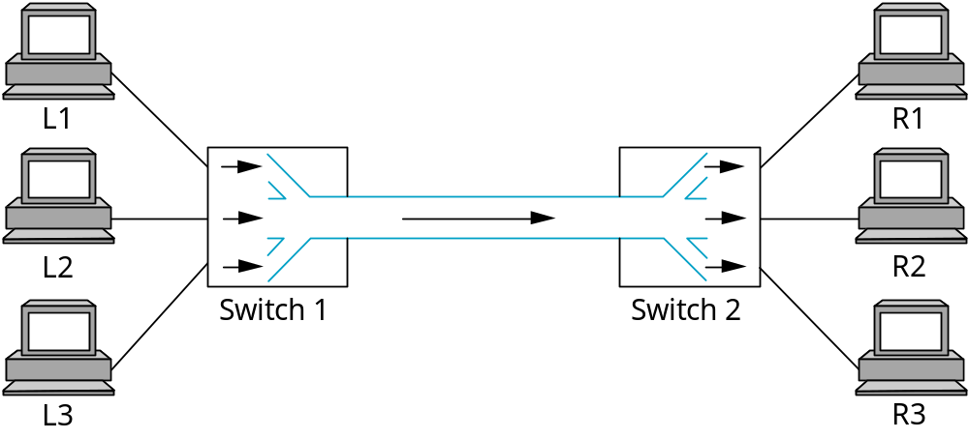
Multiplexing
Circuit switching: carry bit streams
  original telephone network
Packet switching: store-and-forward messages
  Internet

Slide 10
Statistical Multiplexing
On-demand time-division
Schedule link on a per-packet basis
Packets from different sources interleaved on link
Buffer packets that are contending for the link
Buffer (queue) overflow is called congestion
■ ■ ■

Slide 11
What Goes Wrong in the Network?
Bit-level errors (electrical interference)
Packet-level errors (congestion)
Link and node failures
Packets are delayed
Packets are deliver out-of-order
Third parties eavesdrop

Slide 12
Conceptual layering of protocol software
Message sent
Message received
Layer n
Layer 2
Layer 1
Sender
Communication
Recipient
medium

Slide 13
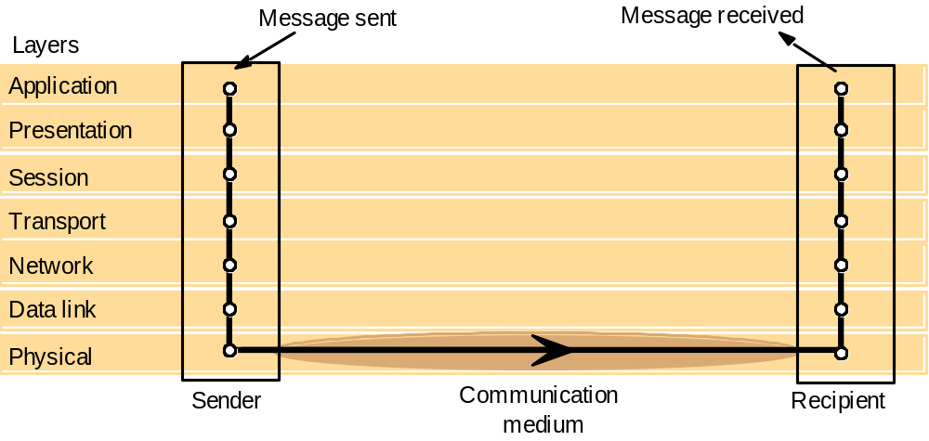
Protocol layers in the ISO Open Systems Interconnection (OSI) model
most peer-to-peer communication is indirect
peer-to-peer is direct only at hardware level

Slide 14
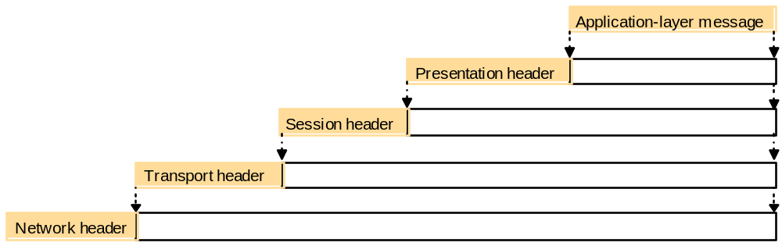
Encapsulation as it is applied in layered protocols

Slide 15
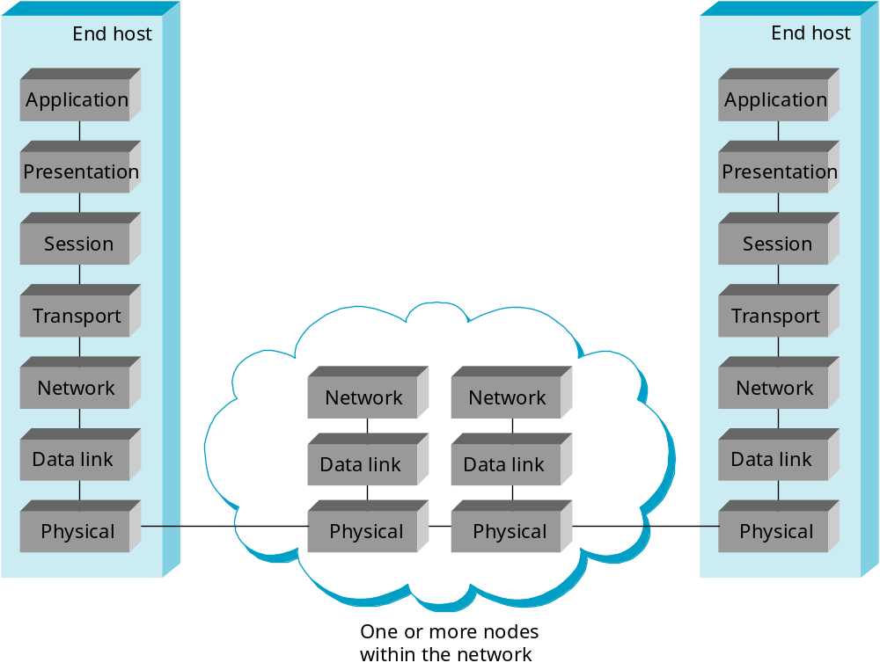
ISO Architecture

Slide 16
OSI protocol summary
Layer
Description
Examples
Application
Protocols that are designed to meet the communication requirements of
HTTP,
FTP
,
SMTP,
specific applications, often defining the interface to a service.
CORBA IIOP
Presentation
Protocols at this level transmit data in a network representation that is
Secure Sockets
independent of the representations used in individual computers, which may
(
SSL),CORBA Data
differ. Encryption is also performed in this layer, if required.
Rep.
Session
At this level reliability and adaptation are performed, such as detection of
failures and automatic recovery.
Transport
This is the lowest level at which messages (rather than packets) are handled.
TCP,
UDP
Messages are addressed to communication ports attached to processes,
Protocols in this layer may be connection-oriented or connectionless.
Network
Transfers data packets between computers in a specific network. In a WAN
IP,
ATM virtual
or an internetwork this involves the generation of a route passing through
circuits
routers. In a single LAN no routing is required.
Data link
Responsible for transmission of packets between nodes that are directly
Ethernet MAC,
connected by a physical link. In a WAN transmission is between pairs of
ATM cell transfer,
routers or between routers and hosts. In a LAN it is between any pair of hosts.
PPP
Physical
The circuits and hardware that drive the network. It transmits sequences of
Ethernet base- band
binary data by analogue signalling, using amplitude or frequency modulation
signalling,
ISDN
of electrical signals (on cable circuits), light signals (on fibre optic circuits)
or other electromagnetic signals (on radio and microwave circuits).

Slide 17
TCP/IP layers
Message
Layers
Application
Messages (UDP) or Streams (TCP)
Transport
UDP or TCP packets
Internet
IP datagrams
Network interface
Network-specific frames
Underlying network

Slide 18
Encapsulation in a message transmitted via TCP over an Ethernet
Application message
TCP header
port
IP header
TCP
Ethernet header
IP
Ethernet frame

Slide 19
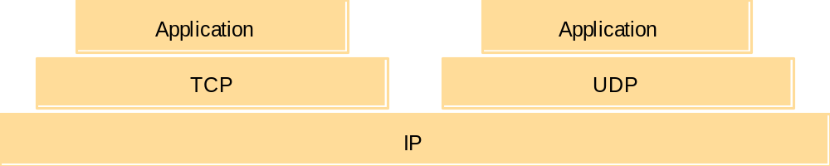
The programmer's conceptual view of a TCP/IP Internet

Slide 20
Internet Architecture
Hourglass Design
Application vs Application Protocol (FTP, HTTP)
FTP
HTTP
SMTP
TFTP
TCP
UDP
IP
NET
1
NET
2
■ ■ ■
NET
n

Slide 21
Protocol Multiplexing
Multiplexing and Demultiplexing (demux key)
Encapsulation (header/body)
Host
Host
Application
Application
Application
Application
program
program
program
program
Data
Data
RRP
RRP
RRP Data
RRP Data
HHP
HHP
HHP RRP Data

Slide 22
Switching

Slide 23
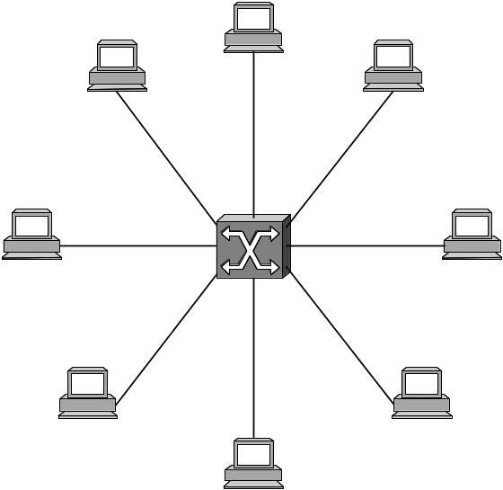
Scalable Networks
Switch
  Connect links to form a larger network.
  Connect switches to form a larger network.
  forwards packets from input port to output port
  port selected based on address in packet header
Advantages
  store and forward
  support large numbers of hosts

Slide 24
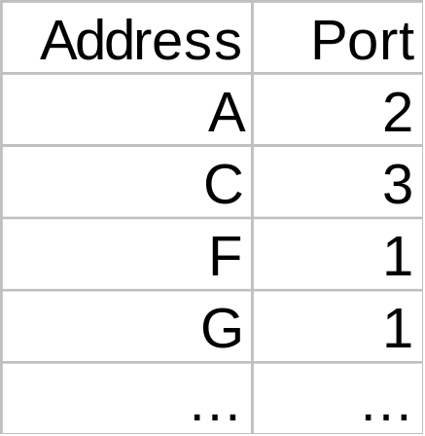
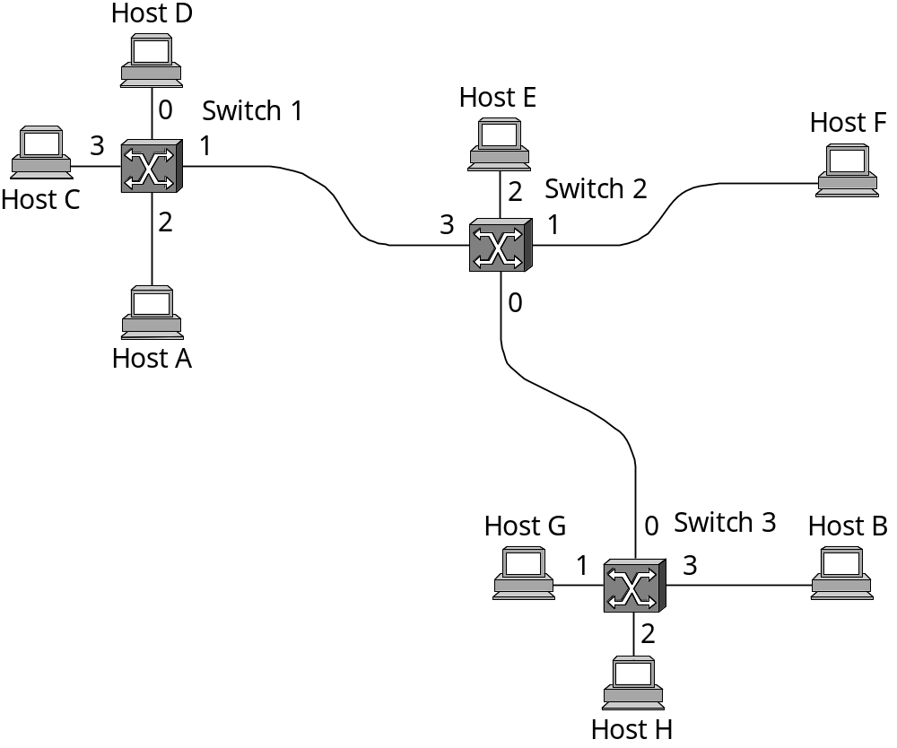
Datagram Switching
No connection setup phase
  Sometimes called connectionless model
Each packet forwarded independently
Each switch maintains a forwarding (routing) table
  Eg. Switch 1

Slide 25
Datagram Model
Source host has no way of knowing if the network is capable of delivering a packet or if the destination host is even up.
  No QoS
Since packets are treated independently, it is possible to route around link and node failures.
Since every packet must carry the full address of the destination, the overhead per packet is higher than for the connection-oriented model.

Slide 26
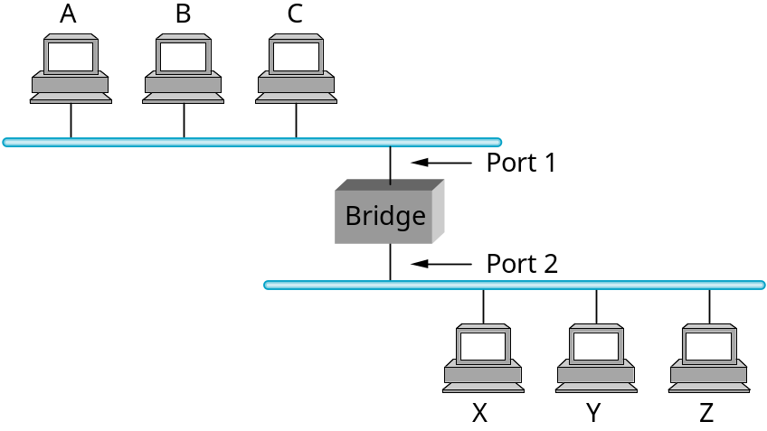
Learning Bridges
Do not forward to all the other ports (broadcast) when unnecessary
Maintain forwarding table
Host Port
A 1
B 1
C 1
X 2
Y 2
Z 2
Learn table entries based on source address
Table is an optimization; need not be complete
Always forward broadcast frames

Slide 27
Routing (IP)

Slide 28
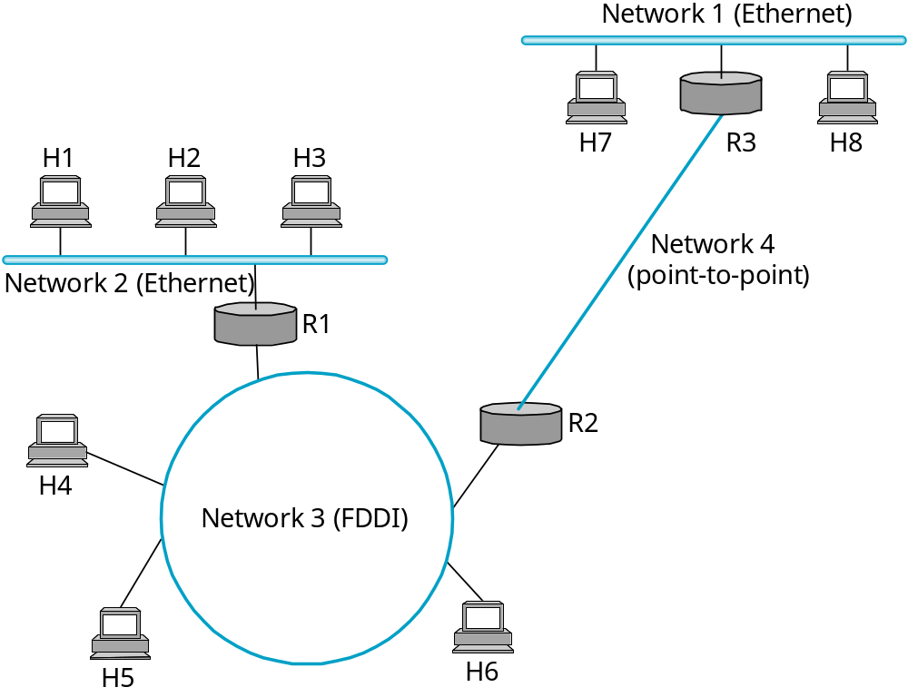
Internetworking
Concatenation of Different Networks

Slide 29
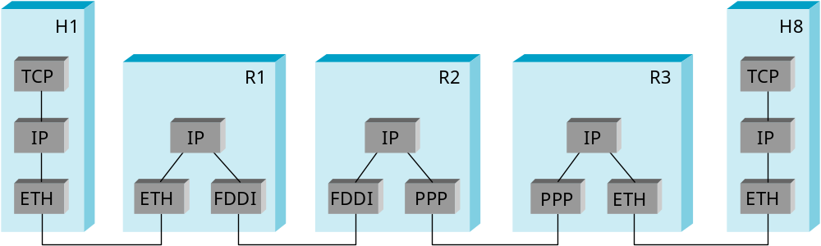
IP Internet
Connecting Problem 1: Heterogeneity of Networks
  Solution: Layered Protocol Stack (IP over …… )
Problem 2: Scalability in Routing and Addressing
  Solution: Address Hierarchy

Slide 30
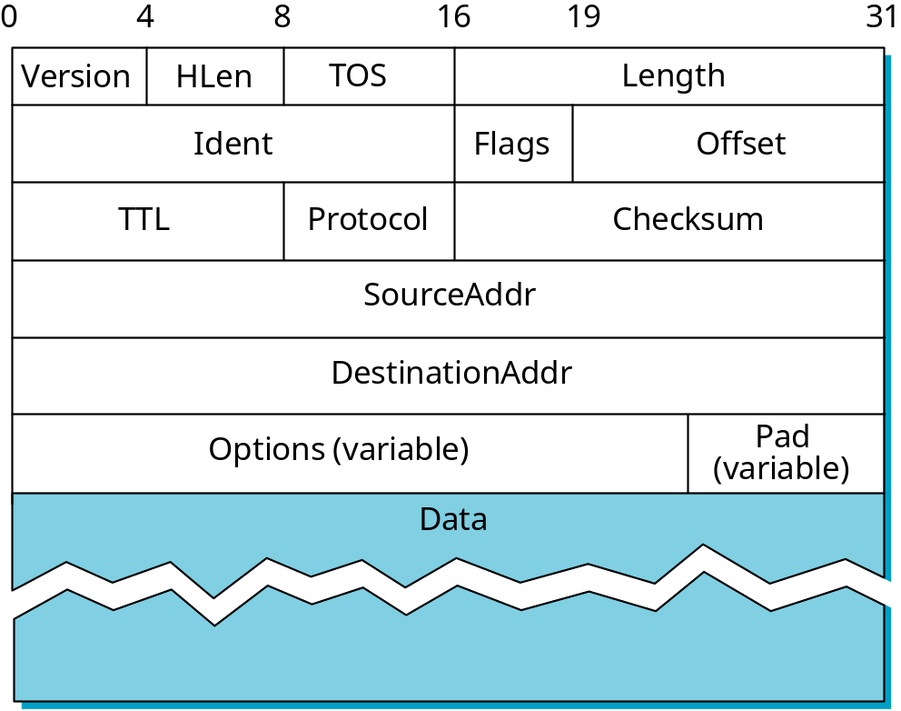
Service Model
Connectionless (datagram-based)
Best-effort delivery (unreliable service)
  packets can be lost, delayed, duplicated, delivered out of order.
Datagram format: IP header

Slide 31
IP Header
Version (always set to the value 4 for IP v4)
IP Header Length (number of 32 -bit words forming the header, usually five)
Size of Datagram (in bytes, header + data)
Flags 3 bits: R (reserved bit set to 0) DF (Don't fragment ) MF (More fragments)
Time To Live (Number of hops /links which the packet may be routed over, decremented by most routers - used to prevent accidental routing loops)
Protocol (the type of transport packet being carried (e.g. 1 = ICMP; 6 = TCP; 17= UDP).
Header Checksum (A 1's complement checksum of IP header, updated whenever the packet header is modified by a node. Packets with an invalid checksum are discarded by all nodes in an IP network)
Source Address / Destination Address

Slide 32
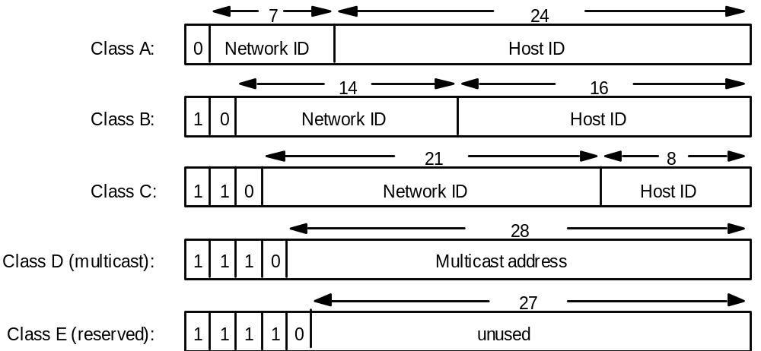
Internet address structure, showing field sizes in bits
globally unique
hierarchical: network + host

Slide 33
Decimal representation of Internet addresses
octet 1
octet 2
octet 3
Range of addresses
Network ID
Host ID
Class A:
1 to 127
0 to 255
0 to 255
0 to 255
1.0.0.0 to
127.255.255.255
Network ID
Host ID
Class B:
128 to 191
0 to 255
0 to 255
0 to 255
128.0.0.0 to
191.255.255.255
Network ID
Host ID
Class C:
192 to 223
0 to 255
0 to 255
1 to 254
192.0.0.0 to
223.255.255.255
Multicast address
Multicast address
Class D (multicast):
224 to 239
0 to 255
0 to 255
1 to 254
224.0.0.0 to
239.255.255.255
Class E (reserved):
240 to 255
0 to 255
0 to 255
1 to 254
240.0.0.0 to
255.255.255.255

Slide 34
Datagram Forwarding Strategy
Every datagram contains destination’s address
if connected to destination network, then forward to the host in LAN
  If network number of destination IP == my network number
if not directly connected, then forward to the host’s default router
Each router maintains a forwarding table
  forwarding table maps network number (rather than host address) into next hop or interface number (if directly connected)

Slide 35
  Traffic: H1 → H3, H1 → H8
  R1: default router is R2
  R2 Routing Table:
  Network Number Next Hop Interface
1 R3 interface 1
2 R1 interface 0
3 - interface 1
4 - interface 0

Slide 36
Address Translation in LAN
Map IP addresses into physical addresses of the destination host (if connected directly) or the next hop router
ARP
  Each host caches its table of IP to physical address bindings
  table entries are discarded if not refreshed
    timeout in about 10 minutes
  broadcast request if IP address not in table
  target machine send its physical address to the sender
  target machine also updates add entry of the source in its table
    It is likely that the target will send IP packets to the source later on.
  Other hosts (who receives the broadcasted request) update table if already have an entry

Slide 37
End-to-End Protocols
Underlying best-effort network
  drop messages
  re-orders messages
  delivers duplicate copies of a given message
  limits packet (not message) to some finite size
  delivers messages after an arbitrarily long delay
Common end-to-end services
  guarantee message delivery
  deliver messages in the same order they are sent
  deliver at most one copy of each message
  support arbitrarily large messages
  support synchronization between sender and receiver
  allow the receiver to flow control the sender
  support multiple application processes on each host

Slide 38
End-to-End Protocols
(UDP/TCP)

Slide 39
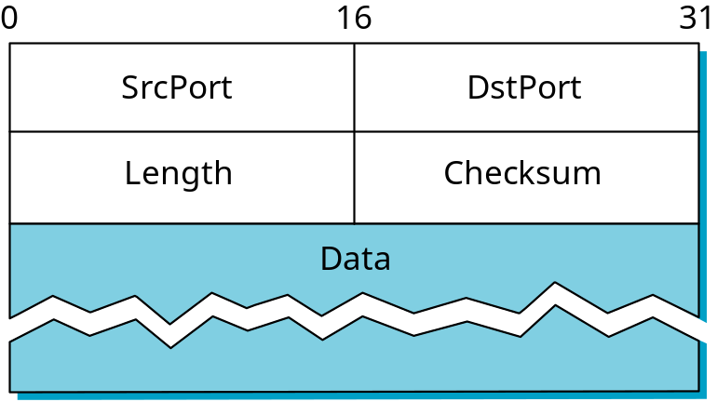
Simple Demultiplexor (UDP)
Unreliable and unordered datagram service
Adds multiplexing
No flow control or error control
  no need for sender-side buffer)
Endpoints identified by ports
  servers listens at well-known ports!
  see /etc/services on Unix
Header format
Optional checksum
  psuedo header (IP.src, IP.dsest, IP.proto, UDP.len) + UDP header + data

Slide 40
TCP Overview
Connection-oriented
Byte-stream
  app writes bytes
  TCP sends segments
  app reads bytes
Full duplex
Flow control: keep sender from overrunning receiver
Congestion control: keep sender from overrunning network
Application process
Application process
Write
Read
bytes
bytes
TCP
TCP
Send buffer
Receive buffer
Segment
Segment
■ ■ ■
Segment
Transmit segments

Slide 41
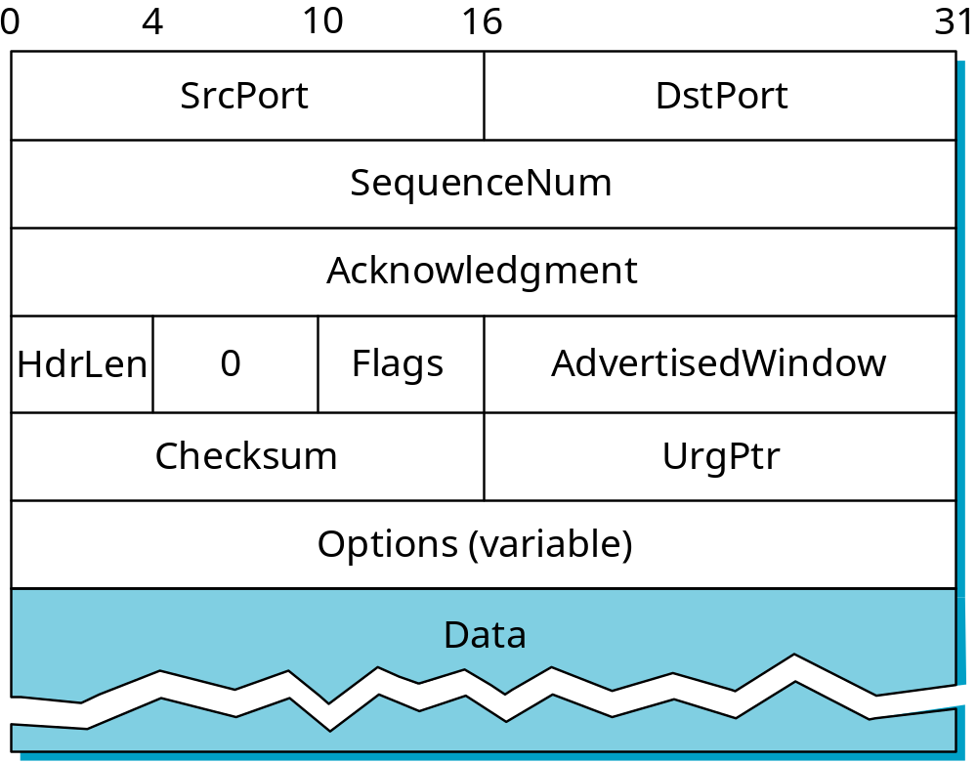
Segment Format

Slide 42
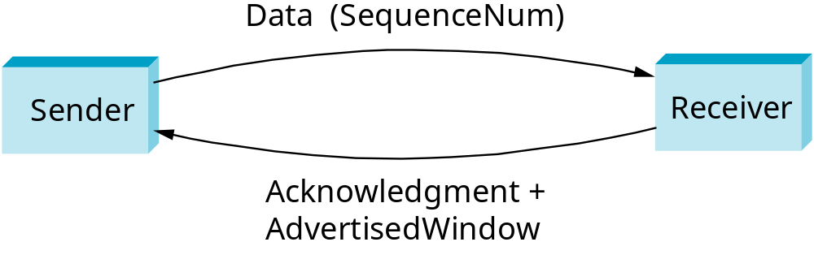
Segment Format (cont)
Each connection identified with 4-tuple:
  (SrcPort, SrcIPAddr, DsrPort, DstIPAddr)
Sliding window + flow control
  acknowledgment, SequenceNum, AdvertisedWinow
Flags
  SYN, FIN, RESET, PUSH, URG, ACK
Checksum
  pseudo header + TCP header + data

Slide 43
Connection Establishment and Three-Way Handshake
Active participant
Passive participant
(client)
(server)
SYN, SequenceNum =
x
SYN+ACK, SequenceNum=y,
Acknowledgment =x+1
ACK, Acknowledgment =y+1

Slide 44
Reliability and Flow Control
The receiver’s buffer has two purposes
  Reorder segments received out of order
  Hold data unread by the application
The sender cannot send more than AdvertisedWindow bytes of unacknowledged data at any given time (Flow Control).
The sender retransmits after timeout
  Adaptive RTT measurement.

Slide 45
Socket API
Creating a socket
  int socket(int domain, int type, int protocol)
    type = SOCK_STREAM, SOCK_DGRAM, SOCK_RAW
Passive Open (on server)
  int bind(int socket, struct sockaddr *addr, int addr_len)
  int listen(int socket, int backlog)
  int accept(int socket, struct sockaddr *addr, int addr_len)
Active Open (on client)
  int connect(int socket, struct sockaddr *addr,
  int addr_len)
Sending/Receiving Messages
  int send(int socket, char *msg, int mlen, int flags)
  int recv(int socket, char *buf, int blen, int flags)

Slide 46
Wireless LAN

Slide 47
Ethernet Overview
The most successful Local Area Networks
Bandwidth: 10Mbps, 100Mbps (Fast), 1Gbps
Avoid Simultaneous on a Shared Line: CSMA/CD
  multiple access
  carrier sense:
    listen before transmitting.
    distinguish an idle and busy link.
  collision detection
    listen while transmitting.
    Collision: What you hear is different from what you listen

Slide 48
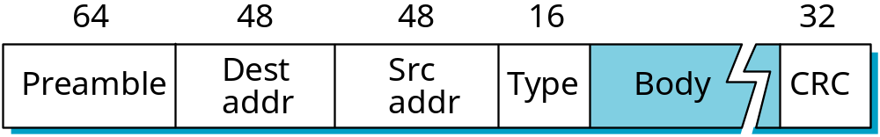
Ethernet Frame
Frame Format
Addresses
  unique, 48-bit unicast address assigned to each adapter
    example: 8:0:e4:b1:2
  Every body hears the frame (shared media). But the one with matching destination address picks up.
  broadcast: all 1s
  multicast: first bit is 1. The host can configure its adaptor to accept some multicast addresses
Preamble (a seq. alternating 0s and 1s ) indicates the start of a frame
Type: high-level protocols

Slide 49
Transmit Algorithm
If line is idle…
  send immediately
  upper bound message size of 1500 bytes
    Limited occupancy on the line.
  must wait 9.6us between back-to-back frames
    To allow other hosts to send.
If line is busy…
  wait until idle and transmit immediately

Slide 50
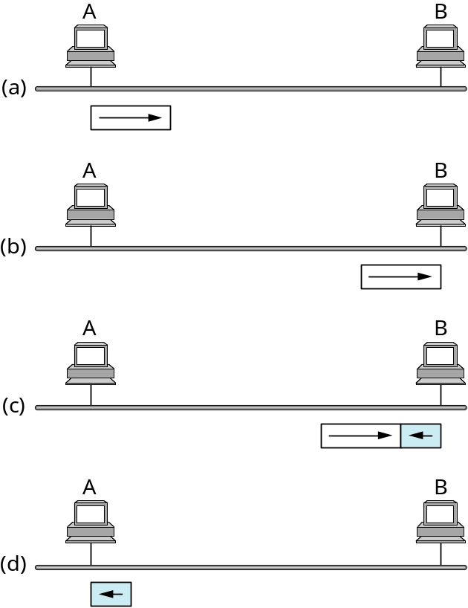
Collisions
The remote side may send its frame before it hears the frame currently being sent
  Both sides detect an idle line
  Due to the propagation delay
For A to detect the collision
  Collisions can only be detected during transmission
  51.2us •10Mbps = 64 bytes

Slide 51
Upon Collision
Send 32 jam bits, then stop transmitting frame
  To ensure other hosts to detect conllision
minimum frame is 64 bytes (header + 46 bytes of data)
delay and try again: exponential backoff
  1st time: 0 or 51.2us selected at random
  2nd time: 0, 51.2, or 102.4us
  nth time: k x 51.2us, for randomly selected k=0..2^{n} - 1
  give up after several tries (usually 16)

Slide 52
Wireless LANs
IEEE 802.11
Bandwidth: 1 - 11 Mbps
Physical Media
  diffused infrared (10m)
    Diffused: the sender do not need a clear line of sight.
  spread spectrum radio (2.4GHz): 11 Mbps ⇒ 54Mbps

Slide 53
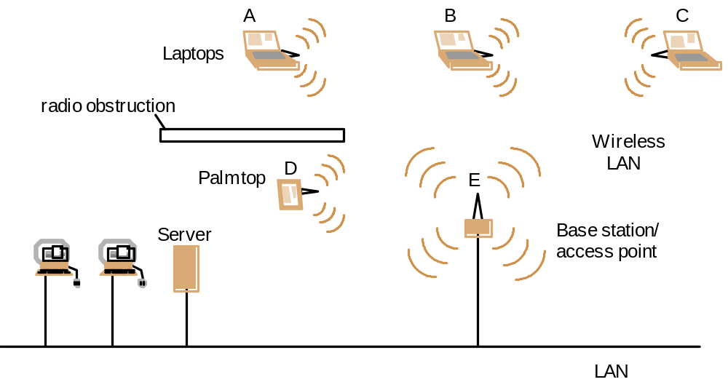
Wireless LAN configuration

Slide 54

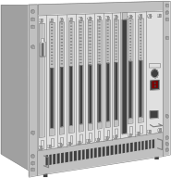


Infrastructure mode
fixed
terminal
mobile terminal
infrastructure
network
access point
application
application
TCP
TCP
IP
IP
LLC
LLC
LLC
802.11 MAC
802.11 MAC
802.3 MAC
802.3 MAC
802.11 PHY
802.11 PHY
802.3 PHY
802.3 PHY

Slide 55
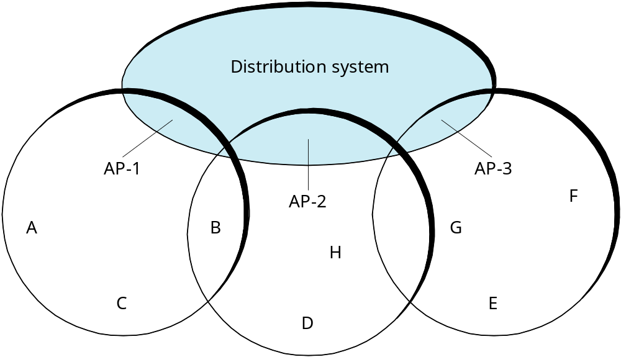
Supporting Mobility
Case 1: ad hoc networking
Case 2: access points (AP)
  Tethered
  each mobile node associates with an AP (base station)
  Mobile nodes sends to AP first; AP forwards

Slide 56
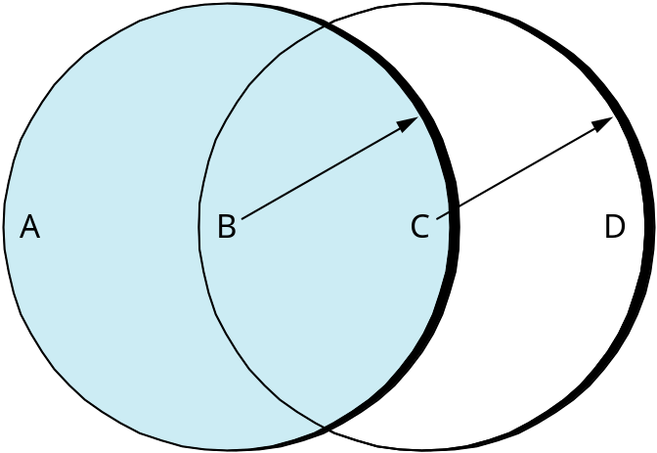
Collisions Avoidance
Similar to Ethernet: Wait until link idle
Problem: hidden and exposed nodes
  A ⇒ C; C ⇒ B;
    Collides at B
    A, C cannot detect: hidden nodes
  B ⇒ A; C ⇒ D;
    C assumes collision
    Actually no collision at A or D
Cannot (listen) detect collision when transmit

Slide 57
802.11 MAC
Priorities
  defined through different inter frame spaces
  no guaranteed, hard priorities
  SIFS (Short Inter Frame Spacing)
    highest priority, for ACK, CTS, polling response
  PIFS (PCF IFS)
    medium priority, for time-bounded service using PCF
  DIFS (DCF, Distributed Coordination Function IFS)
    lowest priority, for asynchronous data service
DIFS
DIFS
PIFS
medium busy
SIFS
contention
next frame
t
direct access if
medium is free ≥ DIFS

Slide 58
802.11 CSMA/CA
contention window
(randomized back-off
mechanism)
DIFS
DIFS
medium busy
next frame
direct access if
medium is free ≥ DIFS
t
slot time
  station ready to send starts sensing the medium (Carrier Sense based on CCA, Clear Channel Assessment)
  if the medium is free for the duration of an Inter-Frame Space (IFS), the station can start sending (IFS depends on service type)
  if the medium is busy, the station has to wait for a free IFS, then the station must additionally wait a random back-off time (collision avoidance, multiple of slot-time)
  if another station occupies the medium during the back-off time of the station, the back-off timer stops (fairness)

Slide 59
802.11 CSMA/CA: contention resolution
DIFS
DIFS
DIFS
DIFS
bo_{e}
bo_{r}
bo_{e}
bo_{r}
bo_{e}
busy
station₁
bo_{e}
busy
station₂
busy
station₃
bo_{e}
busy
bo_{e}
bo_{r}
station₄
bo_{e}
bo_{r}
bo_{e}
busy
bo_{e}
bo_{r}
station₅
t
busy
medium not idle (frame, ack etc.)
bo_{e}
elapsed backoff time
packet arrival at MAC
bo_{r}
residual backoff time

Slide 60
802.11 CSMA/CA: detailed
Sending unicast packets
  station has to wait for DIFS before sending data
  receivers acknowledge at once (after waiting for SIFS) if the packet was received correctly (CRC)
  automatic retransmission of data packets in case of transmission errors
DIFS
data
sender
SIFS
ACK
receiver
DIFS
other
stations
data
t
waiting time
contention

Slide 61
Multiple Access with Collision Avoidance (MACA)
Sender transmits RequestToSend (RTS) frame
  Specifying how long to hold the medium
Receiver replies with ClearToSend (CTS) frame
Neighbors…
  see CTS: keep quiet
  see RTS but not CTS: receiver cannot hear me, ok to transmit
Receive sends ACK when has frame
  neighbors silent until see ACK
Collisions
  no collisions detection
  known when don’t receive CTS or ACK
    The cost of collision with RTS/CTS is much smaller
  exponential backoff

Slide 62
802.11: RTS & CTS
Sending unicast packets
  station can send RTS with reservation parameter after waiting for DIFS (reservation determines amount of time the data packet needs the medium)
  acknowledgement via CTS after SIFS by receiver (if ready to receive)
  sender can now send data at once, acknowledgement via ACK
  other stations store medium reservations distributed via RTS and CTS
DIFS
RTS
data
sender
SIFS
CTS
SIFS
SIFS
ACK
receiver
NAV (RTS)
DIFS
data
other
stations
NAV (CTS)
t
defer access
contention

Slide 63
Mobility (cont)
Scanning (selecting an AP)
  node sends Probe frame
  all AP’s w/in reach reply with ProbeResponse frame
  node selects one AP; sends it AssociateRequest frame
  AP replies with AssociationResponse frame
When
  active: when join or move
    Signal with old AP weakened
    new AP informs old AP via tethered network
  passive: AP periodically sends Beacon frame

