Slide 1
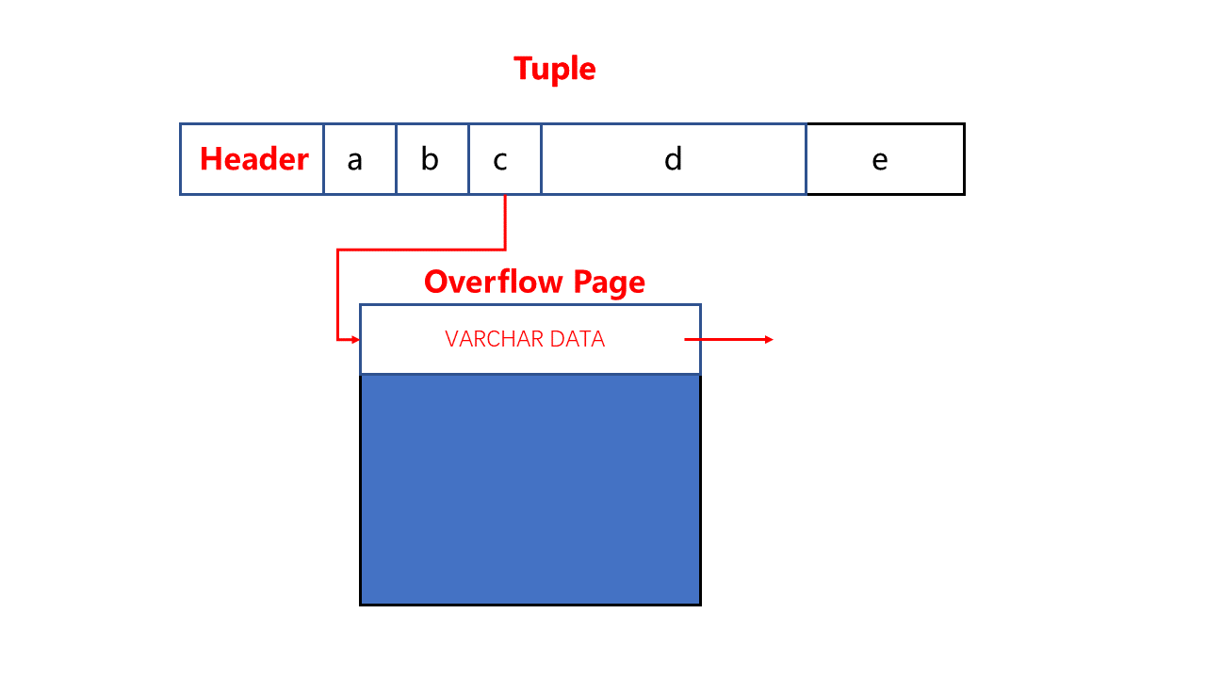
Tuple
Tuple
Header
a
b
c
d
e
Overflow Page
VARCHAR DATA

Slide 2
Tuple
Tuple
Header
a
b
c
d
e
file path
external file
Data

