Slide 1
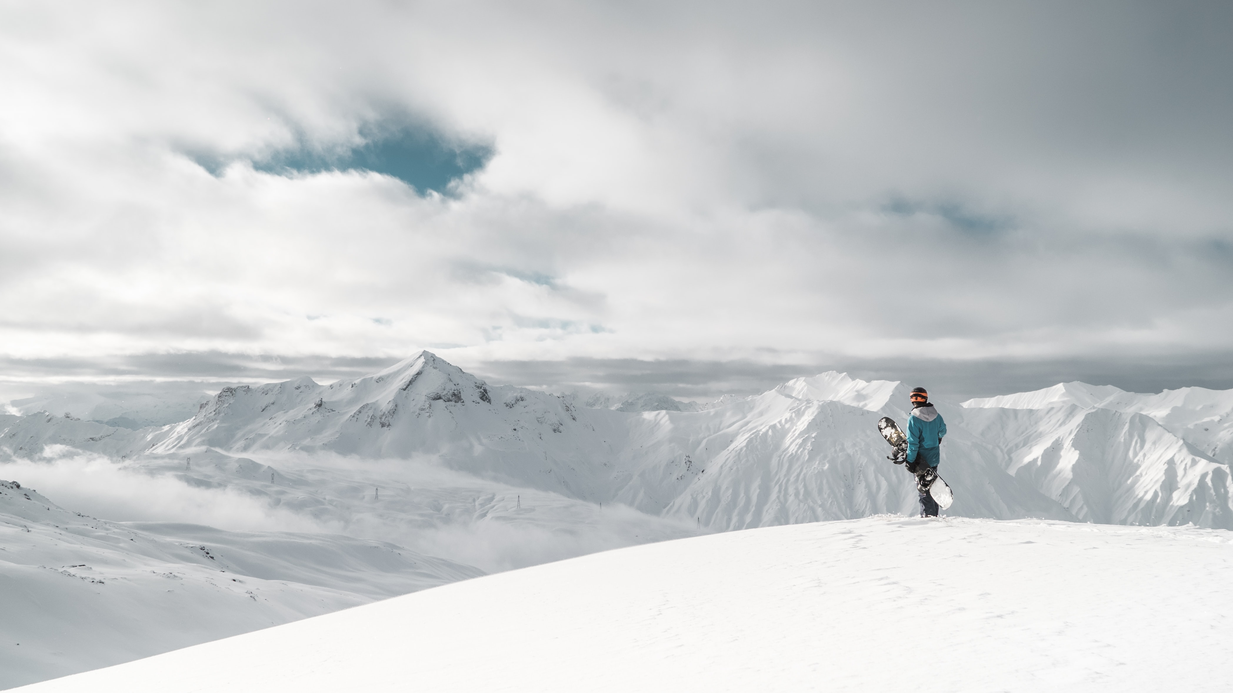

Lisa Millerd Term 3 Week 4

Slide 2
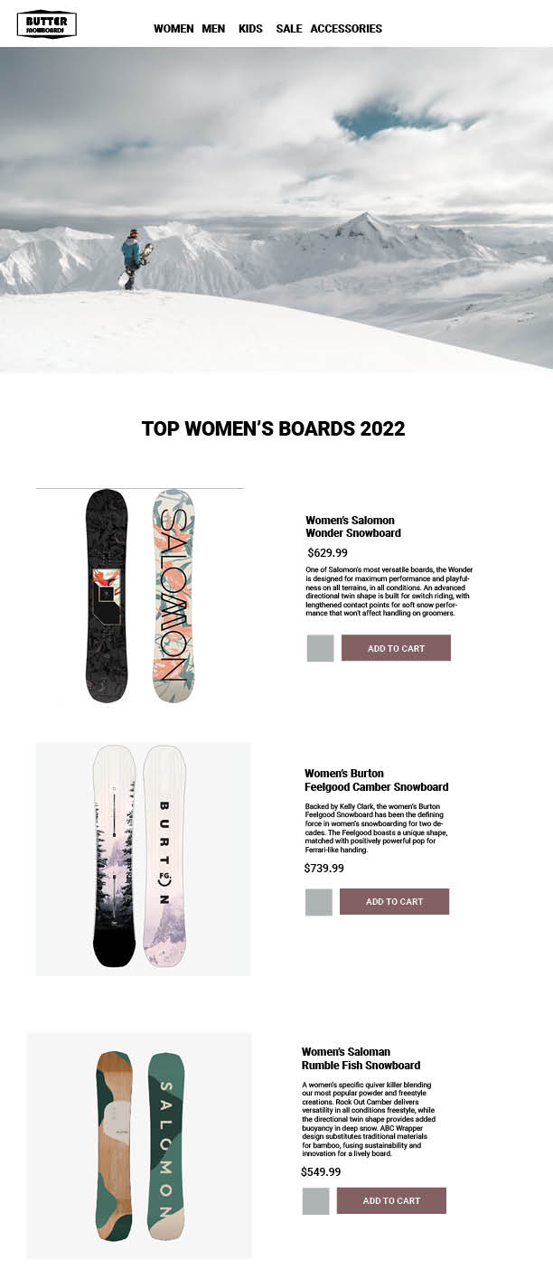
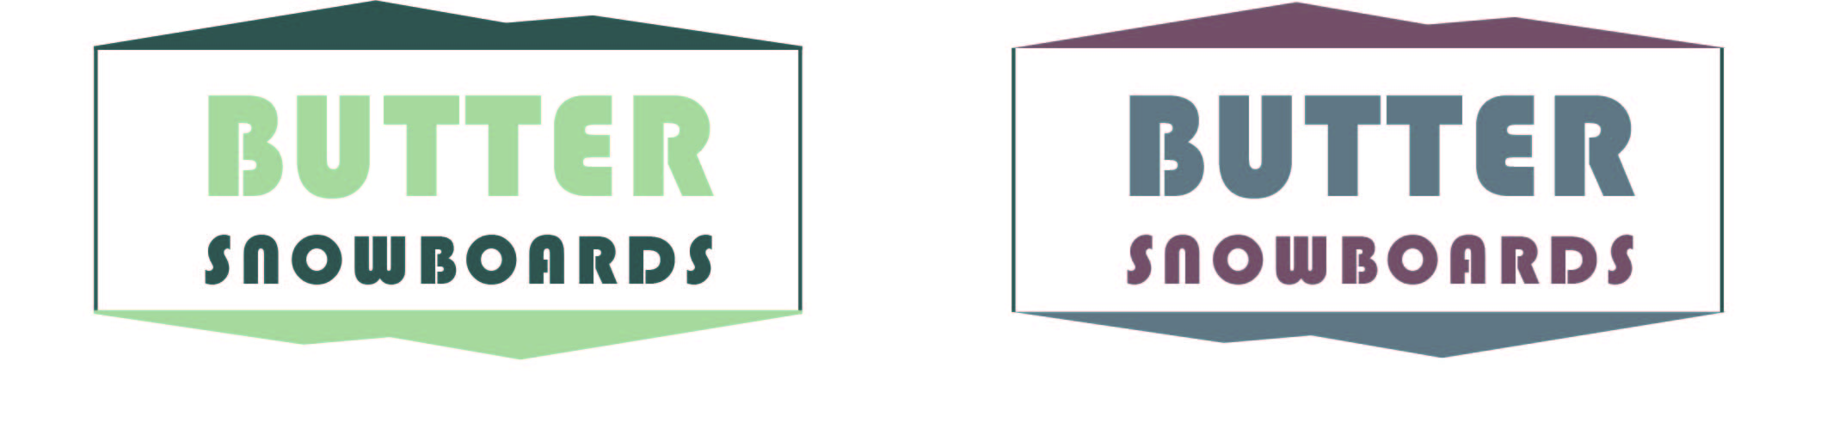
Butter – Leaning on the nose of the board (like a nose manual) and swing the tail of the board to the front.
Butter (2) – Without leaving the ground, performing a 180, 360, or other spin.
Buttery – A term used to describe a snowboard with good flex.

Slide 3
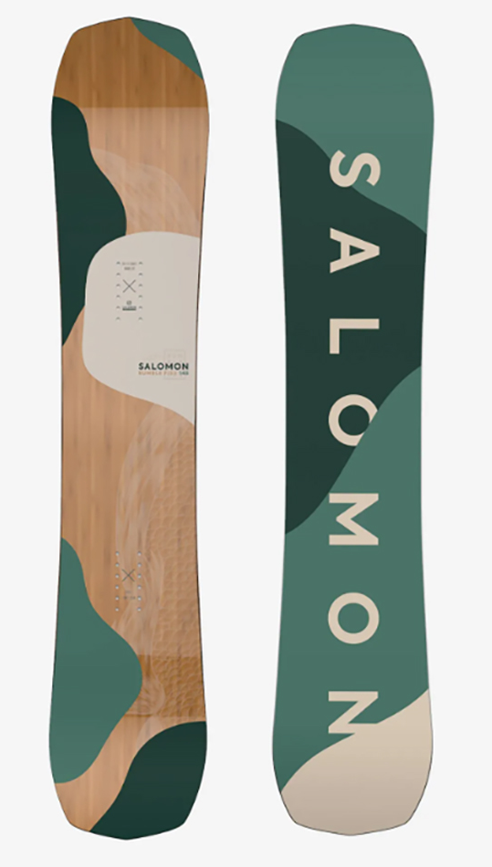
Workflow Strategy
Research/brainstorm (10:00-10:30)
Create logo and wireframe (10:30-11:30)
Build basic structure of site (11:30-1:00)
Adjust responsiveness (1:00-1:30)
Git setup and push
The plan was to return to the design and add more visual interest, but did not have time (1:30-2:00)

Slide 4
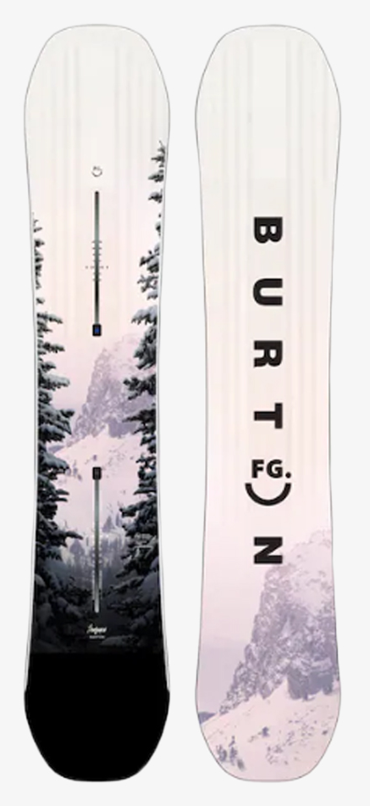
Issues
Background Image
Responsiveness
Still a bit slow with this at times
As usual – time constraints
Difficult to plan time for design and coding, better design = harder to code

