Slide 1
Milestone 2: To store the data into hive we need to : -
Step 1:
Download VM ware to setup a Virtual Machine:
The Operating System I have chosen is Ubuntu
Step 2:
To install Hadoop infrastructure / environment on Ubuntu:
To apply Map reduce for our predictive & descriptive project
Step 3:
To install Hive on Ubuntu:
To create SQL datawarehouse for our data, and to use SQL to process the data on Hadoop
Step 4:
Create / load data into datawarehouse on Hadoop
To store data into HDFS and load it onto the SQL table using Hive

Slide 2
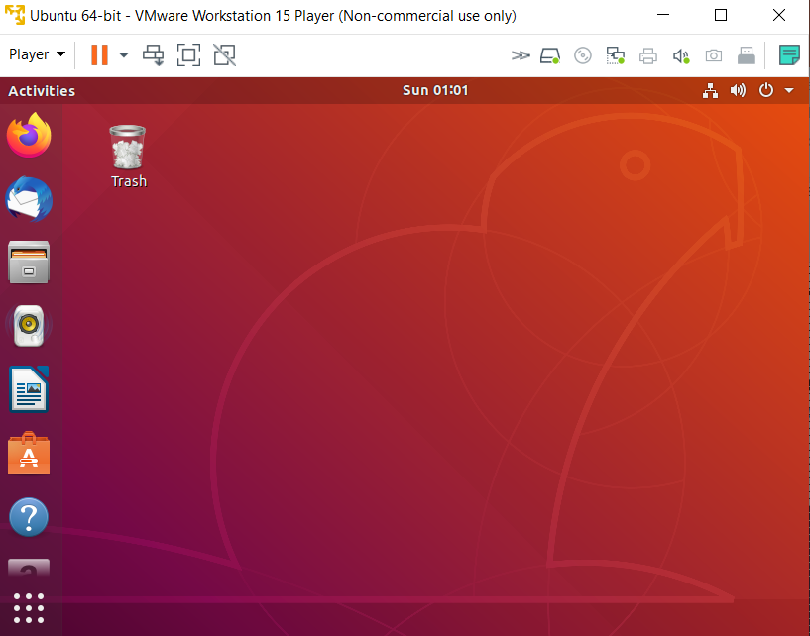
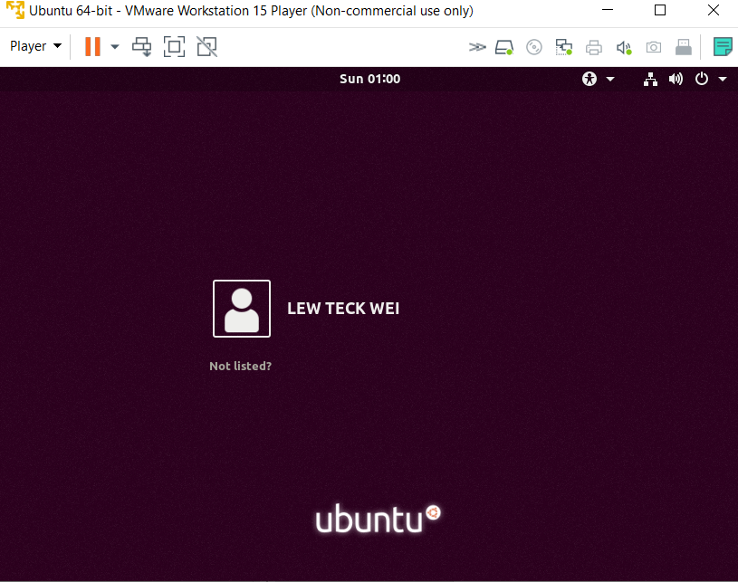
Milestone 2: To store the data into hive we need to : -
Step 1:
Download VM ware to setup a Virtual Machine:
The Operating System I have chosen is Ubuntu

Slide 3

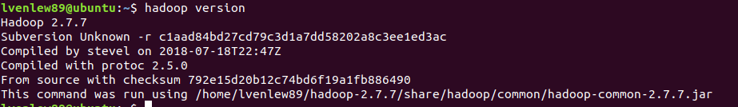

Milestone 2: To store the data into hive we need to : -
Step 2:
To install Hadoop infrastructure / environment on Ubuntu:
To apply Map reduce for our predictive & descriptive project
Download Hadoop using the command as follows:
Extract the file [Hadoop-2.7.7.tar.gz] using the command below:
Perform Hadoop Installation – Setting Environment Variable using and source to refresh such change
→ Checking Hadoop version
→ Checking Java version

Slide 4
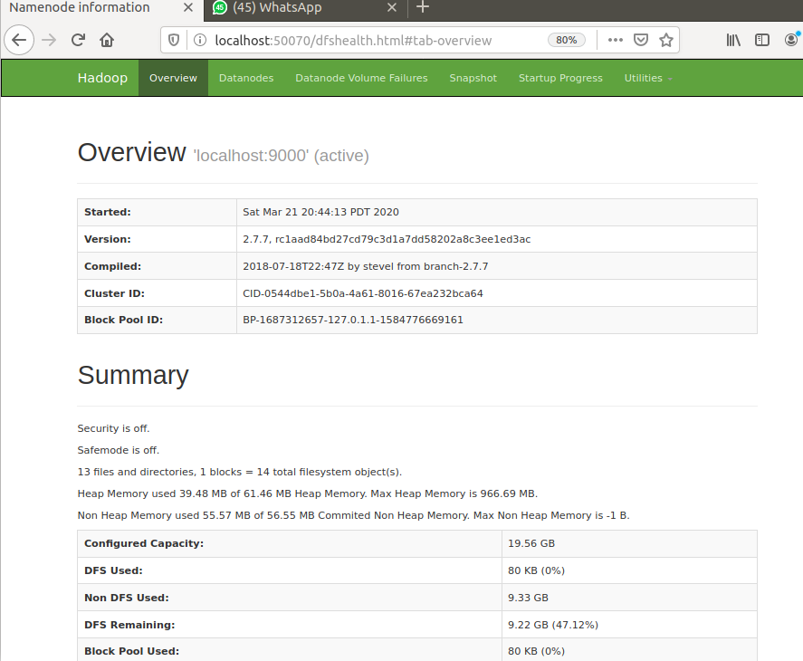
Milestone 2: To store the data into hive we need to : -
Continued from Step 2………:
To install Hadoop infrastructure / environment on Ubuntu:
To apply Map reduce for our predictive & descriptive project
Perform configuration of Hadoop:
Configuring core-site.xml
Configuring hdfs-site.xml
Configuring mapred-site.xml
Configuring yarn-site.xml
Configuring hadoop-env.sh
Formatting NameNode

Slide 5
Milestone 2: To store the data into hive we need to : -
Step 3:
To install Hive on Ubuntu:
To create SQL datawarehouse for our data, and to use SQL to process the data on Hadoop
Download Hadoop using the command as follows:
Extract the file [apache-hive-3.1.2-bin] using the command below:
Perform Hive Installation – Setting Environment Variable using and source to refresh such change
# Set HIVE_HOME
export HIVE_HOME=/home/lvenlew89/apache-hive-3.1.2-bin [update version]
export PATH=$PATH:/home/lvenlew89/apache-hive-3.1.2-bin/bin [update version]
# Hadoop configuration
export PATH=$PATH:/home/lvenlew89/hadoop-3.1.2/bin
export PATH=$PATH:/home/lvenlew89/hadoop-3.1.2/sbin
# Java configuration
export JAVA_HOME=/usr/lib/jvm/java-8-openjdk-amd64/jre
/
Run command: nano /home/lvenlew89/apache-hive-3.1.2-bin/bin/hive-config.sh
# Allow alternate conf dir location.
HIVE_CONF_DIR="${HIVE_CONF_DIR:-$HIVE_HOME/conf}"
export HIVE_CONF_DIR=$HIVE_CONF_DIR
export HIVE_AUX_JARS_PATH=$HIVE_AUX_JARS_PATH
export HADOOP_HOME=/home/lvenlew89/hadoop-2.7.7 [ configure directory]
# Default to use 256MB
export HADOOP_HEAPSIZE=${HADOOP_HEAPSIZE:-256}

Slide 6
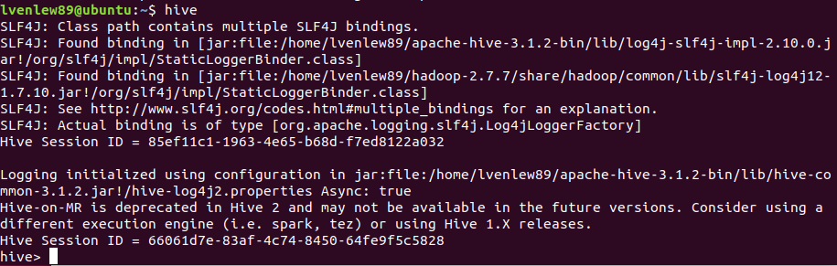

Milestone 2: To store the data into hive we need to : -
Continued from Step 3………:
To install Hive on Ubuntu:
To create SQL datawarehouse for our data, and to use SQL to process the data on Hadoop
Run command: hive to check if Hive is successfully configured
Hive is ready to use!

Slide 7
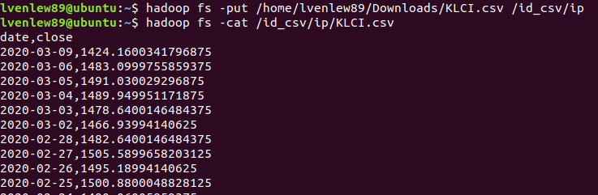
Milestone 2: To store the data into hive we need to : -
Step 4:
Create / load data into datawarehouse on Hadoop
To store data into HDFS and load it onto the SQL table using Hive
Run command below before create Hive directory in Hadoop :
… Then set the schema for metastore
… Then run the command below to load the data into HDFS

Slide 8
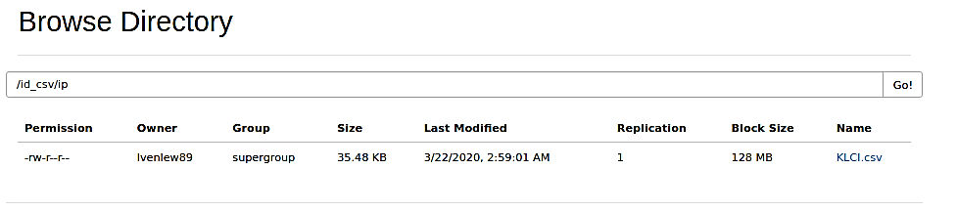
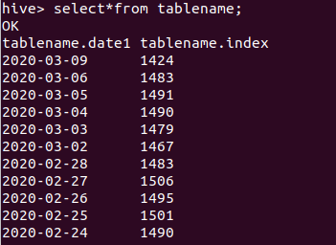
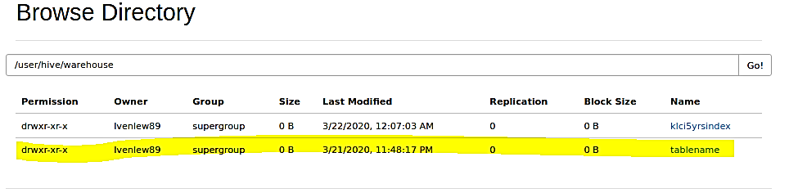
Milestone 2: To store the data into hive we need to : -
Continued from Step 4…….:
Create / load data into datawarehouse on Hadoop
To store data into HDFS and load it onto the SQL table using Hive
Run command below before create a table in HDFS:
….Then to load csv file from HDFS into the table:
load data [+local] inpath '/id_csv/ip/KLCI.csv' into table tablename;
set hive.cli.print.header=true; [including the header of the column]
… the run “select * from tablename;” to check the data is successfully loaded

