Slide 1
Milestone 3: Accessing Hive using Python
Step 1: Install Dependent Module
Install the dependent module on Anaconda Prompt:
pip install thrift+
pip install sasl
pip Install thrift sasl
pip install thrift_sasl
pip install pyhive

Slide 2
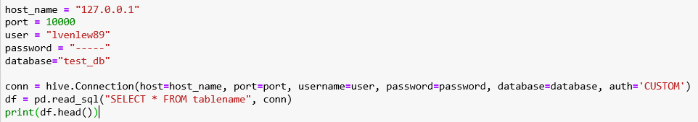

Milestone 3: Accessing Hive using Python
Step 2: Connecting HiveServer2 using Python Pyhive:
Run code below in Jupyter Anaconda
Run code below to connect to hive database to query data
Or

Slide 3
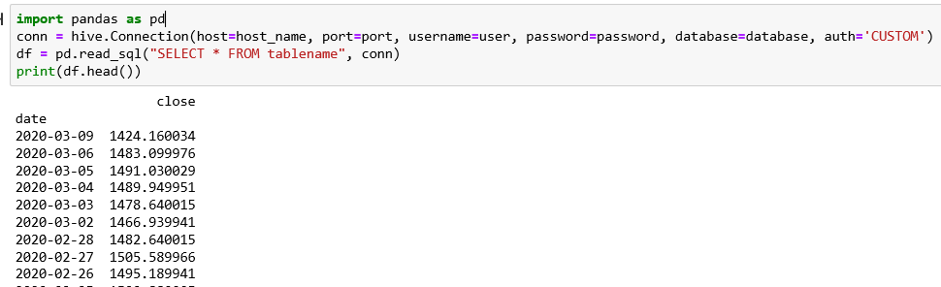
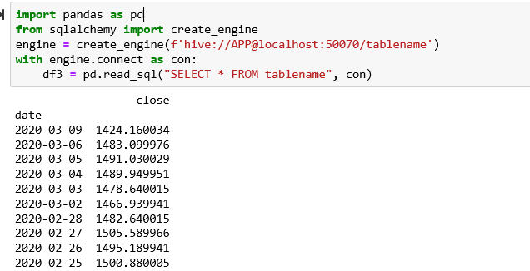
Milestone 3: Accessing Hive using Python
Continued from Step 2: Connecting HiveServer2 using Python Pyhive:
Connection to Hive via Python is successful.

