Slide 1


Devops interns
Michael McFadden
Vincent Kelly
Owen Lyons
Nico Long
Liam Dorrian
Matthew McColgan
Anthony Quinn
Eugene Robb
John Fullerton
Nicky Duffy
Patrick McGee
Stanley Ohai
What we’ve learned
Mentors / Buddies
Formal Training
Interviews
New Roles
What’s Next?

Slide 2
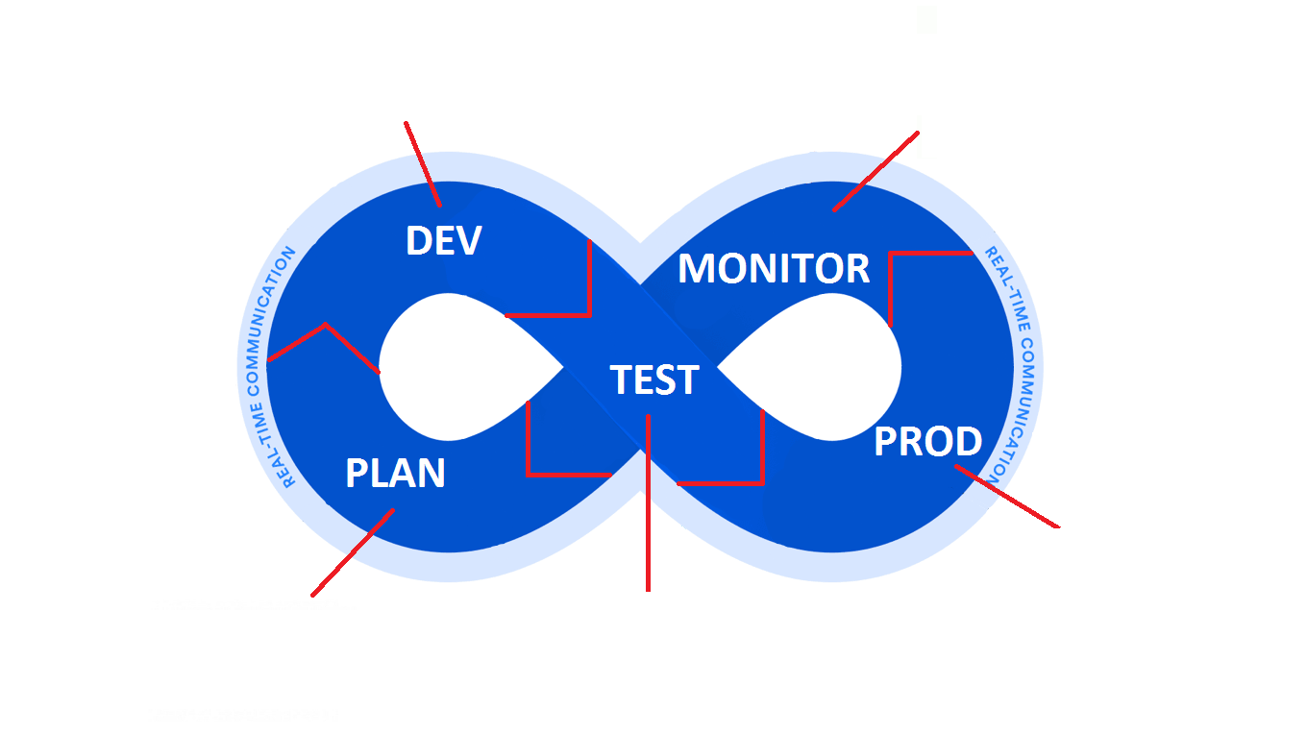
Pramerica / LYIT DevOps Interns Development Pipeline

Slide 3
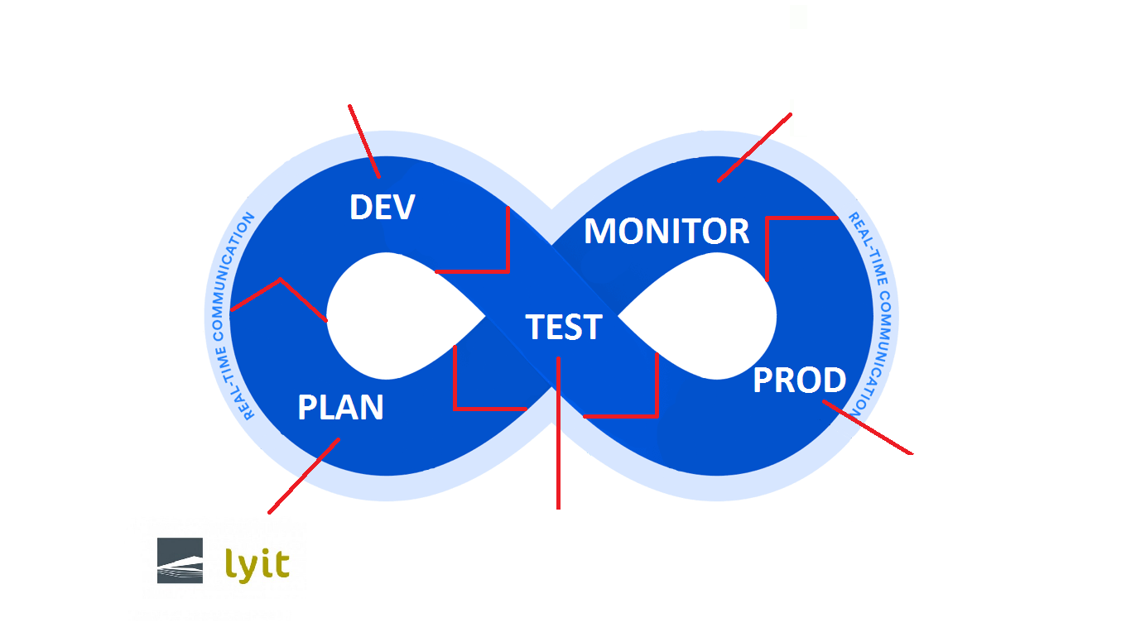
Pramerica / LYIT DevOps Interns Development Pipeline

Slide 4
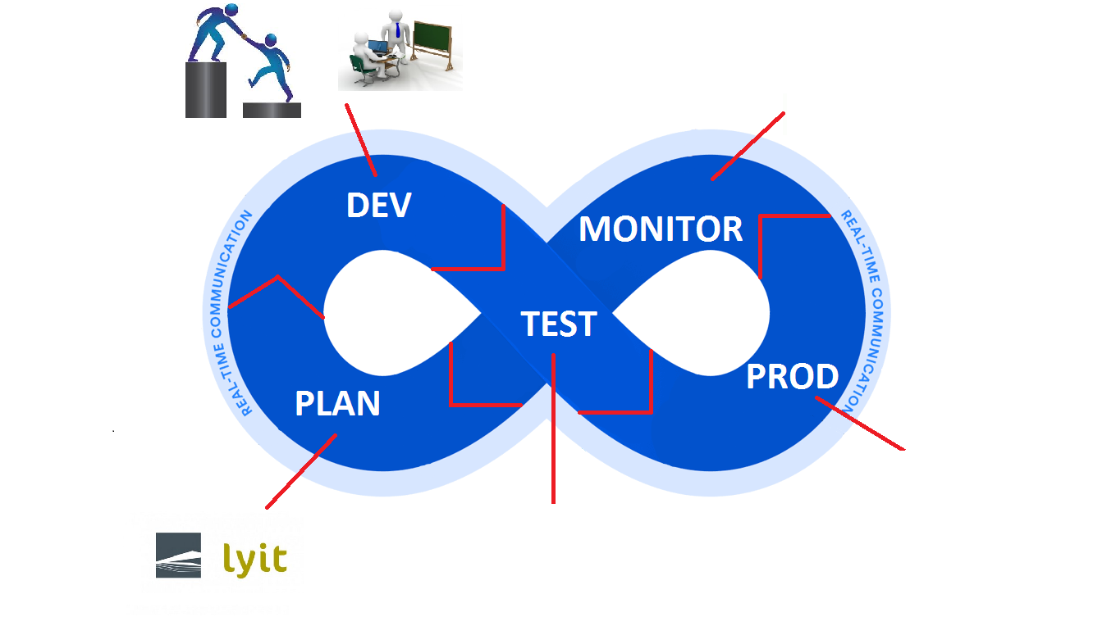
Pramerica / LYIT DevOps Interns Development Pipeline

Slide 5
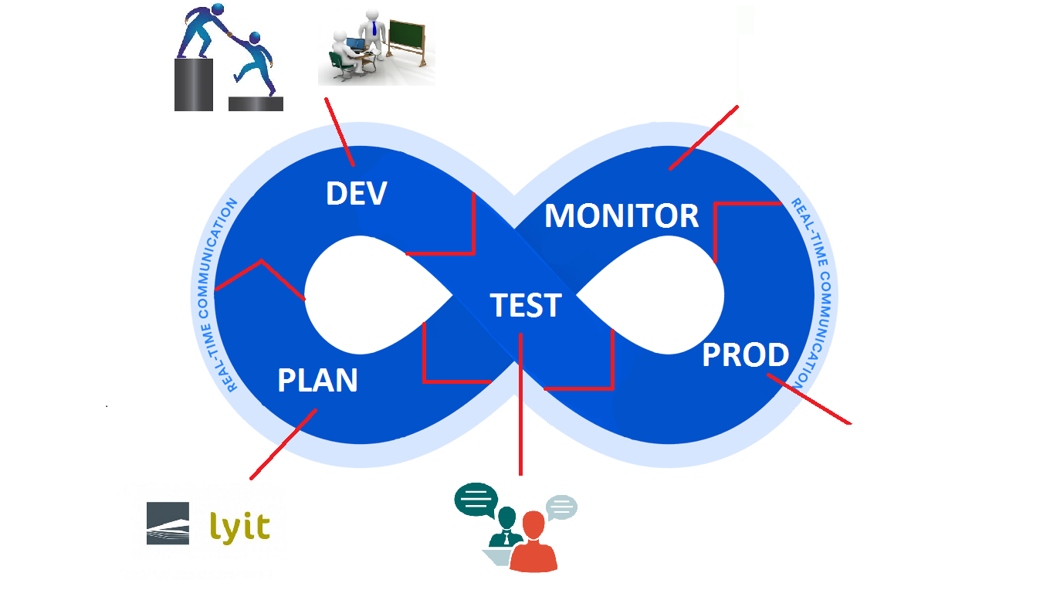
Pramerica / LYIT DevOps Interns Development Pipeline

Slide 6
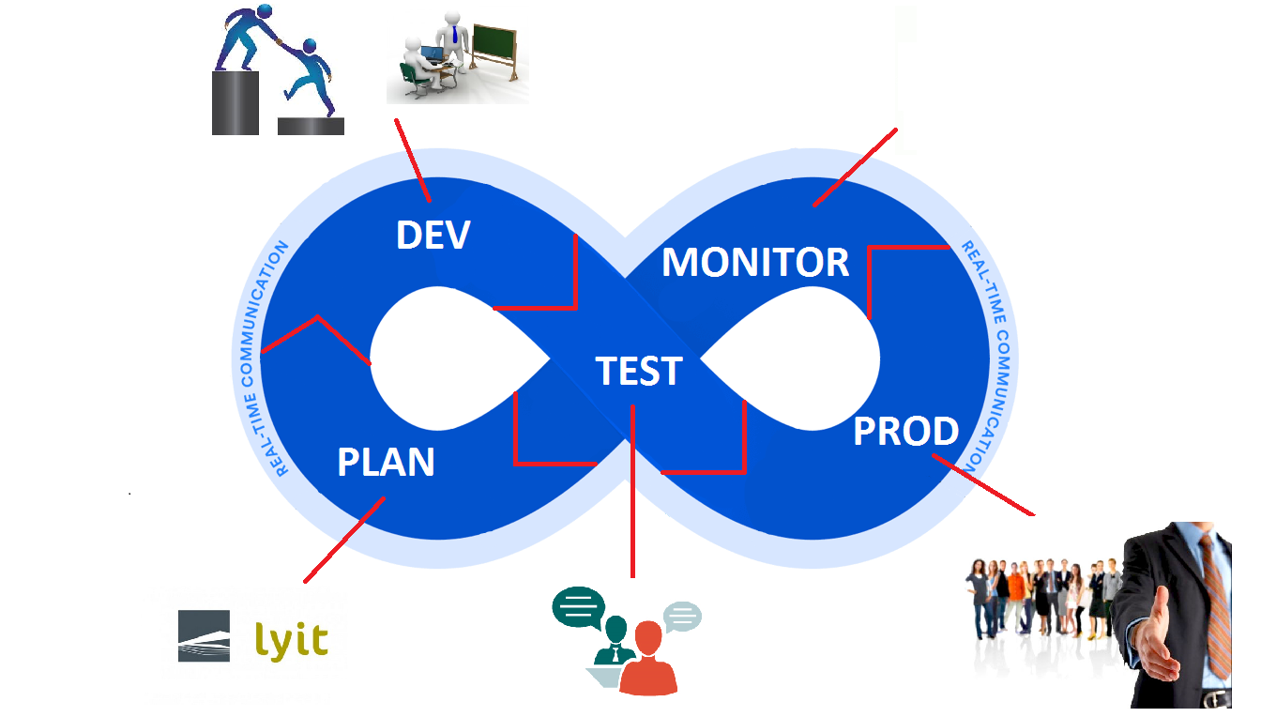
Pramerica / LYIT DevOps Interns Development Pipeline

Slide 7
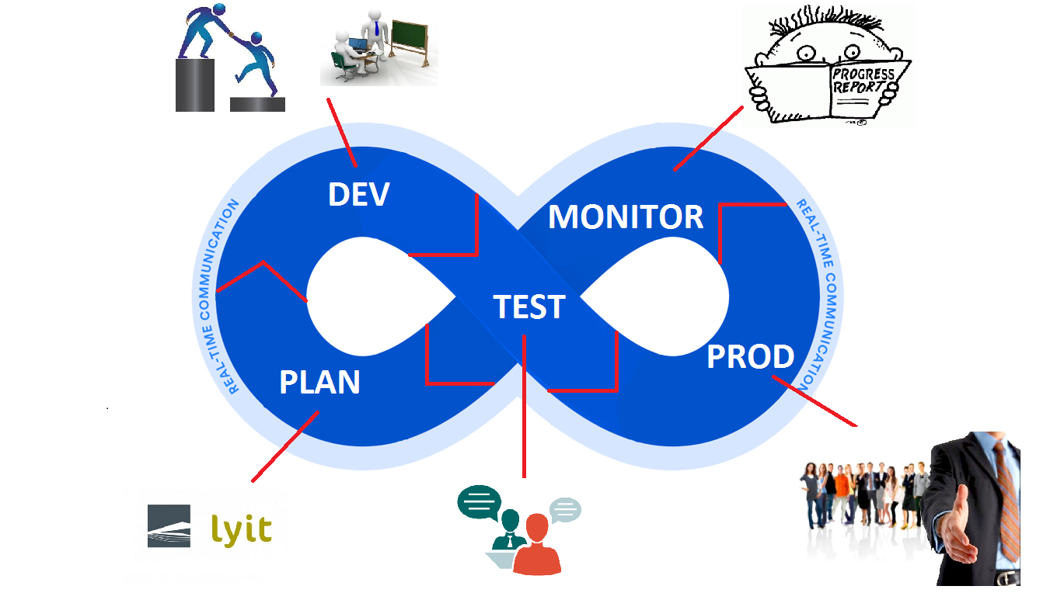
Pramerica / LYIT DevOps Interns Development Pipeline

