Slide 1
ChatGPT Created Threat Model
Priya Joy Kaviyil
Atlantic Technological University
Letterkenny, Ireland

Slide 2
Threat Modelling
Key Principle – “Secure Design”
Identifying, Communicating and Managing Security weaknesses
Data Flow Diagrams
Mapping the architecture, components, trust zones and authentication flows
Common Methodologies - STRIDE, OCTAVE, TRIKE AND PASTA

Slide 3
ChatGPT
Chatbot developed by OpenAI
Generative Pre-trained Transformer (GPT)
Trained on over 45 terabytes of data
Accessibility

Slide 4
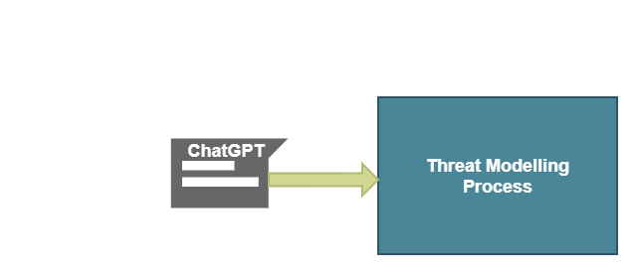
Research
Threat modelling that incorporates different threat modelling methodologies by leveraging the capabilities of ChatGPT
Evaluate the effectiveness of this novel approach and its potential impact

Slide 5
Methodology
Creating a microservice system on AWS connecting to a cloud hosted mongo dB instance
Asking ChatGPT to create a threat model for the microservice system model

Slide 6
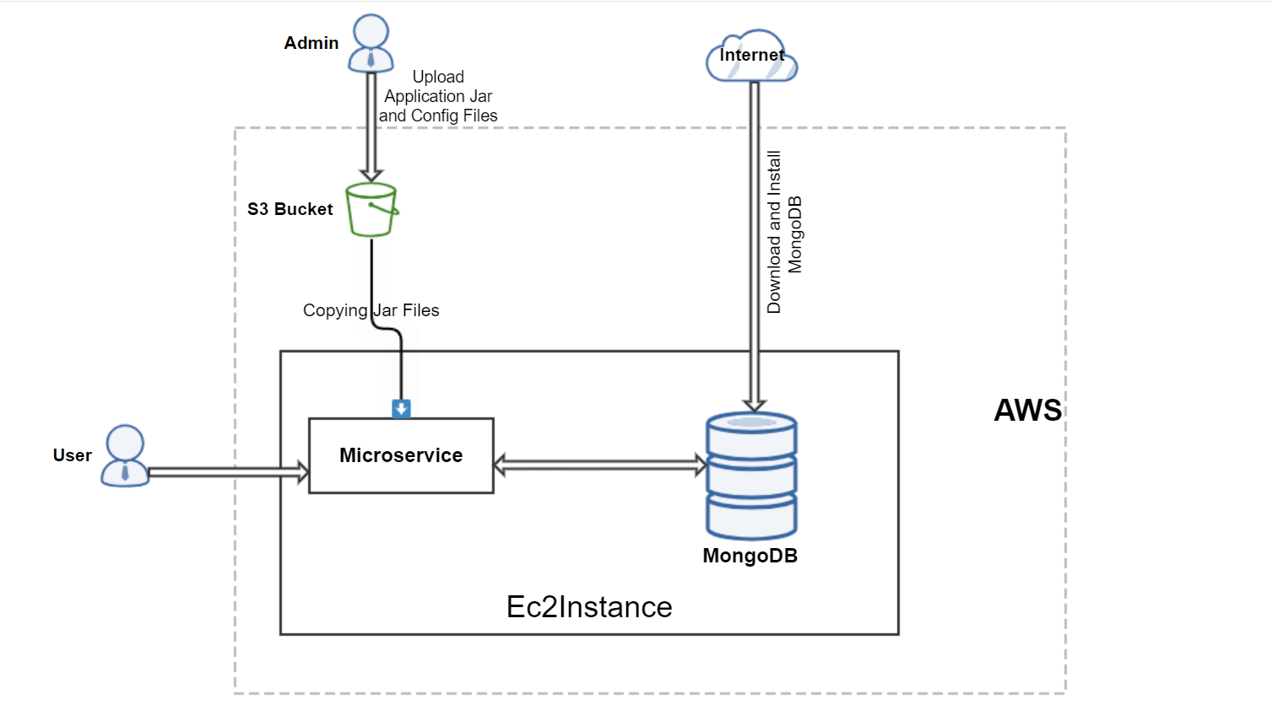
System Model

Slide 7
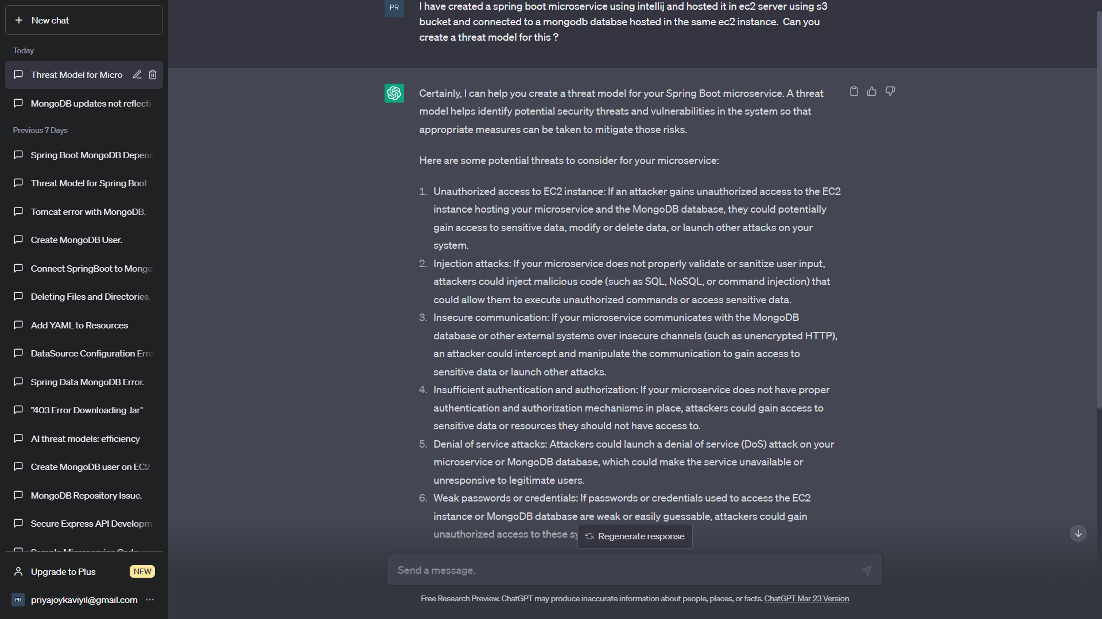
Potential Threats

Slide 8
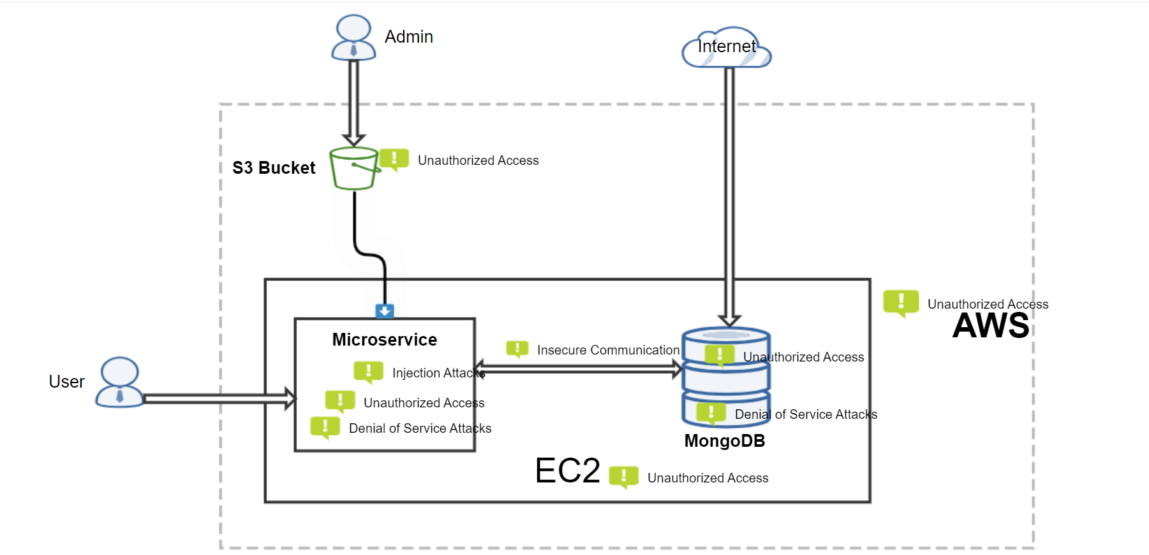
Threat Model

Slide 9
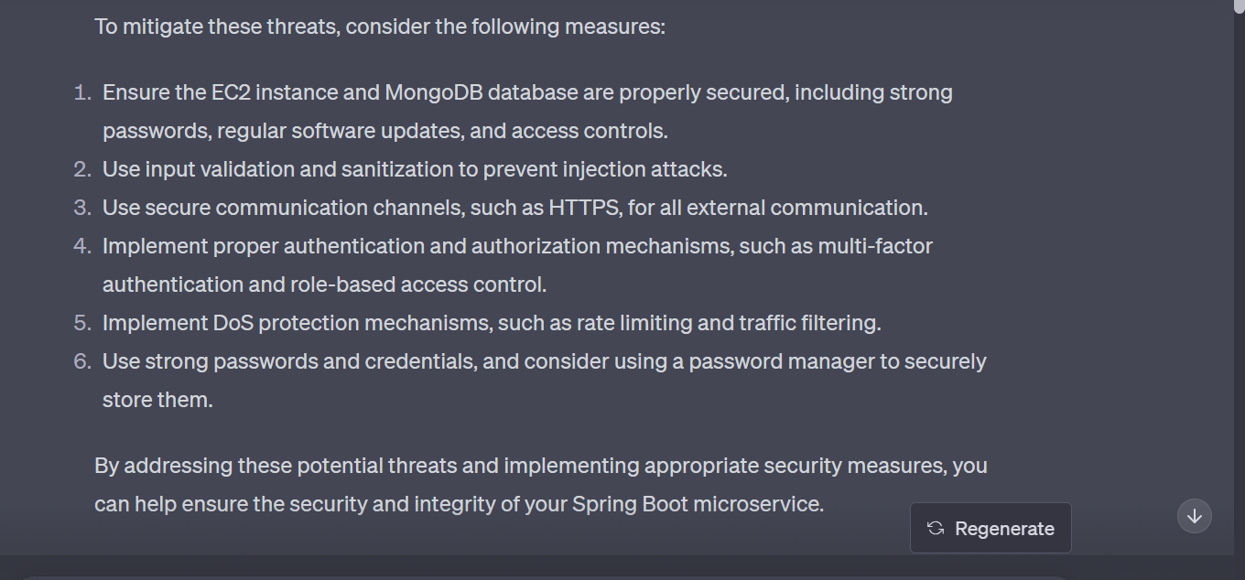
Threat Mitigations

Slide 10
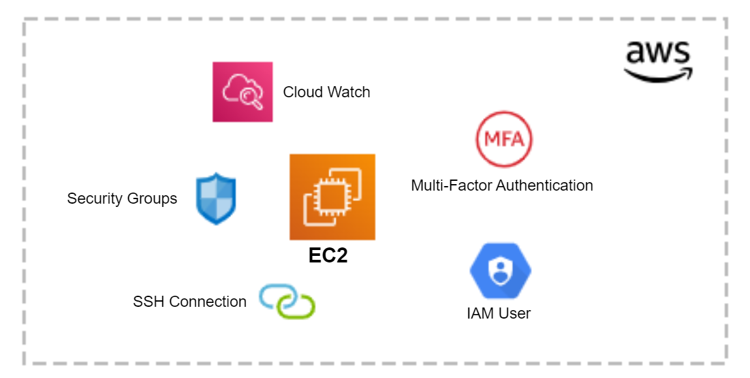
Implementation
Ensuring overall security of EC2 instance and MongoDB database inside the AWS cloud
Effective Denial of Service (DoS) protection mechanisms
Input validation and sanitization to prevent injection attacks

Slide 11
Observations
Efficiency of ChatGPT in identifying potential threats, particularly new and emerging ones
Mitigation measures implementation demonstrating a proactive and multi-layered approach to securing the whole system
Caution needed in formulating prompts and interpreting responses
Double-checking of information accuracy

Slide 12
Lacks practical implementation capability
Tool for generating ideas, not a replacement for human expertise
Risk factors associated with the use of artificial intelligence

Slide 13
Conclusion
Value of ChatGPT as a supportive tool for efficient threat modeling
Use ChatGPT in conjunction with industry guidelines, regulations and consultations with security experts
Necessity of human judgment and extensive research
ChatGPT should not replace human expertise

Slide 14
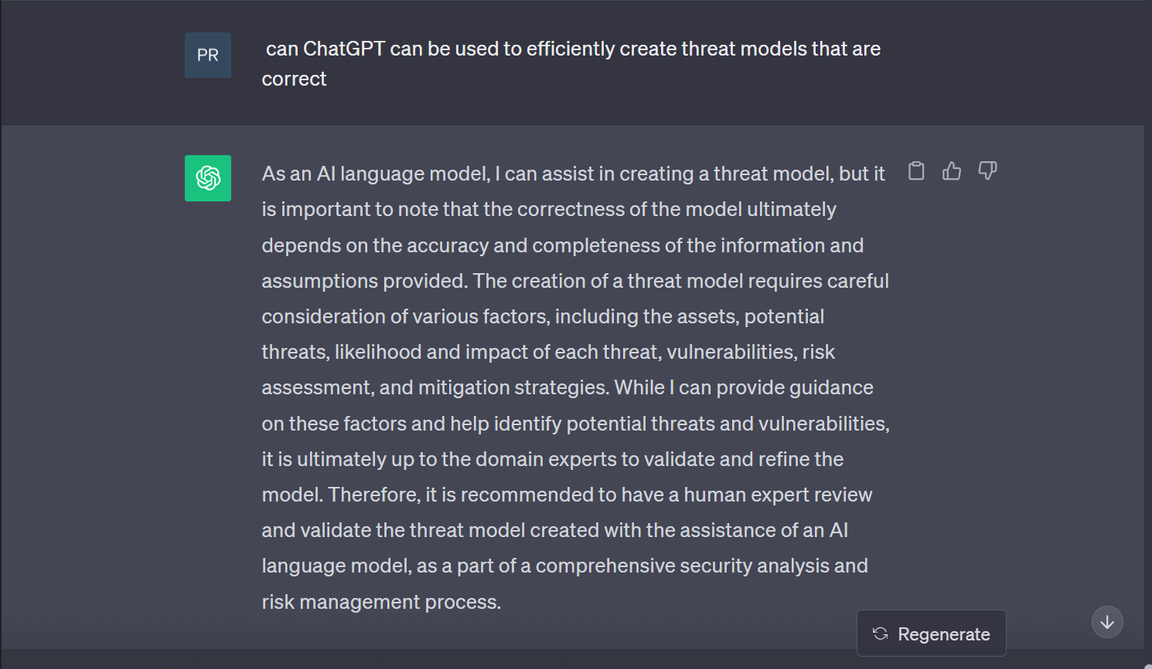
Self Analysis!!

