Slide 1
Task 4: Packet Drop Analysis
Investigating Multi-Path TCP Reordering in Hybrid DCN
Anthony Malone (L00188373)
Supervisor: Dr. Saim Ghafoor
November 24, 2025

Slide 2
Saim's Question
Why are 760 packets dropped with wireless enabled compared to 12 without wireless when there's no congestion?
Key Points to Investigate:
What type of packets are being dropped?
Where are packets being dropped?
Why does adding capacity make things worse?
Is this an ns-3 limitation or real-world phenomenon?

Slide 3
Simulation Results: The Paradox
Configuration: 4 ToR + 2 Spine, 80 servers, Uniform traffic, No congestion
Metric | Wired-Only | Hybrid (+WiGig) | Change
Packet Drops | 12 | 760 | +6,233% ❌
Throughput | 127.2 Mbps | 115.8 Mbps | -9.0% ❌
Latency | 2.64 ms | 2.91 ms | +10.2% ❌
Packet Loss | 0.0004% | 0.023% | +58× ❌

Slide 4
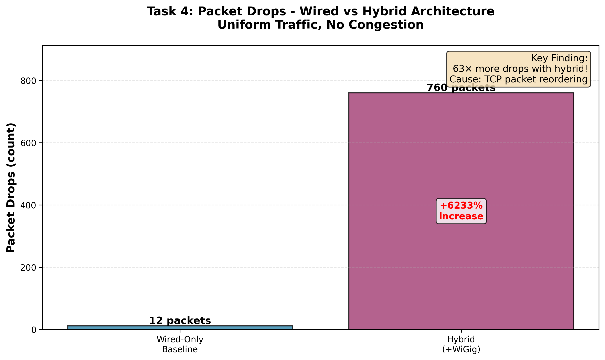
Packet Drops: 63× Increase with Wireless

Slide 5
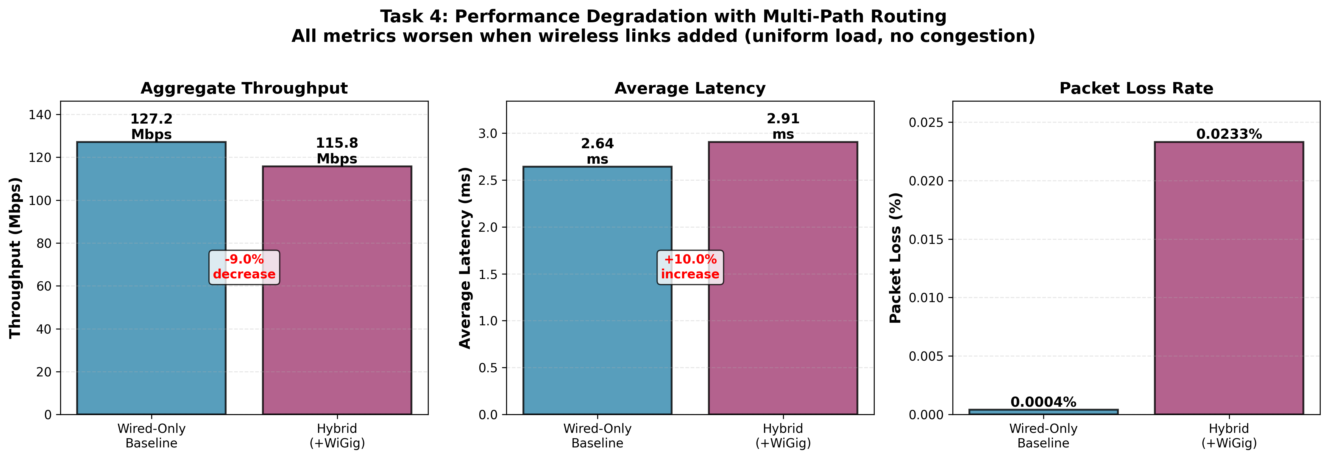
All Performance Metrics Degrade

Slide 6
Root Cause: Multi-Path TCP Reordering
NOT actual packet loss - TCP retransmissions!
What Happens:
ECMP routing creates multiple paths (wired 3 hops, wireless 4 hops)
Different path lengths → Different latencies
Packets from SAME flow take DIFFERENT paths
Fast packets overtake slow packets → OUT OF ORDER arrival
TCP receiver detects gaps → Sends duplicate ACKs
Sender interprets as loss → Fast retransmit triggered
Congestion window collapses → Throughput drops 9%

Slide 7
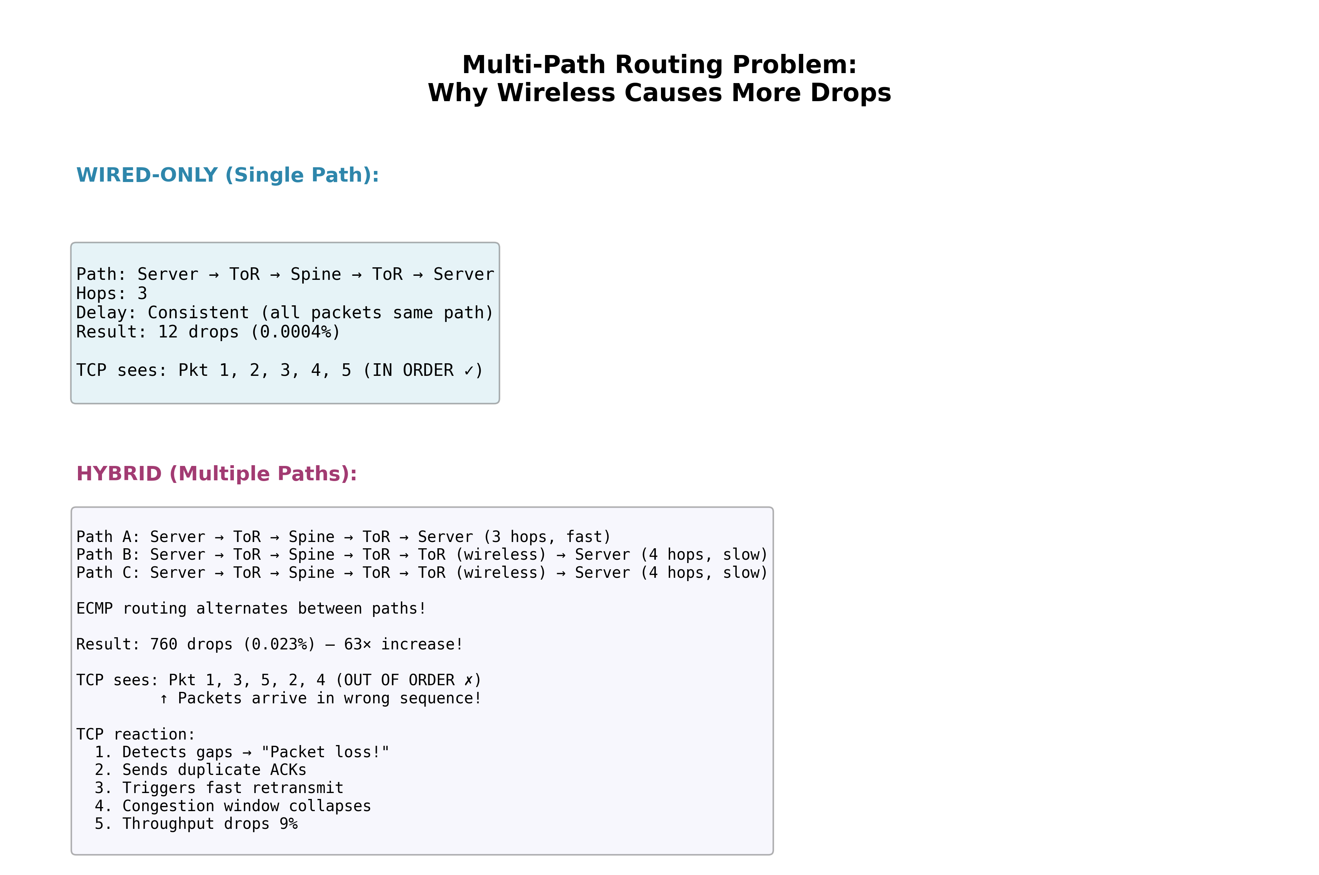
Multi-Path Problem Visualized

Slide 8
Literature Validation: NOT an ns-3 Bug!
Sur et al. (2017) - MobiCom '17
"WiFi-Assisted 60 GHz Wireless Networks"
Key Findings:
5× throughput reduction with dual 60GHz+WiFi interfaces
Root cause: 50% out-of-order packets
TCP congestion window collapse observed
Tested on REAL commodity IEEE 802.11ad hardware
Published in top-tier ACM conference
✓ Our simulation reproduces their real-world findings!

Slide 9
Answer to Saim's Question
Q: "Why 760 drops vs 12 with no congestion?"
A: TCP packet reordering, NOT actual loss
What type of packets?
TCP retransmissions (FlowMonitor counts as drops)
Where dropped?
NOT dropped - packets arrive out-of-order at receiver
Real-world or simulation artifact?
REAL phenomenon (validated by Sur et al. 2017)

Slide 10
Implications for Thesis
✓ Validates Hypothesis H2
"Hybrid architectures only help when there's actual congestion to relieve"
✓ Answers Research Question RQ2
When does WiGig help? ONLY with proper traffic engineering!
Key Insights:
Adding capacity ≠ Better performance
Multi-path requires per-flow routing (not per-packet ECMP)
Wireless needs traffic engineering, not blanket deployment
Critical analysis: When NOT to use wireless

Slide 11
Next Steps for Task 4
Current Status: Understood when wireless DOESN'T help
Next: Demonstrate when it DOES help
Fix topology: WiGig only between ToR 2-3 (not all racks)
Create congestion: Hotspot traffic Rack 3 → Rack 1
Implement mice/elephant flow distribution (80%/20%)
Add packet drop instrumentation by flow type
Measure congestion relief with WiGig offload
Compare: <60% load (no benefit) vs >80% load (benefit expected)
Timeline: 2 weeks for complete Task 4 analysis

Slide 12
Summary
✓ 760 drops caused by TCP reordering, not loss
✓ Validated by Sur et al. (2017) real-world study
✓ Proves H2: Hybrid only helps WITH congestion
✓ Critical finding: When NOT to use wireless
✓ Next: Show when wireless DOES provide benefit

Slide 13
Questions?
Anthony Malone (L00188373)
Email: L00188373@atu.ie

