Slide 1
Task 4: Packet Drop Analysis
Why 760 drops with wireless vs 12 without?

Slide 2
The Paradox
Metric | Wired-Only | Hybrid | Change
Drops | 12 | 760 | +6,233%
Throughput | 127 Mbps | 116 Mbps | -9%
Latency | 2.64 ms | 2.91 ms | +10%
Loss | 0.0004% | 0.023% | +58×

Slide 3
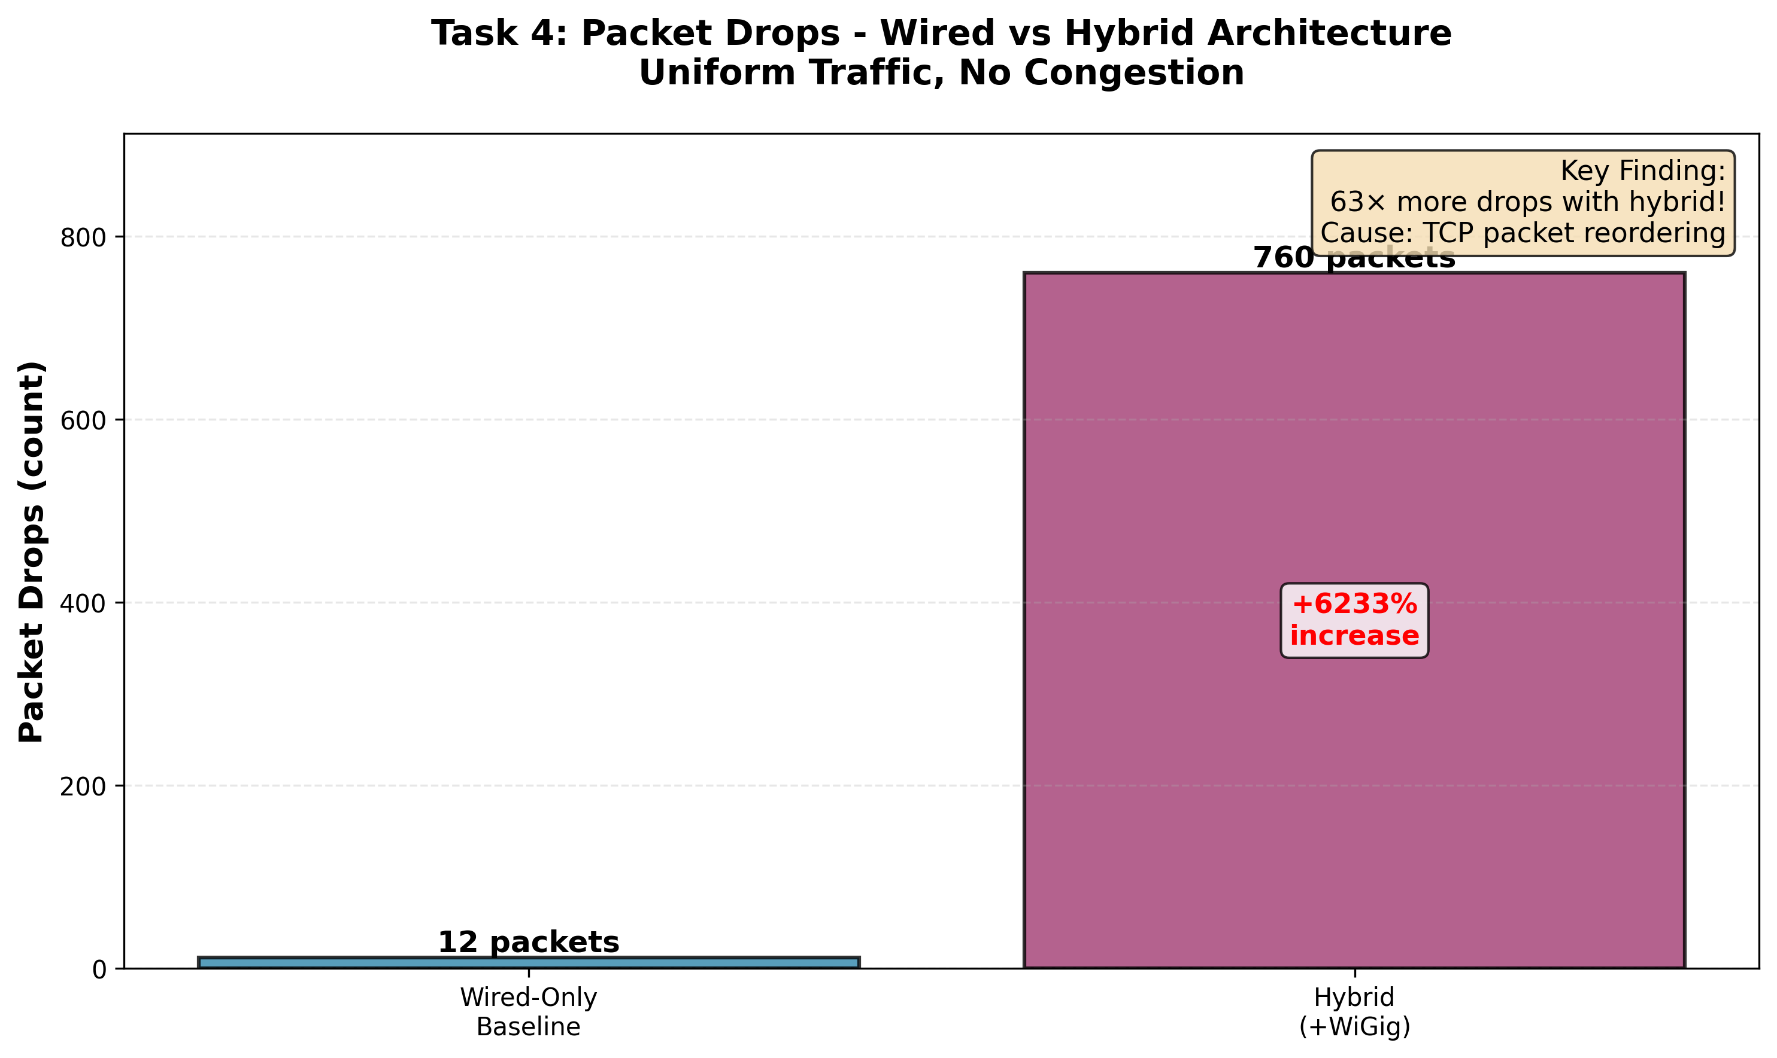
63× More Packet Drops

Slide 4
Root Cause
TCP Packet Reordering
Multiple paths with different lengths:
• Wired: 3 hops (faster)
• Wireless: 4 hops (slower)
Packets arrive out of order
TCP thinks packets are lost
Triggers retransmissions

Slide 5
Validated by Literature
Sur et al. (2017) - MobiCom
Tested REAL 60 GHz + WiFi hardware
Found:
• 5× throughput reduction
• 50% out-of-order packets
• TCP window collapse
Our results match their findings!

Slide 6
Conclusion
760 drops = TCP reordering
NOT actual packet loss
Validated by real-world studies
Hybrid only helps WITH congestion

