Slide 1

Cloud-Native AI-Based Log Correlation for Distributed Trace Reconstruction using Temporal and Semantic Similarity without Trace IDs
Namratha Shetty · L00196930
Supervised by Dr. Saim Ghafoor
M.Sc. in Computing in Cloud Technologies · Department of Computing, ATU Donegal
September 2026

Slide 2
Motivation
Cloud systems are now built as many small services, each writing its own log
Logs are the primary record of what a running system actually did
Severe outages run for hours and carry heavy operational cost (Wang and Qi, 2024)
A large share of production failures repeat earlier ones, so recognising a familiar sequence of events has direct practical value
Faster recovery depends on rebuilding the sequence of events that led to a failure.
Namratha Shetty · ATU Donegal
2 / 10

Slide 3
General Challenge
Engineers rely on three signals: metrics, traces and logs
A trace follows one request across services, held together by a Trace ID
Where that identifier is present, faults can be located quickly and at fine granularity (Yu et al., 2023)
But it must be instrumented into every service, and many platforms cannot supply it
The strongest diagnostic methods assume an identifier that many environments never record.
Namratha Shetty · ATU Donegal
3 / 10

Slide 4
Problem
Without a Trace ID, one request’s lines sit scattered among thousands of others
Timing-based reconstruction rebuilds traces but never reads the message text (Ashok et al., 2024)
Semantic methods read that text closely, but only to label a sequence normal or anomalous
Neither returns a grouping that can be identified and followed afterwards
No reviewed method groups identifier-free log lines into traces and labels them.
Namratha Shetty · ATU Donegal
4 / 10

Slide 5
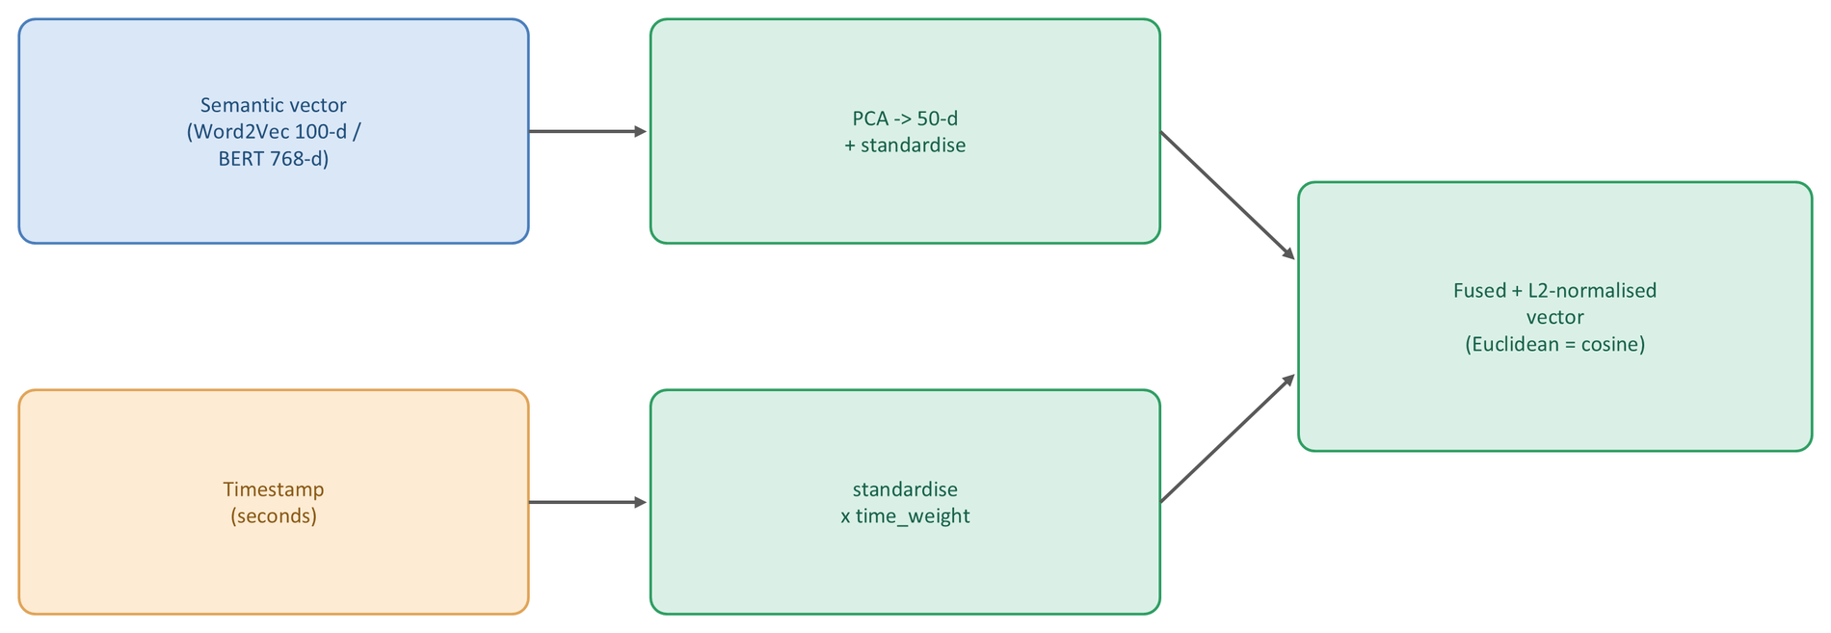
Solution
Use the two signals that survive in any log: when a line was written, and what it says
Fuse a scaled timestamp with a dimensionality-reduced message embedding
Group with density-based clustering, which needs no cluster count and tolerates noise
Give every recovered group a virtual Trace ID, restoring what was never recorded
Semantic clustering is repurposed from detection to reconstruction.
Namratha Shetty · ATU Donegal
5 / 10

Slide 6
Research Questions, Aim and Objectives
Aim and questions
Aim - to establish whether distributed traces can be reconstructed from raw log text alone, with no Trace ID and no instrumentation, and how far that depends on the way meaning is represented
RQ1 - can traces be rebuilt by combining temporal proximity with semantic similarity?
RQ2 - does the choice of representation materially affect the result?
Objectives
Design an unsupervised pipeline that groups log lines and assigns a virtual Trace ID to each group
Implement it twice, with Word2Vec and with BERT, holding every other stage identical
Evaluate against a known ground truth, and separate the two signals by ablation
Namratha Shetty · ATU Donegal
6 / 10

Slide 7
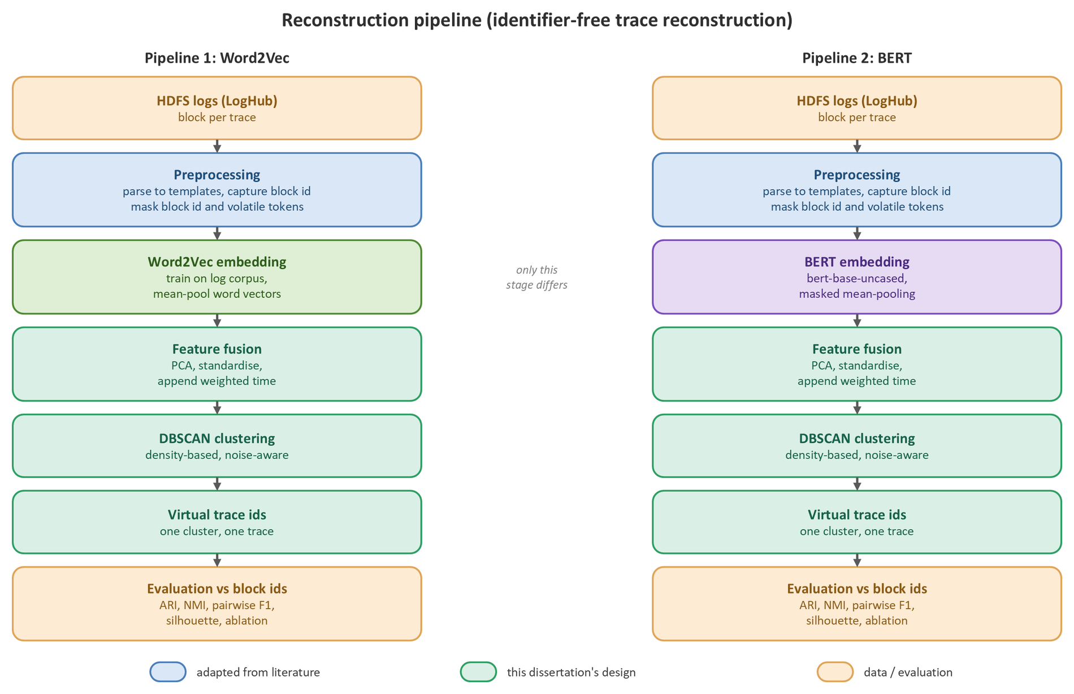
Methodology and Implementation
Two public benchmarks: HDFS (300 blocks, 5,967 lines) and TraceBench (300 traces, 17,744 events)
The true identifier is captured before cleaning and then masked, so the reconstruction is performed blind
DBSCAN over PCA-reduced embeddings fused with a weighted timestamp
One configuration block and a fixed seed govern every run
Only the embedding stage differs, so any difference is attributable to the representation alone.
Namratha Shetty · ATU Donegal
7 / 10

Slide 8
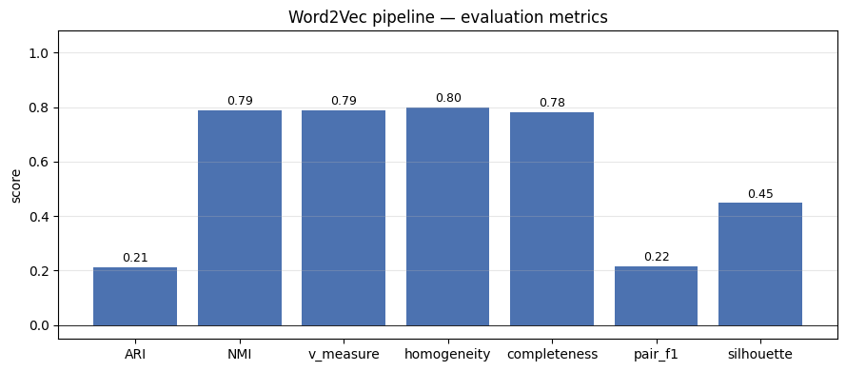
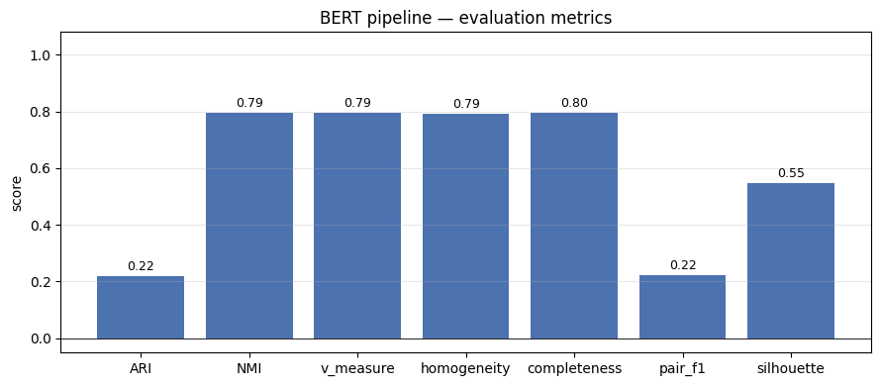
Results: Reconstruction Quality
HDFS - ARI 0.2117 (Word2Vec) and 0.2199 (BERT)
TraceBench - 0.1160 and 0.1125, the lighter model fractionally ahead
Word2Vec: 100 dimensions, trained in seconds on a processor. BERT: 768 dimensions, pre-trained, GPU
A lightweight representation reconstructs these traces as well as a contextual one, at a fraction of the computational cost.
Namratha Shetty · ATU Donegal
8 / 10

Slide 9
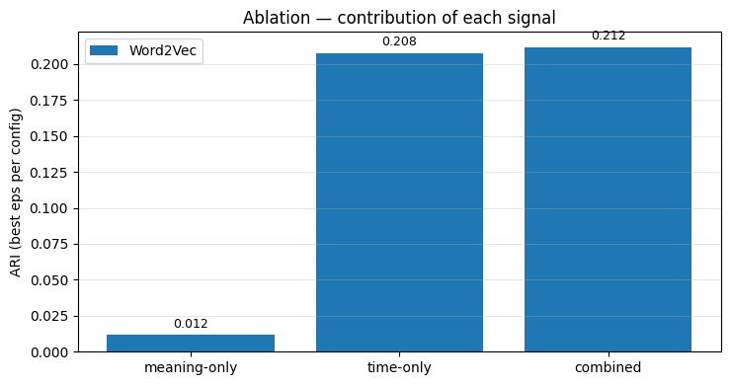
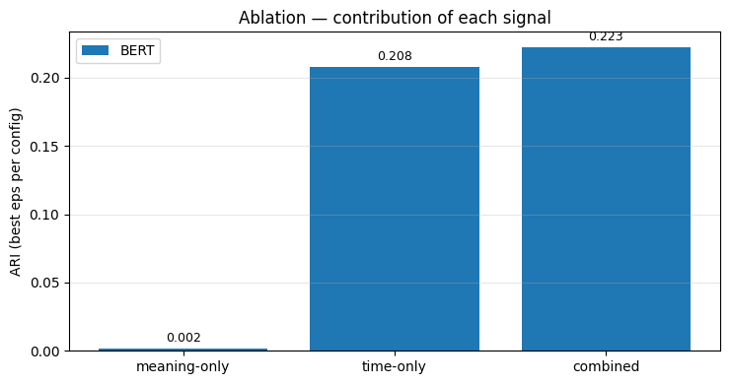
Results: What Drives the Reconstruction
Meaning alone - 0.012 (Word2Vec) and 0.002 (BERT)
Time alone - 0.208 in both pipelines
Combined - 0.212 and 0.223, with the radius retuned per configuration so none is disadvantaged
Temporal proximity supplies almost all of the reconstruction; the balance between the signals governs the result more than the model does.
Namratha Shetty · ATU Donegal
9 / 10

Slide 10
Conclusion
What the work delivers
Traces reconstructed from raw logs with no identifier, measured blind against a hidden ground truth
Every recovered group carries a virtual Trace ID, in the form downstream diagnosis requires
A controlled comparison that answers the representation question with evidence rather than assumption
What follows from it
The temporal weight should be matched to typical trace duration — the relationship is inverse
Apply the pipeline to logs whose messages genuinely differ, where meaning has more to separate
Feed reconstructed traces into a root-cause method and measure whether it still localises accurately
A method that works moderately well and can explain its own behaviour.
Namratha Shetty · ATU Donegal
10 / 10

Slide 11
THANK YOU

