Slide 1
InHERITANCE
COURSE TEACHER : MS. LAMEYA ISLAM
COURSE TITLE : OBJECT ORIENTED PROGRAMMING
COURSE CODE : CSE-214
SECTION : 61_X
DEPARTMENT OF CSE
WELCOME TO OUR
PRESENTATION

Slide 2


TEAM MEMBERS
AMIT KUMAR GHOSH
MEHEDI HASAN
ID : 221-15-4650
ID : 221-15-4680

Slide 3
TABLE OF CONTENT
Introduction
Types of inheritance
Subclass
Override
Super keyword
In this presentation, we will explore the basics of inheritance in Java, including how to create subclasses, override superclass methods, and use inheritance to create more efficient and flexible code.

Slide 4
INTRODUCTION
Inheritance in one of the Four important pilar of Object Orientated Programming. which allows a class to inherit the properties and behaviors of another class. Inheritance promotes code reuse, make code more modular, extensible, and maintainable.

Slide 5
TYPES OF INHERITANCE
1. Single Inheritance:
In single inheritance, a subclass inherits from only one superclass.
2. Multi-level Inheritance:
In multilevel inheritance, a subclass inherits from a superclass, which in turn inherits from another superclass, and so on.
3. Hierarchical Inheritance:
In hierarchical inheritance, multiple subclasses inherit from a single superclass.
4. Multiple Inheritance:
Multiple inheritance allows a subclass to inherit from multiple superclasses. However, Java does not support multiple inheritance of classes, only interfaces.

Slide 6
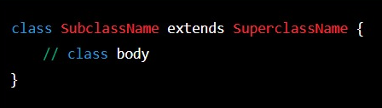
SUBCLASS
In Java, a Class inherit properties and behavior of parent class when we use ‘extends’ keyword, followed by the name of the superclass.
The syntax for creating a subclass is as follows:

Slide 7

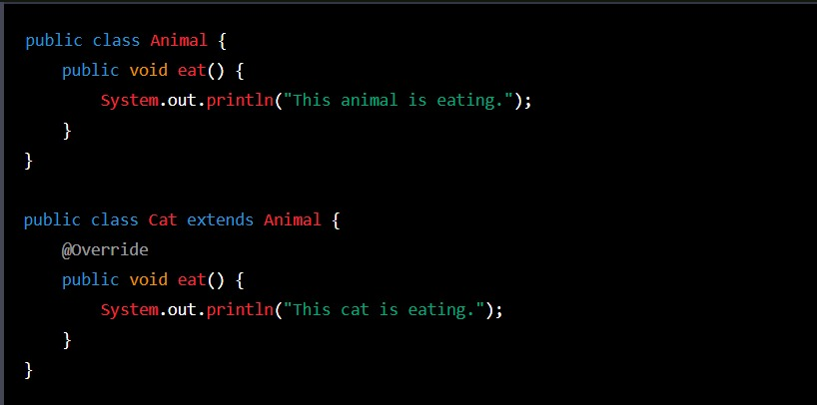
OVERRIDE
To override a method in the superclass, the subclass needs to provide a method with the same name, return type, and parameters, and use the ‘@Override ‘ annotation to indicate that it is intended to override the superclass method.

Slide 8
SUPER kEYWORD
As the name suggest super keyword used to access the member of parent class.
It is used for two purposes in java
The first use of super keyword is to access the hidden data variables of parent class from child class.
The second use of super keyword is to call parent class constructor or method.

Slide 9
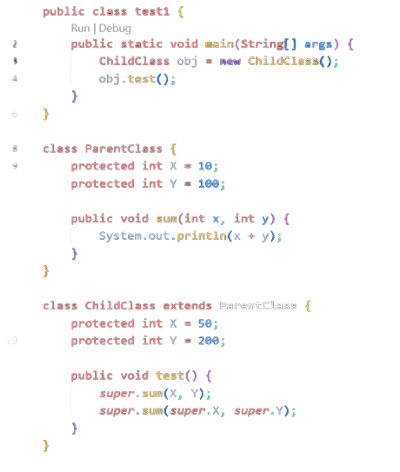
EXAMPLE OF SUPER KEYWORD
Output: 250 110

Slide 10
THANK YOU
Reference :
https://www.slideshare.net/Tech_MX/inheritance-in-java
https://www.educba.com/object-oriented-programming-in-java/

