Slide 1
JAVA CORE - PART1

Slide 2

Lesson Agenda
Java overview
Using Eclipse to create Java
Class, Object
Constructor
Java Basic Syntax
Data types
Operators
String
Array

Slide 3
Java overview
Session 1

Slide 4
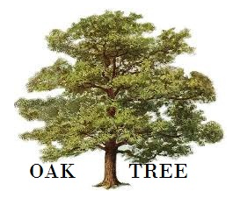





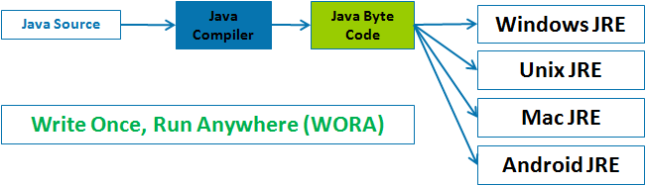
What is Java?
Java was originally developed by Sun Microsystems which was initiated by James Gosling
In 1991: OAK
In 1995 as core component of Sun Microsystems' Java platform (Java 1.0 [J2SE]).
With the advancement of Java and its widespread popularity, multiple configurations were built to suite various types of platforms.
Ex: J2EE for Enterprise Applications, J2ME for Mobile Applications.
Sun Microsystems has renamed the new J2 versions as Java SE, Java EE and Java ME respectively.
Java is guaranteed to be Write Once, Run Anywhere.
Notes:
The history of java starts from Green Team. Java team members (also known as Green Team), initiated a revolutionary task to develop a language for digital devices such as set-top boxes, televisions etc.
Firstly, it was called "Greentalk" by James Gosling and file extension was .gt.
After that, it was called Oak and was developed as a part of the Green project.
Why Oak? Oak is a symbol of strength and choosen as a national tree of many countries like U.S.A., France, Germany, Romania etc.
In 1995, Oak was renamed as "Java"

Slide 5
Java Version History
There are many java versions that has been released. Current stable release of Java is Java SE 8.
JDK Alpha and Beta (1995)
JDK 1.0 (23rd Jan, 1996)
JDK 1.1 (19th Feb, 1997)
J2SE 1.2 (8th Dec, 1998)
J2SE 1.3 (8th May, 2000)
J2SE 1.4 (6th Feb, 2002)
J2SE 5.0 (30th Sep, 2004)
Java SE 6 (11th Dec, 2006)
Java SE 7 (28th July, 2011)
Java SE 8 (18th March, 2014)

Slide 6
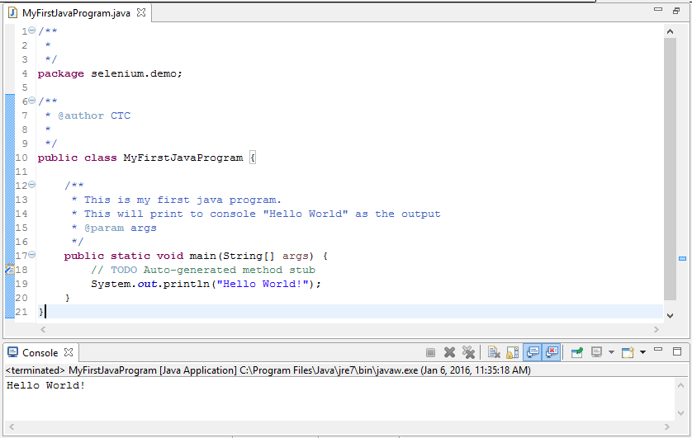
The First Example

Slide 7
Session 2
Java with Eclipse

Slide 8
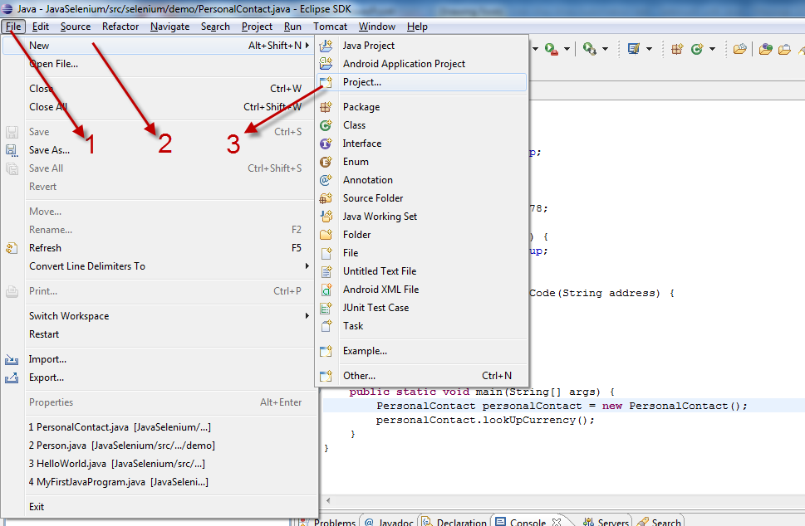
Create a Project

Slide 9
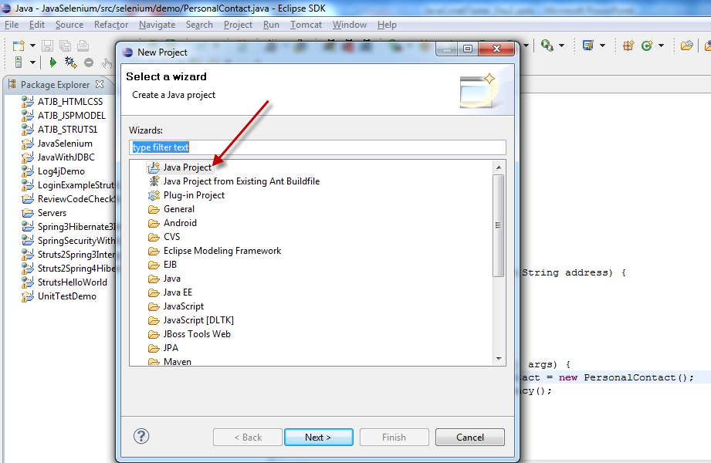
Create a Project

Slide 10
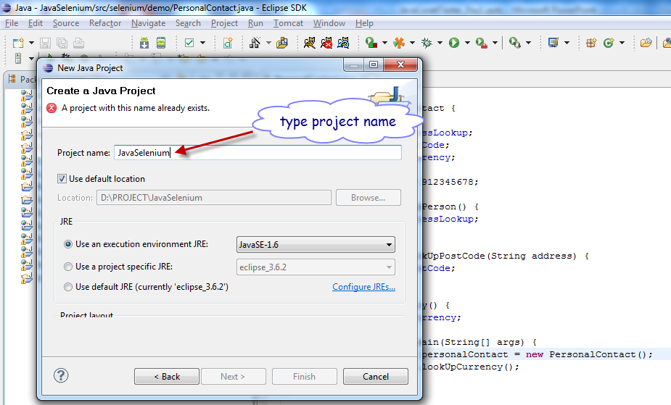
Create a Project

Slide 11
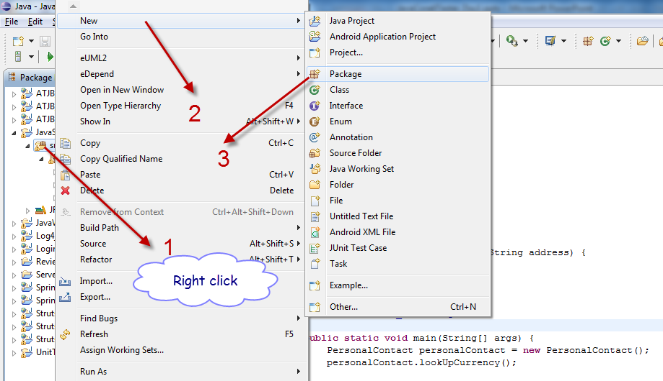
Create a package

Slide 12
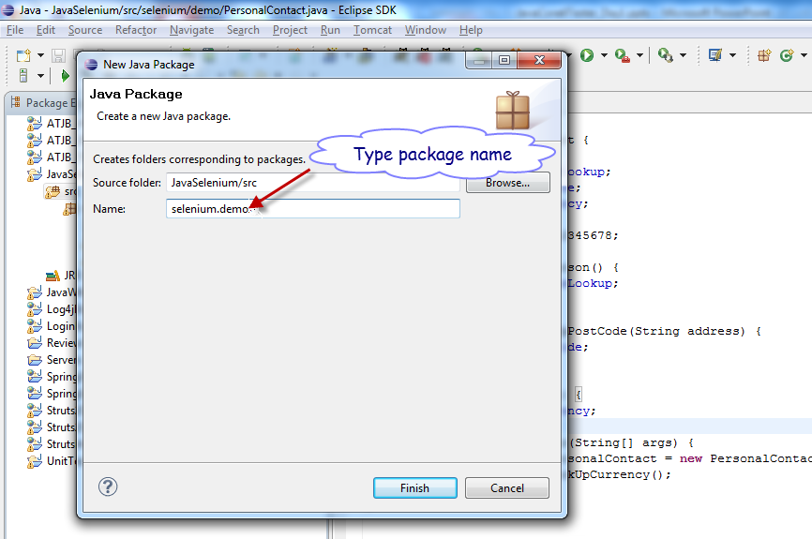
Create a package

Slide 13
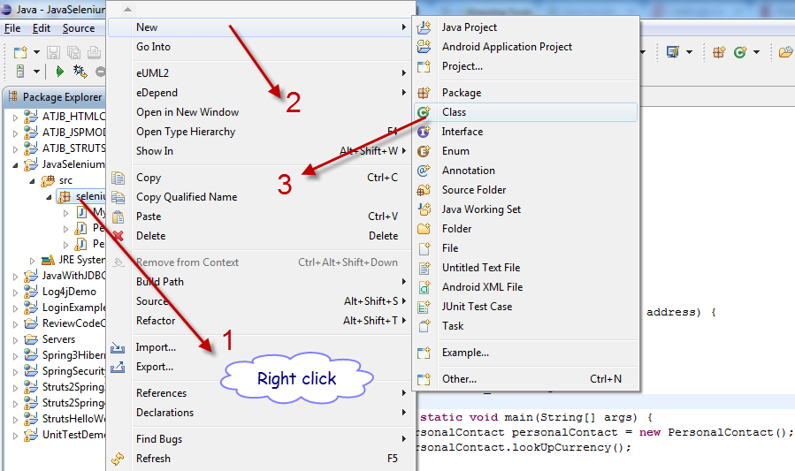
Create a Class

Slide 14
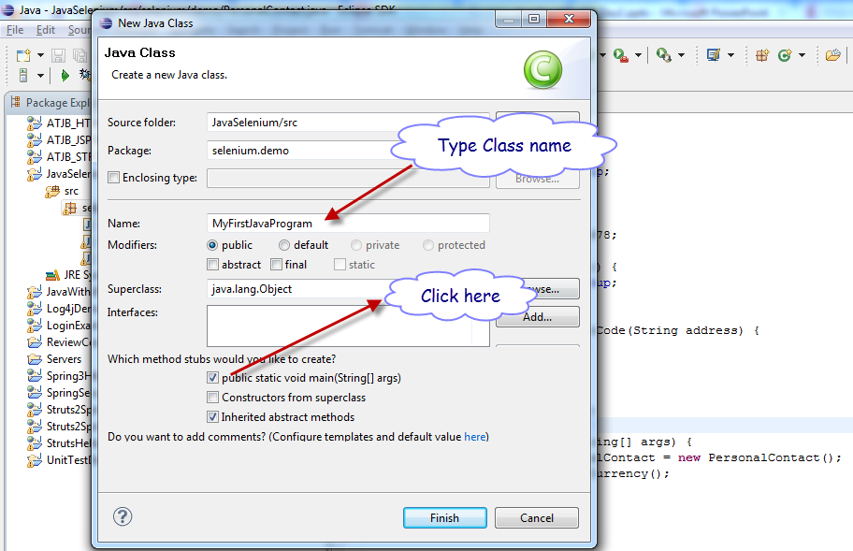
Create a Class

Slide 15
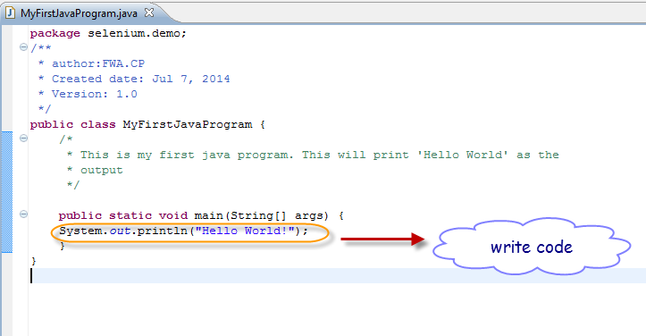
Create a Class

Slide 16
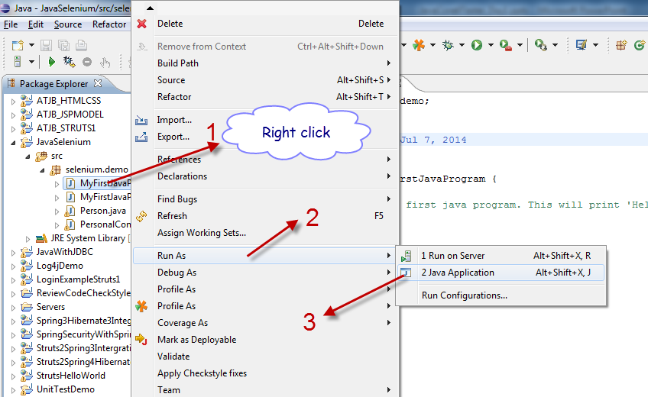
Run
Run

Slide 17
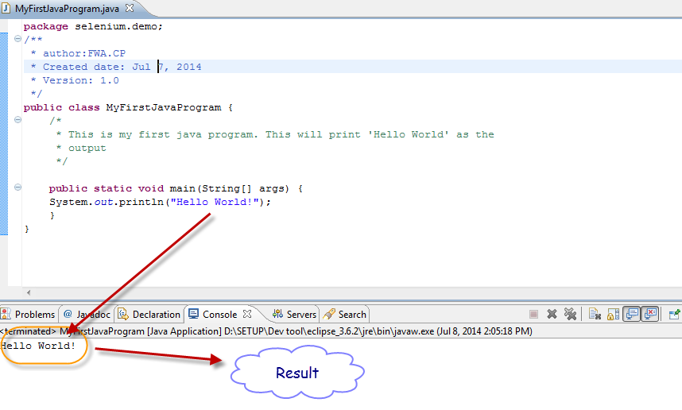
Result

Slide 18
Session 3
Class & Object
©FPT SOFTWARE - Corporate Training Center - Internal Use

Slide 19
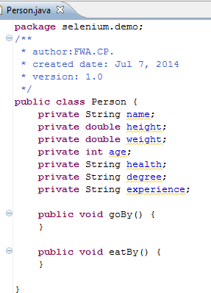

Class
Person
Name
Height
Weight
Age
Health
Degree
Experience
-----------------------
goBy()
eatBy()
Attributes
Methods
Class is a set of Attributes (data) and Methods (functional)

Slide 20

Object
Person
Name
Height
Weight
Age
Health
Degree
Experience
-----------------------
goBy()
eatBy()
Employee
Salary
----------------------getSalary()
setSalary()
Object is an instance of Class
John: Employee
Name = John
Health = Good
Wight = 70kg
Degree = Engineer
Experience = 5 years
Salary = $1000
--------------------------------

Slide 21


Class/Object Exercise
Ex 1. Tạo một class có tên Animal
Khai báo 2 thuộc tính là name và weight
Tạo các phương thức set, get cho 2 thuộc tính này
Tạo ra 2 đối tượng Animal, nhập và hiển thị thông tin 2 đối tượng này

Slide 22
Session 4
Constructor

Slide 23
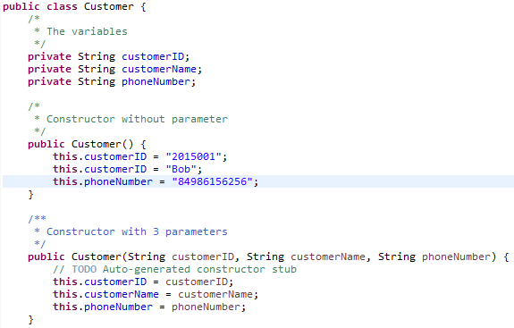
Constructor
Constructors are used to initialize the instance variables (fields) of an object.
A constructors must have the same name as the class its in and without return data type .

Slide 24
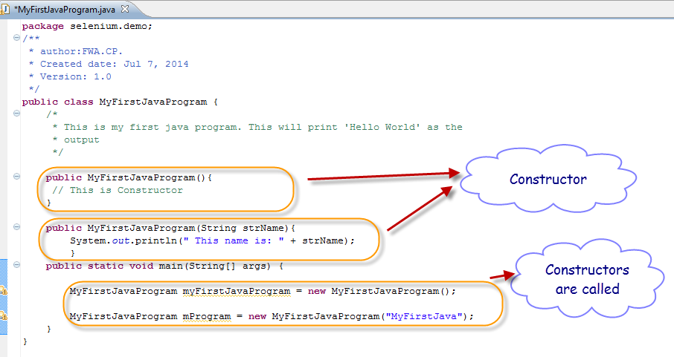
Call Constructor
When you create a new instance (a new object) of a class using the new keyword, a constructor for that class is called.

Slide 25
Constructor Exercise
Ex 2. Tạo 2 class có tên MainClass và SubClass:
Ở SubClass viết một phương thức có tên sumXY(int x, int y), phương thức này tính tổng và trả về kết quả x + y;
Ở MainClass, viết hàm main, dùng Constructor khởi tạo Subclass. Gọi hàm sumXY (10, 20) (x = 10, y = 20). In kết quả ra màn hình
Mục đích:
Biết cách tạo một class
Biết tạo method
Biết dùng Constructor để khởi tạo class
Biết gọi một phương thức trong class

Slide 26
Session 5
Java Basic Syntax

Slide 27
Basic Syntax
Syntax name | Description
Case Sensitivity | Java is case sensitive, which means identifier Hello and hello would have different meaning in Java
Class Names | For all class names the first letter should be in Upper Case Ex: MyFirstJavaClass
Method Names | All method names should start with a Lower Case letter. Each inner word's first letter should be in Upper Case. Ex: public void myMethodName()
Program File Name | Name of the program file should exactly match the class name. Assume 'MyFirstJavaProgram' is the class name. Then the file should be saved as 'MyFirstJavaProgram.java'

Slide 28
Java Identifiers
Identifiers name | Example
All identifiers should begin with a letter (A to Z or a to z), currency character ($) or an underscore (_). | MyVariable, myvariable, MYVARIABLE, i _myvariable, $myvariable _9pins
After the first character identifiers can have any combination of characters.
A keyword cannot be used as an identifier.
Most importantly identifiers are case sensitive.
Examples of legal identifiers: | age, $salary, _value, __1_value
Examples of illegal identifiers: | 123abc, -salary
Names used for classes, variables and methods are called identifiers.

Slide 29
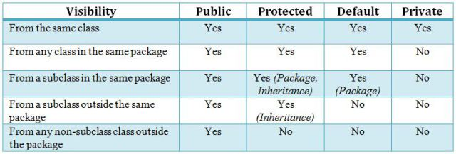
Java Modifiers
It is possible to modify classes, methods, etc., by using modifiers.
Type | Description
Access Modifiers | default, public , protected, private
Non-access Modifiers | final, abstract

Slide 30
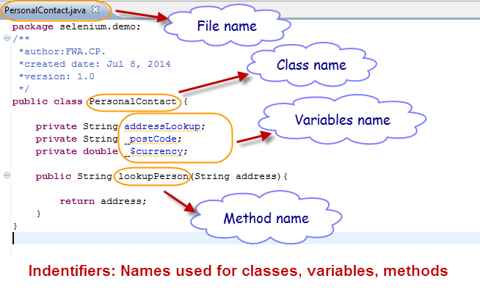
Java Modifiers Example

Slide 31
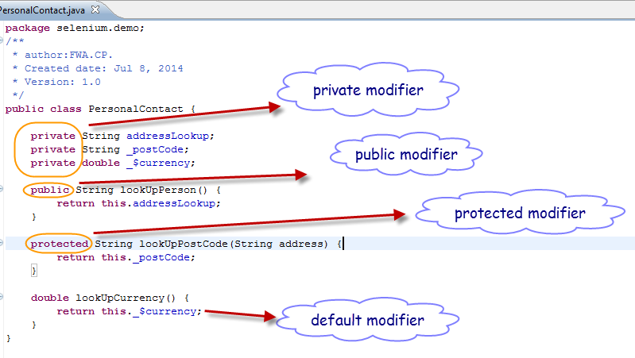
Java Modifiers Example

Slide 32
Java Modifiers Exercise
Ex 3. Tạo một class có tên Employee trong package selenium.demo với các thuộc tính:
private String Full Name
int Age
protected double Level
private float Salary
các phương thức geter, setter
Tạo ra một lớp thứ 2 có tên EmployeeList trong package selenium.demo.list với:
các phương thức nhập và hiển thị employee

Slide 33
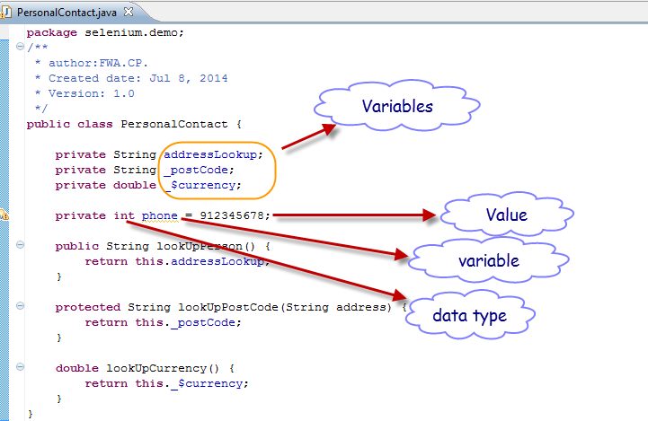
Variables
A variable provides us with named storage that our programs can manipulate.
The basic form of a variable declaration is shown here:
datatype variable [ = value][, variable [= value] ...] ;

Slide 34
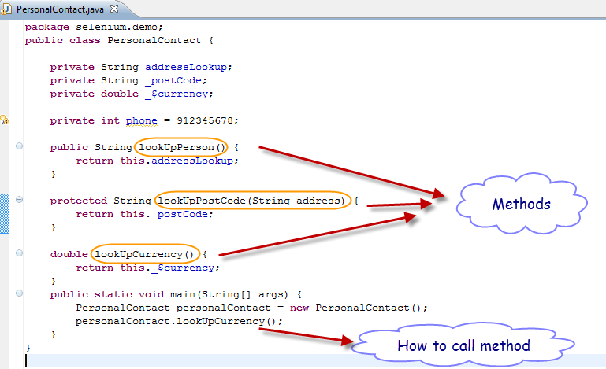
Method
A method is a set of code which is referred to by name and can be called (invoked) at any point in a program simply by utilizing the method's name

Slide 35
Session 6
Data types

Slide 36
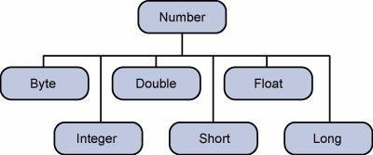
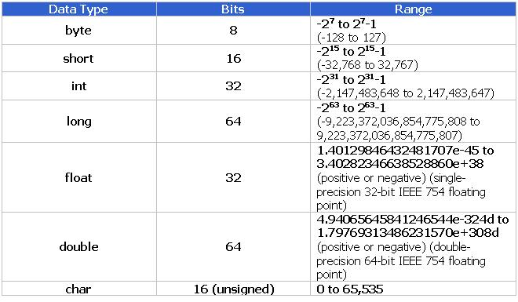
Number types

Slide 37
Session 7
OPERATORs

Slide 38
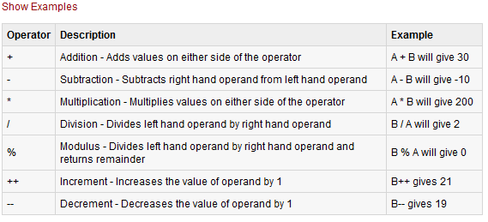
Arithmetic Operators
Arithmetic operators are used in mathematical expressions in the same way that they are used in algebra^{[đại số]}.
The following table lists the arithmetic operators:
Assume interger variable A holds 10 and variable B holds 20, then:

Slide 39
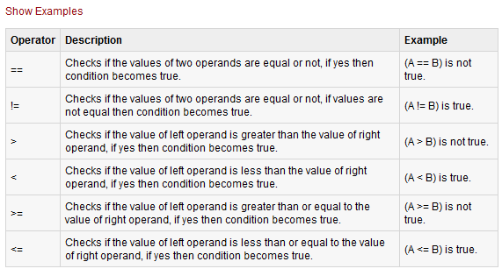
Relational Operators
There are following relational operators supported by Java language.
Assume interger variable A holds 10 and variable B holds 20, then:

Slide 40
Session 8
Character, String type

Slide 41
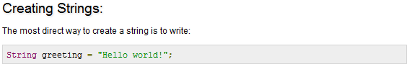
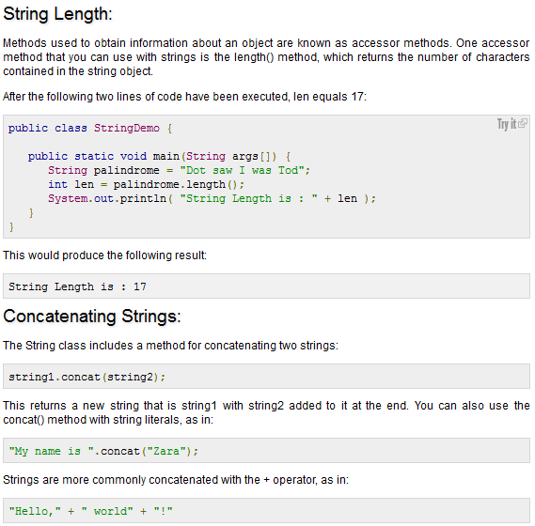
Character, String type

Slide 42
String Exercise
Ex 4. Nhập vào một xâu ký tự sau đó điếm xem xâu này gồm có bao nhiêu từ, có bao nhiêu cặp từ trùng nhau?

Slide 43
Array
Session 9

Slide 44
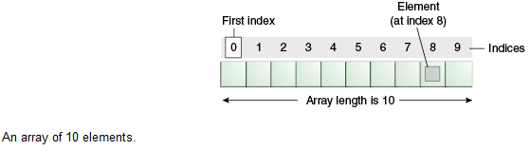
Array in Java
An array is a container object that holds a fixed number of values of a single type.
The length of an array is established when the array is created.
After creation, its length is fixed:

Slide 45
Array Declarations
Syntax: Three ways to declare an array are
datatype[] identifier;
datatype[] identifier = new datatype[size];
datatype[] identifier = {value1,value2,…valueN};
Example:
byte[] bArray;
float[] fArray = new float[20];
int[] iArray = { 32, 27, 64, 18, 95, 14, 90, 70, 60, 37 };
Examine array bArray, fArray, iArray
bArray, fArray, iArray is the array name
fArray.length accesses array c’s length
iArray has 10 elements (iArray[0], iArray [1], … , iArray [9] )
The value of iArray [0] is 32
Notes:
However, convention discourages square brackets after the array's name form; the brackets identify the array type and should appear with the type designation.

Slide 46
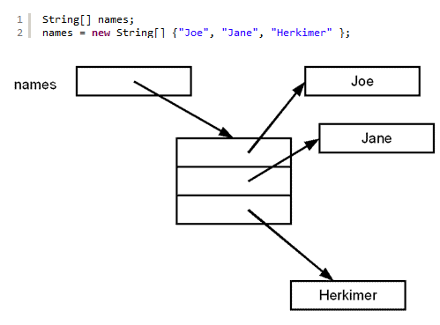
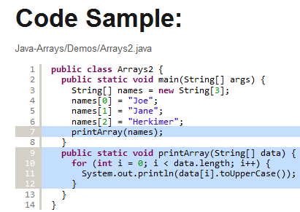
Array Index

Slide 47
Exercises on Array
Ex5: Write a program called GradesAverage, which prompts user for the number of students, reads it from the keyboard, and saves it in an int variable called numStudents.
It then prompts user for the grades of each of the students and saves them in an int array called grades. Your program shall check that the grade is between 0 and 100.
A sample session is as follow:
Enter the number of students: 3
Enter the grade for student 1: 55
Enter the grade for student 2: 108
Invalid grade, try again...
Enter the grade for student 2: 56
Enter the grade for student 3: 57
The average is 56.0

Slide 48
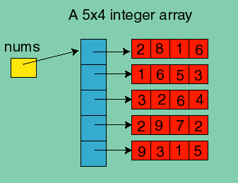
2D Array in Java
Ex: int [][] nums = new int[5][4];
int cols = 4, rows = 5;
for (int i = 0; i < rows; i++) {
for (int j = 0; j < cols; j++) {
System.out.println("Nums[" + i + "," + j + "]: " + nums[i][j]);
}
}

Slide 49
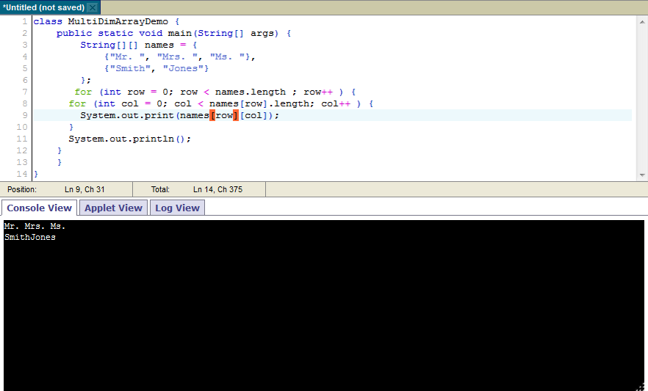
2D Array in Java - Sample

Slide 50
Summary
Java overview
Using Eclipse to create Java
Class, Object
Java Basic Syntax
Identifiers
Java access Modifiers
Variable
Method
Constructor
Data type
Number types
Character, String type
Operators
String
Array

Slide 51
Q&A

Slide 52

Thank you

