Slide 1
JAVA CORE - PART2

Slide 2

Lesson Agenda
Flow controls
Decision-making statements (Control Statements)
Loop Statements (Control Loop)
Branching statement (break, continue, return)
Collection
List
Set
Map
Sorting
Exception
Throwable
Checked Exception
Runtime Exception
Concurrency
Thread Basic
Synchronization
Communication

Slide 3
Flow controls
Session 1

Slide 4
Read character from keyboard
import java.io.IOException;
import java.util.Scanner;
public class InputKeyBoard {
@SuppressWarnings("resource")
public static void main(String[] args) throws IOException{
System.out.print("Input a string: ");
Scanner scanner = new Scanner(System.in);
String userInput = scanner.nextLine();
System.out.println("String is : " + userInput);
}
}

Slide 5
Control Statements
A program executes from top to bottom except when we use control statements, we can control the order of execution of the program, based on logic and values.
In Java, control statements can be divided into the following categories:
Decision-making statements (Control Statements)
Loop Statements (Control Loop)
Branching statement (break, continue, return)

Slide 6
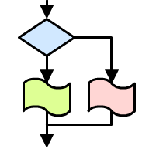
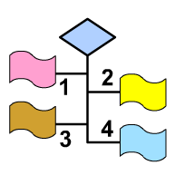
Control Statements
Statements
If… Else
Switch .. Case

Slide 7
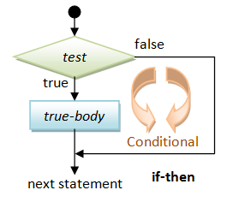
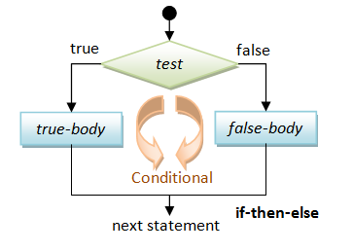
If… Else
Have one or more conditions to be evaluated, along with statements that are to be executed if the condition is determined to be true,
and optionally, other statements to be executed if the condition is determined to be false.

Slide 8
If… Else - Sample
public class IfElseDemo {
public static void main(String[] args) {
int testScore = 76;
char grade;
if (testScore >= 90) {
grade = 'A';
} else if (testScore >= 80) {
grade = 'B';
} else if (testScore >= 70) {
grade = 'C';
} else if (testScore >= 60) {
grade = 'D';
} else {
grade = 'F';
}
System.out.println("Grade: " + grade);
}
}

Slide 9


If …Else - Exercise
Ex1: Write a class
Input number form keyboard
Compare this number, if:
0 <= number < 5 -> print “Yeu”
5 <= number < 7 -> print “Trung Binh”
7 <= number < 8 -> print “Kha”
8 <= number < 9 -> print “Gioi”
9 <= number <= 10 -> print “Xuat Sac”
Ex2: Write a Java program to determine whether an input number is an even number.

Slide 10
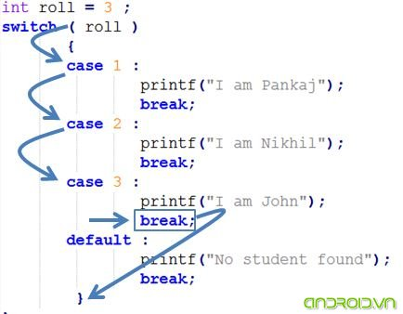
Switch …Case (1)
Unlike if-then and if-then-else statements, the switch statement can have a number of possible execution paths.
A switch works with the byte, short, char, and int primitive data types.
It also works with enumerated types, the String class.
Example:

Slide 11
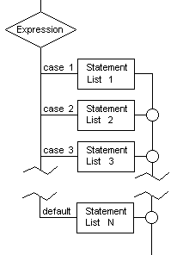
Switch …Case (2)
Syntax:
switch(expression) {
case value_1:
statement_1; [ break;]
case value_2:
statement_2; [ break;]
…
case value_n:
statement_n; [ break;]
default:
statement_n+1; [break;]
}

Slide 12
Switch …Case - Sample 1
Write a class
Input number form keyboard
Compare this number, case:
2 -> print “Monday”
3 -> print “Tuesday”
…
8 -> print “Sunday”

Slide 13
Switch …Case Sample 1 - Solution
public class SwitchDemo {
public static void main(String[] args) {
int day = 7;
String dayString;
switch (day) {
case 2:
dayString = "Monday";
break;
case 3:
dayString = "Tuesday";
break;
case 4:
dayString = "Wednesday";
break;
case 5:
dayString = "Thursday";
break;
case 6:
dayString = "Friday";
break;
case 7:
dayString = "Saturday";
break;
case 8:
dayString = "Sunday";
break;
default:
dayString = "Invalid day";
break;
}
System.out.println(dayString);
}
}

Slide 14
Switch…Case - Multiple case Labels
public class SwitchMultipleCaseDemo {
public static void main(String[] args) {
int month = 2, year = 2020;
int days = 0;
switch (month) {
case 1: case 3: case 5: case 7: case 8: case 10: case 12:
days = 31;
break;
case 4: case 6: case 9: case 11:
days = 30;
break;
case 2:
if (((year % 100 != 0) && (year % 4 == 0)) || (year % 400 == 0))
days = 29;
else
days = 28;
break;
default:
System.out.println("Invalid month.");
break;
}
System.out.println("Number of Days = "+ days);
}

Slide 15
Switch …Case - Sample2
public class SwitchStringTypeDemo {
public static void main(String[] args) {
int month = 1;
String stringMonth;
switch (month) {
case 1:
stringMonth = "January";
break;
case 2:
stringMonth = "February";
break;
case 3:
stringMonth = "March";
break;
case 4:
stringMonth = "April";
break;
case 5:
stringMonth = "May";
break;
case 6:
stringMonth = "June";
break;
case 7:
stringMonth = "July";
break;
case 8:
stringMonth = "August";
break;
case 9:
stringMonth = "September";
break;
case 10:
stringMonth = "October";
break;
case 11:
stringMonth = "November";
break;
case 12:
stringMonth = "December";
break;
default:
stringMonth = "Invalid month.";
break;
}
System.out.println(stringMonth);
}
}

Slide 16
Switch …Case - String type
public class SwitchStringDemo {
public static void main(String[] args) {
String month = "june";
int monthNumber = 0;
switch (month.toLowerCase()) {
case "january":
monthNumber = 1;
break;
case "february":
monthNumber = 2;
break;
case "march":
monthNumber = 3;
break;
case "april":
monthNumber = 4;
break;
case "may":
monthNumber = 5;
break;
case "june":
monthNumber = 6;
break;
case "july":
monthNumber = 7;
break;
case "august":
monthNumber = 8;
break;
case "september":
monthNumber = 9;
break;
case "october":
monthNumber = 10;
break;
case "november":
monthNumber = 11;
break;
case "december":
monthNumber = 12;
break;
default:
System.out.println("Invalid month");
break;
}
System.out.println(monthNumber);
}
}

Slide 17
Switch … Case - Exercise
Ex3: Write a Java program that allows the user to choose the correct answer of a question.
See the example below:
What is the correct way to declare a variable to store an integer value in Java?
int 1x=10;
int x=10;
float x=10.0f;
string x="10";
Enter your choice: c

Slide 18
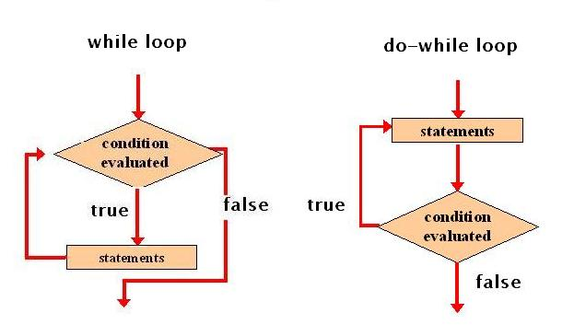
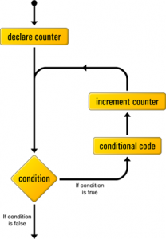
Control Loop
Loop
while…
do … while
for()

Slide 19
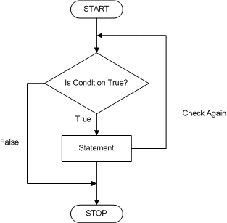
while Loop
while loops are used for situations when a loop has to be executed as long as certain condition is true.
The number of times a loop is to be executed is not pre-determined, but depends on the condition.
The syntax is:
while (condition) {
statements;
}

Slide 20
while Loop - Sample
public class WhileDemo {
public static void main(String[] args) {
int count = 1;
while (count < 11) {
System.out.println("Count is: " + count);
count++;
}
}
}

Slide 21
while Loop - Exercise
Ex4: Write a program called SumAndAverage to produce the sum of 1, 2, 3, ..., to an upperbound (e.g., 100). Also compute and display the average.

Slide 22
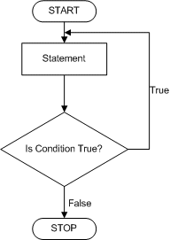
do … while Loop
The do-while loop executes certain statements till the specified condition is true.
These loops are similar to the while loops, except that a do-while loop executes at least once, even if the specified condition is false.
The syntax is:
do {
action statements;
} while (condition);

Slide 23
do … while Loop - Sample
public class DoWhileDemo {
public static void main(String[] args) {
int count = 1;
do {
System.out.println("Count is: " + count);
count++;
} while (count < 11);
}
}

Slide 24
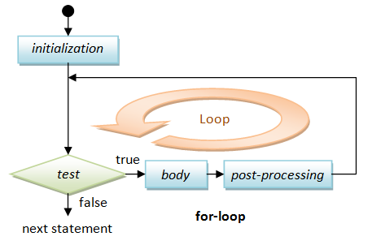
for Loop
All loops have some common features:
a counter variable that is initialized before the loop begins,
a condition that tests the counter variable
and a statement that modifies the value of the counter variable.
Syntax:
for (initialization;loopContinuationCondition; increment)
{ statement;
}

Slide 25
for Loop - Sample
public class SumAndAverage {
public static void main(String[] args) {
int sum = 0; // store the accumulated sum, init to 0
double average; // average in double
int lowerbound = 1; // the lower bound to sum
int upperbound = 100; // the upper bound to sum
// for Loop
for (int i = lowerbound; i < upperbound; i++) {
sum += i;
}
average = sum / 100;
System.out.println("The sum is: " + sum);
System.out.println("The Average is: " + average);
}
}

Slide 26
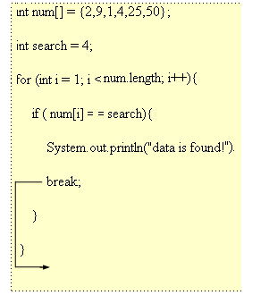
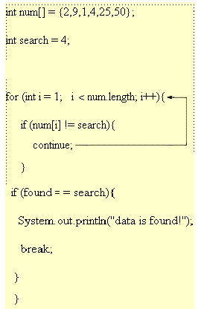
Branching (1)
Break
Continue

Slide 27
Continue Sample
Example:
public class ContinueDemo {
public static void main(String[] args) {
String searchMe = "peter piper picked a peck of pickled peppers";
int max = searchMe.length();
int numPs = 0;
for (int i = 0; i < max; i++) {
// interested only in p's
if (searchMe.charAt(i) != 'p') {
continue;
}
numPs++;
}
System.out.println("Found " + numPs + " p's in the string.");
}
}

Slide 28
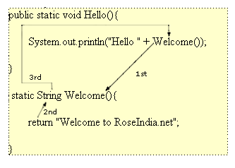
Branching (2)
Return

Slide 29
Collections
Session 2

Slide 30
Collections Overview
A collection - sometimes called a container - is simply an object that groups multiple elements into a single unit.
Collections are used to store, retrieve, manipulate, and communicate aggregate data.
Typically, they represent data items that form a natural group, such as a poker hand (a collection of cards), a mail folder (a collection of letters), or a telephone directory (a mapping of names to phone numbers)

Slide 31
Collections Framework
A collections framework is a unified architecture for representing and manipulating collections. All collections frameworks contain the following:
Interfaces: These are abstract data types that represent collections. Interfaces allow collections to be manipulated independently of the details of their representation. In object-oriented languages, interfaces generally form a hierarchy.
Implementations: These are the concrete implementations of the collection interfaces. In essence, they are reusable data structures.
Algorithms: These are the methods that perform useful computations, such as searching and sorting, on objects that implement collection interfaces.
Notes:
However, convention discourages square brackets after the array's name form; the brackets identify the array type and should appear with the type designation.

Slide 32
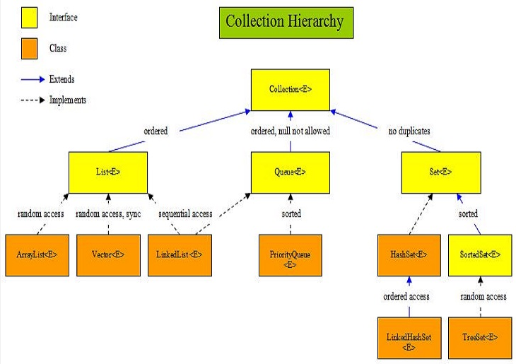
Collection Hierarchy Diagram

Slide 33
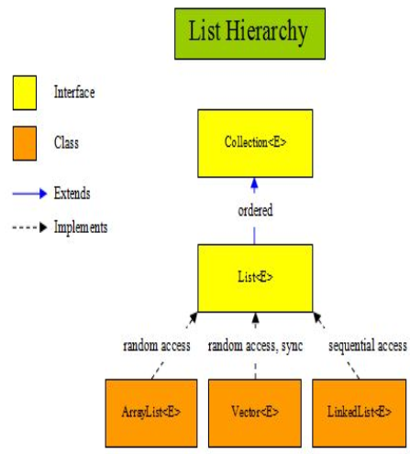
List

Slide 34
List Interfaces & Classes
The table below gives a description of each interface and class within the above diagram:
Interface/Class | Description
Collection<E> | The root interface in the Collection hierarchy which the List<E> interface extends. There is no direct implementation of the Collection<E> interface within the JDK.
List<E> | Interface for ordered collections of elements.
ArrayList<E> | Random access, resizable-array implementation of the List<E> interface that implements all optional list operations and permits all elements, including null.
Vector<E> | Synchronized random access resizable-array implementation of the List<E> interface.
LinkedList<E> | Sequential access linked implementation of the List<E> interface that implements all optional list operations, and permits all elements, including null. The class also implements the Queue<E> interface, providing first-in-first-out queue operations.

Slide 35
ArrayList
The table below shows the declarations of some methods for the ArrayList<E> class implemented from the List<E> interface:
Method | Description
public boolean add(E o) | Appends the specified element to the end of this ArrayList.
public void add(int index, E element) | Inserts the specified element at the specified position in this ArrayList.
public boolean remove(int index) | Removes the element at the specified index in this ArrayList.
public boolean addAll(Collection<? extends E> c) | Adds all of the elements in the specified collection to this ArrayList.
public boolean addAll(int index, Collection<? extends E> c) | Adds all of the elements in the specified collection to this ArrayList, starting at the specified index.
public void clear() | Removes all of the elements from this ArrayList.
public boolean contains(Object o) | Returns true if this ArrayList contains the specified element.
public E get(int index) | Returns the element at the specified index in this ArrayList.
public boolean isEmpty() | Returns true if this ArrayList contains no elements.
public Iterator<E> iterator() | Returns an iterator over the elements in this ArrayList.
public boolean remove(Object o) | Removes a single instance of the specified element from this ArrayList if it is present.
public Object[] toArray() | Returns an array containing all of the elements in this ArrayList in the correct order.

Slide 36
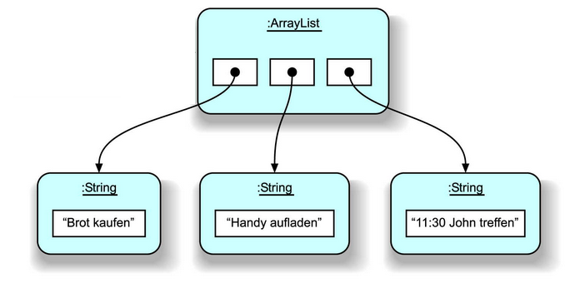
ArrayList
ArrayList supports dynamic arrays that can grow as needed.
Array lists are created with an initial size.
When this size is exceeded, the collection is automatically enlarged.
When objects are removed, the array may be shrunk
Syntax:
List<DataType> arrName = new ArrayList<>();

Slide 37
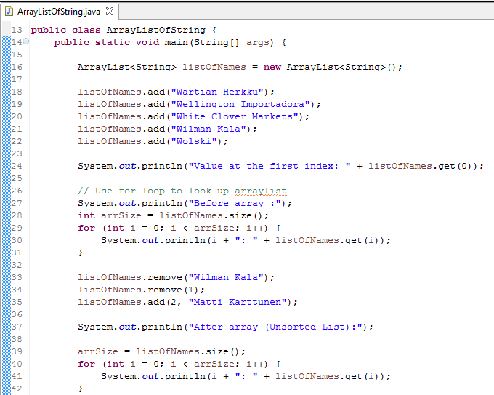
ArrayList - Example
Can use ArrayList to store String, Number:
Instance of ArrayList
Add value into ArrayList
Get value from ArrayList
Using for loop to lookup value
Remove by Value
Remove by Index
Add value by Index

Slide 38
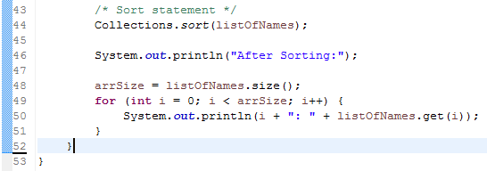
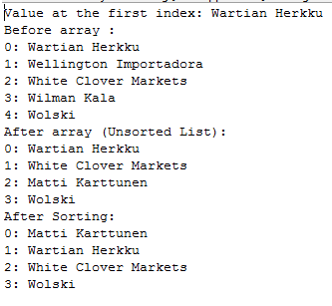
ArrayList - Example
Can use ArrayList to store String, Number:
Result:
Sort statement

Slide 39
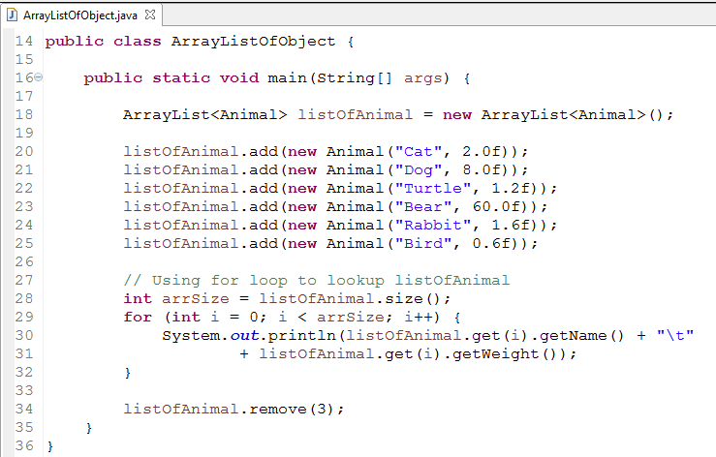
ArrayList with Object
Can use ArrayList to store Objects:
Instance of ArrayList
Add Animal to ArrayList
Use for loop to get
Remove by Index

Slide 40
ArrayList - Exercise
Exercise:
Write a Java program to create a new array list, add some colors (string) and print out the size of collection?
Iterate through all elements in a array list?
Insert an element "Orange" into the array list at the first position?

Slide 41
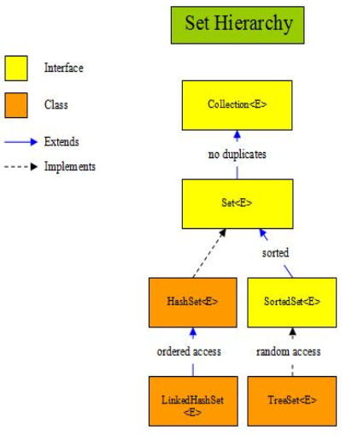
Set

Slide 42
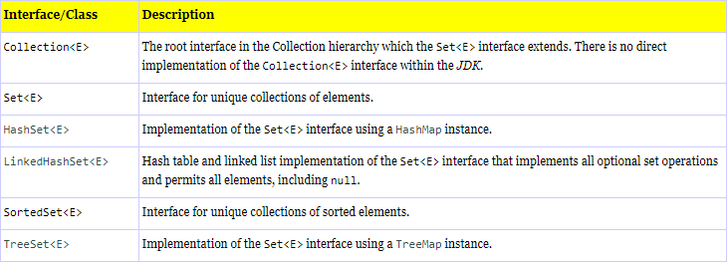
Set Interfaces & Classes
The table below gives a description of each interface and class within the above diagram:

Slide 43
HashSets
A HashSet is an unordered and unsorted implementation of the Set<E> interface, backed by a hash table using a HashMap instance.
This type of set makes no guarantees over iteration order and in particular no guarantees that the iteration order will remain constant over time.

Slide 44
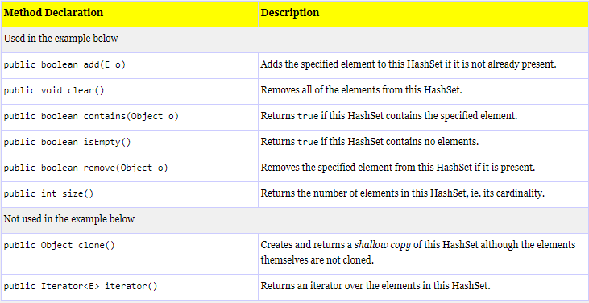
HashSets
The table below shows the declarations of all the methods for the HashSet<E> class implemented from the Set<E> interface:

Slide 45
HashSets - Example
import java.util.HashSet;
import java.util.Set;
public class HashSetDemo {
public static void main(String[] args) {
Set<String> hs = new HashSet<String>();
String s = "hello";
hs.add(s);
hs.add("goodbye");
hs.add(s + s);
System.out.println("hash set size = " + hs.size());
// Use enhanced for loop to iterate over the collection
for (String str : hs) {
System.out.println(str); // Print element
}
hs.remove(s);
System.out.println(hs.contains(s));
System.out.println("hash set size = " + hs.size());
// Use enhanced for loop to iterate over the collection
for (String str : hs) {
System.out.println(str); // Print element
}
// Check for empty set, clear set and then check again
System.out.println(hs.isEmpty());
hs.clear();
System.out.println(hs.isEmpty());
}
}

Slide 46
HashSets - Exercise
Tạo package vn.com.fis.set sau đó tạo mới 2 class với các thuộc tính sau:
Class Post: int postId, String title, String author.
Class Page: int pageId, String description, List<Post> posts, Set<String> authors.
Tạo các getters và setters cho 2 class trên.
Tạo package vn.com.fis.set.main sau đó tạo class MainProgram thực hiện các chức năng sau:
Nhập thông tin 1 Page từ bàn phím.
Nhập thông tin các bài post cho 1 page đã nhập trước đó.
In ra thông tin các authors của 1 page nhập id từ bàn phím.

Slide 47
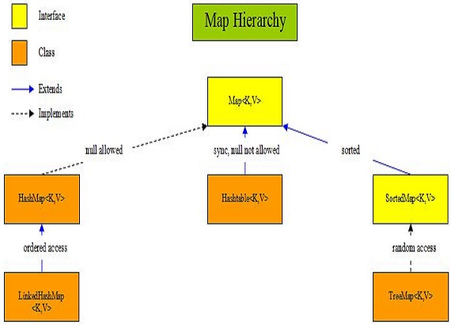
Map

Slide 48
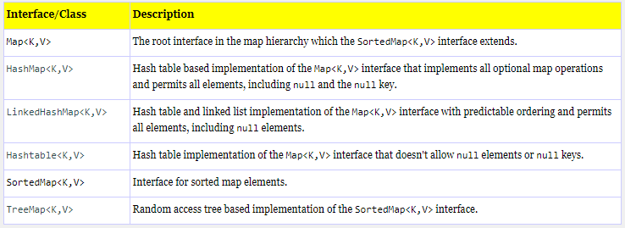
Map Interfaces & Classes
The table below gives a description of each interface and class within the above diagram:

Slide 49
HashMap
A HashMap is an unordered and unsorted implementation of the Map<K,V> interface that allows null values and a null key.
This type of map makes no guarantees over iteration order and in particular no guarantees that the iteration order will remain constant over time.

Slide 50
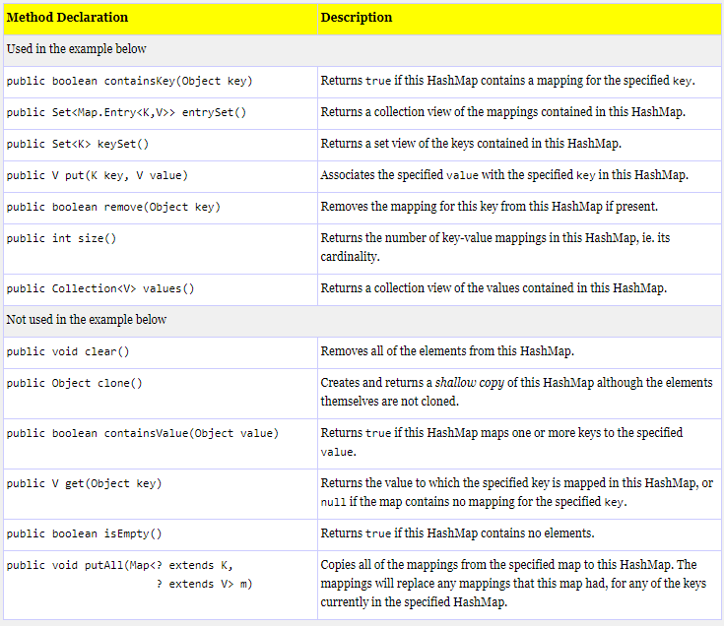
HashMap Overview
The table below shows the declarations of all the methods for the HashMap<K,V> class implemented from the Map<K,V> interface:

Slide 51
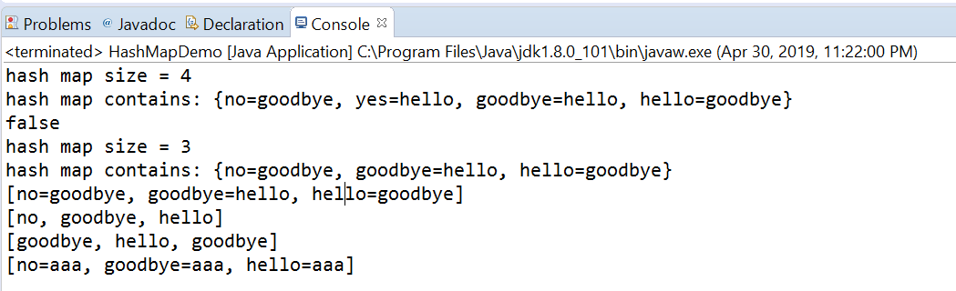
HashMap Example
import java.util.HashMap;
import java.util.Map;
public class HashMapDemo {
public static void main (String[] args) {
Map<String, String> hm = new HashMap<String, String>();
hm.put("hello", "goodbye");
hm.put("goodbye", "hello");
hm.put("yes", "hello");
hm.put("no", "goodbye");
System.out.println("hash map size = " + hm.size());
System.out.println("hash map contains: " + hm);
hm.remove("yes");
System.out.println(hm.containsKey("yes"));
System.out.println("hash map size = " + hm.size());
System.out.println("hash map contains: " + hm);
// Collection-views, results differ dependant upon Map implementation
System.out.println(hm.entrySet());
System.out.println(hm.keySet());
System.out.println(hm.values());
// Use Map static nested class Entry to get a reference and change all values
for (Map.Entry<String, String> map : hm.entrySet()) {
map.setValue("aaa");
}
System.out.println(hm.entrySet());
}
}

Slide 52
Sorting
Collections using the Comparable and Comparator interfaces.
The Comparable interface consists of the following method:
public interface Comparable<T> {
public int compareTo(T o);
}
The Comparator interface consists of a single method:
public interface Comparator<T> {
int compare(T o1, T o2);
}

Slide 53
Sorting
A List list may be sorted as follows:
Collections.sort(list);
If you try to sort a list, the elements of which do not implement Comparable, Collections.sort(list) will throw a ClassCastException.
Similarly, Collections.sort(list, comparator) will throw a ClassCastException if you try to sort a list whose elements cannot be compared to one another using the comparator

Slide 54
Sorting Example
class Student implements Comparable<Student> {
private String studentNo;
private String name;
public Student(String _studentNo, String _name) {
this.studentNo = _studentNo;
this.name = _name;
}
public String getStudentNo() {
return studentNo;
}
public void setStudentNo(String studentNo) {
this.studentNo = studentNo;
}
public String getName() {
return name;
}
public void setName(String name) {
this.name = name;
}
@Override
public int compareTo(Student o) {
if(o == null || o.getStudentNo() == null) {
return 1;
}
return this.studentNo.compareTo(o.studentNo);
}
@Override
public String toString() {
return "{" + this.studentNo + ", " + this.name + "}";
}
}
public class MySorting {
public static void main(String[] args) {
// HashSet without sorting
Set<Student> students = new HashSet<>();
Student st1 = new Student("BB", "KhangPN");
Student st2 = new Student("CC", "DungLA");
Student st3 = new Student("AA", "CuongNV");
Student st4 = new Student("AA", "AnhNV");
Student st5 = new Student("AA", "PhuongNV");
// Collections sorting custom comparators
List<Student> list = new ArrayList<>();
list.add(st1);
list.add(st2);
list.add(st3);
list.add(st4);
list.add(st5);
Collections.sort(list);
System.out.println(list);
}
}

Slide 55
Exception
Session 3

Slide 56
Exception Overview
An exception is an event, which occurs during the execution of a program, that disrupts the normal flow of the program's instructions.
When an error occurs within a method, the method creates an object and hands it off to the runtime system.
Creating an exception object and handing it to the runtime system is called throwing an exception.

Slide 57
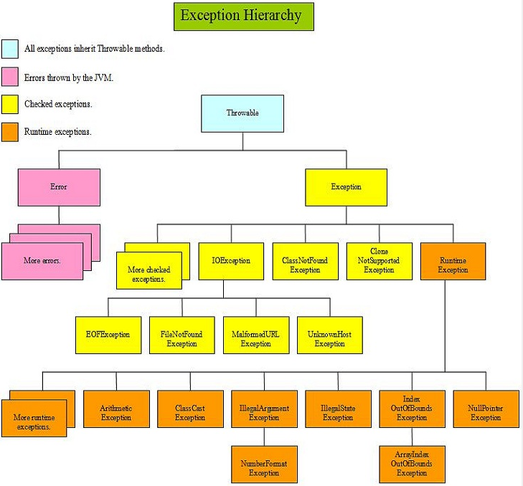
Exception Overview
The diagram below is a representation of the exception hierarchy and by no means a complete list, but should help in visualisation:

Slide 58
Exception Example
import java.io.FileWriter;
import java.io.PrintWriter;
import java.util.ArrayList;
import java.util.List;
public class ExceptionDemo {
private List<Integer> list;
private static final int SIZE = 10;
public ExceptionDemo() {
list = new ArrayList<Integer>(SIZE);
for (int i = 0; i < SIZE; i++) {
list.add(new Integer(i));
}
}
public void writeList() {
// The FileWriter constructor throws IOException, which must be caught.
PrintWriter out = new PrintWriter(new FileWriter("OutFile.txt"));
for (int i = 0; i < SIZE; i++) {
// The get(int) method throws IndexOutOfBoundsException, which must be caught.
out.println("Value at: " + i + " = " + list.get(i));
}
out.close();
}
}

Slide 59
Exception Handler Syntax
The try Block
try {
code
}
catch and finally blocks . . .
The catch Blocks
try {
} catch (ExceptionType name) {
} catch (ExceptionType name) {
}

Slide 60
Exception Handler Syntax
The finally Block
try {
code
} catch (ExceptionType name) {
…
} finally {
code
}
The try-with-resources Statement
static String readFirstLineFromFile(String path) throws IOException {
try (BufferedReader br =
new BufferedReader(new FileReader(path))) {
return br.readLine();
}
}

Slide 61
concurrency
Session 4

Slide 62
Thread
Threads are sometimes called lightweight processes.
Threads exist within a process — every process has at least one.
Multithreaded execution is an essential feature of the Java platform.

Slide 63
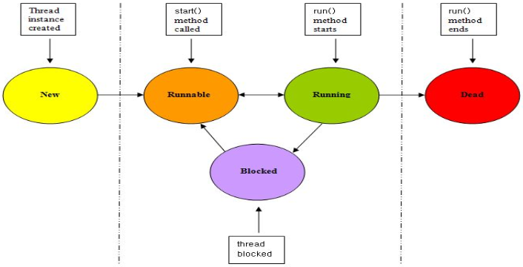
Thread States
To make understanding easier we will use a slideshow as we go through the life of a thread.

Slide 64
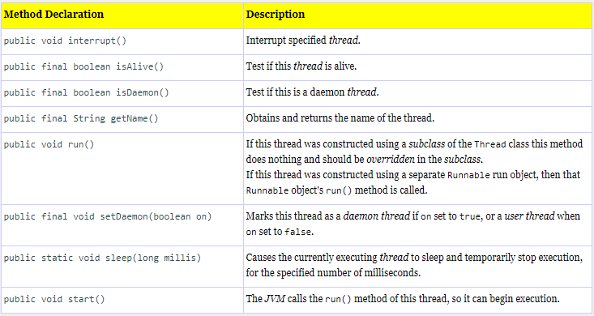
Thread Methods Overview
The table below shows the declarations of the methods of the Thread class:

Slide 65
Thread Example
public class ThreadDemo extends Thread {
public ThreadDemo(String name) {
super(name);
}
// Override run() method of Thread to execute a new thread
public void run() {
System.out.println("The thread named: " + getName() + " is starting."); System.out.println("The thread named: " + getName() + " is ending.");
}
public static void main(String[] args) {
System.out.println("Main user thread has started.");
// Create a new thread
ThreadDemo th = new ThreadDemo("Thread1");
// Power up the thread via the start() method
th.start();
System.out.println("Main user thread has ended.");
}
}

Slide 66
Synchronization
Threads communicate primarily by sharing access to fields and the objects reference fields refer to.
This form of communication is extremely efficient, but makes two kinds of errors possible: thread interference and memory consistency errors.
Describes a simple idiom that can effectively prevent thread interference and memory consistency errors.

Slide 67
Synchronization Example
public class Counter {
private int count = 0;
public synchronized void increment() {
System.out.println(Thread.currentThread() + " Before adding " + count);
this.count += 1;
System.out.println(Thread.currentThread() + " After adding " + count);
}
public synchronized int val() {
return this.count;
}
}

Slide 68
Thread Communication
How threads can communicate with each other when they are within a synchronized method or code block?
The methods in question are wait(), notify() and notifyAll() and allow threads to communicate to other threads that they are entering a blocked state or leaving a blocked state so they can cease or resume execution respectively.

Slide 69
Thread Communication Example
public class TestBingo {
static class Bingo {
public synchronized void method1(boolean isExecuting) {
if (isExecuting) {
System.out.print("Bin");
notify(); // Let method2() run
try {
wait(); // Wait for method2() to complete
} catch (InterruptedException ex) {
System.out.println(ex);
}
} else {
notify();
}
}
public synchronized void method2(boolean isExecuting) {
if (isExecuting) {
System.out.println("Go");
notify(); // Let method1() run
try {
wait(); // Wait for method1() to complete
} catch (InterruptedException ex) {
System.out.println(ex);
}
} else {
notify();
}
}
}
public static void main(String[] args) {
final Bingo bingo = new Bingo();
// Create runnable thread using anonymous inner class
new Thread(new Runnable() {
public void run() {
for (int i=0; i<10; i++) {
bingo.method1(true);
bingo.method1(false);
}
}
}).start();
// Create runnable thread using anonymous inner class
new Thread(new Runnable() {
public void run() {
for (int i=0; i<10; i++) {
bingo.method2(true);
bingo.method2(false);
}
}
}).start();
}
}

Slide 70
Thread Exercise
Viết chương trình kiểm tra số dư tài khoản >= số tiền cần rút thì tiến hành rút, ngược lại chờ nạp tiền vào tài khoản sau đó tiến hành rút?

Slide 71
Summary
Flow controls
Decision-making statements (Control Statements)
Loop Statements (Control Loop)
Branching statement (break, continue, return)
Collection
List
Set
Map
Sorting
Exception
Throwable
Checked Exception
Runtime Exception
Concurrency
Thread Basic
Synchronization
Communication

Slide 72
Q&A

Slide 73

Thank you
73

