Slide 1
Chapter 11 Test Oracle Design

Slide 2
Test Oracle Design
In previous chapters, we have discussed how to generate test data.
Now we discuss: what do we do once we have the test data?
When we execute the program on the test data, how can we tell whether the program executed correctly?
Oracle: a program that analyzes input/output pairs and determines whether the program is acting correctly.
Determination of correct behavior necessarily involves the specification.

Slide 3
Test Oracle Design
Dilemmas of Oracle Design
From Specifications to Oracles
Oracles for State-Based Programs
From Axioms to Oracles
From Rules to Oracles
Chapter Summary

Slide 4
Dilemmas of Oracle Design
Choice of an oracle is both critical and difficult:
Critical: a wrong oracle will miss real faults and signal wrong faults, making the program worse than it started.
Difficult: specifications can be complex; difficult to capture them in a Boolean function.
General format of an oracle:
Binary predicate involving initial state, final state.

Slide 5
Dilemmas of Oracle Design
Requirements on Oracle Design:
Simplicity:
The oracle must be simple so that we can trust in its correctness. An incorrect oracle is disastrous: it will miss real faults, and send us chasing wrong faults.
It must be significantly simpler (less likely to have faults) than the program under test.
Effectiveness:
Ideally, capture all the clauses of the specification.
This may conflict with simplicity. Then, capture most critical aspects, easier to model aspects, aspects that are harder to verify by other means than testing.
Efficiency:
Low priority criterion: reduced overhead.

Slide 6
Dilemmas of Oracle Design
Satisfying the opposing criteria of simplicity and effectiveness is easy when it easier to check the output condition than to produce the output.
Specification.
Program: quadratic function.
Checking the discriminant.
Computing the roots.

Slide 7
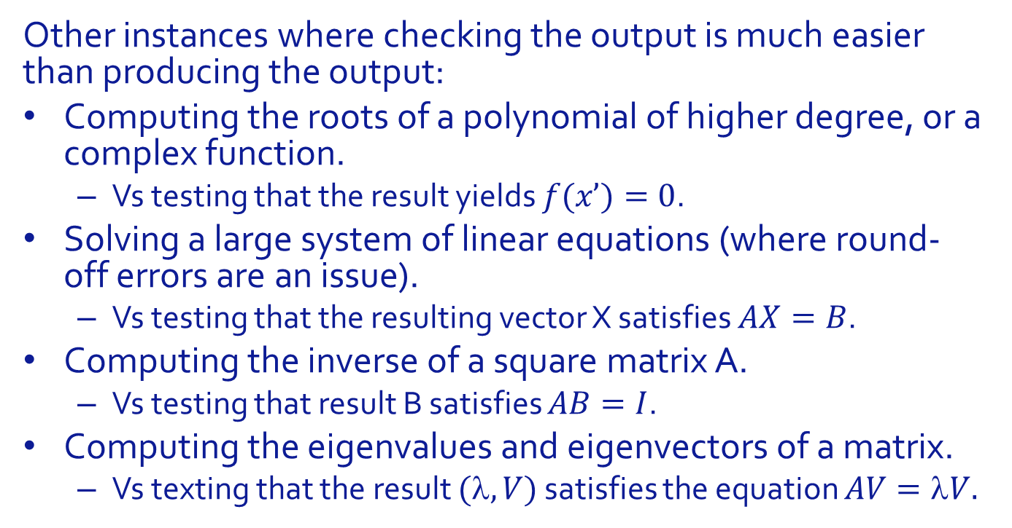
Dilemmas of Oracle Design
Other instances where checking the output is much easier than producing the output:
Computing the roots of a polynomial of higher degree, or a complex function.
Vs testing that the result yields $f(x’)=0$.
Solving a large system of linear equations (where round-off errors are an issue).
Vs testing that the resulting vector X satisfies $AX=B$.
Computing the inverse of a square matrix A.
Vs testing that result B satisfies $AB=I$.
Computing the eigenvalues and eigenvectors of a matrix.
Vs texting that the result $(,V)$ satisfies the equation $AV=V.$

Slide 8
Dilemmas of Oracle Design
But we are not always this lucky. Sometimes the only way to test a program is to solve the same problem and compare notes.
Violates simplicity.
Works only if the specification is deterministic (a single correct output for any input).
Oracle is as prone to be faulty as program under test.
Examples:
A sort program:
You can check that the output is sorted, but
good luck checking that it is a permutation of the input.
A GCD program:
You can check that the output is a common divisor of the inputs,
Good luck checking that it is the greatest common divisor.

Slide 9
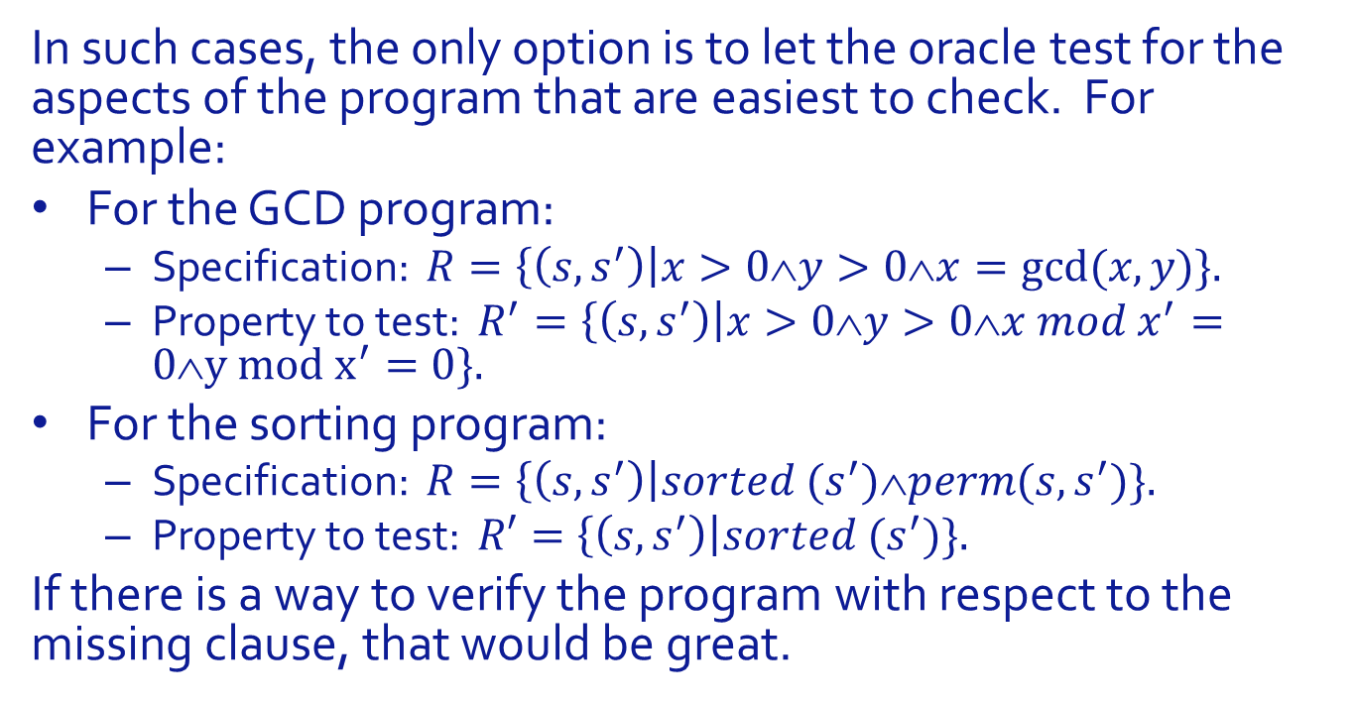
Dilemmas of Oracle Design
In such cases, the only option is to let the oracle test for the aspects of the program that are easiest to check. For example:
For the GCD program:
Specification: $R=\left\{\left(s,s^{′}\right)\right|x>0∧y>0∧x=gcd⁡(x,y)\}.$
Property to test: $R^{′}=\left\{\left(s,s^{′}\right)\right|x>0∧y>0∧x mod x^{′}=0∧y mod x^{′}=0\}.$
For the sorting program:
Specification: $R=\left\{\left(s,s^{′}\right)\right|sorted (s^{′})∧perm(s,s^{′})\}.$
Property to test: $R′=\left\{\left(s,s^{′}\right)\right|sorted (s^{′})\}.$
If there is a way to verify the program with respect to the missing clause, that would be great.

Slide 10
Test Oracle Design
Dilemmas of Oracle Design
From Specifications to Oracles
Oracles for State-Based Programs
From Axioms to Oracles
From Rules to Oracles
Chapter Summary

Slide 11
From Specifications to Oracles
We consider a program g written to satisfy a specification R, and we are interested to write an oracle to test the executions of g.
Question:
What is the connection between R and oracle(s_init,s)?
How do we derive predicate oracle(s_init,s) from relation R?

Slide 12
From Specifications to Oracles
Straightforward answer: oracle(,) tests for R, or for a simpler version of R, if needed.
We will see on an example that this raises a problem.
bool oracle (stateType s_init,s) {return (s_init,s) in R;}

Slide 13
From Specifications to Oracles
Specification, R:
Simpler Specification:
Program:
Oracle:
Test data: {(-5,-5)}.
bool oracle (stateType x_init,y_init, x, y) {return (x_init>0 && y_init>0 && x_init%x==0 && y_init%x==0);}

Slide 14
From Specifications to Oracles
Oracle:
Test data: {(-5,-5)}.
Outcome: program fails the oracle,
Yet, it is correct.
What happened?
A specification includes two sources of information:
Conditions that the program may assume about the inputs.
Conditions that the program must ensure about the outputs.
These must be treated differently by the oracle.
bool oracle (stateType x_init,y_init, x, y) {return (x_init>0 && y_init>0 && x_init%x==0 && y_init%x==0);}

Slide 15
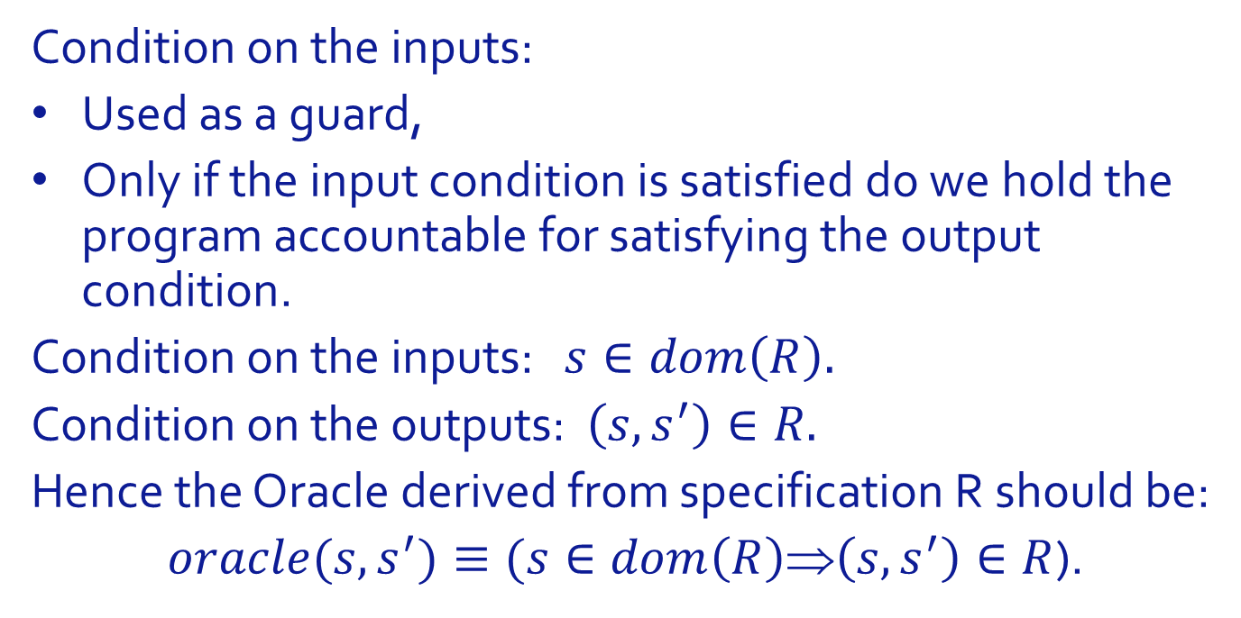
From Specifications to Oracles
Condition on the inputs:
Used as a guard,
Only if the input condition is satisfied do we hold the program accountable for satisfying the output condition.
Condition on the inputs: $s∈dom\left(R\right).$
Condition on the outputs: $\left(s,s^{′}\right)∈R.$
Hence the Oracle derived from specification R should be:
$oracle(s,s^{′})≡(s∈dom\left(R\right)$⇒$\left(s,s^{′}\right)∈R$).

Slide 16
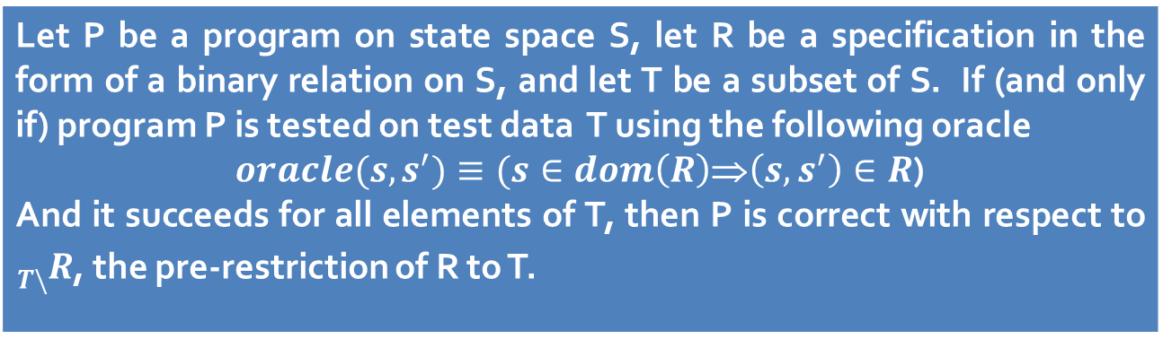
From Specifications to Oracles
We have a Proposition that supports this choice of oracle.
Let P be a program on state space S, let R be a specification in the form of a binary relation on S, and let T be a subset of S. If (and only if) program P is tested on test data T using the following oracle $oracle(s,s^{′})≡(s∈dom\left(R\right)$⇒$\left(s,s^{′}\right)∈R$) And it succeeds for all elements of T, then P is correct with respect to ${}_{T\backslash }^{}R$, the pre-restriction of R to T.

Slide 17
Test Oracle Design
Dilemmas of Oracle Design
From Specifications to Oracles
Oracles for State-Based Programs
From Axioms to Oracles
From Rules to Oracles
Chapter Summary

Slide 18
Oracles for State Based Programs
State based programs:
Implemented by classes (in the OOP sense)
State variables,
Methods that manipulate / control these variables.
How do we design oracles for such programs?
It depends on the goal of testing, and available information.
If goal is fault removal, and we have specifications for each method (from the programmer): Treat each method as simple input/ output program.

Slide 19
Oracles for State Based Programs
If goal is acceptance testing, or if we have no specifications of individual methods, then:
we refer to the specification in the form (X,Y,R), where R is a relation from H=X* to Y.
Specification represented by axioms and rules.
Question: How do we derive oracles from axioms and rules?

Slide 20
Test Oracle Design
Dilemmas of Oracle Design
From Specifications to Oracles
Oracles for State-Based Programs
From Axioms to Oracles
From Rules to Oracles
Chapter Summary

Slide 21
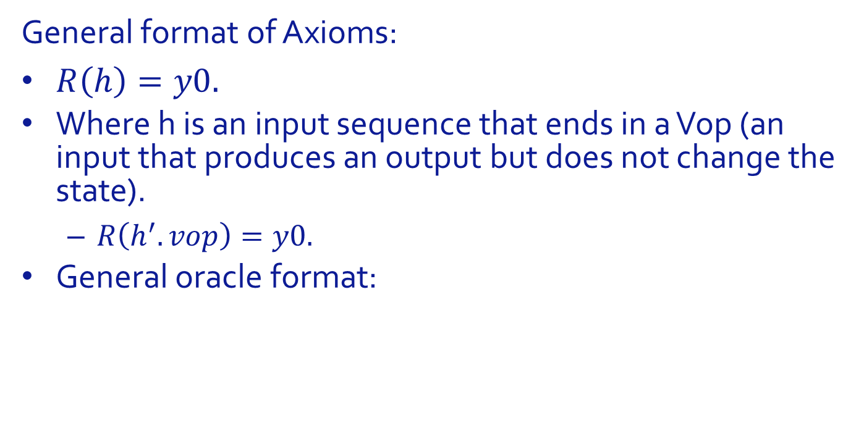
Oracles for State-Based Programs From Axioms to Oracles
General format of Axioms:
$R\left(h\right)=y0.$
Where h is an input sequence that ends in a Vop (an input that produces an output but does not change the state).
$R\left(h^{′}.vop\right)=y0.$
General oracle format:

Slide 22

Oracles for State-Based Programs From Axioms to Oracles
Illustration:
$stack\left(init.top\right)=error.$

Slide 23

Oracles for State-Based Programs From Axioms to Oracles
Illustration:
$stack\left(init.h.push\left(a\right).top\right)=a.$

Slide 24

Oracles for State-Based Programs From Axioms to Oracles
Illustration:
$stack\left(init.size\right)=0.$

Slide 25

Oracles for State-Based Programs From Axioms to Oracles
Illustration:
$stack\left(init.empty\right)=true.$

Slide 26

Oracles for State-Based Programs From Axioms to Oracles
Illustration:
$stack\left(init.push\left(a\right).empty\right)=false.$

Slide 27
Test Oracle Design
Dilemmas of Oracle Design
From Specifications to Oracles
Oracles for State-Based Programs
From Axioms to Oracles
From Rules to Oracles
Chapter Summary

Slide 28

Oracles for State-Based Programs From Rules to Oracles
Common format for rules:
$$∀h: R\left(h^{′}.h\right)=R\left(h^{′′}.h\right),$$
Interpretation: h’ and h’’ are equivalent histories.
Whether we have received one or the other, the current (if h is empty) and future (if h is not empty) output of R is the same.
Examples of such rules from the stack specification:

Slide 29
Oracles for State-Based Programs From Rules to Oracles
Some of these rules end with h+ rather than h, but each instance of h+ in such rules can be replaced by
x1.h
x2.h
…
xn.h
For all the elements ({x1,x2,x3,…,xn}) of X. Hence we can assume a general format where the input sequence ends in h.

Slide 30
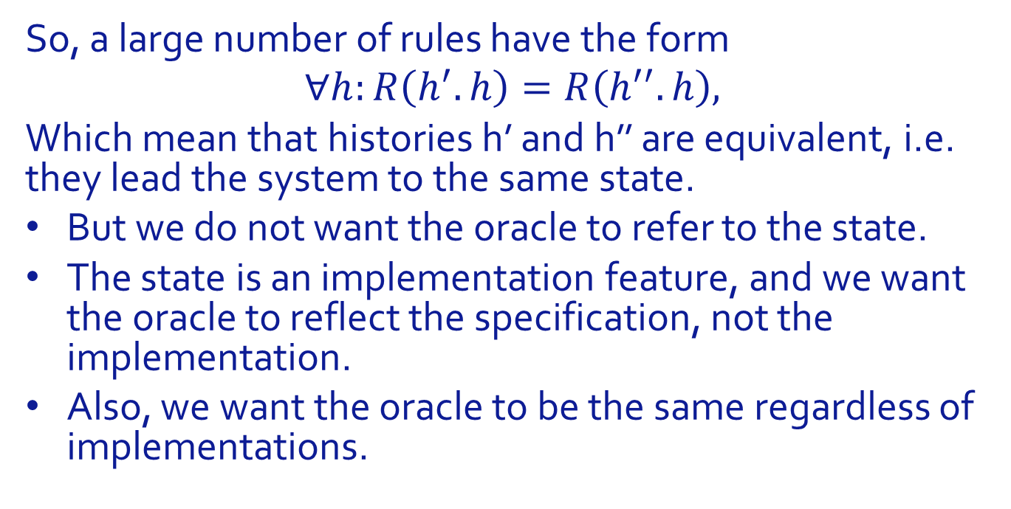
Oracles for State-Based Programs From Rules to Oracles
So, a large number of rules have the form
$$∀h:R\left(h^{′}.h\right)=R\left(h^{′′}.h\right),$$
Which mean that histories h’ and h’’ are equivalent, i.e. they lead the system to the same state.
But we do not want the oracle to refer to the state.
The state is an implementation feature, and we want the oracle to reflect the specification, not the implementation.
Also, we want the oracle to be the same regardless of implementations.

Slide 31
Oracles for State-Based Programs From Rules to Oracles
Compromise: to test that two states are identical, we apply all the Vop functions and check that they return the same results.
A much weaker condition than testing that states are identical.
Can be strengthened by applying some state-altering operations and checking that the Vop functions still return the same values.
But allows us to generate oracle without considering the implementation.

Slide 32

Oracles for State-Based Programs From Rules to Oracles
Illustration:
Init Pop Rule: $stack\left(init.pop.h\right)=stack\left(init.h\right).$
Call Sequence, where g is a stack implementation:
Oracle:

Slide 33

Oracles for State-Based Programs From Rules to Oracles
Illustration:
Size Rule: $stack\left(init.h.size.h^{+}\right)=stack\left(init.h.h^{+}\right).$
Call Sequence, where g is a stack implementation:
Oracle:

Slide 34

Oracles for State-Based Programs From Rules to Oracles
Illustration:
Top Rule: $stack\left(init.h.top.h^{+}\right)=stack\left(init.h.h^{+}\right).$
Call Sequence, where g is a stack implementation:
Oracle:

Slide 35

Oracles for State-Based Programs From Rules to Oracles
Illustration:
Push Pop Rule: $stack\left(init.h.top.h^{+}\right)=stack\left(init.h.h^{+}\right).$
Call Sequence, where g is a stack implementation:
Oracle:

Slide 36
Oracles for State-Based Programs From Rules to Oracles
Not all rules provide equivalence between states.
Sometimes they provide a relationship between Vop values.
Oracle then simply invokes the Vop’s and checks the relationship.

Slide 37

Oracles for State-Based Programs From Rules to Oracles
Illustration:
Size Rule:
$$stack\left(init.h.push\left(a\right).size \right)=1+stack\left(init.h.size \right).$$
Call Sequence, where g is a stack implementation:
Oracle:

Slide 38

Oracles for State-Based Programs From Rules to Oracles
Illustration:
Empty Rule 1:
$$stack\left(init.h.push\left(a\right).h^{′}.empty\right)⇒stack\left(init.h.h^{′}.empty\right).$$
Call Sequence, where g is a stack implementation:
Oracle:

Slide 39

Oracles for State-Based Programs From Rules to Oracles
Illustration:
Empty Rule 2:
$$stack\left(init.h.h^{′}.empty\right)⇒stack\left(init.h.{pop.h}^{′}.empty\right).$$
Call Sequence, where g is a stack implementation:
Oracle:

Slide 40
Test Oracle Design
Dilemmas of Oracle Design
From Specifications to Oracles
Oracles for State-Based Programs
From Axioms to Oracles
From Rules to Oracles
Chapter Summary

Slide 41
Chapter Summary
Generating Test Data is only part of the task of testing a program:
We also need a way to tell whether the program behaves correctly with respect to a specification.
Oracle Design is a three-step process:
Decide what specification to consider, depending on goal of testing activity.
Decide what clauses of the specification we want to test against, depending on difficulty/ efficiency.
Mapping the generated specification onto an oracle.
Fairly straightforward for simple input/output programs.
More complicated for state-based programs (mapping axioms, rules).

Slide 42
Test Oracle Design
Dilemmas of Oracle Design
From Specifications to Oracles
Oracles for State-Based Programs
From Axioms to Oracles
From Rules to Oracles
Chapter Summary

Slide 43
Test Oracle Design
Sample Exercise

