Slide 1
Chapter 12 Test Driver Design

Slide 2
Test Driver Design
In previous chapters, we have discussed:
How to generate test data.
How to design test oracles.
Now we discuss:
How to combine a test data generator and test oracle into an integrated test driver.

Slide 3
Test Driver Design
Selecting a Specification to Test Against
Selecting a Driver Model
State-based Systems
Symbolic Execution
Chapter Summary

Slide 4
Selecting a Specification
Selecting a Specification to Test Against:
Do we get to choose the specification?
The same specification may have several components.
Some are easier to test against than others.
We can:
Test against some,
Prove correctness against others,
Provide fault tolerance with respect to others.
Interestingly, the requirements of testing, proving, fault tolerance are distinct/ complementary.

Slide 5
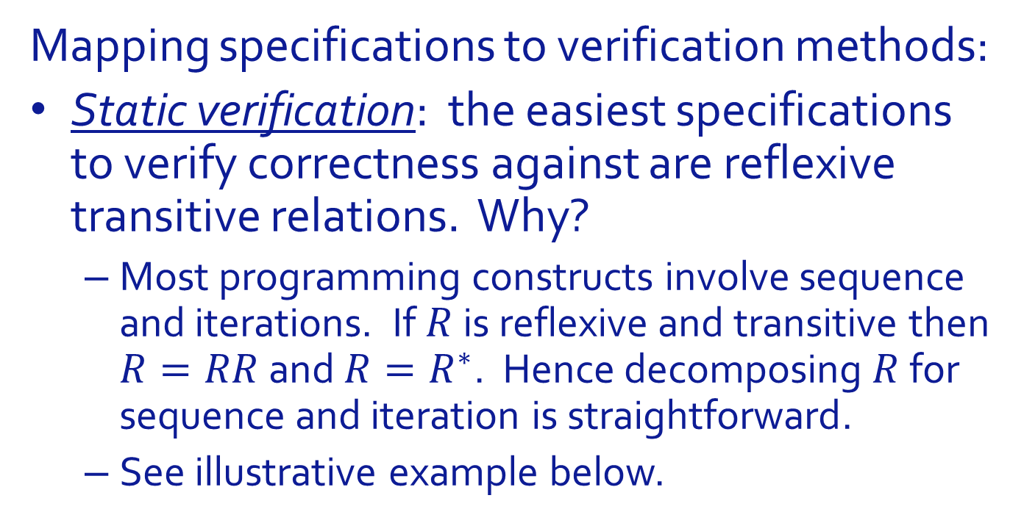
Selecting a Specification
Mapping specifications to verification methods:
Static verification: the easiest specifications to verify correctness against are reflexive transitive relations. Why?
Most programming constructs involve sequence and iterations. If $R$ is reflexive and transitive then $R=RR$ and $R=R^{∗}$. Hence decomposing $R$ for sequence and iteration is straightforward.
See illustrative example below.

Slide 6
Selecting a Specification
Mapping specifications to verification methods:
Testing: the easiest specifications to use as test oracles are relations that represent a simple condition between inputs and outputs.
Simple to program.
Can be verified reliably.

Slide 7
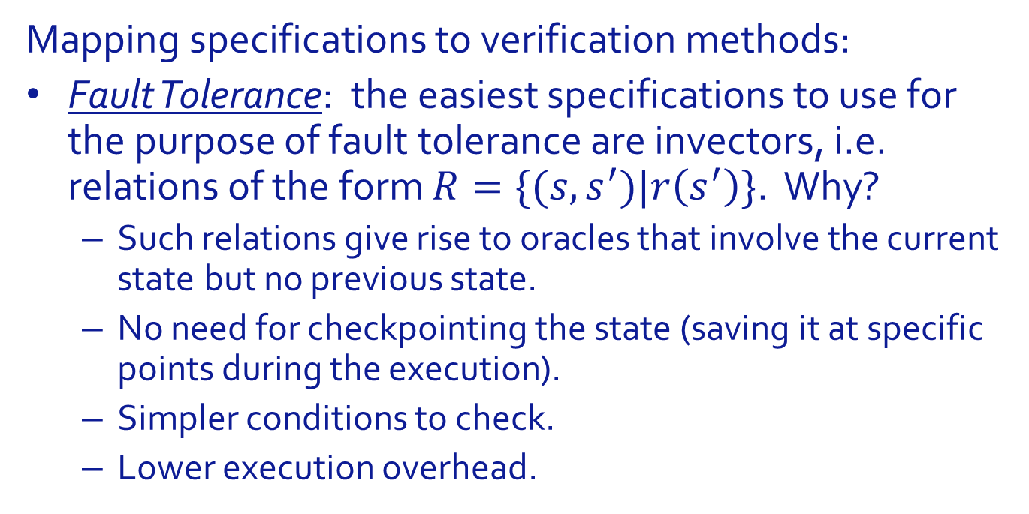
Selecting a Specification
Mapping specifications to verification methods:
Fault Tolerance: the easiest specifications to use for the purpose of fault tolerance are invectors, i.e. relations of the form $R=\{(s,s^{′})|r\left(s^{′}\right)\}$. Why?
Such relations give rise to oracles that involve the current state but no previous state.
No need for checkpointing the state (saving it at specific points during the execution).
Simpler conditions to check.
Lower execution overhead.

Slide 8
Selecting a Specification
Illustration: Reflexive Transitive Relations.
Sorting Routine.
Reflexive transitive component: PRM (permutation).
Proof: all assignments to the array happen in the context of a switch between two cells.
Linear Equations by Gaussian Elimination
Reflexive transitive component: original system and final system have the same set of solutions.
Proof: all transformations of the system involve equivalent linear combinations of equations.
Greatest Common Divisor
Current variables (a,b) have the same GCD as initial variables.
Proof: Euclid’s identities.

Slide 9
Selecting a Specification
Illustration: Unary Relations that lend themselves to testing.
Sorting Routine.
Unary relation: Final array is sorted.
Oracle: check that each cell is <= the next cell.
Linear Equations by Gaussian Elimination
Unary relation: Final matrix is rectangular.
Oracle: lower triangle is at or near zero.
Greatest Common Divisor
Unary relation: Final values of a and b identical.
Oracle: a==b.

Slide 10
Test Driver Design
Selecting a Specification to Test Against
Selecting a Driver Model
State-based Systems
Symbolic Execution
Chapter Summary

Slide 11
Selecting a Driver Model
Selecting a test process/ lifecycle depends on the following (inter-dependent) attributes:
The goal of the test.
Certification? Acceptance? Fault Removal?
How test data is generated.
Pre-recorded? Generated on the fly (random)?
Whether the test must be interrupted on failure, or run through the whole test data and record success/ failure.
Whether test outcomes are recorded for post-mortem analysis.
Specification Model.
Input/Output? State-based?

Slide 12
Selecting a Driver Model
Certification testing, pre-defined test data:

Slide 13
Selecting a Driver Model
Fault removal, pre-defined test data:

Slide 14
Selecting a Driver Model
Measuring inter-failure rate, indefinitely generated test data:

Slide 15
Test Driver Design
Selecting a Specification to Test Against
Selecting a Driver Model
State-based Systems
Symbolic Execution
Chapter Summary

Slide 16
State Based Systems
Several characteristic attributes, from the viewpoint of testing:
Oracle is not a closed form Boolean function.
Rather: axioms and rules.
Test data does not take the form of data to be read and/or assigned to program variables, but rather sequences of method calls.
Design of test drivers for state-based systems:
Case when test data is generated automatically.
Case when test data is pre-generated.

Slide 17
State Based Systems
A possible approach:
Prove correctness of implementation with respect to axioms.
Test implementation against rules.

Slide 18
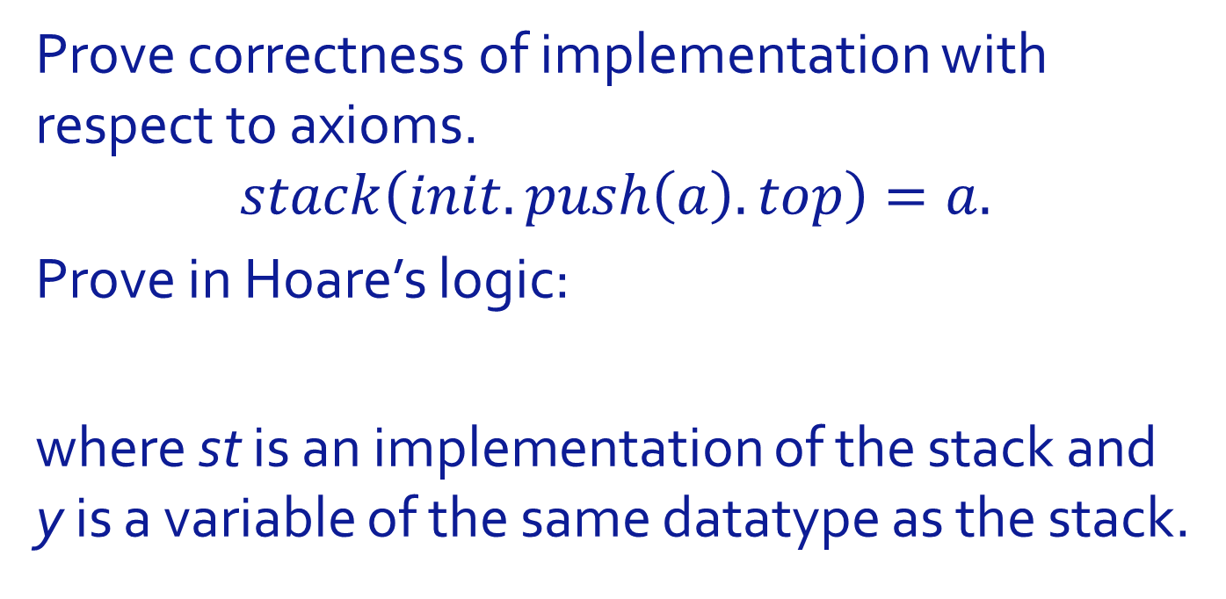
State Based Systems
Prove correctness of implementation with respect to axioms.
$$stack\left(init.push\left(a\right).top\right)=a.$$
Prove in Hoare’s logic:
where st is an implementation of the stack and y is a variable of the same datatype as the stack.

Slide 19
State Based Systems
Test implementation against rules. Vast majority of rules fall into two categories:
Equivalence between two histories (a simple history, a complex history).
An equation between the values of VX operations for two histories (a simple history, a complex history).
Samples:

Slide 20
State Based Systems
Test driver for the stack example.

Slide 21
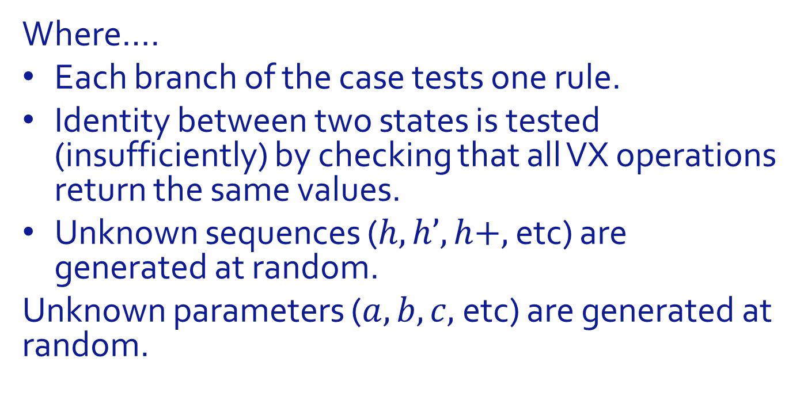
State Based Systems
Where….
Each branch of the case tests one rule.
Identity between two states is tested (insufficiently) by checking that all VX operations return the same values.
Unknown sequences ($h, h’, h+,$etc) are generated at random.
Unknown parameters ($a, b, c,$etc) are generated at random.

Slide 22
State Based Systems
Sample Rule that provides identity between input histories: Push-Pop Rule

Slide 23
State Based Systems
Sample Rule that provides equation between VX values: Size Rule.

Slide 24
State Based Systems
Auxiliary Functions

Slide 25
State Based Systems
Pre-Generated Test Data: Focus on test data.
Visiting all the states.
Crossing all the state transitions.
Applying all the VX operations.

Slide 26
State Based Systems
Test Data. Visiting all the states.

Slide 27
State Based Systems
Test Data. Crossing all the state transitions.

Slide 28
State Based Systems
For Rules Highlighted above.

Slide 29
State Based Systems
Whence the following program.

Slide 30
State Based Systems
Faults and Fault Detection.
Test drivers for stack developed by considering the specification, but not the implementation.
Hence we should be able to use on any implementation of a stack to check correctness or find faults. We deploy it, in fact, on two implementations.
One based on arrays.
One (artificial) using bit representation of an integer.

Slide 31
State Based Systems
Array Based.

Slide 32
State Based Systems
Scalar based.

Slide 33
State Based Systems
Can the data detect Faults?
Array based implementation.

Slide 34
State Based Systems
Can the data detect Faults?
Scalar based implementation.

Slide 35
Test Driver Design
Selecting a Specification to Test Against
Selecting a Driver Model
State-based Systems
Symbolic Execution
Chapter Summary

Slide 36
Symbolic Execution
Actual execution:
We run the program on actual data and observe its output.
Symbolic execution:
We assign symbols to the input values and observe how the program affects them.

Slide 37
Symbolic Execution
Sample program:
read(x); read(y); x=x+y; y=y+1; y=y+x; x=2*x-y;

Slide 38
Symbolic Execution
Sample Execution:
x=4, y=7.
How about, x=9, y=52. draw the table again?
Statement | x | Y
read(x); read(y) | 4 | 7
x=x+y; | 11 | 7
y=y+1; | 11 | 8
y=y+x; | 11 | 19
x=2*x-y; | 3 | 19

Slide 39
Symbolic Execution
Symbolic Execution:
x=X, y=Y.
For X=4, Y=7, we find final values: x=3, y=19.
Statement | x | Y
read(x); read(y) | X | Y
x=x+y; | X+Y | Y
y=y+1; | X+Y | Y+1
y=y+x; | X+Y | X+2Y+1
x=2*x-y; | X-1 | X+2Y+1

Slide 40
Symbolic Execution
If only it was so simple:
In real programs, we have
Complex data structures (records, ADT’s, arrays, files, pointers, etc..).
Complex control structures (sequences, if-then, if-then-else, while loops, repeat loops, recursion, etc..).
Complex name spaces (aliasing, pointer assignments, etc..).
Variable state spaces (memory management, garbage collection, stack, heap, etc..).

Slide 41
Symbolic Execution
To deal with complex control structures:

Slide 42
Symbolic Execution
To deal with complex control structures:

Slide 43
Symbolic Execution
To deal with while loops in particular:

Slide 44
Test Driver Design
Selecting a Specification to Test Against
Selecting a Driver Model
State-based Systems
Symbolic Execution
Chapter Summary

Slide 45
Chapter Summary
Selecting specification component that lends itself to testing.
Mapping it to an oracle.
Complementing with test data to form a test driver.
Test driver depends on many attributes, most notably to source of test data.
Symbolic execution enables us to draw broad conclusions on the behavior of the program,
But only when it is applicable (which is not often).

Slide 46
Test Driver Design
Selecting a Specification to Test Against
Selecting a Driver Model
State-based Systems
Symbolic Execution
Chapter Summary

