Slide 1
Chapter 10 Structural Criteria

Slide 2
Test Data generation
Test Data generation:
We are given a program P, specification R, input domain X (domain of R).
Problem: Generate test data T, subset of X, so that when we observe the behavior of P over T, we can infer its behavior over (all of) X.
How to infer the behavior of P on X from its behavior on T: depends on the goal of testing.
Two methods / sources of information to derive T:
Analyzing specification R (to ensure coverage of functional features).
Analyzing the structure of P (to ensure coverage of syntactic features).
Focus of chapter 9: Analyzing the Specification.
Focus of this chapter: Analyzing the Program.

Slide 3
Test Data generation
It may sound counter-intuitive that we use the program to test the program:
Not unlike a police investigator trying to solve a crime with the help of the prime suspect.
Design flaws in the program may cause flaws in data selection.
Example: if the program fails to make provisions for 50% of the inputs, we will never uncover that unless we refer to a specification that describes what is the input domain.
More generally, all verification relies on redundancy: redundancy between a program and a specification, a program and test data, a program and an oracle, etc.
If we use the program to test the same program, we have no redundancy.

Slide 4
Test Data generation
Nevertheless, structural criteria of test data generation are an important aspect of software testing:
Their focus: ensure coverage of the program’s source code.
Select test data that causes the execution of all statements, all conditions, all paths, etc…
A sensible rationale, but again executing all features is not sufficient:
the same statement/ condition/ path may work successfully for some data but not for other.
Such an approach will never enable us to discover that a feature (statement, condition, path, etc) is missing.
Because it ignores usage profile, this approach may cause us to spend time/ resources removing faults that have little impact.

Slide 5
Test Data generation
One possible characterization of the contrast between functional test data selection and structural test data selection:
Functional is used when the goal of testing is prove the absence of faults.
Structural is used when the goal of testing is to find and remove faults.
…kind of; functional testing still steers us towards faults that have greater impact on failure rate.

Slide 6
Structural Criteria
Paths and Path Conditions
Control Flow Coverage
Data Flow Coverage
Fault-Based Test Generation
Chapter Summary

Slide 7
Paths and Path Condition
We consider a simple structured programming language:

Slide 8
Paths and Path Condition
We define elementary statements that may be used to form execution paths in a program:

Slide 9
Paths and Path Condition
Then we define execution paths in a program as sequences of elementary statements:

Slide 10
Paths and Path Condition
Illustration:

Slide 11
Paths and Path Condition
Illustration:

Slide 12
Paths and Path Condition
Now that we know how to compute program paths, we consider how to compute path functions.
Type declarations define the space.
In case of I/O operations, we assume the implicit declarations of two variables of type stream, is and os (input stream and output stream).
Assignment statement:
Condition tests:
Sequence of statements:

Slide 13
Paths and Path Condition

Slide 14
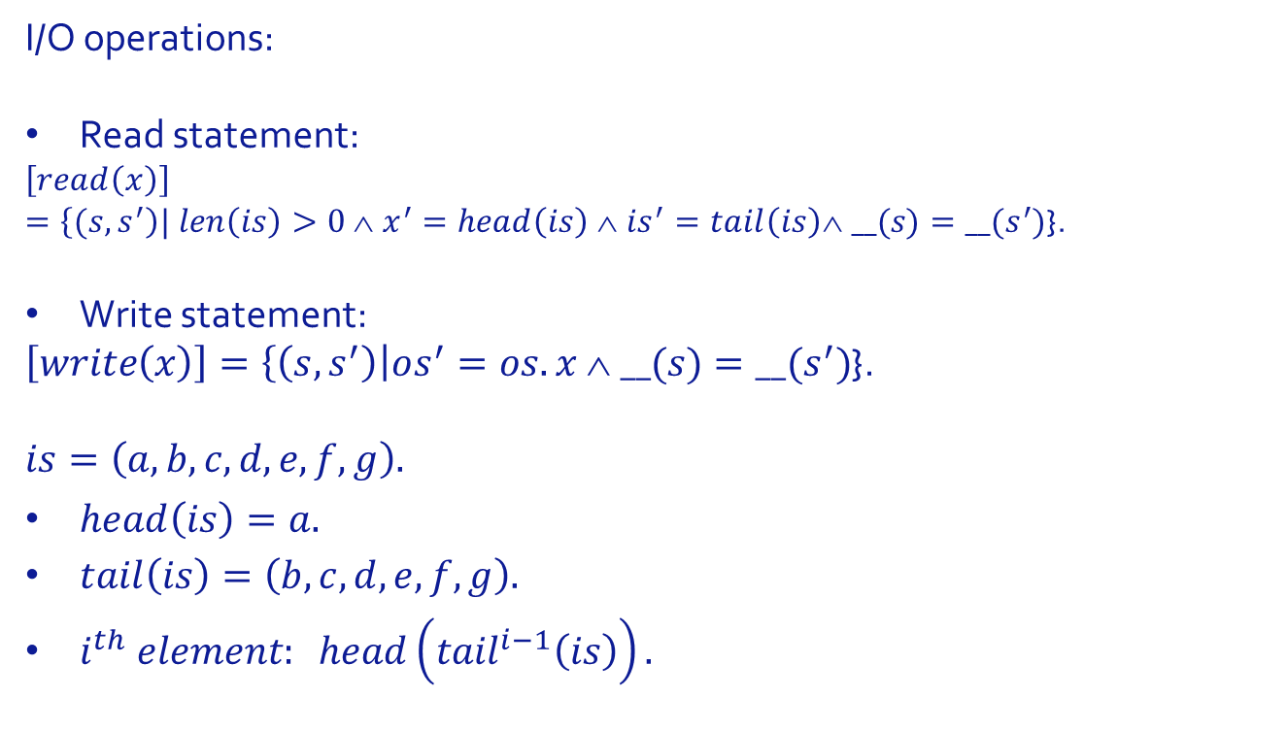
Paths and Path Condition
I/O operations:
Read statement:
$$\left[read\left(x\right)\right]$$
$=\left\{(s,s^{′}\right)| len\left(is\right)>0 ∧ x^{′}=head\left(is\right) ∧ is^{′}=tail\left(is\right)∧ __(s)=__(s^{′})$}.
Write statement:
$\left[write\left(x\right)\right]=\left\{\left(s,s^{′}\right)\right|os^{′}=os.x ∧ __(s)=__(s^{′})$}.
$$is=\left(a,b,c,d,e,f,g\right).$$
$head\left(is\right)=a.$
$tail\left(is\right)=\left(b,c,d,e,f,g\right).$
$i^{th} element: head\left({tail}^{i−1}\left(is\right)\right).$

Slide 15
Paths and Path Condition
Now that we know how to compute the function of each node of a path, we need to know how to compose them:

Slide 16
Paths and Path Condition
Now that we know how to compute the function of each node of a path, we need to know how to compose them:

Slide 17
Paths and Path Condition
Application:

Slide 18
Paths and Path Condition
Application: {(s,s’)| x=2y ^ x’=x-y ^ y’=y}

Slide 19
Paths and Path Condition
Application:

Slide 20
Paths and Path Condition
Application:

Slide 21
Paths and Path Condition
Illustration, consider the following path:
We find the following function:

Slide 22
Paths and Path Condition
We find the following function:
Interpretation:
This path is taken if the input includes at least two values (since we read it from it twice), and if the first value of the input (say x) and the second value (say y) satisfy the condition 5x=3y. Once the path is executed, x takes value 2x-y and y takes value 2y-3x.
Sample test data: x=15, y=25. 2x-y=2y-3x=5.

Slide 23
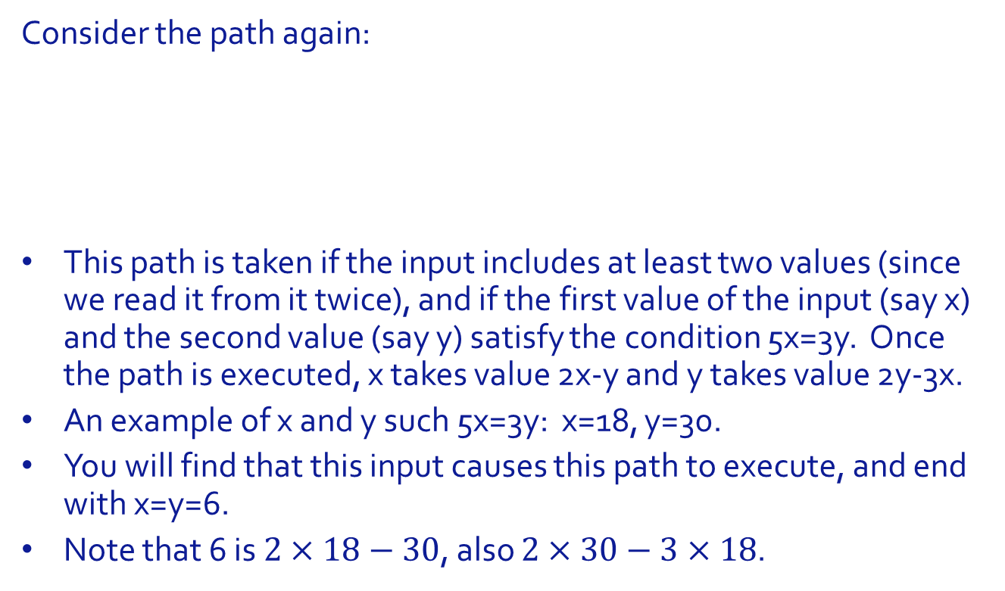
Paths and Path Condition
Consider the path again:
This path is taken if the input includes at least two values (since we read it from it twice), and if the first value of the input (say x) and the second value (say y) satisfy the condition 5x=3y. Once the path is executed, x takes value 2x-y and y takes value 2y-3x.
An example of x and y such 5x=3y: x=18, y=30.
You will find that this input causes this path to execute, and end with x=y=6.
Note that 6 is $2×18−30$, also $2×30−3×18$.

Slide 24
Paths and Path Condition
For the sake of test data generation, what interests us most is the condition under which any particular path is taken.:
The condition of a path is the domain of the path function.
In other words, to derive the condition under which a path is taken, we compute its function, then we extract the domain of the function.

Slide 25
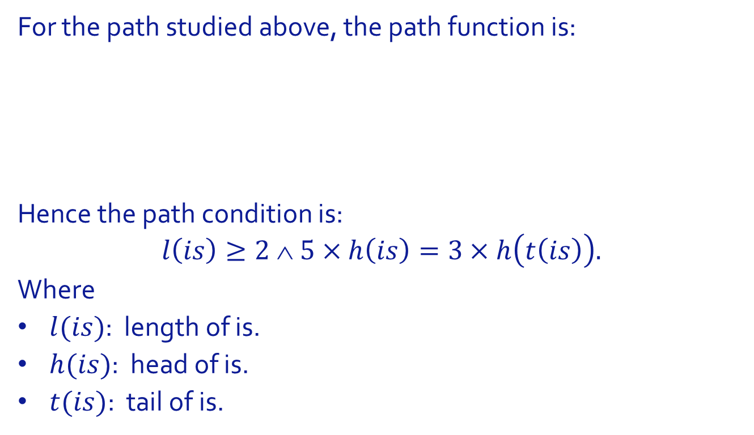
Paths and Path Condition
For the path studied above, the path function is:
Hence the path condition is:
$$l\left(is\right)≥2 ∧ 5×h\left(is\right)=3×h\left(t\left(is\right)\right).$$
Where
$l(is)$: length of is.
$h(is)$: head of is.
$t(is)$: tail of is.

Slide 26
Paths and Path Condition
Trace of Execution:

Slide 27
Paths and Path Condition
Flowchart showing the path in question:

Slide 28
Paths and Path Condition
Exercise:
Generate path conditions for all the paths catalogued in pages 10 and 11.
For each path, generate test data that activates the path.

Slide 29
Structural Criteria
Paths and Path Conditions
Control Flow Coverage
Data Flow Coverage
Fault-Based Test Generation
Chapter Summary

Slide 30
Control Flow Coverage
Statement Coverage
We want to select test data that enables us to execute each statement of the program at least once.
If we want to execute a particular statement, it suffices to:
Find a path that reaches the statement.
Compute its path condition.
Derive test data that satisfies the path condition.
Though generally, we can cover several (all?) the statements in a single path.

Slide 31
Control Flow Coverage
Statement Coverage
Example: Program, P
Path,

Slide 32
Control Flow Coverage
Statement Coverage
Path Function:
Path Condition:
Test Data:

Slide 33
Control Flow Coverage
Statement Coverage
We can try to cover the program with two paths:
Avoid fault interactions.
Reduce likelihood of fault masking.
Exercise: Generate test data for these two paths.

Slide 34
Control Flow Coverage
Condition Coverage
Whenever we have a condition in the program (in an if-then-else, if-then, while-do)
We isolate the terms of the condition,
We generate test data that causes each term to take value TRUE, and other data to yield value FALSE.
If a condition has the form (a&&b||c&&d), we apply this rule to each of a, b, c, d.

Slide 35
Control Flow Coverage
Branch Coverage
This criterion provides for generating test data so that each branch of the program (in an if-then, if-then-else, while-do) gets exercised in each direction (TRUE and FALSE).

Slide 36
Control Flow Coverage
Branch Coverage
Illustration:
Triangle
Program.

Slide 37
Control Flow Coverage
Branch Coverage
Illustration:
Sufficient
set of
Paths

Slide 38
Control Flow Coverage
Branch Coverage
Illustration: Checking Branch Coverage
Branch | TRUE | FALSE
!tri(x,y,z) | p1 | p2, p3, p4, p5, p6
equi(x,y,z) | p2, | p3, p4, p5, p6
iso(x,y,z) | p3, p4 | p5, p6
right(x,y,z) | p3, p5 | p4, p6

Slide 39
Control Flow Coverage
Branch Coverage
Path conditions, test data

Slide 40
Control Flow Coverage
Branch Coverage
Exercise: Apply the branch coverage criterion to the GCD program discussed earlier.

Slide 41
Control Flow Coverage
Condition Coverage
The same as branch coverage, but with individual terms of branch conditions:
For example, if the branch condition has the form (a&&b||c) then we must find test data to cause each of a, b, and c to take values TRUE and FALSE.

Slide 42
Control Flow Coverage
Condition Coverage
The same as branch coverage, but with individual terms of branch conditions:
For example, if the branch condition has the form (a&&b||c) then we must find test data to cause each of a, b, and c to take values TRUE and FALSE.
If you have path P that ends in condition a, and you want to restrict the path so that it ends with a false, then all you do:
P; (a? false).
Compute the function of the new path.
Its domain: the condition under which upon execution of P, a will be false.

Slide 43
Control Flow Coverage
Condition Coverage
Illustration: a version of the triangle program that includes compound conditions.

Slide 44
Control Flow Coverage
Condition Coverage
Test data for TRUE and FALSE outcomes of each term.

Slide 45
Control Flow Coverage
Path Coverage
Generate test data to execute/ exercise every path of the program. If the program has no loops, then the number of paths is finite.

Slide 46
Control Flow Coverage
Path Coverage
Illustration:
Nested
Version of
Triangle
Program

Slide 47
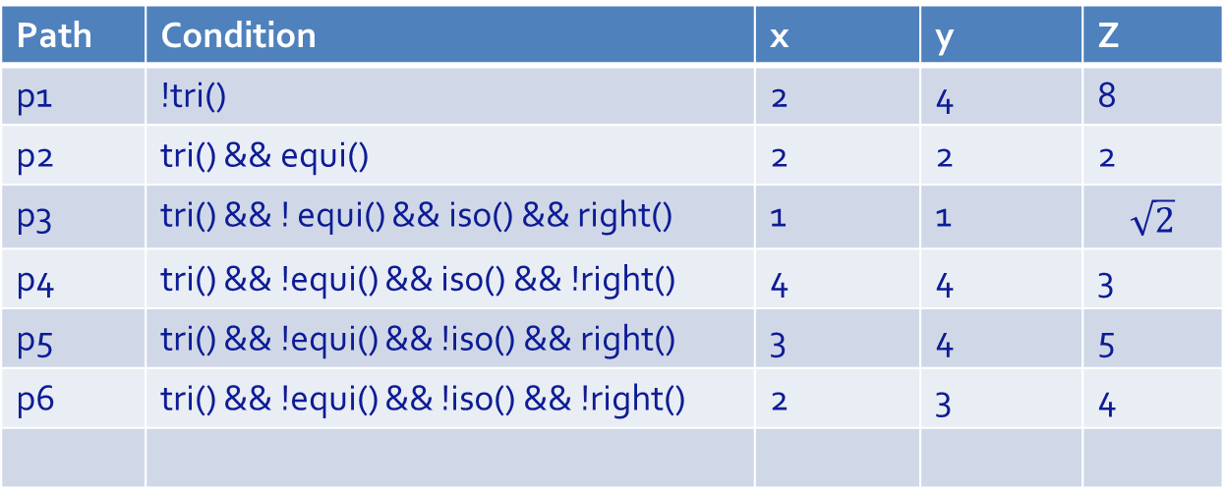
Control Flow Coverage
Path Coverage
Illustration: Path Condition and Test Data.
Path | Condition | x | y | Z
p1 | !tri() | 2 | 4 | 8
p2 | tri() && equi() | 2 | 2 | 2
p3 | tri() && ! equi() && iso() && right() | 1 | 1 | $$\sqrt{2}$$
p4 | tri() && !equi() && iso() && !right() | 4 | 4 | 3
p5 | tri() && !equi() && !iso() && right() | 3 | 4 | 5
p6 | tri() && !equi() && !iso() && !right() | 2 | 3 | 4

Slide 48
Control Flow Coverage
Path Coverage
Illustration:
Sequential
Version of
Triangle
Program

Slide 49

Control Flow Coverage
Path Coverage
Six binary conditions in sequence, but not $2^{6}$ paths:

Slide 50
Control Flow Coverage
Path Coverage
Path conditions, test data:

Slide 51
Control Flow Coverage
Path Coverage
Example with Loop:
We resolve to generate paths that include no more than 3 iterations.

Slide 52
Control Flow Coverage
Path Coverage

Slide 53
Control Flow Coverage
Path Coverage

Slide 54
Control Flow Coverage
Path Coverage

Slide 55
Control Flow Coverage
Path Coverage
Test data

Slide 56
Structural Criteria
Paths and Path Conditions
Control Flow Coverage
Data Flow Coverage
Fault-Based Test Generation
Chapter Summary

Slide 57
Data Flow Coverage
Definitions and Uses
Lifecycle of a variable in a program
Declaration.
Definition: assignment of a value.
Use:
C-use: variable used in an expression.
P-use: variable used in a condition.
Termination: end of scope (e.g. exit from block where variable is declared).

Slide 58
Data Flow Coverage
Definitions and Uses
Illustration:

Slide 59
Data Flow Coverage
Definitions and Uses
Importance of Lifecycle: It may expose faults or suspicious behaviors. Examples of Faults:
A use precedes a definition; use without definition.
A variable is used or defined after termination.
Suspicious behaviors:
Successive definitions without uses in between.
Definition termination without use in between.

Slide 60
Data Flow Coverage
Definitions and Uses
Test Generation Criteria:
All definition-use paths. A path is said to be a definition-use (du) path for some program variable x if and only if it starts with a definition of x and ends with a use of x.
The criterion of all du-paths provides that we must generate test data to execute/ exercise all the du-paths of all the variables of the program.

Slide 61
Data Flow Coverage
Definitions and Uses
All du-paths Process:
List all the variables of the program.
For each variable, list all definitions and all uses.
For each definition/use pair, check existence of execution path from definition to use.
For all paths identified in previous step, find pre-path and post-path.
For each triplet pre/path/post, compute the function of the aggregate path.
Compute the domain of the function.
Generate test data that falls in the domain.

Slide 62
Data Flow Coverage
Definitions and Uses
All p-uses.
A definition-clear path for some variable x is a du-path whose definition is unique (no subsequent definition in the path).
A p-use path is a definition-clear path that ends in a p-use.
The criterion of all p-uses mandates that we generate test data to execute/ exercise all p-use paths.
Same process as du-paths, but focusing on p-uses.

Slide 63
Data Flow Coverage
Definitions and Uses
All c-uses.
A c-use path is a definition-clear path that ends in a c-use.
The criterion of all c-uses mandates that we generate test data to execute/ exercise all c-use paths.
Same process as du-paths, but focusing on c-uses.

Slide 64
Data Flow Coverage
Definitions and Uses
All uses.
Union of the test data generated for all p-uses and for all c-uses.
All Definitions.
Generate test data to ensure that all data definitions are executed at least once.

Slide 65
Data Flow Coverage
Definitions and Uses
Illustration: the GCD program.
All du-paths for variable x.
Definitions: lines 2, 6.
Uses: 4, 5, 6, 8, 9.
Definition use path: [2,3,4]
Pre-path is empty.
Post-path: infinity, we select one at will:

Slide 66
Data Flow Coverage
Definitions and Uses
Path Function:
Domain:
Test Data:

Slide 67
Data Flow Coverage
Definitions and Uses
All p-uses:
The following table shows definitions and p-uses of the GCD program for variables x and y.

Slide 68
Data Flow Coverage
Definitions and Uses
All c-uses:
The following table shows definitions and c-uses of the GCD program for variables x and y.

Slide 69
Data Flow Coverage
Definitions and Uses
All uses:
The union of the test data generated by the previous criteria.
All Definitions:
Test data to executed all the definition statements: 2, 6 for x; 3, 8 for y.

Slide 70
Data Flow Coverage
A Hierarchy of Criteria
The test generation criteria considered so far can be ranked according to the following graph. Relation: data generated by the higher criterion a superset of that generated by lower criterion.

Slide 71
Structural Criteria
Paths and Path Conditions
Control Flow Coverage
Data Flow Coverage
Fault-Based Test Generation
Chapter Summary

Slide 72
Fault based Test generation
Question: How to generate test data to expose specific types of faults? This technique applies to faults in Boolean conditions, and include the following types:
Variable Reference Fault. Invoking the wrong variable.
Variable Negation Fault. Variable is replaced by its negation.
Expression Negation Fault. Boolean expression is replaced by its negation.
Associative Shift Fault. Incorrect parenthetization.
Operator Reference Fault. Use of incorrect Boolean operator.
Relational Operator Fault. Use of incorrect relation operator.

Slide 73
Fault based Test generation
Three conditions/ steps to expose these faults:
Sensitize the fault. Characterize local conditions that must prevail to highlight the presence of the fault.
Activate the fault. Determine what program input will create these local conditions.
Propagate the error. Ensure that the error created by the sensitization of the fault propagate onto an observable output.

Slide 74
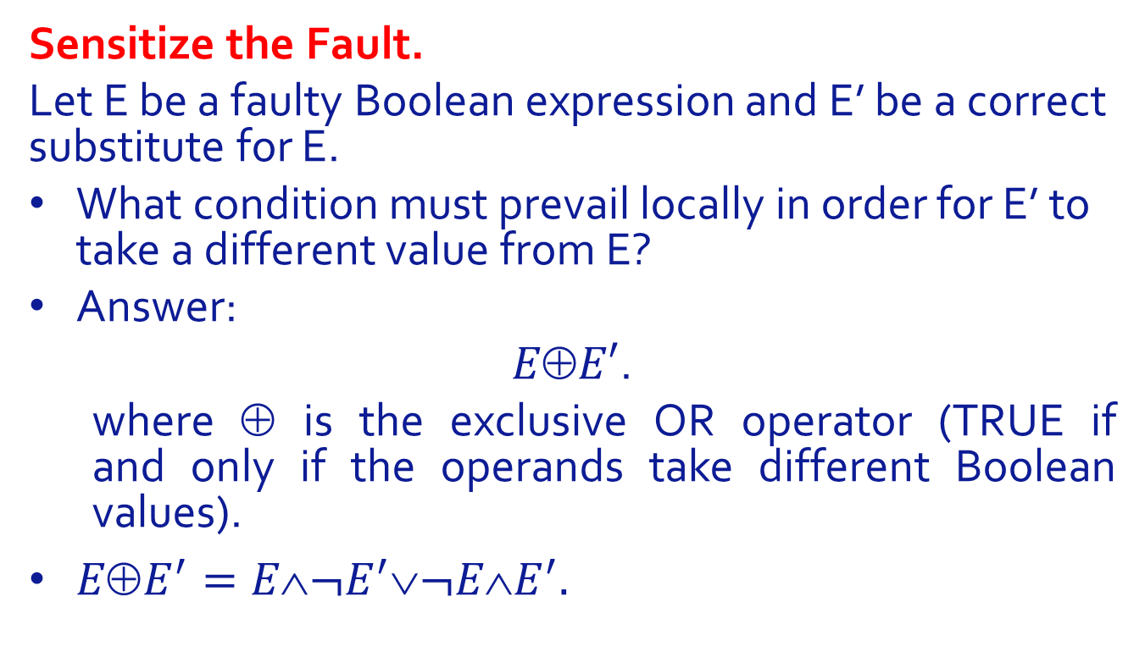
Fault based Test generation
Sensitize the Fault.
Let E be a faulty Boolean expression and E’ be a correct substitute for E.
What condition must prevail locally in order for E’ to take a different value from E?
Answer:
$EE′$.
where $$ is the exclusive OR operator (TRUE if and only if the operands take different Boolean values).
$EE^{′}=E¬E^{′}¬EE^{′}.$

Slide 75
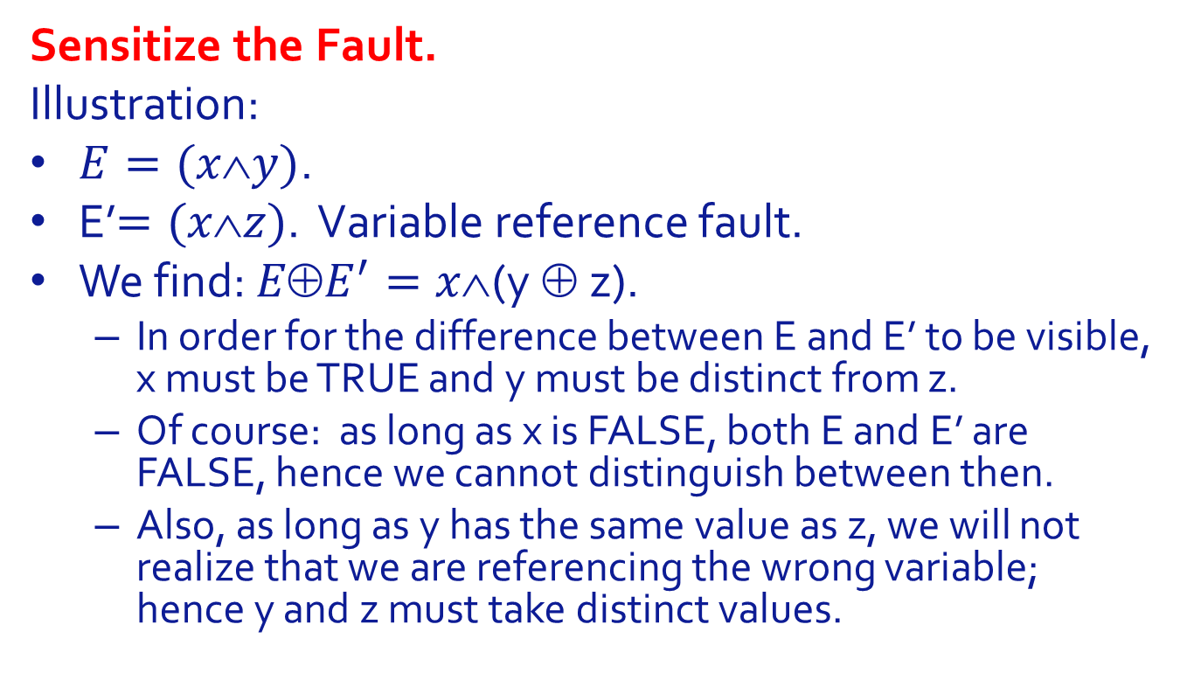
Fault based Test generation
Sensitize the Fault.
Illustration:
$E=(xy)$.
E’$=(xz)$. Variable reference fault.
We find: $EE^{′}=x$(y $$z).
In order for the difference between E and E’ to be visible, x must be TRUE and y must be distinct from z.
Of course: as long as x is FALSE, both E and E’ are FALSE, hence we cannot distinguish between then.
Also, as long as y has the same value as z, we will not realize that we are referencing the wrong variable; hence y and z must take distinct values.

Slide 76
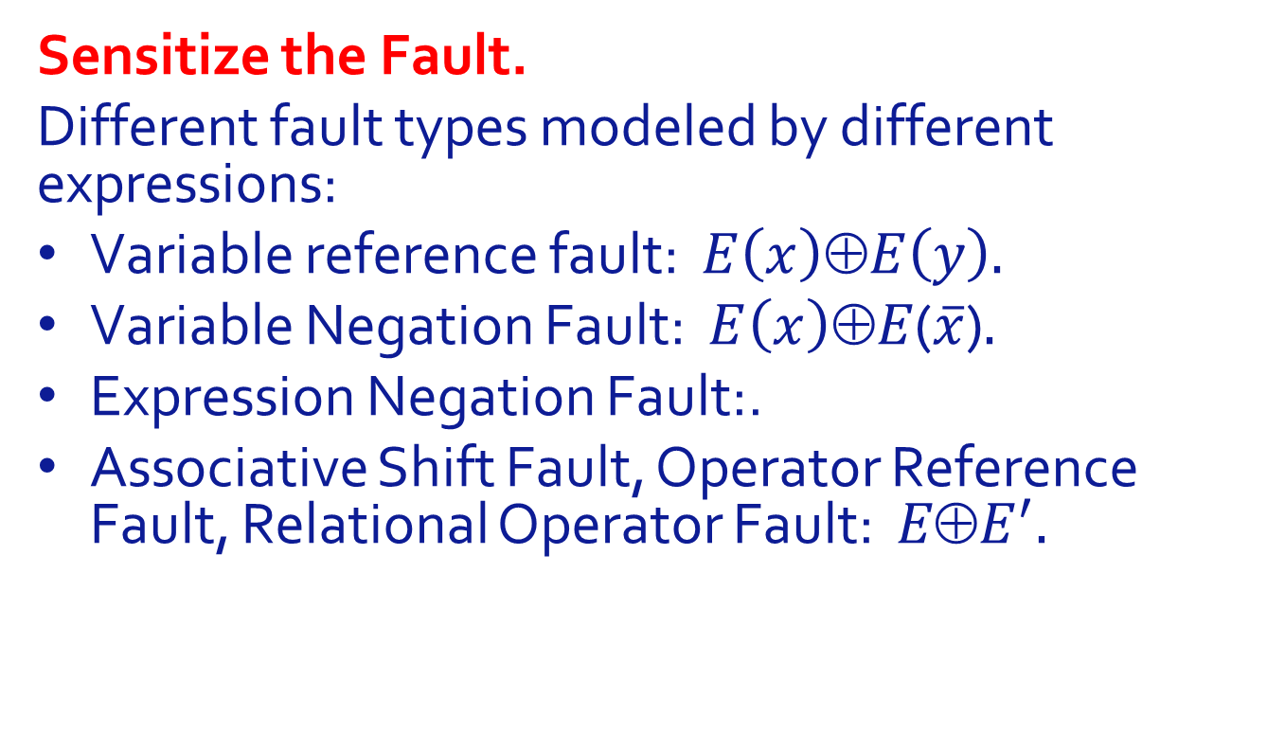
Fault based Test generation
Sensitize the Fault.
Different fault types modeled by different expressions:
Variable reference fault: $E\left(x\right)⊕E\left(y\right).$
Variable Negation Fault: $E\left(x\right)⊕E$($\overline{x}$)$.$
Expression Negation Fault:.
Associative Shift Fault, Operator Reference Fault, Relational Operator Fault: $EE^{′}.$

Slide 77

Fault based Test generation
Sensitize the Fault.
Associative Shift Fault. $E=xyz$, $E^{′}=x∧\left(y∨z\right).$ We find (as shown below: $E⊕E^{′}=\left(z∧\overline{x}\right).$

Slide 78
Fault based Test generation
Generating an Input that Triggers Sensitization
The sensitization conditions that we have discussed earlier are local conditions (at the location of the fault); now we investigate what inputs/ initial states create these local conditions.

Slide 79
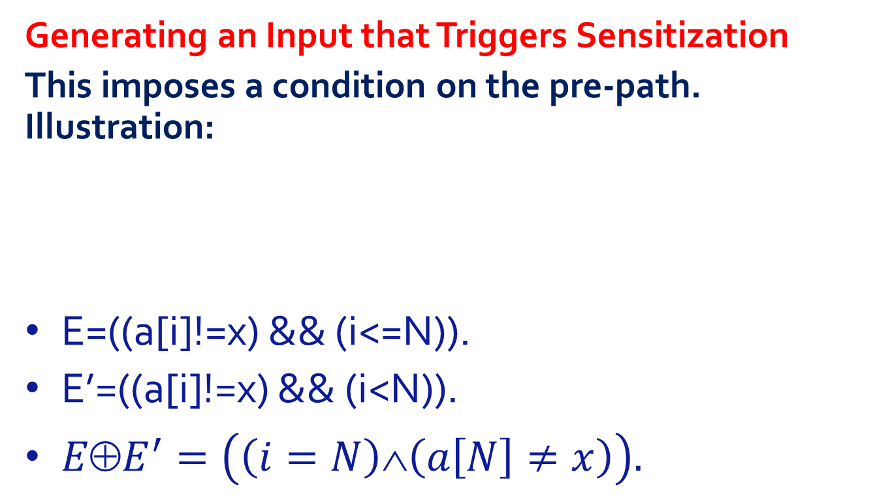
Fault based Test generation
Generating an Input that Triggers Sensitization
This imposes a condition on the pre-path. Illustration:
E=((a[i]!=x) && (i<=N)).
E’=((a[i]!=x) && (i<N)).
$E⊕E^{′}=\left(\left(i=N\right)∧\left(a\left[N\right]≠x\right)\right).$

Slide 80

Fault based Test generation
Generating an Input that Triggers Sensitization
Path:
Path Function:
Path Function, Post restricted to $EE^{′}$:

Slide 81
Fault based Test generation
Generating an Input that Triggers Sensitization
Program
Domain of this path:
Interpretation: By ensuring that the condition (a[j]≠x) holds for all j, we ensure that the condition of the loop is equivalent to (i<=N). That way, we make it possible to distinguish between (i<=N) and (i<N).

Slide 82
Fault based Test generation
Generating an Input for Error propagation
Generating a different local outcome is not sufficient; it is necessary to ensure that the different outcome is propagated to an observable output.

Slide 83
Fault based Test generation
Generating an Input for Error propagation
Illustration
We consider the fault we alluded to earlier: (i<=N) → (i<N).
We know the input condition that sensitizes that fault:

Slide 84
Fault based Test generation
Generating an Input for Error propagation
Illustration
We let G and G’ be the functions of this program as is, and (resp.) with (i<N):
Because the outputs are distinct, the error generated by the fault is propagated.

Slide 85
Structural Criteria
Paths and Path Conditions
Control Flow Coverage
Data Flow Coverage
Fault-Based Test Generation
Chapter Summary

Slide 86
Chapter Summary
This chapter discusses criteria for data selection that are based on an analysis of the program’s source code. Three families of criteria:
Criteria that aim to achieve control flow coverage.
Criteria that aim to achieve data flow coverage.
Criteria that aim to achieve fault coverage.
All require a detailed/ tedious/ labor-intensive analysis of the program.
We must not lose sight of the return on investment of our effort.
Consider automation.
Compare with specification-based random generation.
Keep in mind the dilemma of using the program to test the program.

Slide 87
Structural Criteria
Paths and Path Conditions
Control Flow Coverage
Data Flow Coverage
Fault-Based Test Generation
Chapter Summary

