Slide 1
Chapter 13 Test Outcome Analysis

Slide 2
Test Driver Design
After we have gone through the trouble of:
Generating test data,
Deriving a test oracle,
Designing a test driver,
Running the test (executing the program on the test data, checking it against oracle),
Collected data about the outcome of the test,
It is time to ask the question:
So what? What can we conclude? What claims can we make?
This question is the focus of this chapter.

Slide 3
Test Driver Design
Two types of claims:
Logical Claims
Claims of correctness.
Stochastic Claims
Fault density
Failure probability (aka Reliability)

Slide 4
Test Driver Design
Logical Claims
Concrete Testing
Symbolic Testing
Concolic Testing
Stochastic Claims: Fault Density
Stochastic Claims: Failure Probability
Faults are Not Created Equal
Defining Quantifying Reliability
Modeling Software Reliability
Certification Testing
Reliability Estimation, Reliability Growth
Reliability Standards
Reliability as an Economic Function
Chapter Summary

Slide 5
Logical Claims
Concrete Testing
We consider a program g, a specification R, a test data T.
We test program g on test data T against the oracle derived from specification R.
It runs successfully for all data in T.
What can we say about program g?
It all depends what we mean by: it runs successfully on T.
Whenever the oracle is invoked, it returns TRUE?
If the program does not terminate, the oracle is not invoked.
For all data in T, program g terminates, and when the oracle is invoked upon the termination of g, it returns TRUE?

Slide 6
Logical Claims
Concrete Testing
If we take the second interpretation:
Whenever the oracle is invoked, it returns TRUE.
If the program does not terminate, the oracle is not invoked.
We get the following result:

Slide 7
Logical Claims
Testing by Symbolic Execution
Rather than testing program by running it on actual data.
Analyzing its behavior on symbolic test data.
Very difficult, as it assumes that we can capture the function of a program (with arbitrary control structures, arbitrary data structures).
In addition to being difficult/ error prone/ tedious,
Also often wasteful, as it may force us to analyze functional details of a program that may be of little relevance.
Example: binary search of item x in array a: how are the final values of low and high dependent on a and x? Very difficult to capture.
Yet for all intents are purposes the final values of low and high are irrelevant. What matters: a[i’]=x.

Slide 8
Logical Claims
Testing by Symbolic Execution
If we can actually derive the function of the program, we can check correctness properties.

Slide 9
Logical Claims
Concolic Testing
A combination of concrete testing and symbolic testing.

Slide 10
Logical Claims
Concolic Testing
Concrete testing on actual data,
But uses symbolic execution to compute path conditions and control path coverage.
Focus on execution paths, rather than closed form control structures, targeting path conditions rather than path functions,
Obviates some of the difficulties of symbolic execution.
Systematic approach to path coverage,
Achieves some degree of efficiency,
Each test datum exercises a distinct execution path.

Slide 11
Test Outcome Analysis
Logical Claims
Concrete Testing
Symbolic Testing
Concolic Testing
Stochastic Claims: Fault Density
Stochastic Claims: Failure Probability
Faults are Not Created Equal
Defining Quantifying Reliability
Modeling Software Reliability
Certification Testing
Reliability Estimation, Reliability Growth
Reliability Standards
Reliability as an Economic Function
Chapter Summary

Slide 12
Stochastic Claims: Fault Density
Testing provides little in terms of logical claims.
How about stochastic claims?
First: using testing to estimate fault density (# faults/ KLOC).
Approach:
Seed faults (insert artificial faults into the code).
Run tests, count how many seeded faults are uncovered by the test.
How many unseeded faults are uncovered by the test.
Assume that the test has uncovered the same proportion of seeded and unseeded faults.
Estimate the total number of unseeded faults.

Slide 13
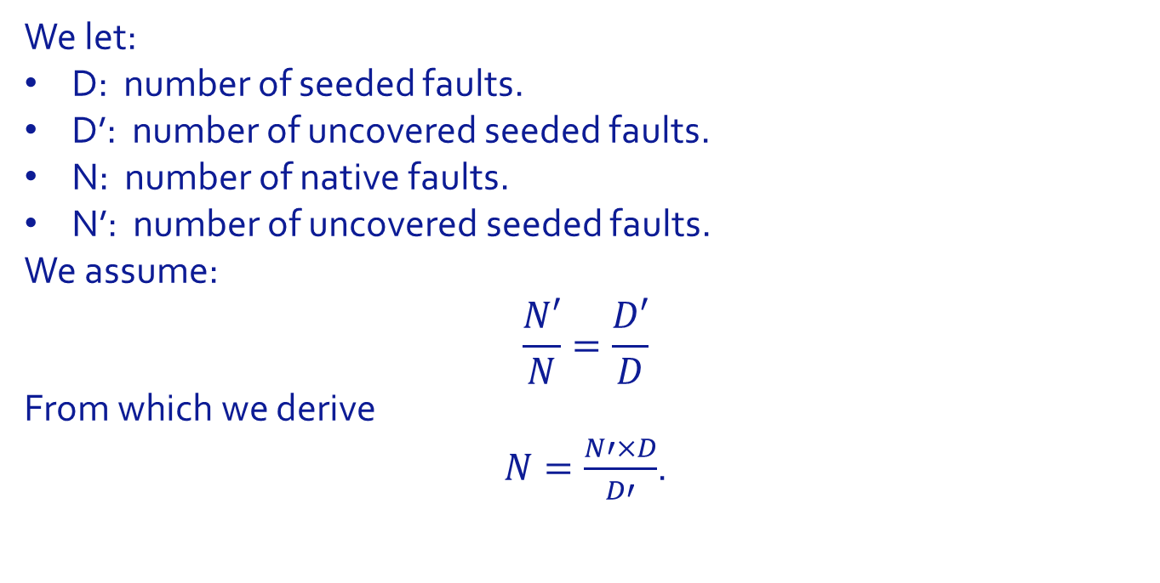
Stochastic Claims: Fault Density
We let:
D: number of seeded faults.
D’: number of uncovered seeded faults.
N: number of native faults.
N’: number of uncovered seeded faults.
We assume:
$$\frac{N′}{N}=\frac{D′}{D}$$
From which we derive
$N=\frac{N′×D}{D′}$.

Slide 14
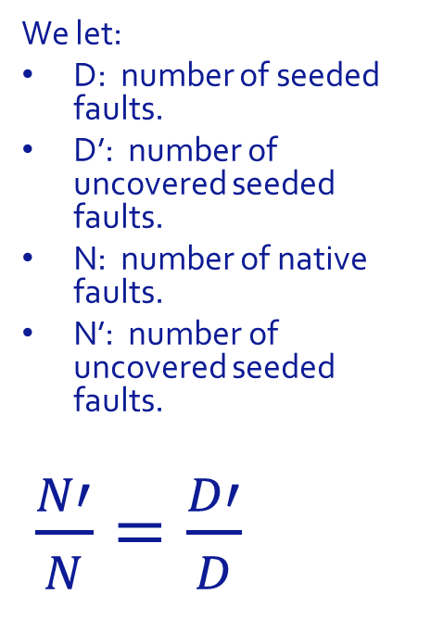
Stochastic Claims: Fault Density
We let:
D: number of seeded faults.
D’: number of uncovered seeded faults.
N: number of native faults.
N’: number of uncovered seeded faults.
$\frac{N′}{N}=\frac{D′}{D}$

Slide 15
Stochastic Claims: Fault Density
Cross Testing:
T1, T2: two test data sets.
F1, F2: sets of faults exposed by (resp.) T1, T2.
Q: set of faults exposed by both T1 and T2.
N: total number of faults estimated to be in the program.
Assumption: Among the faults uncovered by T1, the ration of those that are also uncovered by T2 is the same as the ratio of faults uncovered by T2 over the total number of faults.

Slide 16
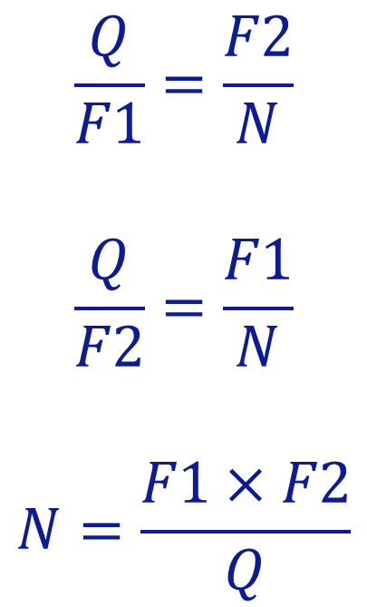
Stochastic Claims: Fault Density
$$\frac{Q}{F1}=\frac{F2}{N}$$
$$\frac{Q}{F2}=\frac{F1}{N}$$
$$N=\frac{F1×F2}{Q}$$

Slide 17
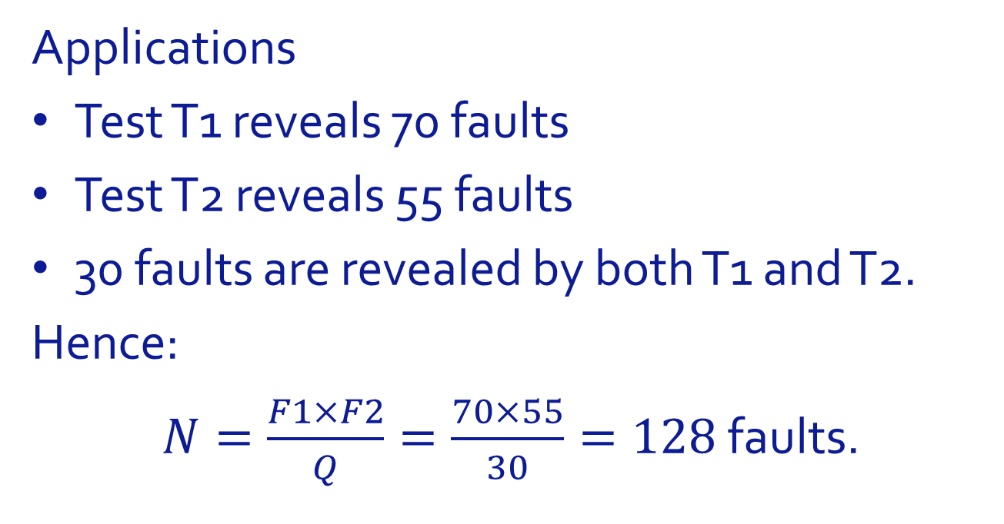
Stochastic Claims: Fault Density
Applications
Test T1 reveals 70 faults
Test T2 reveals 55 faults
30 faults are revealed by both T1 and T2.
Hence:
$N=\frac{F1×F2}{Q}=\frac{70×55}{30}=128$faults.

Slide 18
Test Driver Design
Logical Claims
Concrete Testing
Symbolic Testing
Concolic Testing
Stochastic Claims: Fault Density
Stochastic Claims: Failure Probability
Faults are Not Created Equal
Defining Quantifying Reliability
Modeling Software Reliability
Certification Testing
Reliability Estimation, Reliability Growth
Reliability Standards
Reliability as an Economic Function
Chapter Summary

Slide 19
Stochastic Claims: Failure Probability
Faults are Not Created Equal
Trying to estimate fault density is an interesting exercise, but fault density is not a very meaningful metric.
Faults are not a uniform feature, they depend on each other, and they are difficult to account for.
If we have N faults and we remove one, we do not necessarily get N-1 faults.
Faults are not created equal: some faults have much more impact on failure probability than others.
From the standpoint of a user, failure probability is a more meaningful metric than fault density. The former is a direct, observable, usable attribute; the latter an obscure concept.

Slide 20
Test Driver Design
Defining/ Quantifying Reliability
Correctness is a logical property: a program satisfies its specification.
Reliability is a stochastic property: likelihood of the program to satisfy its specification.
Measures of reliability:
Probability that a random execution completes without failure (satisfies its specification).
Mean time to the next failure (MTTF).
Mean time between failures (MTBF).
Mean number of failures per unit of time.
Probability of failure free operation per unit of time.

Slide 21
Test Driver Design
Defining/ Quantifying Reliability
References to time in above definitions require a clarification:
For real-time systems (process control, flight control, autonomous vehicle, electric grid, telephone switch), time is real clock time.
The MTTF of a modern passenger airplane is in the tens of thousands of hours, i.e. when we take a five-hour flight, the probability of an accident during this flight is so minuscule that we do not think about it.
For transaction processing systems (e.g. an e-commerce system), reliability can be quantified as probability of failure free operation over number of transactions.
For simple input/output programs (a sort routine), reliability can be quantified as the probability of failure-free operation over the number of invocations/ executions.

Slide 22
Test Driver Design
Logical Claims
Concrete Testing
Symbolic Testing
Concolic Testing
Stochastic Claims: Fault Density
Stochastic Claims: Failure Probability
Faults are Not Created Equal
Defining Quantifying Reliability
Modeling Software Reliability
Certification Testing
Reliability Estimation, Reliability Growth
Reliability Standards
Reliability as an Economic Function
Chapter Summary

Slide 23
Test Driver Design
Modeling Software Reliability
Software reliability model: statistical model that represents the reliability of a software product as a function of relevant parameters. Classification of models according to:
Time Domain. Real-time vs number of executions vs frequency of control loop.
Type. Probability distribution function of the number of failures as a function of time.
Category. Two categories, depending on number of failures over infinite time.
Finite failure. Failure intensity as a function of time.
Infinite failure. Failure intensity as a function of the number of observed failure.

Slide 24
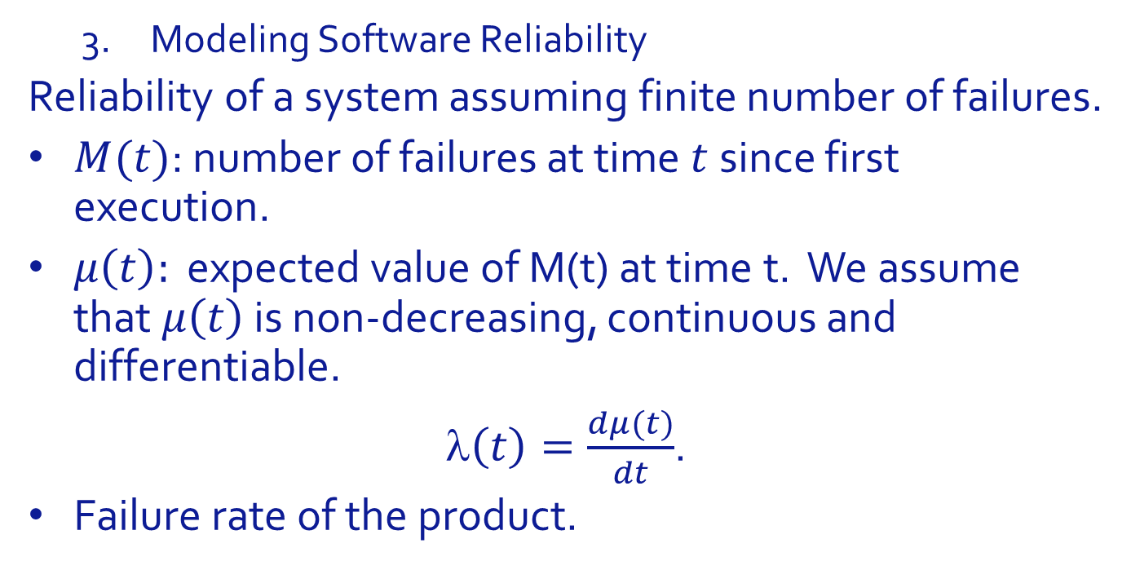
Test Driver Design
Modeling Software Reliability
Reliability of a system assuming finite number of failures.
$M(t)$: number of failures at time $t$ since first execution.
$μ\left(t\right):$ expected value of M(t) at time t. We assume that $μ\left(t\right)$ is non-decreasing, continuous and differentiable.
$\left(t\right)=\frac{dμ(t)}{dt}$.
Failure rate of the product.

Slide 25
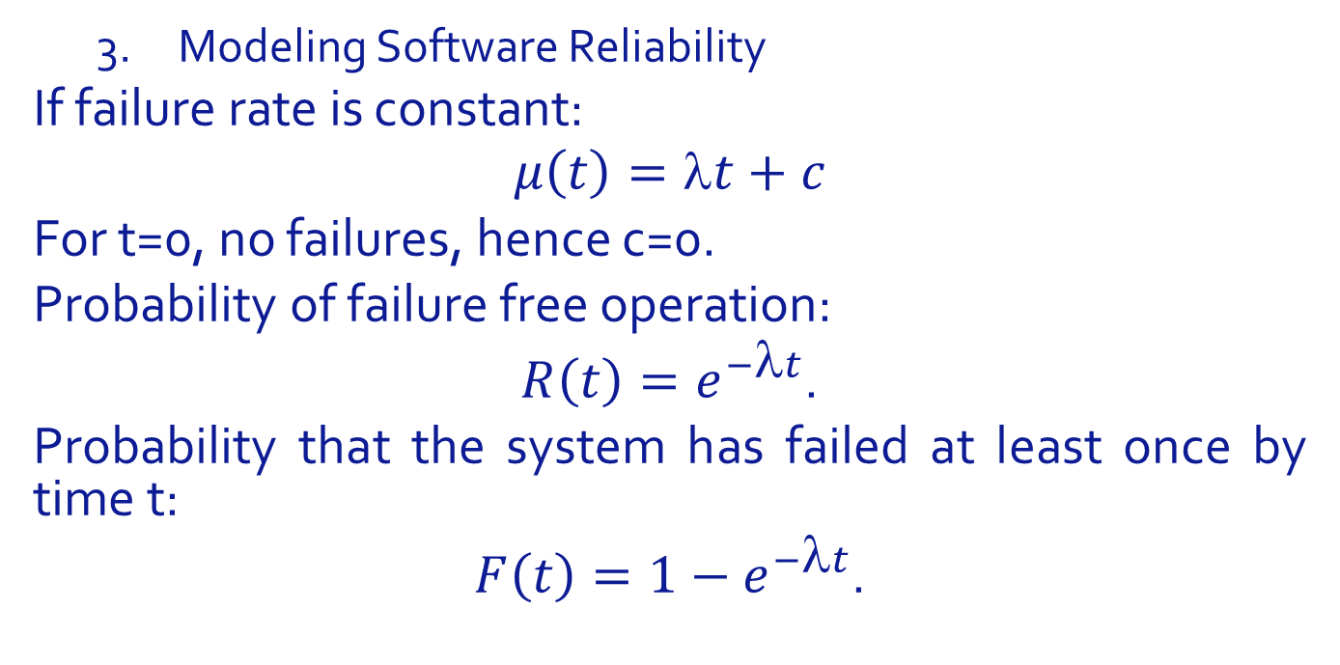
Test Driver Design
Modeling Software Reliability
If failure rate is constant:
$$μ\left(t\right)=λt+c$$
For t=0, no failures, hence c=0.
Probability of failure free operation:
$R\left(t\right)=e^{−λt}$.
Probability that the system has failed at least once by time t:
$F\left(t\right)=1−e^{−λt}$.

Slide 26
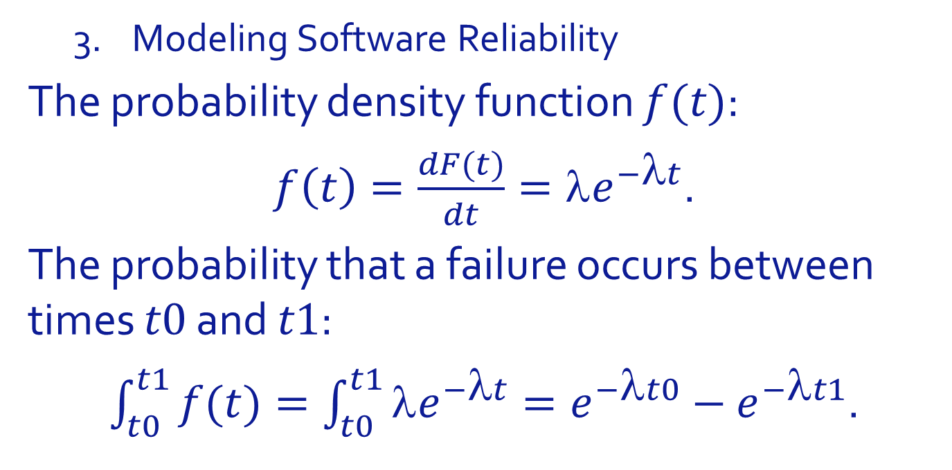
Test Driver Design
Modeling Software Reliability
The probability density function $f(t)$:
$f\left(t\right)=\frac{dF(t)}{dt}=λe^{−λt}$.
The probability that a failure occurs between times $t0$ and $t1$:
$\int_{t0}^{t1}{f(t)}=\int_{t0}^{t1}{λe^{−λt}}=e^{−λt0}−e^{−λt1}$.

Slide 27
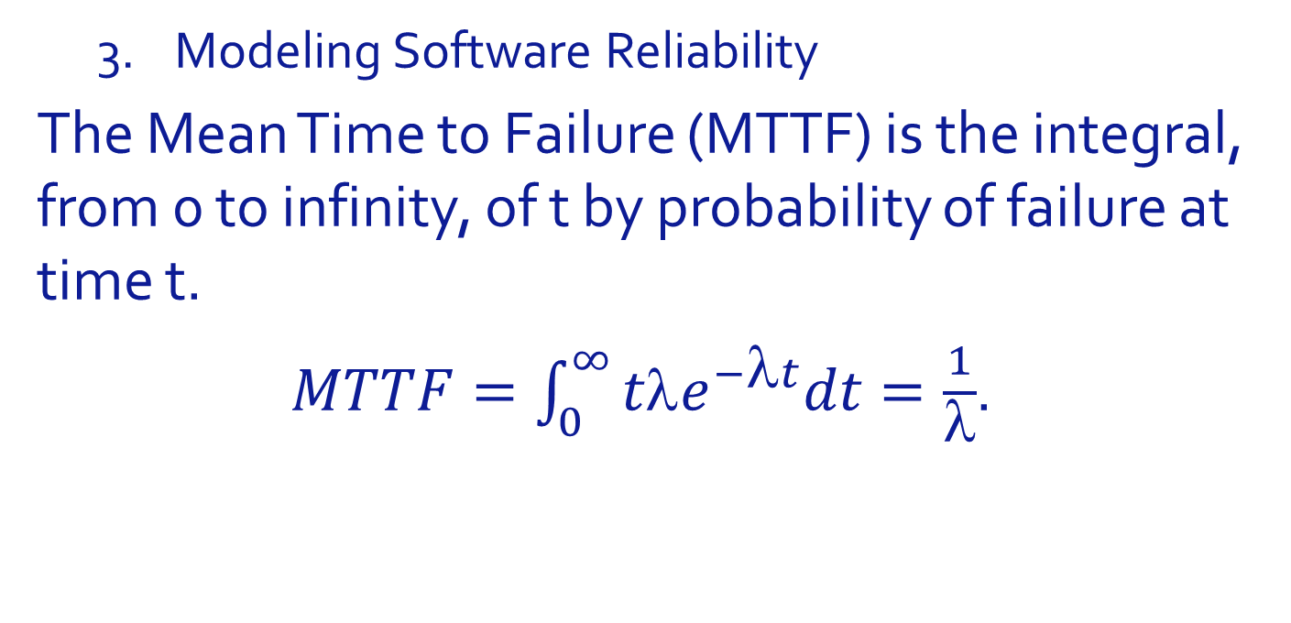
Test Driver Design
Modeling Software Reliability
The Mean Time to Failure (MTTF) is the integral, from 0 to infinity, of t by probability of failure at time t.
$MTTF=\int_{0}^{∞}{tλe^{−λt}dt}=\frac{1}{λ}$.

Slide 28
Test Driver Design
Modeling Software Reliability
For MTTF=10 000, probability of failure free operation.

Slide 29
Test Driver Design
Modeling Software Reliability
For MTTF=10 000, probability of failure within each interval.

Slide 30
Test Driver Design
Logical Claims
Concrete Testing
Symbolic Testing
Concolic Testing
Stochastic Claims: Fault Density
Stochastic Claims: Failure Probability
Faults are Not Created Equal
Defining Quantifying Reliability
Modeling Software Reliability
Certification Testing
Reliability Estimation, Reliability Growth
Reliability Standards
Reliability as an Economic Function
Chapter Summary

Slide 31
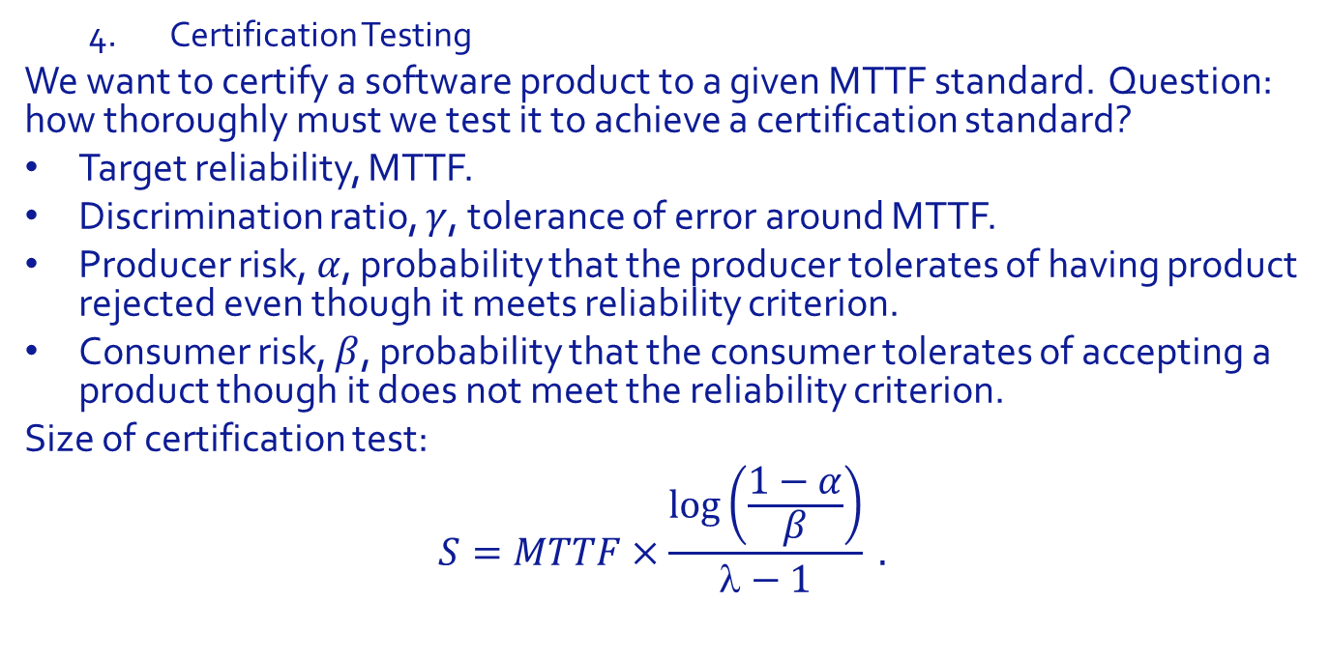
Test Driver Design
Certification Testing
We want to certify a software product to a given MTTF standard. Question: how thoroughly must we test it to achieve a certification standard?
Target reliability, MTTF.
Discrimination ratio, $γ$, tolerance of error around MTTF.
Producer risk, $α$, probability that the producer tolerates of having product rejected even though it meets reliability criterion.
Consumer risk, $β$, probability that the consumer tolerates of accepting a product though it does not meet the reliability criterion.
Size of certification test:
$$S=MTTF×\frac{\log\left(\frac{1−α}{β}\right)}{λ−1} .$$

Slide 32
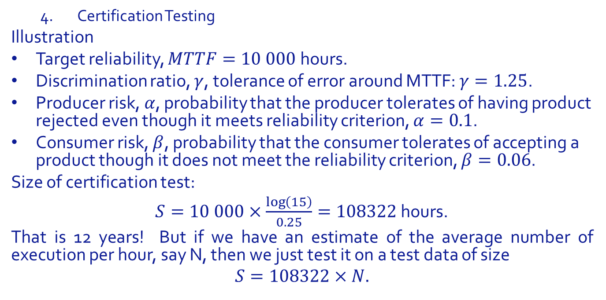
Test Driver Design
Certification Testing
Illustration
Target reliability, $MTTF=10 000$hours.
Discrimination ratio, $γ$, tolerance of error around MTTF: $γ=1.25$.
Producer risk, $α$, probability that the producer tolerates of having product rejected even though it meets reliability criterion, $α=0.1$.
Consumer risk, $β$, probability that the consumer tolerates of accepting a product though it does not meet the reliability criterion, $β=0.06$.
Size of certification test:
$S=10 000×\frac{\log\left(15\right)}{0.25}=108322$ hours.
That is 12 years! But if we have an estimate of the average number of execution per hour, say N, then we just test it on a test data of size
$$S=108322×N.$$

Slide 33
Test Driver Design
Reliability Estimation, Reliability Growth
One way to estimate the MTTF (MTBF?) of a software product: We consider
The software product, P.
The specification that it is supposed to satisfy, R.
A test oracle, Ω, derived from specification R.
A usage pattern, as a probability distribution over dom(R).
A test data generator, according to the usage pattern
We run the following experiment.
Test P over the test data generated by the test data generator, for sufficiently long.
Record the times between successive failures.
Take their average as the MTBF/ MTTF.

Slide 34
Test Driver Design
Reliability Estimation, Reliability Growth
… resulting MTTF estimate may fall short of target reliability.
And we may want to fix the product after each failure.
Cleanroom reliability testing is a disciplined attempt to do this.
Unit testing is replaced by static analysis.
Reliability testing replaces integration testing.
Reliability testing records all executions of the system starting from the very first.

Slide 35
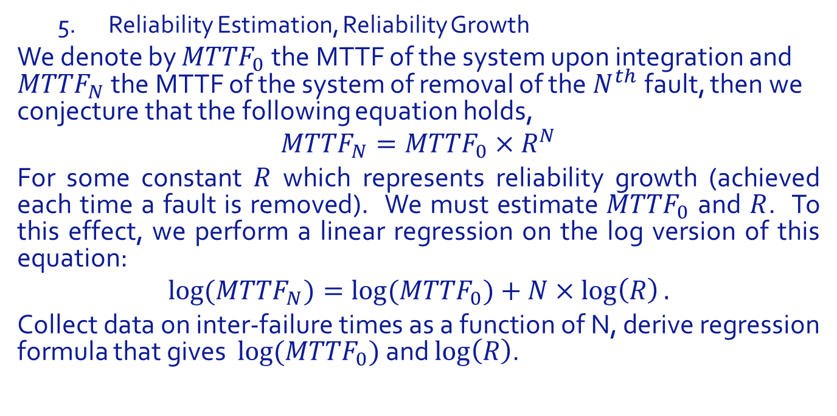
Test Driver Design
Reliability Estimation, Reliability Growth
We denote by ${MTTF}_{0}$the MTTF of the system upon integration and ${MTTF}_{N}$ the MTTF of the system of removal of the $N^{th}$fault, then we conjecture that the following equation holds,
$${MTTF}_{N}={MTTF}_{0}×R^{N}$$
For some constant $R$ which represents reliability growth (achieved each time a fault is removed). We must estimate ${MTTF}_{0}$ and $R$. To this effect, we perform a linear regression on the log version of this equation:
$${log⁡(MTTF}_{N})={log⁡(MTTF}_{0})+N×\log\left(R\right).$$
Collect data on inter-failure times as a function of N, derive regression formula that gives ${log⁡(MTTF}_{0})$ and $\log\left(R\right)$.

Slide 36
Test Driver Design
Reliability Estimation, Reliability Growth
Illustration:

Slide 37
Test Driver Design
Reliability Estimation, Reliability Growth
Illustration:
N | MTTF after N fault removed | Log(previous column)
0 | 24
1 | 20
2 | 36
3 | 400
4 | 510
5 | 10000
6 | XXXXXX (MTTF0 * R^6)

Slide 38

Test Driver Design
Reliability Estimation, Reliability Growth
Linear Regression:
$\log\left({MTTF}_{0}\right)=.95$.
${MTTF}_{0}=8.83$.
$\log\left(R\right)=0.52$.
$R=3.35$.
Equation
${MTTF}_{N}=8.83×{3.35}^{N}$

Slide 39
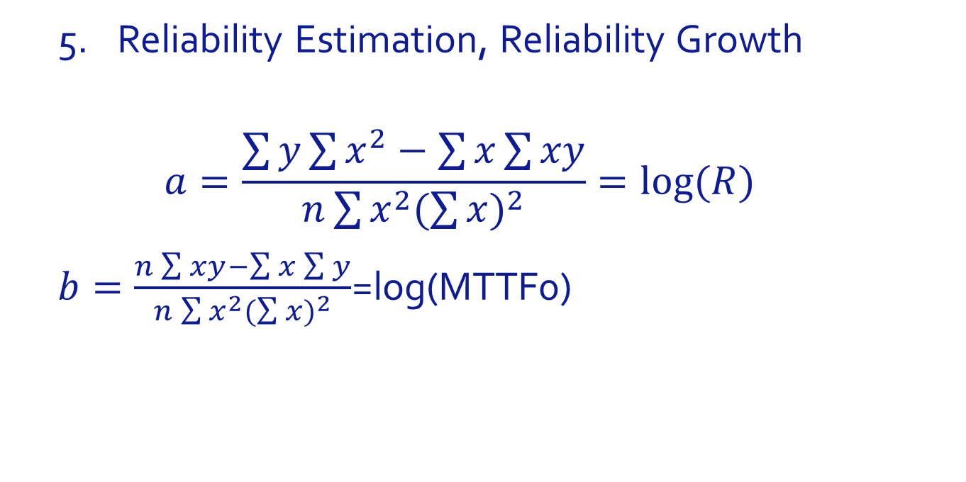
Test Driver Design
Reliability Estimation, Reliability Growth
$$a=\frac{\sum{y}\sum{x^{2}−\sum{x}\sum{xy}}}{n\sum{x^{2}{(\sum{x})}^{2}}}=log⁡(R)$$
$b=\frac{n\sum{xy}−\sum{x}\sum{y}}{n\sum{x^{2}{(\sum{x})}^{2}}}$=log(MTTF0)

Slide 40
Test Driver Design
6. Reliability Standards
International Industrial Standards provide for $1 of tolerable losses per hour of operation. Hence MTTF as a function of stakes attached to failure.

Slide 41
Test Driver Design
6. Reliability Standards
When human life is at stake, MTTF must exceed typical life expectancy.

Slide 42
Test Driver Design
7. Reliability as an Economic Function
In our study of reliability, we have so far made several assumptions,
Stakeholders are a monolith, that have the same stake in failure-free operation.
Different stakeholders have different stakes/ costs associated with failure.
Specifications are monoliths.
Specifications are aggregates of several requirements, which carry different stakes, and have different probabilities of being violated.
Failure is a Boolean condition.
There may be degrees of failure.

Slide 43
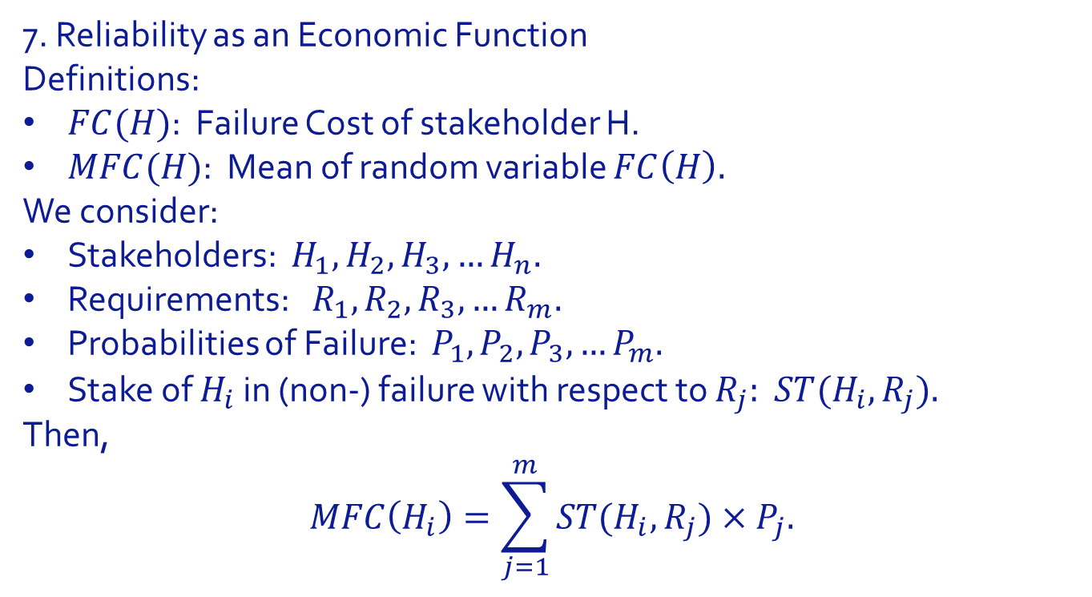
Test Driver Design
7. Reliability as an Economic Function
Definitions:
$FC(H)$: Failure Cost of stakeholder H.
$MFC(H)$: Mean of random variable $FC\left(H\right).$
We consider:
Stakeholders: $H_{1},H_{2},H_{3},…H_{n}.$
Requirements: $R_{1},R_{2},R_{3},…R_{m}.$
Probabilities of Failure: $P_{1},P_{2},P_{3},…P_{m}.$
Stake of $H_{i}$ in (non-) failure with respect to $R_{j}:$ ${ST(H}_{i},R_{j}).$
Then,
$$MFC\left(H_{i}\right)=\sum_{j=1}^{m}{{ST(H}_{i},R_{j})×P_{j}.}$$

Slide 44
Test Driver Design
7. Reliability as an Economic Function
Illustration: Flight Control System.
Stakeholders:
PL: Pilot.
PS: Passenger.
LIF: Passenger’s life insurance company.
AC: Airline company.
AM: Aircraft manufacturer.
INS: Insurance company insuring the aircraft.
FAA: Civil aviation authority.
NGO: Environmental organization.
RES: Resident in the neighborhood of origin/ destination airport.

Slide 45
Test Driver Design
7. Reliability as an Economic Function
Illustration: Flight Control System.
Requirements (massively overlapping/ incomplete/ anecdotal):
AP: Adherence to autopilot settings.
SM: Smoothness of flight.
ECO: Fuel economy.
NOI: Minimizing noise pollution.
CO2: Minimizing CO2 emissions.
SAF: Safety critical requirements.

Slide 46
Test Driver Design
7. Reliability as an Economic Function
Stakes and Stakeholders:

Slide 47
Test Driver Design
7. Reliability as an Economic Function
Stakes and Stakeholders:

Slide 48
Test Driver Design
7. Reliability as an Economic Function
Stakes and Stakeholders:

Slide 49
Test Driver Design
7. Reliability as an Economic Function
Stakes and Stakeholders:

Slide 50
Test Driver Design
7. Reliability as an Economic Function
Stakes and Stakeholders:

Slide 51
Test Driver Design
7. Reliability as an Economic Function
Stakes and Stakeholders:

Slide 52
Test Driver Design
7. Reliability as an Economic Function
Stakes and Stakeholders:

Slide 53
Test Driver Design
7. Reliability as an Economic Function
Stakes and Stakeholders:

Slide 54
Test Driver Design
7. Reliability as an Economic Function
Stakes and Stakeholders:

Slide 55
Test Driver Design
7. Reliability as an Economic Function
Stakes Matrix (NOF: No Failure):

Slide 56
Test Driver Design
7. Reliability as an Economic Function
Probability of Failure with respect to each requirement:

Slide 57
Test Driver Design
7. Reliability as an Economic Function
MFC Vector:

Slide 58
Test Outcome Analysis
Logical Claims
Concrete Testing
Symbolic Testing
Concolic Testing
Stochastic Claims: Fault Density
Stochastic Claims: Failure Probability
Faults are Not Created Equal
Defining Quantifying Reliability
Modeling Software Reliability
Certification Testing
Reliability Estimation, Reliability Growth
Reliability Standards
Reliability as an Economic Function
Chapter Summary

Slide 59
Chapter Summary
Three types of claims we can make from a test:
Logical Claims
Usually very weak, as pertaining to very incomplete specifications.
Estimates of Fault Density
Tenuous connection to failure rate
Limited relevance to users.
Estimates of Reliability
Reliability as an intrinsic attribute of system.
Reliability as a function of the system and stakeholder.
Economic function, quantified in $/hour.

Slide 60
Test Outcome Analysis
Logical Claims
Concrete Testing
Symbolic Testing
Concolic Testing
Stochastic Claims: Fault Density
Stochastic Claims: Failure Probability
Faults are Not Created Equal
Defining Quantifying Reliability
Modeling Software Reliability
Certification Testing
Reliability Estimation, Reliability Growth
Reliability Standards
Reliability as an Economic Function
Chapter Summary

