Slide 1
LMDB
Lightning Memory-Mapped Database

Slide 2
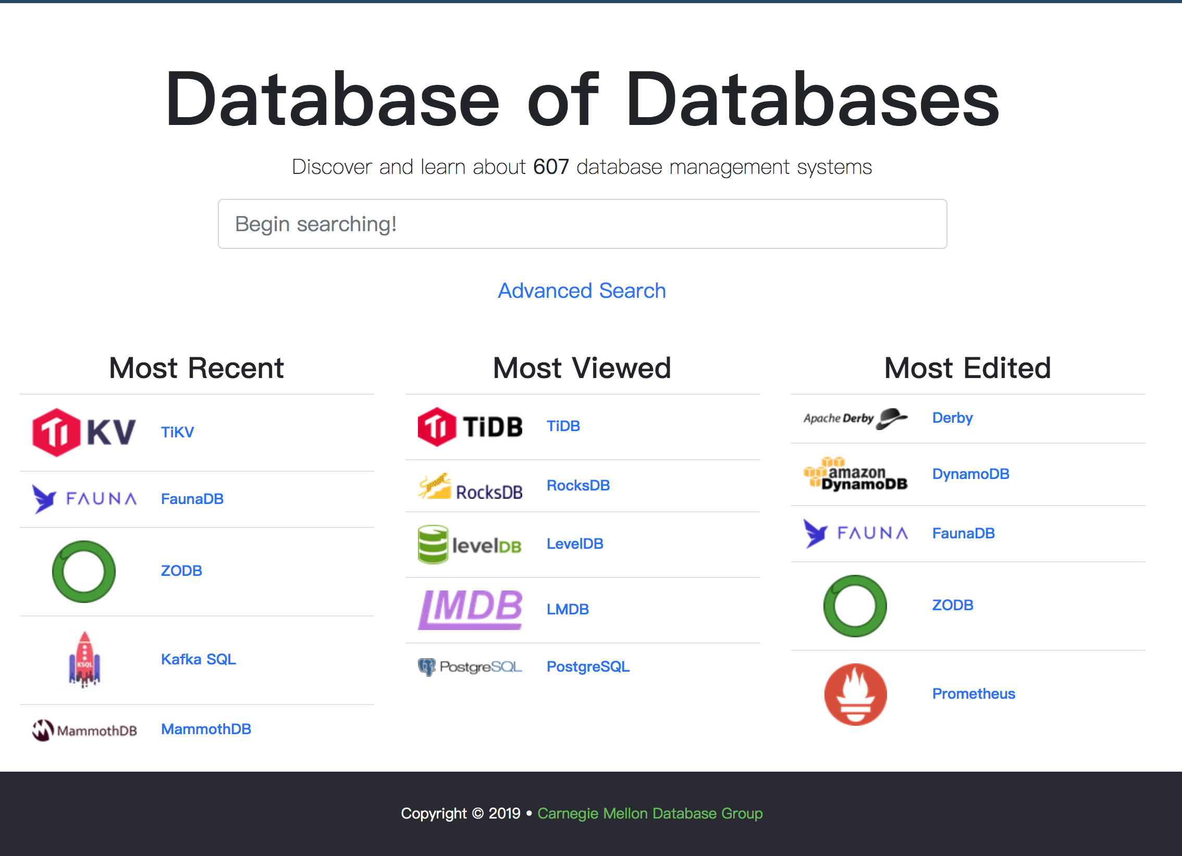
Database world

Slide 3
Overview

Slide 4
Ordered-map interface (keys are always sorted, supports range lookups)
Fully transactional, full ACID (Atomicity, Consistency, Isolation, Durability) semantics with MVCC(Multiversion concurrency control).
Reader/writer transactions: readers don't block writers and writers don't block readers. Writers are fully serialized, so writes are always deadlock-free.
Read transactions are extremely cheap, and can be performed using no mallocs or any other blocking calls.
Supports multi-thread and multi-process concurrency, environments may be opened by multiple processes on the same host.
Multiple sub-databases may be created with transactions covering all sub-databases.
Memory-mapped, allowing for zero-copy lookup and iteration.
Maintenance-free, no external process or background cleanup/compaction required.
Crash-proof, no logs or crash recovery procedures required.
No application-level caching. LMDB fully exploits the operating system's buffer cache.
32KB of object code and 6KLOC of C.

Slide 12
https://my.oschina.net/fileoptions/blog/1828660

