Slide 1
WIPRO CAPSTONE PROJECT
E-Commerce Test Automation Project
Automated Testing for E-Commerce Website and APIs
TEAM MEMBERS: BUG-BUSTERS
Subham Sudeepta — Project Lead & Core Dev
Anand Srivastava — Pytest BDD Lead
Anand Sai — Product & Nav Lead
Sandeep Sai — Cart Management Lead
Ganesh Jangam — Checkout & Orders Lead
Raghuram — API Testing Lead
Sidharth — Authentication Lead
Nithin — Reporting & CI/CD Lead

Slide 2
INTRODUCTION
Project Introduction
This project is an automated testing suite for an e-commerce website. It uses code to automatically test the website and its database, making sure everything works correctly without manual work.
What We Are Testing
We are testing a fully working e-commerce online shop: • User navigation through different clothing tabs (Men, Women, Kids). • Cart features like adding products, changing amounts, and deleting items. • Checkout form where users type their address and place orders. • The database backend that manages user logins and products.
Key Project Ideas
The testing project is built to be clean, smart, and stable: • Automated Actions: Code automatically clicks buttons and types text. • No Random Failures: The code waits for pages to load before doing any action. • Double Verification: We test the visual website and the backend data together.

Slide 3
PROBLEM STATEMENT
Why We Need Automated Testing
Manual Testing Takes Too Long
Clicking buttons and checking checkout forms by hand takes a lot of time and testers can make mistakes.
Slow Page Loading
Sometimes pages load slowly, causing tests to break or fail randomly if the code does not wait.
Hidden Backend Issues
Only testing the website layout can miss errors in the database or server.
No Reports or Details
When tests fail, it is hard to find out why without automatic screenshots or text logs.

Slide 4
PROJECT OBJECTIVES
What We Wanted to Achieve
Automate Key Steps
Test the login page, catalog browsing, shopping cart, and final checkout checkout automatically.
Resilient Testing
Avoid random test failures by writing smart code that waits for buttons to become visible.
Combined UI and API Tests
Validate both the visual layout of the browser and raw data APIs in one go.
Automatic Online Runs
Run all tests automatically on GitHub online every time we update our code.
Time Adherence
Finish all files, settings, and final reports inside our 7-day timeline limit.

Slide 5
SCOPE
What We Tested
Website UI Testing
Testing the visual website using a real browser: • Navigating Men, Women, and Kids fashion sections. • Checking buttons, checkboxes, and input boxes. • Selecting sizes, colors, and adding products to cart. • Taking screenshot images if any page fails to load.
API Testing
Testing the backend server without loading the website: • Verifying username and password verification APIs. • Checking if the list of products from database is correct. • Testing cart additions and order creation data. • Re-trying automatically if server is briefly down.
BDD (Plain English) Testing
Writing tests in simple English so anyone can read: • Writing scenarios using Given, When, Then words. • Connecting simple English files to Python testing code. • Testing different catalog search filters. • Creating report sheets that clients can read.

Slide 6
TECH STACK USED
Tools and Technologies Used
Python 3.14.5
The primary programming language used to write all our automated test code.
Selenium
The automation tool used to open Chrome, click buttons, and type text.
Pytest
The main test runner that starts all tests and displays results.
Pytest-BDD
The plugin used to connect plain English feature files to Python.
Requests
The python library used to send API requests directly to the backend server.
GitHub Actions
The online server that automatically runs all tests when code is updated.
Allure Reports
The dashboard tool that generates interactive charts and reports.
Pytest-HTML
A tool that creates a single, simple HTML file report after tests finish.

Slide 7
DESIGN PATTERN
Page Object Model (POM) Design
BasePage & Common Actions
A central file (base_page.py) containing common commands for the browser: • click(locator): Automatically waits for a button to be clickable, then clicks it. • enter_text(locator, text): Waits for a text box, clears it, and types text. • js_click(locator): Uses JavaScript to click a button if it is hidden behind menus. • Reusability: We write these functions once and use them across all pages.
Separation of Pages and Locators
We separate the test code from the website layout details: • Locators file: Stores IDs and XPATHs (addresses) of buttons and text fields. • Page files: Stores specific user tasks (like login, checkout, search) using locators. • Benefit: If a button's ID changes, we only edit the locators file in one place. All our test cases keep working without changes.

Slide 8
FRAMEWORK ARCHITECTURE
E-Commerce Framework Architecture Diagram
BDD Scenarios (Gherkin English)
Pytest BDD Step Definitions
Page Object Model (BasePage + Pages)
Selenium Chrome Web AUT
API Test Scripts (Python Tests)
REST API Requests Client
Connection Session (Retry adapters)
DummyJSON Mock API Server
CORE RUNNER & HOOKS: Pytest Engine + conftest.py Driver Setup + Automatic Failure Screenshot Capture

Slide 9
BDD IMPLEMENTATION
BDD Implementation (Pytest-BDD)
English Feature Files & Step Code
Makes it easy for anyone to understand what we are testing: • Gherkin Files: Written in simple English using Given, When, Then words. • Reusable Steps: Common steps (like logging in) are written once in code and reused across multiple test scenarios. • Context Fixtures: Used to share dynamic data (like initial item count) between different steps of the same test. • Test Tags: We tag tests as @filter, @positive, or @negative to run them selectively.
Exact Gherkin Filter Scenarios Used
Feature: Product Filtering Functionality @filter @positive Scenario: Apply single category filter Given the user notes the initial product count When the user selects the "Formal" filter checkbox Then the product count should be updated and be less than the initial count And the products displayed should be updated @filter @negative Scenario: Apply incompatible filters yielding no products When the user selects the "Footwear" filter checkbox And the user selects the "Red" filter checkbox Then no products should be displayed in the list

Slide 10
MODULE 1 / 10
Module: Login and Authentication
Redirections & Session Check
Testing user access to account pages: • Redirection: Directs user to 'My Account' page after correct login. • Blocked Access: Redirects unlogged users back to login if they try to access cart checkout. • Session: Checks that user remains logged in during page transitions. • Logout: Logs out user securely, blocking back-button page cache access.
Error Warnings & Blank Inputs
Testing error boundaries on form fields: • Wrong Password: Entering wrong password shows warning banner. • Empty Fields: Leaving username/password blank displays red error labels. • Secure fields: Asserts passwords are typed as hidden stars/dots. Key Files: login_page.py, test_login.py Scenarios Automated: 6 Tests

Slide 11
MODULE 2 / 10
Module: Shop Navigation
Category Navigation Routing
Testing navigation links on main menu: • Category tabs: Clicks and verifies Men, Women, and Kids clothes pages. • Page load states: Verifies page loaders disappear before checking items. • Tab highlights: Assures selected categories are highlighted appropriately. • Breadcrumb matching: Verifies correct path text displays at top of pages.
Running headlessly in cloud
Running tests online without visuals: • Hover Issue: Hover actions did not trigger sub-menus in headless mode. • Solution 1: We used direct category links (URLs) to open pages directly. • Solution 2: Built js_click() to click menu items directly via JavaScript. Key Files: navigation_page.py, test_navigation.py Scenarios Automated: 3 Tests

Slide 12
MODULE 3 / 10
Module: Product Catalog
Product Details Verification
Ensuring items display details correctly: • Detail Pages: Clicking a product card successfully opens its detail page. • Price matching: Confirms catalog price matches detail page price. • Stock Check: Items marked zero stock disable the buy-button and display 'Out of Stock' text. • Image validation: Asserts product pictures load correctly.
Error Redirects & Dynamic Tags
Testing dynamic listing boundaries: • Invalid ID: Typing a wrong product ID in link redirects user back to shop page with an error. • Special Badges: Checks if 'New' or 'Sale' tags show up on products. • UI list grid: Confirms all items display title, price, and thumbnail. Key Files: product_page.py, test_catalog.py Scenarios Automated: 7 Tests

Slide 13
MODULE 4 / 10
Module: Shopping Cart
Cart Actions & Price Sums
Testing additions, modifications, and pricing math: • Add to Cart: Verifies selected size, color, and count transfer to cart. • Quantity Updates: Modifying number of items updates price dynamically. • Math Check: Asserts quantity * item price equals subtotal. • Item Removal: Clicking delete removes item, updating total to 0.
Wait Conditions & Sync
Preventing test failures when website loads slowly: • Slow AJAX updates: Cart badge number updates slowly over network. • Solution: Written wait code that blocks tests from clicking checkout until the cart badge count matches expected amount. • Empty Cart state: Confirms cart shows 'Cart is empty' if no items are inside. Key Files: cart_page.py, test_cart.py Scenarios Automated: 7 Tests

Slide 14
MODULE 5 / 10
Module: Checkout Form
Billing Form Validation
Testing text field inputs during order checkout: • Address Fields: Automatically fills name, street address, zip, and email. • Country Dropdown: Checks country lists respond correctly on click. • Price matching: Verifies total checkout bill matches shopping cart sum. • Delivery options: Selects shipping types (standard or priority).
Required Fields & Format Checks
Testing input limits on billing forms: • Empty Required Fields: Leaving name or zip code blank shows red warning flags. • Wrong Email Format: Typing an invalid email address triggers format error. • Masked inputs: Asserts card number fields are masked during payment typing. Key Files: checkout_page.py, test_checkout.py Scenarios Automated: 3 Tests

Slide 15
MODULE 6 / 10
Module: Order Confirmation
Order Receipts & Success Screen
Capturing purchase confirmations: • Success page: Placing order redirects to order confirmation page. • Thank-You banner: Verifies visual display of 'Thank You for Your Order!' text. • ID Extraction: Automatically parses confirmation text and extracts unique order tracking ID. • Bill matching: Verifies item summary matches checkout totals.
Security checks
Verifying access blocks on confirmation screens: • Block Direct Links: Accessing confirmation link directly with empty cart redirects user back to shop. • Session Clear: Asserts cart database clears completely after checkout finishes. • Duplicate prevention: Reloading page redirects to account history. Key Files: order_status_page.py, test_order.py Scenarios Automated: 2 Tests

Slide 16
MODULE 7 / 10
Module: Product Filters (BDD)
Filtering Scenarios in BDD
Testing catalog filters using plain English step scripts: • Single Filter (Formal category): Selecting 'Formal' reduces items to only formal dresses. • Multiple Filters (Formal + Footwear): Selecting both expands catalog grid count (OR logic). • State comparison: Test code checks listing count before and after applying filter checkboxes.
Zero Matches (Boundary Tests)
Verifying catalog response to incompatible filters: • No matches: Filtering by Footwear and color Red yields zero items. • Zero banner: Checks if 'No products match your criteria' shows up correctly. • Reset filters: Verifies clicking 'Reset' restores the full catalog list. Key Files: features/filters.feature, test_filters.py Scenarios Automated: 3 Tests

Slide 17
MODULE 8 / 10
Module: REST API Testing
API Endpoints Automated
Verifying backend mock database server using direct API calls: • POST /auth/login: Validates user password, returns bearer JWT token. • GET /products: Loads product list data details. • GET /products/{id}: Verifies details of a specific item. • POST /carts/add: Tests adding items to a user cart. • POST /orders: Simulates checkout payment confirmation.
Resilience & Session Controls
Configuring API connections for pipeline stability: • 10s Timeouts: All requests stop after 10 seconds to avoid endless hangs. • Connection Retries: Retries automatically up to 3 times on temporary network failures. • expected failures: Marks API tests as xfail if third-party server crashes, protecting GitHub Action status.

Slide 18
MODULE 9 / 10
Module: Test Reports
Visual Reports & Local HTML Files
Creating simple, clear test results for the project review: • Allure Dashboard: Interactive web report showing pie charts of passed, failed, and skipped tests. • Step lists: Shows Gherkin scenarios with checkmarks next to each step. • Local HTML: Single HTML file report created automatically on local run for easy sharing.
Automatic Screenshots & Logs
Diagnostic helpers when tests fail: • Automatic Screenshots: If a test fails, code instantly takes a picture of Chrome screen. • Report embedding: Attaches failure pictures directly inside Allure steps. • Text Log: Detailed timestamp logging writes actions to logs/execution.log. Key Files: conftest.py, pytest.ini, logs/

Slide 19
MODULE 10 / 10
Module: Continuous Integration (CI/CD)
GitHub Actions Automation Gates
Testing code automatically on the cloud: • Auto Runs: Tests start automatically on push/PR commits to main. • Environment Setup: Installs Python automatically. • Cache speedups: Caches pip folders to reduce package install times. • Cloud browser: Executes tests in headless Chrome on Ubuntu runners.
Headless Settings & Reports Upload
Cloud runner configurations: • Headless Flags: Disables Chrome visuals for speed (--headless=new, --no-sandbox). • Driver manager: Auto-detects cloud browser version and downloads correct driver. • Reports upload: Uploads HTML files and screenshots as artifacts at the end of runs. Key Files: .github/workflows/ci.yml CI Run Time: ~2 min 40 sec

Slide 20
EXECUTION FLOW
Execution Flow: E2E User Journey
1. LOGIN
User logs in with correct password. Browser saves cookie/session values.
2. CATEGORIES
User opens clothes catalog pages (Men, Women, or Kids).
3. FILTER ITEMS
Applies search checkboxes (like size or color) in Gherkin BDD English.
4. CART ADD
Selects product details and adds item to the cart.
5. CART EDIT
Adjusts quantities and checks if totals update correctly.
6. CHECKOUT
Fills address form and submits payment to place order.
7. API CHECK
Sends backend API requests directly to confirm database values match.

Slide 21
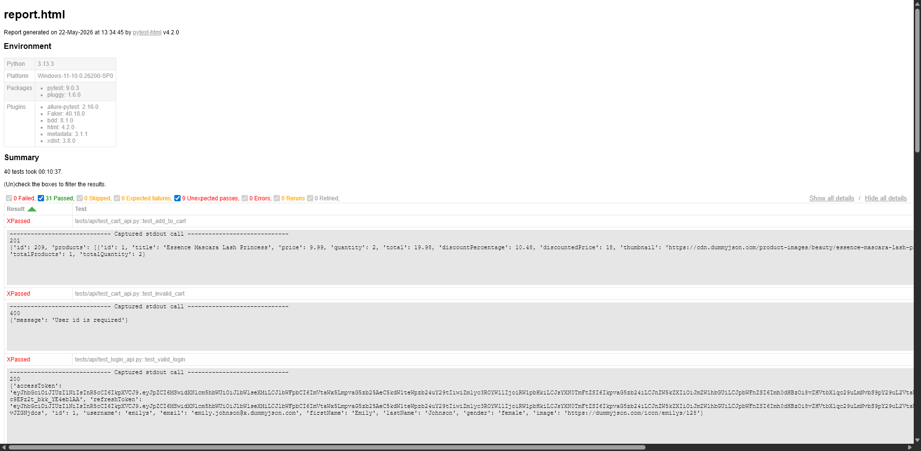
REPORTS
Test Execution Report

Slide 22
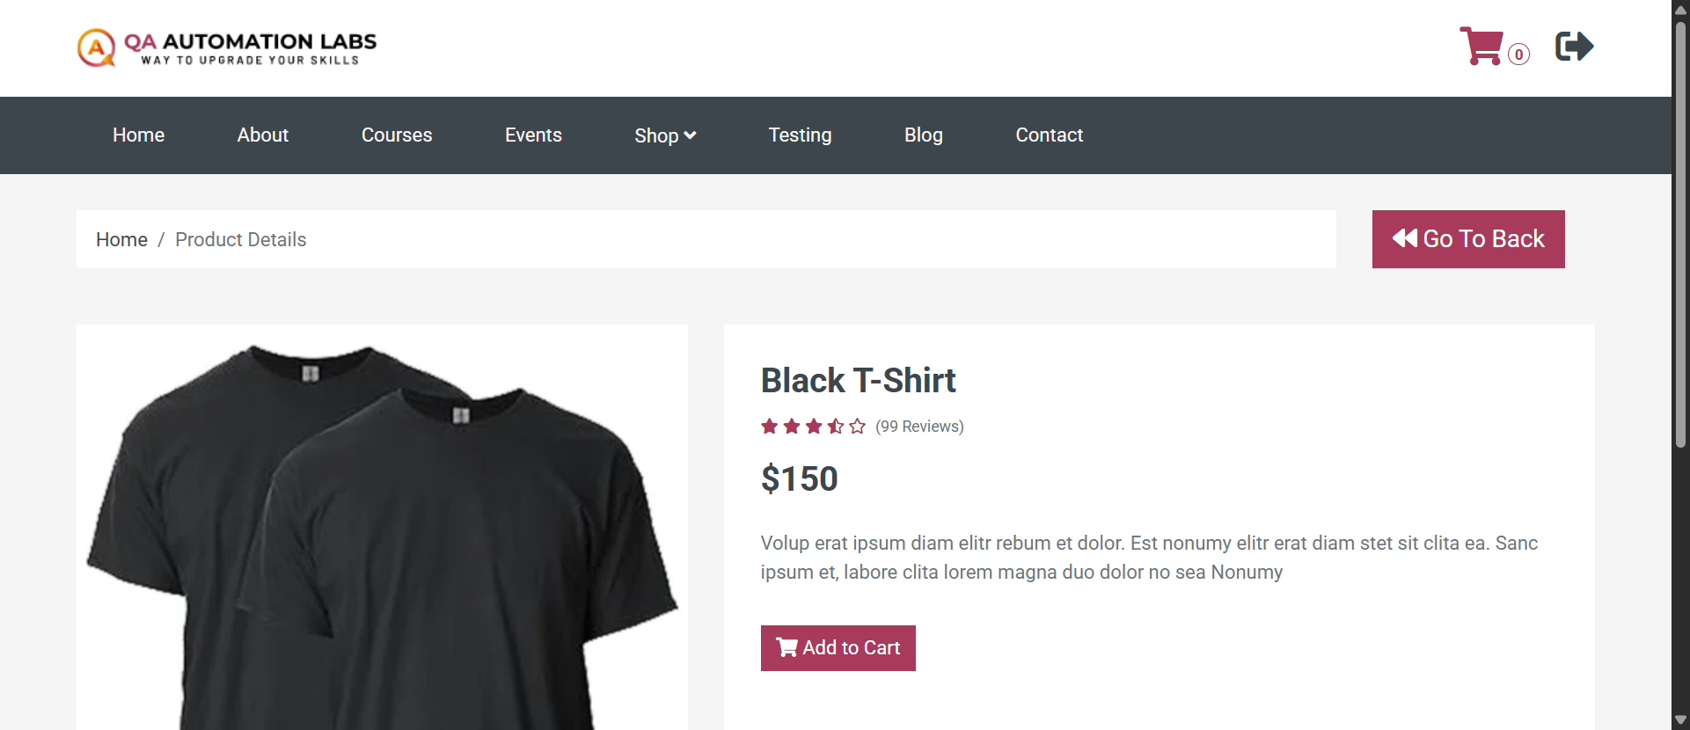
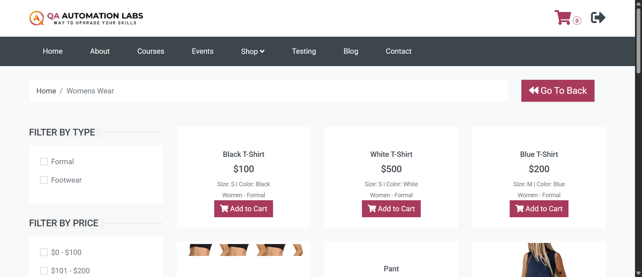
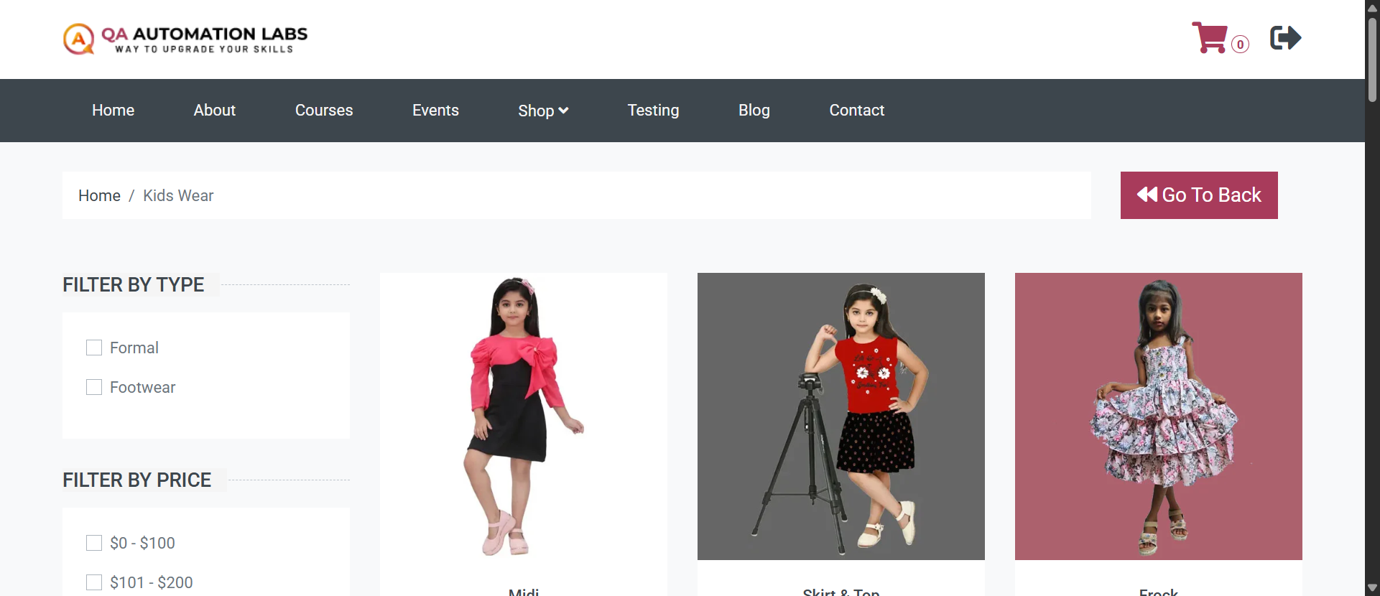
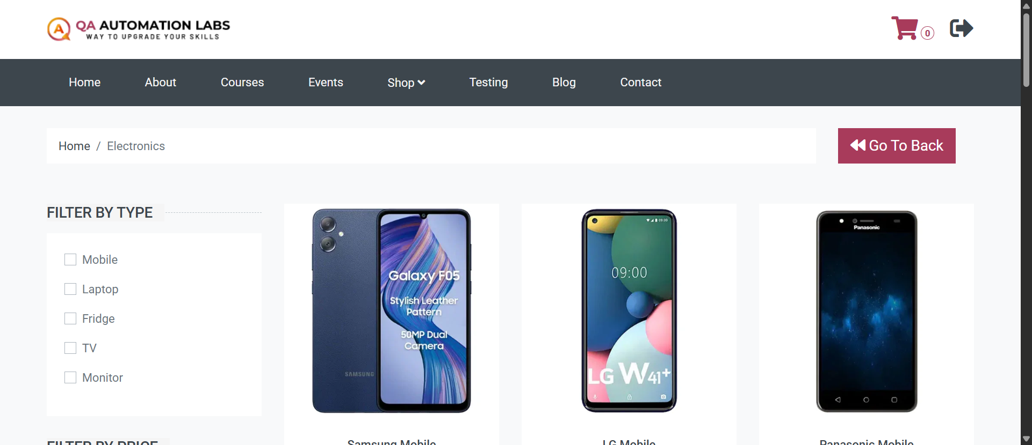
SCREENSHOTS
Website Execution Screenshots

Slide 23
CI/CD INTEGRATION
CI/CD Integration using GitHub Actions
GitHub Workflow Runs
Automatically runs tests in the cloud on every update: • Trigger: Starts automatically on push or pull requests. • Environment: Configures Python environment and restores cached libraries. • Headless Execution: Disables Chrome visuals for faster cloud execution. • Archiver: Packages Allure and HTML results as download files. • Merge Gate: Code must pass tests before being merged to main.
GitHub Actions Cloud Runner Details
• Headless browser options: --headless=new, --no-sandbox.
• Webdriver manager: Installs matching driver version in cloud.
• Average runtime: 2 minutes 42 seconds.
• Pip Caching: Saves ~60 seconds of setup time.
• Artifact Uploads: Test files stored on GitHub for 90 days.
• Parallel execution: Distributes tests on cloud CPUs to run faster.

Slide 24
DEMO / LIVE EXECUTION
How to Run the Tests & Repository Link
Setup Instructions & Repository URL
• GitHub Repository Link:
• https://github.com/L1QU1D26/BUG-Busters-E2E-Automation-Framework.git
• Clone project repository: git clone <url>
• Create python env: python -m venv .venv
• Activate env: .venv\Scripts\activate (Windows)
• Install libraries: pip install -r requirements.txt
• Browser: Google Chrome installed on local computer.
• Configuration: Edit config/config.json for target websites.
Terminal Commands (CLI)
# Run all tests (UI & API) in headless mode
$ pytest --headless=true
# Run tests locally in browser mode
$ pytest
# Run only tests tagged as positive
$ pytest -m positive
# Run only API backend tests
$ pytest tests/test_api.py
# Run and create simple HTML report
$ pytest --html=reports/report.html
# View Allure dashboard
$ allure serve reports/allure-results

Slide 25
CONCLUSION
Conclusion
All Goals Met Successfully
All target automation tests were completed successfully. Covered shopping catalog, login, cart, checkout billing, order receipts, and APIs.
Stable Execution (0% Flaky)
Wait conditions and browser synchronization eliminated random errors in both local and online test runs.
Clean POM Design
Element IDs are separate from test steps. New team members can read and update tests easily.
Continuous Delivery
GitHub Actions status checks make sure no regression code can be merged into main.

Slide 26
✓
Thank You!
Any Questions?
Send us an email:
Enter email address here...
Send

