Slide 1
Zeisler530Week12 Final Project

Slide 2
My Statistical Question
When examining credit card transaction for fraud how does the distance from home affect the likelihood of a transaction being fraudulent?
Thoughts:
As a credit card user, I’ve always been curious what goes into detecting fraud for credit cards. When I go into a gas station outside of my area, I’m usually prompted with requests for addition information, usually my zip code.
This also makes me think about what other pieces of relevant data can be used for detection.

Slide 3
Variables in Dataset
distance_from_home: The distance from home where the transaction happened.
distance_from_last_transaction: The distance from the last transaction.
ratio_to_median_purchase_price: Ratio of the purchased price transaction to the median purchase price.
repeat_retailer: Indicates if the transaction happened with the same retailer.
used_chip: Indicates if the transaction was through a chip (credit card).
used_pin_number: Indicates if the transaction happened by using a PIN number.
online_order: Indicates if the transaction was an online order.
fraud: Indicates if the transaction was fraudulent.

Slide 4
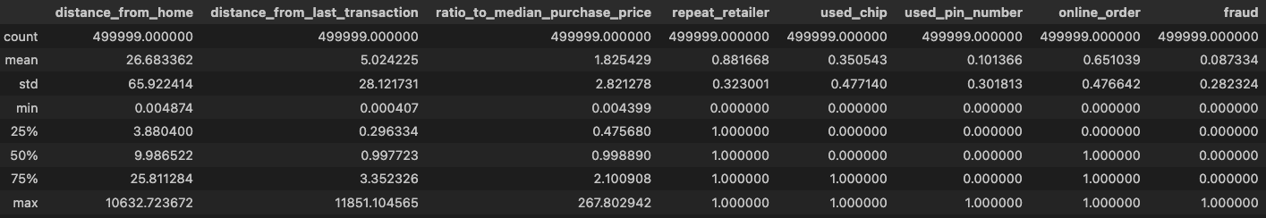
Descriptive Stats

Slide 5
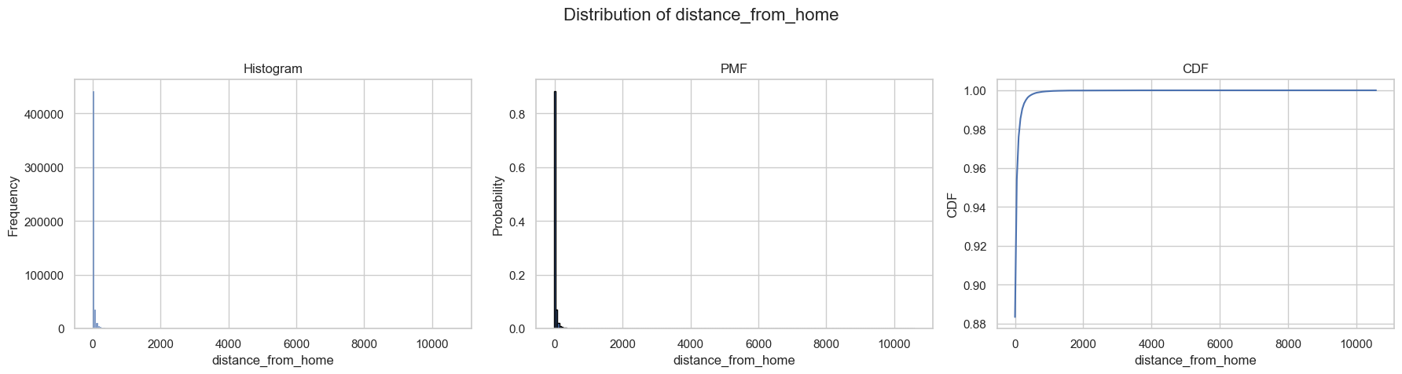
Distribution of distance_from_home

Slide 6
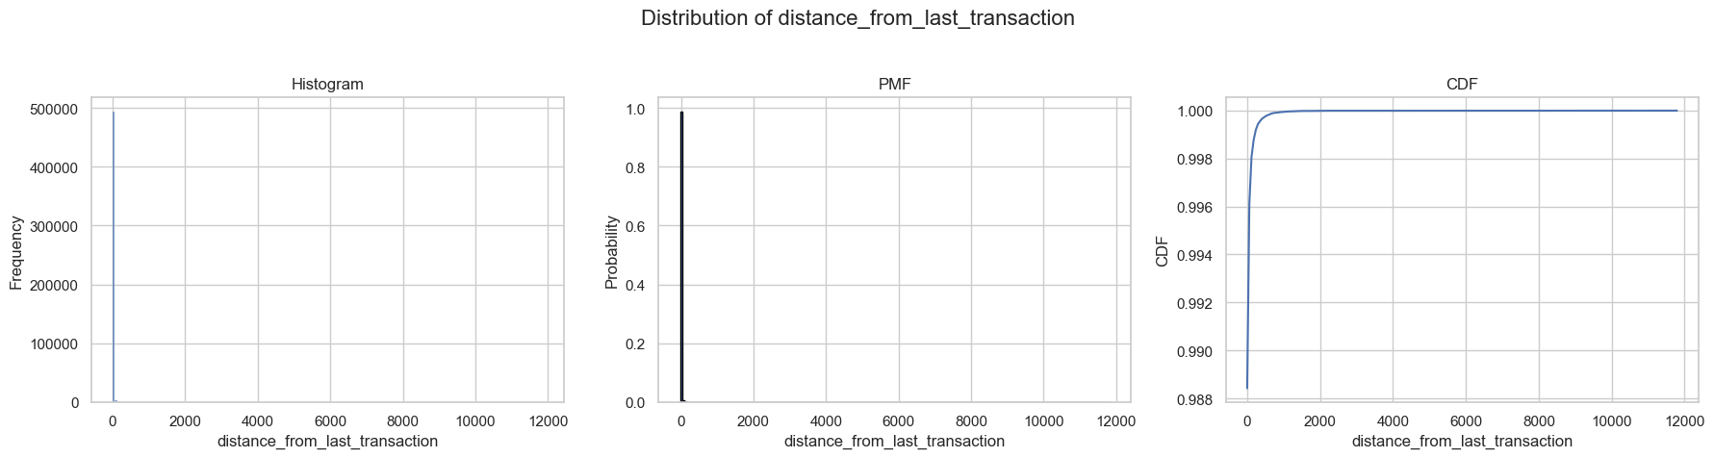
Distribution of distance_from_last_transaction

Slide 7
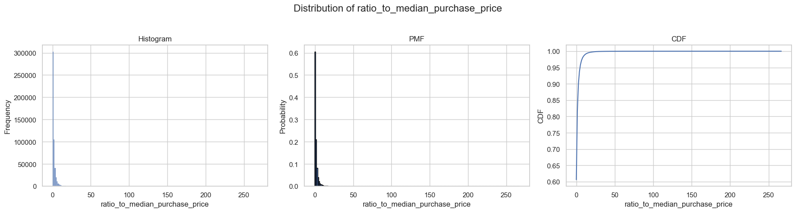
Distribution of ratio_to_median_purchase_price

Slide 8
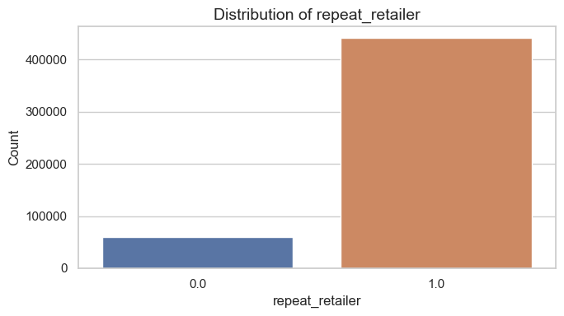
Distribution of repeat_retailer

Slide 9
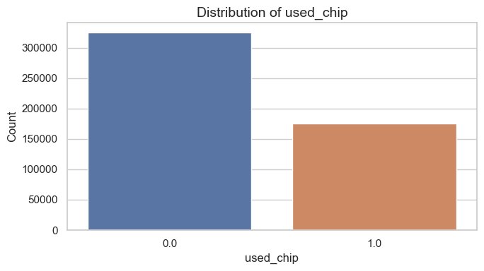
Distribution of used_chip

Slide 10
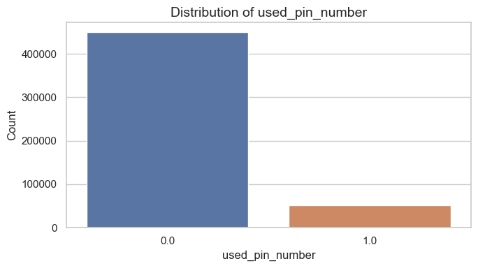
Distribution of used_in_number

Slide 11
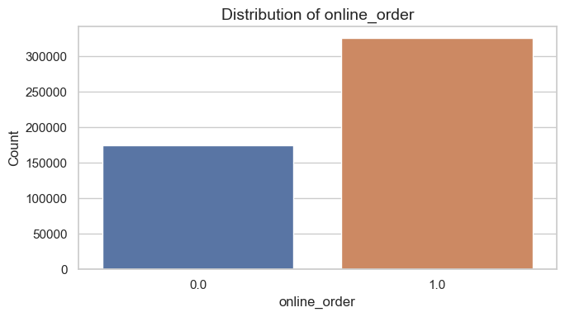
Distribution of online_order

Slide 12
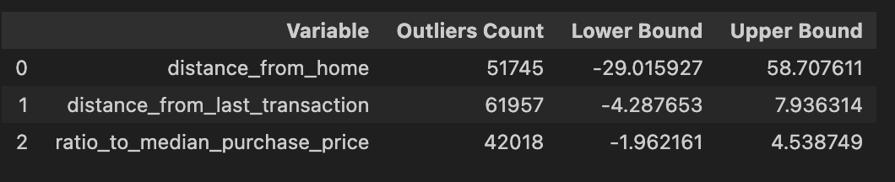
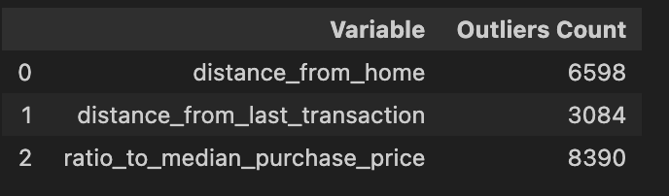
Finding Outliers Methods and Results
IQR:
z-score

Slide 13
Outliers Summary
Anomalies are often used to help determine fraudulent transactions so I will be leaving them in as removing or modifying the data to address outliers can potentially change the data to not indicate fraud when originally there was.

Slide 14
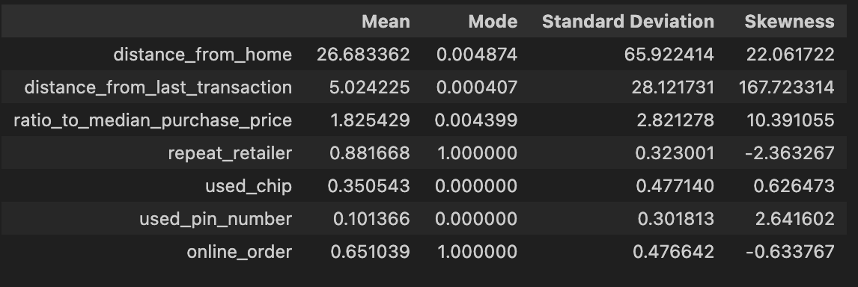
Descriptive Characteristics of Variables
Mean and mode not needed for the binary values, but for consistent display they were left in.

Slide 15
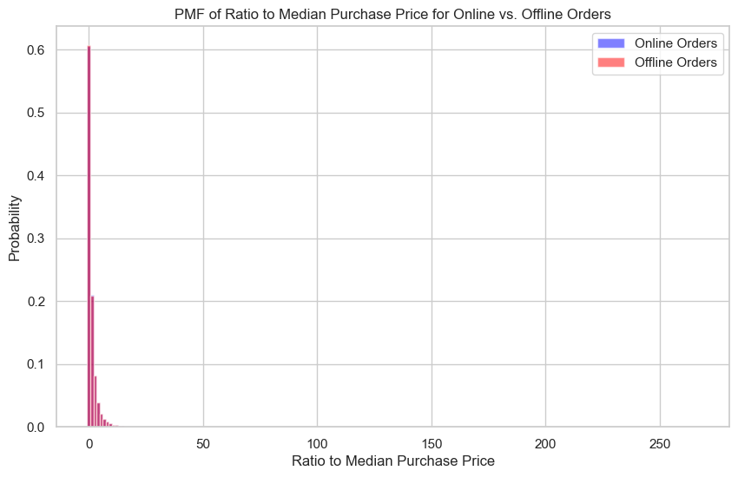
PMF of Ratio to Median Purchase Price for Online vs. Offline Orders

Slide 16
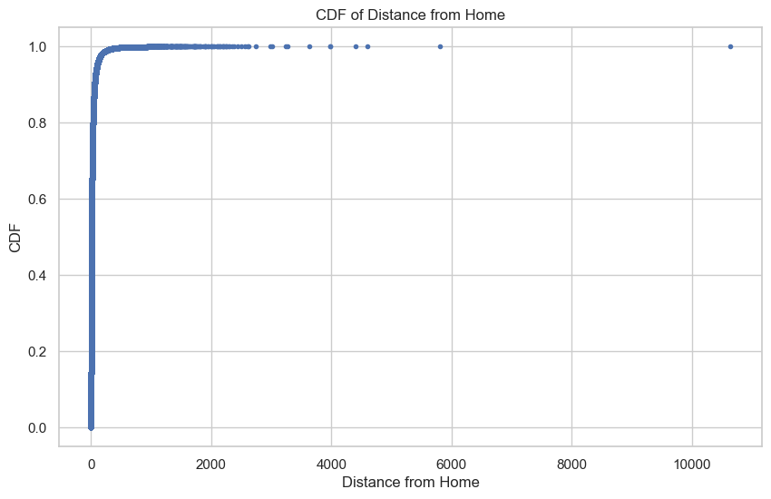
CDF of Distance from Home

Slide 17
CDF of Distance from Home
What does this tell you about your variable and how does it address the question you are trying to answer?
- The CDF doesn’t address the question at hand but what it does tell us is that the purchase locations are all very close to the customer’s home, which is indicated by the very straight line going up and the values don’t vear off to the larger distances until towards the top.

Slide 18
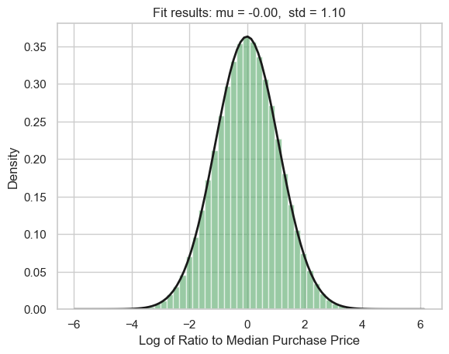
Log of Ratio to Median Purchase Price

Slide 19
Log of Ratio to Median Purchase Price Analysis
The histogram and fitted normal distribution of the log-transformed distance_from_home variable suggest that the original data follows a log-normal distribution. This transformation brings the data closer to normality, enhancing the applicability of statistical models that assume normally distributed inputs. Such an insight can be leveraged in fraud detection to identify transactions with atypically large distance_from_home values, which may indicate potential fraud and why I didn't remove outliers in my original dataset.

Slide 20
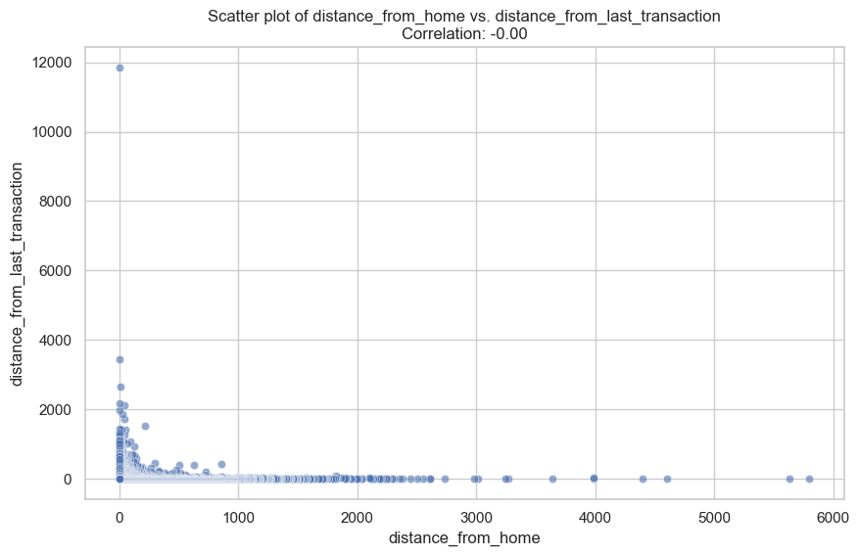
Create two scatter plots comparing two variables

Slide 21
Scatter Plot Analysis
Correlation: A Pearson correlation coefficient of -0.00 suggests no linear correlation between distance_from_home and distance_from_last_transaction. The points are spread out and there's no upward or downward trend as one moves along the x-axis.
Causation: With a correlation coefficient of zero, there is no evidence from this plot alone to suggest that distance_from_home causes changes in the distance_from_last_transaction or vice versa.
Covariance: Given the correlation coefficient is essentially zero, the covariance between these two variables would also be close to zero.
Non-Linear Relationships: The scatter plot does not suggest any clear non-linear relationship either. The points do not cluster or form patterns that would indicate a non-linear association.

Slide 22
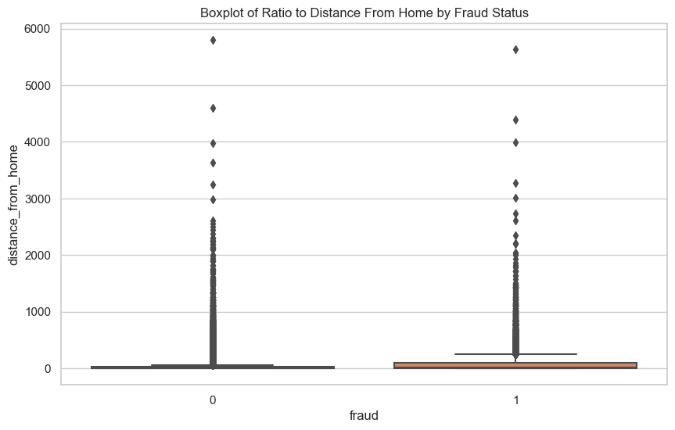

Slide 23
Box Plot Analysis
Distribution Insights: For both fraudulent and non-fraudulent transactions, most of the data points are clustered near the lower end of the distance_from_home spectrum. This suggests that most transactions occur relatively close to home, regardless of fraud status.
Outliers: There are outliers in both categories, but they appear more pronounced and numerous in the fraudulent category. This suggests that while most fraudulent transactions occur close to home, when they do occur at a greater distance, they can be at a significantly greater distance than typical non-fraudulent transactions.
Fraudulent Transactions: The median distance_from_home for fraudulent transactions is not much higher than for non-fraudulent transactions based on the box plot. The presence of more extreme values could warrant further investigation.

Slide 24
Hypothesis Test Summary
The hypothesis test explored the relationship between the distance from home and the likelihood of a transaction being fraudulent. Utilizing a permutation test, I observed a significant difference in the means of the distance from home between fraudulent and non-fraudulent transactions. The observed difference in means was substantial, with a p-value effectively at 0. This suggests that the distance from home plays a role in the likelihood of a transaction being fraudulent, with fraudulent transactions tending to occur further from home.

Slide 25
Regression Analysis Summary
The regression analysis conducted using logistic regression tried to understand the factors influencing the likelihood of credit card fraud. This includes the variables distance_from_home, distance_from_last_transaction, repeat_retailer, used_chip, used_pin_number, and online_order. The model demonstrated an ability to predict fraudulent transactions. The model's pseudo R-squared of 0.1769 means a modest fit. Key findings include a positive association of distance_from_home and distance_from_last_transaction with fraud, suggesting transactions that occur farther from home or from the last transaction location are more likely to be fraudulent.

