Slide 1

Adaptation Kit And Certification Program For Implementing Media Center Extender And PlaysForSure
Scott Evans
Lead Program Manager
eHome Devices
Microsoft Corporation

Slide 2


Media Center Extender Sessions
CON055 – Introduction to Media Center Extender Functionality for Consumer Electronics Devices
CON063 – Media Center Extender UI Remoting and AV Streaming Architecture
CON003 – Adaptation Kit and Certification Program for Implementing Media Center Extender and PlaysForSure

Slide 3


Agenda
Media Center Extender (MCX)
and PlaysForSure (PFS) overview
Device stack view
Adaptation kit approach
  Integration with device functionality
Porting kit details
  Porting example
  Best practices
Certification program
  Testing tools
Platform support
  Demonstration

Slide 4









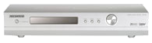

MCX
Complete network entertainment
Full Media Center experience:
TV/PVR, 3rd party applications
Windows Vista Home Premium or Ultimate PC
Premium content via
Windows Media DRM (WMDRM-ND)
Better experience
Any Windows XP
or Windows Vista PC
Personal content:
photos, music, video
DLNA compliant Network CE device (e.g., PVR)

Slide 5

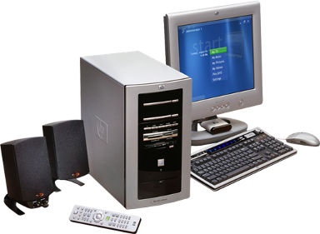

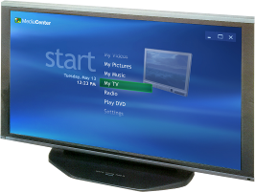

Software Stack For MCX
Online spotlight
Applications
OEM
Local UI
Key
MCE EPG and
live/rec TV
Remote UI
MCX
UI and content
Security/Trust
MCE UI
WMDRM-ND
PFS
MPEG2
WMV
DLNA
Music, pictures,
Videos
HTTP
RTP
UPnP AV
UPnP
IP/WiFi

Slide 6
MCX Program Components
Available Now
KickStart
program
Hardware/software requirements and UX guidelines
Developer’s Guide and Platform SDK documentation
Available to qualified companies under NDA
Available Q2'06
Consolidated
licensing
Interim and final agreements
Covers PFS-ND and MCX technologies under single
license program
Beta Q3'06
Adaptation
kit
Collection of porting kits, documents, and unit tests
Supplies device technologies for PFS-ND and MCX
Includes DLNA Stack
Available 1H'07
Single
certification
process
Verifies PFS-ND and MCX functionality
Builds on existing PFS certification program

Slide 7
MCX Platform Adaptation Kit (MCX-PAK) Overview
Collection of porting kits using a common Platform Abstraction Layer (PAL) and build environment
Porting
kits
Allows for easy cross-compile to a variety of target platforms
Provided as non-modifiable source code
Includes associated documentation and unit tests
Optional
modules
Source code can be used as-is or replaced with alternate implementation
Implementations are recommended and tested, so carefully consider
any replacements
PAL
adapter
Implementation binds porting kits to specific hardware/OS platform
Adapter must be customized to target device
Silicon companies can provide sample PAL Adapter for their platforms

Slide 8
MCX-PAK
Architecture Overview
OEM Shell
Module type
OEM
MCX Client
Session
Manager
LLTD
Client
NPT
Sink
WMDRM-ND
Receiver
RTSP/RTP
Client
XSP
Client
MSTA
Service
Porting kit
MSRX
Service
PAL adapter
Optional
module
Platform Abstraction Layer (PAL)
Graphics
AV Render
Sockets
Input
Executive
Security
UPnP
TLS
Graphics
AV
Render
Sockets
Input
Executive
Security
Windows Media
Connectivity Stack
Embedded OS, Drivers, Hardware Libraries

Slide 9
Porting Kit Itemization
MCX Client
Session
Manager
LLTD
Client
NPT
Sink
WMDRM-ND
Receiver
RTSP/RTP
Client
XSP
Client
MSTA
Service
MSRX
Service
Platform Abstraction Layer (PAL)
Graphics
AV Render
Sockets
Input
Executive
Security
UPnP
TLS
Porting Kit | Definition | Function
LLTD client (with QoS Extensions) | Link Layer Topology Discovery | Enables Windows Vista to reflect device location on the Network Map Provides real-time bandwidth monitoring
NPT sink | Network Performance Tuner | Enables network throughput testing and diagnostics
WMDRM-ND Receiver | Windows Media DRM for Network Devices | Link for streaming of premium AV content Includes: discovery, proximity detection, authorization, key exchange, and content decryption
RTSP client | Real Time Streaming Protocol | Streams audio and video over the network using RTP/UDP Manages the streams using RTSP and RTCP

Slide 10
Porting Kit Itemization
MCX Client
Session
Manager
LLTD
Client
NPT
Sink
WMDRM-ND
Receiver
RTSP/RTP
Client
XSP
Client
MSTA
Service
MSRX
Service
Platform Abstraction Layer (PAL)
Graphics
AV Render
Sockets
Input
Executive
Security
UPnP
TLS
Porting Kit | Definition | Function
XSP client | Extender Session Protocol | Receives and renders the user interface from the PC Handles Remote Control input and AV coordination
MSTA service | Microsoft Trust Agreement | Bi-directional and secure certificate exchange with the PC Used during device initial setup over UPnP
Session manager / MSRX service | Microsoft Remoted Experience | Discovery of Media Center PC Initiation of the Media Center Extender session
MCX client | Media Center Extender client | Interaction between OEM local UI and MCX components Notification of error situations to OEM local UI

Slide 11
PAL Module Itemization
Platform Abstraction Layer (PAL)
Graphics
AV Render
Sockets
Input
Executive
Security
UPnP
TLS
Graphics
AV
Render
Sockets
Input
Executive
Security
UPnP
TLS
PAL Module | Abstraction Function | Example Functions | Platform Considerations
Graphics | Rendering of graphics bitmaps including alpha channel | Graphics_SurfaceBlt(), Graphics_SurfacePresent(), Graphics_SetVideoPosition() | Accelerated BitBlt 32bpp (8bpp alpha)
AV Render | Rendering of audio and video samples | Renderer_GetDecoderBuffer(), Renderer_SetClockRate() | Decoder quality De-interlacing support
Sockets | Network send and receive | Socket_Send(), Socket_SetSendBuffer() | Low CPU usage for network operations
Input | User input from remote control | Input_GetInputEvent(IR_PLAY) | Necessary buttons on OEM remote control

Slide 12
PAL Module Itemization
Platform Abstraction Layer (PAL)
Graphics
AV Render
Sockets
Input
Executive
Security
UPnP
TLS
Graphics
AV
Render
Sockets
Input
Executive
Security
UPnP
TLS
PAL Module | Abstraction Function | Example Functions | Platform Considerations
Executive | Operating System execution layer | Executive_CreateThread(), Executive_WaitForMutex() | Threading support with priorities
Security | Certificate management and data decryption | Security_AESSetKey(), Security_StoreCert() | High performance AES Secure cert storage
UPnP | Binds MSRX and MSTA services to UPnP implementation | UPnP_SetMSTACallbacks(), UPnP_SetMSRXCallbacks() | DLNA compliance
TLS | Binds XSP to TLS implementation | TLS_GetHostCertificate(), TLS_SendData() | Low CPU usage for decryption

Slide 13
Customizing the PAL-Adapter
PAL defines abstractions for platform specific functions
PAK\PAL\pkExecutive.h
Defines platform abstraction functions
Platform Abstraction Layer (PAL)
PAL
Graphics
AV Render
Sockets
Input
Executive
Security
UPnP
TLS
Graphics
AV
Render
Sockets
Input
Executive
Security
UPnP
TLS
Adapter
PAK\Platform\<name>\PALImpl\Executive.c
Implements functions for a specific platform embedded OS

Slide 14
Customizing the PAL-Adapter
Platform Abstraction Layer (PAL)
Graphics
AV Render
Sockets
Input
Executive
Security
UPnP
TLS
pkExecutive.h:
~ 54 functions
Graphics
AV
Render
Sockets
Input
Executive
Security
UPnP
TLS
PAL implementation example – Executive.c for Win32
pkRESULT Executive_CreateLock(pkHANDLE *pHandle)
{
LPCRITICAL_SECTION pLock = (LPCRITICAL_SECTION) malloc(sizeof(CRITICAL_SECTION));
//Create a Win32 critical section
::InitializeCriticalSection(pLock);
*pHandle = pLock;
return pkS_OK;
}

Slide 15
Customizing the PAL-Adapter
Platform Abstraction Layer (PAL)
Graphics
AV Render
Sockets
Input
Executive
Security
UPnP
TLS
pkSocket.h:
~ 35 functions
Graphics
AV
Render
Sockets
Input
Executive
Security
UPnP
TLS
PAL implementation example – Socket.c for ucLinux
int32_t pkAPI Socket_SetSendBuffer(SOCKET_HANDLE s, int32_t iVal)
{
int rc = 0;
int iSendBufSize = (int)iVal;
CLEAR_ERROR_CODE;
//Set Sending buffer size using linux system call
rc = setsockopt ((int)s, SOL_SOCKET, SO_SNDBUF,(const void *)&iSendBufSize,
(socklen_t)sizeof(int));
RETURN_SOCKET_ERROR(rc);
}

Slide 16
Customizing the PAL-Adapter
Platform Abstraction Layer (PAL)
Graphics
AV Render
Sockets
Input
Executive
Security
UPnP
TLS
pkAVRender.h:
~ 32 functions
Graphics
AV
Render
Sockets
Input
Executive
Security
UPnP
TLS
PAL implementation example – AVRender.c for Sigma EM8622L
pkRESULT pkAPI Renderer_SetClockRate (pkHANDLE hRenderer, pkUINT32 uiPPM)
{
if(hRenderer) {
struct renderer_context *prenderer_context=(struct renderer_context *)hRenderer;
struct dcc_context *dcc_info = prenderer_context->dcc_info;
//Set Render Clock using Sigma platform library call
DCCSTCSetSpeedCleanDiv(dcc_info->pStcSource, 1000000 + uiPPM, 1000000);
return pkS_OK;
}
return pkE_POINTER;
}

Slide 17

Windows Media
Connectivity Stack
UPnP
TLS
Windows Media
Connectivity Stack
Announcing
Full UPnP stack provided in MCX adaptation kit
  UPnP core
    SOAP
    GENA
    Device description
  UPnP AV media render
  UPnP AV media control
  XML parser/framer
  HTTP client/server
  TLS client
Provided as portable ANSI C code
DLNA v1.0 compliant

Slide 18
Selecting Functionality
MCX-PAK can build
  PFS-ND
  only device
  PFS-ND +
  MCX device
Porting Kit | PFS-ND | MCX | Included in MCX-PAK
XSP Client | N/A | Required | ☑
RTSP Client | Optional | Required | ☑
MSTA Service | N/A | Required | ☑
Session Manager / MSRX Service | N/A | Required | ☑
WMDRM-ND Receiver | Required | Required | ☑
LLTD Client | Optional | Required | ☑
NPT Sink | N/A | Required | ☑
Windows Media Connectivity Stack | Optional | Optional | ☑
WMA/WMV Decoders | Required | Required | Available through WMLA

Slide 19


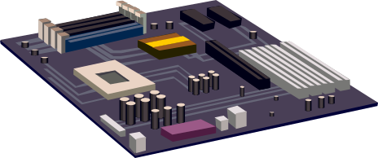
Building A Runtime
Customize PAL Adapter
Integrate with OEM functionality
Cross compile for target platform
Run unit tests to isolate issues and optimize performance
Windows Vista
Premium
Stream UI and AV
Load firmware
OEM prototype
hardware or
reference board
TV
Developer
workstation

Slide 20

Platform Requirements Summary
Platform requirements
  Ethernet
  Optional: Wireless (video capable)
  (5 GHz 802.11a/n)
  MPEG2, LPCM, WMV, …
  AES Support
  Certificate Storage
  Firmware Update
  Analog/digital output protection
  2D Graphics
    32bit color (Alpha Blending)/
    fast render speed (bitblt)
Software requirements
  Local OEM UI
  DLNA Client Stack
  WMDRM-ND
  RTP/RTSP client
DLNA DMP compliant
PlaysForSure certified
MCX certified
For detailed requirements,
see the “hardware/software requirements” document from the ‘MCX KickStart’ program

Slide 21
Certification
 | Formal PFS testing provided by NSTL NSTL is the global authorized independent test lab for the PlaysForSure program Verification testing is required to assure that devices are compliant with the requirements of the program NSTL also provides PFS pre-testing service Visit www.nstl.com/playsforsure for detailed information about obtaining PFS testing
 | MCX requires PFS certification as pre-requisite Details of MCX certification process to be released with MCX Platform Adaptation Kit Working to consolidate testing and certification process with PFS
Test kits will be available for self administered pre-testing

Slide 22



MCX-Platform Adaptation Kit
Sigma Designs Pika 8622L Reference Board

Slide 23
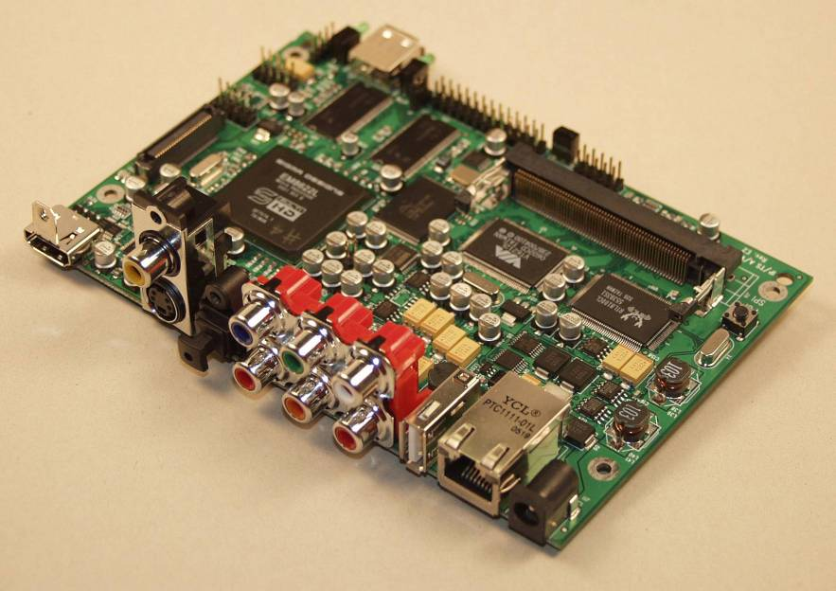
Pika 8622L Reference Board

Slide 24
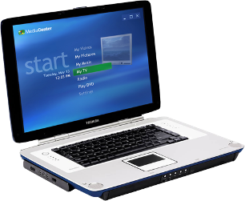

Demo Setup
Serial Debug
Ethernet
Sigma Pika 8622L
Reference Board
(ucLinux)
Windows Vista Beta 2
(with Media Center)
Sigma EM8622L
Development Environment
(Linux with arm-elf-gcc)

Slide 25
Call To Action
Attend or review related MCX sessions
  CON055 – Introduction to Media Center Extender Functionality for Consumer Electronics Devices
  CON063 – Media Center Extender UI Remoting and AV Streaming Architecture
Ensure your platform investments include functionality required to support MCX
E-mail: to obtain additional information about the Media Center Extender partner program
To get started today, implement DLNA DMP and PlaysForSure functionality
mcxprtnr @ microsoft.com

Slide 26

Additional Resources
Related Sessions
  CON074 – Plug and Play for Network Connected Devices
  MED114 – Windows Media DRM Device Ecosystem for Windows Vista
Related Ask the Experts Sessions
  Thursday, May 25, Noon – 1:00 PM
Related Websites
  Digital Living Network Alliance: http://www.dlna.org/
  PlaysForSure: http://www.playsforsure.com
  Sigma 8622L reference board: http://www.sigmadesigns.com/pika
MCX Partner Program Information
  E-mail:
  Website: http://www.microsoft.com/mcxpartner
mcxprtnr @ microsoft.com

Slide 27

© 2006 Microsoft Corporation. All rights reserved. Microsoft, Windows, Windows Vista and other product names are or may be registered trademarks and/or trademarks in the U.S. and/or other countries.
The information herein is for informational purposes only and represents the current view of Microsoft Corporation as of the date of this presentation. Because Microsoft must respond to changing market conditions, it should not be interpreted to be a commitment on the part of Microsoft, and Microsoft cannot guarantee the accuracy of any information provided after the date of this presentation.
MICROSOFT MAKES NO WARRANTIES, EXPRESS, IMPLIED OR STATUTORY, AS TO THE INFORMATION IN THIS PRESENTATION.

Slide 28


