Slide 1

Media Center Extender UI Remoting And AV Streaming Architecture
Todd Bowra
Program Manager
eHome Devices
Microsoft Corporation

Slide 2


Media Center Extender Sessions
CON055 – Introduction to Media Center Extender Functionality for Consumer
Electronics Devices
CON063 – Media Center Extender UI Remoting and AV Streaming Architecture
CON003 – Adaptation Kit and Certification Program for Implementing Media Center Extender and PlaysForSure

Slide 3


Session Outline
Recap of Media Center
Extender (MCX) technology
MCX UI remoting
  Overview of discovery, configuration,
  and connection establishment
  UI remoting protocol details
MCX AV streaming
  AV protocol overview
  Advanced AV streaming functionality
  Summary of technology/protocols included
  in the MCX Platform Adaptation Kit (MCX-PAK)

Slide 4
What You Will Learn
How Media Center Extender works
How MCX technology ensures a high-quality media playback experience
Which protocols are included in the
MCX Platform Adaptation Kit

Slide 5


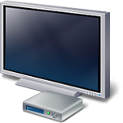



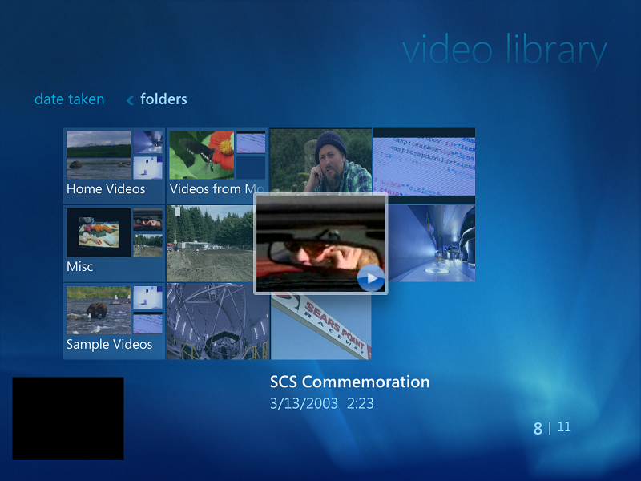

What Is MCX Technology?
Network
PC with Windows Vista Home Premium or Ultimate
Consumer electronics device with MCX
MCX technology delivers the Media Center experience to
network-connected consumer electronics devices within the home

Slide 6

MCX Network Transmission
PC with Windows Vista Home
Premium or Ultimate
Media Center Extender
UI
AV
Network
UI and AV information are sent across the network to the MCX device via two separate channels

Slide 7
MCX UI Remoting

Slide 8
UI Remoting
One-time setup
Before the Media Center UI can be delivered to an MCX device, a trust relationship is created between the
PC and MCX
Two one-time steps are involved
in creating this relationship
  Discovery
  Configuration

Slide 9
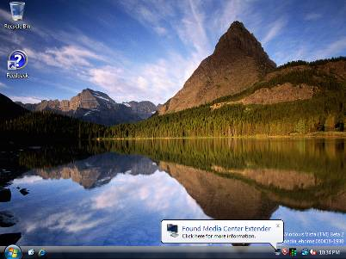
UI Remoting
Discovery
Discovery
PC discovers MCX via
Universal Plug and Play (UPnP) for devices
PC checks device compatibility ID to determine if the device contains MCX functionality
If the device is an MCX
device, the user receives a presence notification

Slide 10
UI Remoting
Configuration
Out-of-band setup key
(entered by user)
Trust negotiation
On first use, the MCX device displays an eight-digit setup key
The user enters the setup key into the MCX setup wizard on the PC
The wizard performs the following actions
  Installs the MCX device on the PC using PnP-X (Plug and Play Extensions for Network Connected Devices)
  Negotiates a trust agreement between the PC and MCX

Slide 11
Discovery And Configuration
Protocols: UPnP, MSTA
UPnP
  Well-established protocol for discovery
  Used by the PC to discover
  network-connected devices
Microsoft Trust Agreement (MSTA)
  Used to associate the MCX device with the PC
  Implemented as a UPnP service
  Employs out of band (user-entered) trust code to enable mutual certificate exchange over an insecure network

Slide 12
UI Remoting
Connection establishment
Once a trust relationship is created, the MCX may connect to the PC at any time
Connection establishment is started
when the user selects the Media Center experience button on the MCX

Slide 13
UI Remoting
Connection establishment
Application advertisement
UI remoting
The PC advertises a Media Center application
Uniform Resource Identifier (URI) to the MCX device
The MCX device validates the authenticity of the advertisement, then connects to the PC
The PC authenticates and authorizes the connection, then remotes the Media Center experience to the
MCX device

Slide 14
Connection Establishment Protocols: MSRX, XSP
Microsoft Remoted Experience Protocol (MSRX)
  Used by the PC to advertise application endpoints to
  network-connected devices
  Advertisements signed using the PC’s private key – enables devices to verify origin of advertisements
Extender Session Protocol (XSP)
  Used to deliver the Media Center user interface to MCX devices
  Specifically designed for application streaming to consumer electronics devices
  Runs over Transport Layer Security (TLS) for enhanced security

Slide 15
UI Protocols
Summary
 | Included in MCX-PAK | Must be provided by MCX OEM
UPnP | ✓
MSTA | ✓
MSRX | ✓
XSP | ✓
Software support for all UI protocols is included in the MCX Platform Adaptation Kit
Details regarding the MCX Platform Adaptation Kit are provided in the CON 003 session

Slide 16

UI Remoting
Excerpted platform implications
Required by MSTA
  Secure certificate and private key storage
  SHA-1 support
  RSA PKCS1 v2.1 support
Required by XSP
  32-bit graphics support
  Support for full-screen alpha-blended bit BLTs on top of video
Full platform requirements are included as part of the MCX partner documentation

Slide 17
MCX AV Streaming

Slide 18
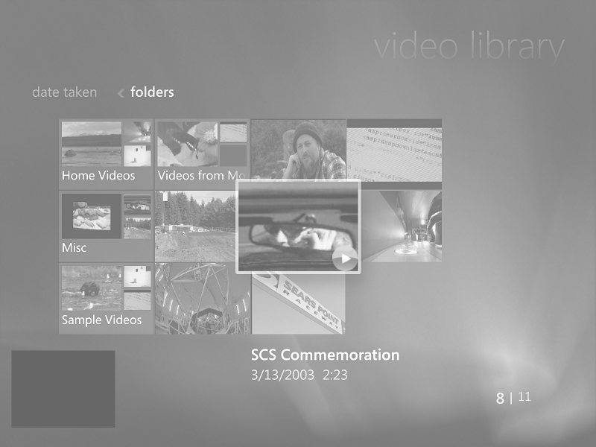
MCX AV Streaming
PC with Windows Vista Home
Premium or Ultimate
Media Center Extender
AV
Network

Slide 19
AV Streaming
Scenarios
MCX technology delivers Media Center AV content to network-connected devices within the home; specifically, it enables the streaming of
  Live and recorded TV
    Including HD native digital cable content
  Radio
  Music
  Videos

Slide 20



AV Streaming
Technology
MPEG-2 | ■ | ■ | ■
Windows Media |  | ■ | ■
Windows Media DRM |  | ■ | ■
Fast pre-roll |  |  | ■
Dynamic network monitoring |  |  | ■
Transrating |  |  | ■
The DLNA word mark and logos are owned by DLNA. Other trademarks and trade names are those of their respective owners

Slide 21
AV Streaming
Transport
Stream Identifier
Play Request
AV Samples
Once the user has selected a media stream to play in the Media Center UI remoted from the PC, Media Center sends an identifier for that stream to the MCX device
The MCX device sends a play request to the PC for that stream
The PC delivers the requested stream to the MCX device

Slide 22
AV Streaming
Transport
RTP
  Used to stream TV, FM radio,
  Windows Media, VC-1, MP3
  Enhanced through use of Quality Windows AV Experience (qWAVE) technology
HTTP
  Used to stream all other formats

Slide 23
RTP/RTSP Streaming – Details
TV, Radio, Windows Media, VC-1, MP3
RTP used for media transport; RTSP used for command and control
Designed for real-time AV streaming
Aligns with Digital Living Network
Alliance (DLNA) guidelines
Well-suited to supporting advanced streaming scenarios
  Fast pre-roll
  High-speed fast forward and rewind
  Transrating

Slide 24
RTP/RTSP Streaming – Enhancements
RTCP, qWAVE
MCX sends buffer fullness information to the
PC using RTCP receiver reports
qWAVE technology monitors the network fabric
  Measures available network bandwidth and provides notification of congestion
  Diagnoses causes of network performance issues
  Dynamically enables Wi-Fi® Multimedia (WMMTM) prioritization when supported by the network
The PC uses RTCP and qWAVE data to maximize AV quality and performance

Slide 25
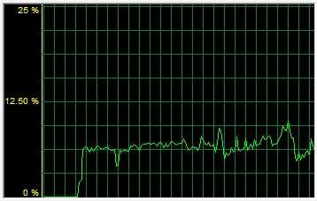
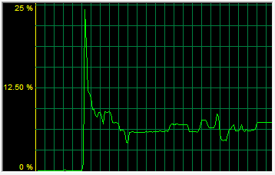
RTP/RTSP Streaming – Startup
Fast pre-roll decreases stream startup latency
Standard pre-roll (non MCX)
MCX fast pre-roll
t = 3 seconds
Buffer full
Rendering begins
t = 250 ms
Rendering begins
Network Throughput
Network Throughput
t = 750 ms
Buffer full
Time
Time
Device buffer fills at 1x the play rate, delaying the start of playback until three seconds have elapsed (based upon three second device jitter buffer)
Device buffer fills at much greater than 1x the play rate; rendering starts 2.75 seconds earlier than standard streaming

Slide 26
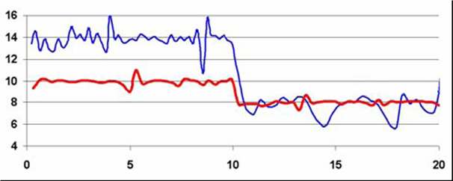
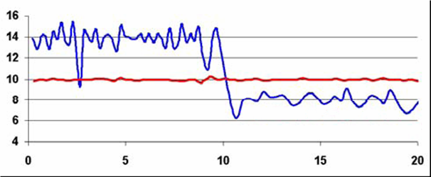
RTP/RTSP Streaming – Quality
WMM improves AV QoS on congested networks
Video
Data
Without WMM:
All streams suffer when network bandwidth is limited
Video
Data
With WMM:
Video throughput is unaffected when bandwidth is limited because video has higher priority than data traffic

Slide 27
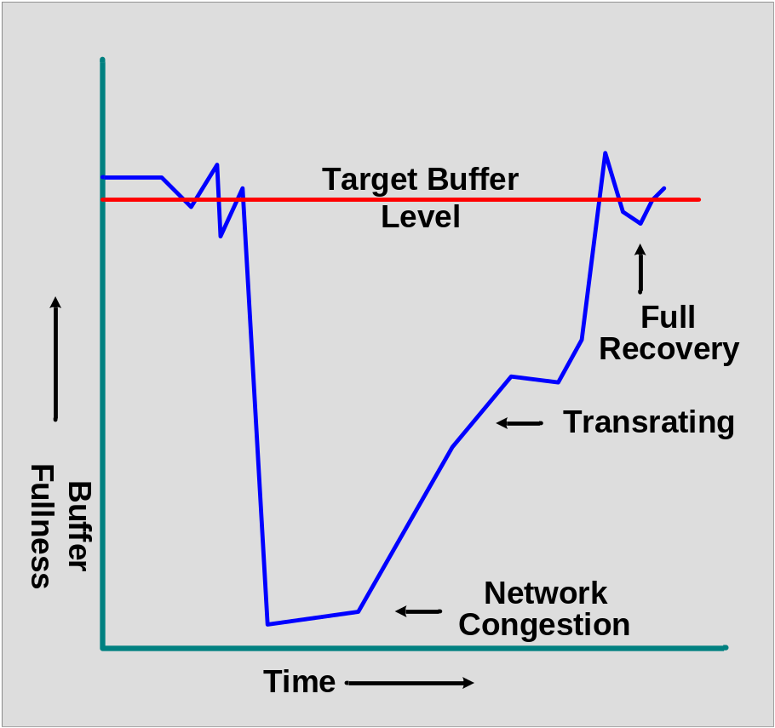
RTP/RTSP Streaming – Quality
Congestion management reduces starvations
The PC monitors network health and MCX buffer fullness
If reduced network capacity is causing device buffers to deplete, the PC transrates the stream to a lower bit-rate
The PC disengages the transrater
once device
buffers recover

Slide 28
RTP/RTSP – Protected Content
Delivering high-value media to MCX
MCX uses Windows Media DRM for Network Devices (WMDRM-ND) to enable playback of DRM-protected media content
Widespread deployment of WMDRM ensures seamless playback experience
  Many online premium content providers, including PlaysForSure content partners and Media Center Online Spotlight partners, provide music and video content protected using WMDRM
  Media Center protected TV content employs WMDRM
  (including native digital cable content)

Slide 29
HTTP Streaming
MPEG-1/-2, WAV, OEM-added formats
HTTP is used to stream media formats
not streamed via RTP
Aligns with DLNA guidelines
Allows devices to support additional media formats without installing software on the Windows Vista PC
  Enables OEM differentiation via addition
  of optional decoders to the MCX device

Slide 30
AV Protocols
Summary
 | Included in MCX-PAK | Must be provided by MCX OEM
RTP/RTSP | ✓
RTCP | ✓
qWAVE | ✓
WMDRM-ND | ✓
HTTP for required media formats | ✓
HTTP for optional media formats |  | ✓
Software support for all required AV protocols is included in the MCX Platform Adaptation Kit
Details regarding the MCX Platform Adaptation Kit are provided in the
CON 003 session

Slide 31
AV Streaming
Excerpted platform implications
Required for media playback
  Decoders for MPEG-1, MPEG-2,
  MP3, AC-3, VC-1, WMV 9, WMA
  High-performance network stack
  (detailed performance metrics available
  as part of MCX partner documentation)
Required for WMDRM-ND
  Analog and digital output protection
  Secure private key storage
  AES and RC4 support
Full platform requirements are included as part of the MCX partner documentation

Slide 32
Call To Action
Attend or review related MCX sessions
  CON055 – Introduction to Media Center Extender Functionality for Consumer Electronics Devices
  CON003 – Adaptation Kit and Certification Program for Implementing Media Center Extender and PlaysForSure
Ensure your platform investments include functionality required to support MCX
E-mail: to obtain addition information about the Media Center Extender partner program
Mcxprtnr @ microsoft.com

Slide 33
Additional Resources
Related Sessions
  CON074 – Plug and Play for Network Connected Devices
  MED114 – Windows Media DRM Device Ecosystem
  for Windows Vista
Related Ask the Experts Sessions
  Thursday, May 25, Noon – 1:00 PM
Related Web sites
  Digital Living Network Alliance: http://www.dlna.org/
  PlaysForSure: http://www.playsforsure.com
MCX Partner Program Information
  E-mail:
  Website: http://www.microsoft.com/mcxpartner
mcxprtnr @ microsoft.com

Slide 34

© 2006 Microsoft Corporation. All rights reserved. Microsoft, Windows, Windows Vista and other product names are or may be registered trademarks and/or trademarks in the U.S. and/or other countries.
The information herein is for informational purposes only and represents the current view of Microsoft Corporation as of the date of this presentation. Because Microsoft must respond to changing market conditions, it should not be interpreted to be a commitment on the part of Microsoft, and Microsoft cannot guarantee the accuracy of any information provided after the date of this presentation.
MICROSOFT MAKES NO WARRANTIES, EXPRESS, IMPLIED OR STATUTORY, AS TO THE INFORMATION IN THIS PRESENTATION.

Slide 35
