Slide 1
Can EEG inform the fNIRS HRF?
HRF estimation on gradCPT mnt-correct trials, with the event-based HRF as the benchmark
N = 6 subjects with simultaneous Cz EEG · image-space parcels · AR-IRLS
Notes:
Every design is compared against the event-based Gaussian-kernel (GK) HRF for mnt-correct trials. All HRFs are fit on the same parcel time series with Cedalion AR-IRLS, and all span -2 to 18 s.

Slide 2
Three EEG designs, each judged against the benchmark
AR-IRLS on the same 410 parcels (new Adot); all predict the average mnt-correct response, −2 to 18 s
Design | What drives the regressor | Uses EEG | Section
Benchmark (event GK) | Mnt-correct onsets, 20 Gaussian kernels (−2 to 18 s, 1 s apart, σ = 1 s), every trial weight = 1 | No | Reference everywhere
EEG-informed GK | Same kernels; each trial weighted by its Cz N2–P3 peak-to-peak ÷ run mean | Trial amplitude | Part 1
Cont-EEG (mnt-correct) | Cz EEG kept only inside mnt-correct trials, delayed −2 to 18 s on 20 B-splines | Waveform in trials | Part 2
Cont-EEG (entire run) | All continuous Cz, delayed 0 to 15 s on 15 B-splines | Whole waveform | Part 3
Preprocessing shared by all fits: 0.02 Hz highpass (0.01 Hz for Cont-EEG) → OLS drift → OLS GSR, then AR-IRLS
Comparison: per-parcel shape r over 0–18 s, RMS amplitude ratio, F-tests, and network means across subjects
Notes:
Subjects: 670, 695, 721, 723, 726, 730 (clean Cz). sub-670 is now included: its shared Y_all no longer has duplicated runs after the fNIRS-EEG matching fix. The estimator comparison (AR-IRLS vs fixAR-IRLS vs AR-iRRR) moved to the appendix.

Slide 3
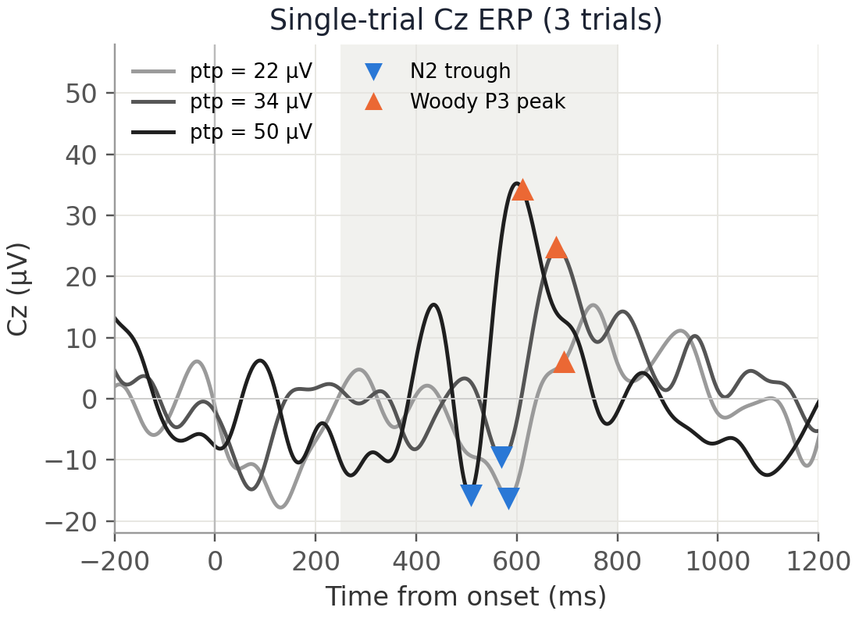
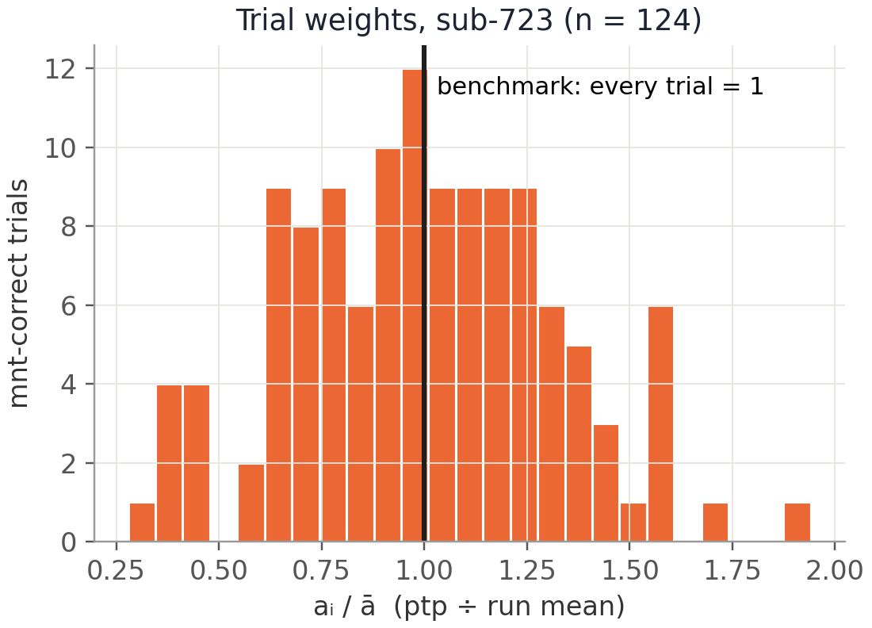
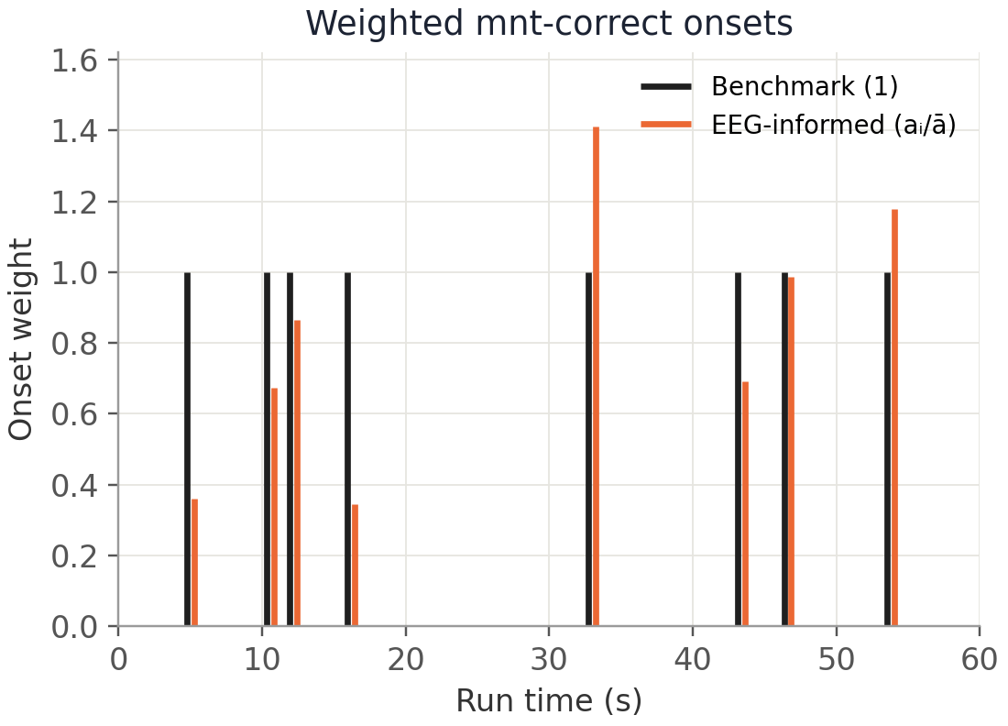
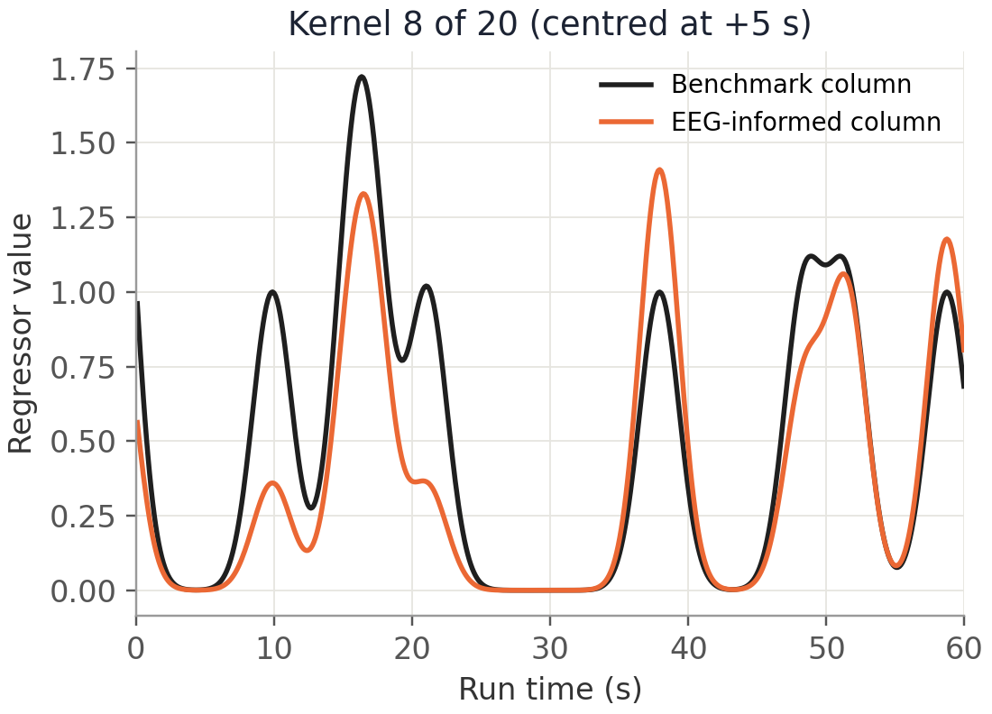
EEG-informed GK: scale each trial’s kernels by its ERP amplitude
Pipeline for one subject (sub-723); the benchmark is the same pipeline with every weight = 1
1
Measure N2–P3 ptp
2
Normalize within run
3
Weight each onset
4
Convolve with kernels
Woody P3 peak minus the N2 trough before it, Cz, per trial
aᵢ / ā, so the average trial weighs 1
Mnt-correct onsets get height aᵢ / ā instead of 1
20 Gaussian kernels (−2 to 18 s) → 20 design columns
Why it could help: if bigger ERPs mean more neural activity, the HbO response should scale with them, and a weighted design should fit better than the onset-only benchmark. Trials rejected for artifacts (> 100 µV) get the mean weight of 1.
Notes:
Built by build_dm_gaussian-kernel_mnt-correct_EEG-informed.py with features from extract_EEG_trial_features.py (cz_N2P3_ptp_woody; Pz when Cz has no clean trials in a run). In sub-723 the weights span 0.28 to 1.94 (SD 0.32). The kernel panel shows kernel 8 of 20 (centred at +5 s).

Slide 4
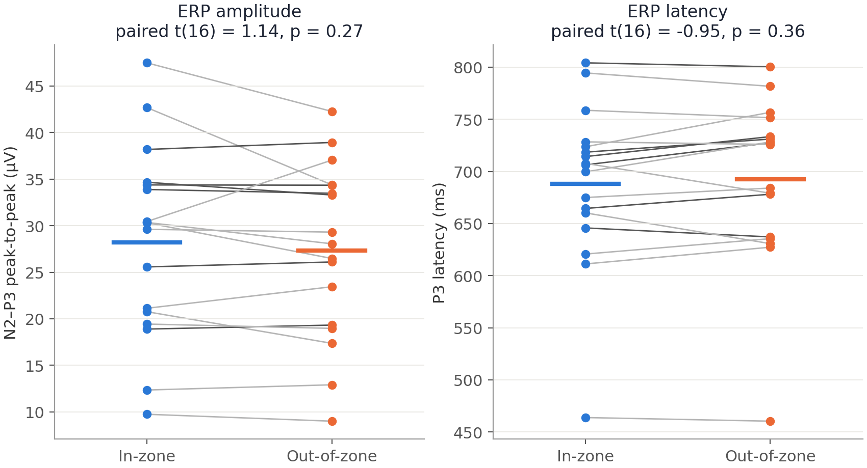
ERP amplitude and latency do not track the zone
Cz, clean mnt-correct trials; in-zone = VTC below the subject’s median; one line per subject (dark: the 6 modeling subjects)
p = 0.27
N2–P3 ptp: 28.2 vs 27.3 µV (in vs out), N = 17
p = 0.36
P3 latency: 688 vs 692 ms (in vs out), N = 17
≥ 10
Clean trials per zone required per subject (sub-747 has none)
Notes:
Paired t-tests on per-subject means. Trial weights in the EEG-informed design vary a lot within subject (SD of a_i/a-bar about 0.3-0.4), but that variation is not tied to attention state. Source: eeg_trial_feats.csv built from the features table and VTC_smoothed.

Slide 5
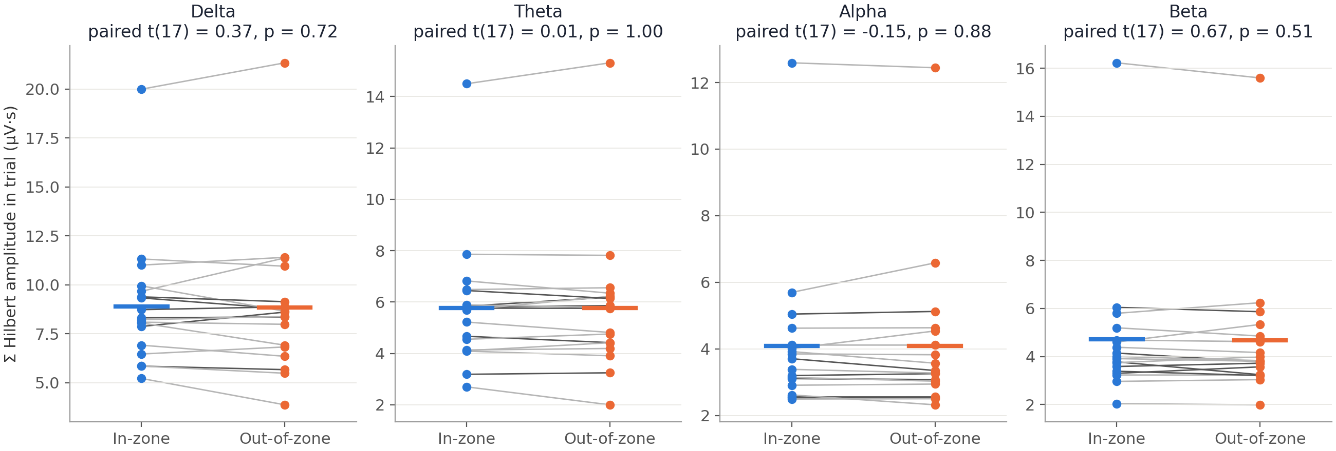
Within-trial band amplitude does not differ between zones either
Cz Hilbert amplitude of the band-passed continuous EEG, summed over each mnt-correct trial (onset to onset + duration), all trials, N = 18
p = 0.72
p = 1.00
p = 0.88
p = 0.51
Delta, 1–4 Hz
Theta, 4–8 Hz
Alpha, 8–13 Hz
Beta, 13–30 Hz
Notes:
Envelope = |hilbert| of a zero-phase band-pass of the preprocessed Cz (0.1-45 Hz, mastoid reference, ICA). Paired t-tests on per-subject means of the per-trial sum (uV*s). The one high subject is the same in every band (overall amplitude, not a zone effect).

Slide 6
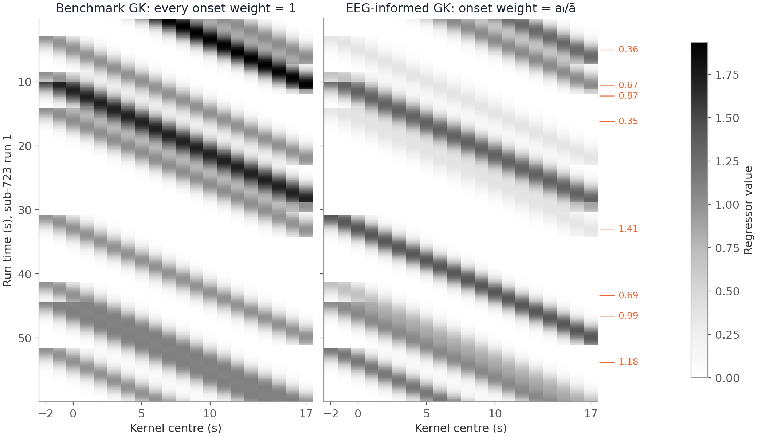
EEG-informed columns are rescaled benchmark columns
sub-723, run 1, 60 s; rows = fNIRS samples, columns = the 20 Gaussian kernels
Same onsets, same 20 kernels; only the height of each trial’s diagonal band changes
Matching columns correlate r = 0.92–0.96 (median per subject)
So the two designs can only differ through the trial-to-trial spread of aᵢ / ā
Notes:
Labels on the right of the EEG-informed matrix are the onset weights in this window. Column correlation computed from the saved full DM (stim vs eeg column, per kernel, median over kernels) for each of the 6 subjects.

Slide 7
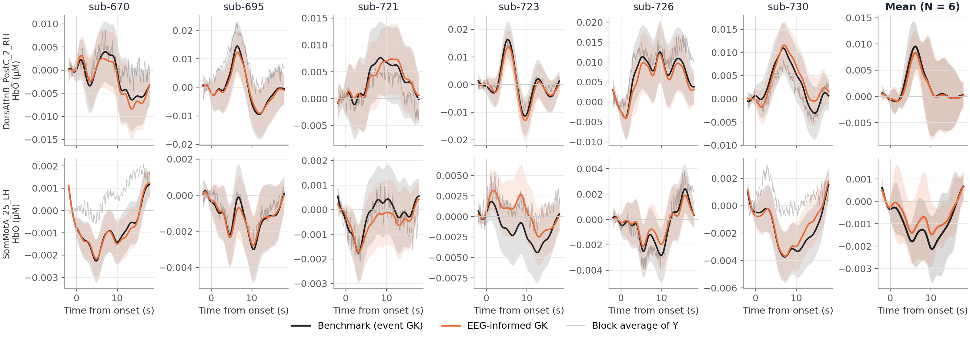
Two parcels: the EEG-informed HRF overlays the benchmark
DorsAttnB_PostC_2_RH and SomMotA_25_LH (locations in appendix); bands = 95% CI (mean panel: across subjects)
r = 0.96
0.96×
8 vs 8
Median shape r vs benchmark, 12 subject-parcels (0.76–0.99)
Median peak amplitude relative to the benchmark
Of 12 F-tests significant: EEG-informed vs benchmark
Notes:
Curves are the predicted response to an average mnt-correct trial, baseline (t<0) removed; the EEG-informed curve is multiplied by the mean weight (1.0). Grey thin line: block average of Y. From cmp_hrf_gaussian-kernel_vs_cont-EEG_mnt-correct.py outputs (2026-11-06, new Adot).

Slide 8
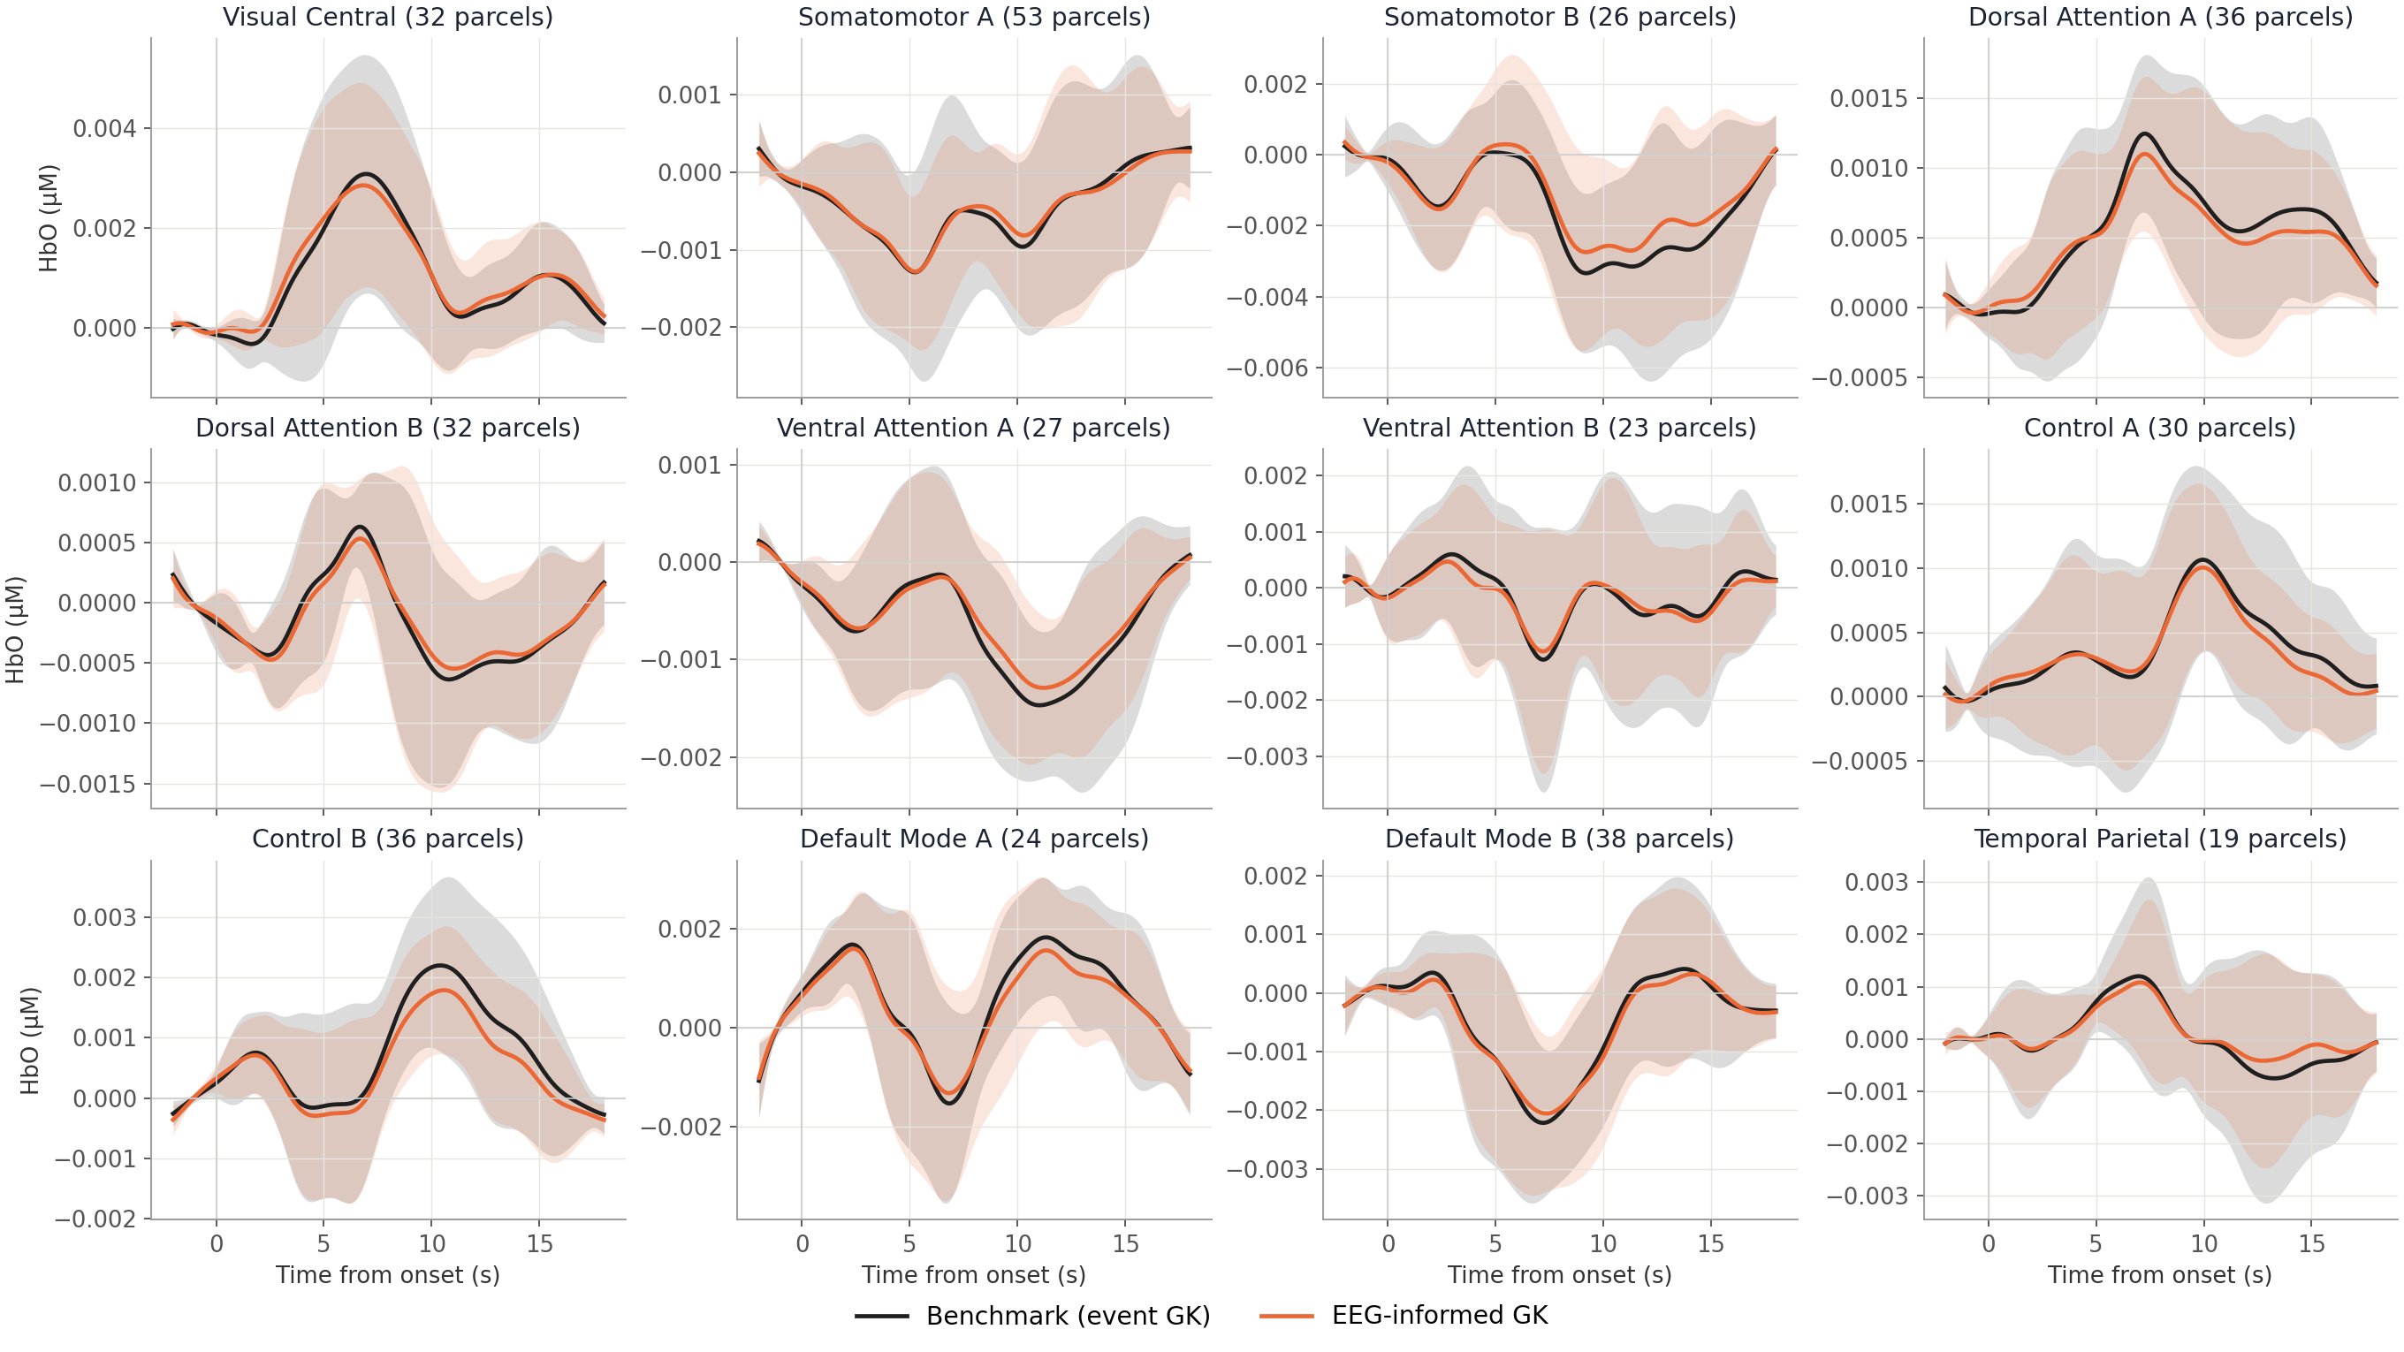
12 networks: EEG-informed GK matches the benchmark
Network-mean HRF, AR-IRLS, −2 to 18 s, N = 6 (mean ± 95% CI across subjects), not normalized
vs benchmark
0.99
Median network r (12 networks, 0.97–1.00)
0.97
Median per-parcel shape r
0.93×
Median per-parcel RMS amplitude
Notes:
Per-parcel r and RMS ratio: median over parcels per subject, then median over subjects. Computed from the saved onlyStim and onlyEEG-woodyN2P3ptp AR-IRLS betas (2026-11-06).

Slide 9
Conclusion 1: EEG-informed GK adds little beyond onset timing
The ERP weights vary from trial to trial, but neither carry attention-state information nor change the HRF
1
Weights carry no state
2
Little design leverage
3
HRF unchanged
p ≥ 0.27
r ≈ 0.93
r = 0.99
N2–P3 ptp, P3 latency and 4-band Hilbert amplitude do not differ in vs out of the zone
Trial-to-trial spread looks like noise, not attention
Weighted and unweighted columns are nearly collinear
Mean weight = 1, so the average-trial response is the same by construction
Network-level shape identical to the benchmark
Per-parcel r = 0.97; amplitude 0.93×
Same F-test significance at the example parcels
Bottom line: the EEG-informed model’s information comes from the onset times; Cz ERP amplitude does not track the state that shapes the HRF.
Notes:
Bottom line: the information in the EEG-informed model comes from the onset times. ERP amplitude as measured at Cz does not track the attentional state that modulates the HRF.

Slide 10
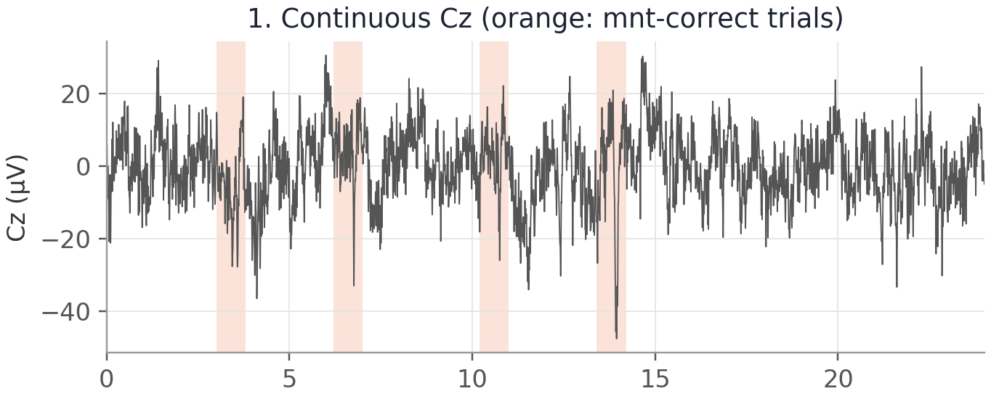
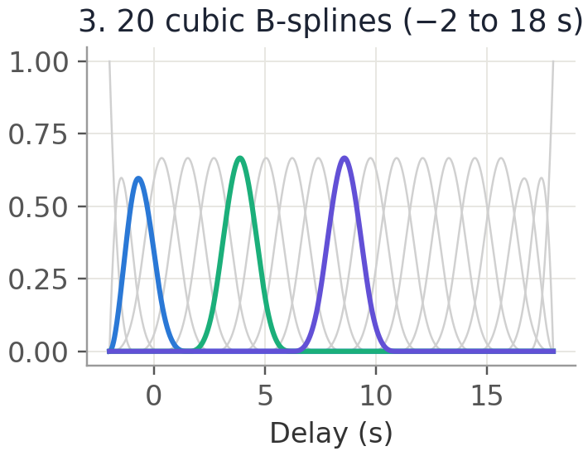
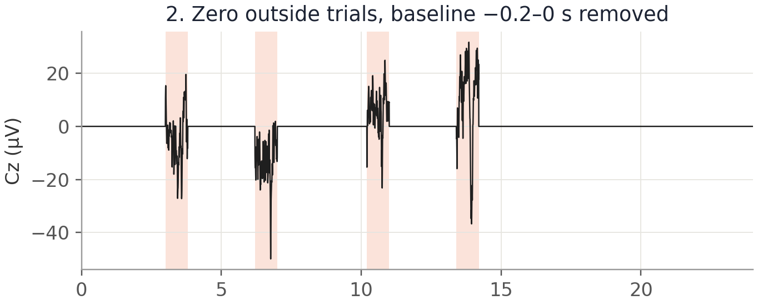
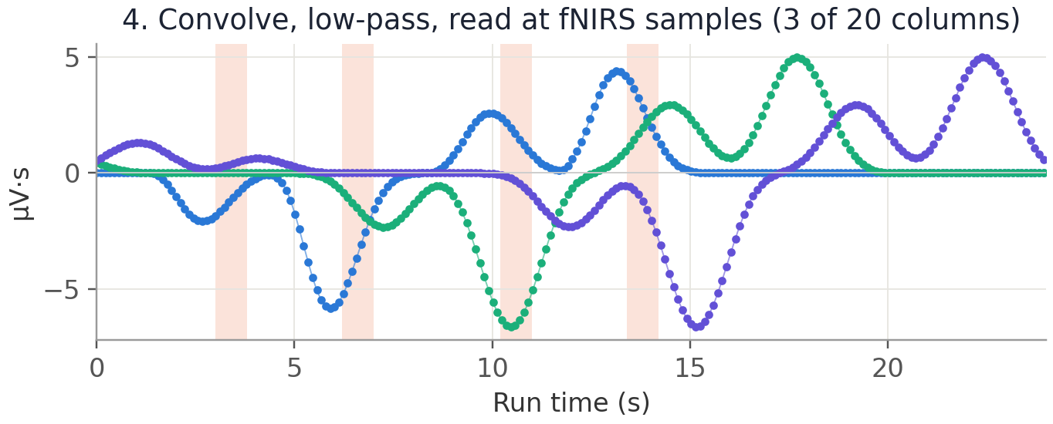
Cont-EEG: mask Cz to mnt-correct trials, then convolve
sub-723, run 2, 24 s; the delay kernel h(d) is fit per parcel and convolved with the masked EEG
Mask: keep Cz from onset to onset + duration (~0.8 s) of each mnt-correct trial; all city and mnt-incorrect time is zero
Delay axis −2 to 18 s projected on 20 B-splines, the same span as the benchmark kernels
Notes:
Same masking as run_model_cont_EEG_city_mnt.py (and the example trial of diag_contEEG_flat_hrf.py): Cz baseline-corrected per trial over -0.2 to 0 s, zero elsewhere; each B-spline column is the masked EEG convolved with that spline, low-passed at the fNIRS Nyquist and read at the fNIRS samples. The model predicts y = h * EEG, so the response to an average trial is h convolved with the average within-trial Cz.

Slide 11
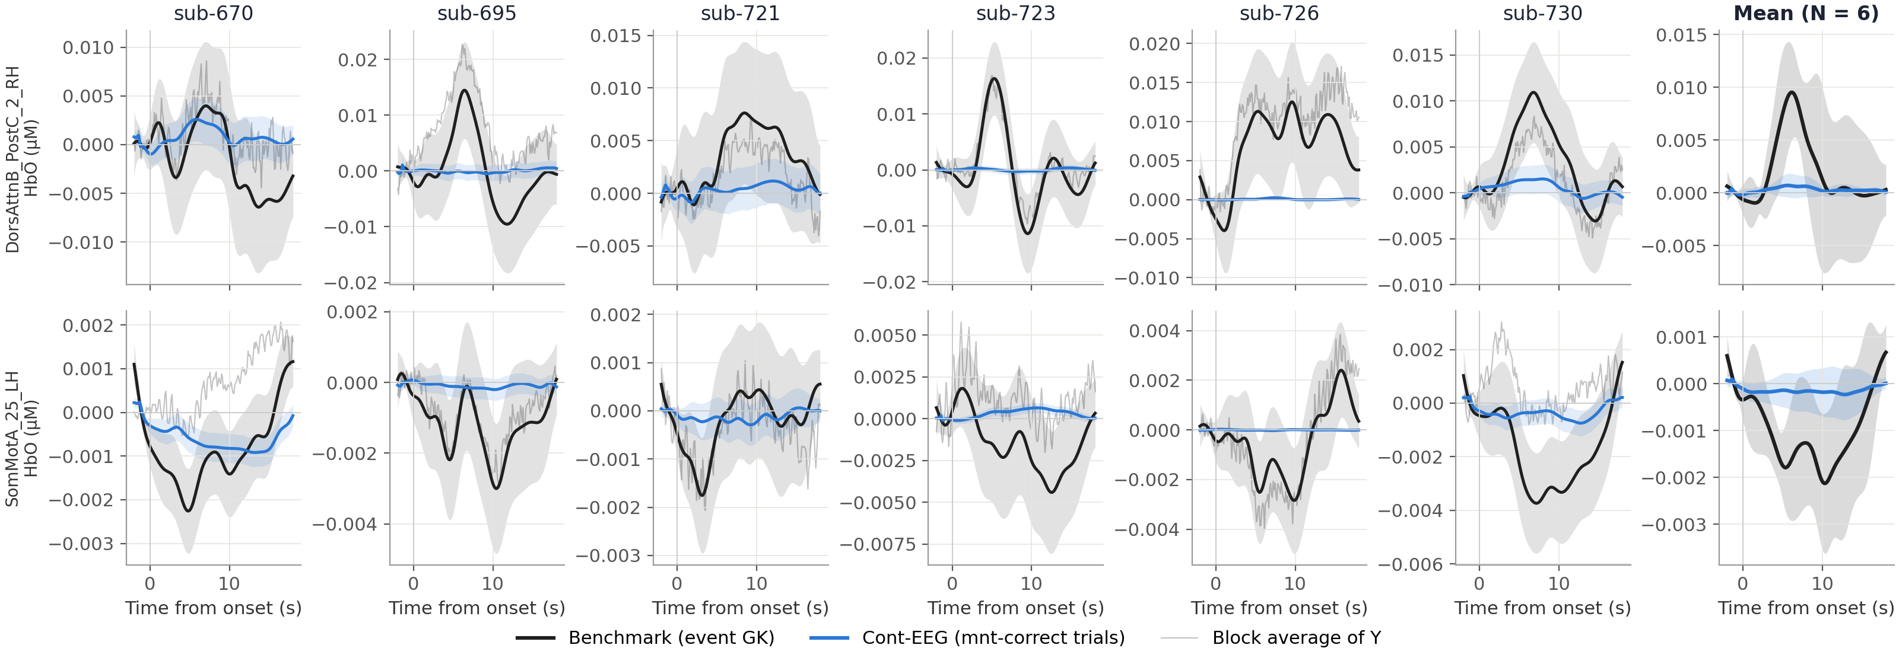
Two parcels: the Cont-EEG response is nearly flat
Predicted response to an average mnt-correct trial (kernel ∗ average within-trial Cz); bands = 95% CI
0.14×
r = 0.28
9 of 12
Median peak amplitude relative to the benchmark
Median shape r, 12 subject-parcels (−0.82 to 0.87)
Cont-EEG F-tests not significant (p > 0.05)
Notes:
Per-subject Cont-EEG curves come from the comparison fit (mnt-correct trials only, 0.02 Hz highpass, as the GK models), which also gives the CIs. The 12-network figure uses the saved run_model_cont_EEG_city_mnt fit (mnt-correct + mnt-incorrect, 0.01 Hz); at these parcels the two agree (median r about 0.93).

Slide 12
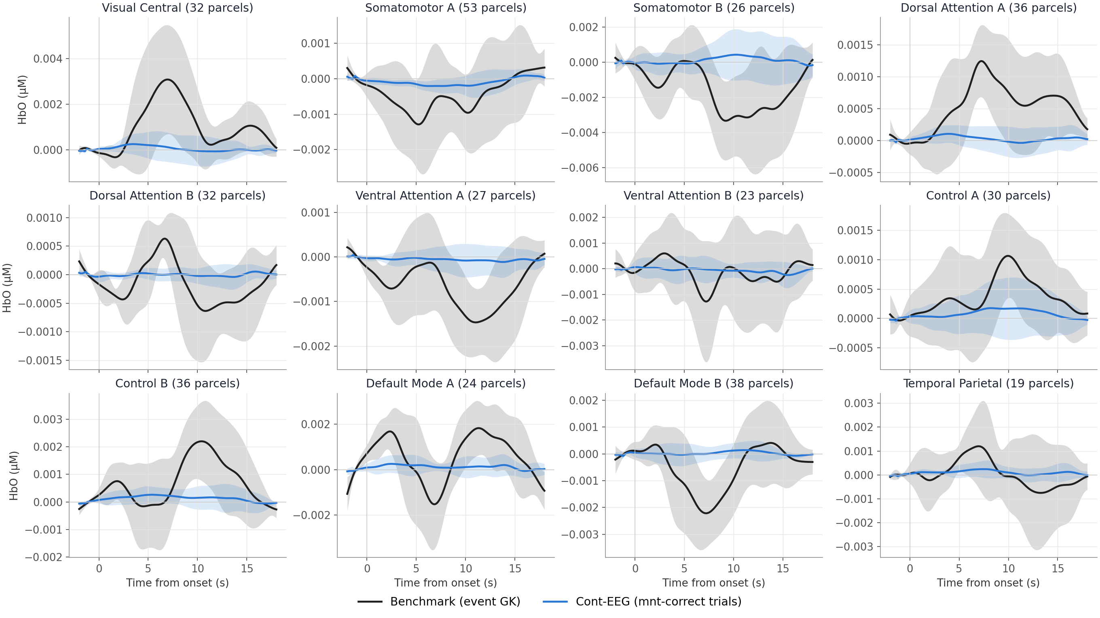
12 networks: Cont-EEG stays near zero
Network-mean response, AR-IRLS, −2 to 18 s, N = 6 (mean ± 95% CI across subjects), not normalized
vs benchmark
0.20×
Median per-parcel RMS amplitude
0.21
Median per-parcel shape r (subjects −0.16 to 0.51)
0.30
Median network r (−0.86 to 0.85)
Notes:
Kernel betas from cont_EEG_cz_mnt_correct_incorrect_pre2post18_bl0.2-0_ar_irls_Hp0.01 (2026-11-06), convolved with each subject’s average within-trial Cz. Shape r varies in sign across networks and subjects, so there is no consistent HRF shape.

Slide 13
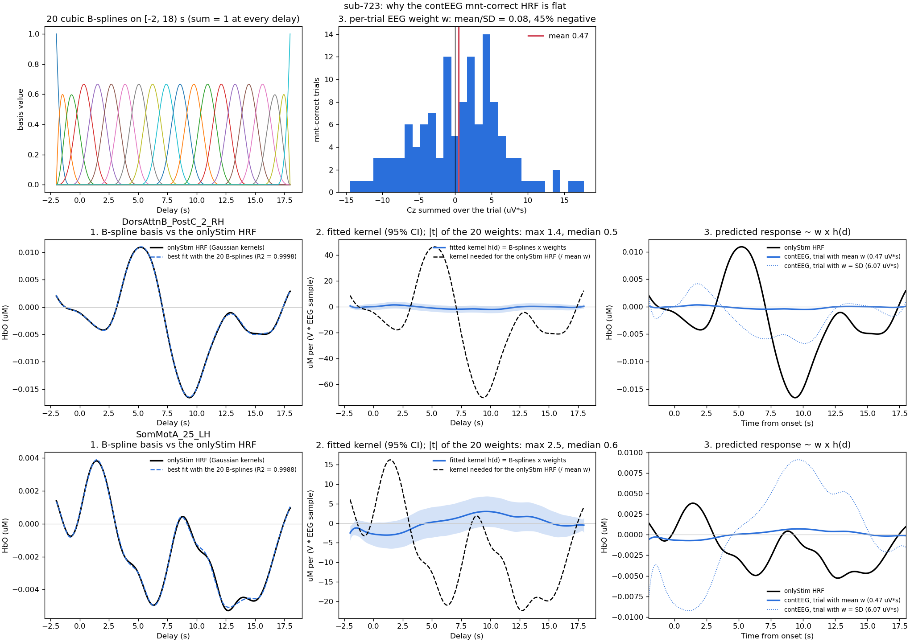
Conclusion 2: Cont-EEG finds no HRF, and why it cannot
Diagnosis on sub-723 (diag_contEEG_flat_hrf.py): the basis is fine; the EEG input cancels itself
1
Not the basis
The 20 B-splines reproduce the benchmark HRF almost exactly (R² = 0.999).
2
Weights ≈ 0
Kernel weights: |t| max 1.4–2.5, median ≈ 0.5; F-test p = 0.8 at DorsAttnB.
3
EEG sums to ≈ 0 per trial
Cz summed over a trial: mean/SD = 0.08, negative in 45% of trials, so the average-trial response ≈ mean(w)·h(d) is flat.
4
No consistent shape
Amplitude 0.2× the benchmark; shape r changes sign across networks and subjects.
Notes:
After per-trial baseline correction the within-trial EEG is roughly zero-mean, so convolving a smooth kernel with it gives a response proportional to the trial sum w, which is near zero on average. To reproduce the benchmark, the kernel would need to be 30-50x larger than the fitted one.

Slide 14
Takeaways
The event-based mnt-correct HRF is the result to report; EEG designs do not improve on it
EEG-informed GK ≈ benchmark (r = 0.99): ERP amplitude, latency and band amplitude do not track attention state
Cont-EEG gives no HRF: zero-mean within-trial EEG cancels, leaving 0.2× amplitude and no consistent shape
Next: EEG features that do not cancel and do vary with state (band-power envelopes, pre-stimulus alpha, frontal theta), with held-out or permutation tests
Notes:
Part 3 checks whether using the whole continuous EEG instead of the masked trials changes the Cont-EEG conclusion.

Slide 15
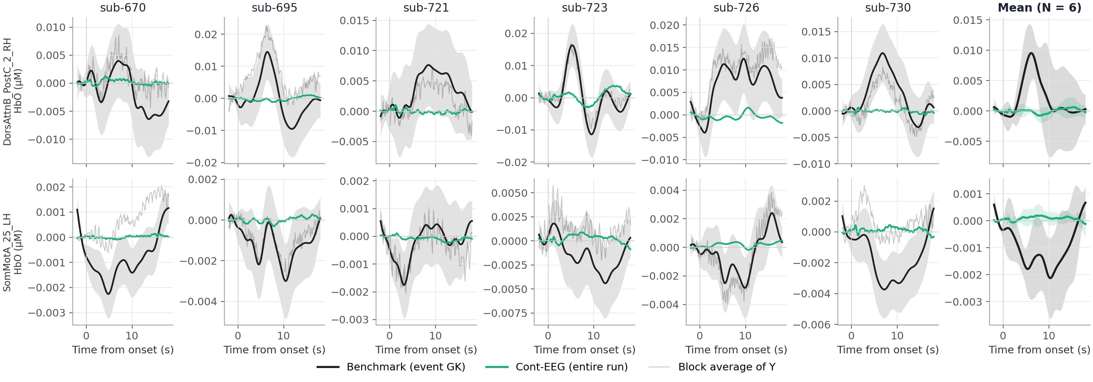
Additional model: Cont-EEG over the entire run is also flat
No trial mask: all continuous Cz, delays 0–15 s on 15 B-splines; prediction = kernel ∗ Cz averaged around mnt-correct onsets
0.14×
r = 0.19
15 vs 20
Median peak amplitude relative to the benchmark
Median shape r, 12 subject-parcels (−0.57 to 0.56)
Spline basis size: 0–15 s causal kernel vs −2 to 18 s
Notes:
Model cont_EEG_cz_3-stage_bspline-test_ar_irls_Hp (2026-11-06). The kernel covariance was not saved, so per-subject panels have no band; the mean panel shows the across-subject 95% CI. The event-locked Cz average covers -17 to 18 s around each mnt-correct onset, so it includes the ERPs of the surrounding city trials.

Slide 16
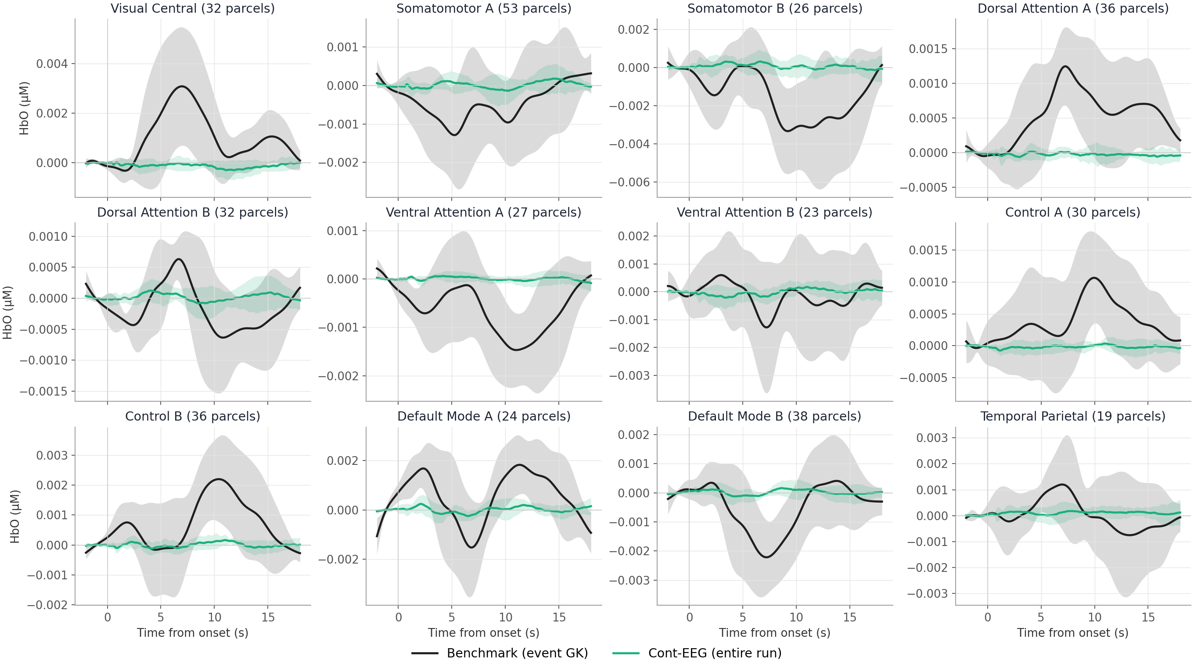
12 networks: entire-run Cont-EEG does not recover the benchmark
Network-mean response, AR-IRLS, −2 to 18 s, N = 6 (mean ± 95% CI across subjects), not normalized
vs benchmark
0.15×
Median per-parcel RMS amplitude
0.19
Median per-parcel shape r (subjects −0.14 to 0.29)
0.28
Median network r (−0.24 to 0.73)
Notes:
Same conclusion as Cont-EEG within trials: tiny amplitude and no consistent shape. Earlier train/test analysis of this design (fixAR-IRLS and AR-iRRR, train run 1) gave in-sample R² < 2% and held-out R² ≈ 0.

Slide 17
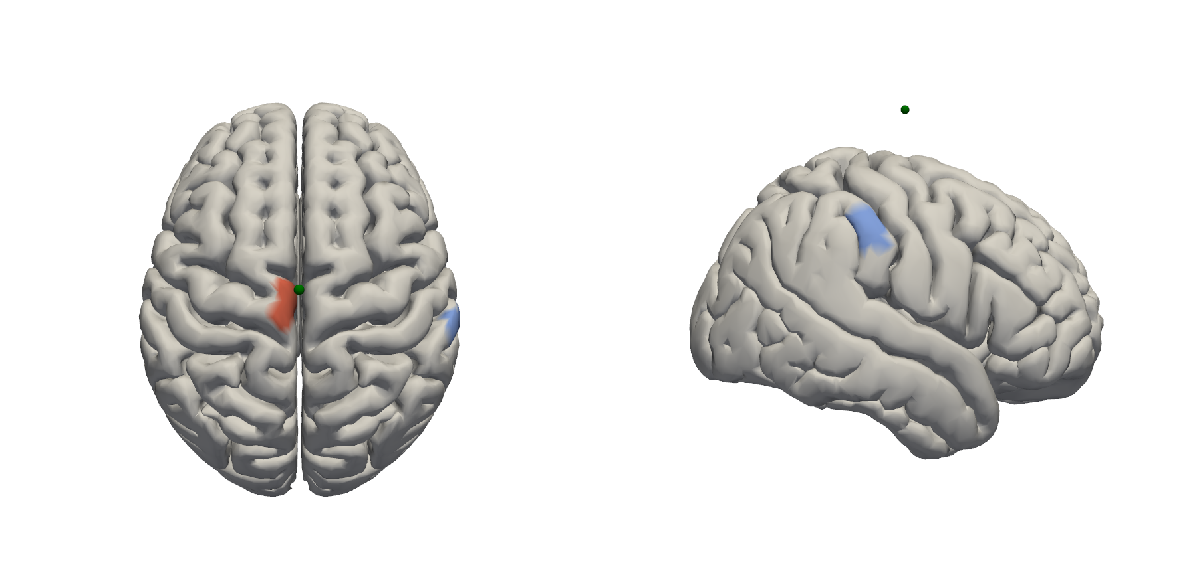
Appendix: location of the two example parcels
ICBM152 brain, superior and right views; green dot = Cz landmark
SomMotA_25_LH
Left somatomotor, next to the midline under Cz
DorsAttnB_PostC_2_RH
Right postcentral, dorsal attention B
Notes:
Rendered with cedalion image_recon on the standard icbm152 head model, as in cmp_fixAR-IRLS_AR-iRRR_single-subj_all-runs.py.

Slide 18
Appendix: EEG and fNIRS preprocessing
Both streams end on the same fNIRS sample grid before any model is fit
EEG
Band-pass
Bad channels
Re-reference
ICA
Trial features
0.1–45 Hz
Flat, abnormal variance or large amplitude removed
Mastoids TP9h / TP10h
Infomax; components matching hEOG / vEOG removed
Epoch −0.2 to 1.6 s, reject > 100 µV; Woody N2–P3, Hilbert bands
fNIRS
Prune channels
OD → image
Parcels
Filter & window
Nuisance
SNR > 5, 1–40 mm, amplitude range
Image recon with the updated Adot (vertex space)
Mean per parcel; keep sensitive parcels (410)
0.02 Hz highpass; first onset → last onset + 15 s
OLS Legendre drift, then OLS GSR; runs concatenated
Alignment and design: fNIRS and EEG runs are matched by the first stimulus onset and first reaction times; EEG regressors are low-passed at the fNIRS Nyquist and read at the exact fNIRS sample times; every design (benchmark, EEG-informed GK, Cont-EEG) is then fit with Cedalion AR-IRLS.
Notes:
EEG: eeg_preprocess_pipeline.py and extract_EEG_trial_features.py. fNIRS: cedalion_v26/STEP1_image_recon.py (ar_irls branch: no TDDR, no band-pass), then run_model_cont_EEG_fNIRS.py builds the shared Y_all. Cont-EEG models use a 0.01 Hz highpass.

Slide 19
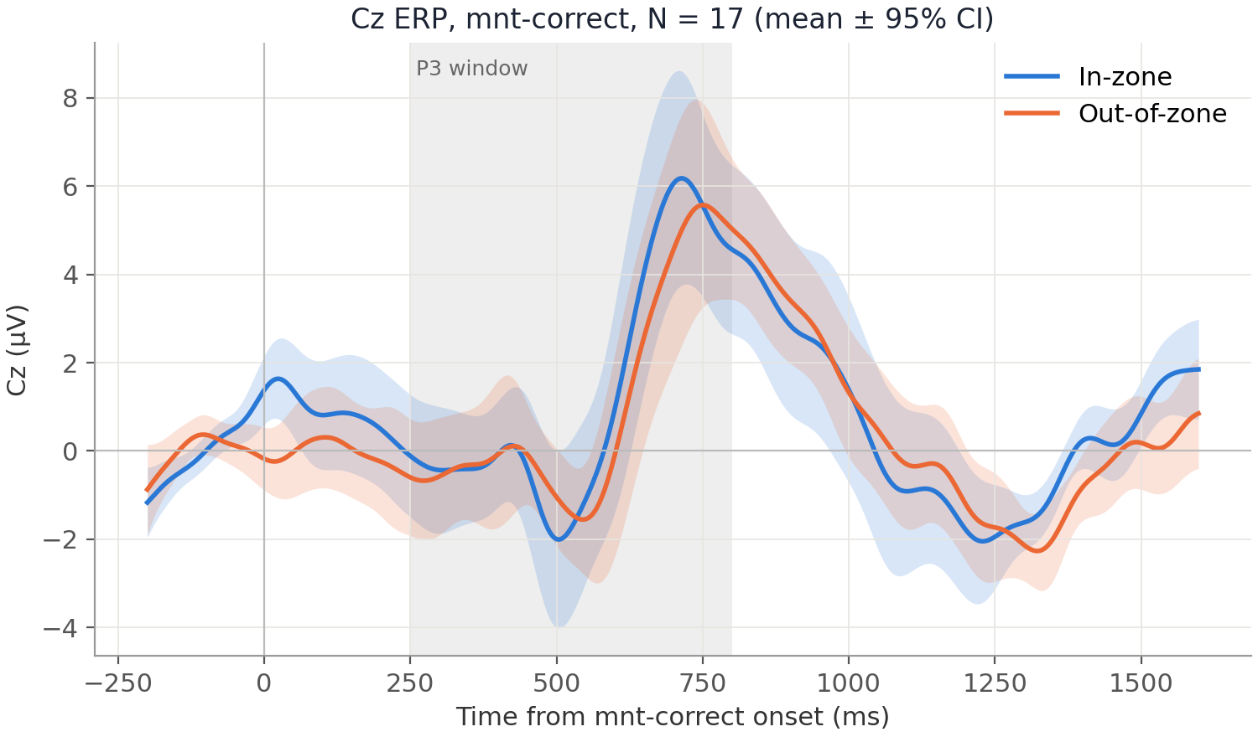
Appendix: P3 in-zone vs out-of-zone
Grand-average Cz ERP, clean mnt-correct trials, 10 Hz low-pass, baseline −0.2–0 s, N = 17
The two waveforms overlap through the N2 and P3 windows
Matches the single-trial result: no amplitude (p = 0.27) or latency (p = 0.36) difference
In-zone = VTC below each subject’s median VTC
Notes:
Per-subject average per zone, then mean and 95% CI across subjects. Shaded: P3 search window 0.25-0.80 s.

Slide 20
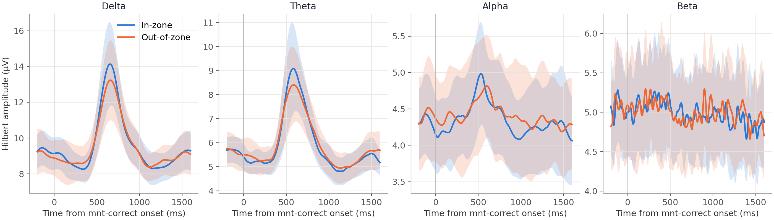
Appendix: Hilbert amplitude in four bands, in vs out of the zone
Cz envelope around mnt-correct onsets, −0.2 to 1.6 s, no baseline correction, N = 17 (mean ± 95% CI)
In-zone and out-of-zone envelopes overlap in every band and at every latency; the within-trial sums tested on the main slide are flat for the same reason.
Notes:
Same envelopes as the BandPowerImage figures in single_Subj_analysis_ERP_ERSP.py, shown as amplitude (uV) rather than power.

Slide 21
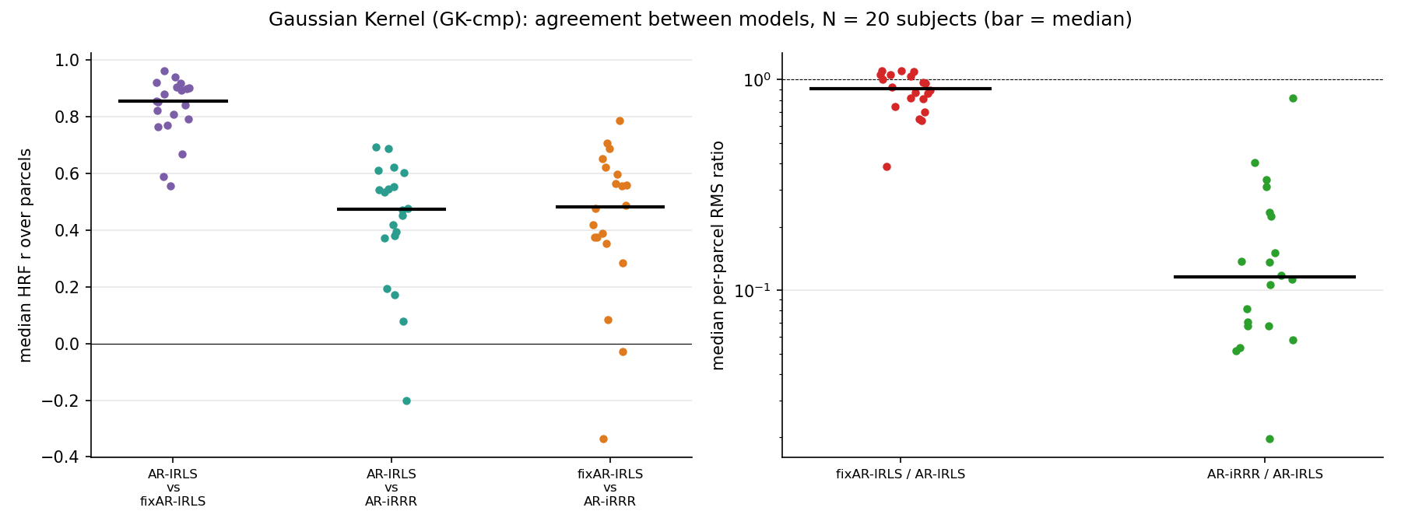
Appendix: estimators change amplitude, not shape
AR-IRLS vs fixAR-IRLS vs AR-iRRR, event GK −2 to 18 s, N = 20; fit before the Adot update
r ≈ 0.86
AR-IRLS vs fixAR-IRLS shape (median)
≈ 0.9×
fixAR-IRLS amplitude vs AR-IRLS
≈ 0.12×
AR-iRRR amplitude (shrunk; r ≈ 0.47)
Notes:
From summary_run_model_cont_EEG_city_mnt section 14 (hrf_corr_amplitude.png, 2026-10-21, previous Adot). Values read from the figure. Not rerun with the new Adot.

