Slide 1


EEG & Pupil Features of Sustained Attention
A literature survey for gradCPT_NN24, with our results · November 2026

Slide 2
Scope: what is already tried vs. what the literature adds
Already in the pipeline
New candidates from the literature
P3 amplitude & latency
Band power (sliding window / Hilbert amplitude)
Pupil diameter
Pupil-diameter derivative
ERP: CNV, P1/N1, MMN, CPP build-up, SSVEP
Spectral: theta/beta ratio, aperiodic exponent, IAF
Dynamics: theta variability, microstates, phase-locking
Pupil/eye: TEPR, pupil variability, blinks, microsaccades, saccade & fixation metrics
Direction of change is always given for degraded attention: lapses, mind wandering (MW), out-of-the-zone, or time-on-task (TOT).

Slide 3

EEG features
Evoked potentials, spectral power and signal dynamics

Slide 4
Evoked potentials shrink before and during lapses
Feature | Direction | Task | Study
P3 amplitude | ↓ during MW and before commission errors | SART + thought probes | Smallwood et al., 2008
P3 amplitude (frontal) | ↓ 3–4 s before a missed target | Continuous temporal expectancy task (CTET) | O'Connell et al., 2009
P3 amplitude & latency | Amplitude ↓, latency ↑ with TOT; reward restores amplitude only | 140-min flanker | Liu et al., 2020
CNV | ↓ during the target interval before misses | CTET | O'Connell et al., 2009
P1 / N1 amplitude | ↓ during MW (sensory decoupling) | SART + probes | Kam et al., 2011
MMN | ↓ during MW | Breath counting + passive oddball | Braboszcz & Delorme, 2011
SSVEP amplitude | No difference before hits vs. misses | CTET (25 Hz flicker) | O'Connell et al., 2009
CPP build-up rate | Slower build-up → slower RT; tracks attention fluctuations | Random-dot motion detection | Kelly & O'Connell, 2013

Slide 5
Spectral power: the direction depends on the task
Feature | Direction | Task | Study
Posterior alpha power | ↑ from ~20 s before a miss | CTET | O'Connell et al., 2009
Alpha power (SVM feature) | ↑ during MW; most predictive feature | SART + visual search | Jin et al., 2019
Alpha / theta / delta power | ↑ during MW (beta unchanged) | Sustained attention task, fMRI-EEG-pupil | Groot et al., 2021
Theta, delta, alpha, beta | θ, δ ↑; α, β ↓ during MW (internal task) | Breath counting, eyes closed | Braboszcz & Delorme, 2011
Frontal theta & alpha | θ ↑ over 4 h; α ↑ then plateaus at ~1 h | Spatial S-R compatibility, 4 h | Wascher et al., 2014
Frontal theta/beta ratio | ↑ during MW episodes | Breath counting | van Son et al., 2019
Aperiodic (1/f) exponent | Frontal exponent tracks sustained-attention performance | CANTAB RVP, resting EEG (older adults) | Campbell et al., 2022 (poster)
Individual alpha frequency | Associated with false alarms | CANTAB RVP (older adults) | Campbell et al. (poster)

Slide 6
Variability and state dynamics are underused EEG markers
Feature | Direction | Task | Study
Frontal-midline theta | ↓ out of the zone; predicts commission errors, lower d′ | gradCPT | Solís-Vivanco et al., 2024
Trial-to-trial theta variability | Higher variability ↔ less stable RTs | gradCPT | Solís-Vivanco et al., 2024
Stimulus-locked (task-related) theta | ↓ with TOT while ongoing θ/α ↑; alpha peak may slow | Prolonged cognitive task | Arnau et al., 2021
Temporal variability of cortical responses | ↑ with TOT; P1/N1 and pre-stimulus α unchanged | 80-min sustained attention task | Reteig et al., 2019
Theta phase-locking (ITC) + P1 | ↓ during MW | SART | Baird et al., 2014
EEG microstates | Microstate C coverage ↑, E duration ↓ with TOT | Modified SART + probes | CNS 2025 poster

Slide 7

Pupil & eye-tracking features
Tonic baseline, phasic responses, variability and oculomotor events

Slide 8
Baseline pupil: the direction is mixed
Feature | Direction | Task | Study
Baseline diameter | Small ↔ lapses, but driven by TOT; ∩ after removing TOT | gradCPT (isoluminant) | van den Brink et al., 2016
Pupil derivative | Linear relation with performance, robust to TOT | gradCPT | van den Brink et al., 2016
Baseline diameter | MW → smaller; external distraction → larger | Sustained attention + probes | Unsworth & Robison, 2016
Baseline diameter | ↑ before encoding failures and slowest 20% RTs | WM vs. choice-RT task | Smallwood et al., 2011
Baseline diameter | Larger before MW reports / during TUT | Reading; fMRI-EEG task | Franklin 2013; Groot 2021
Baseline diameter | Smaller during MW | Breath focus | Grandchamp et al., 2014
Tonic pupil | MW smaller only in external-focus tasks | Four experiments | Unsworth & Robison, 2018

Slide 9
Evoked pupil responses and eye events are more consistent
Feature | Direction | Task | Study
Task-evoked pupil response (TEPR) | Largely absent during MW | WM vs. choice-RT task | Smallwood et al., 2011
TEPR | ↓ with TOT; baseline shows no clear relation | Visual vigilance task; PVT | Martin et al., 2022
Stimulus-evoked dilation | ↓ with fatigue; restored by reward | 2-h 2-back | Hopstaken et al., 2015b
Pupil size & dilation rate | Differ between fastest and slowest RTs | PVT | Kristjansson et al., 2009
Trial-to-trial pupil / TEPR variability | Higher variability predicts off-task thinking | WM / attention battery | Unsworth & Robison, 2017
Blink rate & fixation rate | Blinks ↑, fixations ↓ during MW | Reading | Smilek et al., 2010
Microsaccade rate | ↓ before commission errors | SART | Valsecchi et al., 2025

Slide 10

Studies using gradCPT
Gradual city/mountain transitions (~800 ms) with in/out-of-the-zone states from the variance time course (VTC)

Slide 11
gradCPT studies with EEG, pupil or eye tracking
Study | Modality | Features | Main finding
van den Brink et al., 2016 | Pupil | Baseline diameter; derivative | ∩ after TOT removed; derivative robust
Solís-Vivanco et al., 2024 | EEG, n = 30 | FM theta; theta variability | Theta ↓ out of the zone
Zhang, Zhang & Xu, 2020 | Eye tracking, n = 30 | Pupil mean; pupil variation, saccade duration & velocity, fixation duration | All differ in vs. out of zone
Zuberer et al., 2025 (poster) | Pupil, n = 25 | Pupil size × attention state | Larger pupil out of zone = effort mobilization
Sensors, 2021 | 1-ch EEG (Fp1) | Wavelet-band energy, SD, entropy | SVM 73.5%; energy & SD most informative
Augmented Cognition (LNCS), 2022 | EEG + eye tracking | Multimodal classifier | In/out-of-zone recognition

Slide 12
What the gradCPT fMRI work says about the two states
In the zone
Out of the zone
Low RT variability
High RT variability
Higher default-mode (DMN) activity
Fewer errors, but risk rises if DMN goes too high
Background distractors processed more
More effortful, dorsal-attention (DAN) reliant
DMN/DAN dynamics predict upcoming lapses
Independent of the vigilance decrement
Sources: Esterman et al., 2013, 2014; Fortenbaugh et al., 2018 (n = 140); Esterman & Rothlein, 2019. Within-person prediction: Rosenberg et al., 2020.

Slide 13
EEG features: in the zone vs. out of the zone
Feature | In the zone | Out of the zone | Evidence | Source
Frontal-midline theta (transition-locked) | Higher | Lower; drop predicts errors, lower d′ | gradCPT | Solís-Vivanco 2024
Theta variability across the run | Low-variability people: smaller drop | High-variability people: bigger d′ drop | gradCPT, between-subject | Solís-Vivanco 2024
Posterior alpha power | Lower | Higher (expected) | Lapse / MW | O'Connell 2009; Jin 2019
P3 amplitude (mountain / no-go) | Larger | Smaller (expected) | Lapse / MW | Smallwood 2008; O'Connell 2009
P1 / N1 amplitude | Larger | Smaller (expected) | MW | Kam 2011; Baird 2014
CPP build-up rate | Faster, steadier | Slower, more variable (expected) | Attention fluctuation | Kelly & O'Connell 2013
Trial-to-trial response variability | Lower | Higher (expected) | Time-on-task | Reteig 2019
Responses to background distractors | Larger (counter-intuitive) | Smaller | gradCPT fMRI | Esterman 2014
Teal = measured in gradCPT; grey = expected by analogy to lapses, MW or time-on-task. Our test of every row follows in the next section.

Slide 14

Our data: gradCPT_NN24
18 subjects with EEG, 12 with eye tracking · in vs. out of the zone = run-median split of the smoothed VTC

Slide 15
We added 91 survey features; 5 could not be computed
Added (EEG: fz cz pz oz; Neon eye tracker)
Not computable here
Spectral, 10 s window: aperiodic exponent & offset, IAF, 1/f-removed α/θ, median frequency, θ/β and θ/α ratios, Fz–Pz / Fz–Oz coherence
Stimulus-locked: θ power, θ trial-to-trial SD, θ ITPC, P1/N1, CPP slope & amplitude
Wavelet bands at Fz: energy, approximate entropy, total variation, skewness
Eye: TEPR, pupil & TEPR variability, pupil-size variation, blink, fixation, saccade, microsaccade metrics
Microstates: 4 scalp channels
SSVEP: no flicker
MMN: no auditory oddball
CNV: no cue–target interval
Background distractors: no manipulation
Statistics: per-subject Spearman r with VTC (run and time-on-task partialled) → Fisher-z t-test across subjects, FDR within family; zone contrasts are paired t-tests across subjects (Cohen's dz).

Slide 16
Literature vs. our data: no row survives FDR
Feature | Literature (out vs. in) | gradCPT_NN24 (out vs. in) | Verdict
Frontal-midline theta (transition-locked) | Lower | Higher: Fz dz = +0.57 (p = .03, q = .14), Cz +0.79 (p = .005, q = .06) | Opposite (nominal)
Theta variability across the run | High-variability people: bigger d′ drop | Between subjects r = −0.28 (p = .28); within subject higher out (p = .14) | Trend only
Posterior alpha power | Higher | Higher: Oz dz = +0.46 (p = .07), Pz +0.43 (p = .09) | Trend only
P3 amplitude (no-go) | Smaller | Window mean unchanged; peak lower and later (7.8 vs 6.3 µV) | Partly
P1 / N1 amplitude | Smaller | No effect; gradual transitions evoke no clear P1/N1 | No effect
CPP build-up rate | Slower, more variable | Single-trial slope & SD unchanged; grand average steeper in the zone | Partly
Trial-to-trial response variability | Higher | θ ITPC lower out: Pz dz = −0.68 (p = .013, q = .09), Oz −0.51 (p = .06) | Agrees (nominal)
Responses to background distractors | Smaller | Needs a distractor manipulation | Not testable
Nominal = uncorrected p < .05; q = Benjamini-Hochberg FDR across the 13 contrasts (none < .05). Zone split not TOT-corrected; d′ 3.62 in vs. 2.83 out (p < 1e-4).

Slide 17
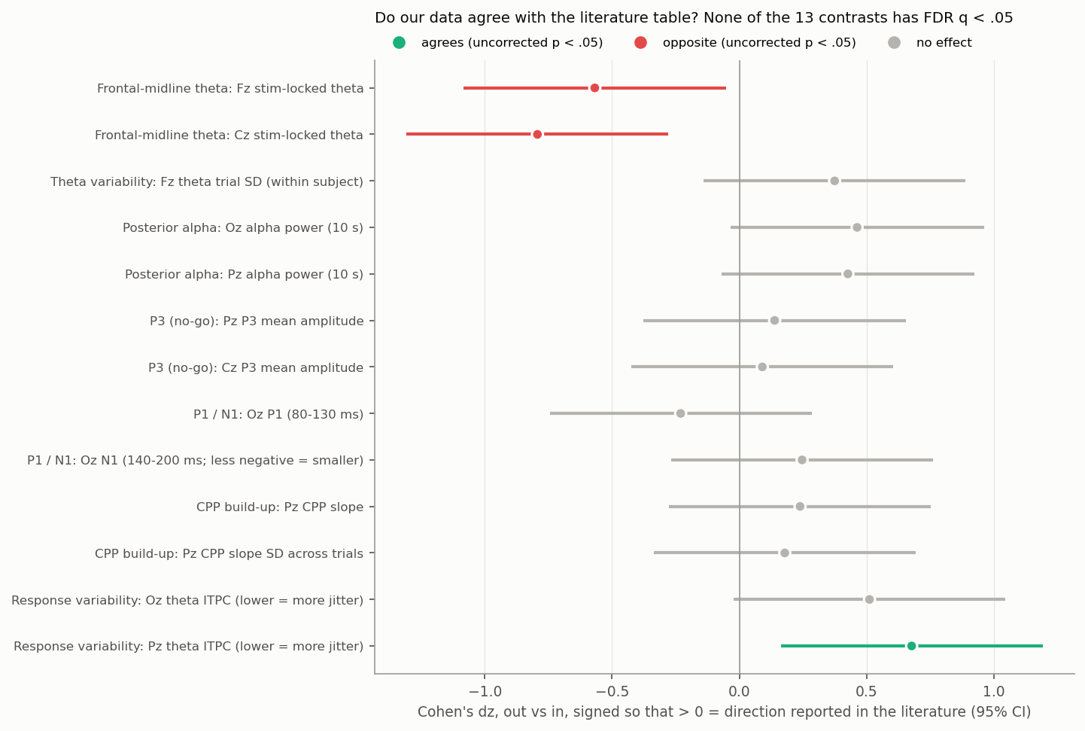
Effects are small and none survives FDR
1
measure agrees (nominal)
Pz θ phase-locking lower out of the zone
2
measures opposite (nominal)
Fz and Cz stimulus-locked θ higher out of the zone
9
measures, no effect
p > .05; all 13 have q > .05

Slide 18
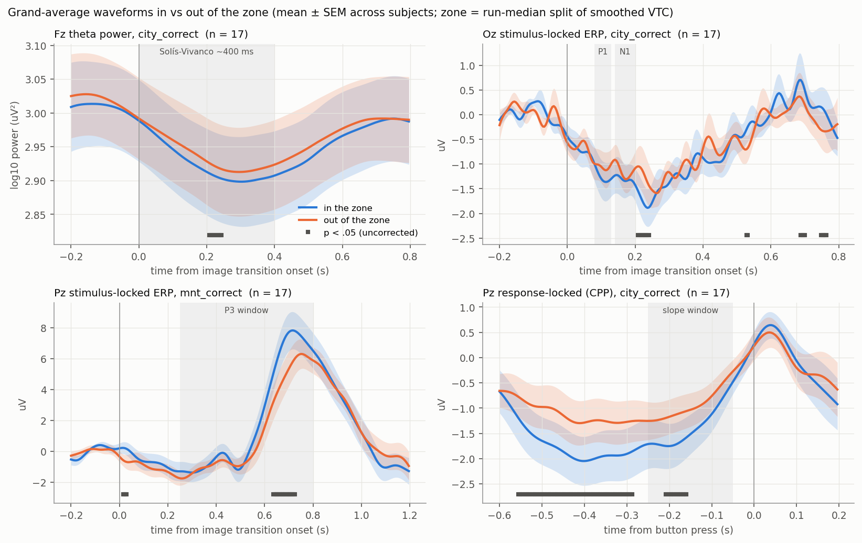
Grand averages: P3 and CPP differ in shape

Slide 19
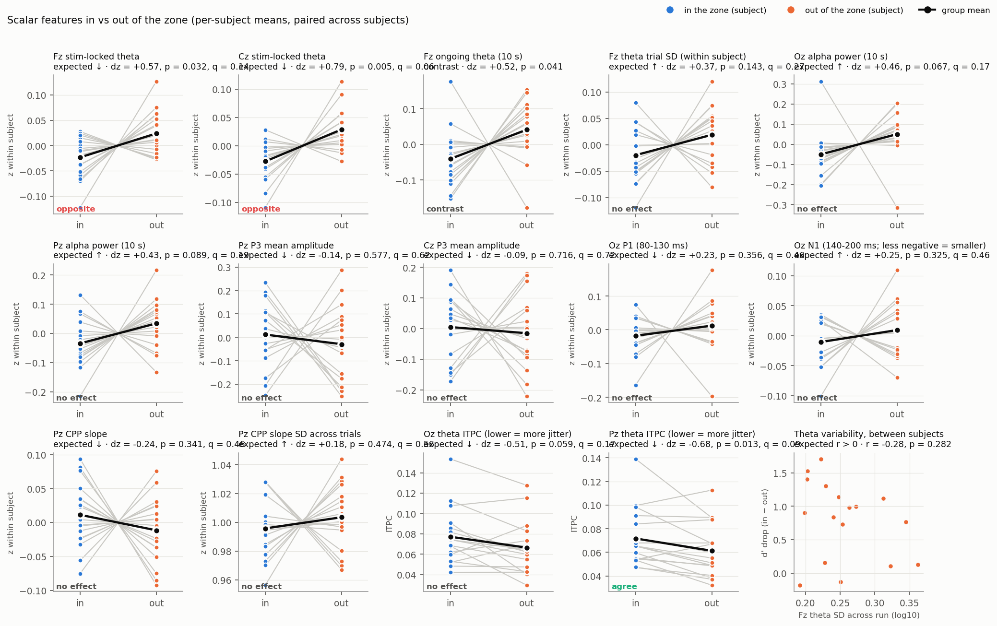
Per-subject zone contrasts

Slide 20
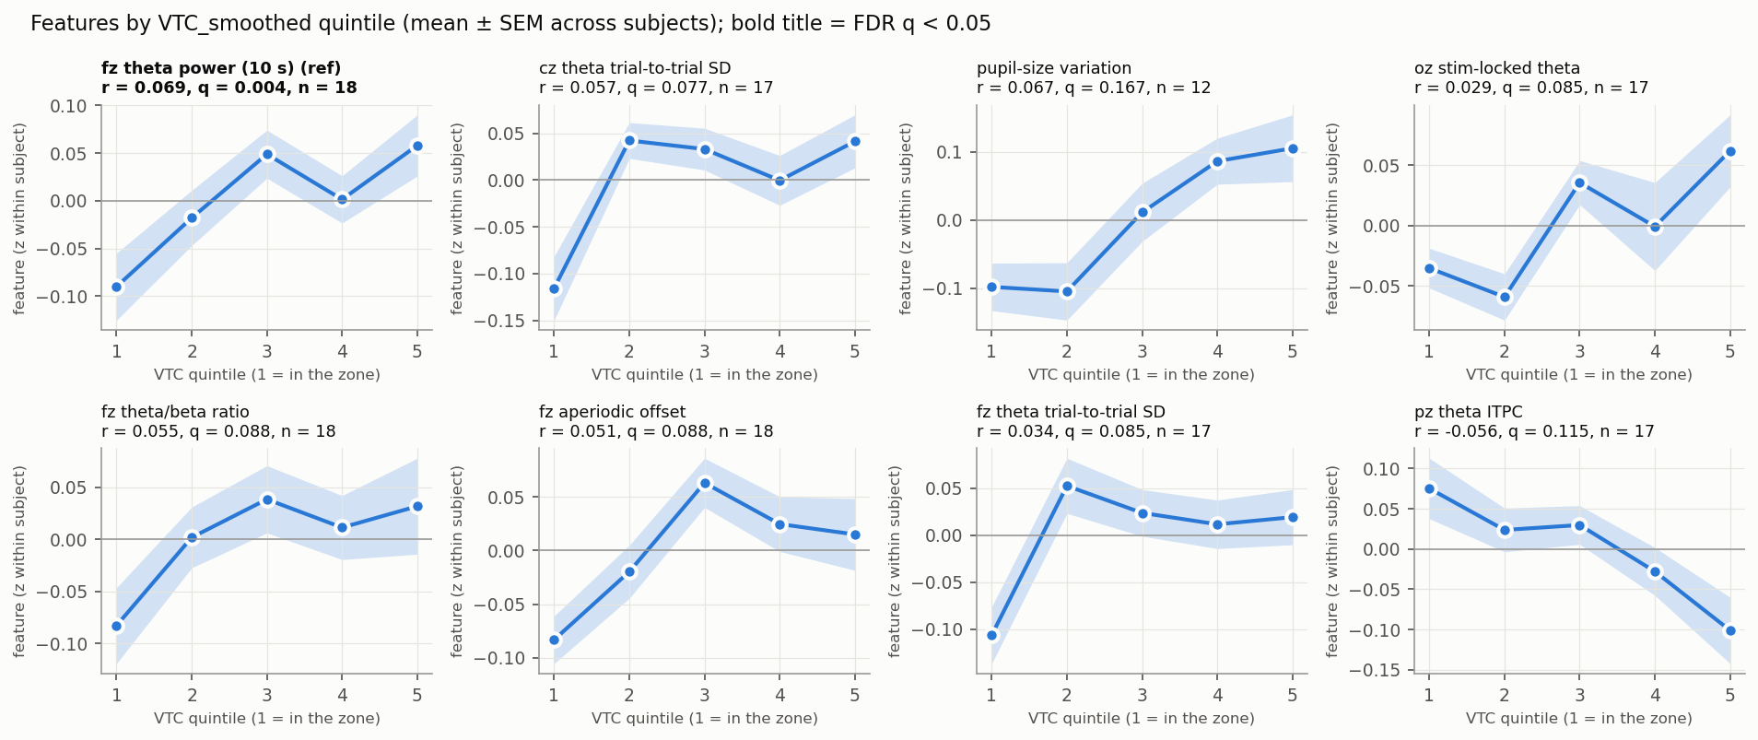
Against continuous VTC, only Fz theta survives FDR
Panels: features with FDR q < .05 first (bold; ref = already in the pipeline), then the 7 new features with the largest |t|. r is TOT-partialled. Pz θ ITPC here is the 15-trial rolling ITPC (r = −0.056, q = .12), not the pooled zone ITPC of slide 16.
r = 0.07
r = 0.10
0 / 91
Fz theta power (already in pipeline), q = .004
pupil-size variation, raw only, q = .007
new features pass FDR after TOT partial

Slide 21



Three takeaways for feature design
Direction is not universal
Control for time-on-task
Split phasic from tonic
Alpha rises with lapses in external tasks but falls in breath counting; baseline pupil goes both ways. Model non-linearly (∩) rather than with one linear term.
Baseline-pupil and band-power effects shrink or flip once TOT is removed; the pupil derivative and evoked responses held up better.
Task-related theta ↓ while ongoing theta ↑; TEPR ↓ while baseline stays flat. Keep evoked and ongoing features separate.
In our data: TOT partialling removed the pupil-variation and Oz-theta effects from FDR significance; stimulus-locked and ongoing theta both rose out of the zone.

Slide 22
Candidate additions: what we found
1
TEPR per transition
2
Variability features
Window TEPR: no relation (r ≈ 0). Deconvolving the overlapping 800-ms responses is still to do.
θ trial SD trends higher out of the zone (q = .08); pupil-size variation r = .10 (raw q = .007).
3
Evoked vs. ongoing theta
4
Aperiodic exponent & IAF
Both higher out of the zone: the reverse of Solís-Vivanco 2024.
No relation; 1/f-removed θ is flat, so the θ effect may be broadband.
5
CPP build-up rate
6
Blinks & microsaccades
Single-trial slope null; grand average steeper in the zone.
No relation (n = 12); events are rare during the task.
No gradCPT study combining fNIRS + EEG + pupil turned up — the gap this project fills.

Slide 23
Key references
Arnau et al. (2021) Psychophysiology
Baird et al. (2014)
Braboszcz & Delorme (2011) NeuroImage
Campbell et al. (2022) posters
Esterman et al. (2013) Cereb Cortex
Esterman et al. (2014) J Neurosci
Esterman & Rothlein (2019) Curr Opin Psychol
Fortenbaugh et al. (2018) NeuroImage
Franklin et al. (2013)
Grandchamp et al. (2014)
Groot et al. (2021) NeuroImage
Hopstaken et al. (2015a, b)
Jin, Borst & van Vugt (2019) CABN
Kam et al. (2011)
Kelly & O'Connell (2013) J Neurosci
Kristjansson et al. (2009) Appl Ergon
Liu et al. (2020) Front Hum Neurosci
Martin et al. (2022) EJN
O'Connell et al. (2009) J Neurosci
Reteig et al. (2019)
Rosenberg et al. (2020) PNAS
Smallwood et al. (2008; 2011)
Smilek et al. (2010) Psychol Sci
Solís-Vivanco et al. (2024) bioRxiv
Unsworth & Robison (2016; 2017; 2018)
Valsecchi et al. (2025) Biol Psychol
van den Brink et al. (2016) PLoS ONE
van Son et al. (2019)
Wascher et al. (2014) Biol Psychol
Zhang, Zhang & Xu (2020) HFES; Zuberer et al. (2025)
Full links are in the companion doc, EEG & Pupil Features of Sustained Attention — Literature Survey. Analysis: EEG_extra_features_vs_VTC.py, EEG_zone_table_comparison.py.

