Slide 1


KPIs
Group: 809 C

Slide 2
Targeted KPIs:
Unplanned Downtime
Throughput
Yield
Fill Rate
Operating Margin
Inventory Turnover
Eliminating Waste
Distribution Cost as Percentage of Revenue

Slide 3
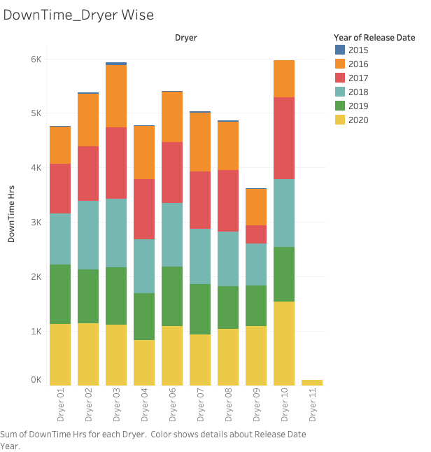
Unplanned Downtime: Keeping costs down is key to improving profitability, and unplanned downtime is one of the major culprits of high maintenance costs and diminished productivity.

Slide 4
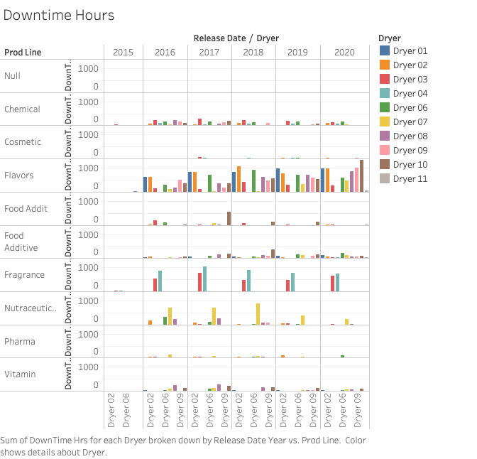
It can be observed that Flavours Product Line has consistently higher downtime.However this behaviour is consistent with all the dryers.
But in case of some Product lines like Fragrance or Food Addit, the downtime has large variation depending upon the dryer in use.

Slide 5
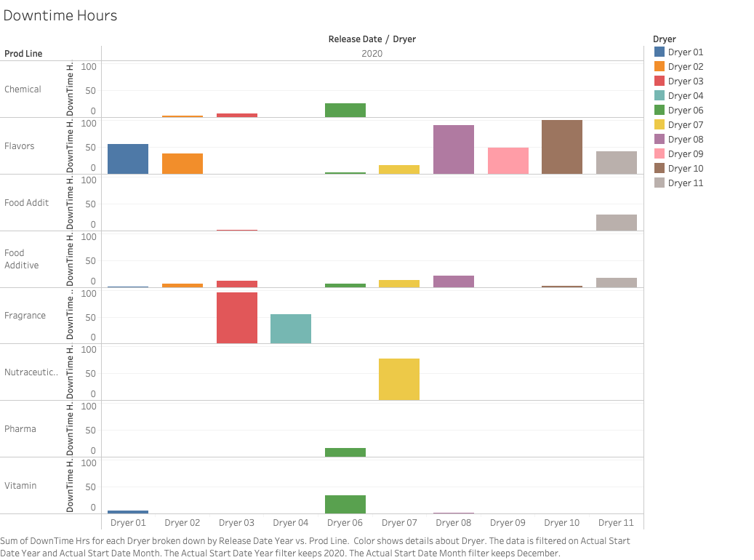
Downtime Hours For December 2020

Slide 6
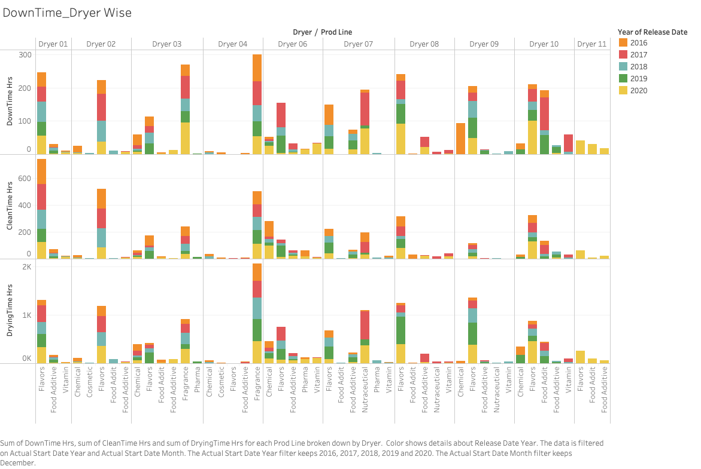

Slide 7
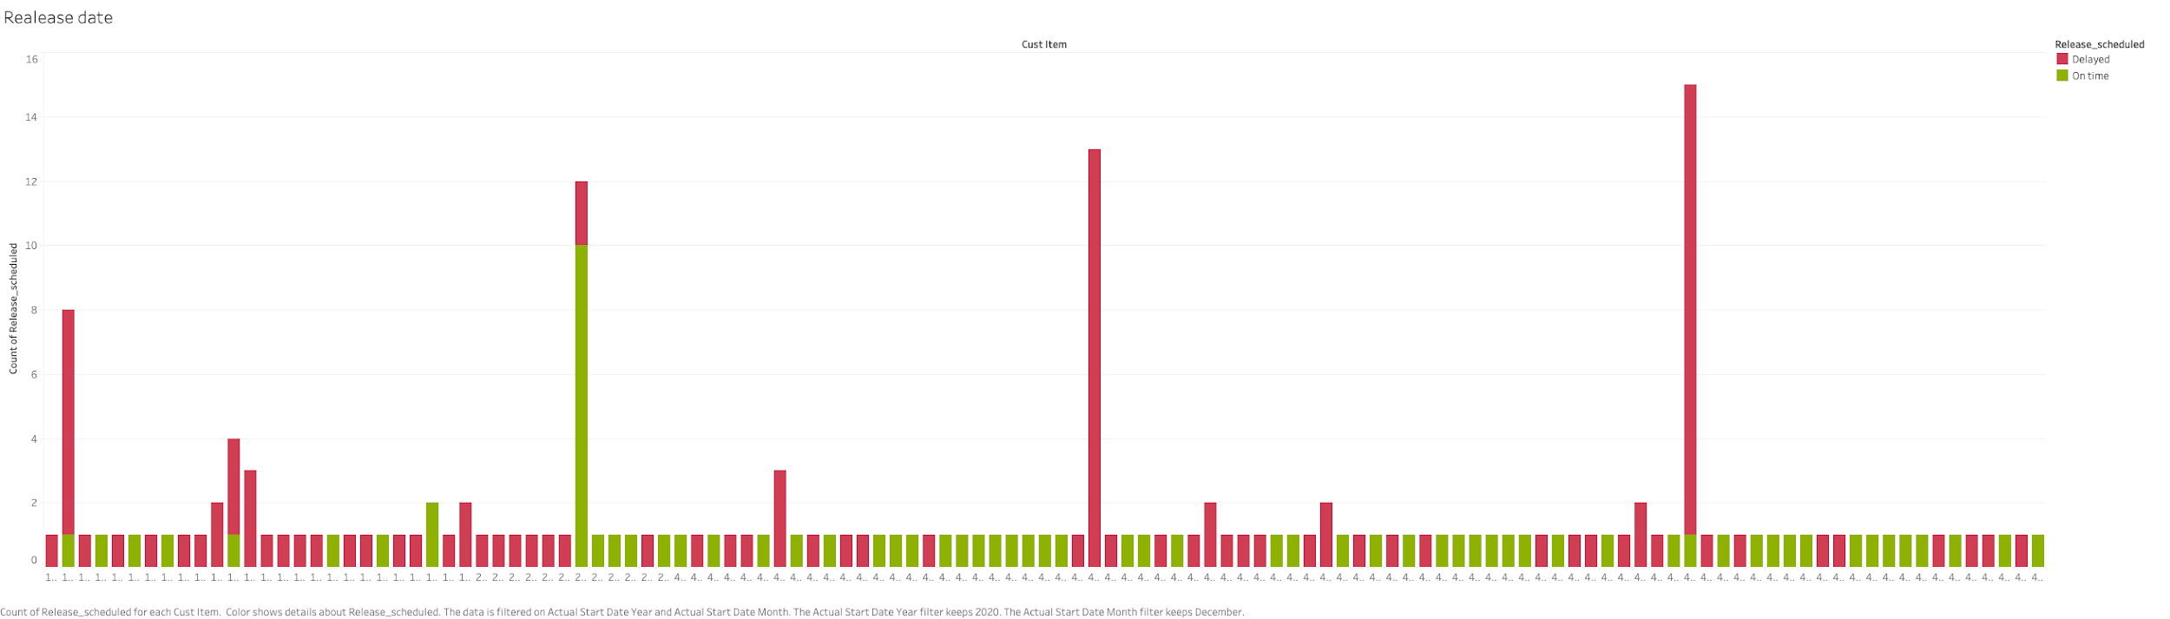
Release Date For December 2021

Slide 8
Throughput : In terms of production, throughput is a measurement of how much product your manufacturing processes are able to put out over a set period of time. This metric can give you an idea of how much you’re able to produce, and when measured for individual machines, it can give you an idea of where bottlenecks may occur in your process. Throughput = Actual Dry Quantity / Total run time hours

Slide 9
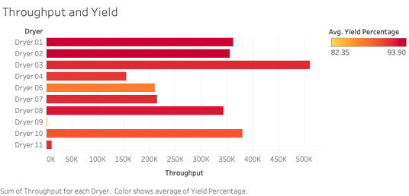
Throughput
Dryer 3 gives the maximum throughput.
Dryer 10 gives a good throughput with less yield.
Dryer 6 has less throughput and low yield.
Dryer 11 seems to be the least productive

Slide 10
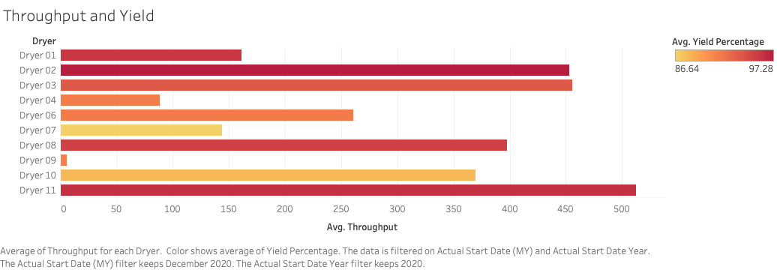
THroughput and Yield for December 2020

Slide 11
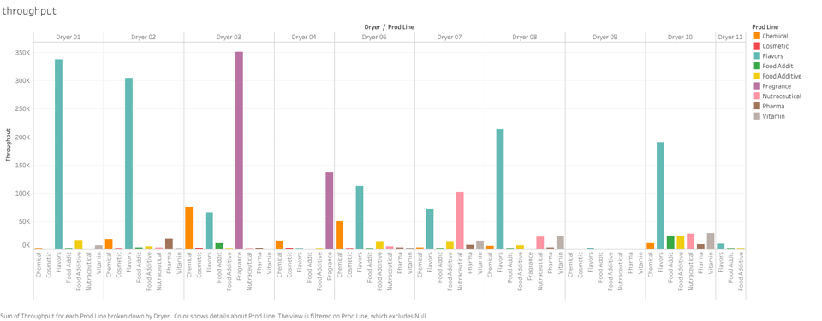
Throughput with product lines
Fragrance gives the throughput in dryer 3 and 4.
Flavours give the maximum throughput with dryer 1 followed by dryer 2.

Slide 12
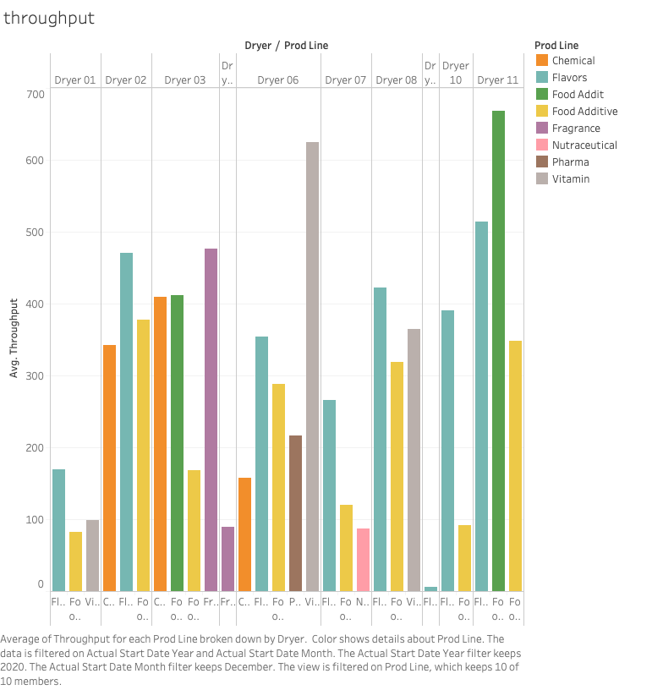
Throughput with product line for December 2020

Slide 13


Yield: yield gets a little more specific by telling you how much of it is produced correctly. If you have a consistent throughput but lower overall yield, it’s a sign that one of your machines or processes may not be operating correctly. (Product Line wise +Year Wise)

Slide 14
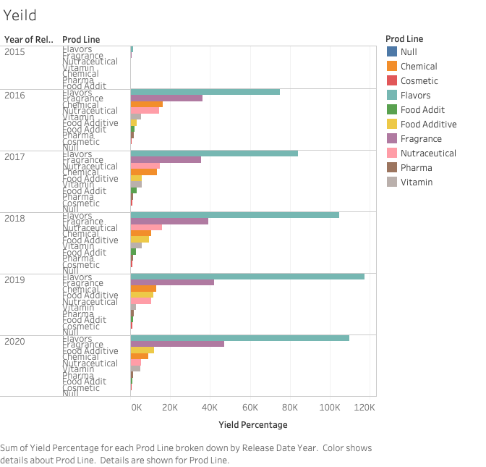
Flavors and Fragrances have an almost constant yield rate and hightest among the all product Lines.
Cosmetic and pharma has constant low yield rate.
Other product lines have changing yield rates that need more detailed study to understand this behaviour.

Slide 15
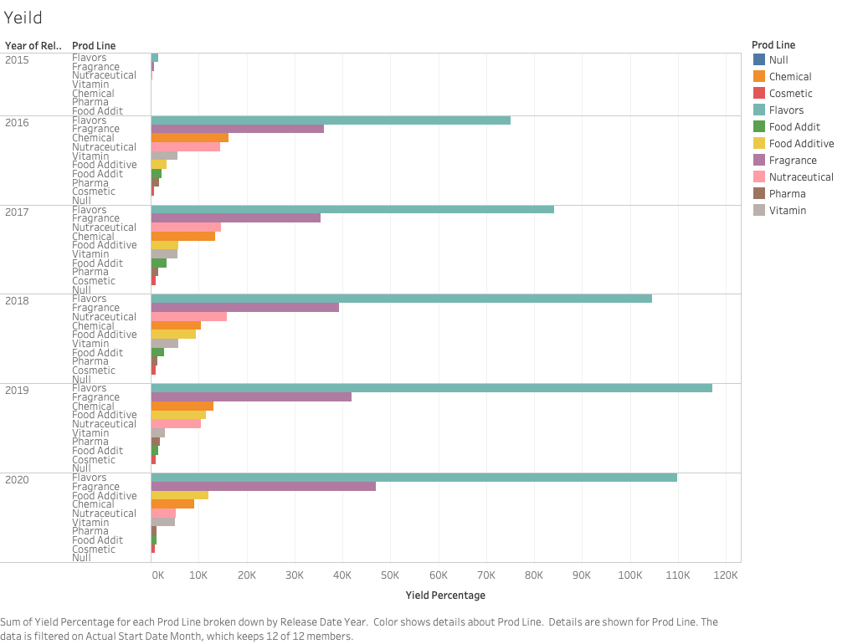
Yield Percentage For December 2020

Slide 16
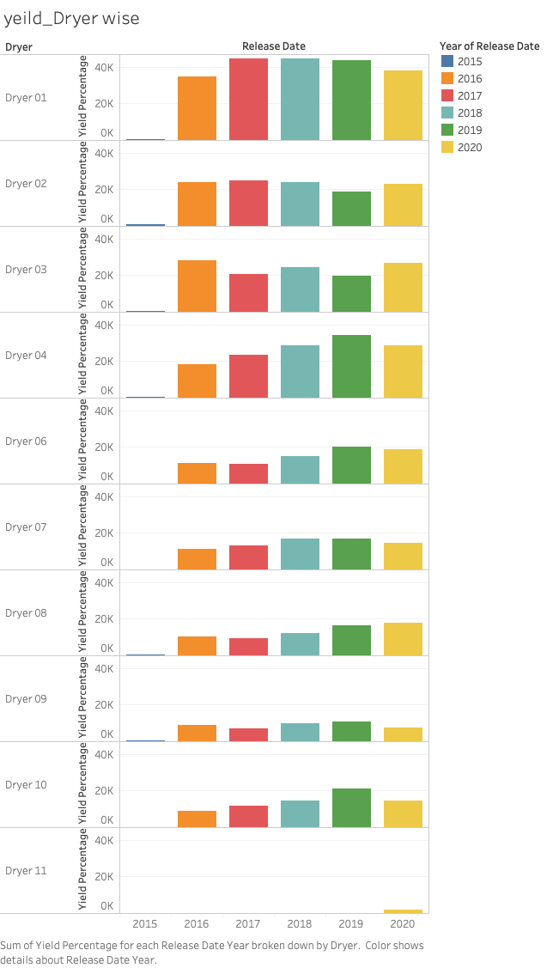
It can be observed that yield rate has be changing over the years for the same dryer.
The reason behind this may be use of dryer for different combination of products.

Slide 17
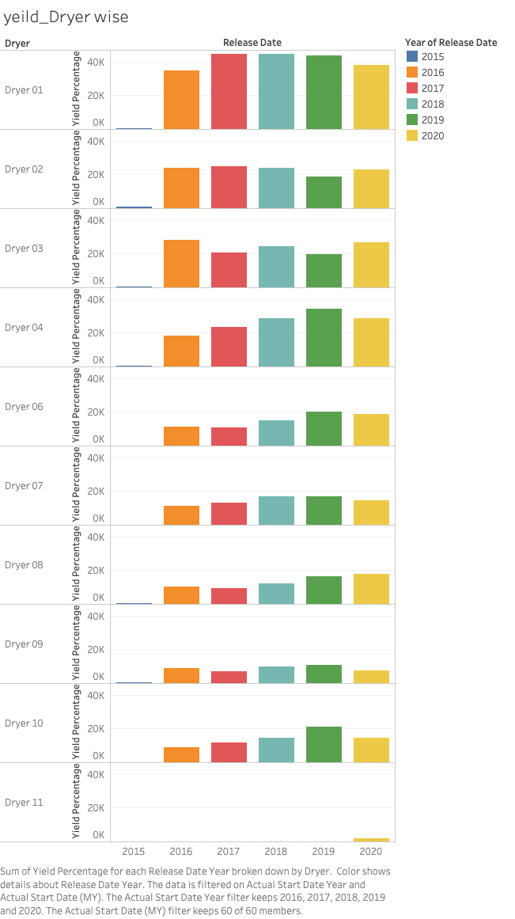
Dryer Wise Yield Percentage For December 2020

Slide 18
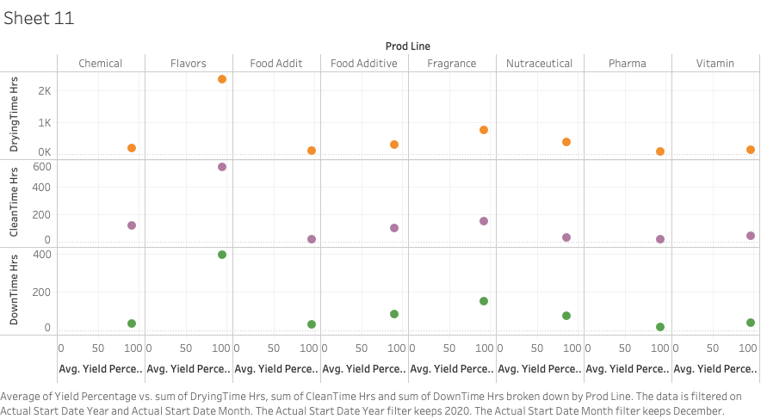
Drying Time, Cleaning Time and Down Time impact on Yield Percentage For December 2020

Slide 19
Fill Rate: fill rate is the percentage of all orders that you ship on time and in full. – Order Rate Vs Delivery Rate
If release date > original scheduled date, the order is delayed.
If release date < original schedule date, the order was complete on time.

Slide 20
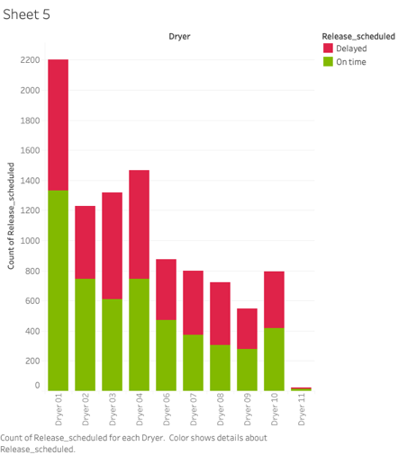
Fill rate with dryer
Dryer 1 gets the maximum orders with maximum delayed orders as well.
For dryer 2, orders completed on time are higher than delayed orders.

Slide 21
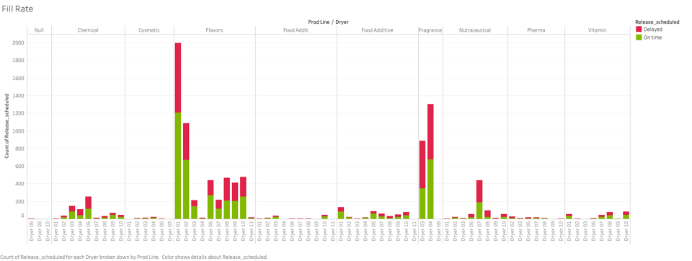
Fill rate with dryer and product line

Slide 22
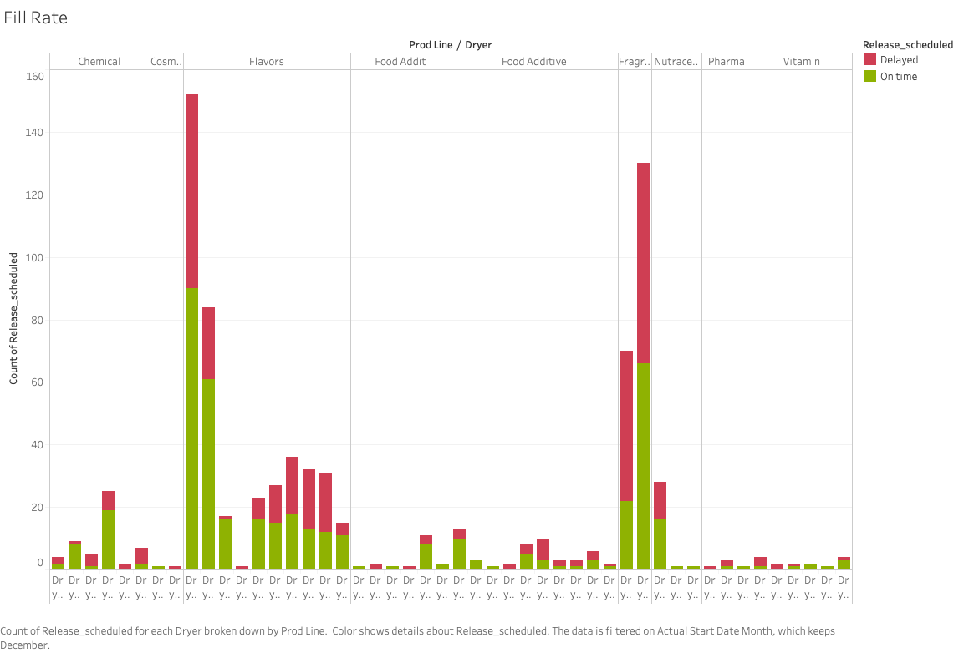
Fill Rate For December 2020

Slide 23
Operating Margin : a measure of how much profit you have left over after variable operating costs (such as wages, materials, operations, administrative costs, etc.) and before paying taxes or interest.

Slide 24
Inventory Turnover : Inventory turnover is a measurement of how many times you cycle through your current inventory over a set period of time. In other words, it shows how often everything in your inventory is sold and replaced.

Slide 25
Eliminating Waste - Benchmark
Depending Upon total output and INput Output

Slide 26
Distribution Cost as Percentage of Revenue: By tracking distribution costs as a percentage of your total revenue, you’ll be able to see how efficient your distribution efforts are over time and take steps whenever they start trending upward.

