Slide 1
SPAM TEXT CLASSIFICATION
TAL & Machine Learning project

Slide 2
Introduction
In this presentation, I will showcase my project on text classification using natural language processing (NLP) techniques.
Throughout the project, I utilized Python programming language along with various libraries such as pandas, nltk, scikit-learn, and keras.

Slide 3
Data Preparation and Model Building Pipeline for Text Classification

Slide 4
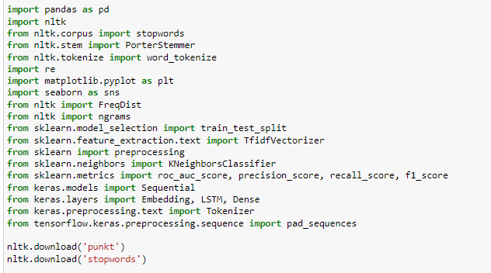
To begin, I imported the necessary libraries for data manipulation, text preprocessing, visualization, and model building. These include pandas, nltk, matplotlib, seaborn, and scikit-learn. I also downloaded required resources from the nltk library, such as tokenizers and stopwords.

Slide 5
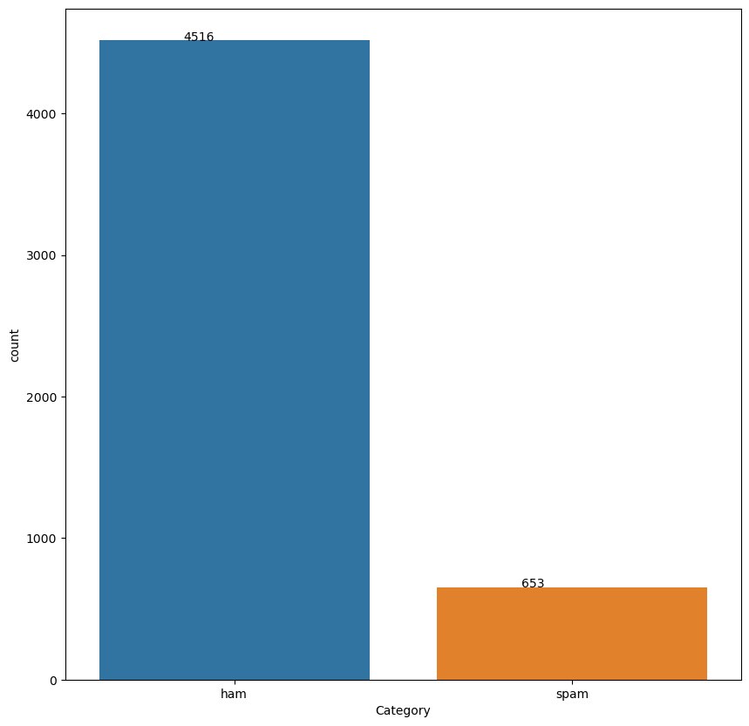
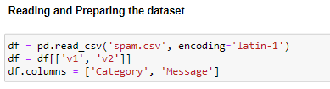


Next, I loaded a dataset containing spam and ham messages using pandas. I performed basic data cleaning steps, including removing duplicate entries and missing values. I visualized the distribution of spam and non-spam messages using a bar plot.

Slide 6



Moving on to text preprocessing, I converted the messages to lowercase and removed punctuation. I tokenized the messages into individual words and removed common stopwords using NLTK's stopwords corpus. Additionally, I applied stemming to reduce words to their root form using the Porter stemmer algorithm.

Slide 7




After preprocessing, I joined the tokenized words back into sentences. I then calculated the frequency distribution of the words and visualized the most frequent unigrams using bar plots.

Slide 8
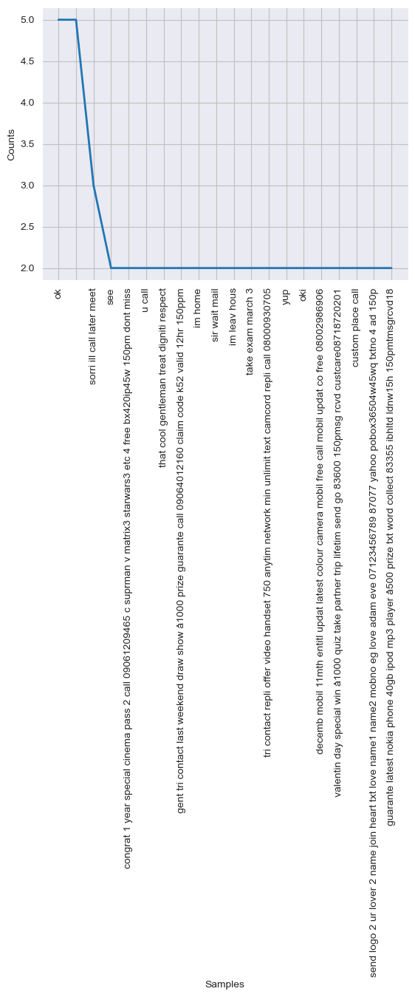
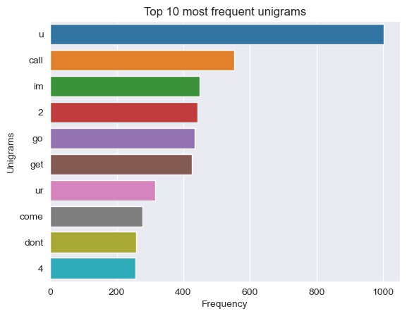

Slide 9
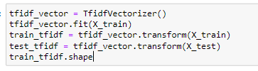

To prepare the data for model training, I split the dataset into training and testing sets using scikit- train_test_split function. I transformed the text datalearn's into numerical features using the TF-IDF vectorization technique.
The TF-IDF vectors were then normalized using
scikit-learn's Normalizer class.

Slide 10

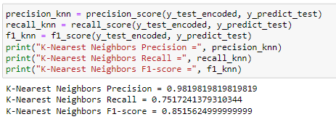
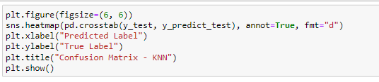

I encoded the target variable (spam or non-spam) using scikit-learn's LabelEncoder. I then trained a K-Nearest Neighbors (KNN) classifier on the training data and evaluated its performance using the test data. I calculated the area under the ROC curve (AUC) and plotted the confusion matrix to assess the model's performance.

Slide 11
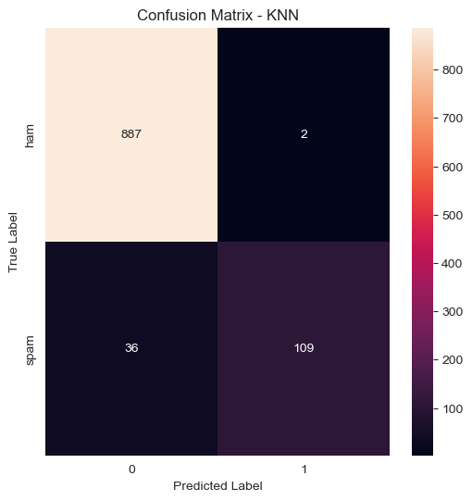

Slide 12



To prepare the text data for input into a Long Short-Term Memory (LSTM) neural network, I performed tokenization and padding. First, I tokenized the text sequences using Keras' Tokenizer class, which converted the sequences into integer tokens. Then, I applied padding to ensure all sequences had the same length using pad_sequences() function from Keras. This step added zeros to the sequences that were shorter than the maximum sequence length, making them equal in size.

Slide 13
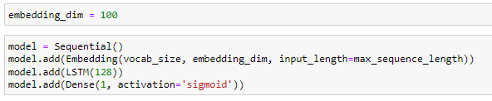

The LSTM model is compiled using binary cross-entropy loss as the loss function and the Adam optimizer. It is then trained on the padded training data, with validation data used for evaluating the model's performance during training. After training, the model's predictions are obtained for the test data. The predictions are evaluated using the AUC score, which is calculated using the roc_auc_score() function. To create a confusion matrix, the model's predictions are converted to string format. The confusion matrix is then plotted using the seaborn and matplotlib libraries.

Slide 14
Epoch 1/10 130/130 [==============================] - 23s 138ms/step - loss: 0.2123 - accuracy: 0.9333 - val_loss: 0.0796 - val_accuracy: 0.9768 Epoch 2/10 130/130 [==============================] - 16s 127ms/step - loss: 0.0366 - accuracy: 0.9886 - val_loss: 0.0696 - val_accuracy: 0.9807 Epoch 3/10 130/130 [==============================] - 17s 129ms/step - loss: 0.0111 - accuracy: 0.9978 - val_loss: 0.0983 - val_accuracy: 0.9797 Epoch 4/10 130/130 [==============================] - 16s 124ms/step - loss: 0.0055 - accuracy: 0.9988 - val_loss: 0.0845 - val_accuracy: 0.9836 Epoch 5/10 130/130 [==============================] - 16s 123ms/step - loss: 0.0023 - accuracy: 0.9995 - val_loss: 0.0802 - val_accuracy: 0.9836 Epoch 6/10 130/130 [==============================] - 16s 126ms/step - loss: 7.5491e-04 - accuracy: 1.0000 - val_loss: 0.0964 - val_accuracy: 0.9816 Epoch 7/10 130/130 [==============================] - 16s 126ms/step - loss: 3.5982e-04 - accuracy: 1.0000 - val_loss: 0.1136 - val_accuracy: 0.9836 Epoch 8/10 130/130 [==============================] - 16s 125ms/step - loss: 1.6763e-04 - accuracy: 1.0000 - val_loss: 0.1144 - val_accuracy: 0.9826 Epoch 9/10 130/130 [==============================] - 16s 124ms/step - loss: 9.7170e-05 - accuracy: 1.0000 - val_loss: 0.1248 - val_accuracy: 0.9845 Epoch 10/10 130/130 [==============================] - 16s 125ms/step - loss: 8.2128e-05 - accuracy: 1.0000 - val_loss: 0.1232 - val_accuracy: 0.9826 33/33 [==============================] - 2s 34ms/step LSTM Test AUC = 0.9816376401225708

Slide 15

In conclusion, this presentation demonstrates my project on text classification using NLP techniques. I performed text preprocessing, visualized the most frequent words, and trained both a K-Nearest Neighbors classifier and an LSTM neural network. The results showcase the effectiveness of these models in distinguishing between spam and non-spam messages in my project.

Slide 16


Merci pour votre attention
E-mail skender.nicolas@gmail.com
Téléphone 56227521

