Slide 1
Welcome to the Memory Game
Group Number: 09
Name: Md. Junaid
Student ID: 2422583642
Name: Asif Mahmood
Student ID: 2423113642
Objective: Match pairs of numbers on a hidden grid.
Key Features:
Board size: 4x4 grid
Randomized pairs of numbers
Game continues until all pairs are matched.

Slide 2
Program Overview
Written in C Programming Language
Key Libraries:
#include <stdio.h>: For input/output operations.
#include <stdlib.h>: For random number generation.
#include <time.h>: To seed random numbers with the current time.
Grid Size: Defined as a macro: #define SIZE 4.

Slide 3
Game Logic
Check for Matches:
Player chooses two coordinates.
If values match: Keep them revealed.
If not: Re-hide them.
Validation:
Ensures valid input within bounds.
Prevents choosing the same card twice or an already revealed card.
End Condition:
Game ends when all pairs are matched.

Slide 4
Main Function
Key Steps:
1. Initialize Board: Set up shuffled pairs and hidden state.
2. Game Loop: Repeats until all pairs are revealed.
Displays board.
Takes user input for two card coordinates.
Validates input and checks for matches.
3. End Game: Congratulates the player.

Slide 5
Highlights and Features
Randomized Setup: Ensures a unique game every time.
User-Friendly: Prompts and validations guide the player.
Educational Purpose: Demonstrates array manipulation, loops, and conditionals in C.

Slide 6
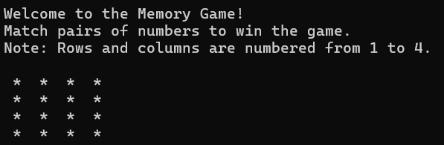
Sample Game Run
1. Initial board display:
* * * *
* * * *
* * * *
* * * *

Slide 7
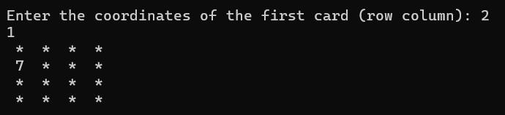
Sample Game Run
1. Initial board display:
* * * *
* * * *
* * * *
* * * *
2. First turn:
* * * *
7 * * *
* * * *
* * * *

Slide 8
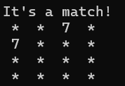
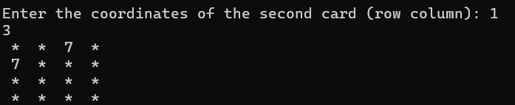
Sample Game Run
1. Initial board display:
* * * *
* * * *
* * * *
* * * *
4. It’s a match:
* * 7 *
7 * * *
* * * *
* * * *
2. First turn:
* * * *
7 * * *
* * * *
* * * *
3. Second turn:
* * 7 *
7 * * *
* * * *
* * * *

Slide 9
Potential Enhancements
Add a timer to track completion time.
Include levels with larger grids.
Add score tracking based on moves taken.
Implement a graphical user interface (GUI).

Slide 10
Conclusion
Combines fundamental programming concepts:
2D Arrays
Loops
Functions
Conditional statements
Provides an engaging way to learn C programming through game development.
**Thank you!**

