Slide 1

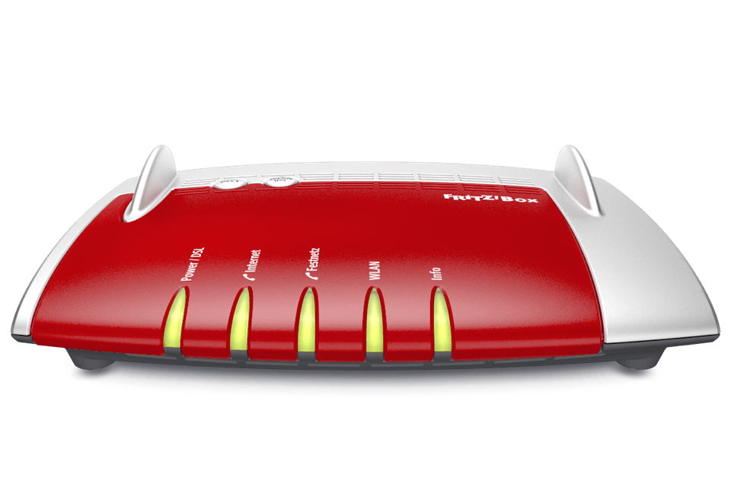


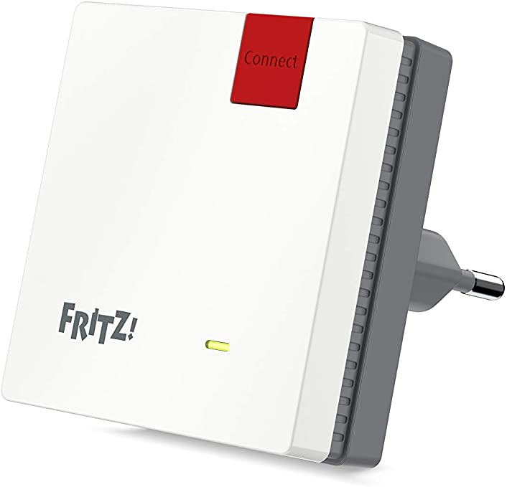




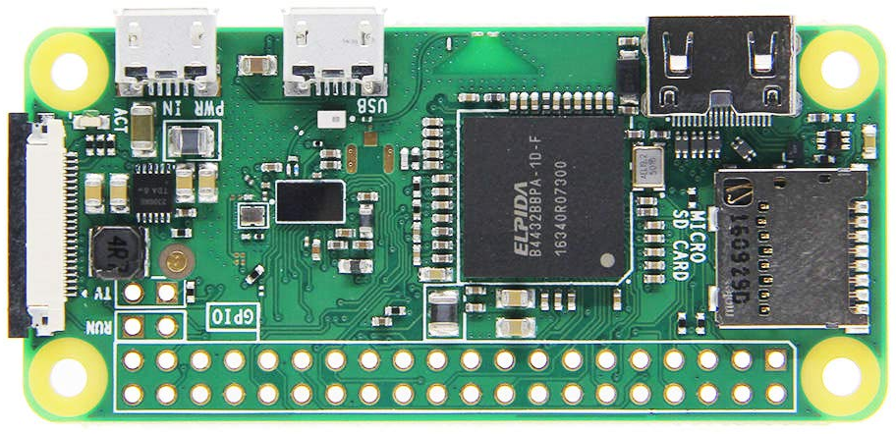


3
Reports motion via Zigbee to Hue Bridge
Zigbee Motion Sensor
Router
Wi-Fi
Detects motion before person reaches the vehicle
Ethernet
Optional Wi-Fi/Zigbee repeater
2
1
Wi-Fi
Enables Sentry Mode through Bluetooth
Subscribes to Hue Bridge and checks for motion
5
4
Sends webhook to tesla-ble-proxy
with private key in request body
Hue Bridge
tesla-smart-sentry
tesla-ble-proxy

