Slide 1
Multiple Access

Slide 2


Slide 3
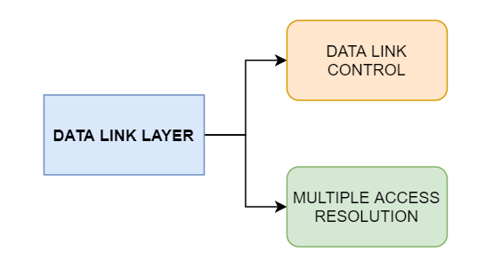
12.<number>

Slide 4
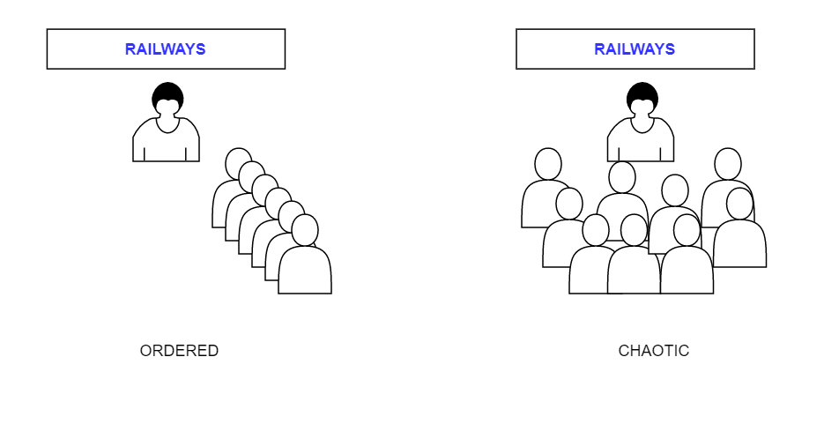
12.<number>

Slide 5
When nodes or stations are connected and use a common link, called a multipoint or broadcast link, we need a multiple-access protocol to coordinate access to the link. (Example – Speaking rules in assembly)
12.<number>

Slide 6


Slide 7
RANDOM ACCESS
In random access or contention methods, no station is superior to another station and none is assigned the control over another. No station permits, or does not permit, another station to send. At each instance, a station that has data to send uses a procedure defined by the protocol to make a decision on whether or not to send.
ALOHA
Carrier Sense Multiple Access
Carrier Sense Multiple Access with Collision Detection
Carrier Sense Multiple Access with Collision Avoidance

Slide 8
Two features
  Random access (no scheduled time - Transmission is random)
  Contention method (no rules – next which station to send)
An access conflict—collision
random-access methods – evolved from ALOHA protocol
A procedure that forces the station to sense the medium before transmitting - carrier sense multiple access (CSMA).
This method later evolved into two parallel methods:
  carrier sense multiple access with collision detection (CSMA/CD), which tells the station what to do when a collision is detected.
  carrier sense multiple access with collision avoidance (CSMA/CA), which tries to avoid the collision.
12.<number>

Slide 9
ALOHA - Additive Links On-line Hawaii Area
12.<number>

Slide 10

Frames in a pure ALOHA network

Slide 11
even if one bit of a frame coexists on the channel with one bit from another frame, there is a collision and both will be destroyed.
  resend the frames that have been destroyed during transmission.
relies on acknowledgments from the receiver.
  acknowledgment does not arrive after a time-out period, the station assumes that the frame (or the acknowledgment) has been destroyed and resends the frame.
12.<number>

Slide 12
If all these stations try to resend their frames after the time-out, the frames will collide again.
  Pure ALOHA dictates that when the time-out period passes, each station waits a random amount of time before resending its frame. The randomness will help avoid more collisions. backoff time TB.
  second method to prevent congesting the channel with retransmitted frames
12.<number>

Slide 13
Pure ALOHA - methods to prevent congesting the channel
  Backoff time (T_{B})
  maximum number of retransmission attempts K_{max}
The time-out period is equal to the maximum possible round-trip propagation delay, which is twice the amount of time required to send a frame between the two most widely separated stations
_{(2 × Tp).}
Procedure to calculate random waiting time (Backoff time)
  In this method, for each retransmission, a multiplier
  _{R = 0 to 2}^{K} − 1 is randomly chosen and multiplied by Tp (maximum propagation time) or Tfr (the average time required to send out a frame) to find TB.
12.<number>

Slide 14

Procedure for pure ALOHA protocol

Slide 15
Vulnerable time
Let us find the vulnerable time, the length of time in which there is a possibility of collision. We assume that the stations send fixed-length frames with each frame taking T_{fr} seconds to send.
12.<number>

Slide 16

Vulnerable time for pure ALOHA protocol

Slide 17
Slotted ALOHA
To improve the efficiency of pure ALOHA.
In slotted ALOHA we divide the time into slots of Tfr seconds and force the station to send only at the beginning of the time slot.
still the possibility of collision if two stations try to send at the beginning of the same time slot.
12.<number>

Slide 18

Frames in a slotted ALOHA network

Slide 19

Vulnerable time for slotted ALOHA protocol

Slide 20
CSMA - Carrier sense multiple access
principle “sense before transmit” or “listen before talk.”
it cannot eliminate the collision.
12.<number>

Slide 21

Space/time model of the collision in CSMA

Slide 22
vulnerable time for CSMA
The vulnerable time for CSMA is the propagation time T_{p}. This is the time needed for a signal to propagate from one end of the medium to the other.
When a station sends a frame and any other station tries to send a frame during this time, a collision will result.
Figure 12.8 shows the worst case.
The leftmost station, A, sends a frame at time t₁, which reaches the rightmost station, D, at time t₁ + T_{p}.
The gray area shows the vulnerable area in time and space.
12.<number>

Slide 23

Vulnerable time in CSMA

Slide 24
Persistence Methods
What should a station do if the channel is busy?
What should a station do if the channel is idle?
Three methods have been devised to answer these questions
  1-persistent method,
  the nonpersistent method, and
  the p-persistent method
12.<number>

Slide 25

Behavior of three persistence methods

Slide 26
P-Persistent
In this method, after the station finds the line idle it follows these steps:
  1. With probability p, the station sends its frame.
  2. With probability q = 1 − p, the station waits for the beginning of the next time slot and checks the line again.
    a. If the line is idle, it goes to step 1.
    b. If the line is busy, it acts as though a collision has occurred and uses the backoff procedure.
12.<number>

Slide 27

Flow diagram for three persistence methods

Slide 28
CSMA/CD
a station monitors the medium after it sends a frame
  If so, success
  If not (Collision occurred), retransmit the frame.
To Handle the collision
Jamming Signal - all other stations become aware of the collision.
12.<number>

Slide 29

Collision of the first bit in CSMA/CD

Slide 30

Figure 12.13 Collision and abortion in CSMA/CD
12.<number>

Slide 31
Difference between ALOHA and CSMA/CD
The first difference is the addition of the persistence process.
The second difference is the frame transmission.
  ALOHA – Entire frame
The third difference is the sending of a short jamming signal
12.<number>

Slide 32

Energy level during transmission, idleness, or collision
On a wired network, energy level is almost double during a collision.
This is how a receiver tells if there is a collision.
But on a wireless network, energy level is not that high (barely 5-10%
higher). So with wireless, we need to avoid collisions.

Slide 33
CSMA/CA
Collisions are avoided through the use of CSMA/CA’s three strategies:
  the interframe space,
  the contention window, and
  acknowledgments
12.<number>

Slide 34
Interframe Space (IFS) - First, collisions are avoided by deferring transmission even if the channel is found idle. When an idle channel is found, the station does not send immediately. It waits for a period of time called the interframe space or IFS. Priority – shortest IFS
Contention Window - The contention window is an amount of time divided into slots. A station that is ready to send chooses a random number of slots as its wait time. Priority – longest waiting time.
Acknowledgment - With all these precautions, there still may be a collision resulting in destroyed data. In addition, the data may be corrupted during the transmission. The positive acknowledgment and the time-out timer can help guarantee that the receiver has received the frame.
12.<number>

Slide 35
Frame Exchange Time Line
Figure 12.17 shows the exchange of data and control frames in time.
1. Before sending a frame, the source station senses the medium by checking the energy level at the carrier frequency.
  a. The channel uses a persistence strategy with backoff until the channel is idle.
  b. After the station is found to be idle, the station waits for a period of time called the DCF interframe space (DIFS); then the station sends a control frame called the request to send (RTS). Distributed coordination function (DCF)
2. After receiving the RTS and waiting a period of time called the short interframe space (SIFS), the destination station sends a control frame, called the clear to send (CTS), to the source station. This control frame indicates that the destination station is ready to receive data.
12.<number>

Slide 36
3. The source station sends data after waiting an amount of time equal to SIFS.
4. The destination station, after waiting an amount of time equal to SIFS, sends an acknowledgment to show that the frame has been received. Acknowledgment is needed in this protocol because the station does not have any means to check for the successful arrival of its data at the destination. On the other hand, the lack of collision in CSMA/CD is a kind of indication to the source that data have arrived.
12.<number>

Slide 37
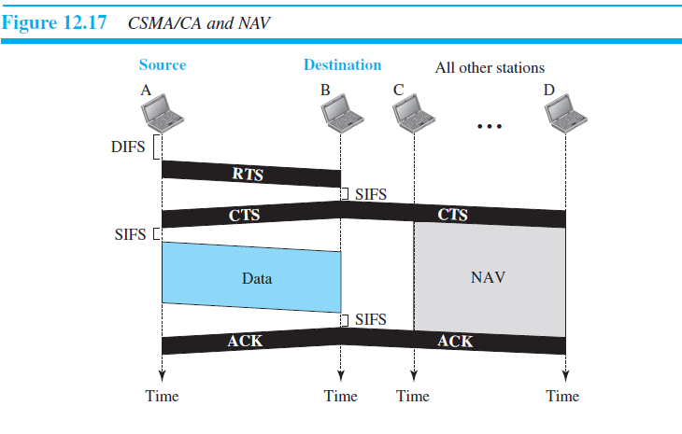

12.<number>

Slide 38
Network Allocation Vector
The network allocation vector can be considered as a counter that counts down to zero.
The maximum NAV duration is the transmission time required by frame, which is the the time for which the channel will be busy.
At the start of transmission of a frame, the NAV value is set to its maximum.
A non-zero value indicates that the channel is busy, and so no station contends for it.
When the NAV value decrements to 0, it indicates that the channel is free and the other stations can contend for it.
12.<number>

Slide 39
Collision During Handshaking
What happens if there is a collision during the time when RTS or CTS control frames are in transition, often called the handshaking period?
Two or more stations may try to send RTS frames at the same time.
  These control frames may collide.
The sender assumes there has been a collision if it has not received a CTS frame from the receiver.
The backoff strategy is employed, and the sender tries again.
12.<number>

Slide 40
Hidden-Station Problem
Figure 12.17 also shows that the RTS message from B reaches A, but not C.
However, because both B and C are within the range of A, the CTS message, which contains the duration of data transmission from B to A, reaches C. Station C knows that some hidden station is using the channel and refrains from transmitting until that duration is over.
12.<number>

Slide 41

Note
In CSMA/CA, the IFS can also be used to define the priority of a station or a frame.

