Slide 1
RTT independence in TCP Prague
Olivier Tilmans <olivier.tilmans@nokia-bell-labs.com>
Koen De Schepper <koen.de_schepper@nokia-bell-labs.com>
20-02-2020, TSVWG interim

Slide 2
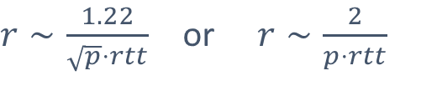
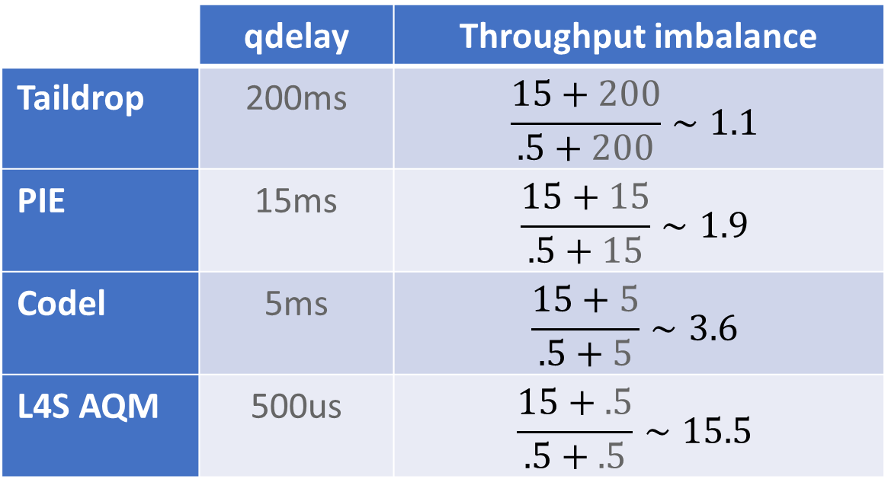
The throughput of competing AIMD flows depends on their RTT ratio
Queuing delays act as cushion
$r∼\frac{1.22}{\sqrt{p}⋅rtt}$ or $r∼\frac{2}{p⋅rtt}$
 | qdelay | Throughput imbalance
Taildrop | 200ms | $$\frac{15+200}{.5+200}∼1.1$$
PIE | 15ms | $$\frac{15+15}{.5+15}∼1.9$$
Codel | 5ms | $$\frac{15+5}{.5+5}∼3.6$$
L4S AQM | 500us | $$\frac{15+.5}{.5+.5}∼15.5$$
Assuming two flows with base RTT of 15ms and 0.5ms, and a constant marking probability

Slide 3
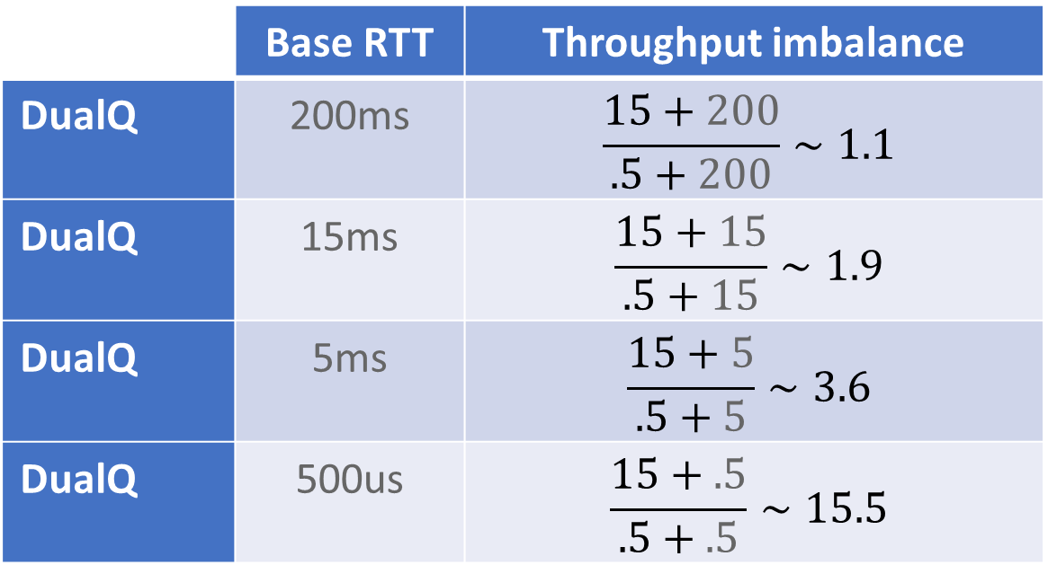
The throughput of competing AIMD flows depends on their RTT ratio
DualQ also gives a different Q per traffic class
$r∼\frac{1.22}{\sqrt{p}⋅rtt}$ or $r∼\frac{2}{p⋅rtt}$
 | Base RTT | Throughput imbalance
DualQ | 200ms | $$\frac{15+200}{.5+200}∼1.1$$
DualQ | 15ms | $$\frac{15+15}{.5+15}∼1.9$$
DualQ | 5ms | $$\frac{15+5}{.5+5}∼3.6$$
DualQ | 500us | $$\frac{15+.5}{.5+.5}∼15.5$$
Assuming DualQ with targets of 15ms and 0,5ms, equal base RTT and a window-fair coupling (k=2)

Slide 4
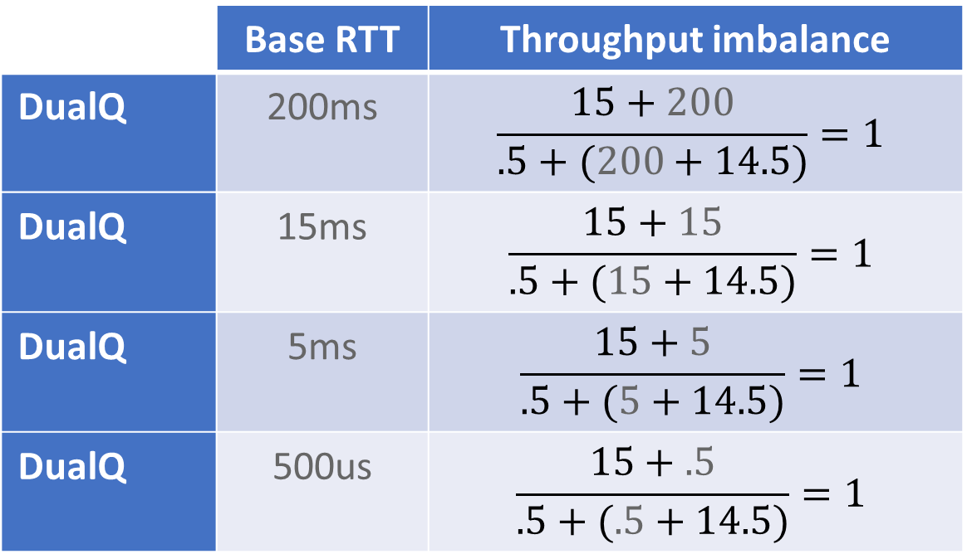

New Prague add-on to steer RTT dependence
Code to be released soon (demo available)
New Prague CC can have $r∼\frac{2}{p⋅f()}$ with a target RTT function $f()$ that can represent any constant or function of flow state
For example $f\left(rtt\right)=(rtt+14.5)$ resulting in:
 | Base RTT | Throughput imbalance
DualQ | 200ms | $$\frac{15+200}{.5+(200+14.5)}=1$$
DualQ | 15ms | $$\frac{15+15}{.5+(15+14.5)}=1$$
DualQ | 5ms | $$\frac{15+5}{.5+(5+14.5)}=1$$
DualQ | 500us | $$\frac{15+.5}{.5+(.5+14.5)}=1$$

Slide 5
(Long term) Throughput balance with other RTT flows
Smart f()
IETF or applications
to decide?
Handle
shorter flows
faster
Accelerate faster
at small RTTs

Slide 6
Controlled RTT dependence in TCP Prague
Key changes to TCP Prague
We control Additive Increase to behave as a target RTT flow
Trigger the same amount/frequency of marks as a target RTT flow
We leave the Multiplicative Decrease unchanged
Preserve responsiveness as much as possible to preserve latency
Control the EWMA update frequency on the target RTT independently from the e2e RTT
Ensure that different RTT flows can converge to the same alpha, even on a step

Slide 7

Other changes to TCP Prague
Switch to unsaturated marking by default, i.e., cwnd growth is $∼\frac{1−p}{p}$, regardless of the congestion state (TCP_CA_CWR, …)
Generalize fixed-point cwnd manipulation, e.g., carry over remainders from successive cwnd increases and reductions
Align to $r∼\frac{2(1−p)}{p⋅f()}$ to support unsaturated signal and smoother throughput
The marking probability is usually too low (e.g., 3%) to yield a single packet reduction
and the increments can become less than a packet per RTT

Slide 8
Demo/video at https://l4steam.github.io/rtt-independence/prague_rtt_independence.mp4
f(rtt)= (rtt + 15ms)
Code available in https://github.com/L4STeam/linux RTT dependence can be controlled with the prague_rtt_* module parameters, e.g.,
for testing f(rtt) = (rtt + 15ms) case use: `echo 3 | sudo tee /sys/module/tcp_prague/parameters/prague_rtt_scaling`
for testing f(rtt) = max(rtt, 15ms) case use: `echo 1 | sudo tee /sys/module/tcp_prague/parameters/prague_rtt_scaling`

Slide 9
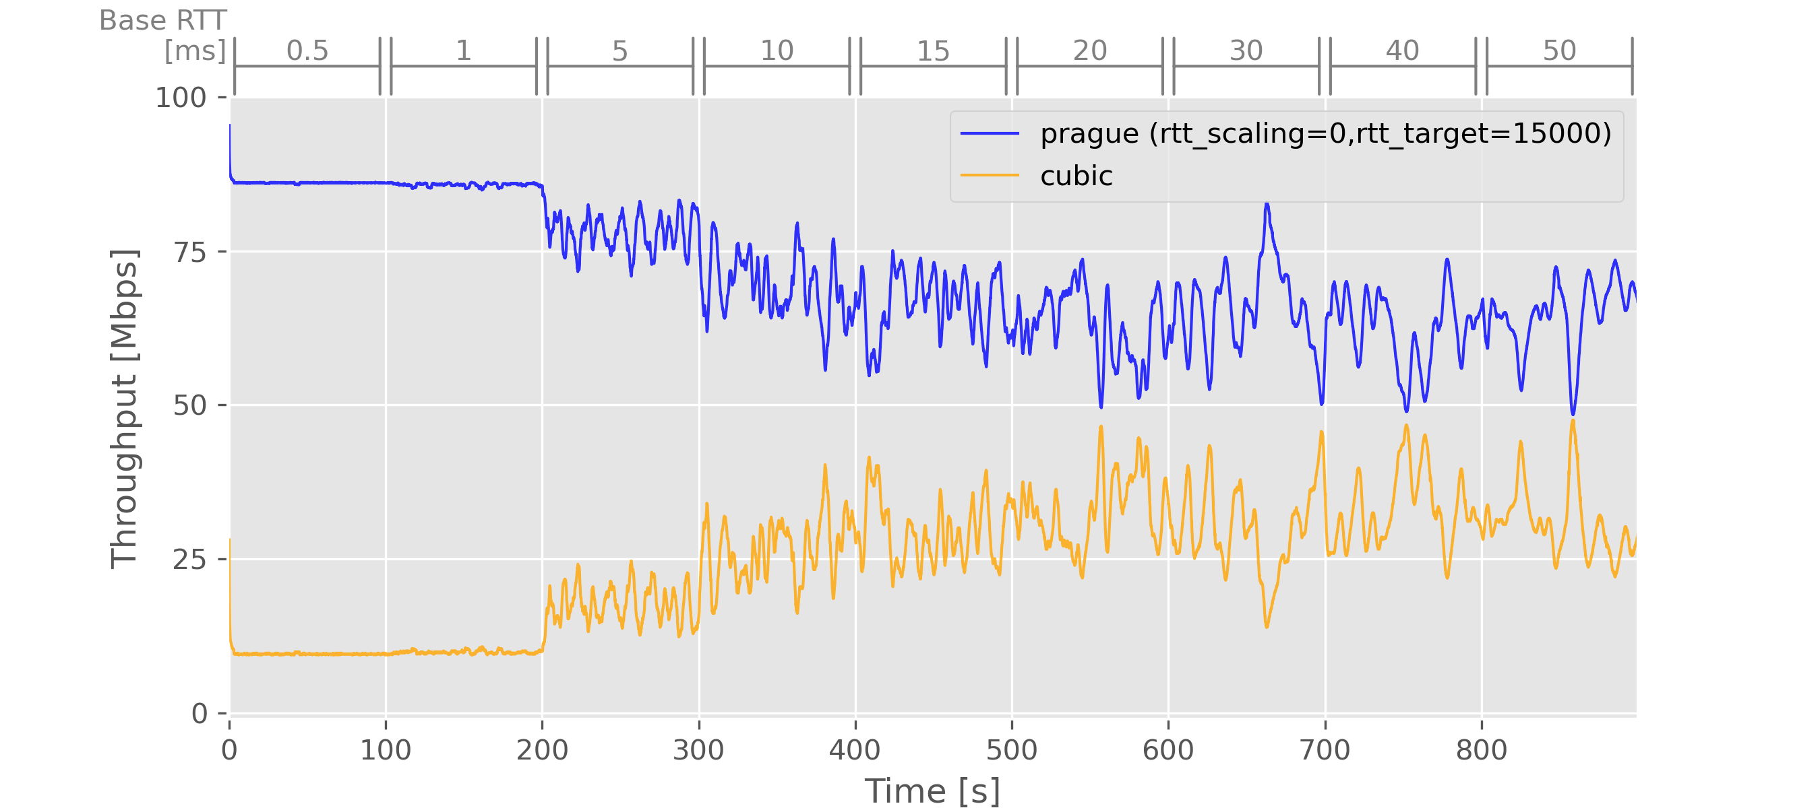
Test results—100Mbit/s bottleneck, increasing base RTTs
Baseline-Prague vs Cubic
baseline f(rtt) = rtt

Slide 10
Test results—100Mbit/s bottleneck, increasing base RTTs
Baseline-Prague vs Cubic
rtt = 0.5
rtt = 1
baseline f(rtt) = rtt
rtt = 5
rtt = 10
rtt = 15
rtt = 20
rtt = 30
rtt = 40
rtt = 50
Difference in DualQ delays only
relevant for lower base RTT cases
rtt = 25
rtt = 30
rtt = 35
rtt = 45
rtt = 55
rtt = 65
rtt = 15.5
rtt = 16
rtt = 20

Slide 11
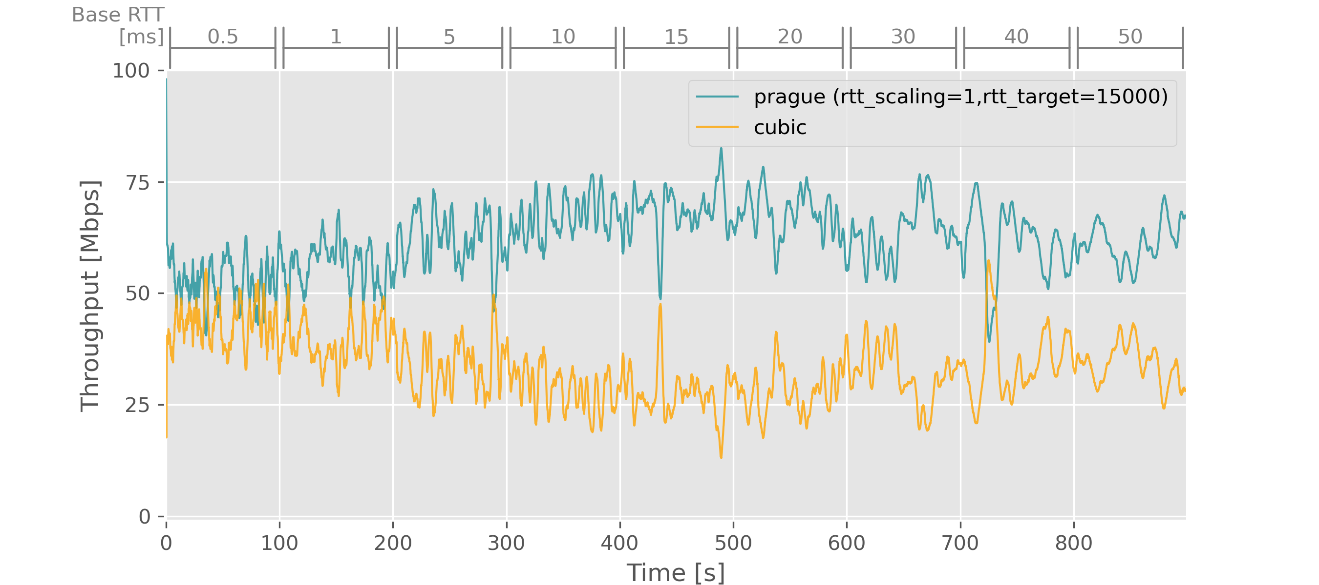
Test results—100Mbit/s bottleneck, increasing base RTTs
Prague using f(rtt) = max(rtt, 15ms) vs Cubic
f(rtt) = max(rtt, 15ms)

Slide 12
Test results—100Mbit/s bottleneck, increasing base RTTs
Prague using f(rtt) = max(rtt, 15ms) vs Cubic
Difference in DualQ delays
solved by limiting Prague’s lower RTTs
f(rtt) = max(rtt, 15ms)
f = 15
f = 15
f = 20
f = 30
f = 40
f = 50
f = 15
f = 15
f = 15
rtt = 15.5
rtt = 16
rtt = 20
rtt = 25
rtt = 30
rtt = 35
rtt = 45
rtt = 55
rtt = 65

Slide 13
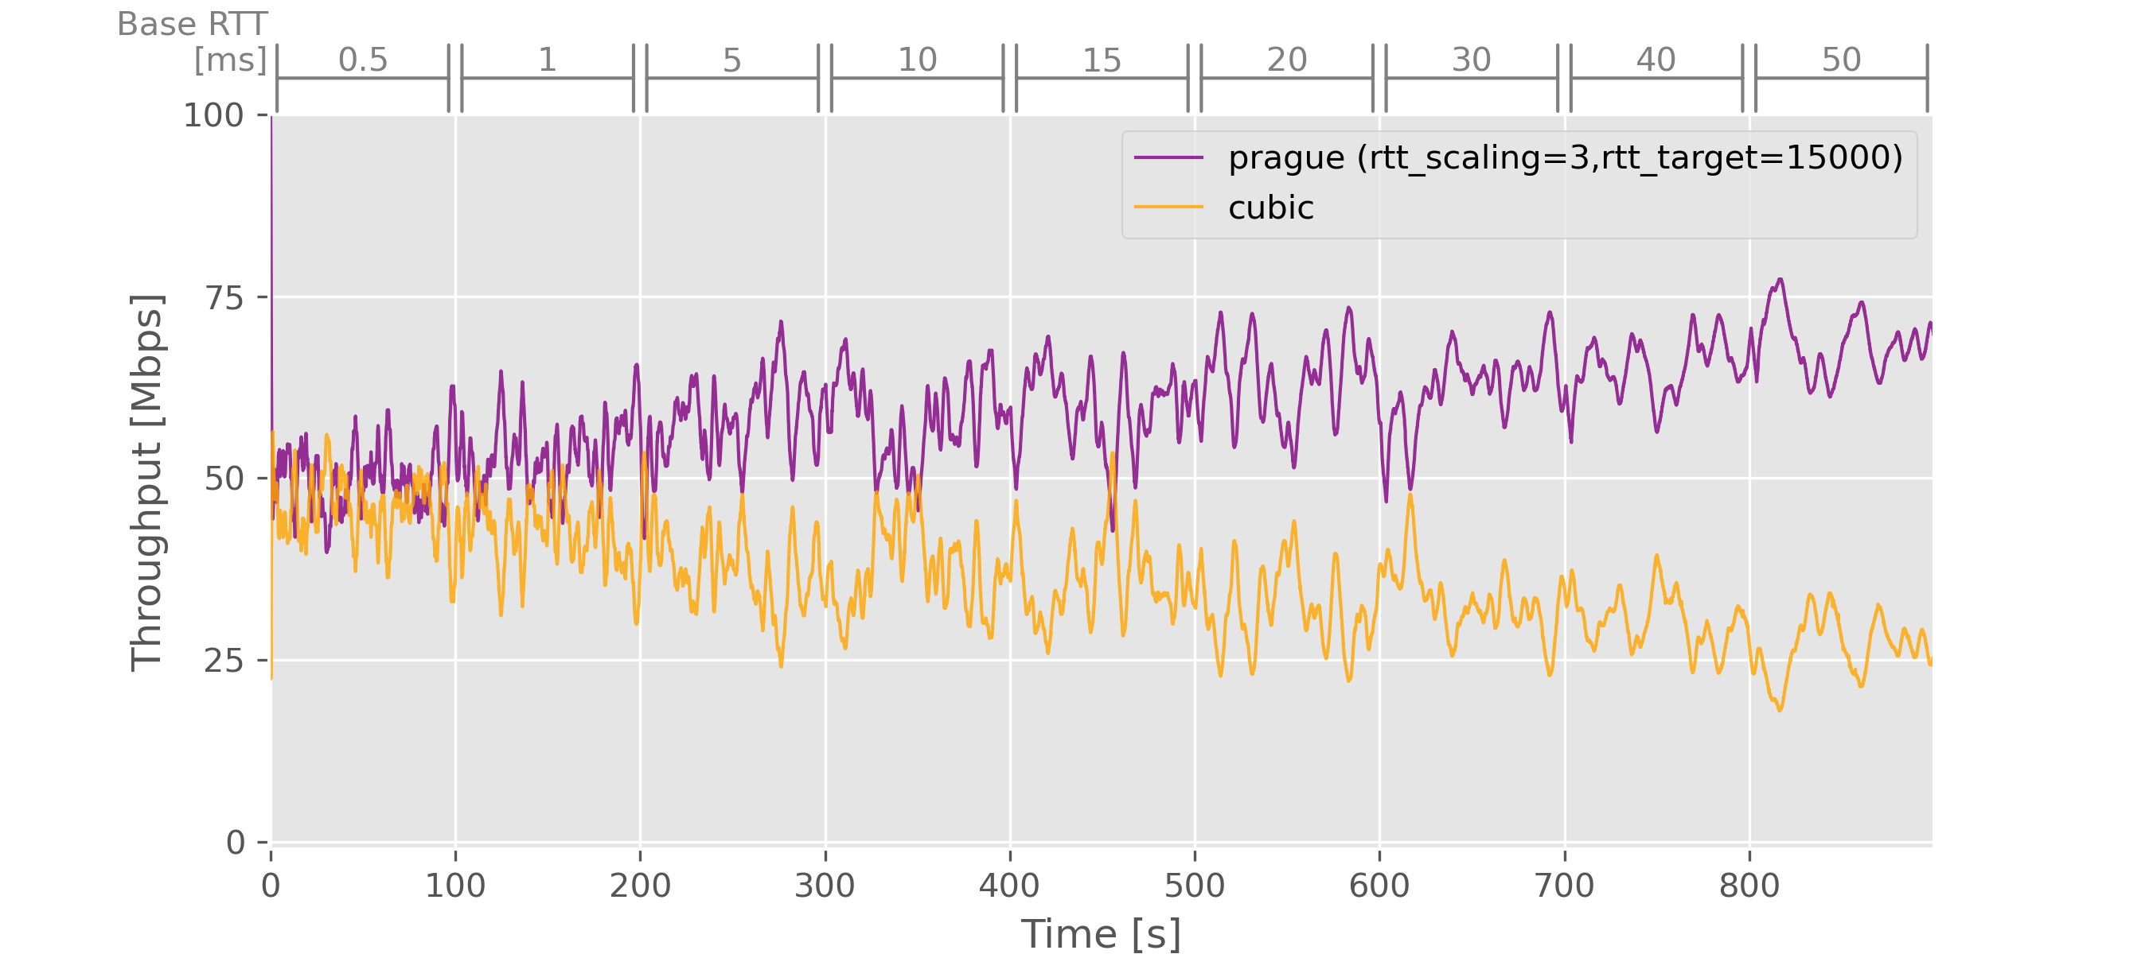
Test results—100Mbit/s bottleneck, increasing base RTTs
Prague using f(rtt) = (rtt + 15ms) vs Cubic
f(rtt) = (rtt + 15ms)

Slide 14
Test results—100Mbit/s bottleneck, increasing base RTTs
Prague using f(rtt) = (rtt + 15ms) vs Cubic
f(rtt) = (rtt + 15ms)
f = 25
f = 30
f = 35
f = 45
f = 55
f = 65
f = 15.5
f = 16
f = 20
Fully compensating RTT difference in
Prague makes no sense
rtt = 15.5
rtt = 16
rtt = 20
rtt = 25
rtt = 30
rtt = 35
rtt = 45
rtt = 55
rtt = 65

Slide 15
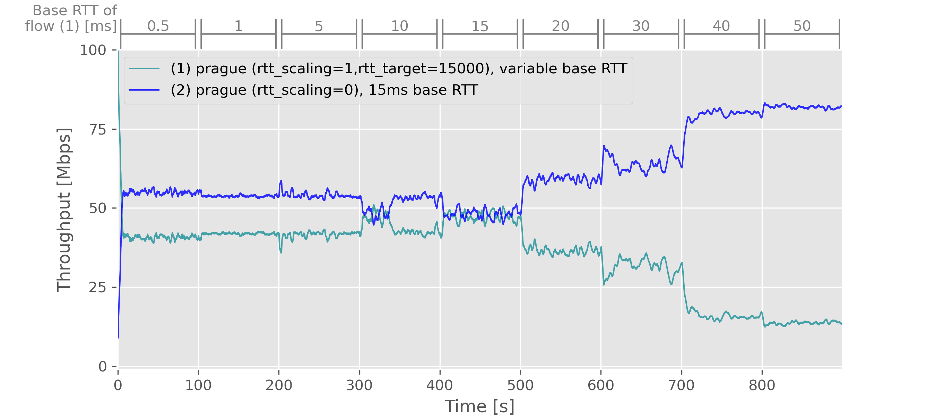
Test results—100Mbit/s bottleneck, mixed base RTTs
Prague using f(rtt) = max(rtt, 15ms) vs Prague with fixed 15ms RTT
f(rtt) = max(rtt, 15ms)
baseline f(rtt) = rtt , 15ms base RTT

Slide 16
Test results—100Mbit/s bottleneck, mixed base RTTs
Prague using f(rtt) = max(rtt, 15ms) vs Prague with fixed 15ms RTT
f(rtt) = max(rtt, 15ms)
baseline f(rtt) = rtt 15ms base RTT
rtt = 15
rtt = 15
rtt = 15
rtt = 15
rtt = 15
rtt = 15
rtt = 15
rtt = 15
rtt = 15
optionally higher RTTs difference can
also be compensated in Prague making f(RTT) = 15ms
f = 15
f = 15
f = 15
f = 15
f = 15
f = 20
f = 30
f = 40
f = 50
Difference in base RTTs are solved by limiting Prague’s lower RTTs

Slide 17
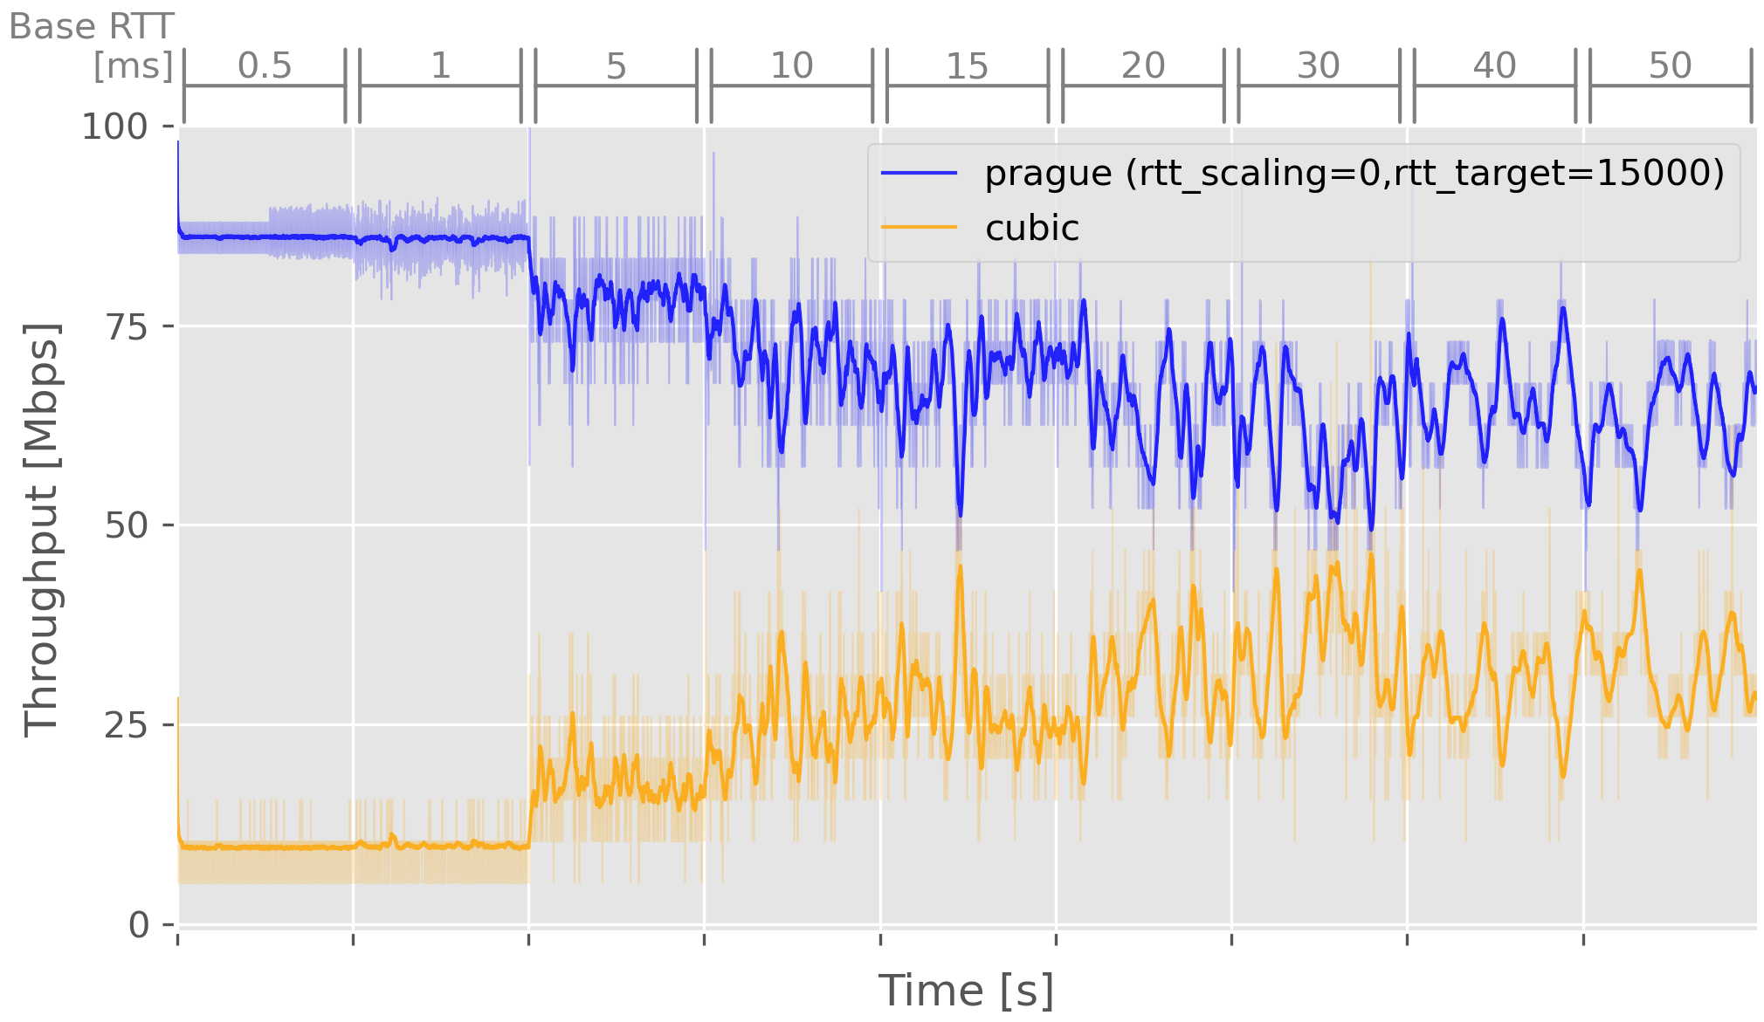
Test results—100Mbit/s bottleneck, increasing base RTTs
Baseline—Prague vs Cubic

Slide 18
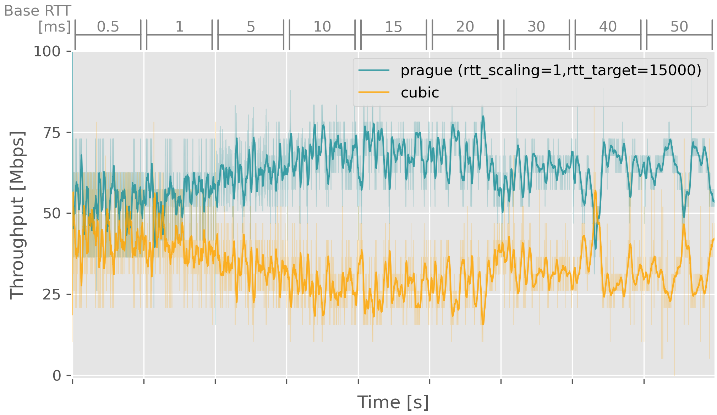
Test results—100Mbit/s bottleneck, increasing base RTTs
Prague [ f(rtt) = max(15ms, rtt) ] vs Cubic

Slide 19
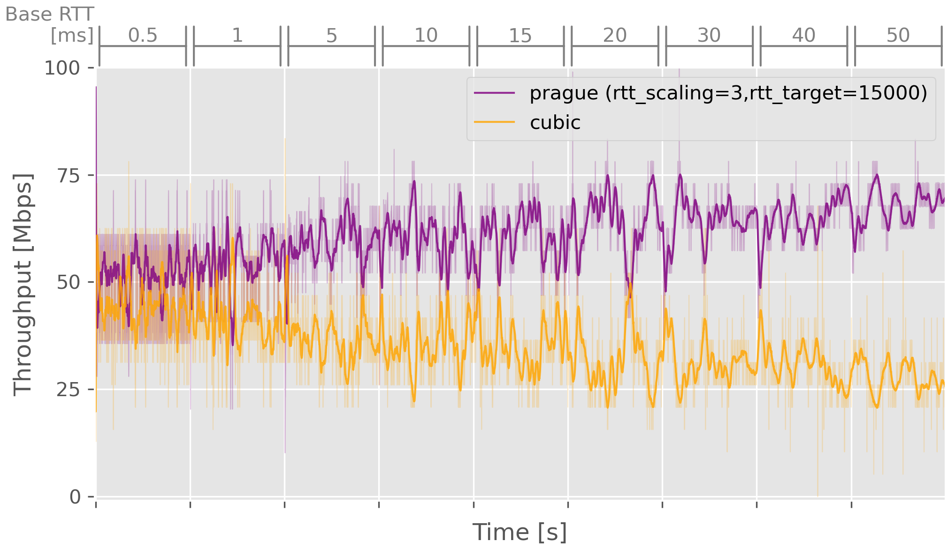
Test results—100Mbit/s bottleneck, increasing base RTTs
Prague [ f(rtt) = rtt + 15ms ] vs Cubic

Slide 20
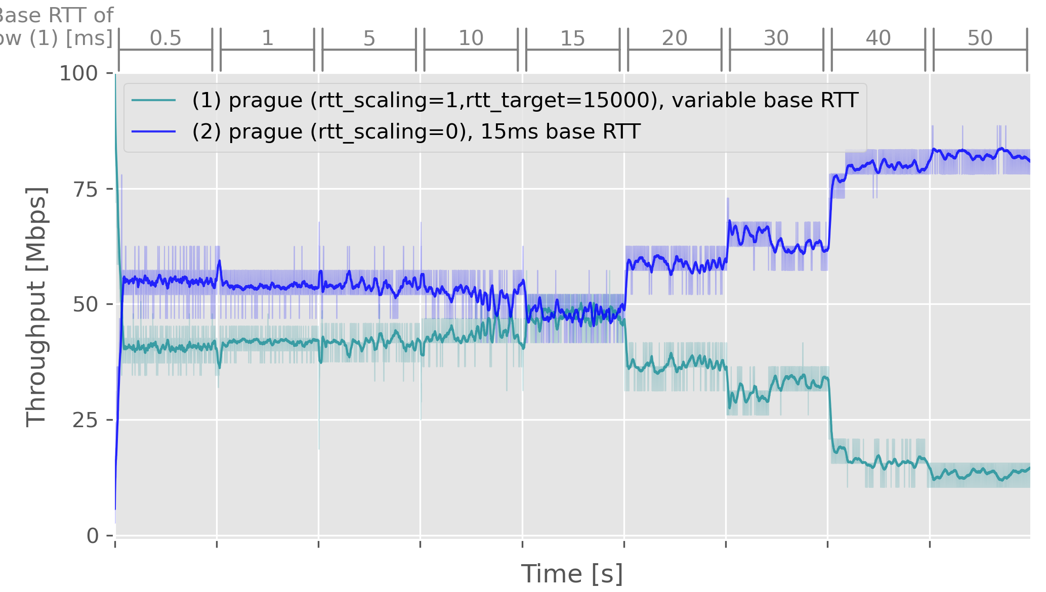
Test results—100Mbit/s bottleneck, mixed base RTTs
Prague [ f(rtt) = max(15ms, rtt) ] vs Prague

