Slide 1



Slide 2


Why?
Brackeys Game Jam
ONE week 16.-23.2.2020
Theme: HOLES

Slide 3
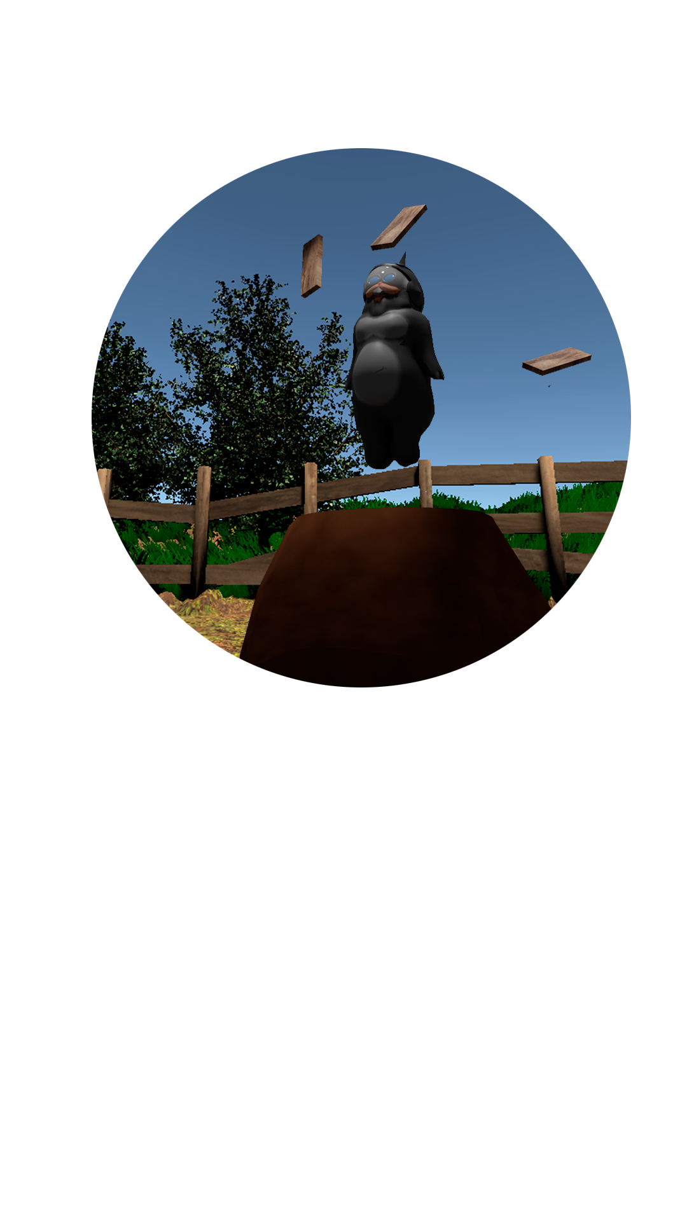
What?
We took classic Whack-A-Mole concept and gave it a hole new twist
Two different mole types
Normal and Elite
If you miss, mole will create a new hole
Lot of holes = Lot of moles = Lot of holes...
But you can also buy Power Ups!
Planks
Water hose
Explosions
Kill the moles before they get to the edge of the level!

Slide 4
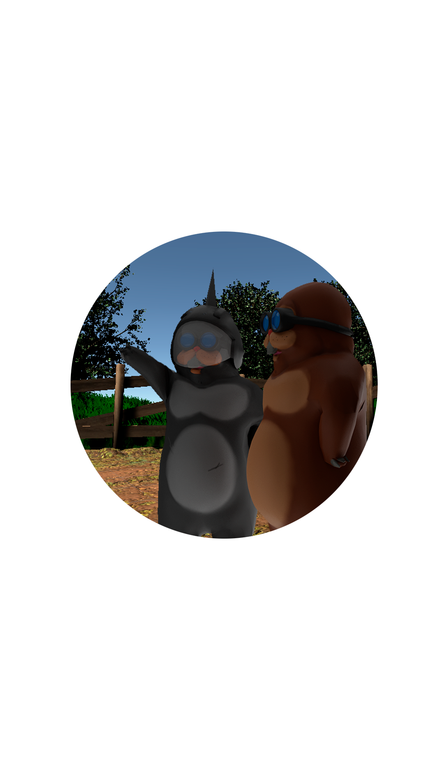
Who?
Team of four:
Pekka Kääriäinen
Programming + Design
Antero Patteri
Art + Design
Cerdic Voncken
Programming
Nick Hermsen
Sound + Music

Slide 5
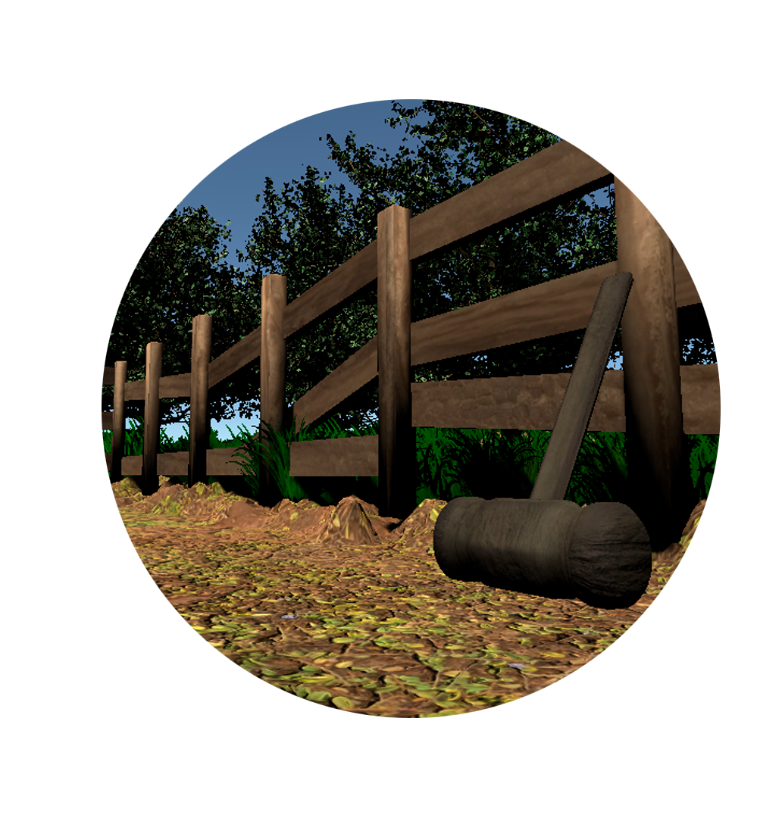
Where I can download it?
Itch.io search Quack-A-Moley
https://gentlemanni.itch.io/quack-a-moley

