Slide 1
Predicting Game’s Sales
By Ghanim Alghanim, Ali Altamimi

Slide 2
Gathering Data

Slide 3
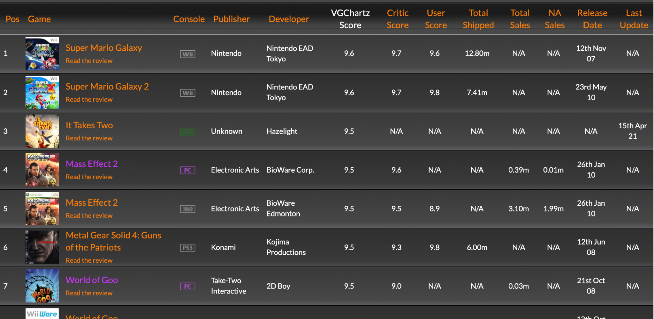

Web Scraping
The dataset from collected VGChartz
~61,000 observation and 18 features.
Some of the features are platform, genre, score, user vote count… etc.

Slide 4
Data Cleaning

Slide 5
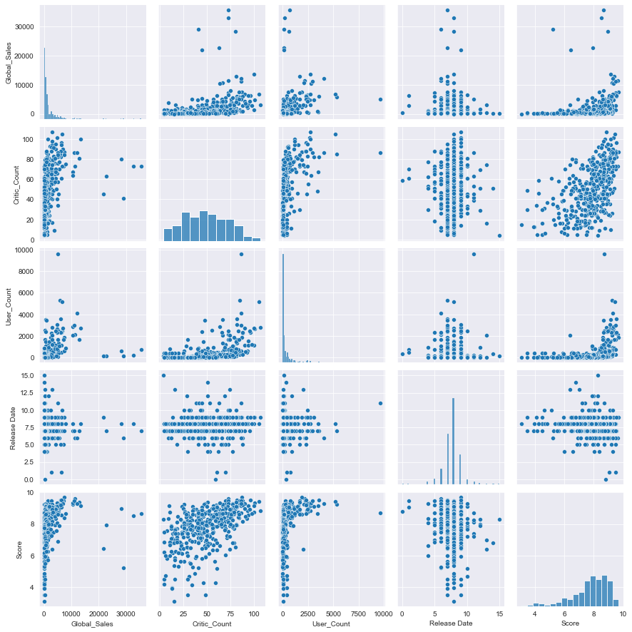
Data Cleaning & Feature Engineering
Notes:
Feature Engineering:
Converting categorical features to binary dummy variables
Fill by mean/median for numerical
Fill by mod for categorical
Convert Year to age
Dropping missing data that can’t be filled due to lack of data.

Slide 6
Data Cleaning & Feature Engineering
~400 observation.
~38 features.
Notes:
Feature Engineering:
Converting categorical features to binary dummy variables
Fill by mean/median for numerical
Fill by mod for categorical
Convert Year to age
Dropping missing data that can’t be filled due to lack of data.

Slide 7
Creating a Model

Slide 8
Splitting The Data Frame
No Categorical
Genre
Console
Rating
Console & Rating
Genre & Console
Genre & Rating
All Categorical

Slide 9
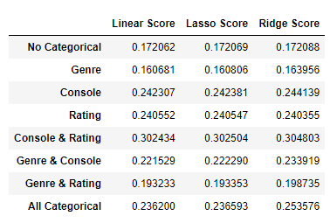
Models used
Linear Regression
Lasso Regression
Ridge Regression

Slide 10
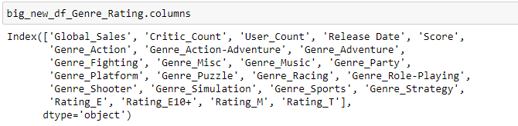
Prediction
[0,0,22,9.9,1,0,0,0,0,0,0,0,0,0,0,0,0,0,0,0,0,0,1]
Prediction Result = 90m

Slide 11
Thank you
Questions ?

