Slide 1
WP1: Syllabus discussion
Reina Camacho / Carlos Sandoval

Slide 2
WP1 - Syllabus
We had a meeting last week (28/05/2020) to summarise all the individual efforts and define common elements for program branches (Minutes written by Teofilo)
Two branches of the program: HEP and Complex Systems (CS). Both branches need to have three axes: theory, instrumentation, data analysis
Results: we realised it is not so straightforward to define common elements. Additional individual and collective reflexions needed. We all recognise the importance of making progress with the syllabus definition!
HEP |  | CS
Data Analysis | HEP related hands-on projects | Data Analysis | CS related hands-on projects
HEP Theory | Common Theory | Common Theory | CS theory
HEP Instrumentation | Common Instrumentation | Common Instrumentation | CS Instrumentation
Optional course(s) | Optional course(s) | Optional course(s) | Optional course(s)

Slide 3
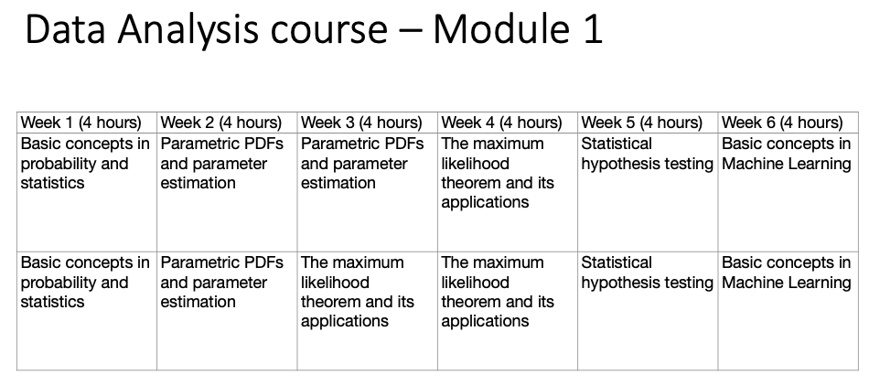
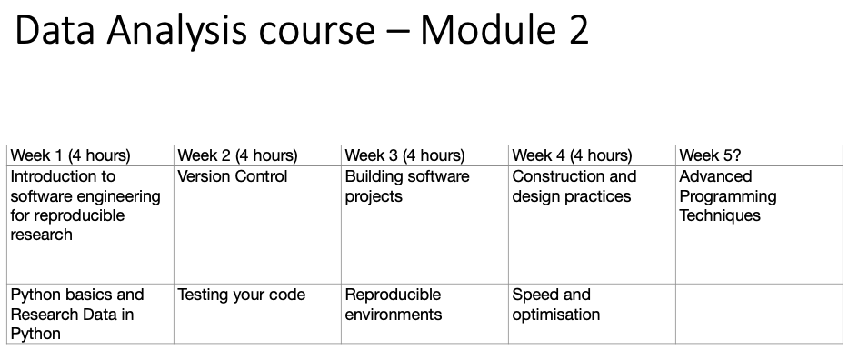
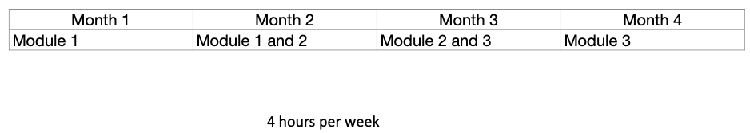
WP1 - HEP
We have 3 courses with syllabus and schedule
Data Analysis: stats and research software engineering modules should be (in principle) common to both branches

Slide 4
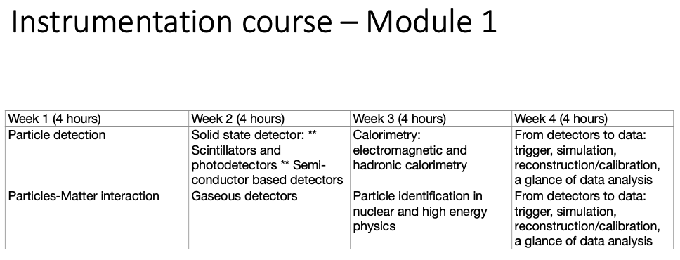
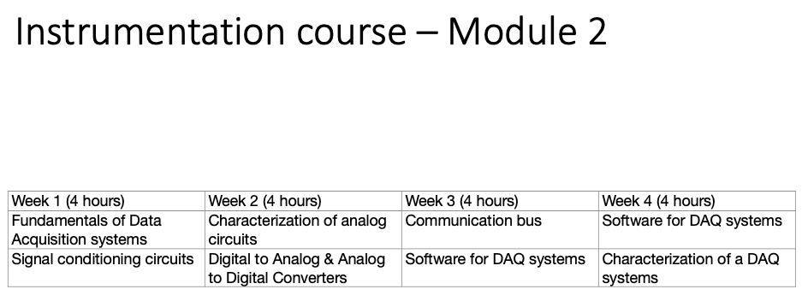
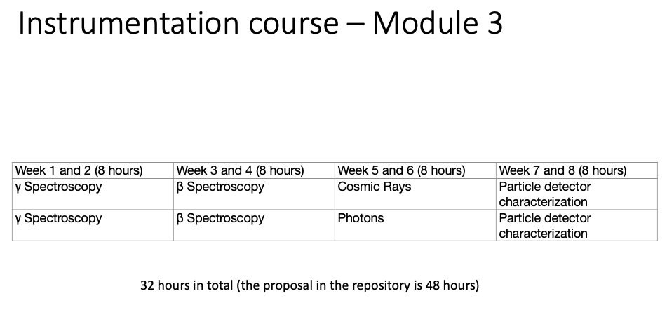
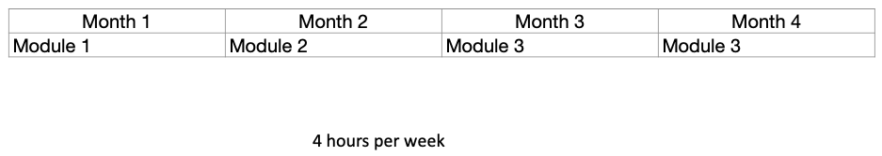
WP1 - HEP
We have 3 courses with syllabus and schedule
Data Analysis: stats and research software engineering modules should be (in principle) common to both branches
Instrumentation course: 3 modules in place. They all have a strong HEP component for now

Slide 5
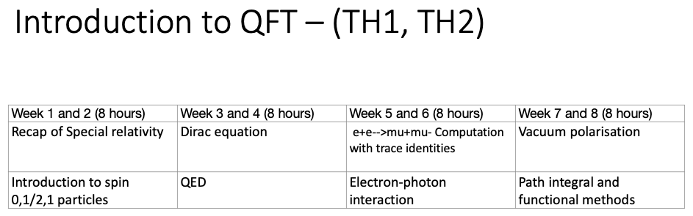
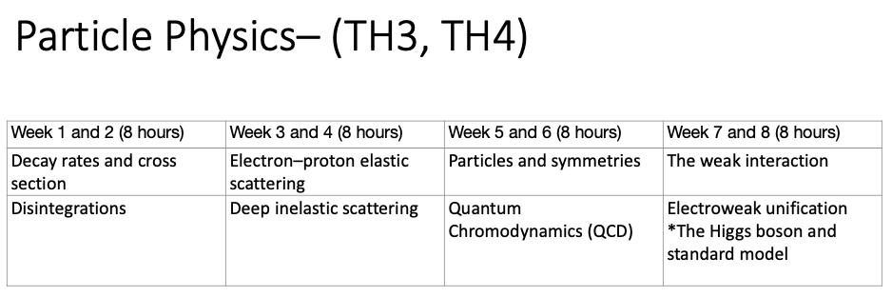
WP1 - HEP
We have 3 courses with syllabus and schedule
Data Analysis: stats and research software engineering modules should be (in principle) common to both branches
Instrumentation course: 3 modules in place. They all have a strong HEP component for now
Theory course: TH1 and TH2 would be common to both branches (modifications in the content probably needed). Particle physics (TH3, TH4) is tailored for the HEP branch

Slide 6
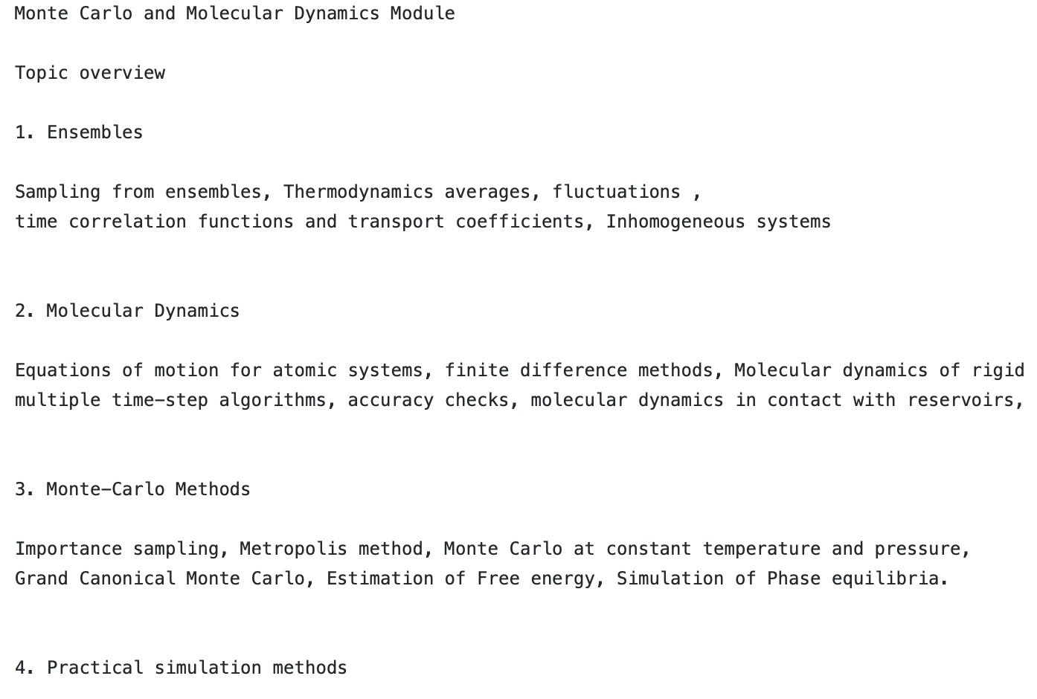
WP1 - CS
Data Analysis course: third module proposal (“hands-on”) is called “Monte Carlo and Molecular Dynamics”. MC could also be a common point with HEP

Slide 7
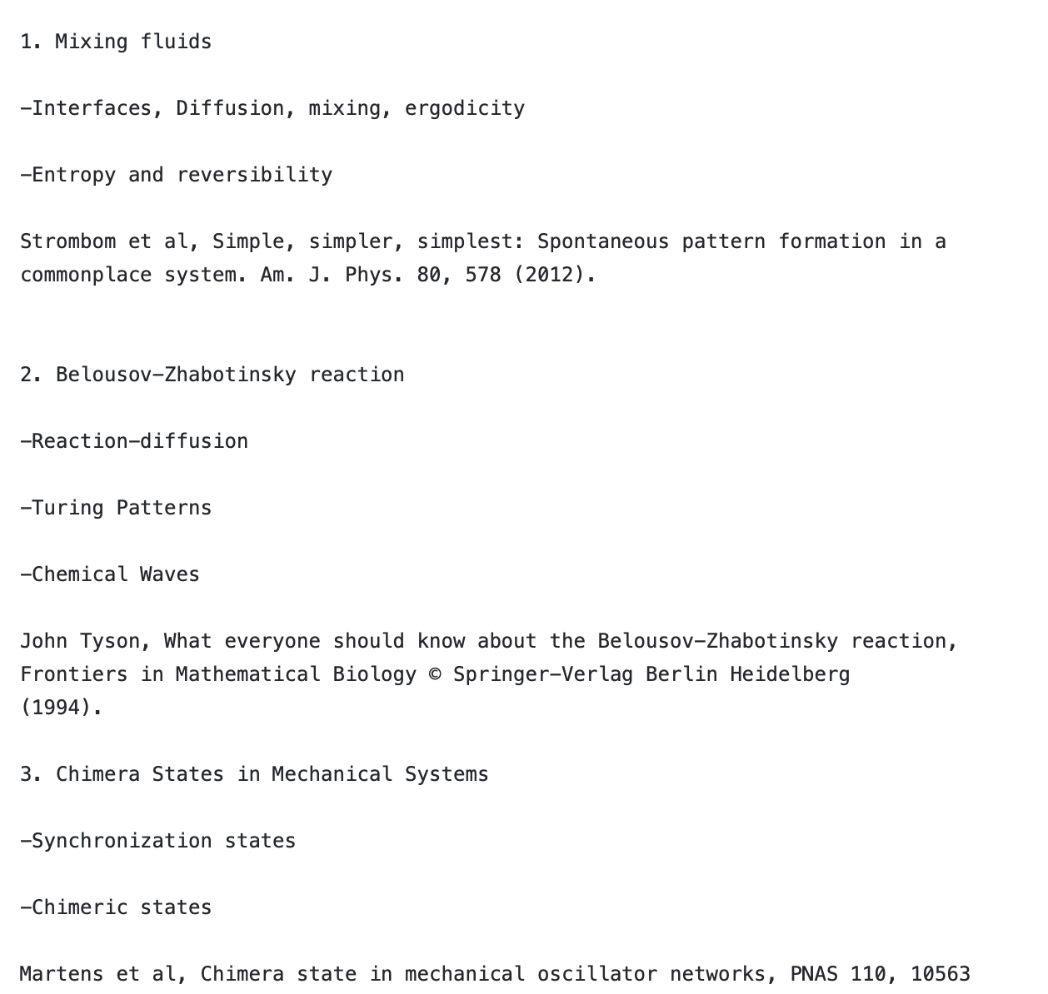
WP1 - CS
Data Analysis course: third module proposal (“hands-on”) is called “Monte Carlo and Molecular Dynamics”. MC could also be a common point with HEP
Instrumentation course: an experimental module “Systems-out-of-equilibrium” proposed. Common aspects with other modules not clear yet

Slide 8
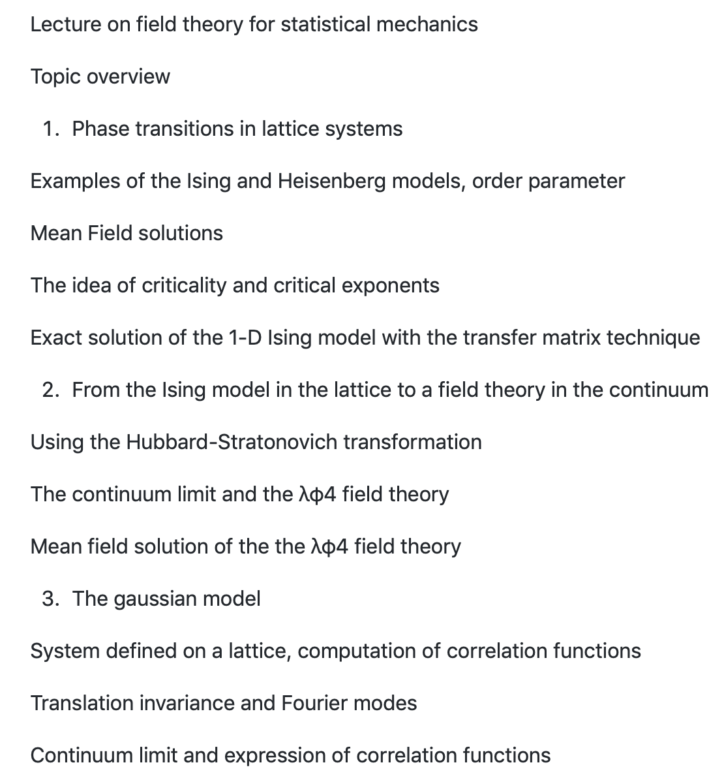
WP1 - CS
Data Analysis course: third module proposal (“hands-on”) is called “Monte Carlo and Molecular Dynamics”. MC could also be a common point with HEP
Instrumentation course: an experimental module “Systems-out-of-equilibrium” proposed. Common aspects with other modules not clear yet
Theory course: two modules proposed. TH3: Non-equilibrium statistical Mechanics and TH4: Field Theory of Statistical Mechanics

Slide 9
Discussion - 1: Schedule and structure
HEP |  | CS
Data Analysis | HEP related hands-on projects | Data Analysis | CS related hands-on projects
HEP Theory | Common Theory | Common Theory | CS theory
HEP Instrumentation | Common Instrumentation | Common Instrumentation | CS Instrumentation
Optional course(s) | Optional course(s) | Optional course(s) | Optional course(s)
We have a lot of content that needs to fit into a packed schedule
Re-think courses/module length and probably content
The output of some courses should be the inputs to others: need to make sure the current contents take this into account
Is the syllabus based on the student profile we want out of this master?
Option | January | February | March | April | May | June | July | August | September | October | November | December
1 | IC-1 | IC-2 | IC-3 | IC-3 | TH-1 | TH-2 | TH-3 | TH-4 | Internship | Internship | Internship | Internship
 | DA-1 | DA-1,2 | DA-2,3 | DA-3 | OP-1 | OP-2 | OP-3 | OP-4 | Internship | Internship | Internship | Internship
2 | IC-1 | IC-3 | DA-1 | DA-2,3 | TH-1 | TH-3 | OP-1 | OP-3 | Internship | Internship | Internship | Internship
 | IC-2 | IC-3 | DA-2,3 | DA-3 | TH-2 | TH-4 | OP-2 | OP-4 | Internship | Internship | Internship | Internship

Slide 10
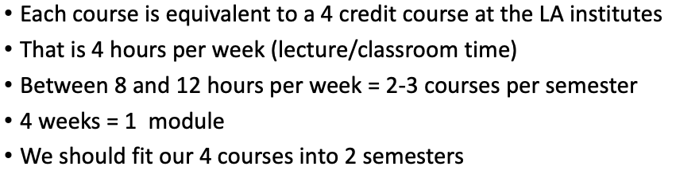
Discussion - 1: Schedule and structure
HEP |  | CS
Data Analysis | HEP related hands-on projects | Data Analysis | CS related hands-on projects
HEP Theory | Common Theory | Common Theory | CS theory
HEP Instrumentation | Common Instrumentation | Common Instrumentation | CS Instrumentation
Optional course(s) | Optional course(s) | Optional course(s) | Optional course(s)
We have a lot of content that needs to fit into a packed schedule
The current proposal is based on:
Option | January | February | March | April | May | June | July | August | September | October | November | December
1 | IC-1 | IC-2 | IC-3 | IC-3 | TH-1 | TH-2 | TH-3 | TH-4 | Internship | Internship | Internship | Internship
 | DA-1 | DA-1,2 | DA-2,3 | DA-3 | OP-1 | OP-2 | OP-3 | OP-4 | Internship | Internship | Internship | Internship
2 | IC-1 | IC-3 | DA-1 | DA-2,3 | TH-1 | TH-3 | OP-1 | OP-3 | Internship | Internship | Internship | Internship
 | IC-2 | IC-3 | DA-2,3 | DA-3 | TH-2 | TH-4 | OP-2 | OP-4 | Internship | Internship | Internship | Internship

Slide 11
Discussion - 1: Schedule and structure
HEP |  | CS
Data Analysis | HEP related hands-on projects | Data Analysis | CS related hands-on projects
HEP Theory | Common Theory | Common Theory | CS theory
HEP Instrumentation | Common Instrumentation | Common Instrumentation | CS Instrumentation
Optional course(s) | Optional course(s) | Optional course(s) | Optional course(s)
We have a lot of content that needs to fit into a packed schedule
Should we consider more compact 3-month courses? To allow for breaks, preparation for the internship and activities like the hackatons
Month | 1 | 2 | 3 | 4 | 5 | 6 | 7 | 8 | 9 | 10 | 11 | 12
Option 1 | IC-1 | IC-2 | IC-3 | Break | TH-1 | TH-2 | TH-3 | Break | Internship | Internship | Internship
 | DA-1 | DA-1,2 | DA-2,3 | Break | OP-1 | OP-2 | OP-3 | Break | Internship | Internship | Internship
Option 2 | IC-1 | IC-3 | DA-2,3 | Break | TH-1 | TH-3 | OP-2 | Break | Internship | Internship | Internship
 | IC-2 | DA-1 | DA-3 | Break | TH-2 | OP-1 | OP-3 | Break | Internship | Internship | Internship

Slide 12
Discussion - 2: Content
HEP |  | CS
Data Analysis | HEP related hands-on projects | Data Analysis | CS related hands-on projects
HEP Theory | HEP Theory | CS Theory | CS theory
HEP Instrumentation | Common Instrumentation | Common Instrumentation | CS Instrumentation
Optional course | Optional course | Optional course | Optional course
Some content could be trimmed
Data Analysis and Instrumentation (HEP) courses already have a 3 module structure
TH1 through TH4 (HEP) could be merged to form 3 modules
Would require separate theory modules for CS branch? The discussion on Content is not purely practical: What do we want our students to learn/know at the end of the programme?

Slide 13
Discussion - 3: LA-CoNGA student profile
HEP |  | CS
Data Analysis | HEP related hands-on projects | Data Analysis | CS related hands-on projects
HEP Theory | HEP Theory | CS Theory | CS theory
HEP Instrumentation | Common Instrumentation | Common Instrumentation | CS Instrumentation
Optional course | Optional course | Optional course | Optional course
We should define what our students/graduates should have learnt in the programme
- What level of theory knowledge? - Instrumentation skills - Computing skills - HEP or CS applicability of those skills
- Contact with industry world - …

Slide 14
Discussion - 4: Optional course(s)
HEP |  | CS
Data Analysis | HEP related hands-on projects | Data Analysis | CS related hands-on projects
HEP Theory | HEP Theory | CS Theory | CS theory
HEP Instrumentation | Common Instrumentation | Common Instrumentation | CS Instrumentation
Optional course | Optional course | Optional course | Optional course
We have not started this discussion yet
How many courses? Which kind of elective courses we want?

Slide 15
Next steps
HEP |  | CS
Data Analysis | HEP related hands-on projects | Data Analysis | CS related hands-on projects
HEP Theory | HEP Theory | CS Theory | CS theory
HEP Instrumentation | Common Instrumentation | Common Instrumentation | CS Instrumentation
Optional course | Optional course | Optional course | Optional course
A meeting next week to continue the syllabus work
This will require an individual reflexion beforehand on the points raised here
We need participation from both branches: HEP and CS
Need to make sure all the updated information is on git and available to all the members of the consortium
Timescale: before summer (?) Instructors need enough time to prepare the material by January + get familiar with the e-learning platform!

