Slide 1
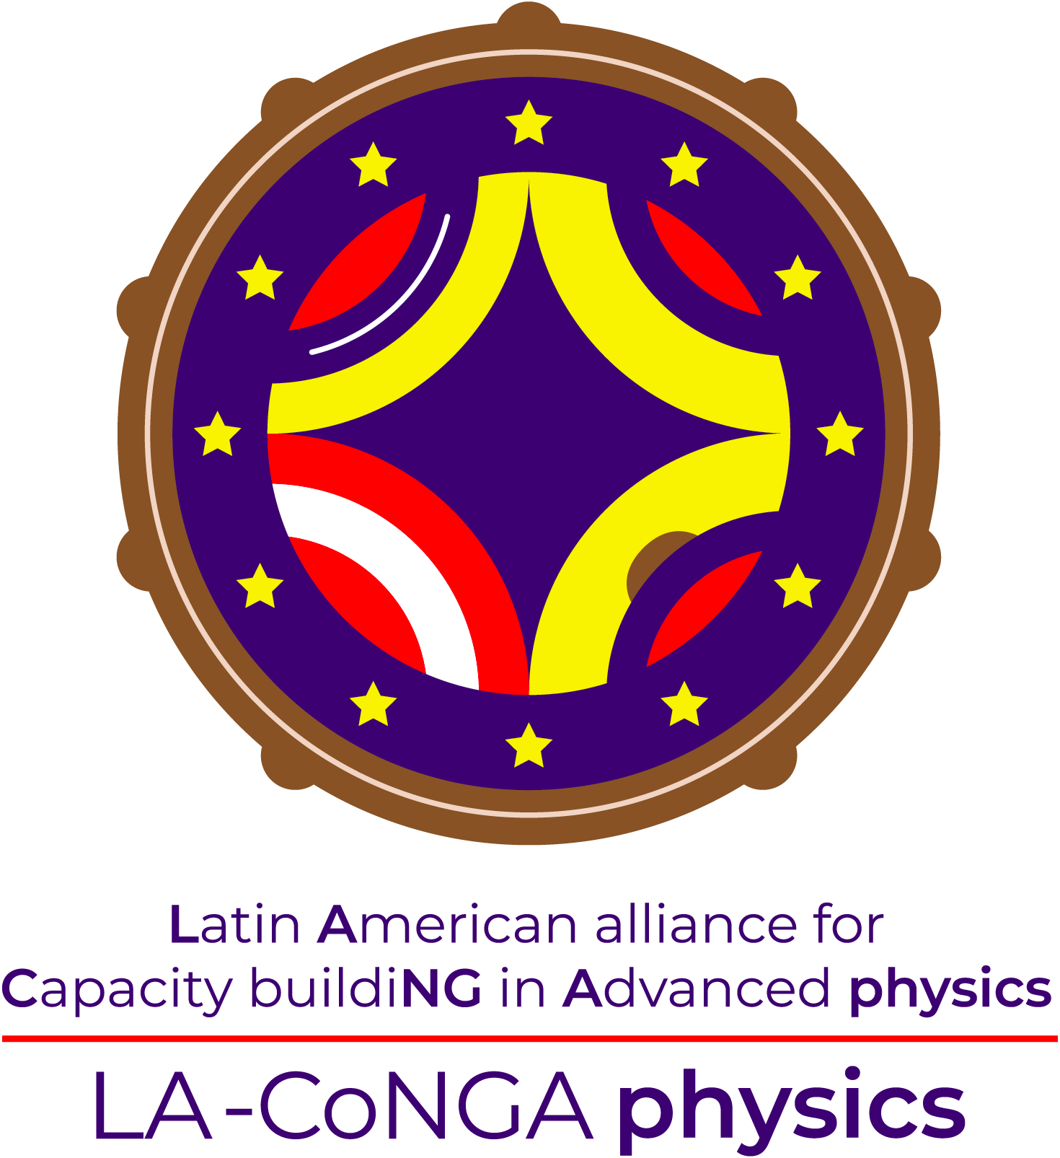
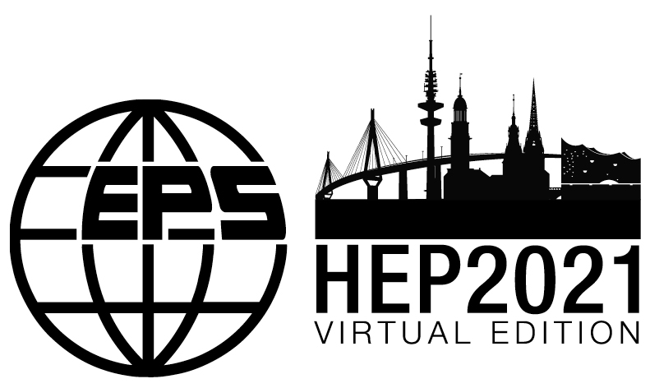
LA-CoNGA physics an open science education collaboration between Latin America and Europe for High Energy Physics
J. Peña-Rodríguez
on behalf of LA-CoNGA physics community
07-29-2021

Slide 2
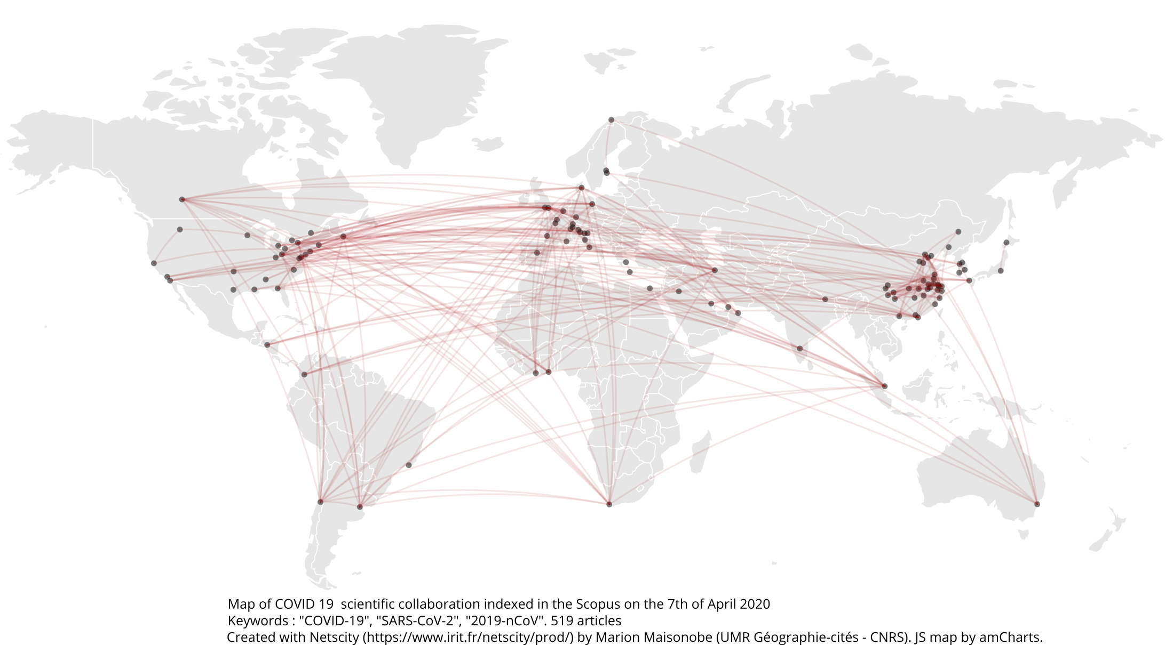
Scientific collaboration and education at a global scale
Science and higher education
globally distributed,
collaborative and
multidisciplinary
University-research-society link
knowledge generation,
application and transfer
Virtual Research and
Learning Networks
play a key role
A network where data, software tools,
research facilities, teaching and
information resources
are seamlessly shared

Slide 3




The importance of virtual research and learning networks
Internationalization
collaborative international environment
Accessibility
Modernization
open educational resources,
connectivity, acquisition
of digital skills, and
use/development of new
learning methods
Each institution/group
might not have
all the resources/staff
Sánchez, A., and Atlas Collaboration. "The CEVALE2VE case.” PoS ICHEP2016 (2016) 322
Caicedo, M., et al. "Virtual research and learning communities in Latin America: The CEVALE2VE case." Interciencia 42.11 (2017): 733-738

Slide 4


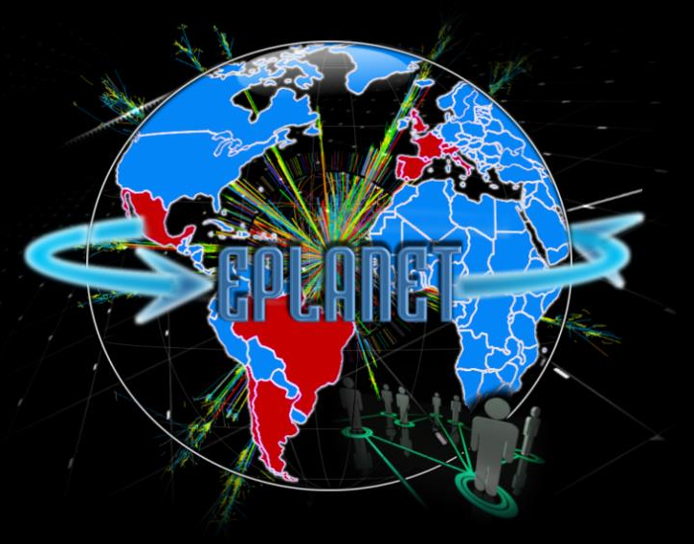
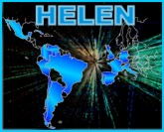
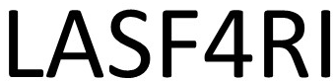
HECAP context in Latin America
High energy, cosmology and astroparticle physics community has grown in Latin America in the last decades
Latin American Giant
Observatory
High Energy Physics Latinamerican European
Network
Latin American Strategy
Forum for Research Infrastructure
The European Particle
physics Latin America NETwork
The HECAP development is nuanced and variable country-by-country,
, but it has huge potential thanks to:
Diversity of interests and skills
A young generation with potential and eagerness to learn
Collaborative work make us stronger

Slide 5
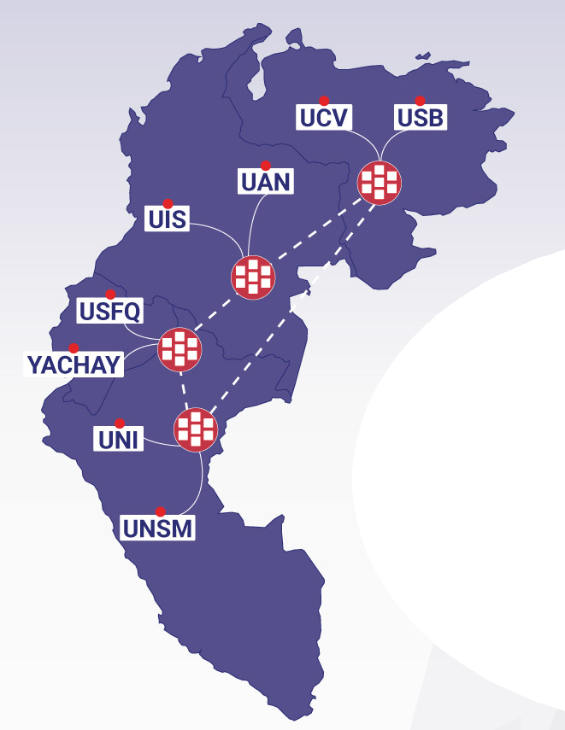

LA-CoNGA physics
https://laconga.redclara.net/
An Erasmus+CBHE (Capacity Building in Higher Education) project co-funded by the European
Commission’s Education, Audiovisual and Culture Executive Agency
Responding to the strategy of the participating institutions and the
capacity building in higher education strategy promoted by the EU
A 3-years project. Officially started in January 2020
11 universities from Latin America and Europe join efforts with other scientific (CERN, CNRS, DESY, ICTP, IRFU) and industrial partners to contribute to the modernisation, accessibility and internationalisation of higher education in Colombia, Ecuador, Perú and Venezuela

Slide 6
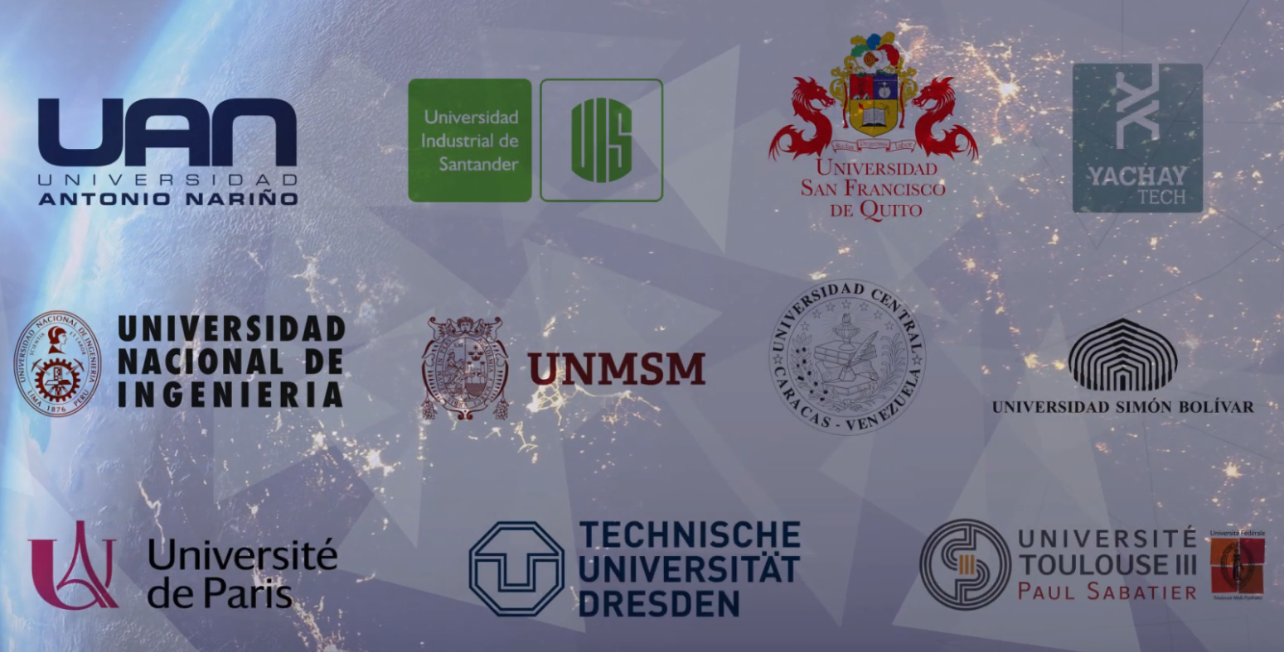
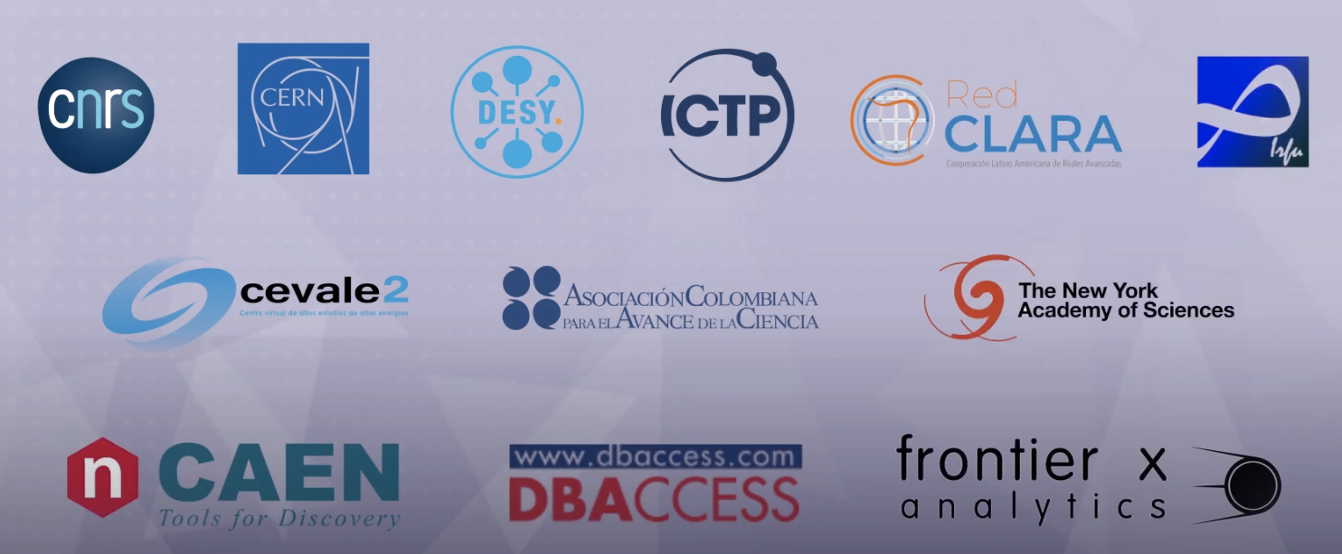
Universities
Scientific and
Industrial partners

Slide 7

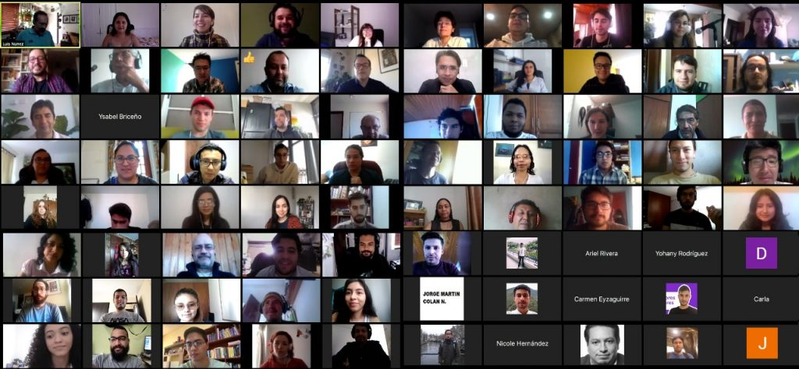
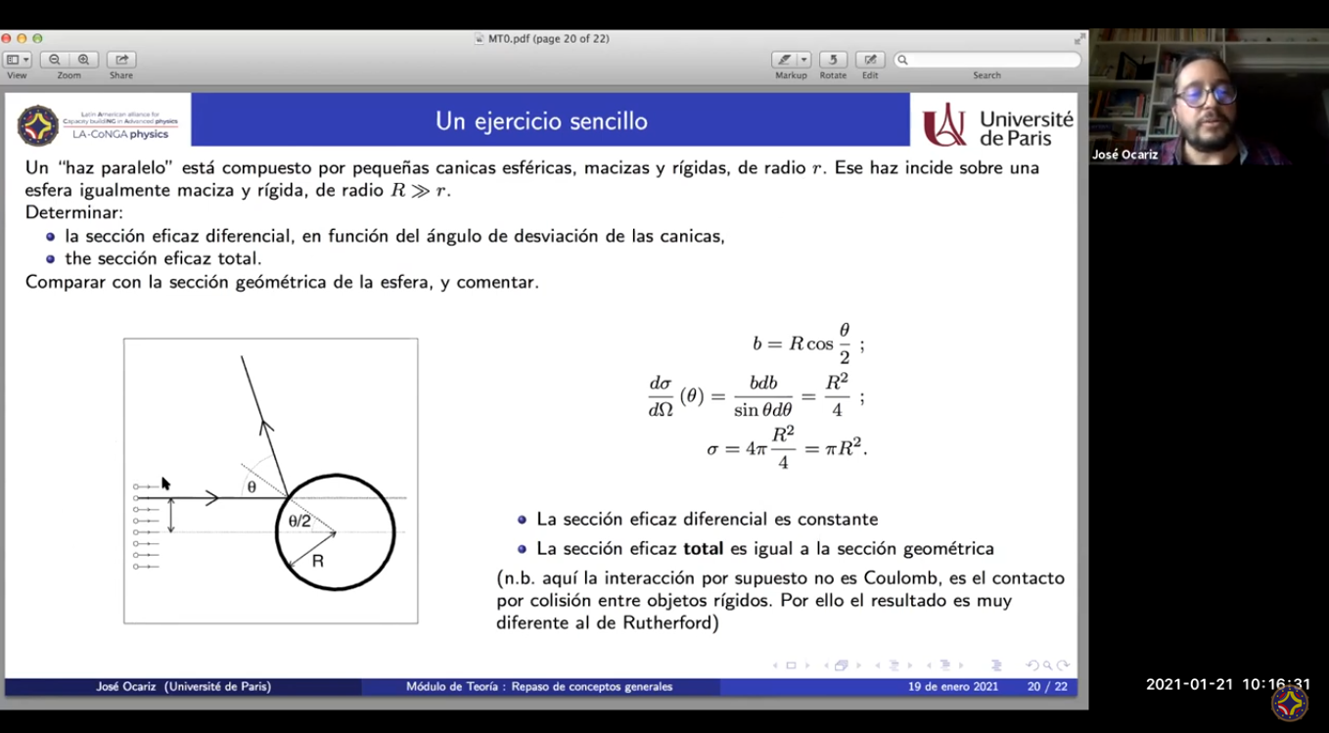
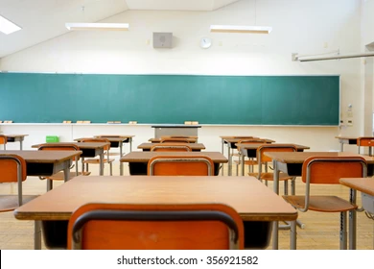
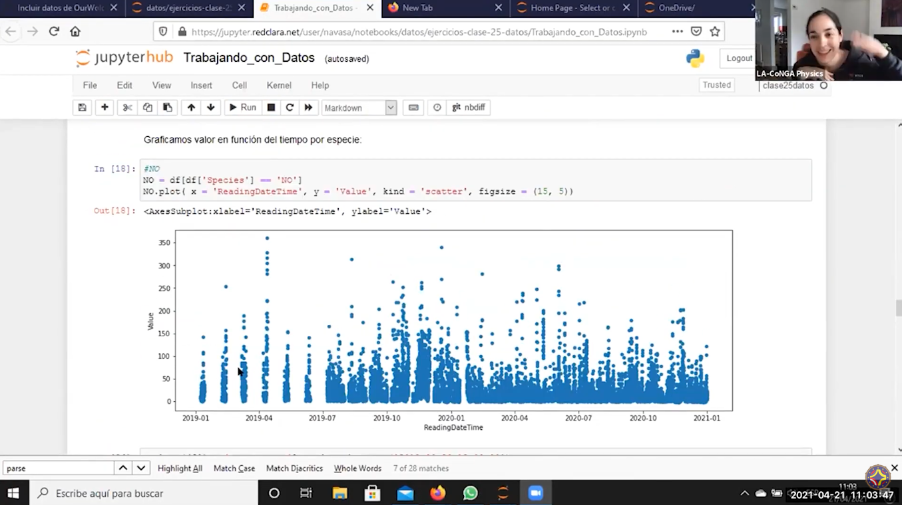
LA-CoNGA physics
A one-year specialization that fulfils the Bologna Declaration, with a homologation system of courses between the participant university academic programs.

Slide 8






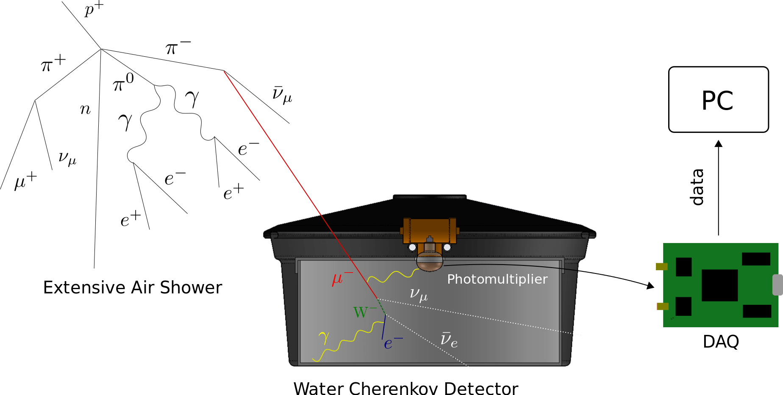



Methodology and platform
An e-learning open-access platform
Good practices of scientific reproducibility
Remote-access experimental facilities
Spanish teaching material

Slide 9
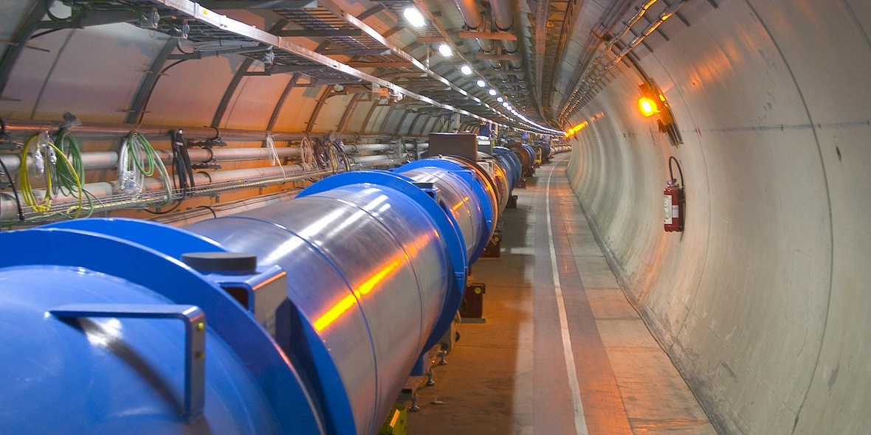
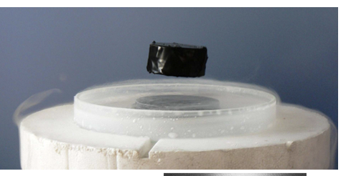
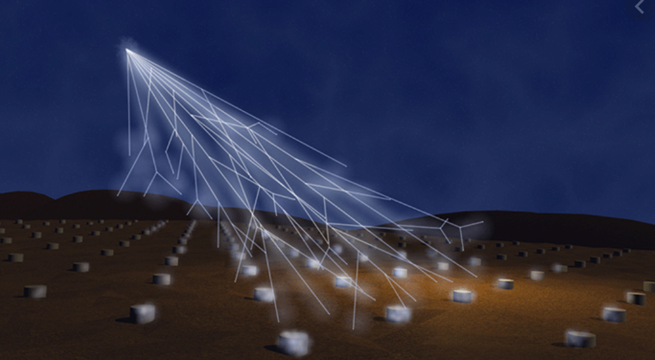
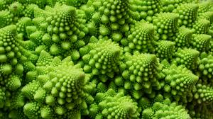
Thematic areas
High Energy Physics
Complex Systems
https://laconga.redclara.net/courses/
Theoretical fundamentals and experimentation
International collaborations
Knowledge transfer
Study of matter states
Ubiquity of studied models
Networks and collective behaviour
Highly interdisciplinary field

Slide 10
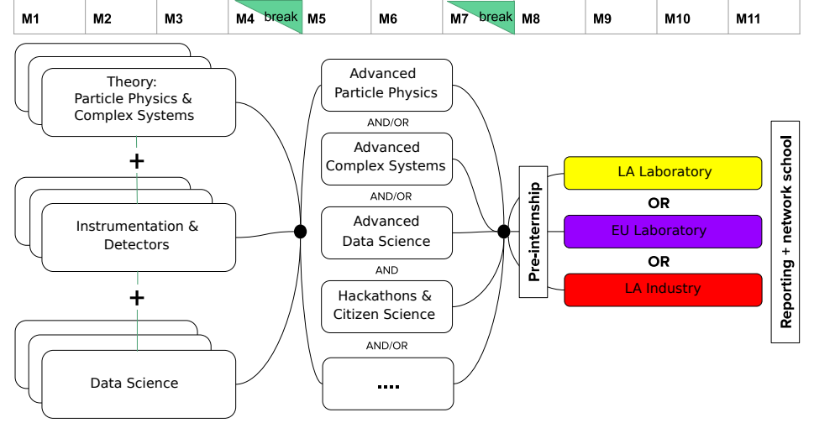
Implementation

Slide 11



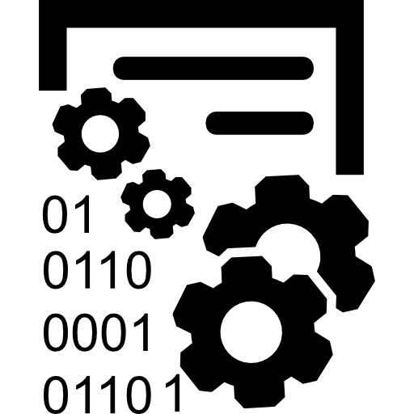

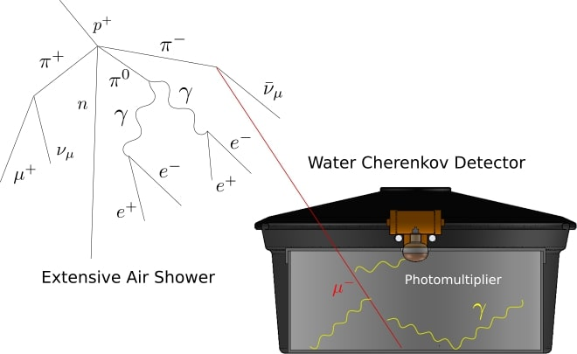
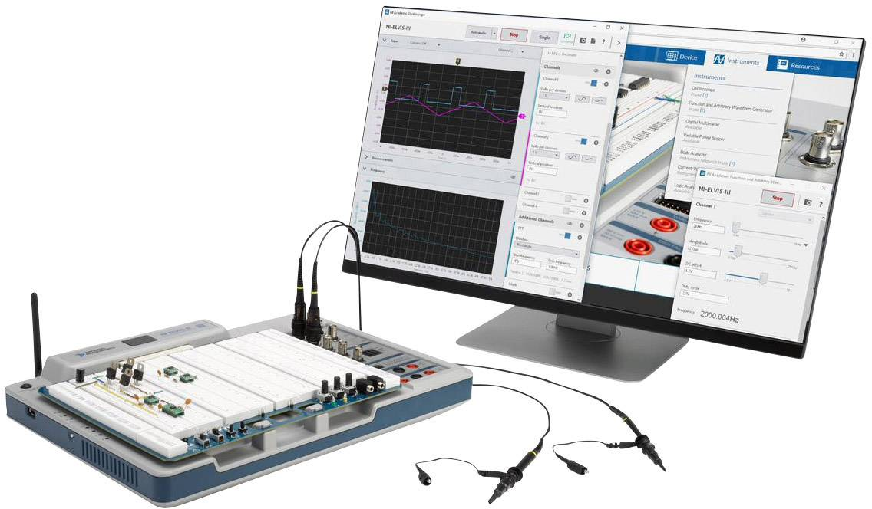
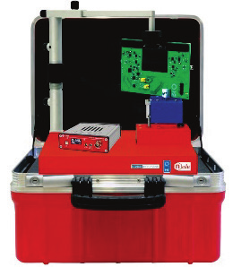
Remote labs
Biblio.
Demo
Control and data taking
Communication
Remote detectors and instruments
CAEN
National Instruments

Slide 12
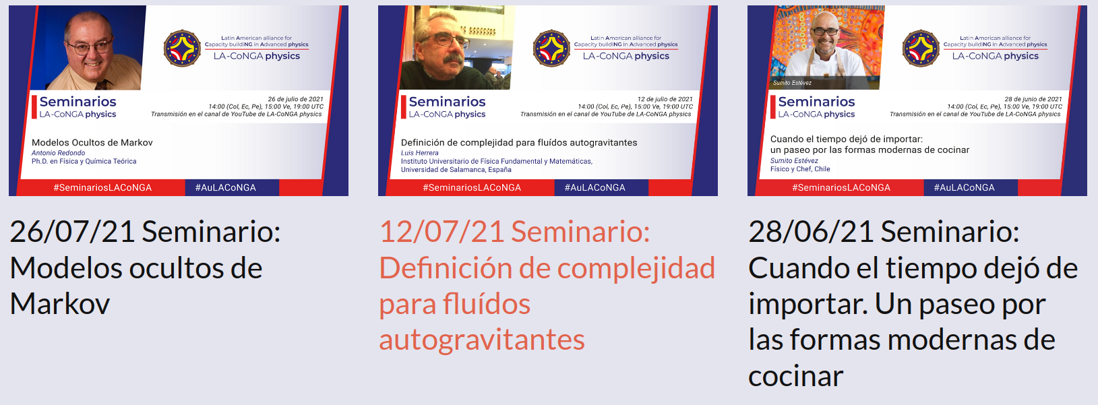
Seminars
Open-access virtual seminars taking place twice a month
Knowledge and expertise sharing from people working
on industry and academy
https://www.youtube.com/hashtag/seminarioslaconga

Slide 13
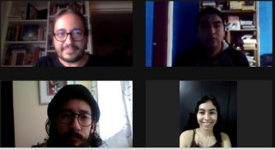

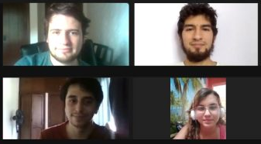
How is it going on?
First Semester
30 instructors
from Latin America and Europe
Particle Physics &
Complex Systems
more than 50 students
from 4 countries
Instrumentation &
Detectors
more than 100 classes
Data Analysis &
Statistics
https://laconga.redclara.net/terminamos-el-primer-semestre/
Second Semester
Reproducibility in
Science
Statistical Mechanics
Astroparticles &
Cosmology
Medical Physics

Slide 14
Our values and vision
We strengthen a sustainable, dynamic, collaborative, interconnected, and diverse virtual research and learning network of Latin American and European researchers in advanced physics
With close ties to the productive sector, which leads the development of science and technology in the region
Contributing to the modernisation, accessibility and internationalisation of higher education systems in the region
Using of technology in educational environments to enhance learning
Applying good scientific practices and gender equality
We envision similar experiences in other disciplines

Slide 15
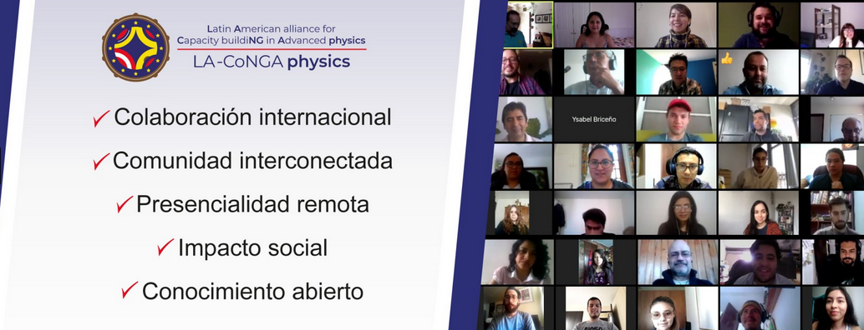
Thanks!

Slide 16
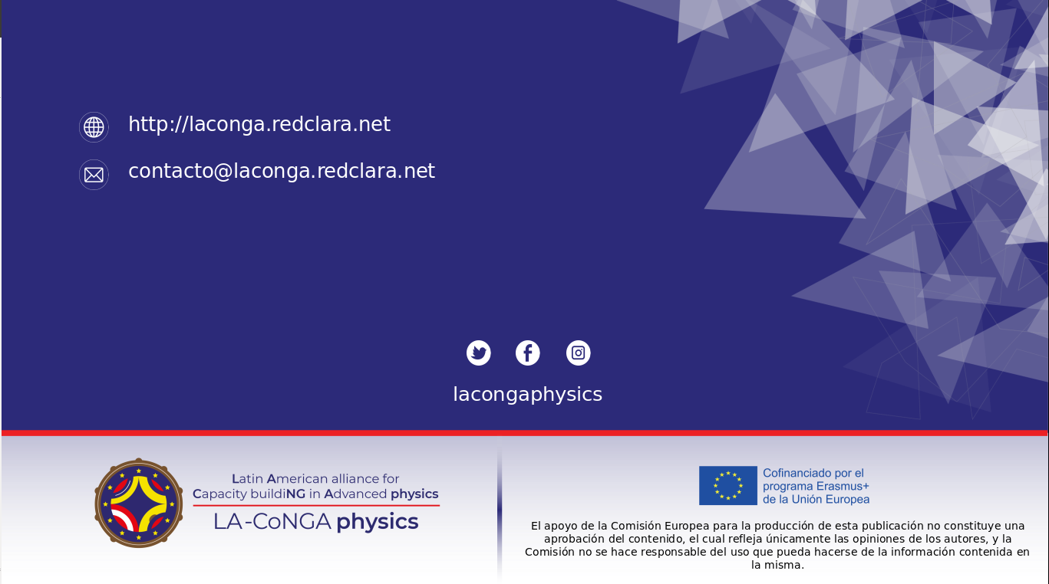

Slide 17

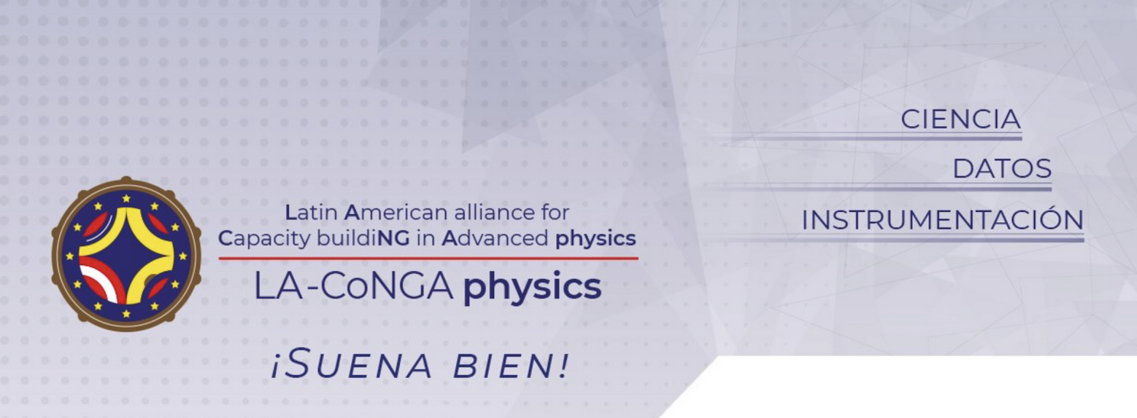


Competences

Slide 18
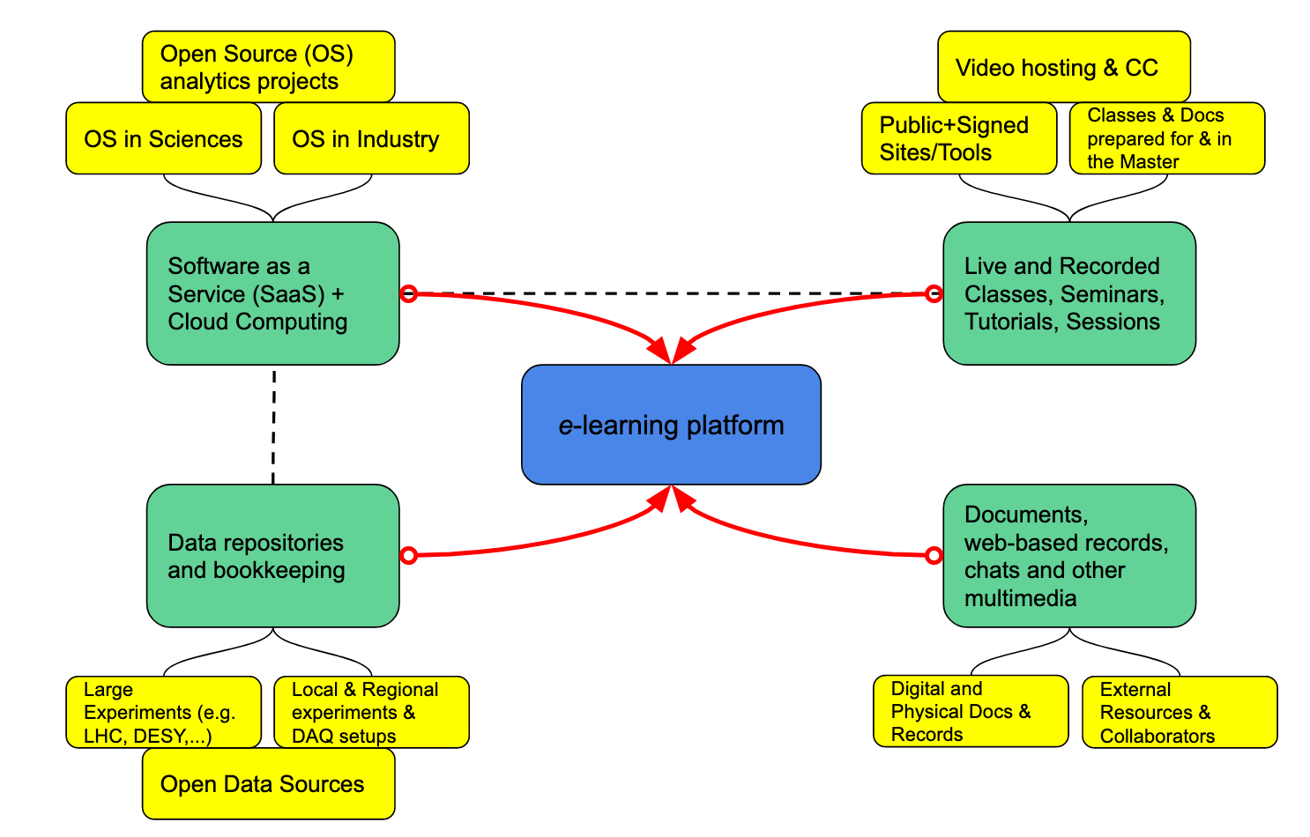
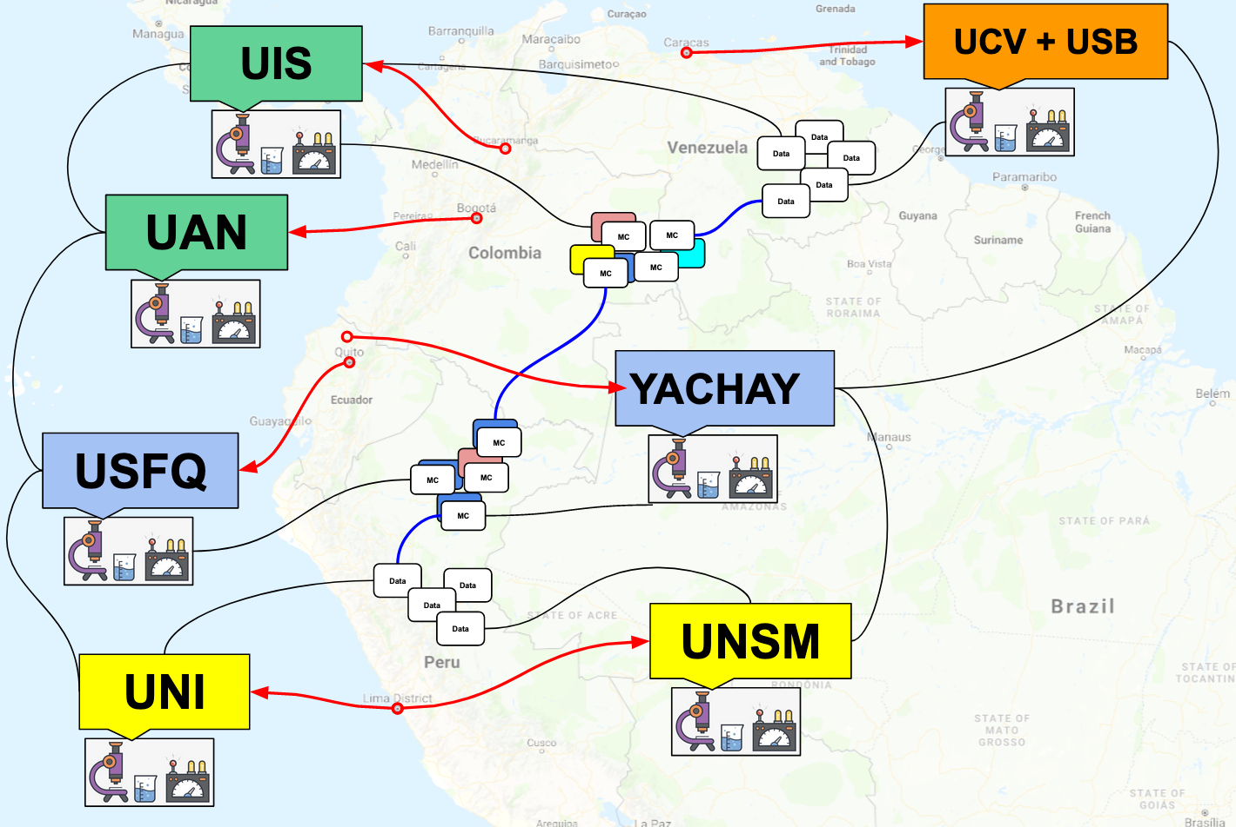
Methodology and platform
An e-learning open-access platform
Remote-access experimental facilities
Good practices of scientific reproducibility
Mobility program in Latin America and Europe for internships

