Slide 1

Mobile Security – Dangers and Visions
What is possible now and in the future?

Slide 2

Declaration
All the images and other information used in this presentation are from the PUBLIC Internet
All the stories were read on HTML pages or in E-mails (unknown/fake sender addresses)
Conclusion: all the “black underpants & socks” agent can leave the room, but in silent, without handcuff’s noise

Slide 3
Ruining GSM Security Delusions
Same targets can be achieved than in the case of the Internet
  We will see...
Examples for
  eavesdropping,
  SIM card cloning,
  PIN code guessing,
  Simple DoS attack, blocking, etc.
Maybe the attacks need special HW
Security by obscurity

Slide 4
Examples
HIP’97…(http://cuba.xs4all.nl/hip)
SIM cloning (due to security by obscurity)
PIN guessing old and nowadays
WAP DoS and remedy
Certificate handling (PKI, trust, hierarchy, CRL-handling, etc.)
You are victim of the system / privacy issues
Human factor (phone card stories from Hungary)
Vision of secure Personal Trusted Device!

Slide 5



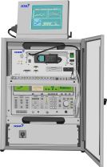

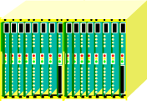
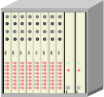
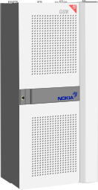
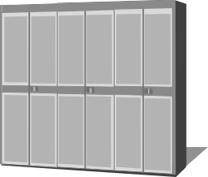
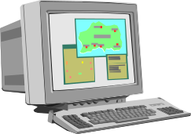
MS
Base Station Subsystem
Network Switching Subsystem
NMS
VLR
HLR
OMC
MSC
EIR
AC
TC
ISDN, PSTN, PSPDN, etc.
© pici@elte.hu
BSC = Base Station Controller
OMC = Operator and Maintenance Center
NMS = Network Management Subsystem
MSC = Mobile Switching Centre, uses TMSI for authentication of mobiles
TC = Transcoding Center
VLR = Visitor Location Register, (on MSC territory)
HLR = Home Location Register, (IMSI database).
EIR = Equipment Identification Register, access of mobiles by their IMSI number
AC = Authentication Centre, for subscribers
BSC
BTS
Air_{encrypted}

Slide 6
Authentication
SIM and AC stores the subscriber ID (IMSI) and the auth. key (K_{i})
The authentication is done by VLR with the help of AC
The AC creates one authentication triplet, which consists of: random number (RAND), digitally signed response (SRES) and encryption key (K_{c}), where
  SRES = A₃(RAND, K_{i})
  K_{c} = A₈(RAND, K_{i}), this is for encryption of the data flow with A₅
The SIM knows the A3 and A8 algorithms
VLR sends RAND, the SIM counts SRES and sends it back
if the value given by AC and the value counted by SIM is the same, then VLR give access to the network for the subscriber.
© pici@elte.hu

Slide 7
GSM Architecture - Attack Points
SIM, ME, SIM – ME communication
ME Internals
ME - BS communication in both directions
Base Station - MSC
Other Telecom Elements
Certificate architecture and implementation, PKI
WAP, Mobile Internet
Beyond Technology, the lovely humanoid

Slide 8
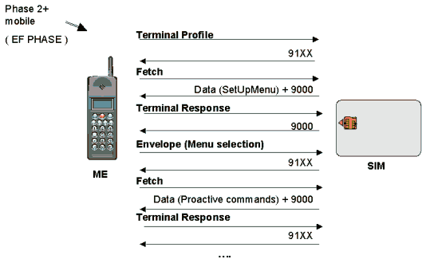
SIM-ME Communication

Slide 9
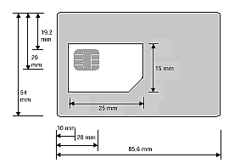
SIM Related Threats
Based on one or more smart cards
Memory structure and storage
PIN/PUK codes, PKI keys, data for Ax algorithms
Master/slave relation in APDU communication
Additions: biometry (extra solution or extra danger?)
Behaviour of humanoids (social engineering)

Slide 10

SIM cloning
Security by obscurity falls!
Comp128, A3 - A8, A5
The background of weaknesses
Katsumi, the new algorithm for the future?
After cloning which one is the original?
Operator: it is problem for the user…

Slide 11
ME - Hardware Security
Classification:
  device: keyboard, panel, microphone, camera...
  card: certificates, keys, identity data, random generator
Device
  lock, firewall, additional memory, privacy handling
SIM card → WIM (Wireless Identity Module) card
  PIN, APDU, memory structure, E2E security
Environment
  WAP → IP world, servers (SSL/TLS), gateways (encode/decode), networks (IPSec...), modems, microphone, receptors (infra), etc.

Slide 12
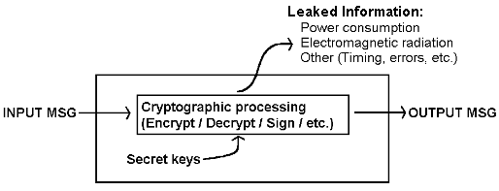
PIN guessing
Bad trials increases a counter (writing process), which needs high voltage…
Counter is increased in advance and decreased / reset after giving the good PIN, but reading or writing works between different temperatures…
Mentionable: (differential) power analysis

Slide 13
ME - Future Software Issues
Good idea, but still possible bad implementation
Operating system bugs
Management software bugs
Firewall (both in device and in chip!)
Attachments, download & install & autorun
Key-handling for crypto-protocols
Logging (what to log and how/where to store?)
Others: sniff, portscan, biometry, viruses, etc.

Slide 14
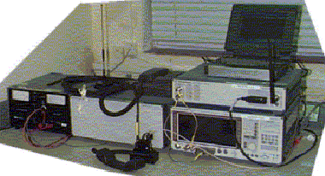
Air security…
Lauri Pesonen: GSM Interception (21.11.1999)
IMSI catcher
Roaming security
Echelon?
Satellite security?
Bluetooth security?
OTA Provisioning (Over The Air Configuration)

Slide 15
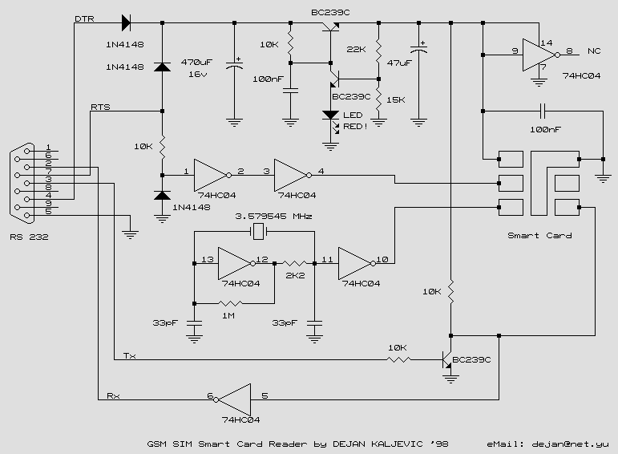
Build yourself

Slide 16
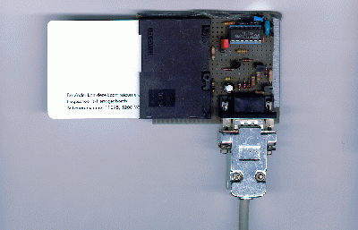
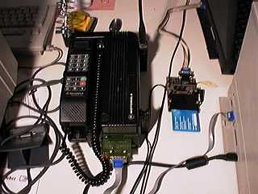
Make Yourself
DumbMouse reader
Complex analyzing tools

Slide 17
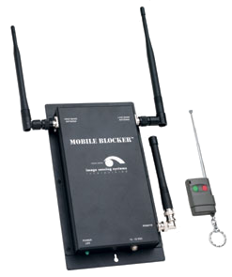
Buy Yourself - Example
Indoor Mobile Blocker
  Coverage: 30-40 meters (up to 131.23 feet depending on installation site)
Overall Unit Dimension:
  (L x W x D) 305 mm x 153 mm x 25 mm (12 in x 6 in x 1 in)
Total Weight:
  Less than .45 K (1.0 lb) including antennas and wall-mounted AC power supply
Operating Temperature Range:
  –34? C to +74? C (–30? F to +166? F)
Question: it will be used just in “right places”?

Slide 18
WAP Issues
Architectural Problems
  Due to narrow bandwidth
  Easy WAP Denial of Service or Blocking (method found and solution provided by SEARCH-Lab)
  Analogies found with Internet security (ex. SSL/WTLS)
About security in deep
  Markku-Juhani Saarinen: Attacks against the WTLS protocol (http://www.cc.jyu.fi/~mjos/wtls.pdf)
  Sami Jormalainen and Jouni Laine: Security in the WTLS (http://www.hut.fi/~jtlaine2/wtls)

Slide 19
Securing Mobile Internet
Certificate handling
Certificate Revocation Lists
Online Certificate Status Protocol
Security of databases (ex. LDAP…)
Security of connection of queries
Validation chains (circles…)
Evaluation of different cases, artificial intelligence
Human factor: Verisign certificate asked by Mr. X for m$ security patch

Slide 20
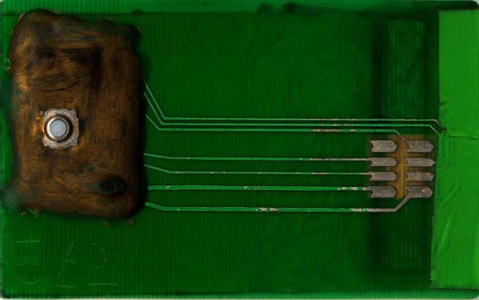
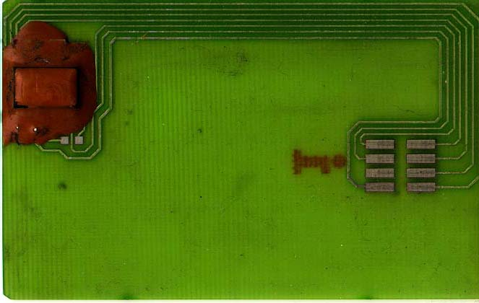
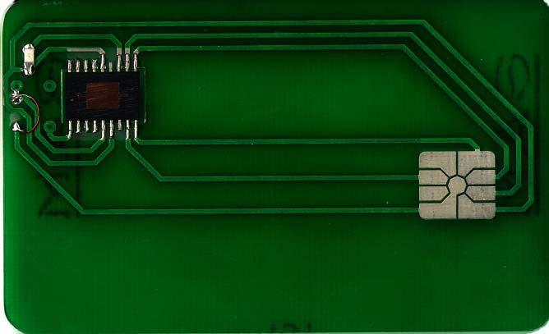
Human factor beyond technology
Jealous operator monitors his girlfriend moves
Ananova news: phones have chips that pick up sounds and voices, allowing to eavesdrop by dialling a special code to activate the chip. The spy phone costs between £700 to £900.
Talent university students, evolution steps:

Slide 21
For the Trip Home
”Security is a process, not a product!” /Bruce Schneier/
Web has several faces – hard to find immediately the right
Subscribe to Crypto-gram: http://www.counterpane.com
Read books (Web, bookstore: Security Engineering, by Ross J. Anderson)
Widen your view, your way of think, and be open minded
Search for a legal group, where you can use your experiences (learn and teach!)
Get closer to science (U. Twente: Pieter Hartel): http://www.ecs.soton.ac.uk/~phh/ifip-wg88, http://www.cardis.org
Never underrate the other side!

Slide 22
Conclusion and closing
Now you should not think mobile world is more secure than the PC or Internet world
Additional information from other speakers and attendees?
Examples from different countries?
Contact “Zoli” (use finger -l for PGP-key):
  kincses@mit.bme.hu
  (PGP-FP: 432E E83F C2B1 16F5 5F7E CCA2 AA5B 0597)

Slide 23
Commemoration…??.10.1998.
Official press release of Chaos Computer Club about the strange death of TRON:
http://www.ccc.de/CRD/CRD241098.en.html

