Slide 1

Large Language Models (LLMs) & Agentic AI Workflows
Dr.S.Mahesh Anand

Slide 2
How Transformer Changed the Landscape of Artificial Intelligence?

Slide 3
A. Vaswani et al., "Attention is all you need," in Advances in Neural Information Processing Systems, 2017, pp. 5998–6008.

Slide 4
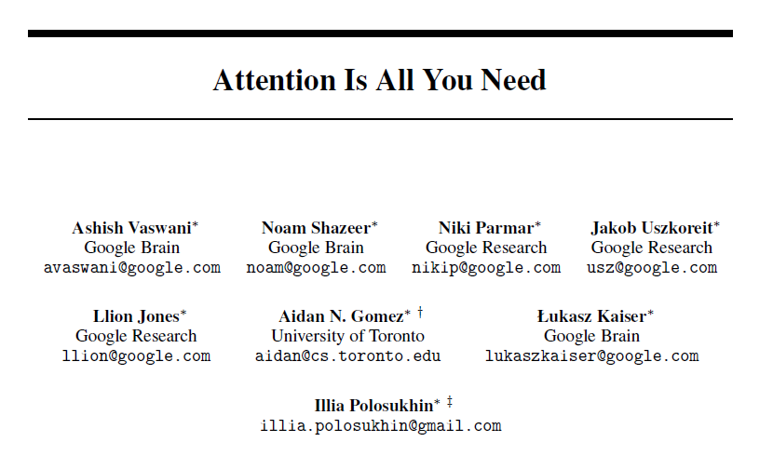

Slide 5
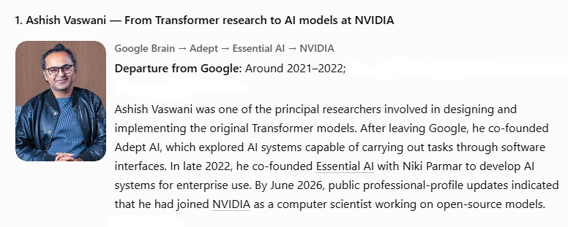
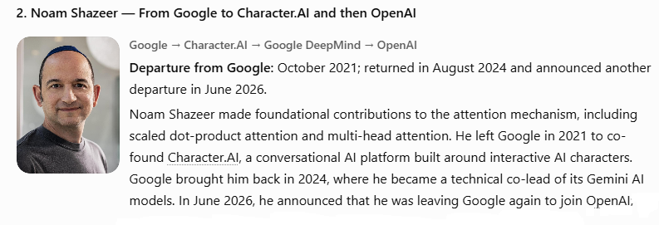

Slide 6
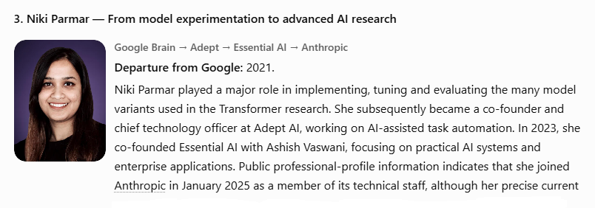
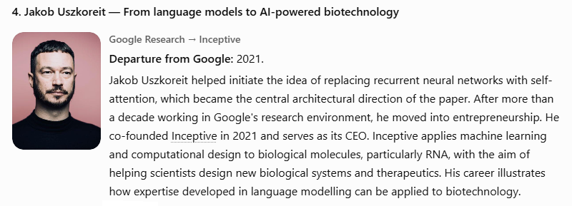

Slide 7
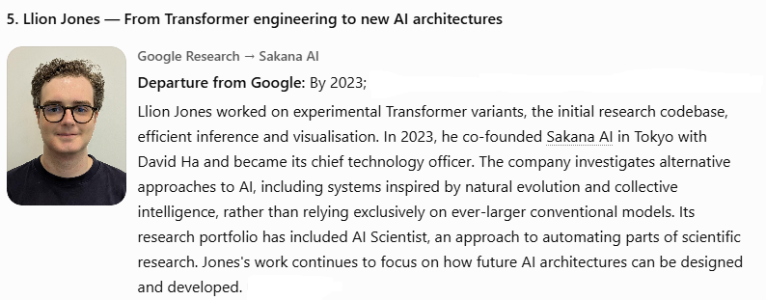
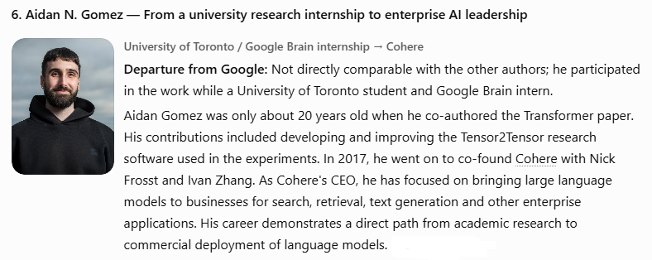

Slide 8
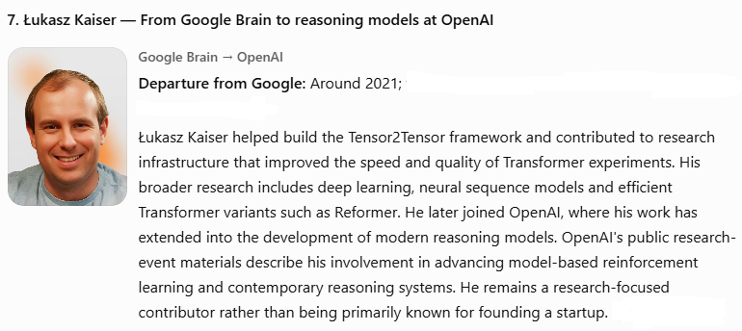
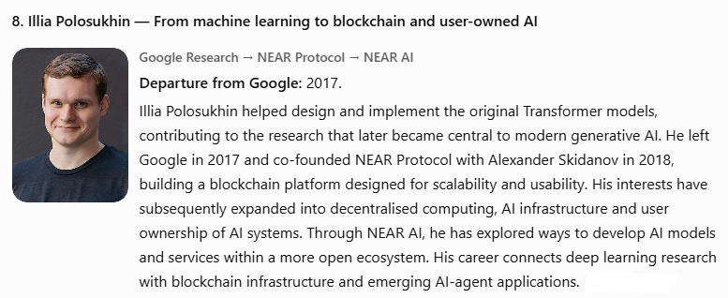

Slide 9
How can an organization that leads in foundational research lose the first-mover advantage in commercializing that research and subsequently recover?
The important distinction is that OpenAI did not invent the Transformer. It successfully packaged advanced language-model technology into a product [Nov-2022] that people could immediately understand and use.
However, Google had a particular challenge: its search business depended on delivering reliable information and maintaining users' trust. A chatbot that confidently generated incorrect answers could damage that trust.
On 6 February 2023, Sundar Pichai announced Bard, Google's experimental conversational AI service. The timing was significant: Microsoft was preparing to integrate ChatGPT into Bing, and Google faced the prospect of a competitor challenging its search business.

Slide 10
Bard's launch and the James Webb mistake
Bard was introduced to the public with a promotional example asking what discoveries from the James Webb Space Telescope could be explained to a child.
Unfortunately, Bard gave an incorrect answer. It suggested that the James Webb Space Telescope had taken the first pictures of planets outside our solar system. In reality, the first direct images of exoplanets had been captured earlier using the European Southern Observatory's Very Large Telescope.
The mistake became a global news story. Alphabet shares fell sharply during trading, wiping out roughly $100 billion in market value at one point.

Slide 11
Bard rebranded as Gemini on Feb 2024
Google rebranded Bard as Gemini on 8 February 2024.
Anthropic introduced Claude on 14 March 2023. Founded by former OpenAI employees, Anthropic placed considerable emphasis on building AI systems that are helpful, honest, harmless and steerable.

Slide 12
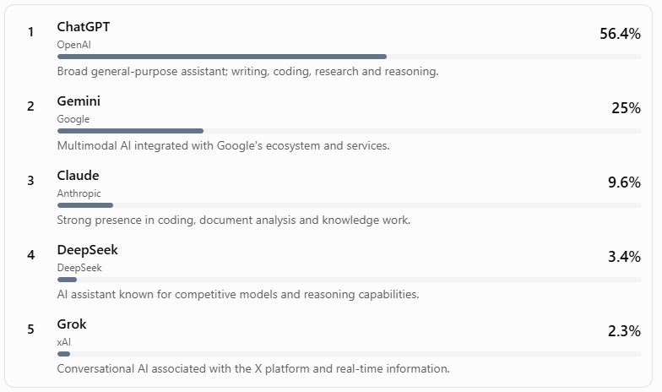
Top five by estimated website-visit share

Slide 13
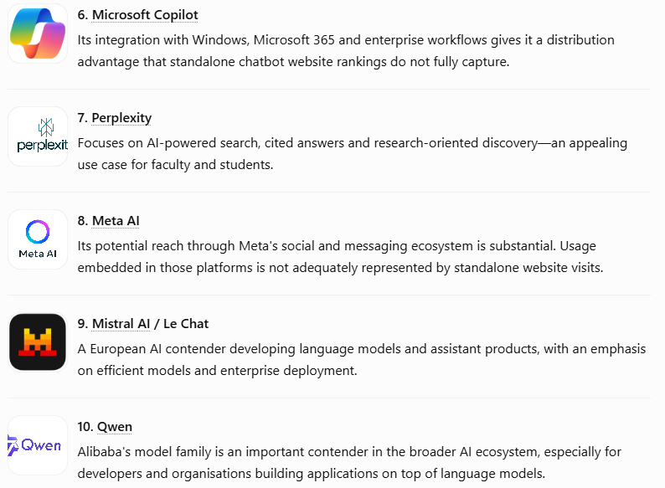
The next five challengers to watch

Slide 14
Smart way of using Word Embedding
https://projector.tensorflow.org/

Slide 15
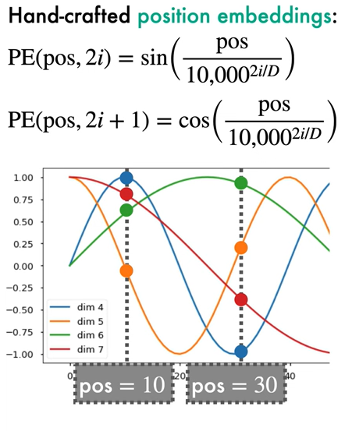
Positional Encoding

Slide 16
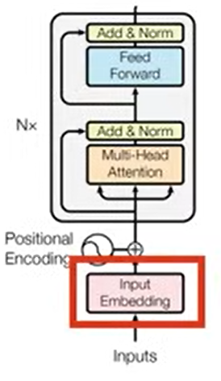
Transformer Encoder

Slide 17
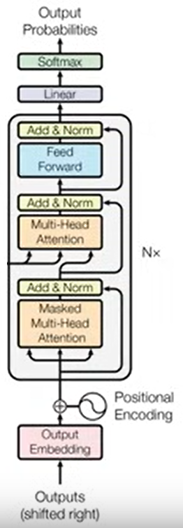
Transformer Decoder

Slide 18
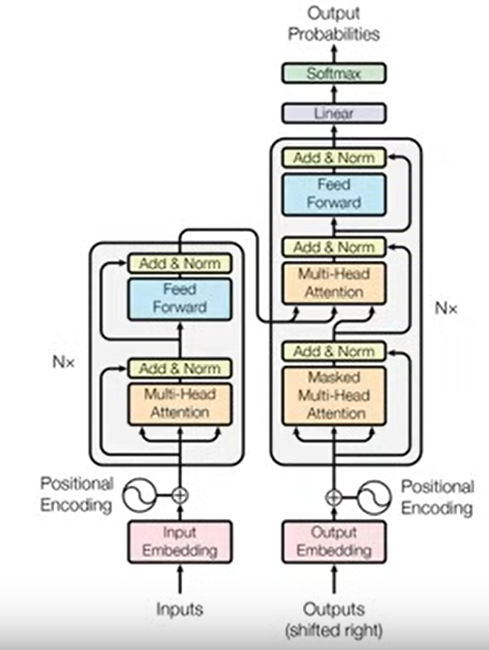
Complete Transformer
Architecture

Slide 19
Decoder Response in Production
The decoder generates a Query from the <SOS> token, looking to find relevant information to start the sentence.
The Query from the decoder is used to attend to the Keys (K) from the encoder. The Query asks, "Which parts of the input are relevant to what I need to generate next?" The Keys help answer this by indicating the importance of each token in the input sentence.
The attention scores (computed from Query and Key) determine how much focus each part of the input gets. These scores are used to weight the Values, which contain the actual content information from the input sentence.
The output from the cross-attention (a weighted sum of Values) gives the decoder rich contextual information from the input sentence. This helps the decoder generate the next token.
The process repeats for each subsequent token in the output sentence. Each time, the Query is formed from the previously generated part of the output sentence and is used to attend to the Keys (importance) and Values (content) from the encoder.

Slide 20
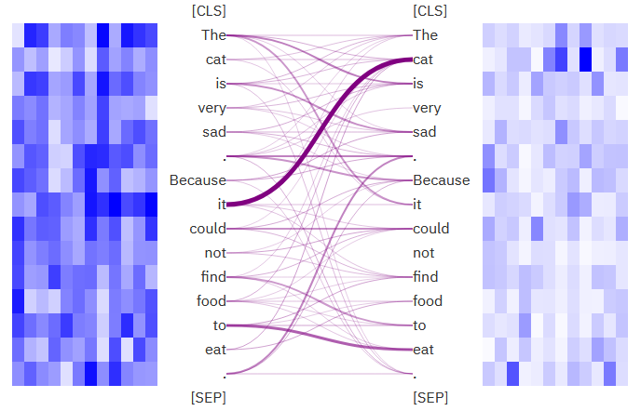
https://huggingface.co/spaces/exbert-project/exbert

Slide 21
Retrieval-augmented generation (rag)
Unstructured Case Sheets to Vector Space

Slide 22
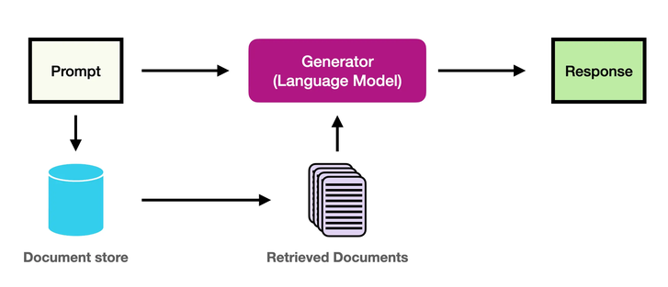

Slide 23
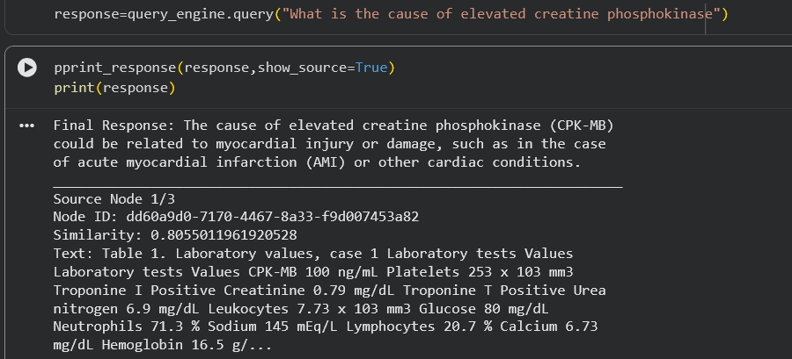
Retrieval using Llama Index

Slide 24
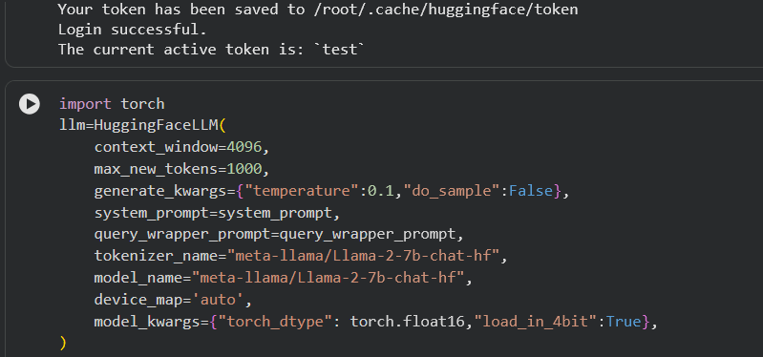
Configuring RAG with Llama-2 Model

Slide 25
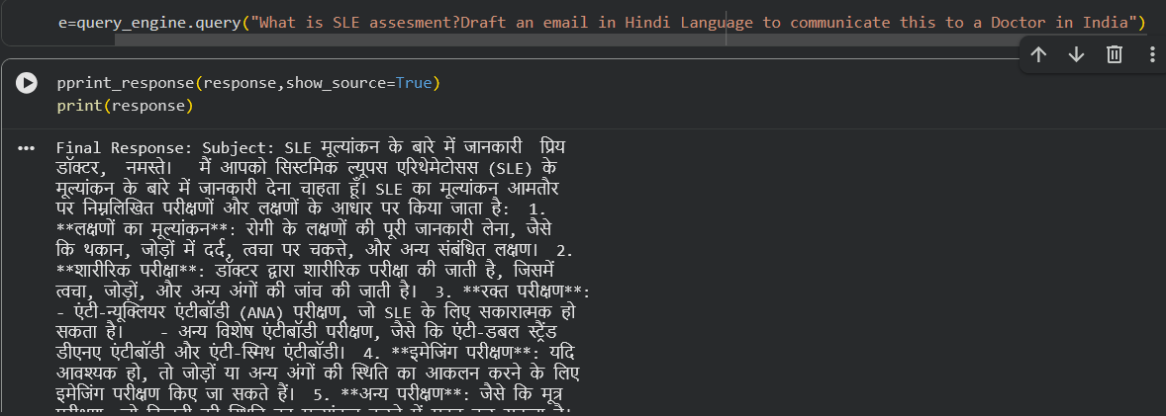
Configuring RAG with GPT-4 Model

Slide 26
Vision Transformer Architecture for Computer Vision

Slide 27
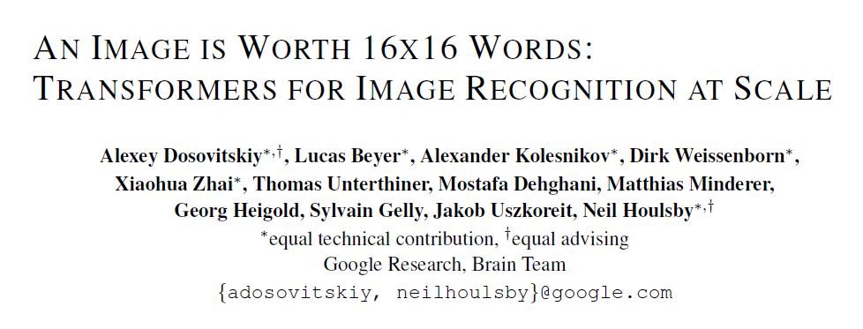

Slide 28
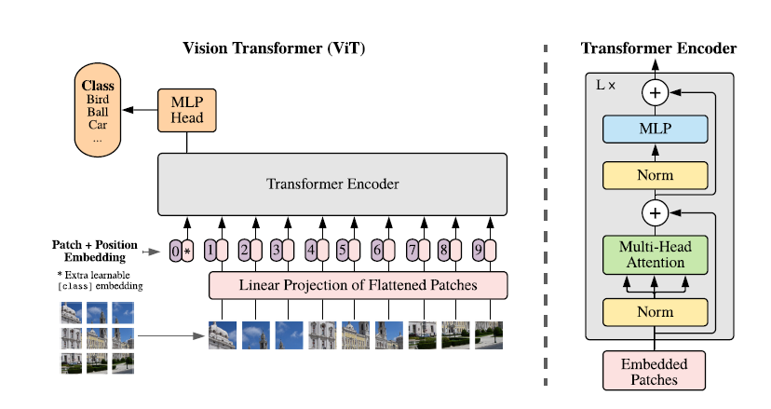

Slide 29
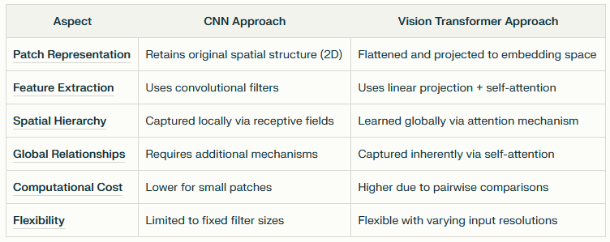

Slide 30
CNN Vs ViT
CNNs excel at capturing local features but struggle with global dependencies unless explicitly designed (e.g., using global pooling).
ViTs, on the other hand, leverage self-attention mechanisms to dynamically model relationships across all patches, making them more suitable for tasks requiring holistic understanding of images.
ViTs can learn how each patch interacts with others globally, while CNNs would primarily focus on localized patterns within each patch.

Slide 31
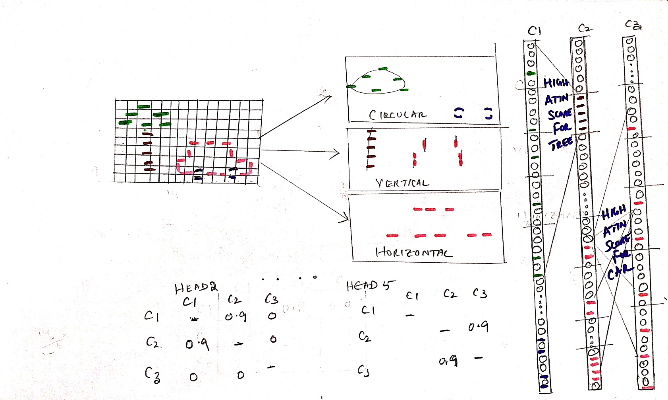
Detection Transformer (DETR)

Slide 32
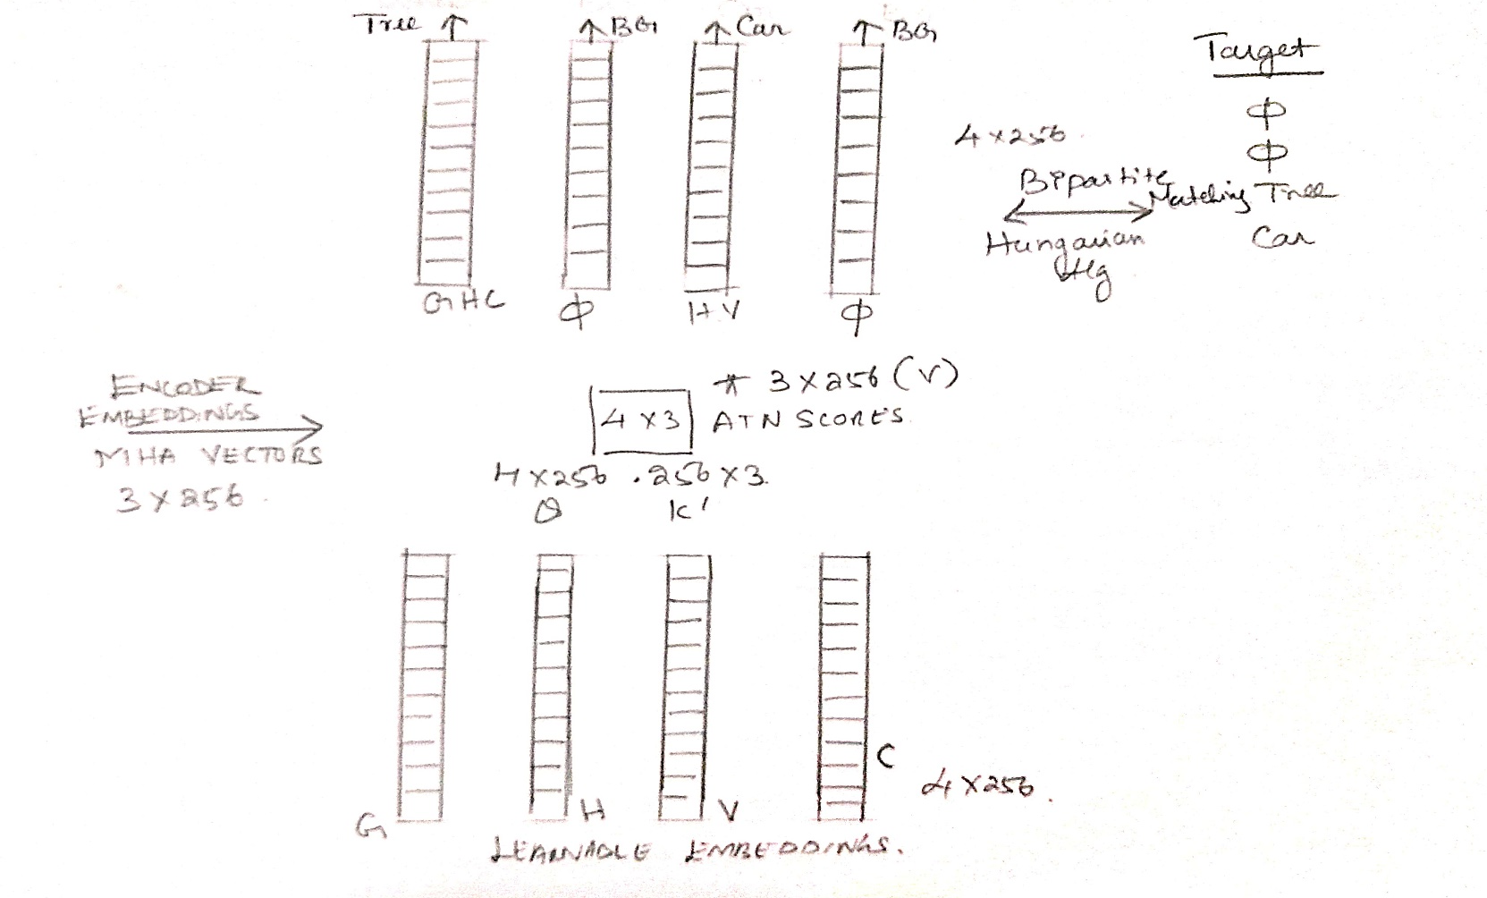

Slide 33
Segment Anything Model (SAM): Architecture & Data Flow
Purpose:
Promptable, real-time segmentation for any object, using points, boxes, masks, or text as prompts.
Core Components
Image Encoder:
  Type: Vision Transformer (ViT)
  Input: Image (e.g., 1024×1024×3)
  Output: Dense feature map (e.g., 256 channels × 64 × 64 spatial grid)
Prompt Encoder:
  Input: User prompt (points, boxes, masks, or text)
  Sparse prompts (points/boxes): Encoded with positional embeddings + learned prompt type embeddings
  Dense prompts (masks): Embedded via convolutions, summed with image embedding
  Text prompts: Encoded using a pre-trained text encoder (like BERT/CLIP)
  Output: Prompt embedding(s) (e.g., 256-dim vector per prompt)

Slide 34
Contd…
Mask Decoder:
Input: Image features + prompt embeddings
Process: Modified transformer decoder block with prompt self-attention and cross-attention (prompt-to-image and image-to-prompt)
Output: Segmentation mask(s) (e.g., 256×64×64 → upsampled to input image size)
Decoding Head:
SAM’s decoder is lightweight, optimized for real-time mask prediction, and designed for fusing prompt and image features for segmentation

Slide 35
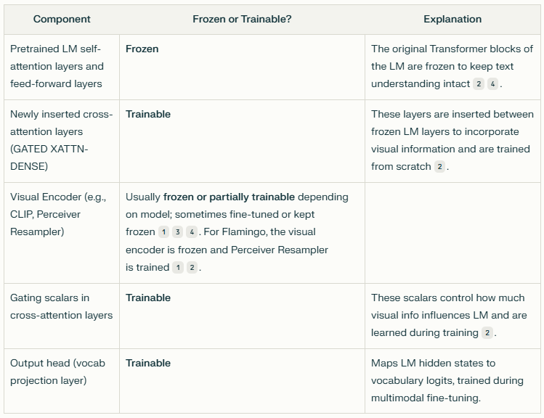
Vision Language Model (VLM)

Slide 36
Summary
Vision Transformer Models is becoming the state-of-the-art in Computer Vision applications, not only in healthcare, but also in rest other fields from Machine Vision in Industry Quality Control to Agriculture & Food Technology Industry because of its powerful Text integration (Multimodal) capability.

Slide 37
Thank You
https://learnaiwithanand.com
dranand.scs@gmail.com

