Slide 1
Kinetic modeling of acidogenic fermentation in a batch reactor
Course project -2
2231 CHE 2410 SEC1030 MATHMTCL METHD IN CHMCL ENGR 1
Lakshmi Yasodhara Ananthabhotla

Slide 2
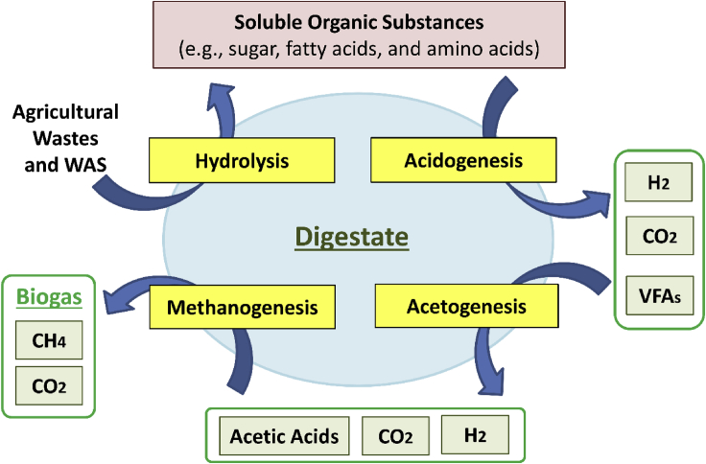
What is acidogenic fermentation?
It is the initial phase of anaerobic digestion of organic compounds to convert into hydrogen and volatile fatty acids
Growth kinetic and fermentation is inhibited due to the undissociated acid concentrations
Pan SY, Tsai CY, Liu CW, et al. Anaerobic co-digestion of agricultural wastes toward circular bioeconomy. Iscience. 2021 Jul;24(7):102704. DOI: 10.1016/j.isci.2021.102704. PMID: 34258548; PMCID: PMC8253966.
Notes:
39th most densely populated state in the US.

Slide 3
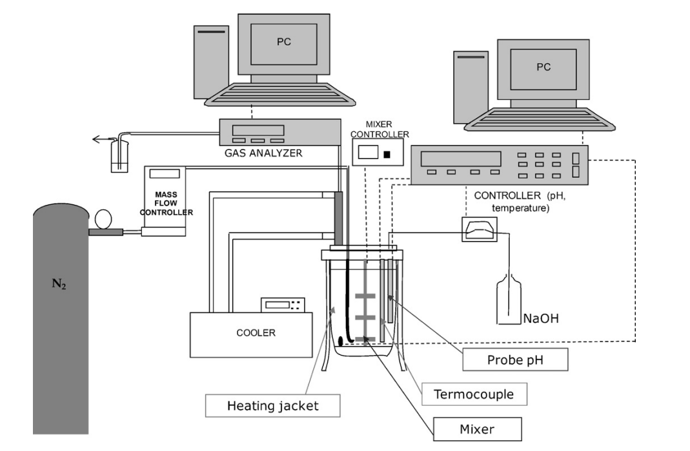
Experimental setup
Biomass – Synthetic wastewater
Substrate – Glucose
pH adjustments – 3N NaOH
Volume of the batch reactor – 2.5 liters
Infantes, D., del Campo, A. G., Villaseñor, J., & Fernández, F. J. (2012). Kinetic model and study of the influence of pH, temperature and undissociated acids on acidogenic fermentation. Biochemical engineering journal, 66, 66-72.
Notes:
39th most densely populated state in the US.

Slide 4
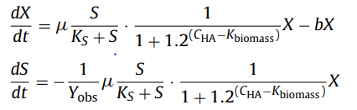
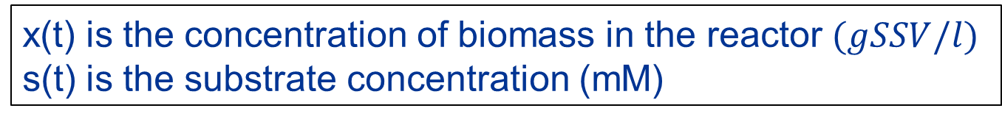
Kinetic modeling
Monod equation was used to describe the inhibition effects caused on biomass growth and substrate consumption
x(t) is the concentration of biomass in the reactor $(gSSV/l)$
s(t) is the substrate concentration (mM)
Infantes, D., del Campo, A. G., Villaseñor, J., & Fernández, F. J. (2012). Kinetic model and study of the influence of pH, temperature and undissociated acids on acidogenic fermentation. Biochemical engineering journal, 66, 66-72.
Notes:
39th most densely populated state in the US.

Slide 5
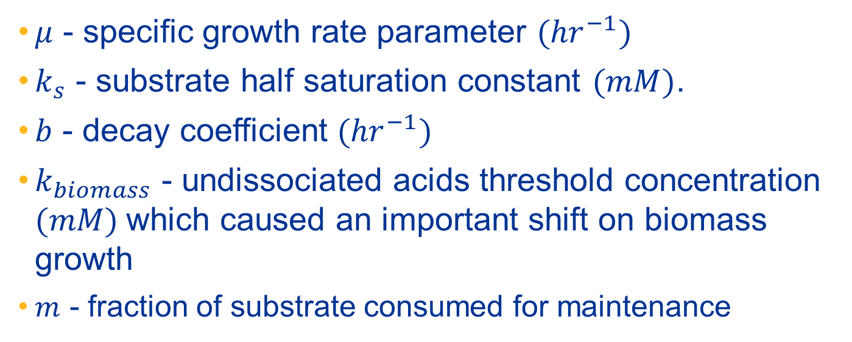
Parameter estimation
$μ$ - specific growth rate parameter ${(hr}^{−1})$
$k_{s}$ - substrate half saturation constant $(mM)$.
$b$ - decay coefficient ${(hr}^{−1})$
$k_{biomass}$ - undissociated acids threshold concentration $(mM)$which caused an important shift on biomass growth
$m$ - fraction of substrate consumed for maintenance
Infantes, D., del Campo, A. G., Villaseñor, J., & Fernández, F. J. (2012). Kinetic model and study of the influence of pH, temperature and undissociated acids on acidogenic fermentation. Biochemical engineering journal, 66, 66-72.
Notes:
39th most densely populated state in the US.

Slide 6
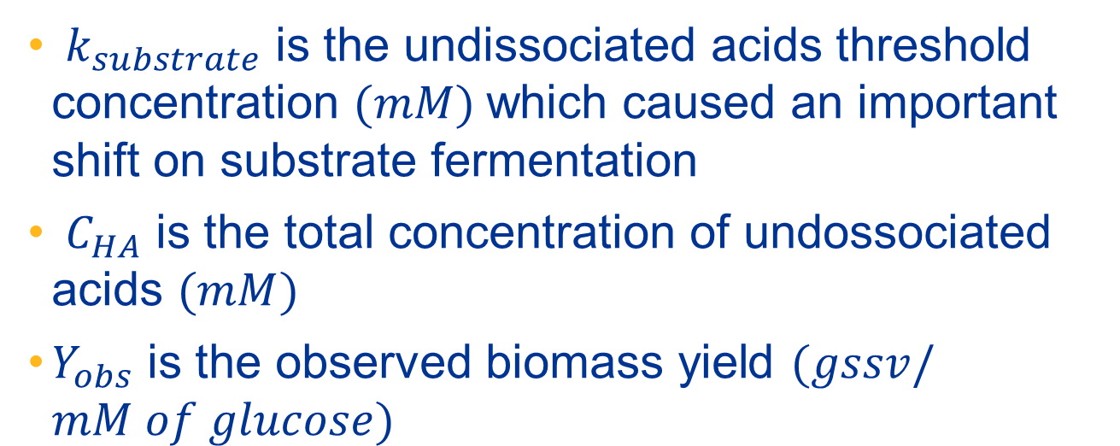
Parameter estimation
$k_{substrate}$ is the undissociated acids threshold concentration $(mM)$which caused an important shift on substrate fermentation
$C_{HA}$ is the total concentration of undossociated acids $(mM)$
$Y_{obs}$ is the observed biomass yield $(gssv/mM of glucose)$
Infantes, D., del Campo, A. G., Villaseñor, J., & Fernández, F. J. (2012). Kinetic model and study of the influence of pH, temperature and undissociated acids on acidogenic fermentation. Biochemical engineering journal, 66, 66-72.
Notes:
39th most densely populated state in the US.

Slide 7
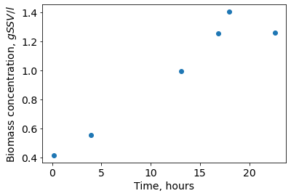
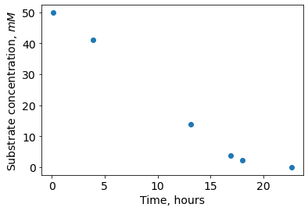

Experimental data
Experimental data plots for $26℃$ temperature and $6 pH$
Infantes, D., del Campo, A. G., Villaseñor, J., & Fernández, F. J. (2012). Kinetic model and study of the influence of pH, temperature and undissociated acids on acidogenic fermentation. Biochemical engineering journal, 66, 66-72.
Notes:
39th most densely populated state in the US.

Slide 8
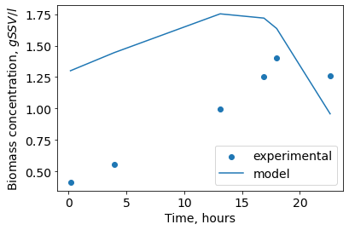
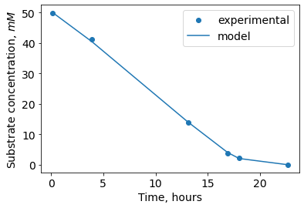
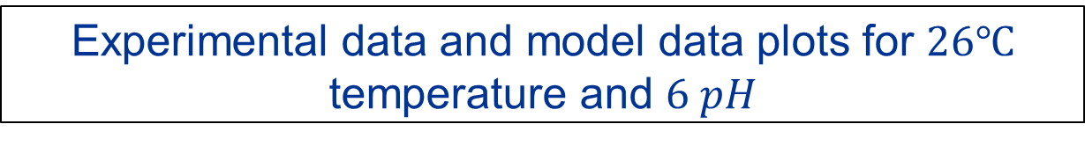
Fitting the model
Experimental data and model data plots for $26℃$ temperature and $6 pH$
Infantes, D., del Campo, A. G., Villaseñor, J., & Fernández, F. J. (2012). Kinetic model and study of the influence of pH, temperature and undissociated acids on acidogenic fermentation. Biochemical engineering journal, 66, 66-72.
Notes:
39th most densely populated state in the US.

Slide 9
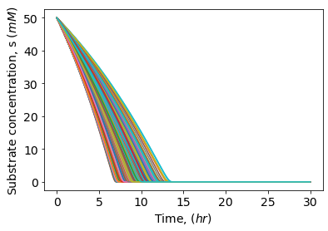
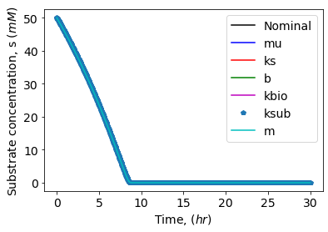
Sensitivity analysis
Global and local sensitivity plots of all parameters for the change in substrate concentration
Notes:
39th most densely populated state in the US.

Slide 10
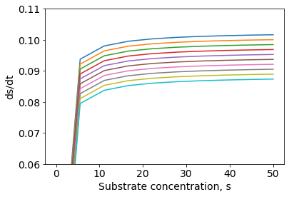
Bifurcation analysis
Most sensitive parameter: “b” (decay coefficient)
Bifurcation analysis using the decay coefficient, b
Plot represents the change in substrate concentration with time vs substrate concentration
Notes:
39th most densely populated state in the US.

Slide 11
Discussion and future work
Bifurcation analysis clearly shows different behaviors of the ODE by varying the sensitive parameter, b (decay coefficient)
Local sensitivity analysis can be improved for the observed sensitive parameters
First ODE (dx/dt) can be further modified to obtain a better fit
More experimental data can be collected over the span of 25 hours to increase the accuracy of the fitting model
Notes:
39th most densely populated state in the US.

Slide 12
Thank you!
Notes:
39th most densely populated state in the US.

