Slide 1


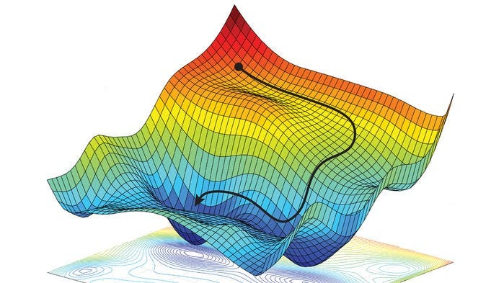
Master DATA & AI
Variable Neighborhood Search (VNS)
Presented By:
LAAOUAF Fatiha
Supervised By:
Mr. SOUISSI Omar
2026/2027

Slide 2
PLAN

Slide 3



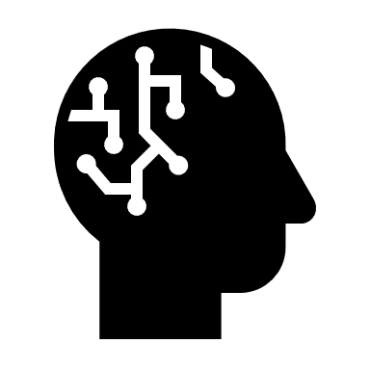


2.GVNS
&VND
1.VNS
3.
APPLICATION
4. K-Means & J-Means
5. VNS & k-means
6. CONCLUSION

Slide 4
1.VNS

Slide 5
Definition: VNS is an optimization metaheuristic that systematically changes neighborhood structures to explore different regions of the search space and escape local optima.
It combines:
Shaking.
Local Search.
Neighborhood Change.
Purpose: Find good solutions to difficult optimization problems.
1.VNS
definition
Algorithm
implementation
Visualization

Slide 6
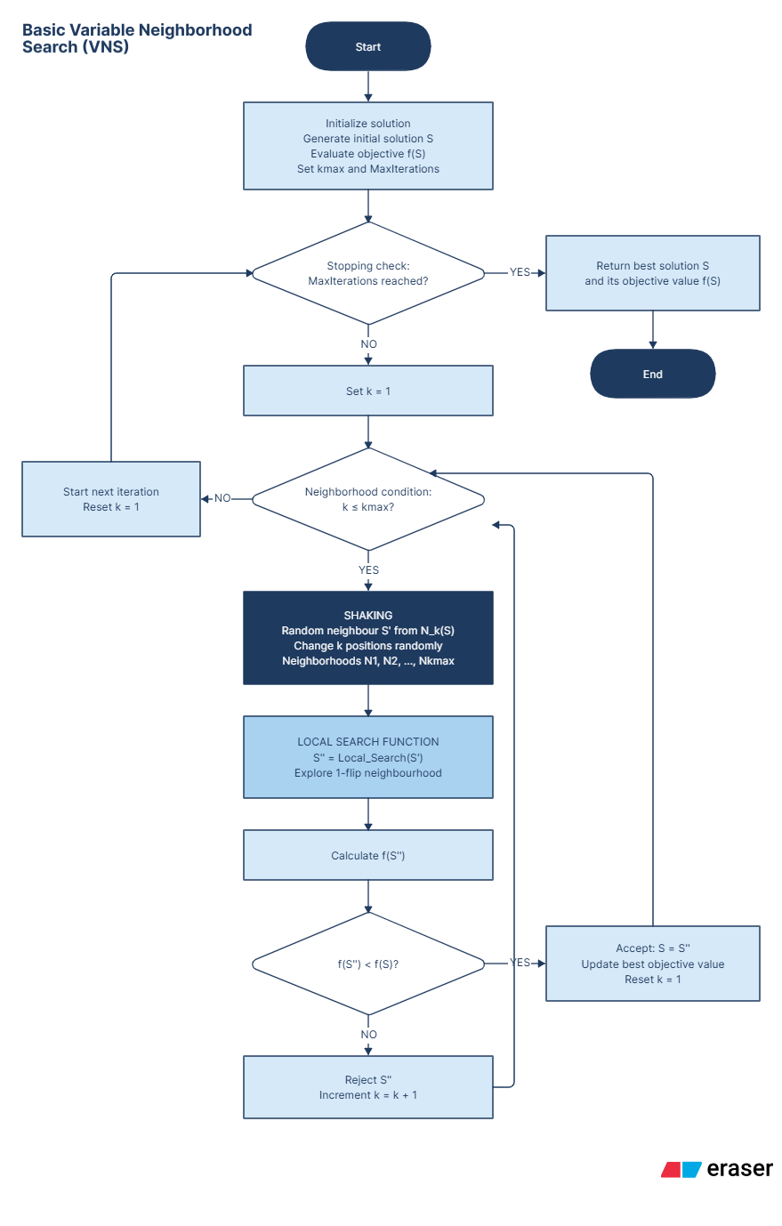
1.VNS
definition
Algorithm
implementation
Visualization

Slide 7
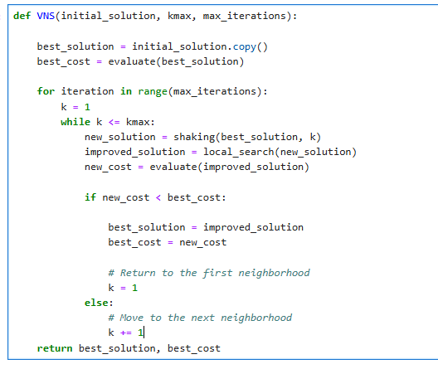
1.VNS
definition
Algorithm
implementation
Visualization

Slide 8
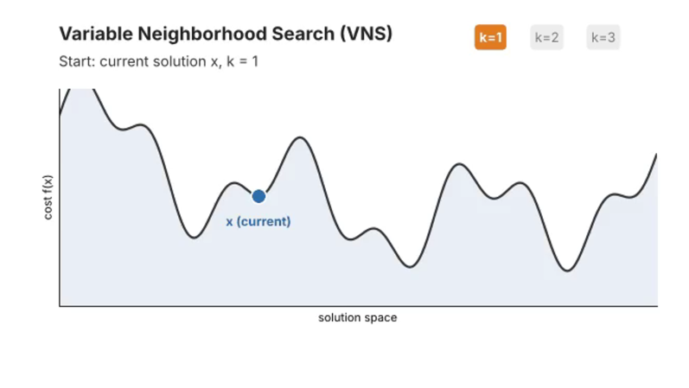
1.VNS
definition
Algorithm
implementation
Visualization

Slide 9
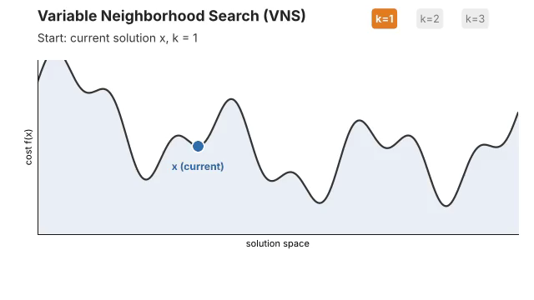

Slide 10
2.GVNS
&VND
1.VNS
3.
APPLICATION
4.
K-means
5.
MATERIALS
AND SIMULATION
6.
CONCLUSION

Slide 11
2.GVNS
&VND
1.VNS
3.
APPLICATION
4. K-Means & J-Means
5. VNS & k-means
6. CONCLUSION

Slide 12
2. GVNS &VND

Slide 13
Definition: GVNS (General Variable Neighborhood Search) is an optimization metaheuristic that combines shaking with Variable Neighborhood Descent (VND) to explore different regions of the search space and escape local optima.
It combines:
Shaking.
Variable Neighborhood Descent (VND).
Neighborhood Change.
Purpose: Find better solutions to difficult optimization problems by exploring multiple neighborhoods systematically.
2. GVNS
&VND
definition
Algorithm
implementation
Visualization

Slide 14
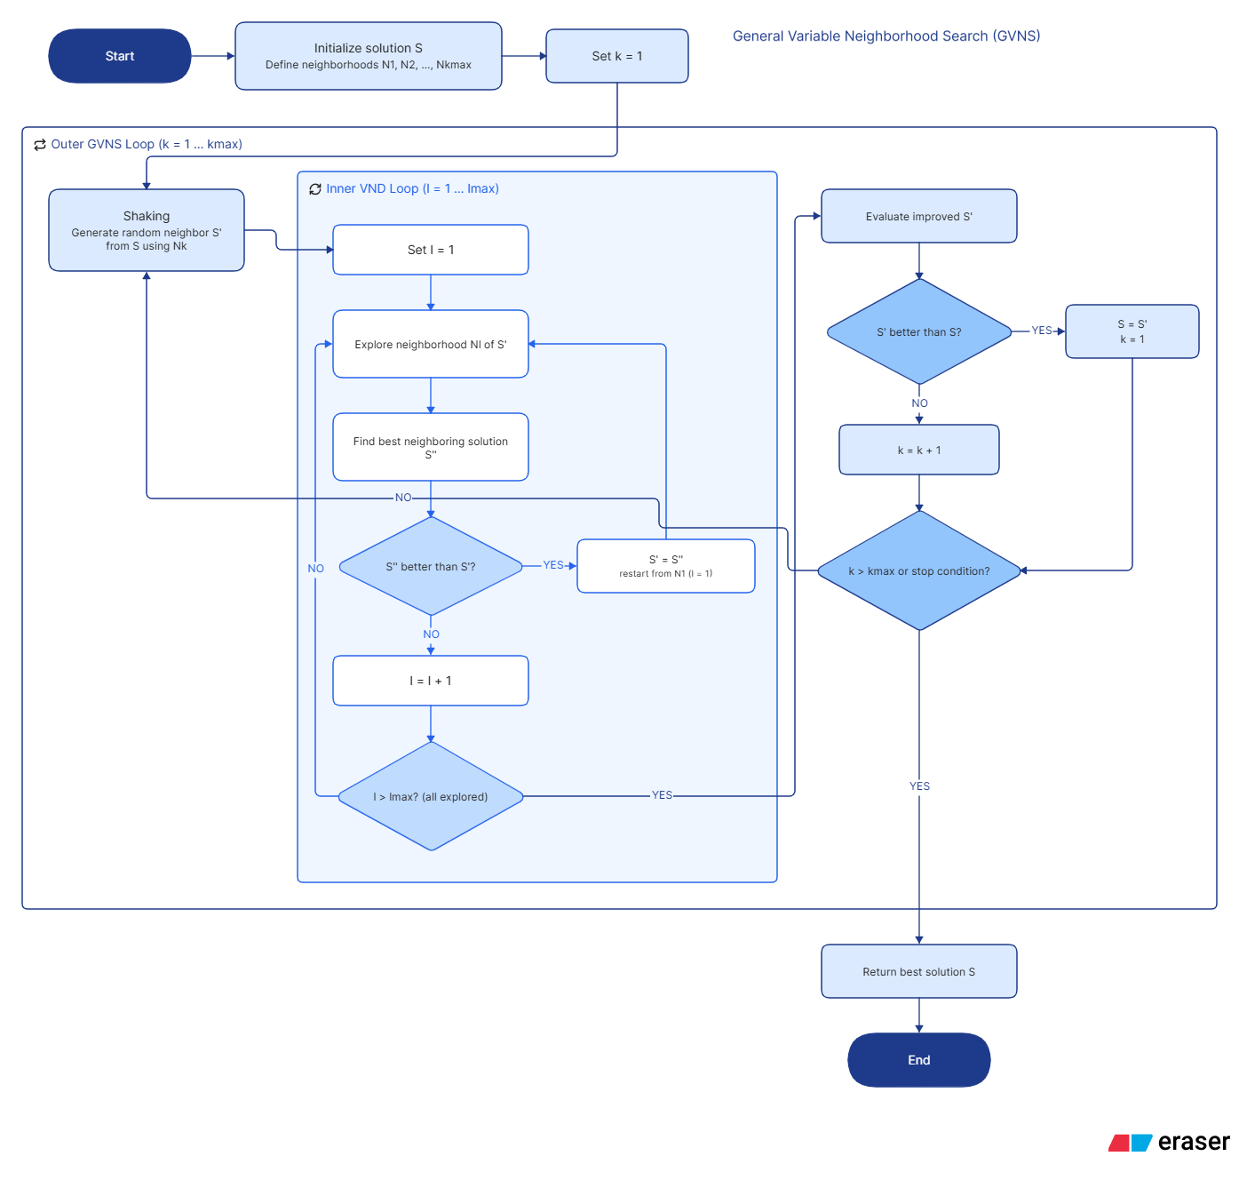
2. GVNS
&VND
definition
Algorithm
implementation
Visualization

Slide 15
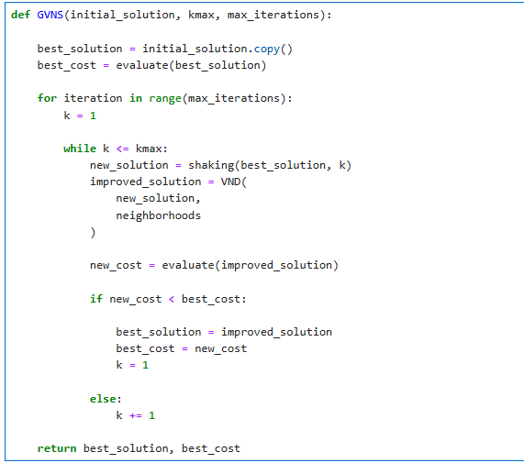
2. GVNS
&VND
definition
Algorithm
implementation
Visualization

Slide 16
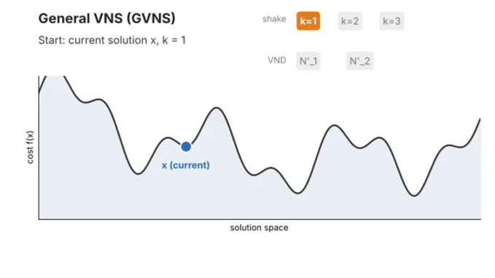
2. GVNS
&VND
definition
Algorithm
implementation
Visualization

Slide 17
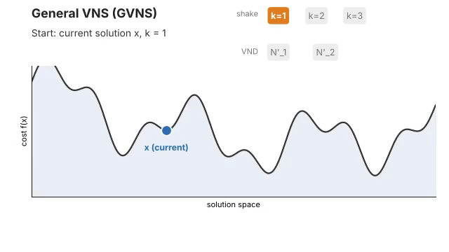

Slide 18
2.GVNS
&VND
1.VNS
3.
APPLICATION
4. K-Means & J-Means
5. VNS & k-means
6. CONCLUSION

Slide 19
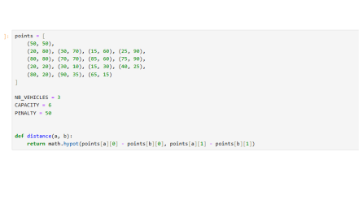
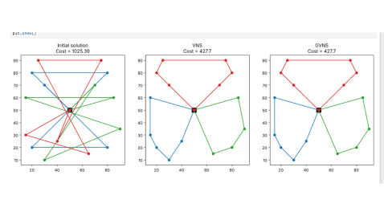
3.
APPLICATION

Slide 20
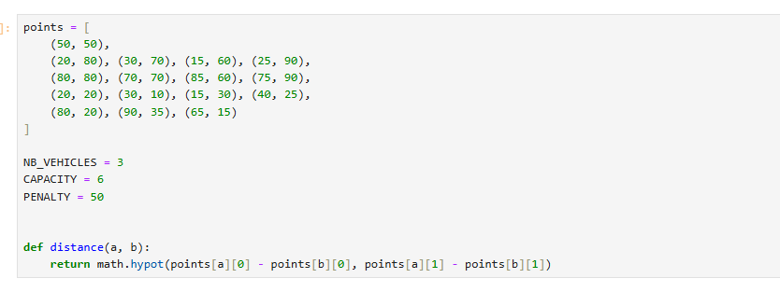

Slide 21
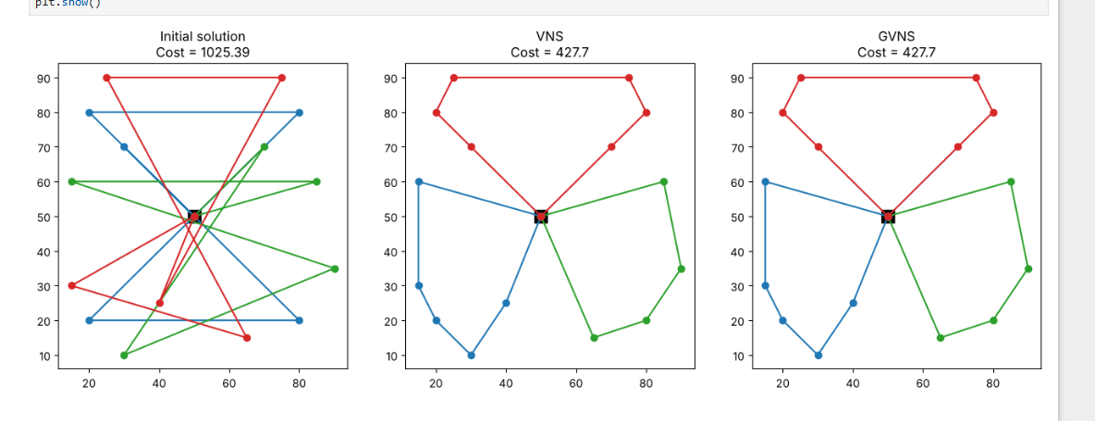

Slide 22
2.GVNS
&VND
1.VNS
3.
APPLICATION
4. K-Means & J-Means
5. VNS & k-means
6. CONCLUSION

Slide 23
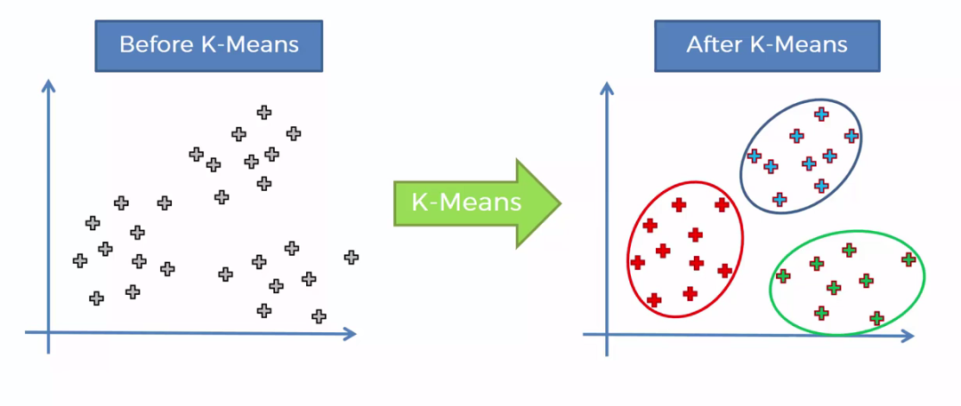
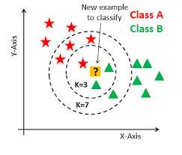
4. K-Means & J-Means
K-Means is an unsupervised clustering algorithm that divides a dataset into K clusters by assigning each data point to the nearest cluster centroid (mean).

Slide 24
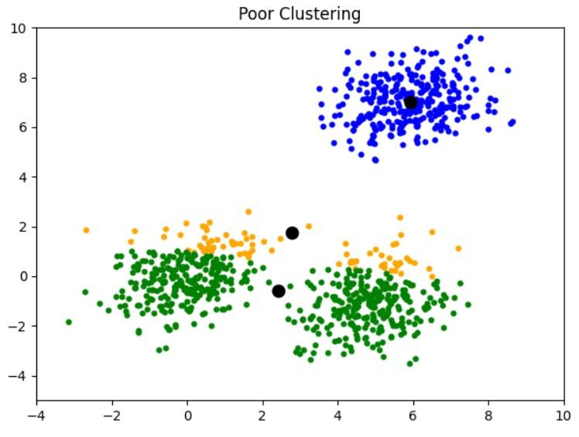
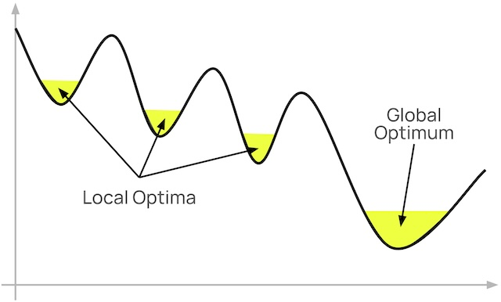
4. K-Means & J-Means

Slide 25
2.GVNS
&VND
1.VNS
3.
APPLICATION
4. K-Means & J-Means
5. VNS & k-means
6. CONCLUSION

Slide 26
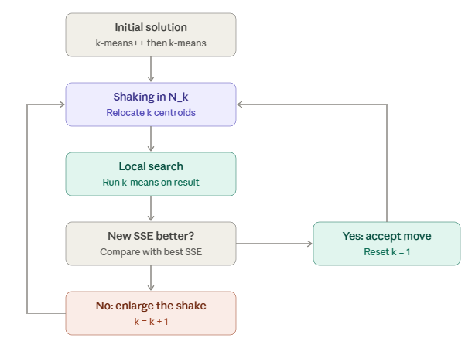
5. VNS & k-means

Slide 27
6. Conclusion &Questions

Slide 28
THANK YOU

