Slide 1

Basic Details of the Team and Problem Statement
Ministry/Organization Name/Student Innovation:
National Technical Research Organisation,(NTRO)
PS Code: SIH1447
Problem Statement Title: Identification and Extraction of Forward Error Correction(FEC) Schemes of unknown demodulated signals
Team Name: Innovation Alteers
Team Leader Name: A Sai Kavya
Institute Code (AISHE): IC202014406
Institute Name: G. Pulla Reddy Engineering College (Autonomous)
Theme Name: Miscellaneous

Slide 2

Identification and Extraction of FEC Schemes
We proposed a Deep Learning Based tool to identify FEC Scheme of an unknown demodulated signal:
Integrating Signal Processing and Machine Learning Techniques for robust communication analysis
Based on different parameters of demodulated signal we can extract the FEC scheme
Tools:
➔ Machine Learning Algorithms like Neural networks( CNN). Tool – Google Colab
→ GUI Creation. Tool - Visual Studio Code

Slide 3
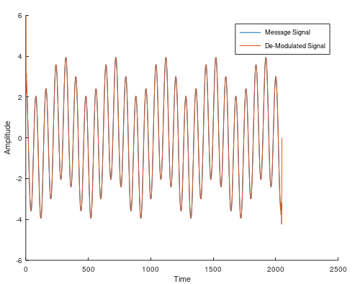

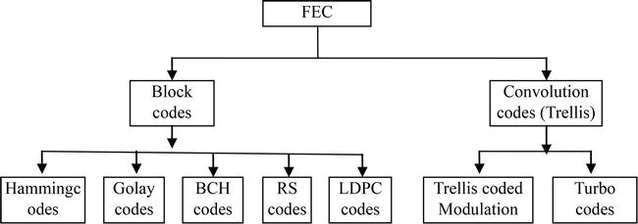
PARAMETERS
Number of sample signals – 25,000
When an unknown demodulated signal is fed to our tool, the following characteristics were observed:
1.Signal is modulated and demodulated using QPSK, BPSK or 8PSK
2.Bit length of 1024
3. Bit Rates are ½, 3/2, ¼
4.Noise Characteristics: Additive White Gaussian 5.Noise with SNR: -3dB to 10dB
The FEC Schemes that were trained on are Turbo, LDPC, Reed-Solomon, BCH, Convolutional FEC’s.
Unknown demodulated signal
Analysing the signal (ML)
Selecting one suitable scheme from extracted parameters

Slide 4
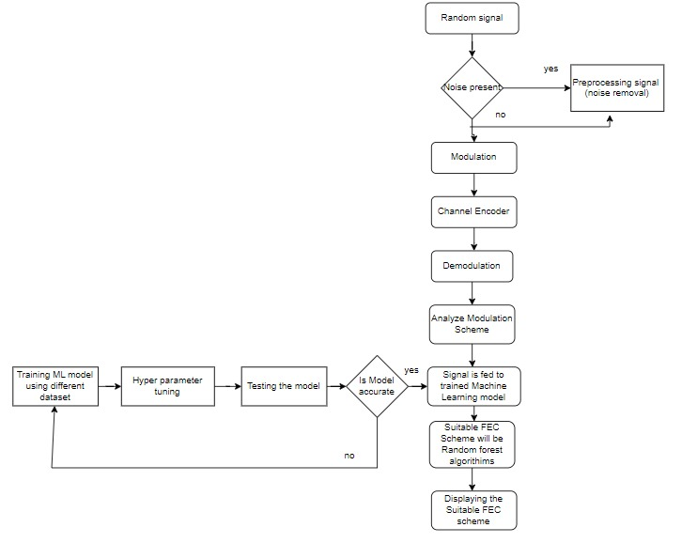
SOLUTION

Slide 5
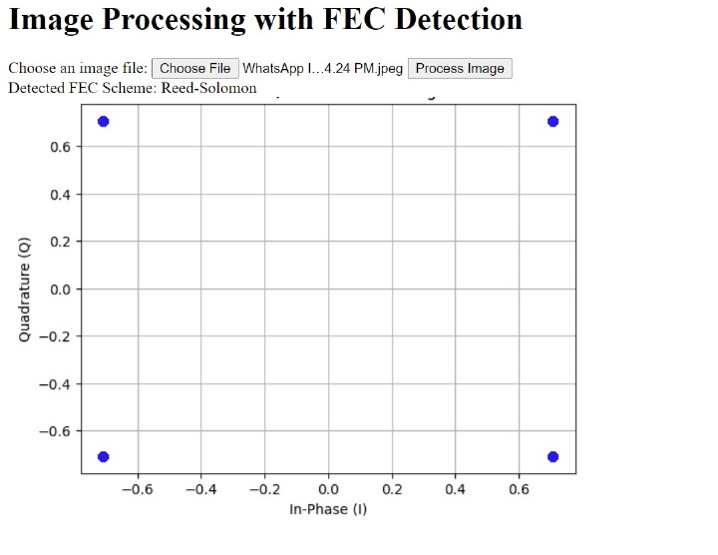

Simulation Results
Fig. Accuracy Of the CNN Model
The parameters considered for FEC Identification from demodulated signal are:
Bit Error Rate
Variance
SNR Estimate
Fig. GUI Of The Tool

Slide 6
Further Scope
As a further scope to enhance the capabilities of our project focused on FEC scheme identification, we can consider implementing error correction mechanisms. This extension involves not only identifying the specific FEC scheme utilized in the received signal but also integrating functionality to automatically correct errors present in the signal based on the identified FEC scheme. By incorporating error correction capabilities, the system aims to improve the reliability and accuracy of the transmitted information, contributing to a more robust and efficient communication system.

Slide 7


Slide 8
Team Member Details
Team Leader Name: A SAI KAVYA
Branch : BTech Stream : ECE Year: IV
Team Member 1 Name: P CHANDANA
Branch : BTech Stream: CST Year :II
Team Member 2 Name: M HEMASUNDAR REDDY
Branch : BTech Stream : CIV Year: II
Team Member 3 Name: L SRIKANTH BABU
Branch : BTech Stream : CSE Year: II
Team Member 4 Name: R HRISHI
Branch : BTech Stream : CIV Year: II
Team Member 5 Name: G PRANAV KUMAR
Branch : BTech Stream : CSE Year: II
Team Mentor 1 Name: Y VENKATA SIVA KUMAR
Category : Academic Expertise : Domain Experience : 8 years

