Slide 1

Title: Airline Reservation System
MPP Project
Instructor :
Mr. Obinna Kalu
Presented by :
Ayoub Lachhab
Hannah Gail Ruba Fajutag
Alba Elizabeth Padilla Pacheco

Slide 2
Problem Statement
Air travel can be stressful, as the demand of travelling is getting higher, we need to provide the best solution for the airline companies and the potential guest to book /reserve, monitor and manage their own flight details in their convenience.

Slide 3
Plan
I. Class Diagram
III. System Features
IV. Sequence Diagram
VI. Method of coding in team
VII. Application Demo
V. DataBase Design
II Use Case Diagram

Slide 4
Class Diagram

Slide 5

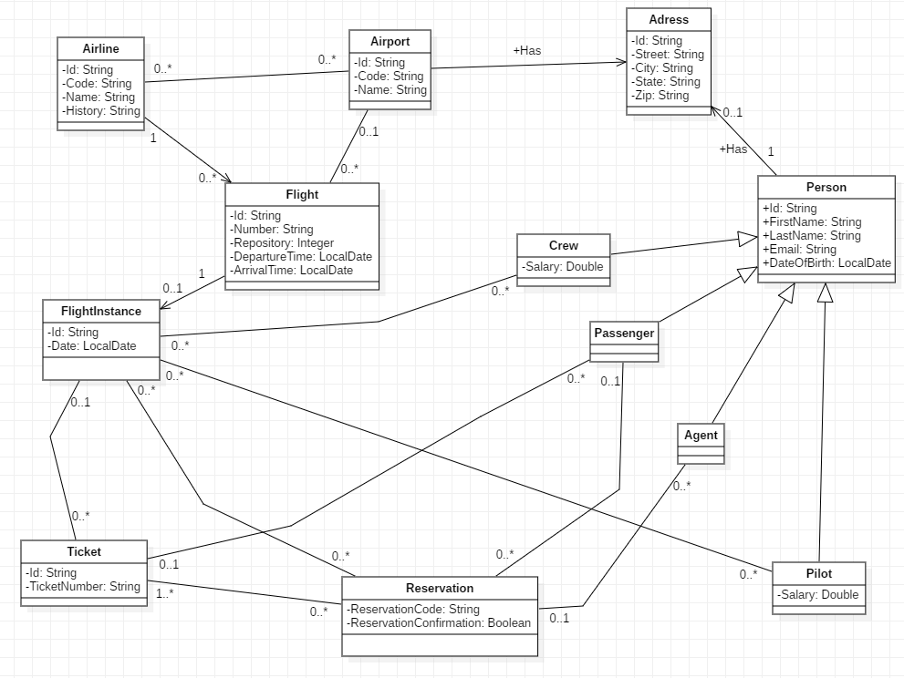

Slide 6
Use case diaGram

Slide 7
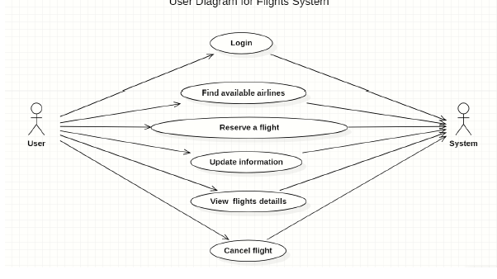

Slide 8
System Features

Slide 9
View the list of all airports
View the list of airport by code
View the list of Airline in Airoport
View the list of Flight from an Airoport to another in a particular date
View the list of all my Reservation
View the list of all my Passengers (Agent)
Make a Reservation
Confirme a Reservation
Cancel a Reservation
View the airport by code
Log-In Page (Passenger , Agent , Admim)

Slide 10
Sequence Diagrams

Slide 11
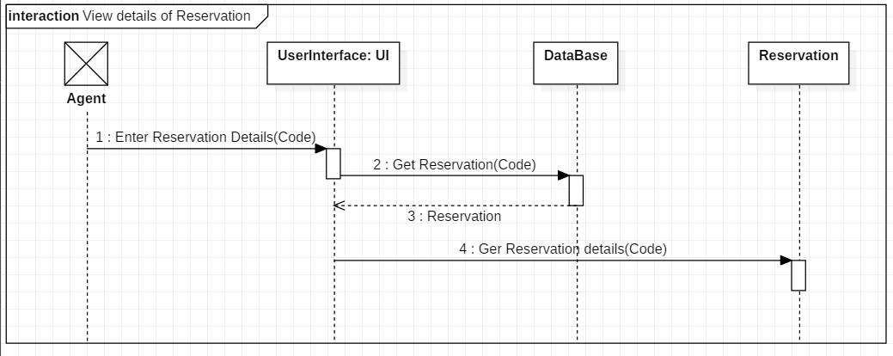

Slide 12
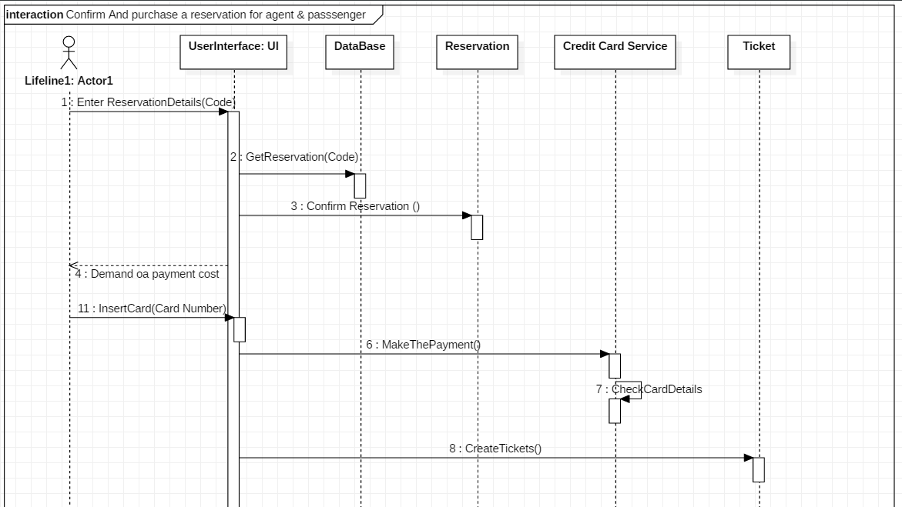

Slide 13
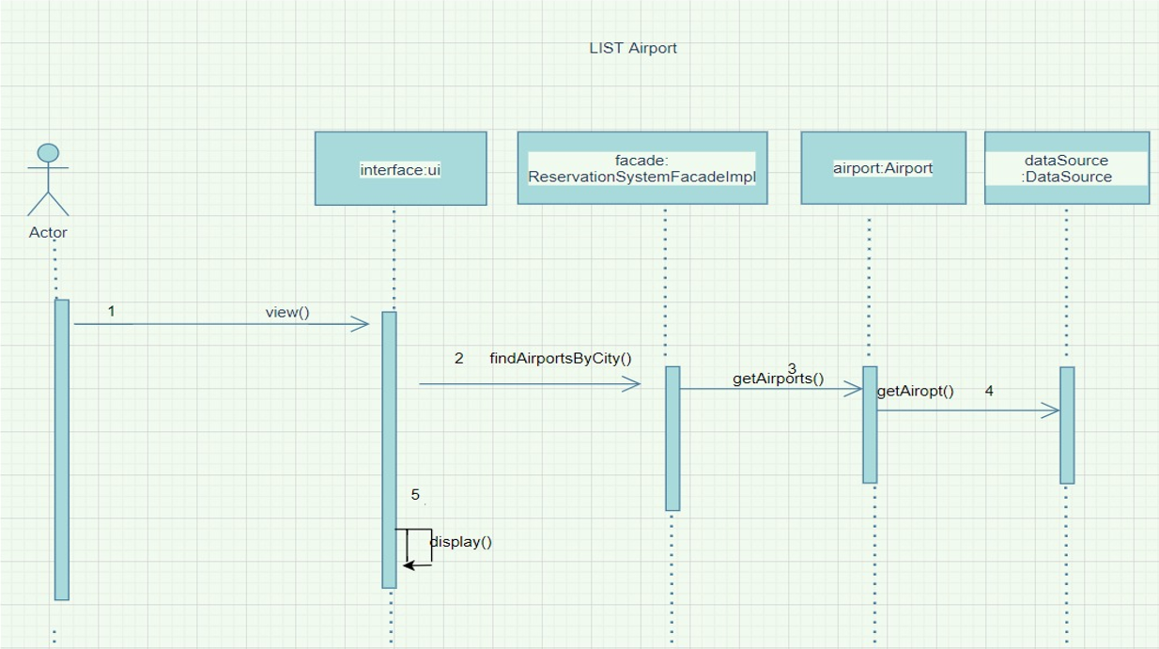

Slide 14
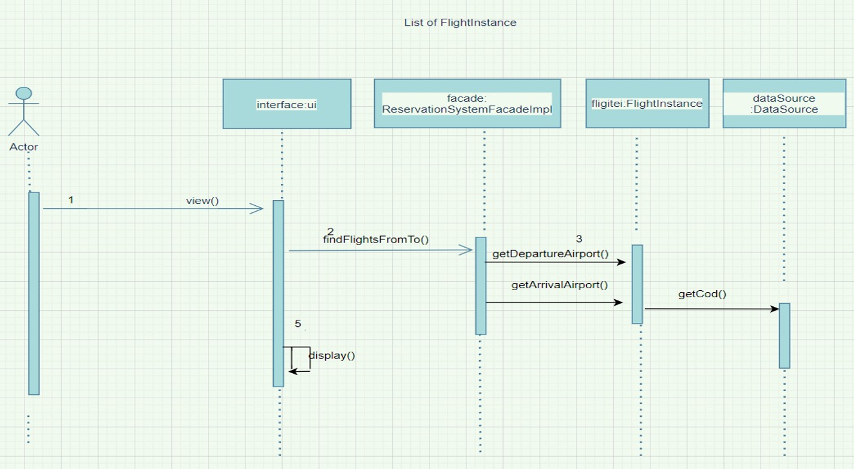

Slide 15
database design

Slide 16
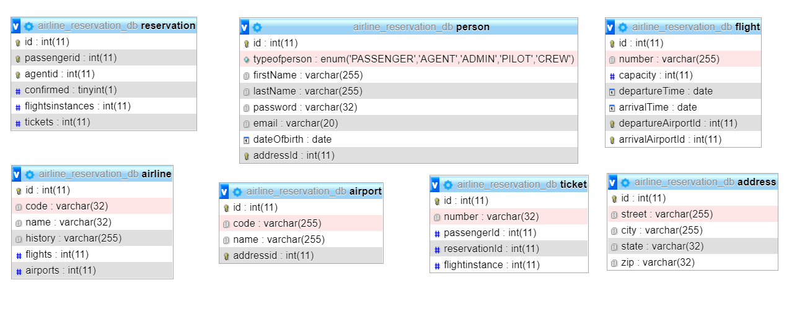

Slide 17


Method of conding in team

Slide 18
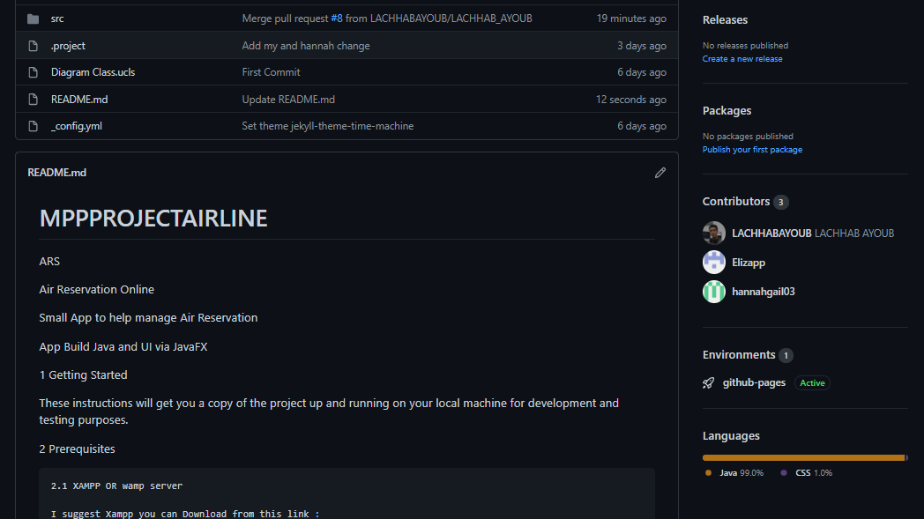

Slide 19
SYSTEM DEMO

Slide 20


