Slide 1

Titled: Airline Reservation System
MPP Project
Instructor :
Mr. Obinna Kalu
Presented by :
Ayoub Lachhab
Hannah Gail Ruba Fajutag
Alba Elizabeth Padilla Pacheco

Slide 2
Plan
I. Class Diagram
III. System Features
IV. Sequence Diagram
VI. Method of conding in team
VII. Application Demo
V. DataBase Design
II Use Case Diagram

Slide 3
Class Diagram

Slide 4

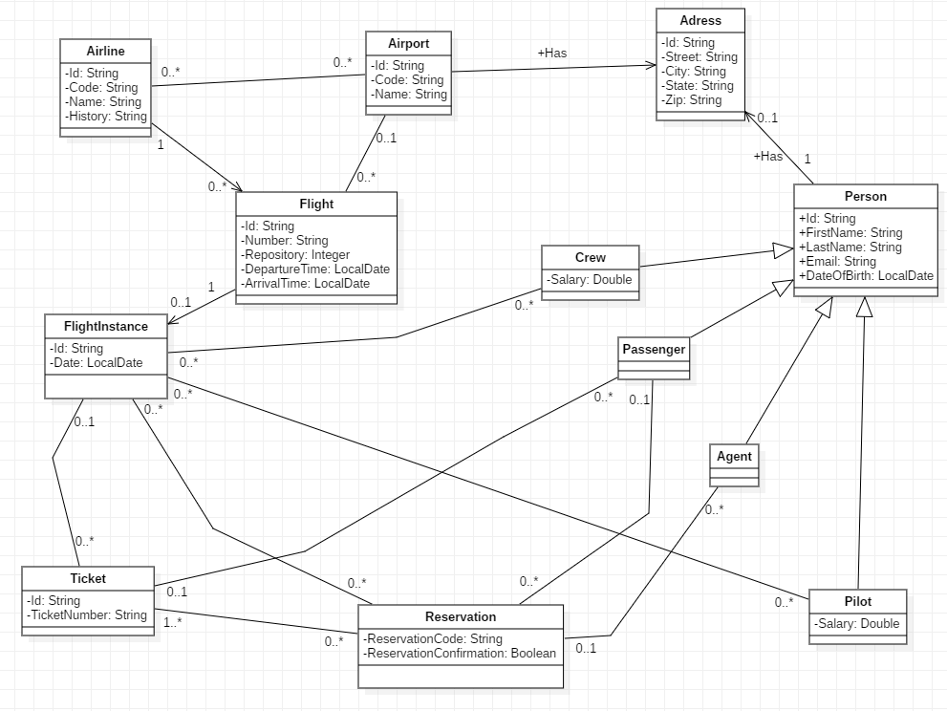

Slide 5
Use case digaram

Slide 6
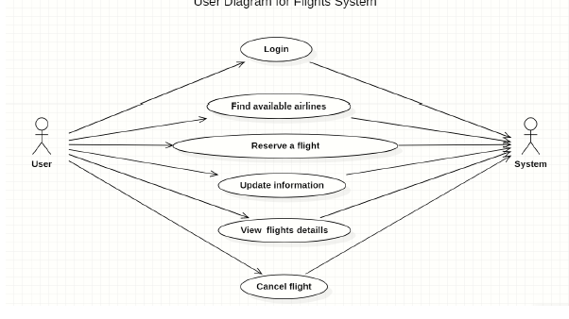

Slide 7
System Features

Slide 8
View the list of all airports
View the list of airport by code
View the list of Airline in Airoport
View the list of Flight from an Airoport to another in a particular date
View the list of all my Reservation
View the list of all my Passengers (Agent)
Make a Reservation
Confirme a Reservation
Cancel a Reservation
View the airport by code
Log-In Page (Passenger , Agent , Admim)

Slide 9
Sequence Diagrams

Slide 10
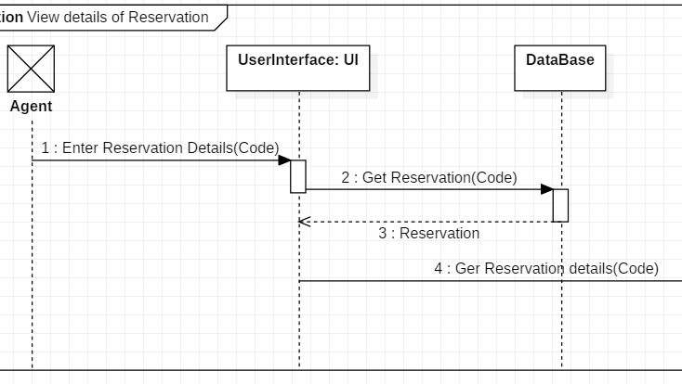

Slide 11
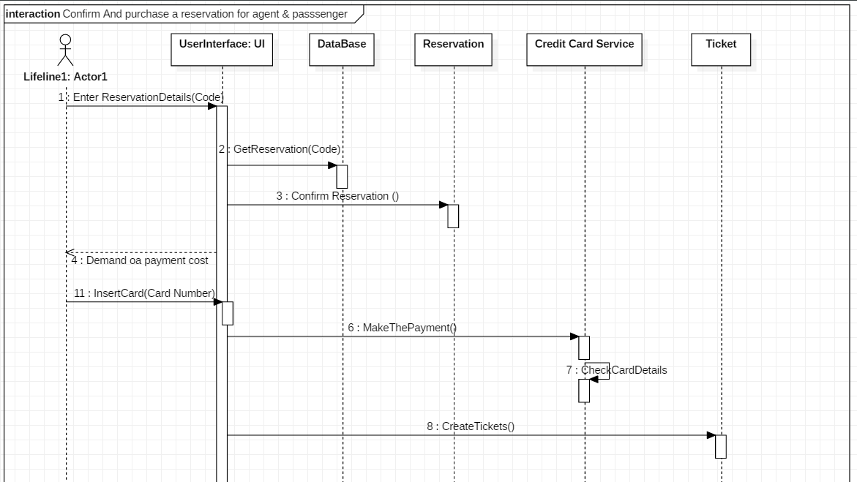

Slide 12
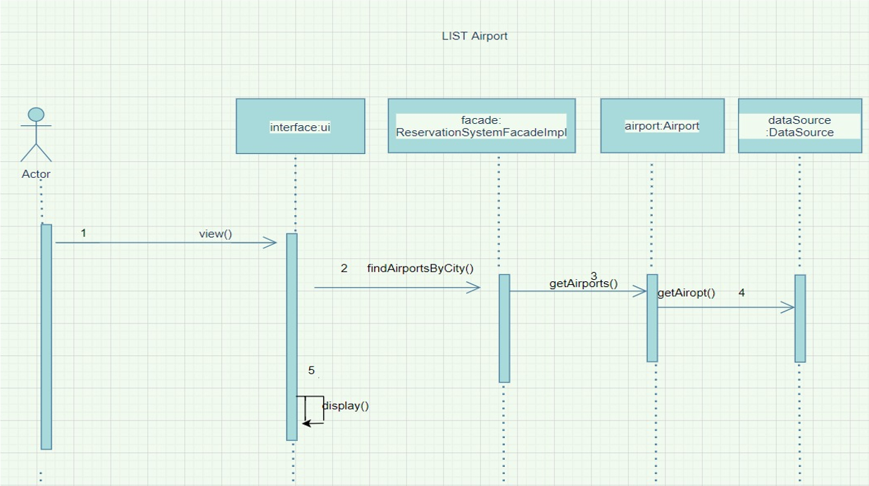

Slide 13
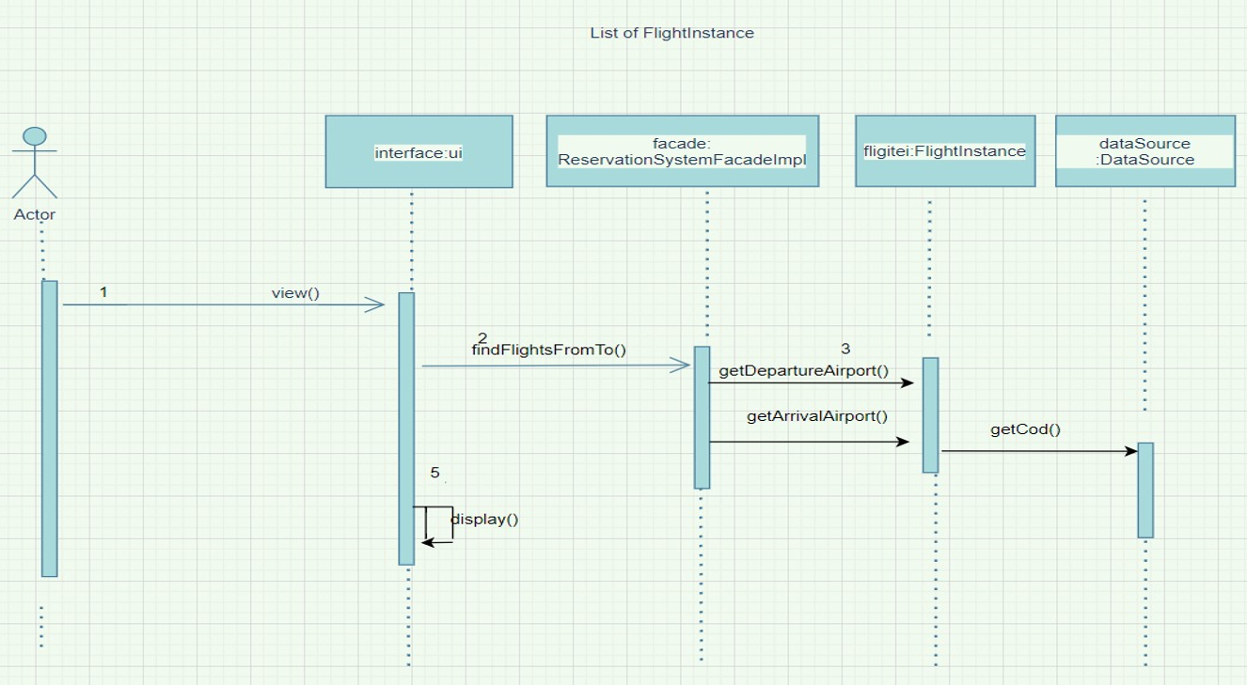

Slide 14
database design

Slide 15
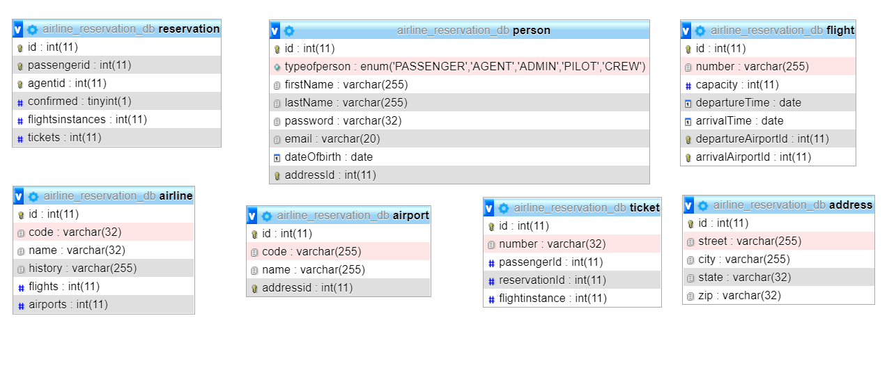

Slide 16


Method of conding in team

Slide 17
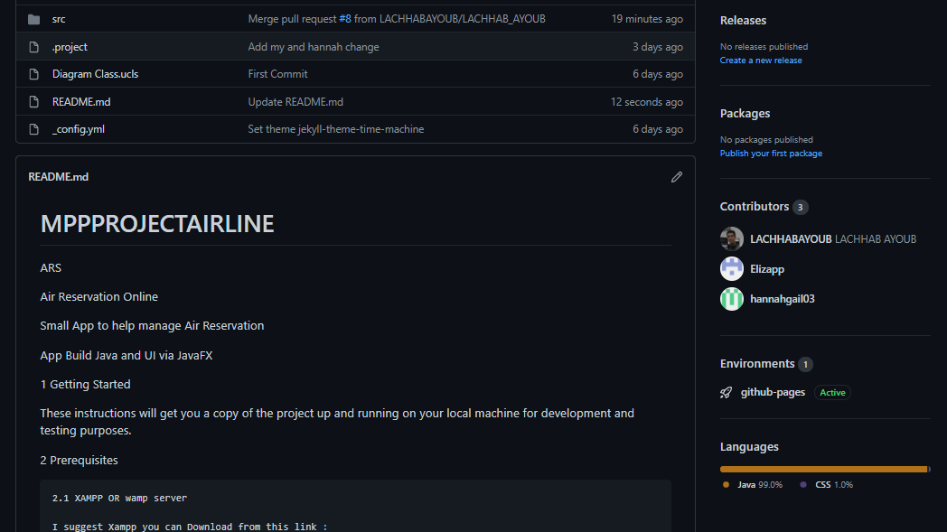

Slide 18
SYSTEM DEMO

Slide 19


