Slide 1

Titled: Airline Reservation System
MPP Project
Instructor :
Mr. Obinna Kalu
Presented by :
Ayoub Lachhab
Hannah Gail Ruba Fajutag
Alba Elizabeth Padilla Pacheco

Slide 2
Plan
I. Class Diagram
II. System Features
III. Sequence Diagram
V. Method of conding in team
VI. Application Demo
IV. DataBase Design

Slide 3
Class Diagram

Slide 4

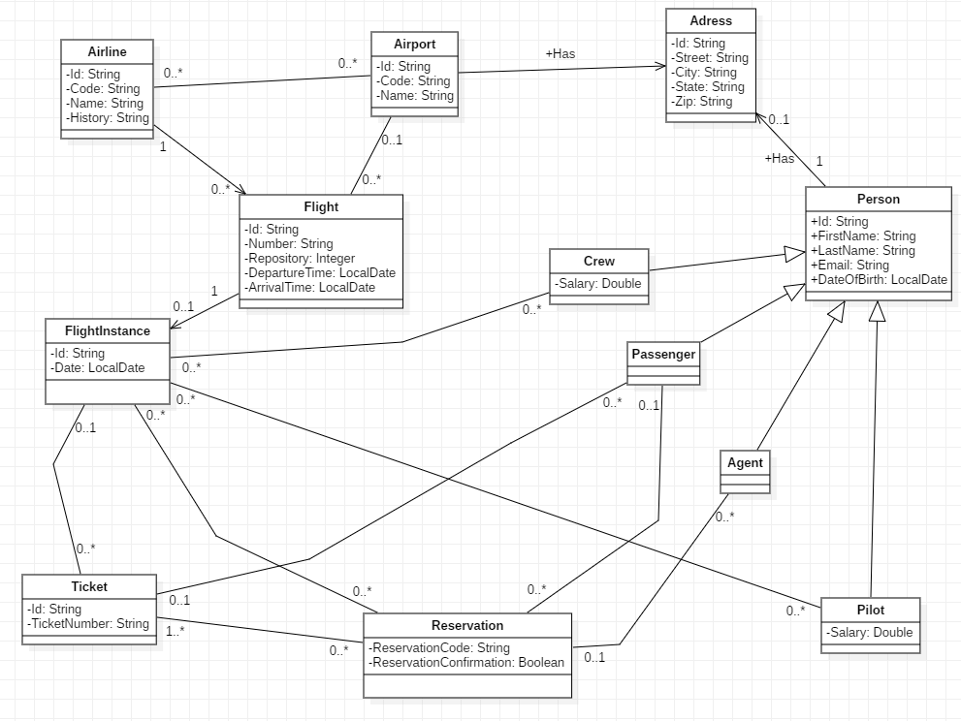

Slide 5
System Features

Slide 6
View the list of all airports
View the list of airport by code
View the list of Airline in Airoport
View the list of Flight from an Airoport to another in a particular date
View the list of all my Reservation
View the list of all my Passengers (Agent)
Make a Reservation
Confirme a Reservation
Cancel a Reservation
View the airport by code

Slide 7
Sequence Diagrams

Slide 8
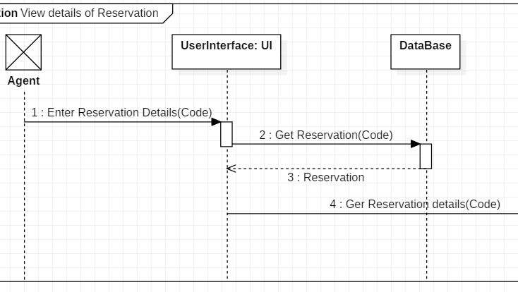

Slide 9
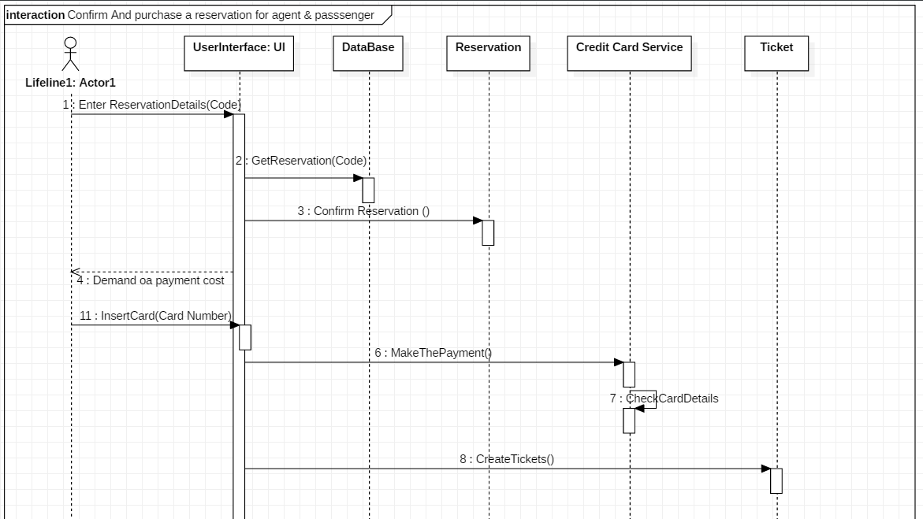

Slide 10
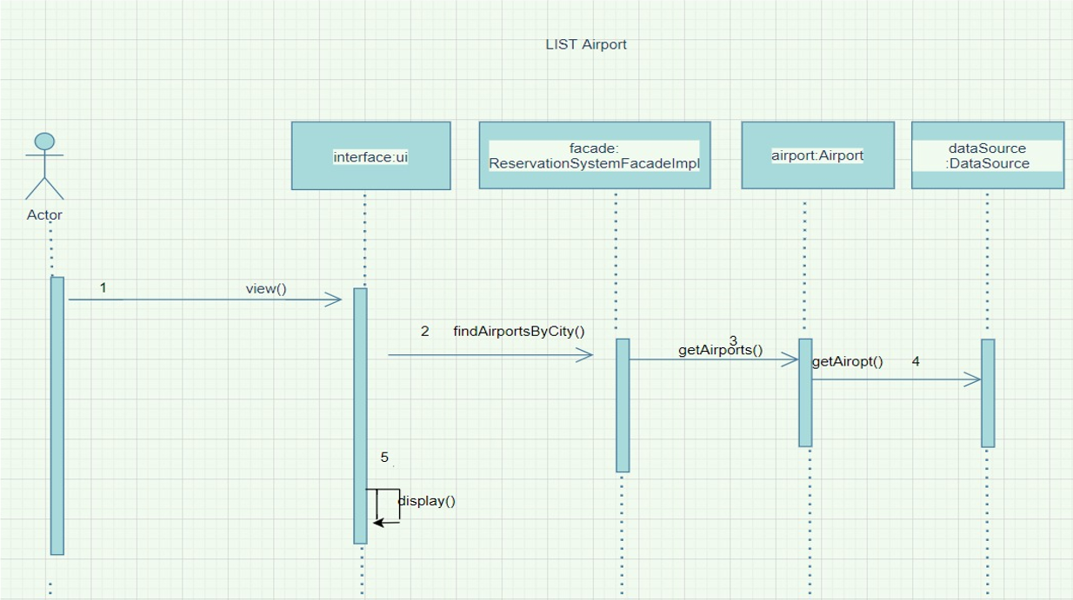

Slide 11
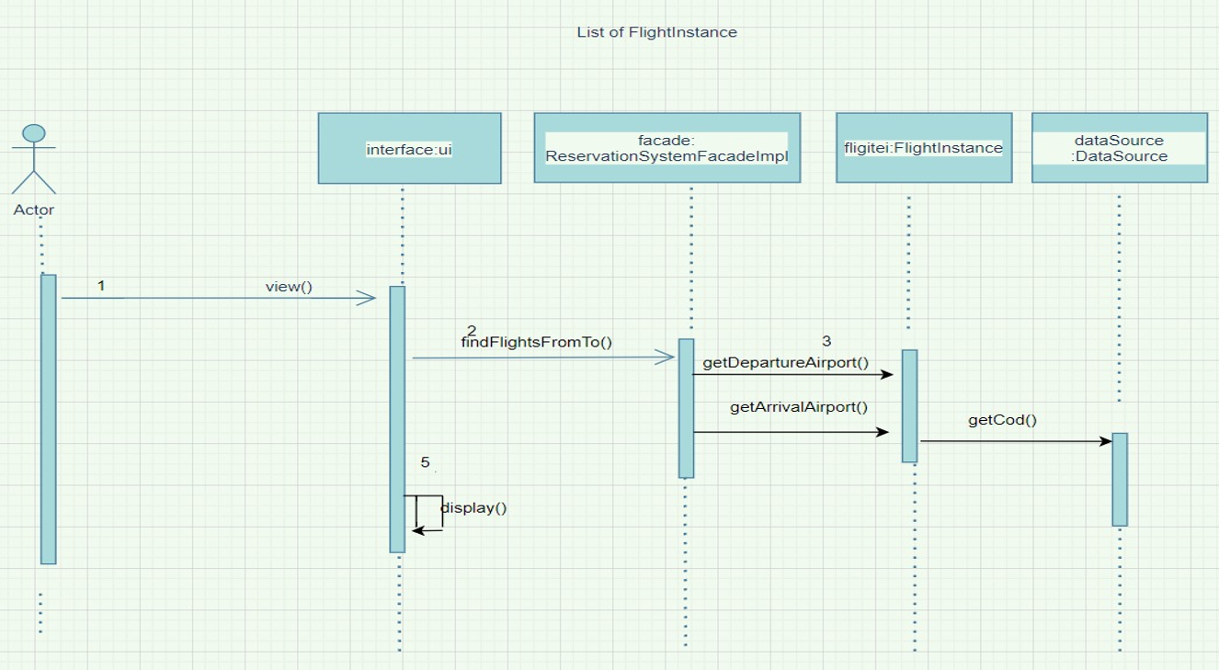

Slide 12
database design

Slide 13
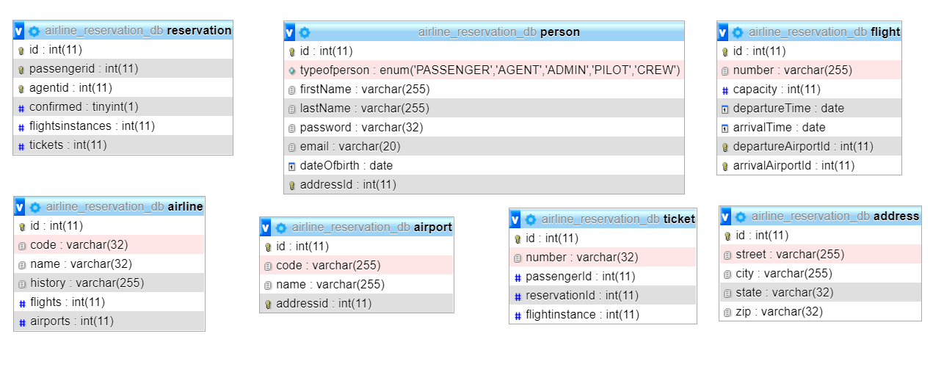

Slide 14


Method of conding in team

Slide 15
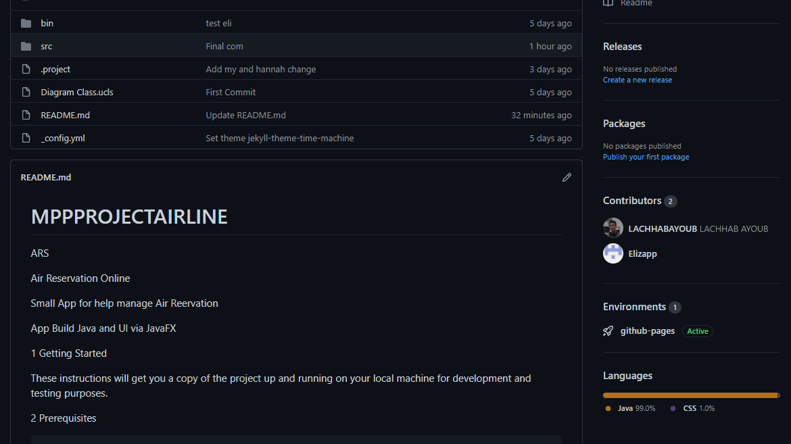

Slide 16
SYSTEM DEMO

Slide 17


