Slide 1
MARKETING ANALYTICS
2025 Performance Review
From acquisition volume to conversion efficiency, engagement and customer experience
Presented by LACHHEB Karima

Slide 2
01 • EXECUTIVE SUMMARY
2025: conversion resilience, but a sharp decline in reach
The year maintained overall conversion performance while social-media volume contracted substantially.
CONVERSION RATE
VIEWS
CLICKS
AVG. RATING
8.55%
1.10M
67.6K
3.66 / 5
2024: 8.48%
2024: 2.98M
2024: 458.3K
2024: 3.67 / 5
+0.07 pp vs 2024
−63.2% vs 2024
−85.2% vs 2024
−0.01 vs 2024
WHAT CHANGES
Conversion stayed broadly stable despite much lower traffic, indicating that the remaining audience still converted at a similar annual rate.
Customer feedback remained generally positive, but the 3.66 average rating leaves a clear gap versus a 4.0 target.
Traffic weakened through most of the year: monthly views fell from 168K in January to 46K in September, before a modest Q4 recovery.
The strongest conversion products in 2025 shifted toward Hockey Stick, Climbing Rope, Surfboard and Cycling Helmet.
Marketing Analytics • 2025 Performance Review
02

Slide 3
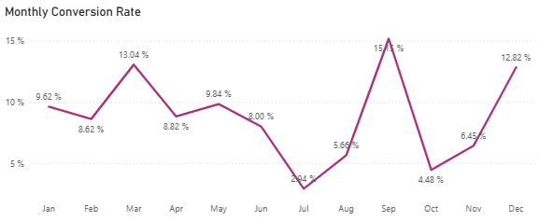
02 • CONVERSION PERFORMANCE
Conversion remained stable — but performance was highly seasonal
Annual conversion reached 8.55%, with a wide monthly spread between the weakest and strongest periods.
ANNUAL CONVERSION
BEST MONTH
LOWEST MONTH
YEAR-END
8.55%
15.15%
2.94%
12.82%
vs 8.48% in 2024
peak monthly rate
largest performance dip
strong Q4 finish
+0.07 pp
September
July
December
WHAT CHANGES
March and September were the clearest conversion peaks.
July fell to 2.94%, showing a major mid-year weakness.
December rebounded to 12.82%, closing the year strongly.
The priority is to reproduce peak-month conditions in weaker periods.
Marketing Analytics • 2025 Performance Review
03

Slide 4
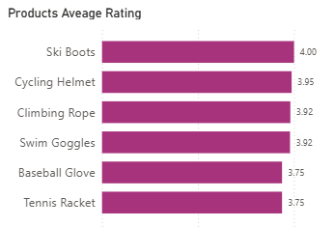
03 • PRODUCT PERFORMANCE
A small group of products led 2025 conversion
The product mix reveals clear candidates for promotion, merchandising and campaign prioritization.
TOP PRODUCT CONVERSION
Hockey Stick
20.8%
Climbing Rope
20.0%
Surfboard
18.9%
Cycling Helmet
18.2%
Baseball Glove
11.5%
Dumbbells
9.4%
ACTIONABLE TAKEWAY
Prioritize high-converting and highly rated products in paid campaigns and seasonal promotions, then test whether their success can be replicated across weaker products.
Marketing Analytics • 2025 Performance Review
04

Slide 5
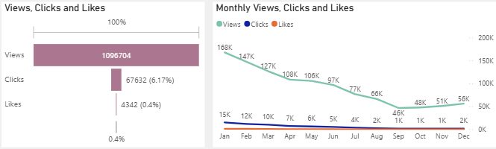
04 • SOCIAL ENGAGEMENT
Reach contracted sharply — and the decline persisted into Q3
2025 generated 1.10M views, but interaction volume was materially lower than in 2024.
VIEWS
CLICKS
LIKES
CLICK / VIEW
1,096,704
67,632
4,342
6.17%
−63.2% YoY
−85.2% YoY
−94.1% YoY
vs 15.37% in 2024
WHAT CHANGED
Views dropped from 168K in January to 46K in September.
Q4 recovered modestly: 48K → 51K → 56K views.
Clicks represented 6.17% of views; likes represented only 0.40%.
The priority is to rebuild reach while improving content-to-action efficiency.
Marketing Analytics • 2025 Performance Review
05

Slide 6
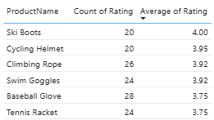
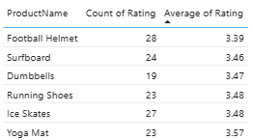
05 • CUSTOMER FEEDBACK
Customer sentiment was positive with room to raise the rating
The 2025 review base was positive overall, but mixed and negative feedback identifies an improvement opportunity.
AVERAGE RATING
POSITIVE REVIEWS
NEGATIVE + MIXED
4–5 STAR REVIEWS
3.66 / 5
292
178
292
−0.01 vs 2024
61% of reviews
37% of reviews
61% of reviews
RATINGS DISTRIBUTION
SENTIMENT MIX
1 star
27
Positive
292
2 stars
60
Negative
81
3 stars
98
Mixed negative
56
4 stars
154
Mixed positive
41
5 stars
138
Neutral
7
Marketing Analytics • 2025 Performance Review
06

Slide 7
06 • RECOMMENDATIONS
Turn 2025 signals into a focused 2026 action plan
The dashboard points to three priorities: recover reach, stabilize conversion, and lift customer satisfaction.
01
REBUILD REACH
02
SCALE CONVERSION
03
LIFT EXPERIENCE
Diagnose the sustained decline in monthly views.
Replicate peak-month tactics from March, September and December.
Target the 3.66 average rating toward 4.0+.
Refresh content formats and distribution cadence.
Prioritize Hockey Stick, Climbing Rope and Surfboard.
Investigate recurring mixed/negative review themes.
Strengthen calls-to-action and audience targeting.
Use seasonal offers around proven demand windows.
Close the feedback loop with product and support teams.
Use Q4 recovery as a base for scaling.
Monitor product-level conversion weekly.
Track rating movement by product and month.
Marketing Analytics • 2025 Performance Review
07

