Slide 1
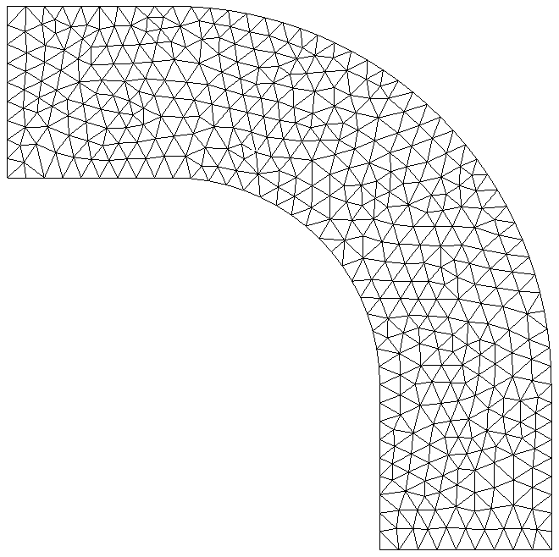
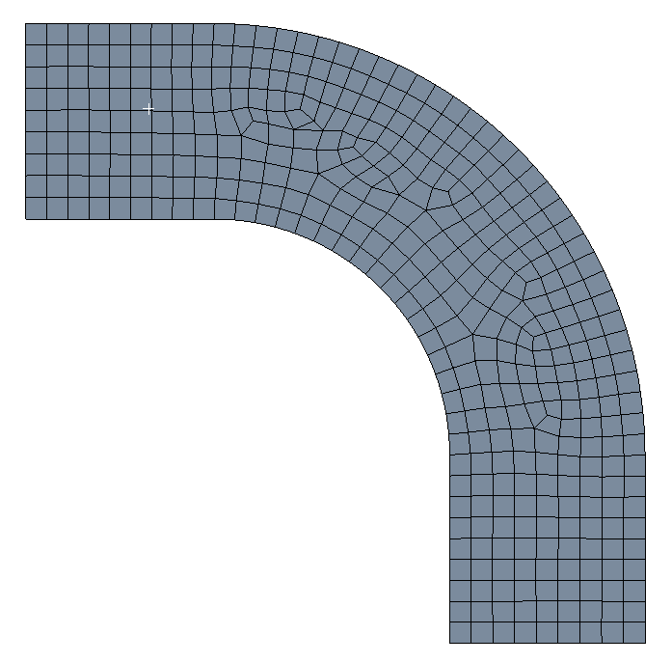
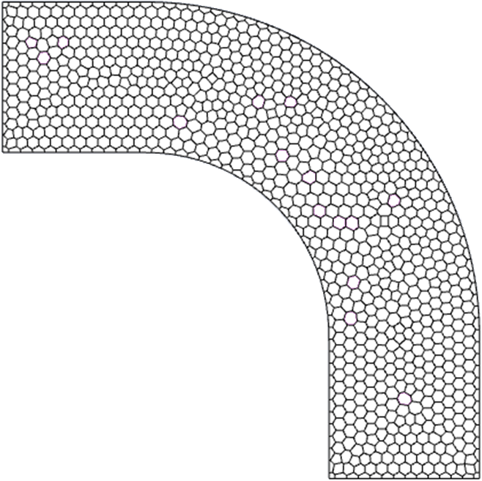

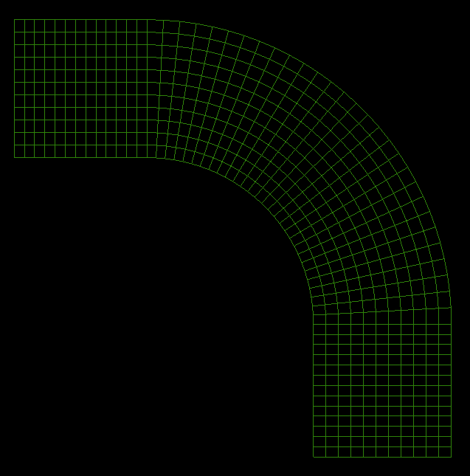
Unstructured mesh (tetrahedral)
Unstructured mesh (hexahedral)
Unstructured mesh (polyhedral)
Cartesian cut-cell mesh
Structured mesh

Slide 2
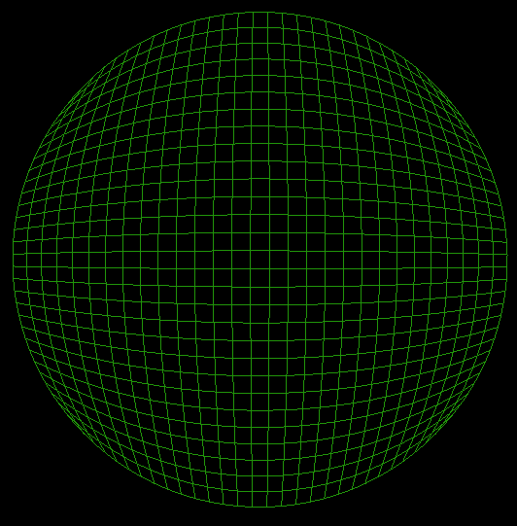
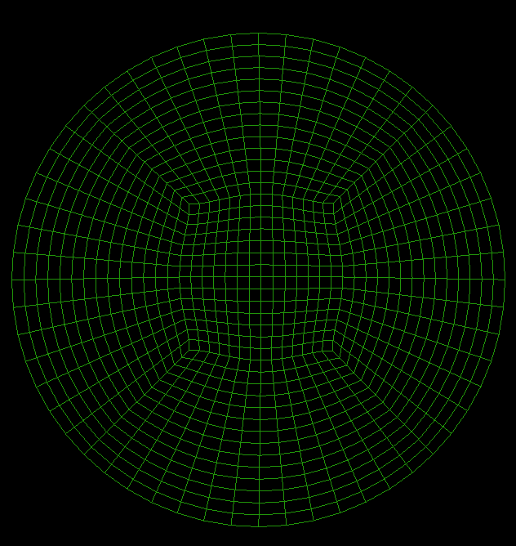
Poorly formed structured grid
Correctly formed O-grid

Slide 3
u
Freestream flow
y
Outer layer
Boundary
layer
Buffer layer
Viscous sublayer
Wall

Slide 4
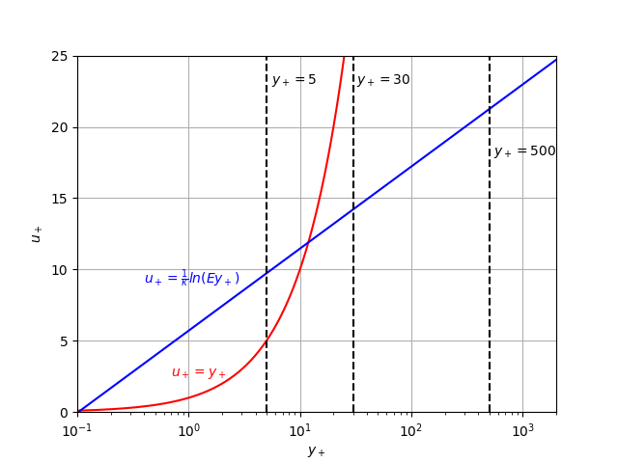

Slide 5
Resolved viscous sublayer mesh
Unresolved viscous sublayer mesh
u
u
y
y
Wall
Wall

Slide 6
C≤1
Particle passes one element or less per step
t₀
t₁
t₂
t₃
C>1
Particle passes more than one element per step
t₀
t₁
t₂
t₃

Slide 7

β
Δy
θ
Δx
$$AR=\frac{Δx}{Δy}$$

