Slide 1
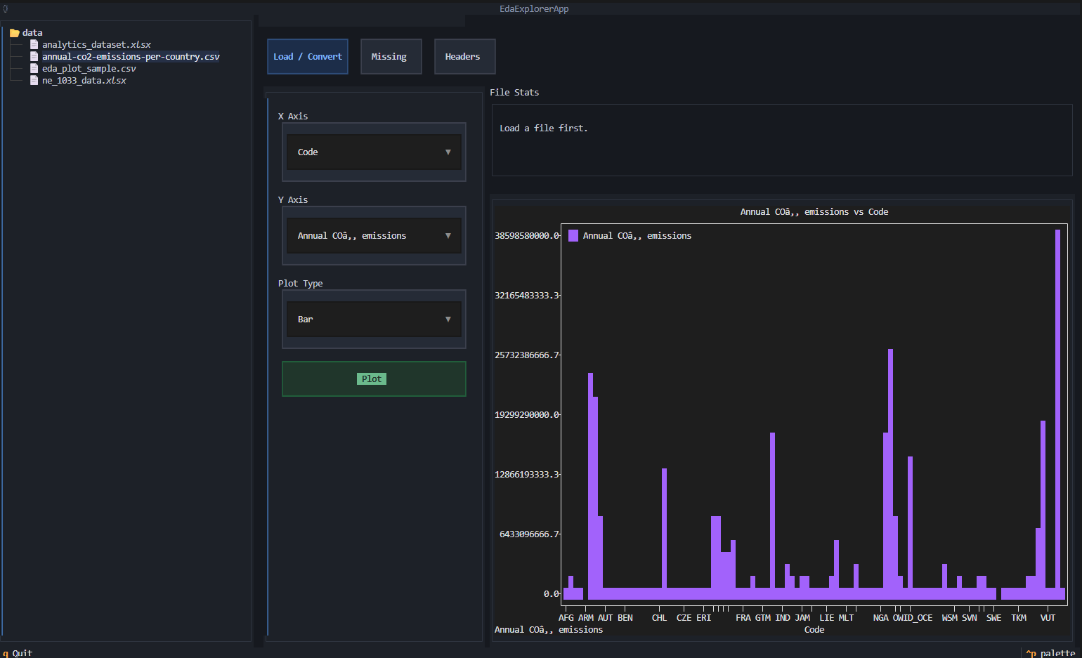
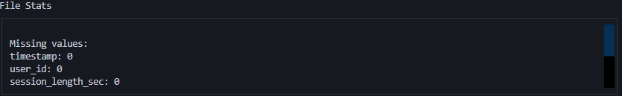
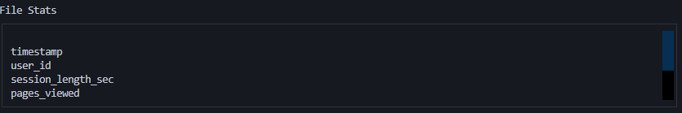
EDA From Your Terminal
By: Brennan Holt and Levi Edmonds
Goal:
Our project builds a terminal user interface (TUI) for exploratory data analysis. The goal is to let the user:
Load csv and excel datasets
Inspect file structure and column information
View basic dataset summaries
Choose columns for plotting
Generate simple visualizations in the terminal
Data:
Our data is Table of structured data in a .csv or .xlsx format. The files are stored in a data/ folder. We obtained the data from Our World in Data
Results:
Reflection:
What worked well:
Textual allowed for clean, usable interface
DirectoryTree allowed for selection of excel or csv files
File stats and headers improved usability
Plotting in terminal created a smooth workflow
Challenges:
Large data sets can freeze the TUI
Improvements:
make plotting work better with larger datasets
Allow for more summary stats
Allow for export of plots
Workflow:
Select File -> Load/Convert Data -> Parse Columns -> Inspect Stats -> Choose x/y -> Select Plot Type -> Make Plot
Useful Code:
FilteredDirectoryTree: restricts selectable files to csv or excel
Textual: TUI layout and controls
Plotext/textual_plotext: terminal plotting

