Slide 1
From scale to speed: adaptive sampling for image editing
Alibaba
sample candidates
Core questions
Can test-time compute be spent adaptively rather than uniformly?
How should we be spending our compute?
verify and prune
stop when enough
Xiangyan Qu et al., From Scale to Speed: Adaptive Test-Time Scaling for Image Editing, arXiv 2026

Slide 2
ROADMAP
We build from diffusion sampling to adaptive test-time search
Score-based diffusion sampling
Conditional scores and CFG
Test-time scaling / Image-CoT
Why editing changes the scaling logic
ADE-CoT method and evidence
Xiangyan Qu et al., From Scale to Speed: Adaptive Test-Time Scaling for Image Editing, arXiv 2026
02

Slide 3
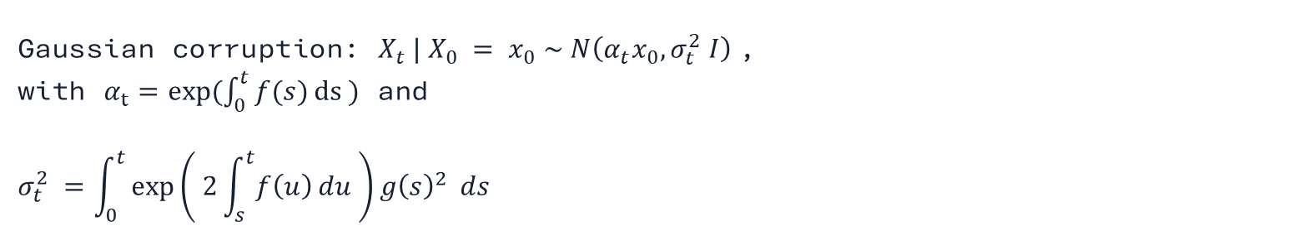
DIFFUSION BACKGROUND
Forward noising gives a tractable family of corrupted marginals
Forward SDE:$dX_{t}= f\left(t\right)X_{t}dt + g\left(t\right)dW_{t}$ $t=0$ data $→t=T$ noise
Gaussian corruption: $X_{t} | X_{0} = x_{0} \sim N\left(α_{t}x_{0}, σ_{t}^{2} I\right)$,
with $α_{t}=exp⁡(\int_{0}^{t}{f(s)}ds )$ and
$$σ_{t}^{2} =\int_{0}^{t}{\exp\left( 2\int_{s}^{t}{f\left(u\right)}du \right)g{\left(s\right)}^{2}} ds$$
Score: $s_{t}\left(x\right)≈∇_{x}\log{p_{t}\left(x\right)}$
Sampling uses the learned score to move from noise back toward data.
Yang Song et al., Score-Based Generative Modeling through Stochastic Differential Equations, ICLR 2021, Outstanding Paper Award
03

Slide 4
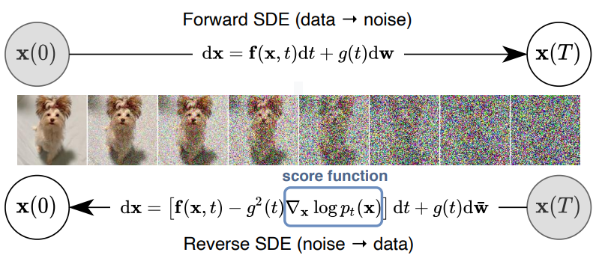
DIFFUSION VISUAL
The sampling story is easiest to see as a trajectory through noise levels
Forward process corrupts data into near-Gaussian noise
Reverse sampler moves from noise back toward data
Intermediate states are where ADE-CoT can preview, score, and prune
Yang Song et al., Score-Based Generative Modeling through Stochastic Differential Equations, ICLR 2021, Outstanding Paper Award
04

Slide 5
DIFFUSION BACKGROUND
Reverse SDEs, probability-flow ODEs, and Tweedie connect score to denoising
Reverse SDE drift: $f\left(X_{t},t\right)− g{\left(t\right)}^{2}s_{t}\left(X_{t}\right) t=\text{T} \text{noise} →t=\text{0} \text{data}$
Probability-flow ODE: $dX_{t}= \left[f\left(X_{t},t\right)− 0.5 g{\left(t\right)}^{2}s_{t}\left(X_{t}\right)\right]dt$
Tweedie: $𝔼\left[X_{0} \right| X_{t}=x]= \frac{x+σ_{t}^{2} s_{t}(x)}{α_{t}}$
NFE counts score/model evaluations along these numerical trajectories.
Yang Song et al., Score-Based Generative Modeling through Stochastic Differential Equations, ICLR 2021, Outstanding Paper Award
05

Slide 6
FLOW MODELS
Flow models learn a velocity field rather than a score
Diffusion/score view: learn $s_{t}\left(x\right)≈∇_{x}\log{p_{t}\left(x\right)}$
Flow matching view: learn $v_{θ}(x,t) ≈ v_{t}(x, t)$
Sampling ODE: ${dX}_{t}= v_{θ}\left(X_{t},t\right)dt$
For ADE-CoT the key commonality is still trajectory structure: intermediate states can be previewed, scored, pruned, and continued.
Yaron Lipman et al., Flow Matching for Generative Modeling, ICLR 2023
06

Slide 7
CONDITIONING
Image editing uses a conditional score tied to the source image and instruction
Mathematical notation
Interpretation
Condition: $y = \left(I_{src}, c\right)$
Text-to-image: condition is a prompt
Image editing: condition is source image plus edit instruction
Conditional score: $s_{t}(x | y) =∇_{x} log⁡p_{t}(x | y)$
The output must both change and preserve content
Conditional ODE: $dX_{t} = [f(X_{t},t) − 0.5 g{\left(t\right)}^{2} s_{t}(X_{t} | y)] dt$
Yang Song et al., Score-Based Generative Modeling through Stochastic Differential Equations, ICLR 2021, Outstanding Paper Award
Xiangyan Qu et al., From Scale to Speed: Adaptive Test-Time Scaling for Image Editing, arXiv 2026
07

Slide 8
SAMPLING CONTROL
Classifier-free guidance is an inference-time score modification
Unconditional score: $s_{uncond}(x,t) =∇_{x} log⁡p_{t}(x)$
Conditional score: $s_{cond}(x,t;y) =∇_{x} log⁡p_{t}(x | y)$
CFG score: $s_{CFG} = s_{uncond} + w (s_{cond} − s_{uncond})$, with $w≫1$
CFG is a small example of a larger theme: sampling-time decisions matter.
Jonathan Ho and Tim Salimans, Classifier-Free Diffusion Guidance, NeurIPS Workshop 2021
08

Slide 9
SAMPLING SPEED
Classical acceleration reduces steps per sample; ADE-CoT optimizes across samples
DDIM / deterministic samplers
DPM-Solver and high-order numerical solvers
Distillation and consistency-style models
Flow matching / rectified-flow formulations
ADE-CoT is orthogonal: given any base sampler, it adaptively decides how many trajectories to start, prune, continue, and stop.
Jiaming Song et al., Denoising Diffusion Implicit Models, ICLR 2021
Cheng Lu et al., DPM-Solver, NeurIPS 2022
Tim Salimans and Jonathan Ho, Progressive Distillation for Fast Sampling of Diffusion Models, ICLR 2022
Yang Song et al., Consistency Models, ICML 2023
09

Slide 10
MULTIPLE SAMPLES
Best-of-N improves quality when candidate quality varies
Sample N candidates from different noise seeds
->
Score each candidate with a verifier
->
Return the candidate with the highest score
If one sample costs C denoising steps, Best-of-N costs about N x C.
Nanye Ma et al., Scaling Inference Time Compute for Diffusion Models, CVPR 2025
10

Slide 11
VERIFIERS
A verifier turns generation into search under a compute budget
1
2
3
Generator proposes candidate images
Verifier scores quality, instruction following, and preservation
Search policy uses scores to prune or continue candidates
The verifier can be CLIP-style, perceptual, learned, or an MLLM judge.
Max Ku et al., VIEScore: Towards Explainable Metrics for Conditional Image Synthesis Evaluation, ACL 2024
Nanye Ma et al., Scaling Inference Time Compute for Diffusion Models, CVPR 2025
11

Slide 12
TEST-TIME SCALING
Text-to-image test-time scaling has several established families
Noise / sample scaling: draw many seeds and select the best image
Prompt-level intervention: rewrite or expand the prompt to generate stronger candidates
Reflective updates: generate, critique failures, revise the prompt, and regenerate
Trajectory search: branch, score, and prune denoising paths with verifiers
These methods mostly target open-ended text-to-image generation; ADE-CoT asks how this changes for constrained image editing.
Nanye Ma et al., Scaling Inference Time Compute for Diffusion Models, CVPR 2025
Shufan Li et al., Reflect-DiT
Le Zhuo et al., From Reflection to Perfection
12

Slide 13
EARLY PRUNING
Pruning saves compute only if early scores preserve future potential
Partially denoise each candidate
->
Inspect a preview or intermediate state
->
Discard low-potential candidates before full denoising
The statistical risk is a false negative: pruning a candidate that would later become good.
Renrui Zhang et al., Let's Verify and Reinforce Image Generation Step by Step, CVPR 2025;
Zechuan Zhang et al., In-Context Edit
13

Slide 14
TASK STRUCTURE
Text-to-image is open-ended; image editing is goal-directed
Text-to-image
Image editing
Many valid outputs
Diversity is valuable
More samples can keep helping
Constrained by source image
Instruction specifies a target change
One correct edit may be enough
Xiangyan Qu et al., From Scale to Speed: Adaptive Test-Time Scaling for Image Editing, arXiv 2026
14

Slide 15
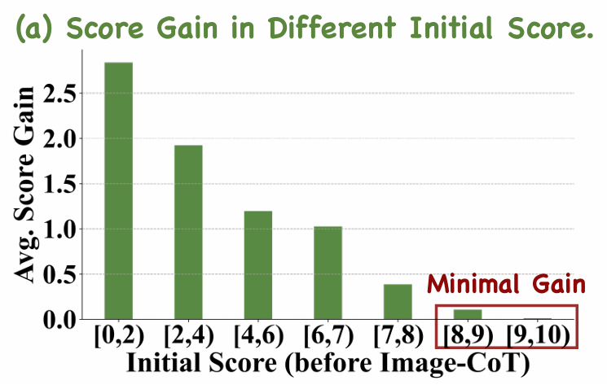
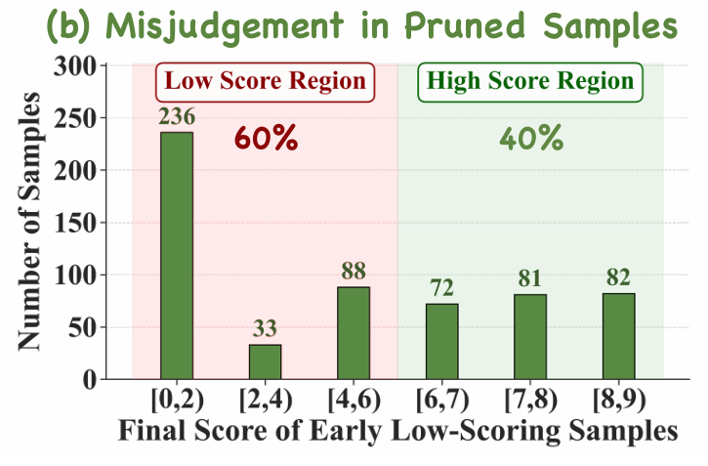
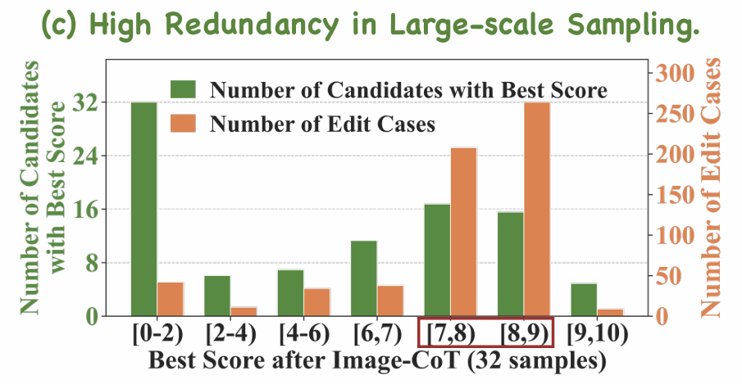
MOTIVATION
Existing Image-CoT wastes compute in three editing-specific ways
Fixed budgets waste samples on easy edits
General early verifiers prune candidates that later score well
Large-scale sampling produces redundant correct outputs
Xiangyan Qu et al., From Scale to Speed: Adaptive Test-Time Scaling for Image Editing, arXiv 2026
15

Slide 16
FRAMING
The paper is a statistical decision problem around a generator
Generator
Verifier
Multistep stochastic generator: diffusion image editor proposes candidates
Scoring rule: verifier evaluates instruction alignment and preservation
Budget
Policy
Budget: every trajectory costs denoising steps and verifier calls
Policy: decide which candidates to continue, prune, or stop
Xiangyan Qu et al., From Scale to Speed: Adaptive Test-Time Scaling for Image Editing, arXiv 2026
16

Slide 17
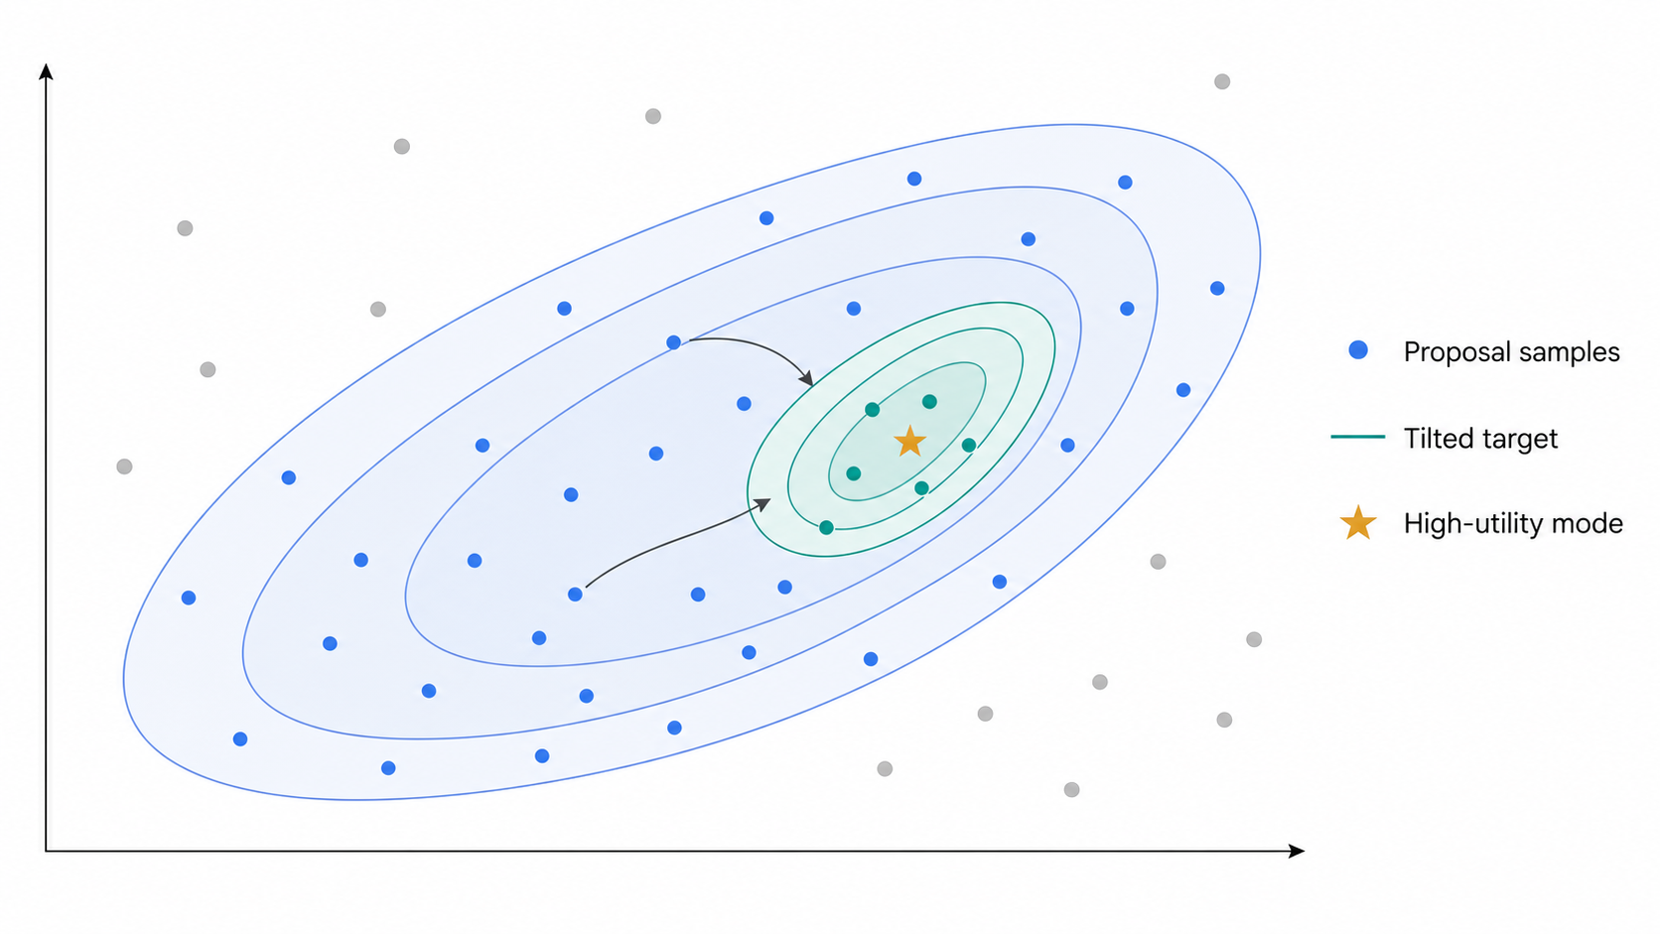
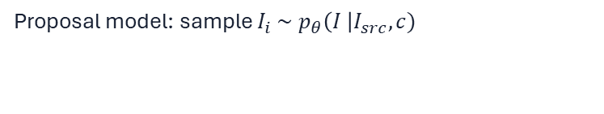
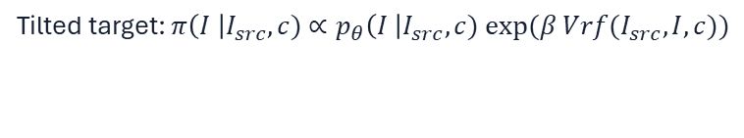
STATISTICAL ANALOGUE
Editing can be viewed as posterior tilting of a proposal model
Proposal model: sample $I_{i} \sim p_{θ}\left(I \right|I_{src}, c)$
Tilted target: $π\left(I \right|I_{src},c)$ $∝p_{θ}\left(I \right|I_{src},c) exp⁡(β Vrf(I_{src},I,c))$
For editing, acceptable mass may concentrate near one high-utility region. We want a single good sample.
Daniel Sanz-Alonso and Zijian Wang, Bayesian Update with Importance Sampling: Required Sample Size, Entropy 2021; Xiangyan Qu et al., From Scale to Speed, arXiv 2026
17

Slide 18
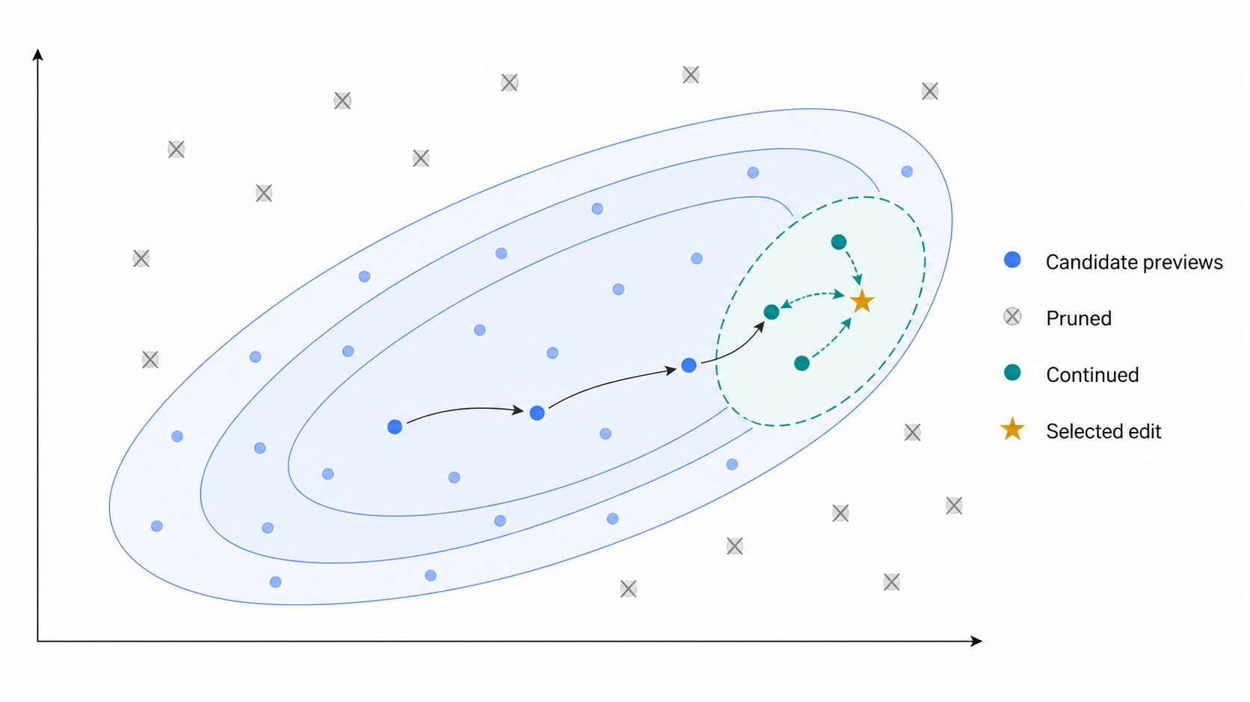
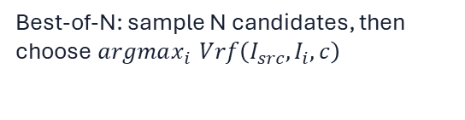
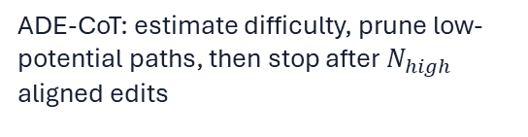
DECISION VIEW
Best-of-N brute-forces the mode; ADE-CoT searches sequentially
Best-of-N: sample N candidates, then choose $argmax_{i }Vrf\left(I_{src},I_{i},c\right)$
ADE-CoT: estimate difficulty, prune low-potential paths, then stop after $N_{high}$ aligned edits
Statistical analogue: spend samples where high-utility mass is still uncertain
Nanye Ma et al., Scaling Inference Time Compute for Diffusion Models, CVPR 2025; Xiangyan Qu et al., From Scale to Speed, arXiv 2026
18

Slide 19
THESIS
ADE-CoT replaces fixed sampling scale with adaptive compute allocation
1
2
3
Difficulty-aware budget: easy edits receive fewer candidates
Edit-specific pruning: early previews are judged with region and caption signals
Opportunistic stopping: stop once enough intent-aligned edits are found
Xiangyan Qu et al., From Scale to Speed: Adaptive Test-Time Scaling for Image Editing, arXiv 2026
19

Slide 20
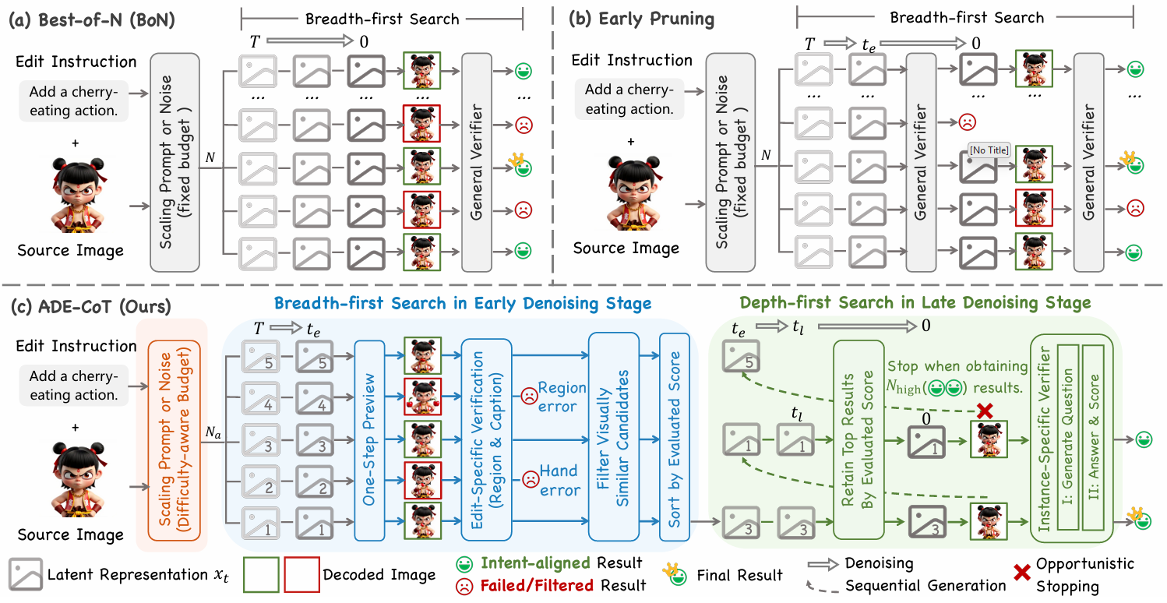
ADE-COT OVERVIEW
ADE-CoT adapts both the amount and schedule of sampling compute
Estimate difficulty and set a dynamic budget
Use edit-specific early verification and similarity filtering
Generate late-stage candidates sequentially and stop opportunistically
Xiangyan Qu et al., From Scale to Speed: Adaptive Test-Time Scaling for Image Editing, arXiv 2026
20

Slide 21
COMPONENT 1
A cheap pilot score sets the per-instance sampling budget
Generate one initial candidate and score it with the verifier
High score implies easy edit; low score implies difficult edit
$$N_{a}= N_{min}⁡+ ceil\left.\left(\left(N − N_{min}\right){\left(1 −\frac{S}{S_{\max{ }}}\right)}^{γ}\right.\right)$$
Default $γ= 0.15$, $N_{min}=1$, $N=32$, $S_{max}=10$.
Xiangyan Qu et al., From Scale to Speed: Adaptive Test-Time Scaling for Image Editing, arXiv 2026
21

Slide 22
COMPONENT 2A
Tweedie-style one-step previews make early pruning cheaper
Goal: inspect an intermediate latent at time $t_{e}$ without extra denoising
Use Tweedie’s formula: ${\hat{x}}_{0|t_{e}}=\frac{x_{t_{e}}+ σ_{t_{e}}^{2} s_{θ}\left(x_{t_{e}},t_{e}\right|I_{src}, c)}{α_{t_{e}}}$
Decode ${\hat{x}}_{0|t_{e}}$to obtain a preview for scoring
The paper writes this in model-prediction notation; this deck uses the score/Tweedie form.
Yang Song et al., Score-Based Generative Modeling through Stochastic Differential Equations, ICLR 2021, Outstanding Paper Award; Xiangyan Qu et al., From Scale to Speed: Adaptive Test-Time Scaling for Image Editing, arXiv 2026
22

Slide 23

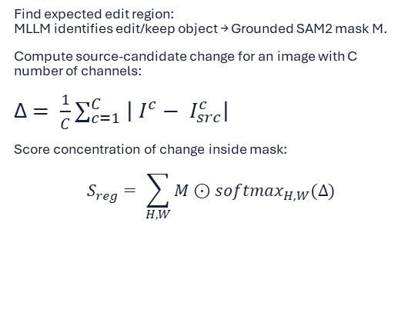


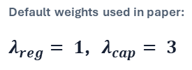
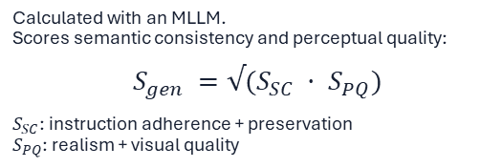
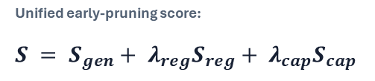

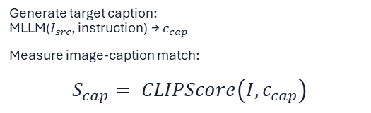
COMPONENT 2B
Edit-specific verification adds region and caption checks to the general judge
Used during early pruning: score each one-step preview image $I_{0|t_{e}}$, prune low-score candidates, then sort survivors.
MLLM
Mask
CLIP
1. General judge: $S_{gen}$
2. Region score: $S_{reg}$
3. Caption score: $S_{cap}$
Calculated with an MLLM.
Scores semantic consistency and perceptual quality:
$$S_{gen} =√(S_{SC} · S_{PQ})$$
$S_{SC}$: instruction adherence + preservation
$S_{PQ}$: realism + visual quality
Find expected edit region:
MLLM identifies edit/keep object → Grounded SAM2 mask M.
Compute source-candidate change for an image with C number of channels:
Δ$= \frac{1}{C}∑_{c=1}^{C} \left| I^{c}− I_{src}^{c}\right|$
Score concentration of change inside mask:
$$S_{reg}= \sum_{H,W}{M}⊙softmax_{H,W}(Δ)$$
Generate target caption:
MLLM($I_{src}$, instruction) → $c_{cap}$
Measure image-caption match:
$$S_{cap}= CLIPScore\left(I, c_{cap}\right)$$
Coarse global judgment; can miss localized edit errors.
High when pixels change mainly where the edit should occur.
Checks whether the preview matches the intended edited result.
Unified early-pruning score:
$$S = S_{gen}+ λ_{reg}S_{reg}+ λ_{cap}S_{cap}$$
Default weights used in paper:
$λ_{reg}= 1$, $λ_{cap}= 3$
$S = S_{gen}+ S_{reg}+ 3 S_{cap}$
Qu et al., From Scale to Speed: Adaptive Test-Time Scaling for Image Editing, arXiv 2026; VIE-Score; Grounded SAM2; CLIP.
23

Slide 24
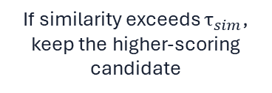
COMPONENT 2C
Similarity filtering removes redundant candidates before full generation
Embed early previews using DINOv2
->
Compute pairwise visual similarity
->
If similarity exceeds $τ_{sim}$, keep the higher-scoring candidate
The paper argues redundancy is already visible in early previews.
Alec Radford et al., Learning Transferable Visual Models from Natural Language Supervision, ICML 2021; Maxime Oquab et al., DINOv2, TMLR 2024; Xiangyan Qu et al., From Scale to Speed: Adaptive Test-Time Scaling for Image Editing, arXiv 2026
24

Slide 25
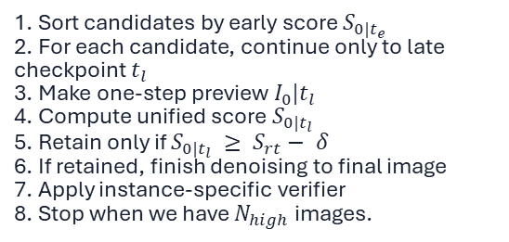
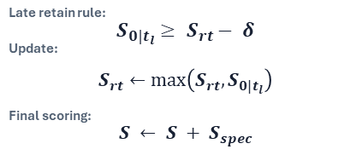
COMPONENT 3
Late-stage search finishes only promising candidates, then stops early
After early pruning, candidates are sorted by early score. ADE-CoT processes them sequentially and stops once enough intent-aligned results are found.
Baseline
ADE-CoT
Breadth-first baseline: finish everything
ADE-CoT: depth-first opportunistic stopping
1. Start with surviving candidates after early pruning
2. Fully denoise every candidate to final image
3. Score all final images
4. Select best at the end
1. Sort candidates by early score $S_{0|t_{e}}$
2. For each candidate, continue only to late checkpoint $t_{l}$
3. Make one-step preview $I_{0}|t_{l}$
4. Compute unified score $S_{0|t_{l}}$
5. Retain only if $S_{0|t_{l}} ≥ S_{rt}− δ$
6. If retained, finish denoising to final image
7. Apply instance-specific verifier
8. Stop when we have $N_{high}$ images.
Late retain rule:
$S_{0|t_{l}}≥ S_{rt}− δ$
Update:
$$S_{rt}←\max\left(S_{rt}, S_{0|t_{l}}\right)$$
Final scoring:
$$S ← S + S_{spec}$$
Cost grows with number of retained candidates.
$N_{high}=4$
Key idea: early stage is breadth-first to avoid losing good candidates; late stage is depth-first because previews are more reliable and many correct edited results are redundant.
Qu et al., From Scale to Speed: Adaptive Test-Time Scaling for Image Editing, arXiv 2026
25

Slide 26
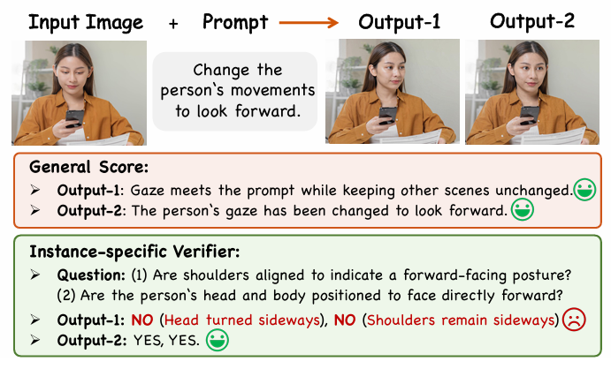

SPECIFIC VERIFIER
Instance-specific yes/no questions expose subtle edit failures
MLLM first generates five edit-specific verification questions
MLLM then answers yes/no for each candidate
All-yes candidates count toward opportunistic stopping
MLLM generates 5 yes/no questions, then answers them on the final candidate.
$S_{spec}$= number of yes answers
Xiangyan Qu et al., From Scale to Speed: Adaptive Test-Time Scaling for Image Editing, arXiv 2026
26

Slide 27
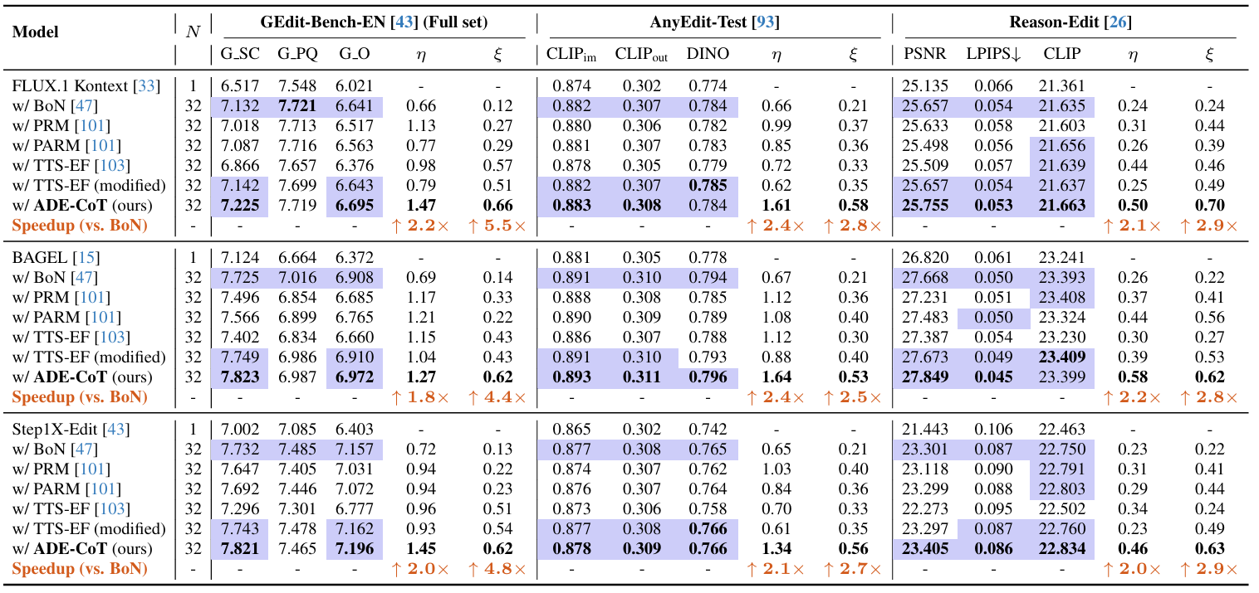
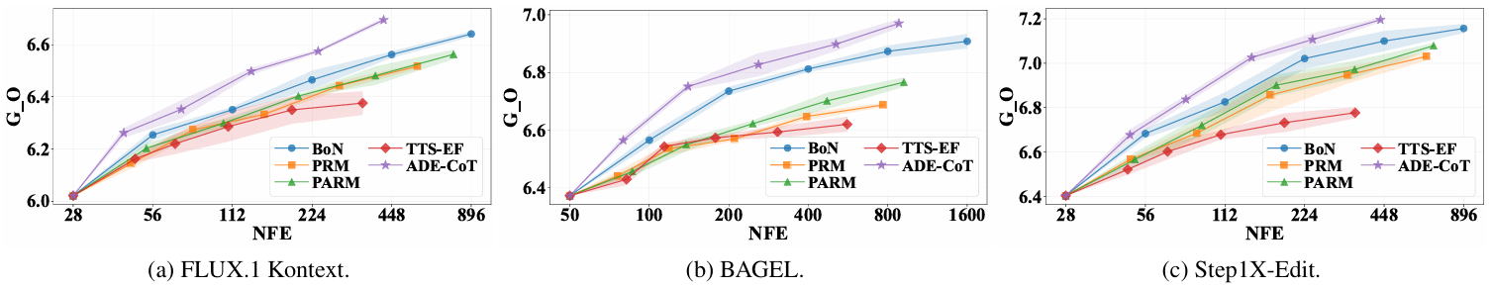
MAIN RESULT
ADE-CoT preserves or improves quality while cutting compute by more than 2x
Xiangyan Qu et al., From Scale to Speed: Adaptive Test-Time Scaling for Image Editing, arXiv 2026
28

Slide 28
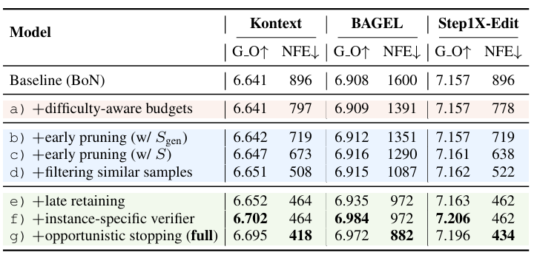
ABLATION
The compute savings accumulate across several modest design choices
Difficulty-aware budgets reduce cost with little quality loss
Edit-specific pruning and similarity filtering create the largest NFE drops
Instance-specific verification recovers fine-grained quality
Xiangyan Qu et al., From Scale to Speed: Adaptive Test-Time Scaling for Image Editing, arXiv 2026
29

Slide 29
LIMITATIONS
The method inherits the cost and fragility of verifier-guided systems
MLLM verifier calls add latency and system cost
No mathematical framework / formalism
Evaluation partly relies on model-based judges
Several thresholds and prompts must be tuned or trusted
Xiangyan Qu et al., From Scale to Speed: Adaptive Test-Time Scaling for Image Editing, arXiv 2026
32

Slide 30
RESEARCH DIRECTIONS
The natural next step is calibrated adaptive inference
Train smaller specialized edit-quality verifiers
Calibrate early-stage scores to future final quality
Design stopping rules with uncertainty, bandits, or optimal stopping
Extend adaptive compute allocation to video editing and other constrained generation tasks
Xiangyan Qu et al., From Scale to Speed: Adaptive Test-Time Scaling for Image Editing, arXiv 2026
33

Slide 31
TAKEAWAYS
The lesson is not just more compute; it is better allocation of compute
1
2
3
Test-time scaling is becoming an algorithmic design space
Image editing needs different scaling logic than open-ended generation
Adaptive sampling policies may matter as much as raw sampling scale
Xiangyan Qu et al., From Scale to Speed: Adaptive Test-Time Scaling for Image Editing, arXiv 2026
34

