Slide 1




The Multi-Armed Bandit Problem
Theo Crookes
Notes:
Triggered Bandits Within Streaming Data Settings.

Slide 2
The Multi-Armed Bandit Problem
Some slot machines have a higher expected reward than others
How do you pull the arms of the machines to maximise the cumulative reward received?
You enter a casino containing K one-armed bandits
Each slot machine gives a stochastic reward when an arm is pulled

Slide 3
Applications
To motivate the importance of these algorithms, (contextual) multi-armed bandit algorithms have been applied across a wide variety of settings including:
Finance
Clinical Trials
Anomaly Detection
Recommender Systems

Slide 4
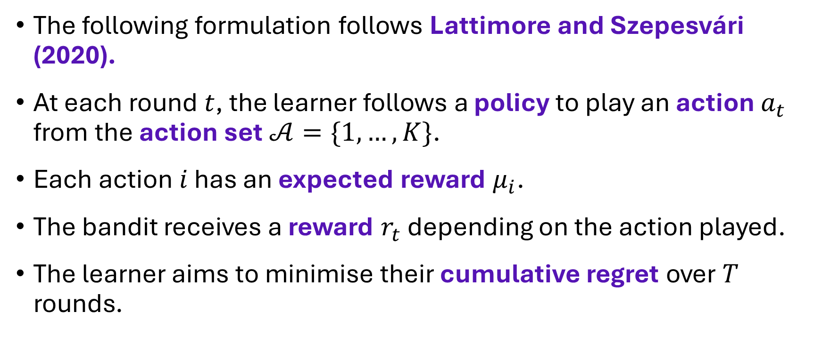
Problem Formulation
The following formulation follows Lattimore and Szepesvári (2020).
At each round $t$, the learner follows a policy to play an action $a_{t}$ from the action set$𝒜=\{1,…,K\}$.
Each action $i$ has an expected reward $μ_{i}$.
The bandit receives a reward $r_{t}$ depending on the action played.
The learner aims to minimise their cumulative regret over $T$ rounds.

Slide 5

Regret
Instantaneous expected regret is the difference between the expected reward of the optimal action and the action played:
$$μ_{a^{∗}}−μ_{a_{t}}$$

Slide 6


Regret
Expected cumulative regret over $T$ rounds,
$$ℛ_{T}=Tμ_{a^{∗}}−\sum_{t=1}^{T}{μ_{a_{t}}}$$
Notes:
Note: Mention difference between pseudo-regret and random regret.

Slide 7
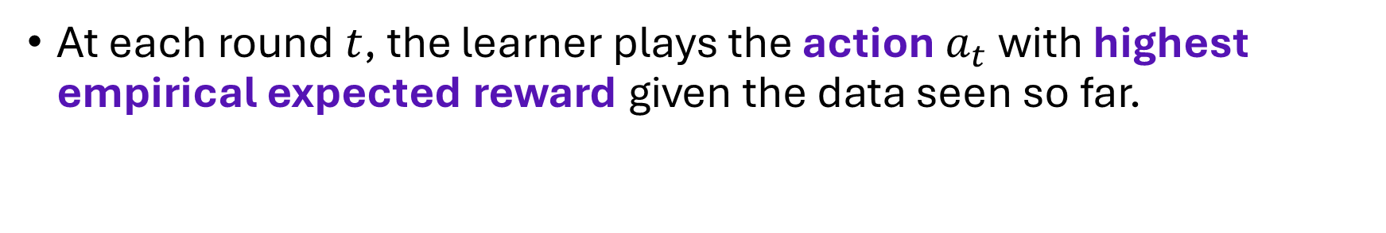
The Greedy Policy
10
100
5
14
2
6
10
8
At each round $t$, the learner plays the action $a_{t}$ with highest empirical expected reward given the data seen so far.
9
10
12

Slide 8
The Greedy Policy
The Greedy Policy always exploits the empirically optimal action.
If the bandit underestimates the reward of the optimal arm initially, it may never play the optimal arm again.
To improve upon this policy, we need to introduce some exploration.

Slide 9

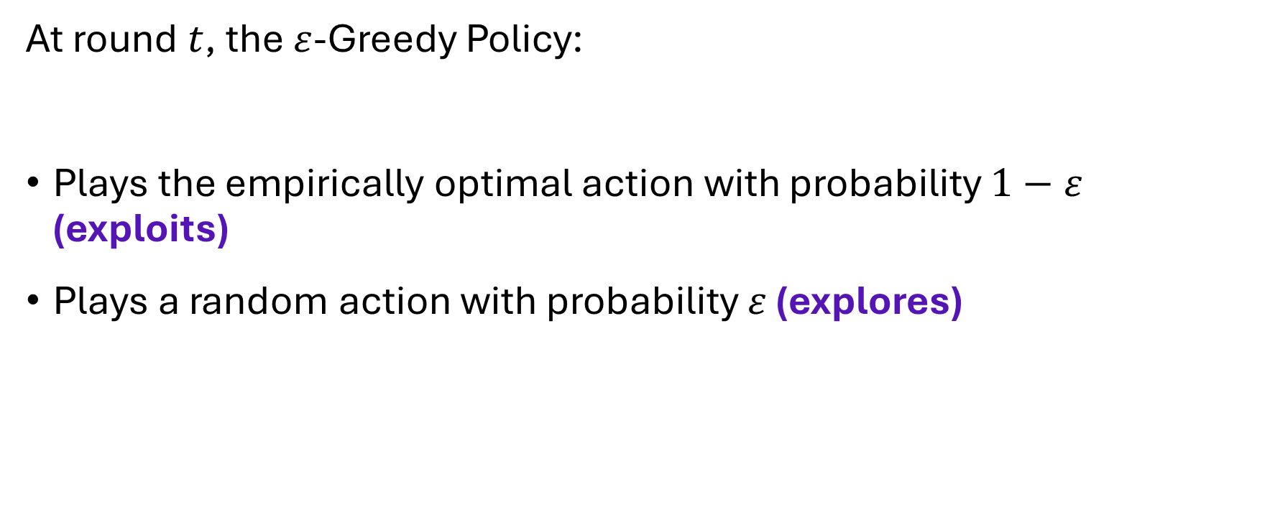
The $ε$-Greedy Policy
At round $t$, the $ε$-Greedy Policy:
Plays the empirically optimal action with probability $1−ε$ (exploits)
Plays a random action with probability $ε$ (explores)

Slide 10



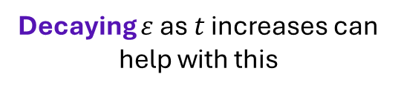
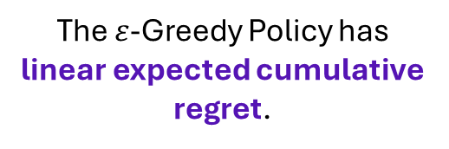
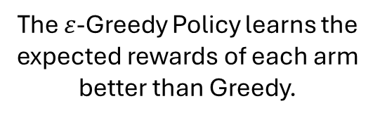
The $ε$-Greedy Policy
The $ε$-Greedy Policy learns the expected rewards of each arm better than Greedy.
The $ε$-Greedy Policy has linear expected cumulative regret.
Decaying $ε$ as $t$ increases can help with this
Notes:
Exploring with a fixed probability means playing a suboptimal action with at least some fixed probability

Slide 11
Optimism in the Face of Uncertainty
Optimism in the face of uncertainty is the idea underpinning the Upper Confidence Bound (UCB) algorithms.
UCB algorithms assign a label to each:
$$UCB=Expected Reward+Uncertainty$$

Slide 12

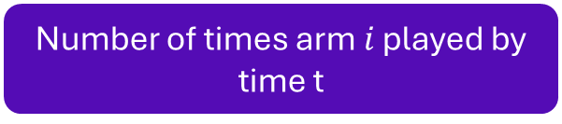
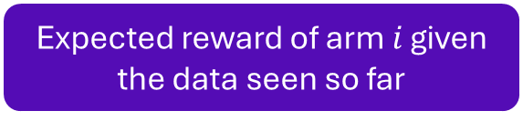
UCB1
UCB1 was first proposed by Auer et al. (2002)
The UCB1 algorithm assigns the following UCB terms to each arm:
$${UCB}_{i}={\hat{μ}}_{i}+\sqrt{\frac{2ln(t)}{T_{i}(t)}}$$
Expected reward of arm $i$ given the data seen so far
Number of times arm $i$ played by time t

Slide 13
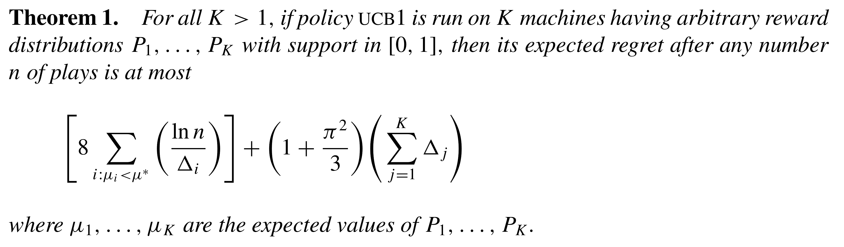
UCB1
Auer et al. (2002)

Slide 14
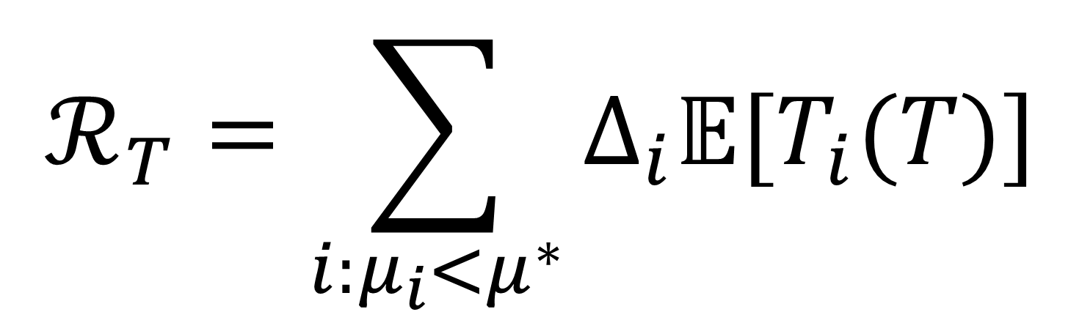
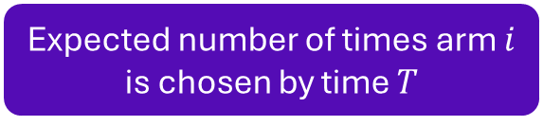
Proof
The following proof follows Auer et al. (2002).
We can decompose the regret in the following way:
$$ℛ_{T}=\sum_{i:μ_{i}<μ^{∗}}{Δ_{i}𝔼[T_{i}(T)]}$$
Expected number of times arm $i$ is chosen by time $T$
Suboptimality gap

Slide 15


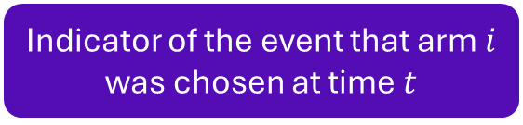

Proof
We can decompose the regret in the following way:
$$T_{i}\left(T\right)=1+\sum_{t=K+1}^{T}{𝟙(a_{t}=i)}$$
Indicator of the event that arm $i$ was chosen at time $t$
$$≤l+\sum_{t=K+1}^{T}{𝟙(a_{t}=i,T_{i}\left(t−1\right)≥l)}$$
For integer $l>0$

Slide 16

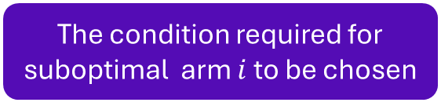

Proof
We can decompose the regret in the following way:
$$≤l+\sum_{t=K+1}^{T}{𝟙(a_{t}=i,T_{i}\left(t−1\right)≥l)}$$
The condition required for suboptimal arm $i$ to be chosen
$$≤l+\sum_{t=K+1}^{T}{𝟙({UCB}_{T^{∗}\left(t−1\right)}^{∗,t−1}≤{UCB}_{T_{i}\left(t−1\right)}^{i,t−1},T_{i}\left(t−1\right)≥l)}$$

Slide 17

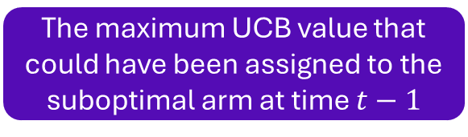
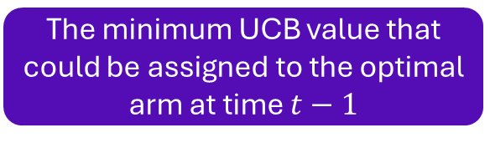

Proof
We can decompose the regret in the following way:
$$≤l+\sum_{t=K+1}^{T}{𝟙({UCB}_{T^{∗}\left(t−1\right)}^{∗,t−1}≤{UCB}_{T_{i}\left(t−1\right)}^{i,t−1},T_{i}\left(t−1\right)≥l)}$$
$$≤l+\sum_{t=K+1}^{T}{𝟙(\min_{0<s<t}{{UCB}_{s}^{∗,t−1}}≤\max_{l<s_{i}<t}{{UCB}_{s_{i}}^{i,t−1}})}$$
The minimum UCB value that could be assigned to the optimal arm at time $t−1$
The maximum UCB value that could have been assigned to the suboptimal arm at time $t−1$

Slide 18

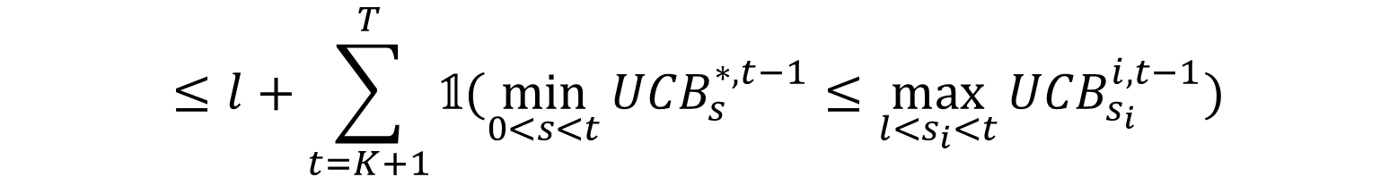
Proof
We can decompose the regret in the following way:
$$≤l+\sum_{t=K+1}^{T}{𝟙(\min_{0<s<t}{{UCB}_{s}^{∗,t−1}}≤\max_{l<s_{i}<t}{{UCB}_{s_{i}}^{i,t−1}})}$$
$$≤l+\sum_{t=0}^{∞}{\sum_{s=1}^{t−1}{\sum_{s_{i}=l}^{t−1}{𝟙\left({UCB}_{s}^{∗,t}≤{UCB}_{s_{i}}^{i,t}\right)}}}$$

Slide 19

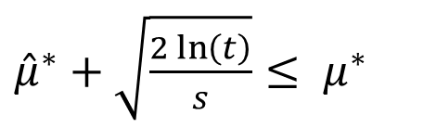

Proof
We are now concerned about when the following event occurs:
$${UCB}_{s}^{∗,t}≤{UCB}_{s_{i}}^{i,t}$$
1
2
3
$$μ^{∗}−μ_{i}−2\sqrt{\frac{2\ln\left(t\right)}{s_{i}}}<0$$
${\hat{μ}}^{∗}+\sqrt{\frac{2\ln\left(t\right)}{s}}≤ μ^{∗}$
${\hat{μ}}_{i}+\sqrt{\frac{2\ln\left(t\right)}{s_{i}}}≥μ_{i}$
UCB of the optimal arm less than (or equal to) the true reward of the optimal arm
UCB of the suboptimal arm greater than (or equal to) the true reward of the suboptimal arm
The mean of the optimal arm is less than the mean of the suboptimal arm plus 2 times the uncertainty term of the suboptimal arm

Slide 20
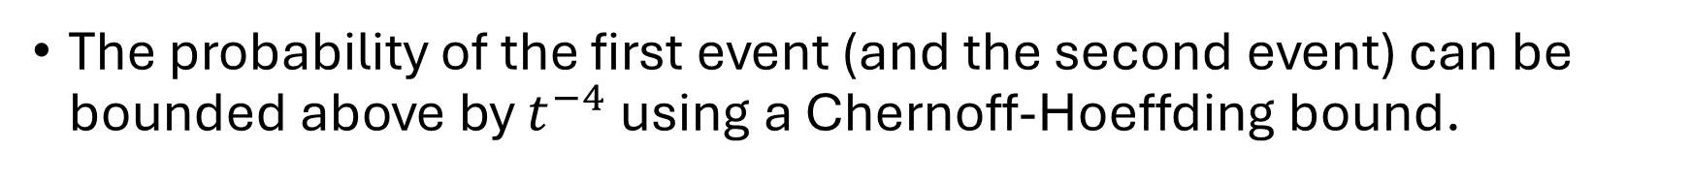
Proof
1+2
The probability of the first event (and the second event) can be bounded above by $t^{−4}$ using a Chernoff-Hoeffding bound.

Slide 21
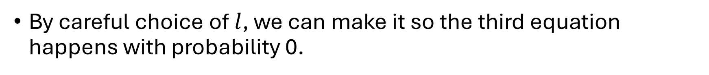
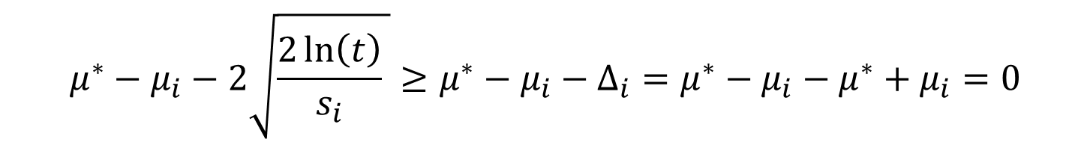
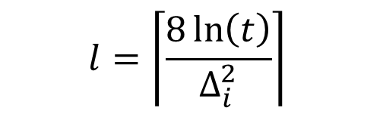
Proof
3
By careful choice of $l$, we can make it so the third equation happens with probability 0.
$$l=\left\lceil \frac{8\ln\left(t\right)}{Δ_{i}^{2}}\right\rceil$$
$$μ^{∗}−μ_{i}−2\sqrt{\frac{2\ln\left(t\right)}{s_{i}} }≥μ^{∗}−μ_{i}−Δ_{i}=μ^{∗}−μ_{i}−μ^{∗}+μ_{i}=0$$

Slide 22

Proof
Combining the previous, we obtain:
$$𝔼[T_{i}(T)]≤\frac{8\ln\left(t\right)}{Δ_{i}^{2}}+\sum_{t=0}^{∞}{\sum_{s=1}^{t−1}{\sum_{s_{i}=l}^{t−1}{2t^{−4}}}}$$
$$≤\frac{8\ln\left(t\right)}{Δ_{i}^{2}}+1+\frac{π^{2}}{3}$$

Slide 23


Proof
Combining the previous, we obtain:
$$ℛ_{T}=\sum_{i:μ_{i}<μ^{∗}}{Δ_{i}𝔼[T_{i}(T)]}$$
$$≤\sum_{i:μ_{i}<μ^{∗}}{\frac{8\ln\left(t\right)}{Δ_{i}}}+\left(1+\frac{π^{2}}{3}\right)\sum_{i=1}^{K}{Δ_{i}}$$

Slide 24
Thompson Sampling
Thompson Sampling also considers using exploration to make more informative decisions in the future.
Thompson Sampling uses randomness to encourage exploration.
The idea underpinning Thompson Sampling is to play each action with probability that it is the optimal action.
The ideas of Thompson Sampling date back to Thompson (1933).

Slide 25

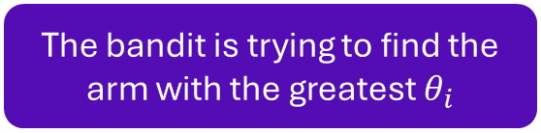
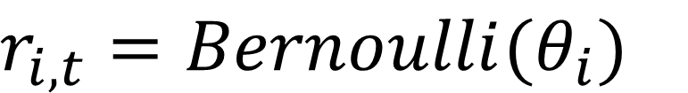
Thompson Sampling
We will look at the case where the rewards received by the bandit are assumed to come from Bernoulli distributions, the following description follows Agrawal and Goyal (2012).
For each arm $i$,
$r_{i,t}=Bernoulli(θ_{i})$
The bandit is trying to find the arm with the greatest $θ_{i}$

Slide 26




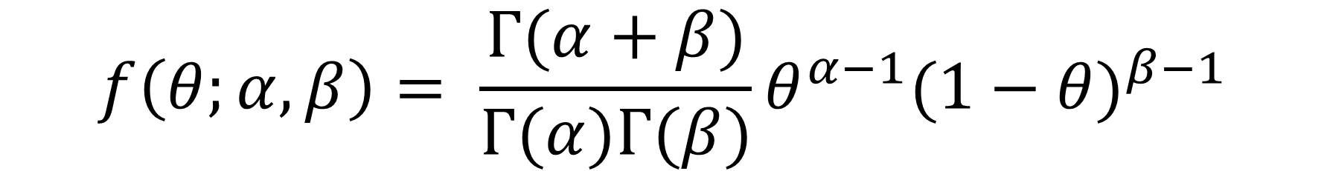
Thompson Sampling
Thompson Sampling in the Bernoulli bandit setting involves placing $Beta(α,β)$ priors on each of the $θ_{i}$
$$f\left(θ;α,β\right)= \frac{Γ(α+β)}{Γ(α)Γ(β)}θ^{α−1}{(1−θ)}^{β−1}$$
$$\frac{α}{α+β}$$
PDF of $Beta(α,β)$
Mean of $Beta(α,β)$

Slide 27
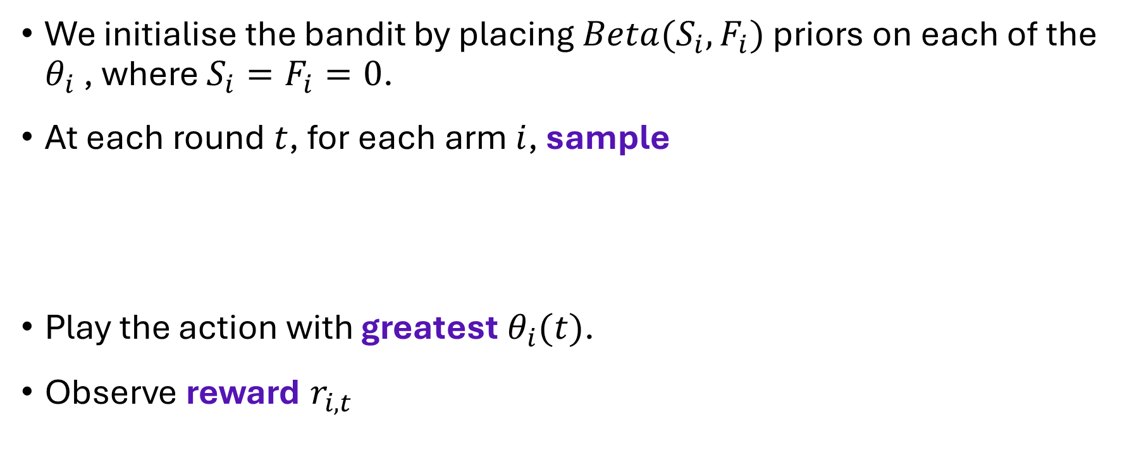
Thompson Sampling
We initialise the bandit by placing $Beta(S_{i},F_{i})$ priors on each of the $θ_{i}$ , where $S_{i}=F_{i}=0$.
At each round $t$, for each arm $i$, sample
Play the action with greatest $θ_{i}(t)$.
Observe reward $r_{i,t}$
$$θ_{i}(t)=Beta(S_{i}+1,F_{i}+1)$$

Slide 28
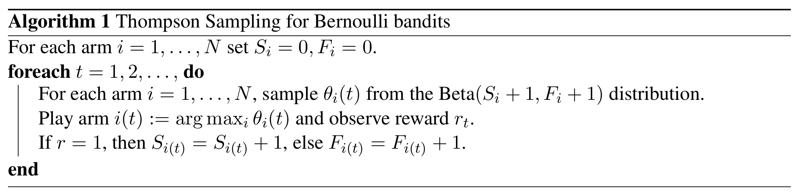

Thompson Sampling
If the reward $r_{i,t}=0$, update $F_{i}=F_{i}+1$
If the reward $r_{i,t}=1$, update $S_{i}=S_{i}+1$
Agrawal and Goyal (2012).

Slide 29
Thompson Sampling
The ideas of Thompson Sampling can be applied to other reward distributions.
For Gaussian rewards, see: Honda and Takemura (2014).

Slide 30
Thompson Sampling
Thompson Sampling has been shown in some settings to have logarithmic expected cumulative regret.
For a proof of this in the setting where rewards are drawn from Bernoulli distributions, see: Agrawal and Goyal (2012)

Slide 31
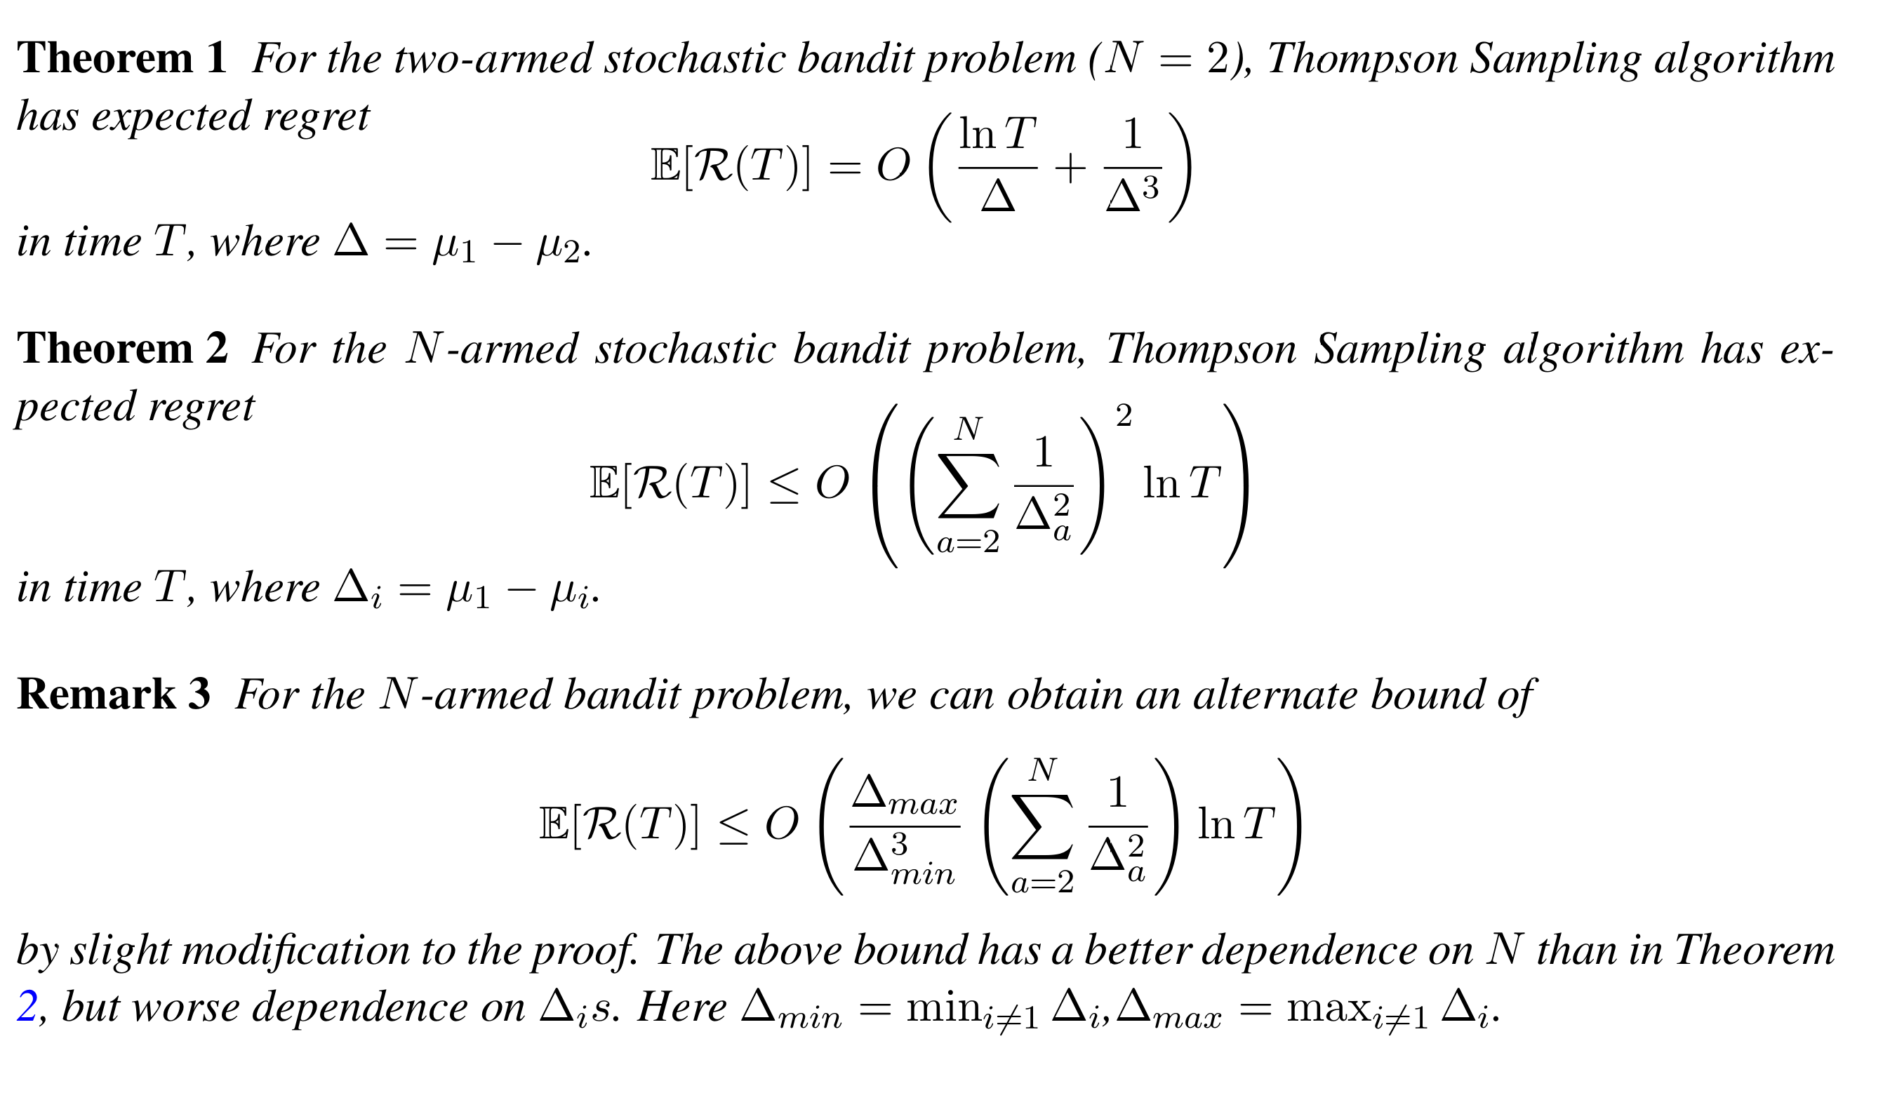
Agrawal and Goyal (2012).

Slide 32
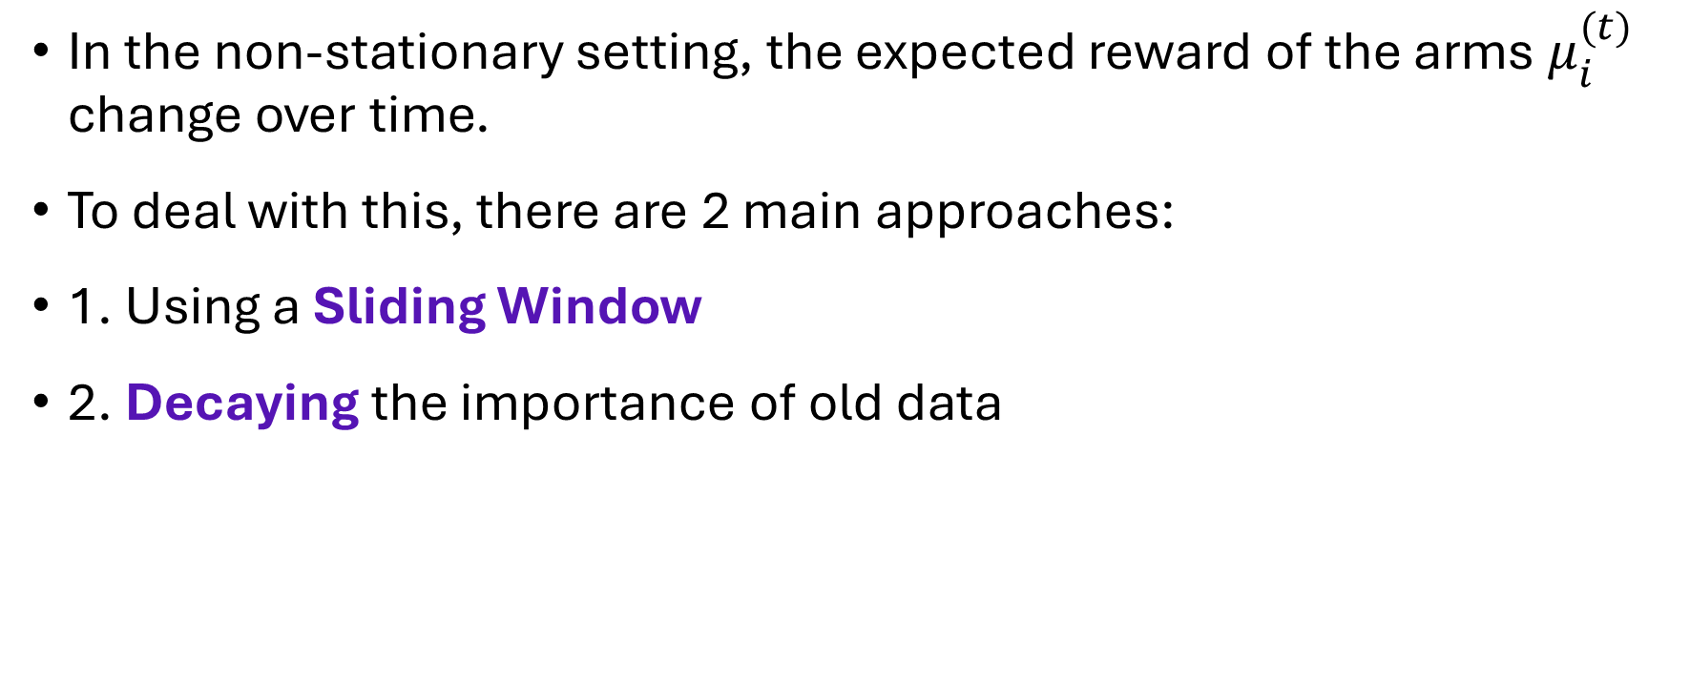
Non-Stationary Settings
In the non-stationary setting, the expected reward of the arms $μ_{i}^{(t)}$ change over time.
To deal with this, there are 2 main approaches:
1. Using a Sliding Window
2. Decaying the importance of old data

Slide 33
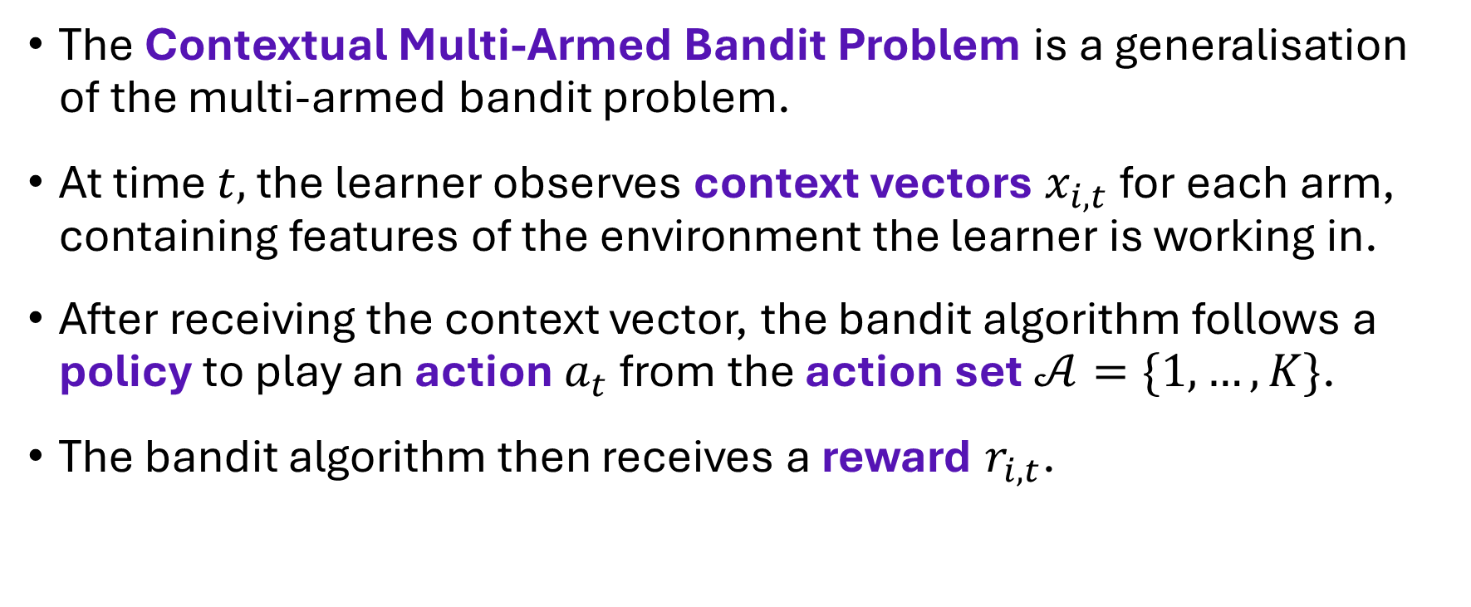
Contextual Multi-Armed Bandits
The Contextual Multi-Armed Bandit Problem is a generalisation of the multi-armed bandit problem.
At time $t,$ the learner observes context vectors $x_{i,t}$ for each arm, containing features of the environment the learner is working in.
After receiving the context vector, the bandit algorithm follows a policy to play an action $a_{t}$ from the action set$𝒜=\{1,…,K\}$.
The bandit algorithm then receives a reward $r_{i,t}$.

Slide 34

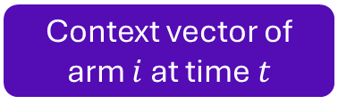

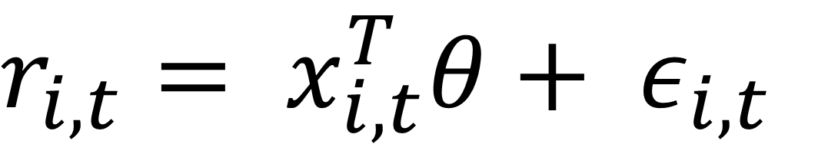
Contextual Multi-Armed Bandits
The bandit algorithm then receives a reward $r_{i,t}$.
We will look at the setting where rewards arise under a linear model with noise:
$r_{i,t}= x_{i,t}^{T}θ+ ε_{i,t}$
Reward of arm $i$ at time $t$
Context vector of arm $i$ at time $t$
Underlying model parameter
Sub-gaussian noise

Slide 35
Examples of Contextual Multi-Armed Bandits
The context vectors contain features of the environment, examples could include:
Finance: The arms are investment opportunities, and the context vectors contain features of that investment at a given time.
Recommender Systems: The context vectors could contain features of users and/or features of items to recommend.

Slide 36

Regret
Instantaneous expected regret at time s the difference between the expected reward of the optimal action at that time and the action played at that time:
$$x_{a_{t}^{∗},t}^{T}θ−x_{a_{t},t}^{T}θ$$

Slide 37
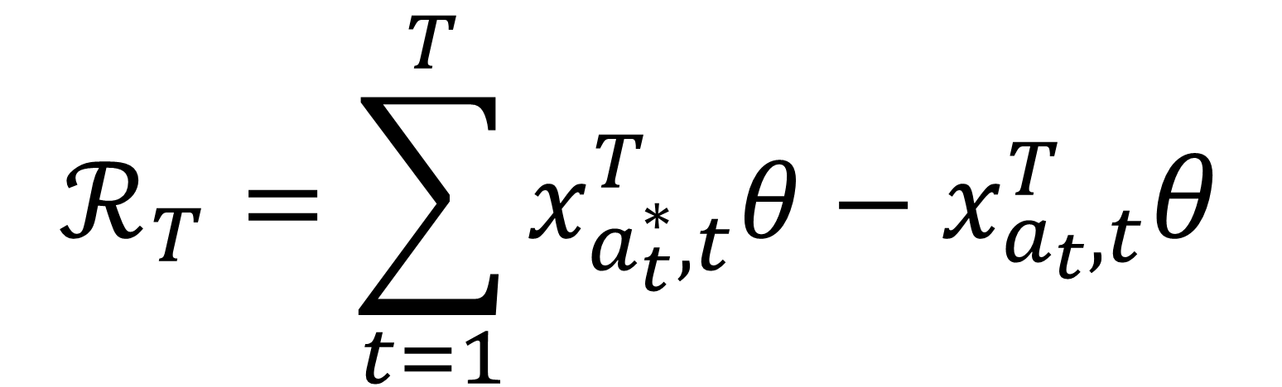
Regret
Expected cumulative regret over $T$ rounds,
$$ℛ_{T}=\sum_{t=1}^{T}{x_{a_{t}^{∗},t}^{T}θ−x_{a_{t},t}^{T}θ}$$
Notes:
Note: Mention difference between pseudo-regret and random regret.

Slide 38
Contextual Multi-Armed Bandits
In this presentation we will look at two contextual multi-armed bandit policies:
LinTS
LinUCB
The following descriptions are adapted from Kim et al. (2023)

Slide 39
LinTS
LinTS was first proposed in Agrawal and Goyal (2013).
LinTS is a Thompson Sampling based algorithm designed to tackle the contextual multi-armed bandit problem.
Notes:
B is initialised as the identity, hat(theta) is initialised as 0d and f is initialised as 0d.

Slide 40
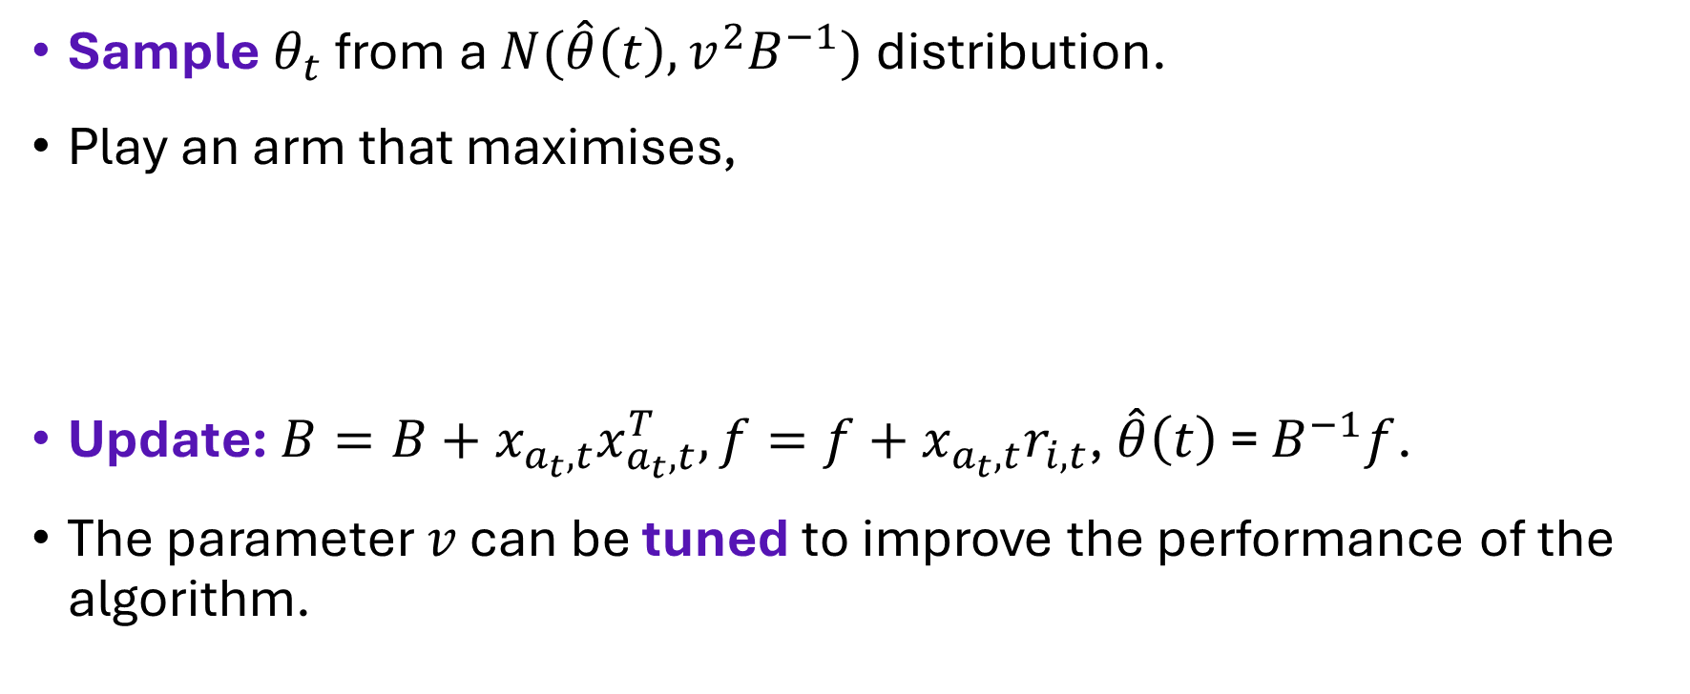


LinTS
Sample $θ_{t}$ from a $N(\hat{θ}\left(t\right),v^{2}B^{−1})$ distribution.
Play an arm that maximises,
Update: $B=B+x_{a_{t},t}x_{a_{t},t}^{T}, f=f+$ $x_{a_{t},t}r_{i,t}$, $\hat{θ}\left(t\right)$ = $B^{−1}f$.
The parameter $v$ can be tuned to improve the performance of the algorithm.
$$x_{i,t}^{T}θ_{t}$$
Ridge estimator of $θ$
Notes:
B is initialised as the identity, hat(theta) is initialised as 0d and f is initialised as 0d.

Slide 41
LinUCB
LinUCB was first developed in Li et al. (2010), designed for the news article recommendation setting.
LinUCB uses a UCB approach to tackle the contextual multi-armed bandit problem.
$$UCB=Expected Reward+Uncertainty$$

Slide 42
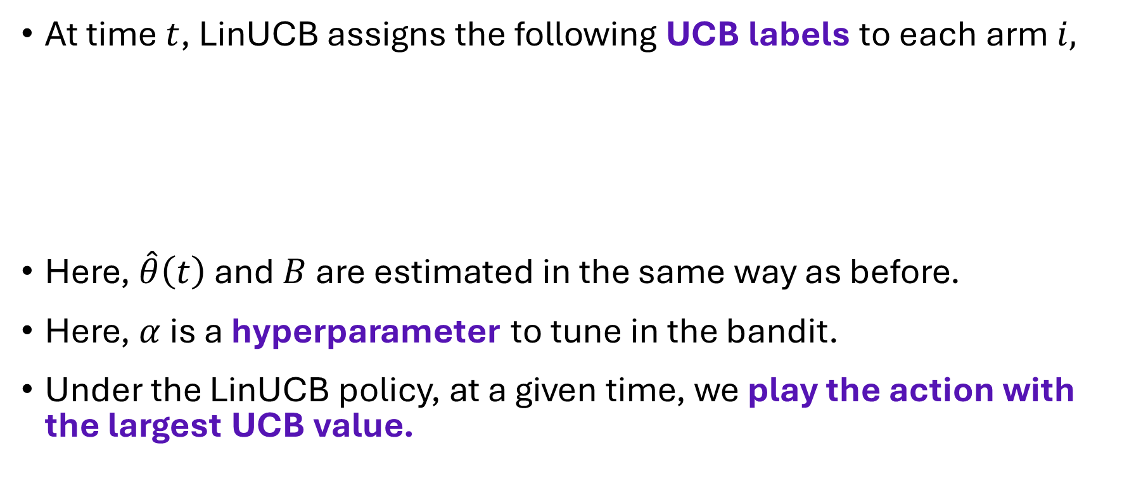
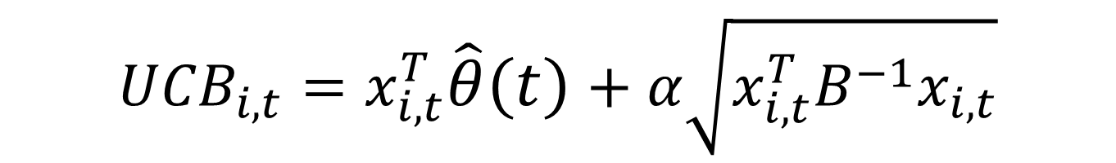
LinUCB
At time $t$, LinUCB assigns the following UCB labels to each arm $i,$
Here, $\hat{θ}\left(t\right)$ and $B$ are estimated in the same way as before.
Here, $α$ is a hyperparameter to tune in the bandit.
Under the LinUCB policy, at a given time, we play the action with the largest UCB value.
$${UCB}_{i,t}=x_{i,t}^{T}\hat{θ}\left(t\right)+α\sqrt{x_{i,t}^{T}B^{−1}x_{i,t}}$$

Slide 43
LinUCB vs LinTS
Kim et al. (2023) investigate the use of bandit algorithm to assist with healthcare planning for elderly patients with a variety of complex health and care requirements.
This paper investigates the setting in which one action is best for all patients and also the setting in which different patients have different optimal actions leading to personalised care.
The patient’s characteristics are stored within the context vectors.

Slide 44

LinUCB vs LinTS
The regret that Kim et al. (2023) investigate is defined as:
Note this is slightly different to the expected cumulative regret, but in practice is very similar.
$$ℛ_{T}=\sum_{t=1}^{T}{r_{a_{t}^{∗},t}−r_{a_{t},t}}$$

Slide 45
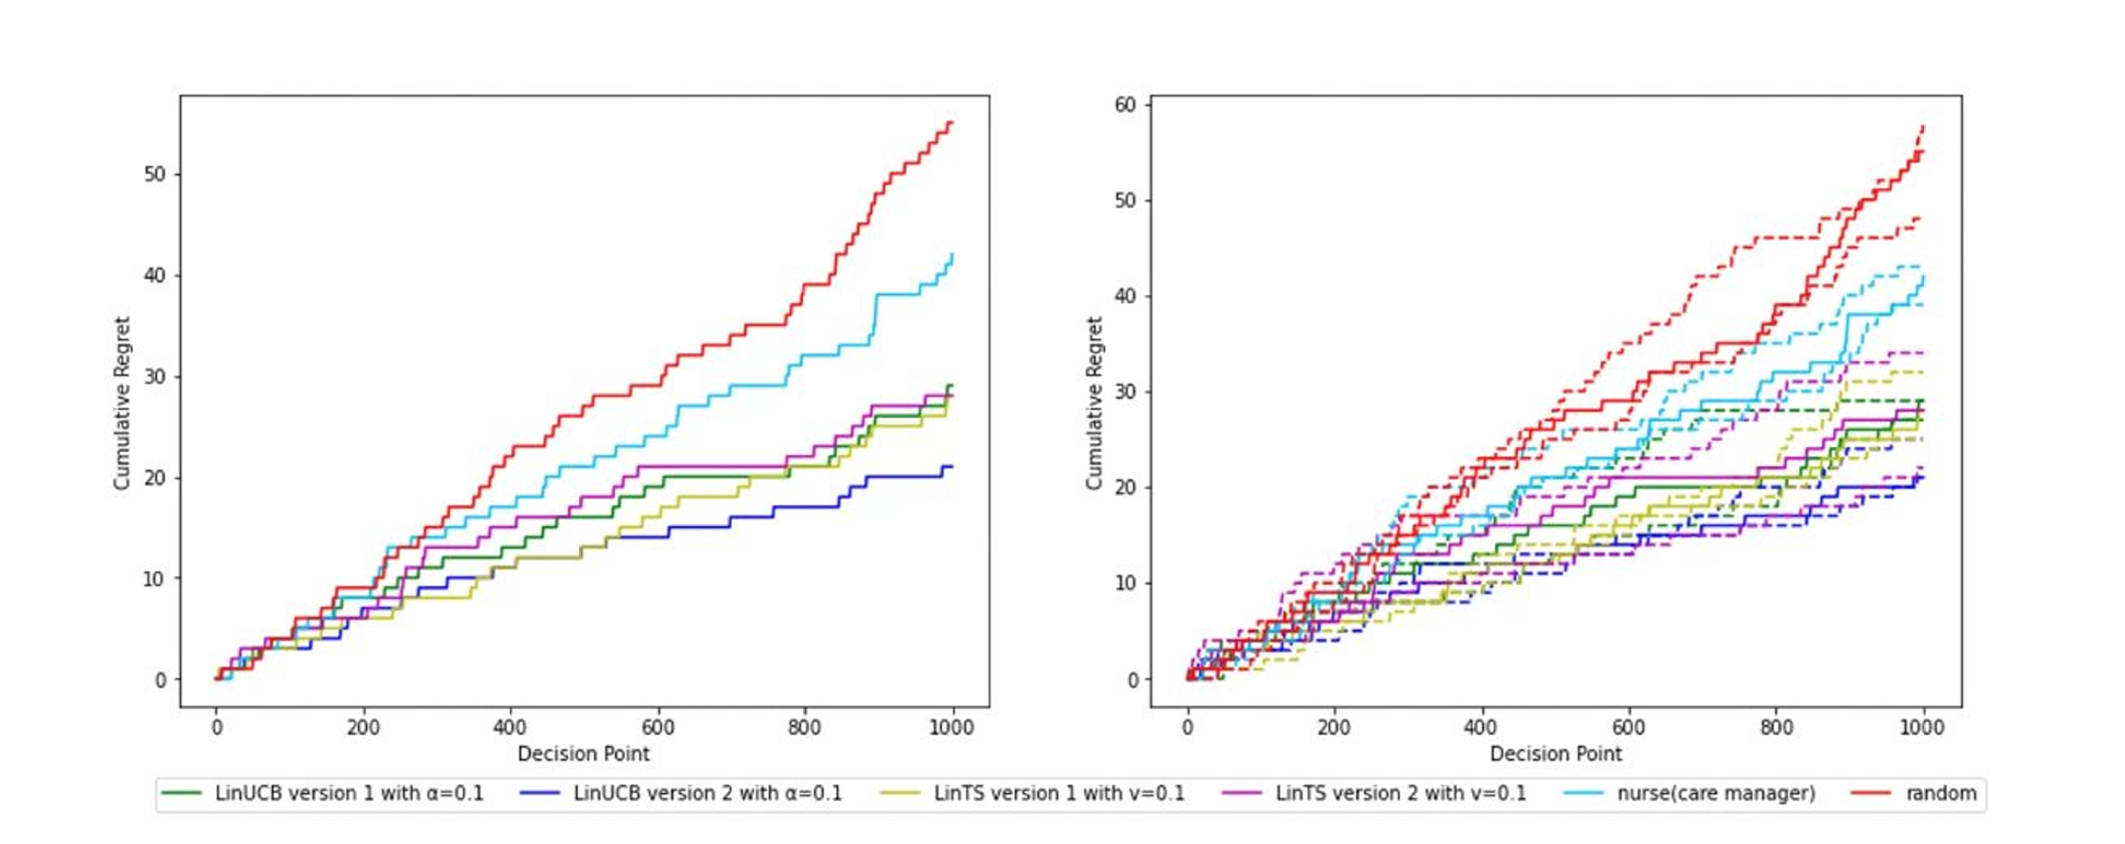
Kim et al. (2023)

Slide 46
References
Lattimore, T., & Szepesvári, C. (2020). Bandit algorithms. Cambridge University Press.
Agrawal, S., & Goyal, N. (2013). Thompson sampling for contextual bandits with linear payoffs. In International Conference on Machine Learning (pp. 127-135). PMLR.
Kim, G. S., Hong, Y. S., Lee, T. H., Paik, M. C., & Kim, H. (2023). Bandit-supported care planning for older people with complex health and care needs. In 2023 IEEE 5th International Conference on Artificial Intelligence Circuits and Systems (AICAS) (pp. 1-5). IEEE.

Slide 47
References
Li, L., Chu, W., Langford, J., & Schapire, R. E. (2010). A contextual-bandit approach to personalized news article recommendation. In Proceedings of the 19th international conference on World Wide Web (pp. 661-670).
Lai, T. L., & Robbins, H. (1985). Asymptotically efficient adaptive allocation rules. Advances in Applied Mathematics, 6(1), 4-22.
Thompson, W. R. (1933). On the likelihood that one unknown probability exceeds another in view of the evidence of two samples. Biometrika, 25(3-4), 285-294.

Slide 48
References
Auer, P., Cesa-Bianchi, N., Fischer, P.: Finite-time analysis of the multiarmed bandit problem. Machine Learning 47(2-3), 235–256 (2002).
Agrawal, S., & Goyal, N. (2012). Analysis of Thompson sampling for the multi-armed bandit problem. In Conference on Learning Theory (pp. 39-1). JMLR Workshop and Conference Proceedings.
Honda, J., & Takemura, A. (2014). Optimality of Thompson sampling for Gaussian bandits depends on priors. In Artificial Intelligence and Statistics (pp. 375-383). PMLR.

Slide 49
References
Yan, C., Han, H., Zhang, Y., Zhu, D., & Wan, Y. (2022). Dynamic clustering based contextual combinatorial multi-armed bandit for online recommendation. Knowledge-Based Systems, 257, 109927
Bouneffouf, D., Rish, I., & Aggarwal, C. (2020, July). Survey on applications of multi-armed and contextual bandits. In 2020 IEEE Congress on Evolutionary Computation (CEC) (pp. 1-8). IEEE.

Slide 50
Thank you for listening!
Any Questions?

